Slide 1


Ed Study Groups
Name: Nirali Thakkar
CS 6460: Educational Technology
Professor: Dr. David Joyner
Mentor: Tyler Bobik
College of Computing, Georgia Tech
Final Presentation

Slide 2
Dashboard
Introduction
This project focuses on the research on the ‘study with me’ community.
Currently, the only form of social interaction in MOOCs as well as online certification or graduation programs is through forums, discussion threads, or invite links to third-party softwares such as Discord, Zoom, Google Meet, etc.
No software exists where university students can join at any time and study together.
Ed Study groups provides - (i) Authenticated web application that supports video chat, (ii) personalized accountability tool that guides students on different studying methods to increase their productivity

Slide 3
Student Motivation
Students most likely feel the need to study online when they want company, to stay consistent, to be more productive, need to stop procrastinating
“Study with me” community focuses on how studying is an inspiring and aesthetic process
Study Together and StudyStream discord servers have over 200K students and approximately 2000 students studying daily
The concept is to update the other person about your progress, chat with friends during breaks, shared study timers and to-do lists
Students join video calls and may choose remain to stay anonymous by only streaming themselves making notes or typing

Slide 4
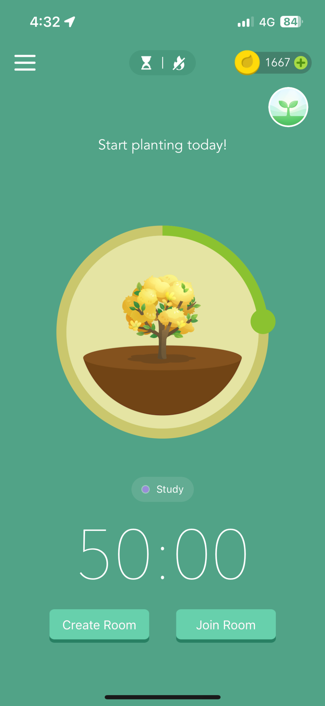
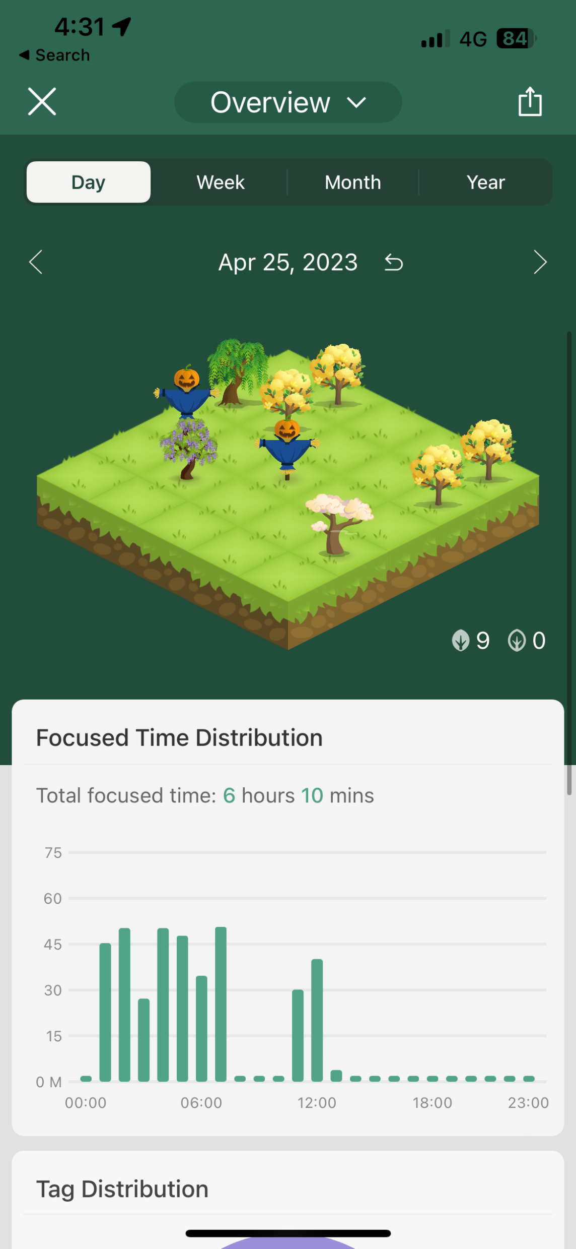
Accountability
The most famous accountability tool is Forest with over 2 million users
It helps the user track their productivity by recording the number of hours studied
It also shows a track of the time of the day the user was most productive
However, it is in no way interactive to provide different studying approaches or help the student in their academics

Slide 5
Dashboard
Existing Product Analysis – Coworking Spaces
Product | Description | Pros | Cons
Discord | Video chat application | Set different channels, see who is studying on call without having to join the call, personalized usernames and avatars | No authentication, UI is complex
Microsoft Teams | Video chat application | Authentication, admin can control participants on call | No personalized usernames or avatars, cannot see who is studying without joining
Zoom | Video chat application | Admin can control participants on call | No authentication, chat history is not saved
Google Meet/Classroom | Video chat application | Admin can control participants on call | No authentication, chat history is not saved
Focusmate | Book a study session with a group on calendar | Calendar booking, personal profiles | No authentication, compulsory to keep video and mic on
Todoist | Update lists and chat with others | Productivity statistics | No video calling, no authentication

Slide 6
Dashboard
Existing Product Analysis – Coworking Spaces
Product | Description | Pros | Cons
LifeAt Spaces | Virtual dynamic backgrounds and study space | Aesthetic environment, mindfulness tool, to-do lists | Paid subscription for group study
My Focus Space | Book a study session with a group on calendar | Analysis for productivity, to-do lists | No authentication
Flow Club | Book a study session with a group on calendar | To-do lists | Paid Subscription, no authentication
Social Pomodoro | Randomly connect with someone to study with | Randomly connect with a user | No video calling, no authentication
Focused Space | Video chat application | Wake up calls, Community session, Accountability check-in | Paid subscription, no authentication
Study Together | Virtual background and study space | Analysis for productivity, to-do lists, aesthetic environment, mindfulness tool | No authentication, poor UI design

Slide 7
Dashboard
Existing Product Analysis – Accountability Tools
Product | Description | Pros | Cons
Forest | Timer by planting trees with a group of people | Aesthetic timer, productivity statistics | No authentication
Marinara Timer | Directly starts pomodoro timers | Customization as well as automated timer | No authentication, no productivity statistics
Pomodor | Timer | Productivity Statistics | No authentication
FocusList |  | Calendar-wise productivity statistics | No authentication
Toggl Track | Track other people’s progress | Calendar-wise productivity statistics | No authentication
Flow, Be Focused | Timer | Calendar-wise productivity statistics | No authentication
Snaz | Timer – Countdown and Countup | Connect with OBS for live-streaming, add timer as a widget | No authentication
Fivable | Form a group and set timer, share to-do lists | Shared to-do lists, chat in-between | No authentication

Slide 8
Analysis Inference
Coworking spaces like Slack and Microsoft Teams are authenticated to university but Slack does not support video calling and Microsoft Teams has a complicated design
Discord supports video calling but is difficult to use for new people due to its cluttered design
LifeAt Spaces supports video calling and chat features along with themed virtual backgrounds but does not have authentication
Accountability tools gather user’s data but do not provide any feedback or suggestions

Slide 9
Project Deliverables
Ed Study Groups is a platform where students can study with their peers from the same course
It supports chat and video calling
It is authenticated to university; no continuous supervision is required by TAs because if a student is reported, university can take action against them
It provides a chance for students to study together and stay connected
It has a personalized accountability tool

Slide 10
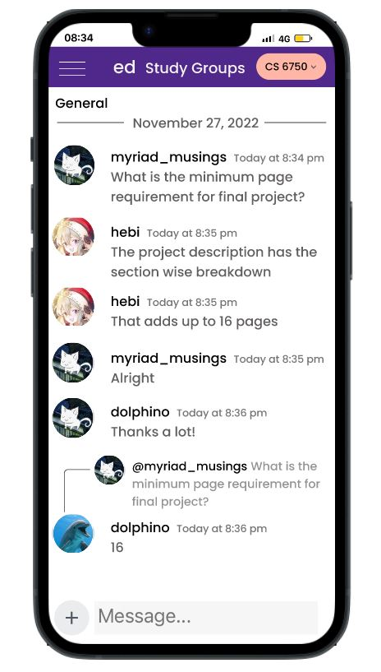
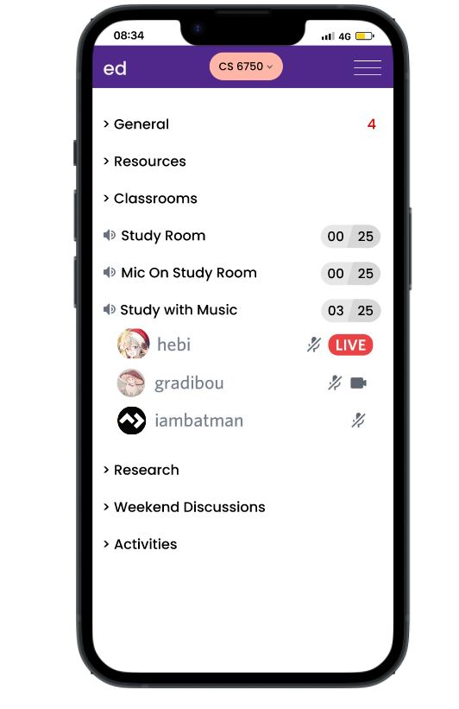
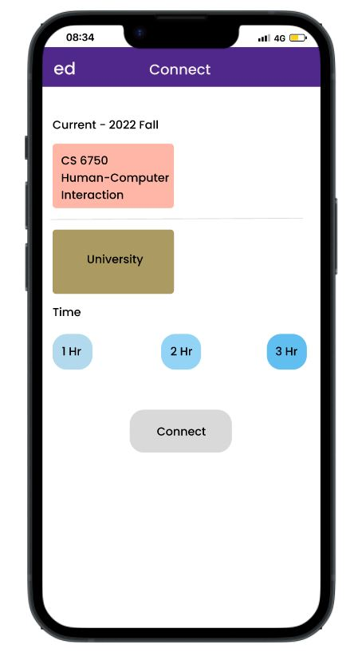
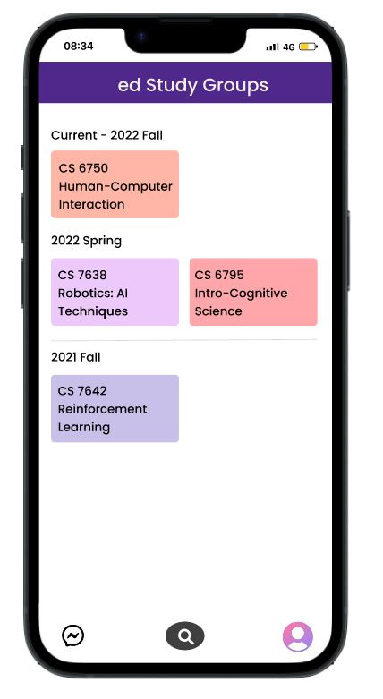
UI Prototype Design

Slide 11
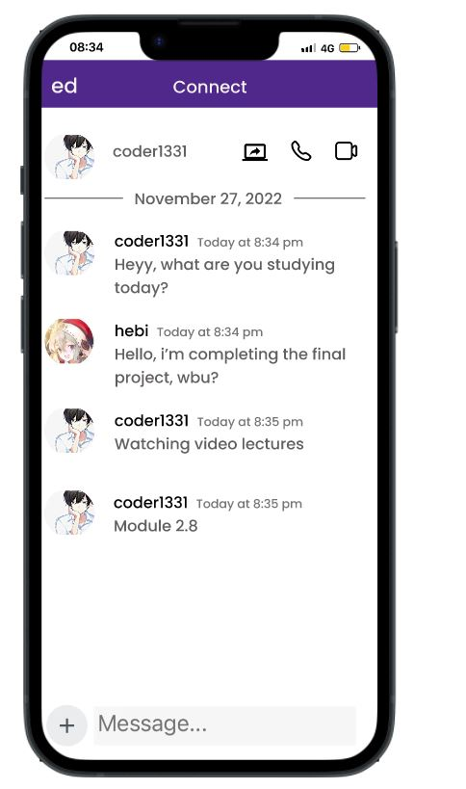
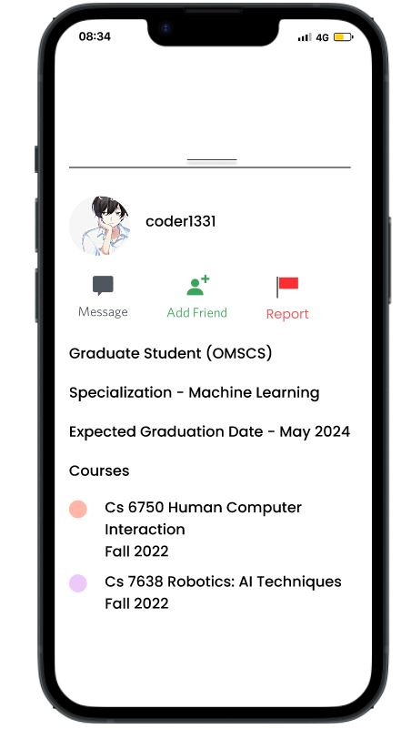
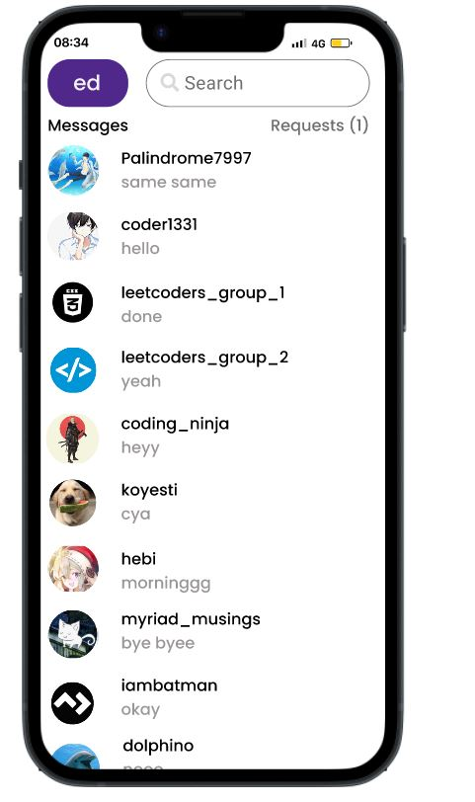
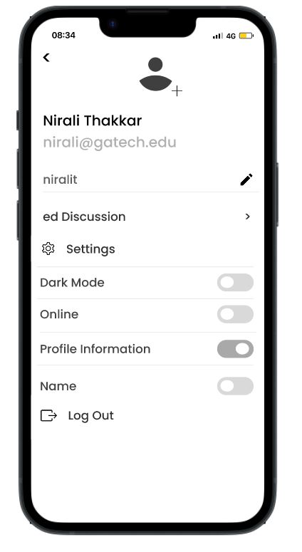
UI Prototype Design

Slide 12
Survey Results
A survey of the prototype of Ed Study Groups was conducted on 73 participants
Survey shows that approximately 93% of the participants found the card prototype easy to understand.
The results show that approximately 75% of the participants would like to have customized usernames and avatars.

Slide 13
Ed Study Groups
https://ed-study-groups.web.app/
Login connected to Google single sign in. The idea is to connect it the same way to Georgia Tech Sign In and import the student details.
Student can select the respective course to join the study group.
The study group shows the chat screen and options to create a text channel. Ideally only the TA should be able to create or delete channels to avoid clutter.
Students can customize their profiles but their university ID remains unique to them
Students can video call and use the accountability chatbot

Slide 14
Accountability Tool – List of Study Tips Dataset - 1
Study Method | Description
Eat The Frog | Identify your most important task and complete it in the morning. Eat your frog = Eat your breakfast!
The Eisenhower Matrix | Identify your tasks that are urgent/not urgent and important/not important.
Kanban Method | Sort your tasks into to-do, doing, and done
Leitner System | Keep track of the things you need to revise every day, every four hours, every nine days, and every fourteen days
Objectives and Key Results (OKRS) | Identify your objective and break it down into key results, that is, describe where you are going and how to get there
2-minute rule | Identify a task that can be done in two minutes or less and do It right away!
80/20 rule (Pareto Principle) | 80% of your results come from 20% of your efforts. Identify the tasks that need majority of the work done when you begin.

Slide 15
Accountability Tool – List of Study Tips Dataset - 2
Study Method | Description
Seinfield Method | Identify a task that needs to be done on a daily basis to form a habit
Reverse Planning | Identify a task that involves working backwards from a deadline and breaking a task into smaller, manageable parts
Active Recall | Identify a task that involves actively recalling information from memory, such as by taking practice tests or quizzes (Example - Learning a new language, interview preparation)
Mind maps (Anki Web is a famous software) | Mindmaps help create visual representations of concepts or ideas, using diagrams or flowcharts to help you understand and remember information
Cornell Method | It is a note-taking system that involves dividing your notes into three sections – a small section for the main points, a larger section for details and examples, and a summary section at the bottom
The Learning Pyramid | Identify tasks that require passive learning (less effective) such as reading and listening to lectures compared to active learning (more effective)that involves doing such as practicing, teaching, discussing the material with others

Slide 16
Accountability Tool – List of Study Tips Dataset - 3
Study Method | Description
SQ3R Method/SQ4R (Survey, Question, Read, Reflect, Recite, Review) | Survey, Question, Read, Recite, and Review – This method is a systematic approach to read and study textbooks. Survey the material by reading headings and subheadings, formulate your questions, read and recite answers to your questions, review the material by summarizing it
Mind Palace Technique (Method of Loci) | Create a mental image of a familiar location and associate different pieces of information with different locations within that space
Chunking Method | Break down long reading assignments into smaller subtopics, which can help you focus on one piece of information at a time
The Reflection Method | Take time to reflect on what you have learnt and consider how you might apply that knowledge in different situations
The Analogical Reasoning Method | Compare the new information to something you already know, or using a metaphor to explain the new information
The Inquiry Method | Asking further questions on a topic to deepen the knowledge
Reading Aloud | Read notes aloud

Slide 17
Accountability Tool – List of Study Tips Dataset - 4
Study Method | Description
The Mnemonic Devices Method | Using memory aids such as acronyms, rhymes, or songs to memorize lists, formulas, or vocabulary words
The Feedback Method | Involves seeking feedback from peers or instructors on your performance
The Brainstorming Method | Generate a list of ideas related to a topic or question without worrying about their quality or relevance
The Multi-Modal Learning Method | Using different senses such as light, sound, touch to learn and remember information
Mindfulness | Taking a few minutes before studying to clear your mind and study with a calm and centered mindset
The Storytelling Method | Using stories or narratives to help you remember information
The Dual-Coding Method | Combining words and images to help understand and remember information

Slide 18
Accountability Tool – List of Study Tips Dataset - 5
Study Method | Description
Pre-reading Method/Flipped Classroom | Previewing the material before starting to read or watch lecture
The Jigsaw Method | Dividing topics and having each member in a study group become an expert on one of the parts and teaching it to one another
The Mind Dump Method | Write down everything you know about a topic, then organize and review the information to identify gaps and reinforce learning
The Gamification Method | Reward yourself after completing a set of tasks
The Exercise Method | Taking breaks during studying to engage in physical exercise. This can help you improve focus and reduce stress and anxiety (Example, play with a ball, learn a dance move)
The Dual-Language Learning Method | Learn a material in two languages to improve retention and enhance language skills
The KWL Method | Know, Want to know, Learned Method
The Six Thinking Hats Method | Look at a topic from six different perspectives or modes of thinking

Slide 19
Dashboard
Challenges
Security and privacy of student data
Timely action on reported content
Scaling a large number of users on video call
Providing personalized answers to user for their accountability

Slide 20
Dashboard
Future Work
Conducting survey on the feedback and activity in the study group
Connecting student data with Canva so accountability tool can predict your grade in advance and guide you accordingly

