Slide 1

Self - Introduction

Slide 2

My Name is Nirali H Parmar I am From Junagadh. Currently I am Pursuing My Diploma in Software Testing and Automation Course From Tops And Technologies.

Slide 3
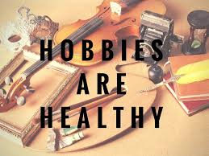
Hobbies…
Dancing
listening Music
Travelling

Slide 4
I Am …
Respectful
Brave
Helpful
Kind
Confident

Slide 5

I Love …
Travelling
Long Drive
Spending Time with Family
20XX
5

Slide 6

I Hate ….
Liar
Fake People
Selfishness
Negativity

Slide 7
Education
Diploma In software Testing And Automation
Currently, pursuing My Diploma in Software Testing And Automation course from Tops And Technologies.
BSc. Biotechnology
10th – 12th
My S.S.C & H.S.C Completed From R J Kaneria High School Junagadh.
I did my graduation complete from Collage of Computer Science And Information Technology, Junagadh.

Slide 8

Strength …
Positivity
Problem Solver
Discipline
Resourceful

Slide 9

Weakness …
Too detail Oriented
Impatient
Saying NO
Open Communicator

Slide 10

Presented By Nirali H Parmar

