Slide 1

National Institute of Business Management (NIBM)
Coventry University (CU)
NB6015CEM | RESEARCH PROJECT PREPARATION
Critical Literature Review
Day 2 - Critical Literature Review
BSc (Hons) Ethical Hacking & Network Security
Niranga Dharmaratna | niranga@nibm.lk
Notes:
Session 2 of 4. This session covers: finding and judging sources; critical vs descriptive engagement; identifying and justifying a research gap; APA7 for the security domain. Full example bank in Section 5 of the build prompt.

Slide 2
Session Overview
Finding, judging and engaging with sources - and arguing for the gap
Find the right sources: peer-reviewed security venues, IETF RFCs, and authoritative technical guidance
Judge source quality before you cite: a source-triage test for currency, credibility and type
Engage critically - do not describe what each source says; analyse, compare, and interrogate it
Identify and justify a specific research gap: the proof that your question is sharply framed
Apply APA7 accurately for the source types specific to this domain
This session feeds directly into the Week 8 proposal draft - specifically the literature review chapter
Notes:
Remind students: the Week 8 checkpoint is a full four-chapter draft. The literature review they build from today directly determines how strong that chapter is. ILO2 and Criterion 2 are the yardstick for this whole session.

Slide 3
The Through-Line: Framing Against the Known
In S1 you framed the research question - the problem made precise and technically specific
S2 is the same framing muscle under load: you are now positioning the question against what is already known
You can only name a gap if your question is sharp enough to measure the literature against
The gap is the proof that your question is framed - the literature review is the argument that produces it
S2 feeds the literature review chapter of the Week 8 full proposal draft
Session 1 framed the question. Session 2 frames it against the known. The gap is where those two framing acts meet.
Notes:
The key insight to drive home: a vague research question produces a vague literature review, which cannot produce a gap. The S1 and S2 problems are causally linked, not independent.

Slide 4
KEY CONCEPT
A literature review is an argument that builds a gap
It is not a summary of what has been done.
The literature is your evidence. Your research question is the case you are building. The gap is the verdict - the specific absence the literature cannot fill, which is exactly what your project is designed to address.
Notes:
STOP here. Let this slide breathe. This is the thesis of the whole session. The description-vs-engagement distinction and the gap articulation all flow from this. Students who miss this frame will produce reviews that list sources and call it done.

Slide 5
Where to Find Credible Sources
Peer-reviewed security conferences: IEEE Symposium on Security and Privacy (S&P), USENIX Security, ACM Conference on Computer and Communications Security (CCS), Network and Distributed System Security Symposium (NDSS)
IETF Request for Comments (RFCs): the definitive specification for the protocols you are studying - TLS, DNS, BGP, HTTP/2, OAuth
NIST Special Publications: technical guidance on security controls, frameworks, and standards (for example SP 800-207 on zero trust, SP 800-115 on penetration testing)
UK National Cyber Security Centre (NCSC): advisories, guidance papers, and technical publications
OWASP: application security testing guides, vulnerability taxonomy, and project-specific standards
Currency: strong preference for sources published within the last five years - the field moves quickly
Notes:
Emphasise: these are starting points, not an exhaustive list. Students should follow citation trails from strong papers. A paper in USENIX Security 2023 cites earlier foundational work that is fine to include even if older - what matters is not citing old work as state-of-the-art.

Slide 6
Judging What You Find: Source Triage
Strong - cite with confidence
Peer-reviewed paper from a top security venue within five years - primary, current
IETF RFC defining the protocol under study - authoritative primary specification
NIST / NCSC / OWASP authoritative guidance publication - standards-body primary source
Use with care - useful for context, not evidence
Vendor security blog: useful for real-world threat context, but promotional - not for core claims
Conference paper older than five years: cite for historical origin only, not for state-of-the-art
Weak - do not cite as academic evidence
Encyclopaedia entry: tertiary source - use it to orient yourself, then find and cite the primary source
Personal blog or Q&A forum: unvetted and not a citable academic or technical source
Notes:
Run through this slide quickly - about 5 minutes. The triage test is: (1) Was it peer-reviewed or published by an authoritative body? (2) Is it within five years or foundational? (3) Is it a primary or secondary source? If all three are weak, do not cite it as evidence.

Slide 7
Source Triage in Practice
Credible - Use These
Weak - Do Not Rely On
USENIX Security paper (< 5 years)
Peer-reviewed. Top venue. Primary research. Use with confidence.
IETF RFC for the protocol under study
Authoritative specification. The primary source. Cite the specific RFC number.
NIST Special Publication on the control being tested
Authoritative technical guidance. Standards-body primary source.
Vendor security blog (product announcement)
Useful for real-world threat context only. Promotional. Not for core claims.
2009 conference paper on the same topic
Cite for historical origin only. Not state-of-the-art. The field has moved.
Wikipedia / encyclopaedia entry
Tertiary. Find the primary source it points to, and cite that instead.
Personal blog or Q&A forum answer
Unvetted. Not a citable academic or technical source.
Notes:
Spend about 5 minutes here. This is a recognition exercise - students need to be able to instantly sort sources before they waste time reading weak material. The goal is fast, confident triage, not exhaustive analysis of every source type.

Slide 8
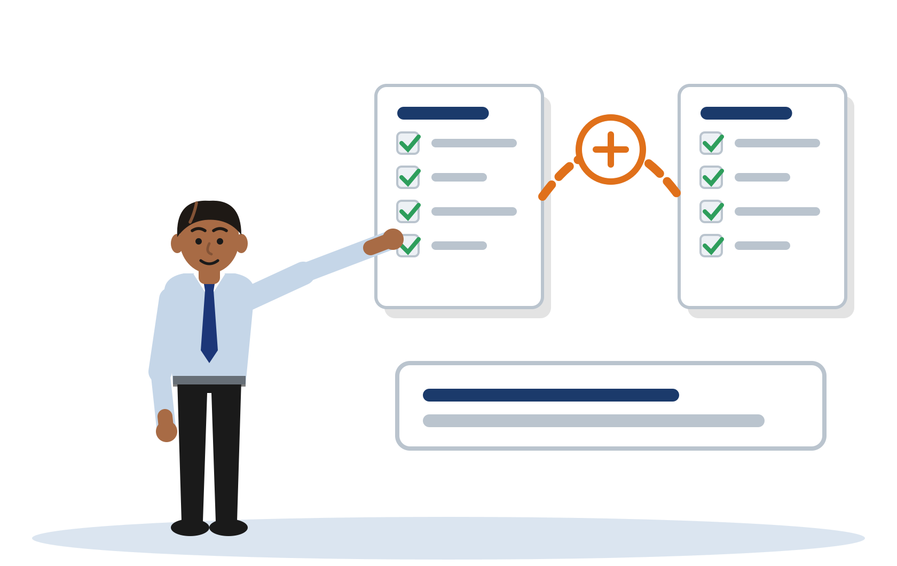
01 Describe vs Engage

Slide 9
Describing Reports. Engaging Argues.
Describing (Pass band)
"Perera (2021) developed rate-limiting. Silva and Fernando (2022) proposed machine learning. Jayawardena (2023) used fingerprinting."
Each sentence reports what one source did. No source is compared to another. No connection is made to the research question.
Engaging (Merit to Distinction band)
"Threshold methods such as rate-limiting (Perera, 2021) are cheap to deploy but degrade against distributed attacks - precisely the case a mobile-banking endpoint faces."
Sources are grouped, contrasted, and evaluated. A limitation is named. The connection to the research question is explicit.
This is where Criterion 2 marks are won or lost - not in finding sources, but in what you do with them.
Notes:
Core distinction: describing = "X did A, Y did B" with no analysis. Engaging = grouping, comparing, naming limitations, wiring back to the RQ. Criterion 2 rewards the same behaviour at its top band, in the rubric's own terms: it looks for a review in which the student works on the sources rather than reporting them, setting them against each other and pressing on what they claim. Paraphrased deliberately, because the rubric is the yardstick for this session but its descriptors are not read out verbatim. Same idea, different words.

Slide 10
Side by Side: Tharindu's Credential-Stuffing Question
Descriptive - Pass Band
Critical - Distinction Band
[Illustrative example - do not cite]
Structure: source-by-source listing
"Perera (2021) developed... Silva and Fernando (2022) proposed... Jayawardena (2023) used..." - each sentence one source, no relationship between them
Verbs: reporting only
"developed, proposed, used, reports" - no analysis of what these findings mean together
Close: vague approval
"These approaches show that... is an active area of research" - no gap, no connection to the RQ
[Illustrative example - do not cite]
Structure: grouped by approach
"Detection approaches divide into threshold-based and feature-based methods - the division matters for a SOC keeping false positives low."
Contrast: limitation named in context
"Rate-limiting degrades against distributed attacks - the precise case a mobile-banking endpoint faces."
Close: gap wired to RQ and baseline
"That absence is the gap this project occupies - what the comparison against a rate-limiting baseline tests."
Notes:
ILLUSTRATIVE EXAMPLE - DO NOT CITE
DESCRIPTIVE VERSION:
Several approaches to detecting credential-stuffing have been proposed. Perera (2021) developed a rate-limiting method that blocks IP addresses after a threshold of failed logins. Silva and Fernando (2022) proposed a machine-learning classifier using login-frequency features. Jayawardena (2023) used device fingerprinting to identify suspicious sessions. Each of these studies reports high detection rates. These approaches show that credential-stuffing detection is an active area of research.
CRITICAL VERSION:
Detection approaches for credential-stuffing divide broadly into threshold-based and feature-based methods, and the division matters for a SOC that must keep false positives low. Threshold methods such as IP rate-limiting (Perera, 2021) are cheap to deploy but degrade against distributed attacks that stay under per-IP limits, which is the precise case a mobile-banking endpoint faces. Feature-based classifiers (Silva and Fernando, 2022; Jayawardena, 2023) address distribution by scoring behaviour rather than volume, but both evaluate on web traffic with stable client fingerprints, whereas mobile clients churn device and network identifiers in ways that may inflate false positives. No reviewed study evaluates feature-based detection on mobile-banking authentication specifically, and none reports a false-positive rate against a triage threshold. That absence is the gap this project occupies, and it is what the research question's comparison against a rate-limiting baseline is designed to test.
NAMED MOVE: from "X did A, Y did B, Z did C" to "these methods split into approaches A and B; A fails in my context, B has limitation L in my context, and nobody has tested either in context C, which is my gap."

Slide 11
The Four Moves That Make a Review Critical
1
Group, do not list
Cluster sources by approach or claim, not by author and date. "Threshold methods (Perera, 2021) and feature-based methods (Silva and Fernando, 2022; Jayawardena, 2023) differ in how they handle distributed traffic."
2
Contrast, do not accumulate
Name how two approaches differ, and say why that difference matters for your specific problem. Not "A and B both exist" but "A fails precisely where B would need to succeed."
3
Name a limitation
Where does the approach fail? Specifically, why does it fail in your context? This is the analytical step that earns critical engagement marks on the rubric.
4
Wire back to the question
Every paragraph should connect its analysis to the problem you are solving. The limitation you name is the foothold for the gap; the gap is the justification for the question.
Notes:
This is the action list: students should be able to apply all four moves in the Activity on the next slide. The most commonly missing move is "wire back to the question" - students identify a limitation but do not connect it to why their project fills the resulting gap.

Slide 12
Make It Critical
Your task (8 minutes)
Read the descriptive paragraph in your notes (Tharindu's credential-stuffing review).
Rewrite it to engage. Apply all four moves:
1 Group sources by approach
2 Contrast and name a limitation
3 Connect the limitation to the specific research context
4 Point at the gap and wire it back to the research question
The paragraph to rewrite
[Illustrative example - do not cite]
Several approaches to detecting credential-stuffing have been proposed. Perera (2021) developed a rate-limiting method that blocks IP addresses after a threshold of failed logins. Silva and Fernando (2022) proposed a machine-learning classifier using login-frequency features. Jayawardena (2023) used device fingerprinting. Each study reports high detection rates.
Notes:
FACILITATION: Hand out (or point to student notes Section 3) for the full paragraph. Run 8 minutes strictly. Debrief: ask 2-3 students to read their rewrites. For each, ask the class: "Did they group? Did they contrast? Did they name a limitation? Did they wire back to the RQ?" The four tells provide the structure for the debrief. The strong version is Slide 10 right column and student notes Section 3.

Slide 13
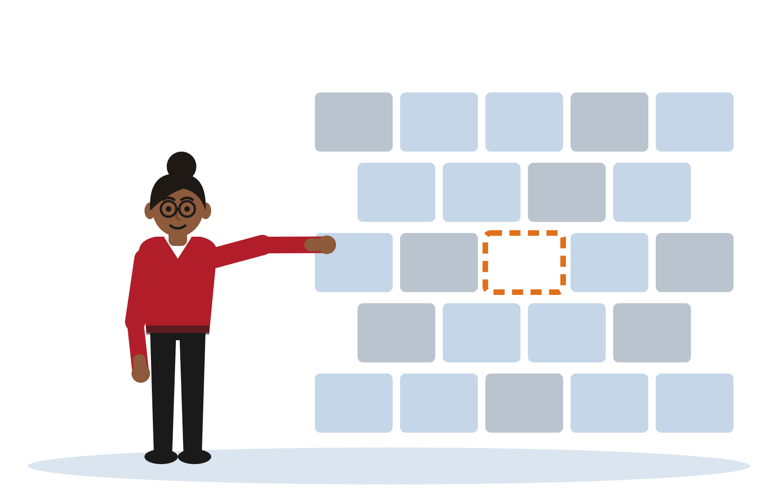
02 Finding the Gap

Slide 14
A Gap Is Not "More Research Is Needed"
A gap is a specific absence in the literature that your project is designed to fill
"More research is needed" names nothing. It does not say what is missing or why your approach addresses it. Pass-band failure.
The gap must follow from your review, never be asserted after it.
Naming the gap type lifts a Merit statement to a Distinction one
Methodology gap: No one has applied method M to problem P in this form. The approach exists; the application does not.
Context gap: Method M has been studied but not in context C (for example, not on mobile clients, not in healthcare systems, not against a specific threat model).
Evaluation gap: Studies exist but none measure outcome O rigorously - for example, none reports a false-positive rate against a triage threshold.
Notes:
The distinction between gap types is subtle but important. A methodology gap is different from a context gap: one says the method is new, the other says the application is new. Students who name the type show they understand what their project is actually contributing. "More research is needed" is the most common Criterion 2 failure mode.

Slide 15
Gap in Action: Dilini's Healthcare API Project
[Illustrative example - do not cite]
1 What the literature establishes
Broken object-level authorisation ranks among the most prevalent and damaging API weaknesses. Scanners detect injection and authentication flaws well but authorisation flaws poorly, because authorisation is context-specific rather than pattern-based.
2 What is absent
Structured testing methodologies exist for web applications, but the literature offers no repeatable, taxonomy-driven methodology for object-level authorisation in healthcare FHIR-style APIs, where the protected object is a patient record and the rules are clinical.
3 The gap - and its type
The gap is a methodology gap, not a tooling gap. This distinction matters: the tools to test APIs exist; what is missing is a structured, repeatable approach calibrated to this clinical context.
Research question: Does a structured object-level-authorisation methodology detect a higher proportion of seeded flaws than unstructured manual testing in a controlled FHIR-style API?
Notes:
FULL GAP STATEMENT (illustrative - do not cite):
"The literature on API security testing establishes that broken object-level authorisation is consistently ranked among the most prevalent and damaging API weaknesses, and that automated scanners detect injection and authentication flaws well but detect authorisation flaws poorly, because authorisation is context-specific rather than pattern-based. Structured testing methodologies exist for web applications generally, but the reviewed literature offers no repeatable, taxonomy-driven methodology aimed specifically at object-level authorisation in healthcare FHIR-style APIs, where the protected object is a patient record and the access rules are clinical. The gap is therefore a methodology gap, not a tooling gap. The research question follows directly from it, asking whether a structured object-level-authorisation methodology detects a higher proportion of seeded flaws than unstructured manual testing in a controlled FHIR-style API."
Teaching point: "methodology gap, not a tooling gap" is the phrase that separates a Merit gap statement from a Distinction one. Precision about the type of absence is the Distinction move.

Slide 16
The Gap and the Review Are One Argument
You cannot claim a gap that is not there - the review must build the case that the absence exists
Every claim in your gap statement must be evidenced in the review: if you say "no study has done X", your review must show you actually looked
If your review cannot produce a specific, named gap, your research question is not yet framed sharply enough
Analogy
The literature is a wall others have built. The gap is the one brick-shaped hole your project is the right size to fill. You have to show the hole is really there before you claim it - measuring the wall is the literature review, and pointing at the hole is the gap statement.
Notes:
The analogy grounds what can feel like an abstract skill. The wall metaphor has two useful extensions: (1) you have to measure the whole wall to find the hole - that is why breadth of review matters; (2) the hole has to be the right shape - that is why naming the gap type matters. A methodology-gap project is a different shape from a context-gap project.

Slide 17
Gap and Question: Two Ends of One Sentence
"No reviewed study evaluates feature-based detection on mobile-banking authentication specifically, and none reports a false-positive rate against a triage threshold... [gap] ...which is what this project tests by comparing a feature-based classifier against a rate-limiting baseline." [question]
If you can write that sentence, your framing is working. If you cannot, the question is not yet sharp enough - and the review has not produced a gap.
The self-check: read your gap statement, then read your research question. Is one the direct consequence of the other? If not, one of them needs to be rewritten.
This is the Session 1 framing muscle, now visible in the literature review. A gap that cannot produce a question was never a real gap. A question that cannot be traced to a gap was never properly framed.
Notes:
Loop back to Session 1 explicitly here. The research question formulation from S1 and the gap articulation from S2 are two sides of the same act of framing. Students who struggled with the research question in S1 will find the gap difficult here - the Week 2 supervision records are useful context.

Slide 18

03 Judging Reviews
and Referencing

Slide 19
Grade This Review
As a group, judge this short review excerpt against Criterion 2:
1 Does it engage critically, or does it describe?
2 Is there a gap? Is it specific and typed?
3 Are the sources current and from credible venues?
4 Name the ONE edit that moves it up a band.
5 Which Criterion 2 band does it sit in, and why?
See the excerpt in your student notes (Section 3). Time: 10 minutes group discussion, then debrief.
Notes:
FACILITATION: Use the canonical discussion excerpt (student notes Section 3.5, full answer key in lecturer guide Section 5.5). Do NOT reuse the Tharindu descriptive paragraph here - the room has already dissected it on slide 10 and rewritten it in the slide 12 activity, so grading it again teaches nothing. The canonical excerpt is deliberately unattributed, carries a live APA7 error, and closes with the Pass-band gap failure. Groups of 3-4. After 10 minutes, ask each group to name their band verdict and the single highest-value edit. Do not accept "add more sources" as an edit - it is not a Criterion 2 lever. The edit should be structural: grouping, contrasting, naming a gap, or specifying its type. On the referencing question, treat it as priming rather than assessment - the room only has to notice that the last reference looks wrong. Slides 20 and 21 supply the answer immediately after. Keep the room in charge of the judging; you chair, you do not grade.

Slide 20
APA7 for This Domain: Three Forms to Get Right
Conference paper
Wrong
Author, A. (2022). Title of paper. Journal of Security, 14(3), 22-31.
Right
Author, A. (2022). Title of paper. In Proceedings of the 31st USENIX Security Symposium (pp. 1123-1140). USENIX Association.
IETF RFC
Wrong
Internet Engineering Task Force. (n.d.). TLS 1.3. https://www.rfc-editor.org/...
Right
Rescorla, E. (2018). The Transport Layer Security (TLS) protocol version 1.3 (RFC 8446). RFC Editor. https://doi.org/10.17487/RFC8446
NIST Special Publication
Wrong
https://csrc.nist.gov/... (or "the NIST website")
Right
Rose, S., Borchert, O., Mitchell, S., and Connelly, S. (2020). Zero trust architecture (NIST SP 800-207). National Institute of Standards and Technology. https://doi.org/10.6028/NIST.SP.800-207
Notes:
Move briskly through this - about 8 minutes. The forms are in the student notes for reference. The key points: (1) conference papers are NOT journal articles - they have Proceedings, not volumes and issues; (2) RFCs have authors, dates, and DOIs - they are not anonymous web pages; (3) NIST SPs list named individual authors on the cover page - use them (Rose et al. for SP 800-207), not just "NIST website", with NIST itself as the issuing body. The APA7 error set on the next slide covers the five most common failures.

Slide 21
Five Common APA7 Errors in This Domain
An RFC cited as a bare webpage: no author, no date, just a URL. Fix: find the RFC number, author, and year - cite in full as shown on the previous slide.
A conference paper dressed as a journal article: invented volume and issue numbers. Fix: use the Proceedings format with conference name, page range, and publisher.
NIST or NCSC guidance reduced to a URL or "the NIST website". Fix: use the named authors where the document lists them, then year, title, SP number, issuing body, and DOI.
An OWASP project with no author, date, or version. Fix: OWASP Foundation. (2021). OWASP Top 10:2021. https://owasp.org/Top10/
A second-hand citation passed off as first-hand (citing a paper you only saw quoted in another). Fix: read the original, or cite honestly as Author (Year, as cited in OtherAuthor, Year).
Notes:
These five errors account for the majority of APA7 problems seen in this cohort. Errors 1-3 are format errors; error 4 is a sourcing error; error 5 is an integrity issue. Error 5 is worth naming explicitly: if you have not read the original, do not cite it as though you have. "As cited in" is always available.

Slide 22
What Comes Next
Week 8 checkpoint - the full proposal draft: all four chapters, including a complete literature review. Aim to arrive with a review that groups sources by approach, names a typed gap, and wires it to the research question.
Critical-vs-Descriptive Mirror tool: paste any literature-review paragraph to get instant feedback on whether you are describing or engaging. Access from the module page.
Criterion 2 at Distinction: current sources from credible venues, critical engagement throughout, a named and typed gap, and APA7 accurate for conference papers, RFCs, and NIST SPs.
Session 3 (Week 6) - Methodology: the gap becomes a testable, evaluable research design. The question you have framed determines what methodology can answer it.
Notes:
The one-line bridge to S3: "The gap you articulated today determines what methodology is appropriate - that is what S3 covers." Students whose research questions are still vague after today will struggle with S3 methodology justification. Flag them for the Week 8 supervision.

Slide 23

Questions &
Discussion
NB6015CEM - Research Project Preparation
Day 2 - Critical Literature Review
NB6015CEM | Research Project Preparation | Level 6
Notes:
Closing prompt: "By the end of today, you should be able to (1) triage any source you find; (2) group and contrast sources rather than list them; (3) name a specific typed gap; and (4) connect that gap to your research question. If any of those four feels shaky, bring it to the Week 5 supervision."

Slide 24
Disclaimer & Copyrights
The information presented in this presentation is intended for general informational purposes only. It is not meant to be comprehensive or to constitute professional advice. Any reliance you place on such information is strictly at your own risk. While I strive to keep the information accurate and up-to-date, I make no representations or warranties of any kind, express or implied, about the completeness, accuracy, reliability, suitability, or availability concerning the content within this presentation.
This presentation may include references or links to third-party websites or content. I do not endorse the views expressed or the information provided on such external sites. I am not responsible for the content of any linked site or any link contained in a linked site.
Any action you take upon the information presented in this presentation is strictly at your own discretion. I will not be liable for any losses or damages in connection with the use of this information.
This disclaimer is subject to change without notice.
© 2026 Niranga Dharmaratna
School of Computing & Engineering
National Institute of Business Management
Licensed under CC BY-NC-ND 4.0, creativecommons.org/licenses/by-nc-nd/4.0
Last modified: 3 October 2026

