Slide 1

National Institute of Business Management (NIBM)
Coventry University (CU)
NB6015CEM | RESEARCH PROJECT PREPARATION
Responsible Practice
Day 4 - Responsible Practice, Delivery Planning and Ethics
BSc (Hons) Ethical Hacking & Network Security
Niranga Dharmaratna | niranga@nibm.lk
Notes:
Final taught session. Two duties: teach responsible practice, delivery planning and risk, and close the four-session framing arc. Neither may be dropped for time.

Slide 2
Today's aims
Making the law specific to your project
What this unlocks
The Week 8 proposal draft
The Week 7 ethics application window, opening today
Appendix A of the Week 12 submission
Analyse the legal, ethical, social and professional implications for your project, not for projects in general
Build a milestone-based delivery plan and a two-register risk assessment
Start the ethics application
Notes:
State the two payloads early: the legal and ethical analysis, and the delivery plan with its two risk registers. Say that the ethics window opens today because Session 3 fixed the method.

Slide 3
The arc completes
Session 1 framed the problem.
Session 2 framed it against the known.
Session 3 framed it as testable.
Session 4 frames its boundaries and consequences.
Authorisation limits, legal exposure and disclosure define where the work may and may not go.
Notes:
One line per session. The arc is the content, not a courtesy. Students should leave able to state it in one sentence.

Slide 4
The diagnostic
A Pass-band responsible-practice section names the instruments and applies neither
It asserts compliance instead of deriving obligations: "conducted ethically", "stored securely"
It never says what data the project actually holds
Its risk register lists the risks of being a student, not the risks of this project
The test you will apply all session: Could this sentence appear unchanged in someone else's proposal?
Notes:
Do not reveal the crimson punch line here. Let the room sit with the symptom for a moment before naming the cause on the next slide.

Slide 5
KEY CONCEPT
Why your legal section reads like everyone else's
The law becomes specific at the exact moment your method does. Generic legal analysis is a symptom of an uncommitted method, not a missing statute.
Notes:
One idea, plainly. No bullets. Give it real time. This is the sentence the whole session proves.

Slide 6
Proof: three projects, three answers
Project | The method feature that triggers it | What bites hardest
E1 Tharindu, detection | Consumes authentication events that link a credential identifier to an access attempt | Data protection: lawful basis and data minimisation
E2 Chathura, hardening | Produces a measured map of which attack techniques a configuration baseline stops and which it does not | No statute bites; the live issues are dual-use and disclosure
E3 Dilini, methodology | Seeds authorisation flaws into a health-domain API and tests reaching records across roles | Special-category data, and the authorisation boundary itself
Every answer is derived from the method, not from the law.
Notes:
Ask which has the least legal exposure. The room will say Chathura and be right. Then make the point: least legal exposure is not least ethical exposure. Chathura produces the thing most useful to an attacker.

Slide 7
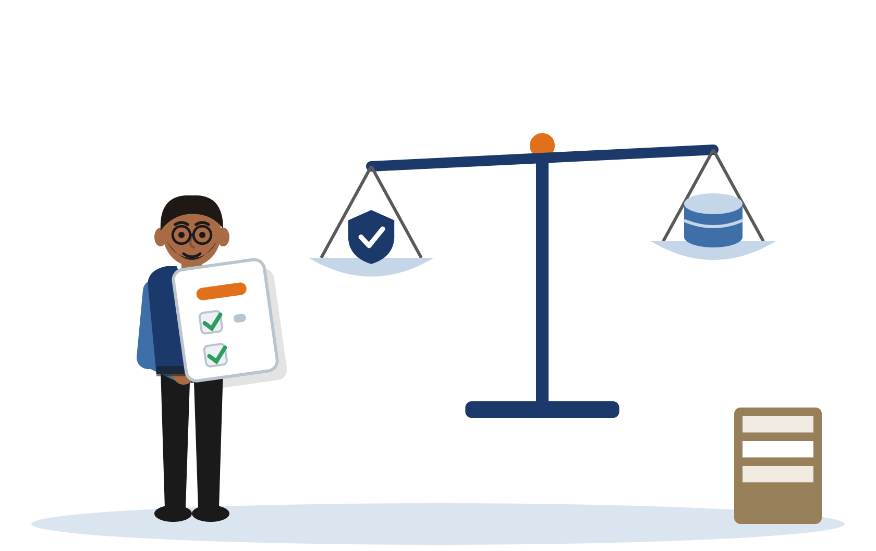
01 Legal, Ethical and
Responsible Practice
Notes:
Divider.

Slide 8
Computer Misuse Act 1990
Section 1: unauthorised access to computer material
Section 3: unauthorised acts with intent to impair the operation of a computer
Authorisation is the hinge. Both sections turn on access or acts being unauthorised
It is a question of fact about permission, not a question about your intent or your skill
A skilled, well-meaning test on a system you do not own is still unauthorised. A clumsy test on your own testbed is not.
Notes:
Move briskly. This is scaffolding, not the differentiator. If time is lost, fold slide 9 into this one.

Slide 9
Authorisation and testing boundaries
Work in a cleared environment: a self-built testbed is authorised by its owner, and you are the owner
Document that authorisation in the project log rather than assuming it
Isolate the environment so that nothing you generate reaches an external host
Decide the boundary before the work starts, never after something interesting happens
An owned testbed is an authorisation, not a loophole. Say why the section is not engaged.
Notes:
Correct the common misreading directly: students hear "my own lab" as a way around the Act. It is not a way around it; it is the reason the Act is not engaged, and they must be able to say so.

Slide 10
GDPR: the provisions that bite
Lawful basis: on what basis do you process the personal data your method touches?
Data minimisation: what is the least you could hold and still answer your question?
Special-category data: does your domain make the data health, biometric or otherwise special?
Storage limitation and retention: how long do you hold it, and what destroys it?
Each one is a question about your dataset, not a definition to be recited.
Notes:
Frame all four as questions. A student who cannot answer them has not yet decided what data they hold, which is the session thesis surfacing again.

Slide 11
Applied to the cast
Tharindu, Sevana Bank: authentication events link a credential identifier to an access attempt, so they are personal data
Dilini, Suwa Sevana Teaching Hospital: patient-portal records sit squarely in special-category territory
Both answer the same way: generate the data synthetically rather than capture it
Synthetic generation is the strongest answer available to a student because it removes the question rather than satisfying it.
Notes:
Teach synthetic generation as the preferred student strategy. Do not let the room read it as proof that the law is avoidable.

Slide 12
Generic versus project-specific
Generic: fits anyone
Specific: could only be Tharindu
This project will comply with the Computer Misuse Act 1990 and the General Data Protection Regulation. All testing will be conducted ethically and within the law. Data will be stored securely and deleted after the project. Ethical approval will be obtained before any work begins.
The three tells
A named provision. A named artefact of this project. A consequence that changes what you will do.
Anchor phrases from the full paragraph
"section 1 is not engaged, and the authorisation is recorded in the project log"
"the dataset is generated synthetically rather than captured, which removes the lawful-basis question under Article 6"
"identifiers hashed and truncated, applying data minimisation under Article 5(1)(c)"
Full paragraph: student notes, Section 2.
Notes:
The single most important slide in the deck. Read the left column aloud and ask whose proposal it is. Then read two anchor phrases from the right and ask the same question. The full strong paragraph is in the notes; do not try to fit it here.

Slide 13
Make yours specific
Take one sentence of your own legal or ethical writing.
Rewrite it so that it could not appear in anyone else's proposal.
Ten minutes. Then we debrief against the three tells.
Debrief against the three tells
A named provision
A named artefact of this project
A consequence that changes what you will do
All three present? It cannot be pasted into anyone else's proposal.
Notes:
Facilitation: circulate and look for the sentence that names an instrument but no provision, which is the most common draft. Debrief instrument is the paste test: read a rewritten sentence aloud and ask the room whether it could be anyone else's.

Slide 14
Responsible disclosure
If your work finds a real flaw in a real product or service: stop testing it
Do not publish, and do not demonstrate it further
Contact the vendor, or a national CERT where no vendor contact exists, through a coordinated route
Agree a disclosure timeline before any detail appears in your report
Record it in the proposal as a contingency, not as an afterthought
State it because it is a foreseeable outcome of the method, not because you expect it.
Notes:
The position statement to write into is in the student notes, Section 3. Students should lift the shape and fill it with their own method.

Slide 15
Dual-use, social and professional impact
A defensive artefact is also a map of what defeats the defence
An evaluation of which techniques a baseline stops is an attack playbook read backwards
State it honestly: report in aggregate, and withhold tunable configurations
Supplementary context: the BCS Code of Conduct is the professional frame a practitioner would recognise. It is not a module requirement
Being defensive is not an exemption from dual-use. Chathura's project has the least legal exposure and the most.
Notes:
Correct the common omission: students skip dual-use because their project is defensive. Chathura is the counter-example and the room can check it. The BCS Code of Conduct is supplementary context only: it is not cited in the module specification, the teaching plan or the rubric, and nothing is assessed against it.

Slide 16
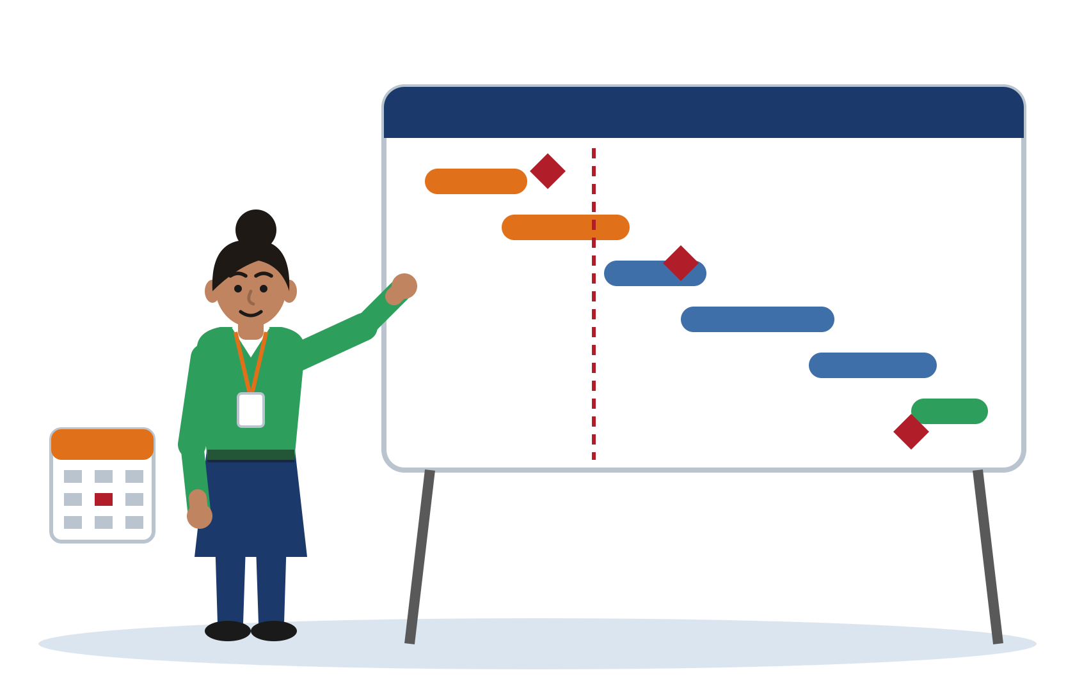
02 Delivery Planning
and Risk
Notes:
Divider.

Slide 17
What the timeline is a plan for
It is the plan for the project you will run next, in NB6019CEM Research Project Delivery
It is not a plan for writing the proposal. That is the most common scoping error in this section
A milestone is a verifiable deliverable with a date: something that either exists or does not
A date range with an activity beside it is not a milestone. "D3 to D12: implementation" hides slippage until the end
Milestones are written in P-weeks for this term and D-weeks for delivery
The ethics sequence is the one exception that spans both modules: approval is obtained now and evidenced in Appendix A.
Notes:
Name the scoping trap out loud. Students routinely submit a plan for producing the proposal. Introduce P-weeks (this module) and D-weeks (delivery) here, because slide 18 depends on them.

Slide 18
A worked milestone plan: Chathura
ID | Milestone (a verifiable deliverable) | Timing | Dependency
M1 | Ethics application submitted with method annexe | P7 | Method fixed in Session 3
M2 | Ethics approval received and filed as Appendix A | P10 | Hard dependency: no data or runs before this
M3 | Testbed built: domain controller, two workstations, isolated host-only network | D2 | M2 in hand; first delivery milestone
M4 | Technique set defined and validated against the unhardened baseline | D5 | M3
M5 | Hardened configuration applied and second snapshot taken | D8 | M4
M6 | Comparative run complete, results recorded against both snapshots | D12 | M5
M7 | Analysis and write-up complete | D16 | M6
[Illustrative example - do not cite] Chathura, Pahana Retail. Full plan: student notes, Section 4.
Notes:
M2, ethics approval, is the one milestone the student does not control, which is why it sits in the preparation term: approval is in hand before D1. Everything buildable is a D-week milestone. Point at the critical path explicitly, then at M7: a final milestone in the first month of delivery would mean the proposal was planned, not the project.

Slide 19
Two registers, not one
Register A: delivery and project risks
Register B: technical and security risks
Time, illness, scope creep, approval delay, resource limits.
Real, and they belong in the proposal.
But every student in the room can write them.
The inherent technical or security risks of the implementation itself.
Sample containment, environment recovery, re-identification, exposure of a deliberately vulnerable instance.
This is the one students omit, and the rubric names it explicitly.
A ransomware-spread study whose register does not mention sample containment has not understood its own project.
Notes:
The rubric asks for both. Students write one. Say which one goes missing and why it matters.

Slide 20
Register B: risks only these projects could have
Project | Technical or security risk | Mitigation
E2 Chathura | A hardening setting breaks authentication in the domain and the testbed cannot be recovered | Snapshot before each policy application; baseline snapshot held read-only
E2 Chathura | The measured technique set constitutes a working attack sequence against a default configuration | Reported at the level of the published framework reference, not as runnable procedure
E1 Tharindu | The replayed credential dataset, even hashed, is re-identifiable if the source corpus is known | Truncation after hashing; source corpus not named; dataset destroyed at project end
E3 Dilini | The deliberately vulnerable API instance is reachable from the campus network | Bound to loopback on an isolated host; no port forwarding; instance destroyed between sessions
[Illustrative example - do not cite] Full register with both sides: student notes, Section 5.
Notes:
Each entry could not be moved to another project. That is the test. Read one aloud and ask whether it would fit the neighbour.

Slide 21
The risk only you could name
Ask of every entry: could this sit on my neighbour's page unchanged?
If yes, it belongs in Register A, and Register B is still empty
Mitigations must match their risks: backups do not mitigate illness
Analogy
A risk register that could belong to anyone is a register of being a student, not a register of doing this project. The risks that matter are the ones that would not appear on your neighbour's page.
Notes:
Put the diagnostic question to the room directly: name the one risk that only your project could have. If the answer would fit a neighbour, the register is not finished.

Slide 22
Grade this responsible-practice section
The excerpt is in your notes, Section 5.5.
Judge it against Criterion 4. Which band, and why?
Then name the single edit that moves it up a band.
One edit, not more laws and not more risks.
Notes:
The room will find the risk problem faster than the legal one. Let them have that win quickly, then hold them on round 2: the missing noun in the data sentence is the session thesis in miniature. Full answer key in the lecturer guide, Section 5.5.

Slide 23

03 Ethics Approval
and Submission
Notes:
Divider.

Slide 24
The ethics application
The form asks what data you touch, whose it is, where the work runs, and what you destroy afterwards
A fixed method answers all four. An unfixed method cannot answer any of them
The window opens now, in P7. Institutional turnaround is under three weeks
Target final approval around P10, and file the evidence as Appendix A
Appendices and references sit outside the 2,000-word limit
Ethics is a constraint on the method, not a form to be filed after it.
Notes:
If a student cannot answer the form, the finding is that the method is not yet committed. Send them back to Session 3, not to the legal textbook.

Slide 25
The standard you are marked against
Criterion 4, Project Delivery & Responsible Practice - Distinction band
Timeline is realistic, milestone-structured, and reflects genuine understanding of the project’s scope and complexity. Risk assessment addresses both delivery/project risks and the inherent technical or security risks of the implementation, with specific mitigations. Legal and ethical analysis is substantive - Computer Misuse Act 1990 and GDPR are applied specifically to the project context, not cited generically. Ethics approval evidence is complete. Social and professional impact is thoughtfully and critically considered.
Criterion 4, Project Delivery & Responsible Practice - Pass band
Timeline is included but lacks milestones or appears unrealistic in places. Risk assessment is present but superficial, addressing only the most obvious risks. Legal and ethical considerations are mentioned but treated generically without project-specific application. Ethics documentation may be incomplete. Social and professional impact is briefly noted.
Notes:
Both descriptors quoted whole and attributed. The Pass descriptor is the diagnostic mirror: the cohort failure appears in the marking standard's own words. Read the phrase about generic treatment aloud.

Slide 26
Closing the arc, and what happens next
S1 framed the problem. S2 framed it against the known. S3 framed it as testable. S4 frames its boundaries and consequences
Week 8: proposal draft, including the responsible-practice and delivery sections
Week 12: final proposal submitted, with ethics evidence as Appendix A
Week 13: the proposal defence, a required must-pass element that concludes CW1 and carries no separate mark
This is the last taught session. Supervision from here is for your project, not for the syllabus: bring drafts, not questions about the module.
Notes:
Say plainly what supervision now exists for. The room turns practical at this point and the boundary is worth stating.

Slide 27

Questions &
Discussion
Bring your method summary. The ethics window is open.
NB6015CEM | Research Project Preparation | Level 6
Notes:
Close on the arc, then open the floor.

Slide 28
Disclaimer & Copyrights
The information presented in this presentation is intended for general informational purposes only. It is not meant to be comprehensive or to constitute professional advice. Any reliance you place on such information is strictly at your own risk. While I strive to keep the information accurate and up-to-date, I make no representations or warranties of any kind, express or implied, about the completeness, accuracy, reliability, suitability, or availability concerning the content within this presentation.
This presentation may include references or links to third-party websites or content. I do not endorse the views expressed or the information provided on such external sites. I am not responsible for the content of any linked site or any link contained in a linked site.
Any action you take upon the information presented in this presentation is strictly at your own discretion. I will not be liable for any losses or damages in connection with the use of this information.
This disclaimer is subject to change without notice.
© 2026 Niranga Dharmaratna
School of Computing & Engineering
National Institute of Business Management
Licensed under CC BY-NC-ND 4.0, creativecommons.org/licenses/by-nc-nd/4.0
Last modified: 3 October 2026
Notes:
Built from the style YAML disclaimer keys.

