Slide 1

National Institute of Business Management (NIBM)
Coventry University (CU)
NB6015CEM | RESEARCH PROJECT PREPARATION
RESEARCH PROJECT PREPARATION
Day 1 - Launch, Topic Selection & Research Questions
BSc (Hons) Ethical Hacking & Network Security
Niranga Dharmaratna | niranga@nibm.lk

Slide 2

What We Cover Today
From capable builder to capable researcher - your first rep
Orient to the full research project journey and what each session unlocks
Select a tractable, Level-6-scoped topic within cybersecurity or network engineering
Form an achievable, evaluable research question
Understand what Criterion 1 of the assessment rubric demands

Slide 3
Module Learning Outcomes
ILO 1
Devise an achievable research question on a topic of interest.
ILO 2
Critically evaluate and summarise the state of the art in a research area through a structured literature review.
ILO 3
Analyse the impact of social, legal, and ethical considerations of the proposed research project.
Session 1 focuses on ILO 1 - forming an achievable research question. ILOs 2 and 3 are taught in Sessions 2, 3, and 4.

Slide 4
KEY CONCEPT
You Can Already Build
The skill this module grows is framing - turning a topic into a question you can actually answer.
Sessions 2, 3, and 4 each revisit it from a different angle. Today is your first rep.

Slide 5
The Module at a Glance
13
Weeks
Teaching + supervised production
4
Sessions
Front-loaded: Weeks 1, 4, 6 and 7
3+
Checkpoints
Plus must-pass Week 13 defence
Wk | Activity | Focus
1 | S1 - Today | Topic selection and research-question formation
3 | Checkpoint 1 | Problem outline - research question assessed, revision expected
4 | S2 | Critical literature review
6 | S3 | Methodology, tooling and evaluation design
7 | S4 | Responsible practice, delivery planning and ethics
8 | Checkpoint 2 | Full draft - feedback across all five rubric criteria
12 | Checkpoint 3 | Summative submission (CW1) with ethics-approval evidence
13 | Defence | Presentation and viva voce - must-pass gate

Slide 6
S1 - Today
Topic selection and research-question formation. Framing taught head-on.
Your Research Project Journey
S2 - Week 4
Critical literature review. Framing the problem against the known.
Each session unlocks a different stage of the research process.
S3 - Week 6
Methodology, tooling and evaluation design. Framing as testable.
Then: passing the Week 13 defence bridges you into NB6019CEM Research Project Delivery, where you build it.
S4 - Week 7
Responsible practice, delivery planning and ethics. Framing boundaries.

Slide 7
What a Strong Project Looks Like - Exemplar A
[Illustrative example - do not cite]
Tharindu | Sevana Bank mobile-banking app
Problem: The SOC sees a flood of failed logins but cannot cheaply separate distributed credential-stuffing from ordinary user error.
Solution: A lightweight detection module scoring authentication events on velocity, device-fingerprint dispersion and failure-pattern features, evaluated on replayed and synthetic traffic in a VM testbed.
Research question: "To what extent can an unsupervised, feature-based model detect distributed credential-stuffing against a mobile-banking authentication endpoint at a false-positive rate low enough for SOC triage, compared with a rate-limiting baseline?"

Slide 8
What a Strong Project Looks Like - Exemplar B
Chathura | Pahana Retail (Windows and Active Directory, no hardening baseline)
Problem: A growing e-commerce business running Windows and Active Directory on out-of-the-box defaults with no hardening applied.
Solution: Apply the CIS Windows secure-configuration baseline (CIS Control 4, NIST CSF Protect) and measure change in exploitability against a fixed set of common attack techniques in a VM testbed, versus the unhardened default.
Research question: "To what extent does applying the CIS Windows secure-configuration baseline reduce the success rate of a defined set of common attack techniques in a small Active Directory testbed, compared with an out-of-the-box default configuration?"

Slide 9
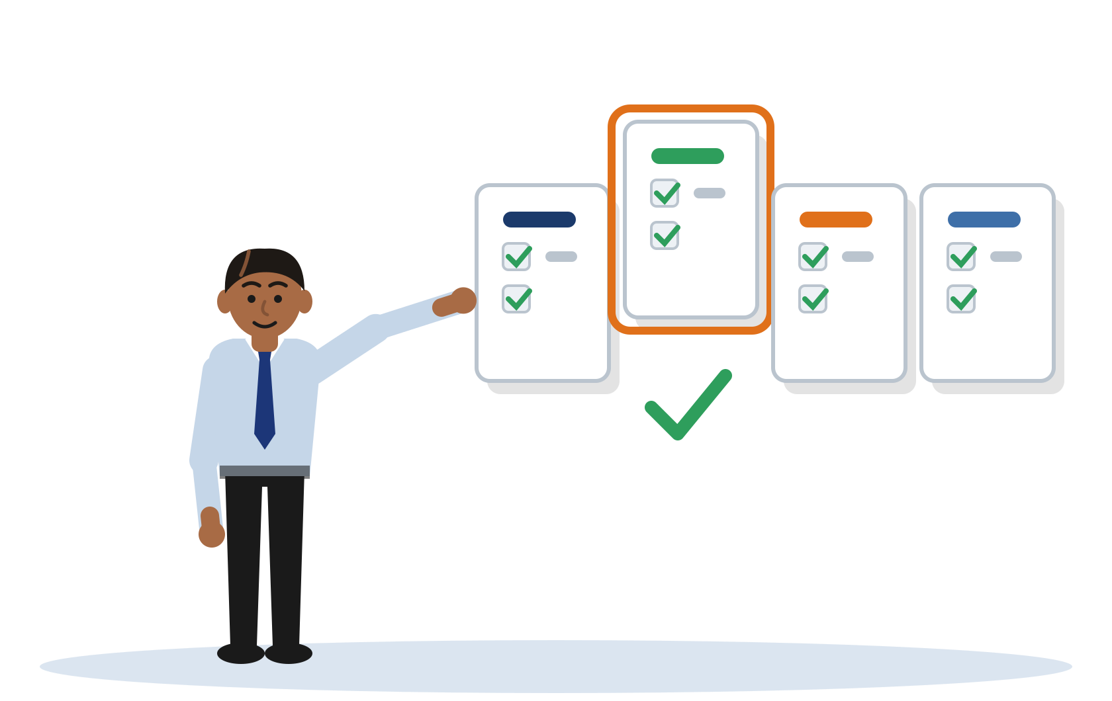
01 Topic Selection

Slide 10
The Four Solution Archetypes
Detection/monitoring tool - identify threats or anomalies in system or network traffic
Hardening/defence framework - reduce the attack surface or exploitability of a system through structured configuration controls
Protocol/architecture design - design or evaluate a secure communication, authentication, or network architecture
Security-testing methodology - a structured, repeatable approach to finding a defined class of vulnerability
A project proposes a concrete solution. It is not a survey.

Slide 11
What Makes a Topic Level-6 Tractable?
Bounded: the scope is clearly delimited - one system, one threat class, one control. Not "all hospitals" or "the whole internet".
Buildable in a testbed: the solution can be implemented and tested in a self-built virtualised environment. No access to a live third-party network is required or proposed.
Evaluable against a baseline: there is a measurable before-and-after, or a comparison with an alternative. The question has an answer that is not simply yes or no.
Achievable in the time available: the core proof-of-concept is completable within the project timeline.

Slide 12
Topic vs Research Question
A topic names what you are interested in.
A research question commits you to a specific, walkable path through it - one you can prove you have completed.
"Intrusion detection" is a topic. A research question names the classifier, the threat, the environment, the metric, and the baseline.
Analogy
A topic is a destination on a map. A research question is the specific, walkable route you commit to and can prove you completed. "Intrusion detection" is the destination. The strong question names the road, the distance, the terrain, and the arrival condition.

Slide 13
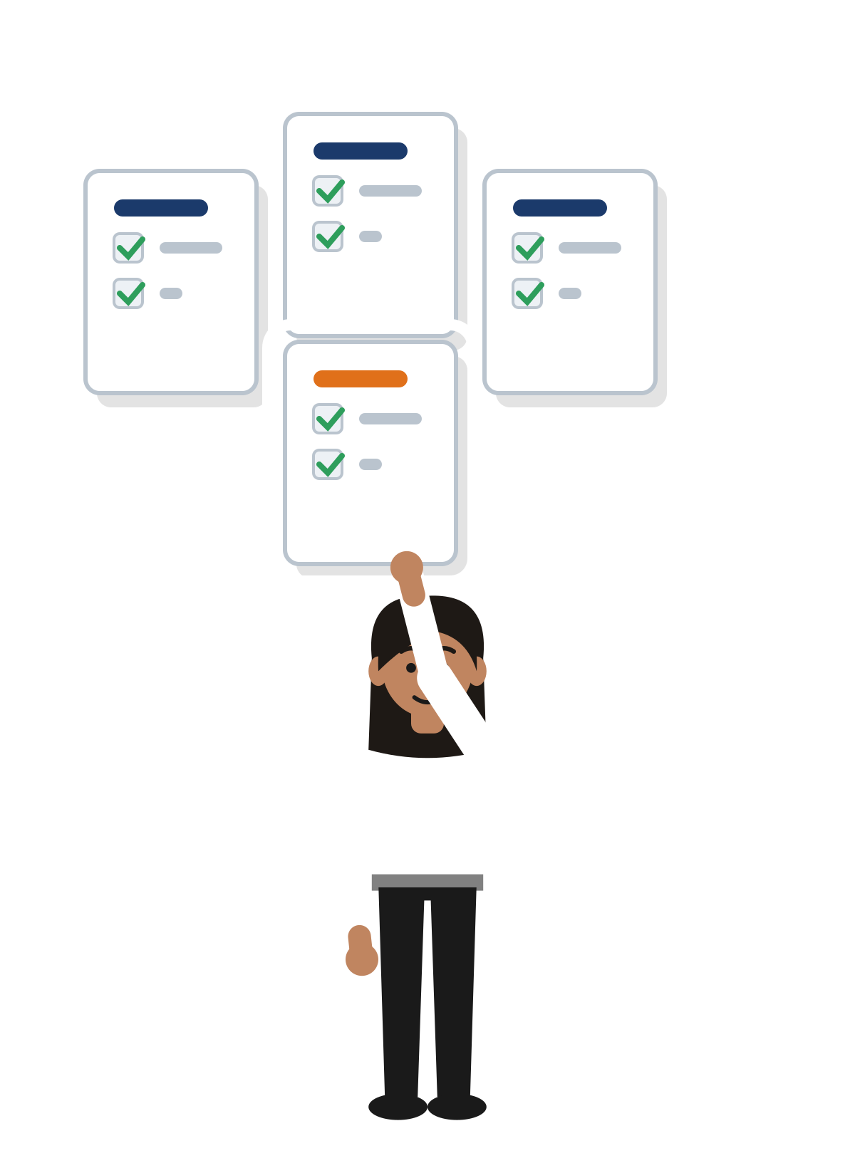
Activity - Pick a Problem
Time: 20 minutes
1. Choose one starting context:
Sarala Pay (microfinance wallet) - SIM-swap account takeover
Arogya Family Clinics - flat, unsegmented clinic network
Yathra Logistics - public REST API
Campus BYOD wireless network
2. Pick an archetype
Detection | Hardening | Protocol/architecture | Methodology
3. Draft a first-cut research question
It will be weak. That is the point. Week 2 is the question clinic.

Slide 14

02 From Topic to
Research Question

Slide 15
A Topic Is Not a Question
A topic states what you are interested in. A research question defines what you will measure, build, and prove.
Kavindu's topic: intrusion detection. His first draft:
"How can machine learning be used to improve intrusion detection?"
Why it fails Criterion 1:
No technique named
No threat named
No environment specified
No metric and no baseline
A topic wearing a question mark.

Slide 16
An Achievable Research Question - Four Properties
Specific: names the technique, the threat class, and the system or protocol. Not "machine learning" but "a tree-based classifier trained on flow-level features".
Technically grounded: draws on real domain mechanisms. The question makes sense to a security practitioner who has never taken a research methods course.
Achievable at Level 6: evaluable in a self-built virtualised testbed within the project timeline. Nothing requires access to a live production system.
Evaluable: includes a measurable outcome, a comparison or baseline, and a defined environment. Not answerable by a simple yes or no.

Slide 17
Aims vs Objectives
An aim is the single, overarching outcome the project is working toward.
Objectives are the differentiated, measurable steps that together deliver the aim.
Common error: listing three identical sentences all phrased as "to investigate" or "to examine". That is one aim stated three times.
Example aim (Chathura / Pahana Retail):
To evaluate whether applying the CIS baseline reduces the exploitability of a Windows SME testbed.
Example objectives:
Establish an unhardened baseline testbed and document its attack surface
Apply the CIS Windows configuration baseline to the testbed
Measure the change in attack-technique success rate against the hardened versus baseline state

Slide 18
Transformation 1 - Weak vs Strong (Kavindu)
Weak
Strong
"How can machine learning be used to improve intrusion detection?"
Why it fails:
No technique named
No threat named
No environment
No metric, no baseline
A topic wearing a question mark.
"To what extent can a tree-based classifier trained on flow-level features detect lateral-movement traffic within an enterprise LAN at a false-positive rate suitable for analyst review, compared with a signature-based IDS baseline?"
The move:
Pin all five: technique, threat, environment, metric, baseline.

Slide 19
Transformation 2 - Yes/No Value Judgement (Pasan)
Pasan | Topic: securing a citizen e-services login portal
Weak: "Is multi-factor authentication good for government web portals?"
Why it fails: answerable yes/no, value-laden ("good"), nothing to build or measure.
Strong: "How does adding a phishing-resistant WebAuthn second factor to a citizen e-services portal affect account-takeover success rate and login completion time, compared with OTP-based MFA, in a security-and-usability testbed?"
The move: From "is X good" to "how does design choice X affect measurable outcome Y against alternative Z."

Slide 20
Transformation 3 - Unbounded Scope (Ishara)
Ishara | Topic: ransomware resilience in a campus network
Weak: "How can we prevent ransomware in universities?"
Why it fails: "prevent" is unachievable as stated, "universities" is unscoped, no method, no measure.
Strong: "To what extent does application allowlisting combined with network micro-segmentation reduce the simulated spread of commodity ransomware across a campus VLAN testbed, compared with endpoint antivirus alone, measured by hosts encrypted and time-to-containment?"
The move: From "prevent X everywhere" to "reduce measurable spread of X under a defined control versus a baseline in a bounded testbed."

Slide 21
What Criterion 1 Distinction Asks For
What the Distinction band looks for, in paraphrase (70 to 100%):
A question stated with precision and real technical specificity, anchored to a cybersecurity or network engineering problem you can point to in the world.
One aim, plus objectives that are visibly different from one another, each measurable, and sized for what one student can finish independently at Level 6.
A technical setting described with the exactness a working practitioner would expect.
Your yardstick: every word in your question should earn its place. If it could apply to any computing project, or can be answered by a quick search, it is not there yet.

Slide 22
Discussion - Critique This Question
Ruwan's draft question:
"This project will develop a phishing-detection system using machine learning to protect online-banking customers, aiming to achieve high accuracy."
Grade it against Criterion 1. What is missing? Then steer it up one band.
Consider: is this a question? What type of phishing? What ML approach? What does "high accuracy" mean - and compared with what baseline? Where is the testbed?

Slide 23
What Happens Next
Week 2 - Research Question Clinic: bring your draft question. The heaviest supervision week. Weak-to-strong iteration in the room.
Week 3 - Checkpoint 1 (Problem Outline): your question is assessed against Criterion 1. Revision is expected. A vague question caught here means five weeks of work are not built on a weak foundation.
Self-Check Tool: run your question through the five Criterion 1 dimensions before the clinic. It identifies exactly which property to fix first.
Session 2 (Week 4) - Critical Literature Review: framing the problem against what is already known.

Slide 24
Today's Thesis
You can build. This module grows a different muscle: framing. Today was your first rep.
A topic names what you are interested in. A research question commits you to what you will prove.
A strong question is specific, technically grounded, achievable at Level 6, and evaluable.
Aims and objectives are differentiated - one overarching outcome, several measurable steps.
The Criterion 1 Distinction descriptor is your yardstick.
Self-study: re-read the student notes (including Exemplar C), draft and re-draft your question, run the Self-Check tool, bring it to the Week 2 clinic.

Slide 25

Questions &
Discussion
NB6015CEM - Research Project Preparation | Session 1
NB6015CEM | Research Project Preparation | Level 6

Slide 26
Disclaimer & Copyrights
The information presented in this presentation is intended for general informational purposes only. It is not meant to be comprehensive or to constitute professional advice. Any reliance you place on such information is strictly at your own risk. While I strive to keep the information accurate and up-to-date, I make no representations or warranties of any kind, express or implied, about the completeness, accuracy, reliability, suitability, or availability concerning the content within this presentation.
This presentation may include references or links to third-party websites or content. I do not endorse the views expressed or the information provided on such external sites. I am not responsible for the content of any linked site or any link contained in a linked site.
Any action you take upon the information presented in this presentation is strictly at your own discretion. I will not be liable for any losses or damages in connection with the use of this information.
This disclaimer is subject to change without notice.
© 2026 Niranga Dharmaratna
School of Computing & Engineering
National Institute of Business Management
Licensed under CC BY-NC-ND 4.0, creativecommons.org/licenses/by-nc-nd/4.0
Last modified: 3 October 2026

