Slide 1

National Institute of Business Management (NIBM)
Coventry University (CU)
NB6015CEM | RESEARCH PROJECT PREPARATION
Methodology and Evaluation
Day 3 - Methodology, Tooling and Evaluation Design
BSc (Hons) Ethical Hacking & Network Security
Niranga Dharmaratna | niranga@nibm.lk
Notes:
Session 3 of 4. The through-line reaches its methodology stage. Open by naming what the session is for: turning a research question into something that can be tested, measured and judged. Assessment link is Criterion 3, Methodology and Technical Rigour, worth 20 per cent of CW1.

Slide 2
Today: method, tools, evaluation
Turning a question into a defined, evaluable claim.
Criterion 3, Methodology & Technical Rigour - 20 per cent of CW1
ILO1 (primary)
Devise an achievable research question on a topic of interest.
ILO3 (secondary)
Analyse the impact of social, legal, and ethical considerations of the proposed research project.
Select and justify a research method
Justify tools on domain grounds, not lists
Sketch a credibly implementation-ready architecture
Design an evaluation with measurable criteria
Unlocks the Week 8 draft, and opens the ethics window
Notes:
Read the aims quickly. Spend the time on the right-hand panel: this session is the one that serves Criterion 3, and Criterion 3 is 20 per cent of the mark. Note that ILO3 is stated here and handed on to Session 4; it is not taught today.

Slide 3
Where this sits in the through-line
Session 1 framed the problem. You wrote a question that names a technique, a threat, an environment, a metric and a baseline.
Session 2 framed it against the known. You placed that question in the literature and justified the gap.
Session 3 frames it as testable. Method is where the question either becomes deliverable, or is exposed as undeliverable.
Methodology is what turns a question into a defined, evaluable claim.
Notes:
One line per session, no longer. The point of the slide is continuity: the room should hear that this is the same argument continuing, not a new topic. Land the last line and move on.

Slide 4
What a methodology chapter is for
What is typically submitted: a build plan. Collect the data, pre-process it, train the models, present the results.
What the chapter is for: a design for finding something out. It states what will be measured, against what, and where.
The difference in one phrase: what I will build, against how I will know it worked.
A build plan describes activity. A methodology chapter defends a claim. Marks under Criterion 3 sit almost entirely on the second.
Notes:
This slide sets up the crimson frame that follows. Do not deliver the punch line here. Ask the room, before advancing, how many of them have written the words "the system will be tested to confirm it works". Then advance.

Slide 5
KEY CONCEPT
Your evaluation design is already written into your research question.
If it is not, your question was never testable.
This is a claim you can check for yourself. The next slide checks it three times.
Notes:
Stop here. Say it once, then say nothing for a beat. Do not explain it on this slide; the next slide is the proof and the explanation. If the room disagrees, that is the right reaction and slide 6 settles it.

Slide 6
Proof: the design is already in the question
Project | Metric | Baseline | Environment
Tharindu Sevana Bank | False-positive rate at a level suitable for SOC triage | Rate limiting | Virtualised testbed, replayed and synthetic authentication traffic
Chathura Pahana Retail | Success rate of a defined set of attack techniques | Out-of-the-box default configuration | Small Active Directory testbed
Dilini Suwa Sevana | Proportion of seeded authorisation flaws detected | Unstructured manual testing | Controlled patient-records API, comparable time budget
Not three examples. One claim, tested three times: the evaluation design was already latent in the comparison clause. Now try the extraction on your own question.
Notes:
Abbreviated from the canonical derivation table; the full table is in the student notes, Section 4. Work across one row at a time, then invert the test: give the room two minutes to pull metric, baseline and environment out of their own question. An empty column is the intended finding, not a failure. Send those students back to the question rather than forward into a method.

Slide 7
Three parts every evaluation needs
A metric. What you count. Without it the claim is unmeasurable and cannot be argued either way.
A baseline. What you compare against. Without it the result is uncompared and therefore uninterpretable.
An environment. Where it runs, and why a result there means anything. Without it the work is unreproducible.
Three failures, one per part: an unmeasurable claim, an uncompared result, an unreproducible setup. Each is visible to a marker in a single reading.
Notes:
These three words carry the rest of the session and the HTML tool. Say them in this order every time you use them today: metric, baseline, environment. Repetition of the ordering is deliberate.

Slide 8
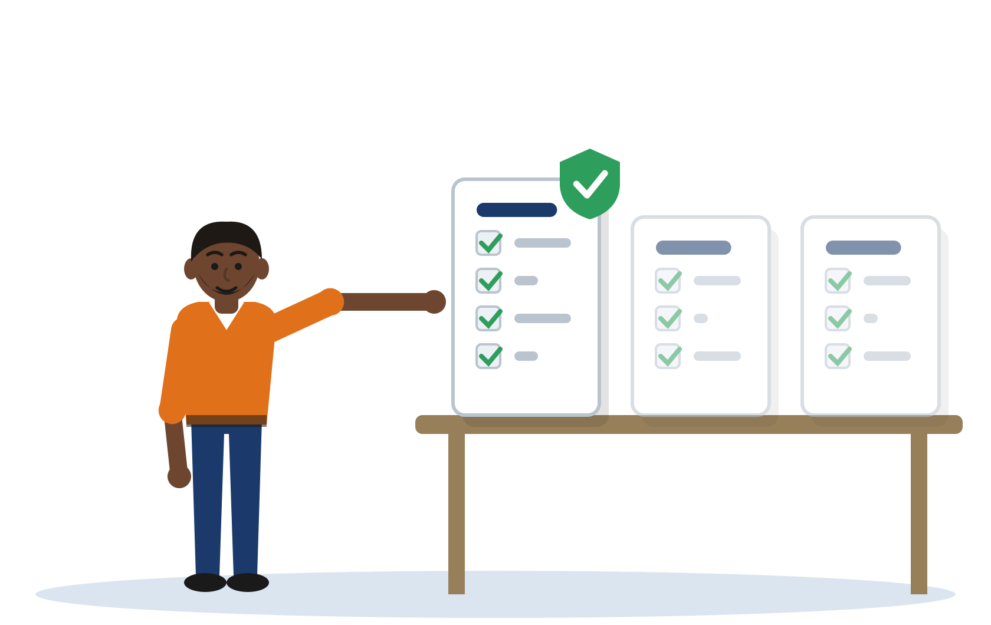
01 Choosing and Justifying
a Method
Notes:
Short divider. Signal the shift from why evaluation matters to how the method gets chosen. Keep the taxonomy brisk: naming a method is not where this cohort loses marks.

Slide 9
Three method families
Experimental. A treatment is applied and an outcome measured against a control. Supports a causal claim within the environment tested.
Design-science. An artefact is built and evaluated against a defined need. Supports a claim that the artefact does something better than the incumbent.
Build-and-evaluate, or proof-of-concept. Something is built, then measured against a baseline. Supports a claim of comparative performance.
Name your family, then move on. Marks are not lost here. They are lost in the three sections that follow.
Notes:
Brisk. Eight minutes at most. The taxonomy is scaffolding: students need it to name what they are doing, but naming it has never been where the marks go.

Slide 10
Matching method to archetype
Solution archetype | Usual method family | Why
detection/monitoring tool | build-and-evaluate | A detector is constructed, then measured against a baseline on defined traffic. The claim is comparative, so the method must produce numbers.
hardening/defence framework | experimental | A treatment is applied and technique success rate measured before and after against a control. The claim is causal within the testbed.
security-testing methodology | design-science | The artefact is the methodology itself; the evaluation shows it beats incumbent practice on a defined measure.
protocol/architecture design | design-science | Usually analytical or simulation-based, because building the full stack is rarely feasible in the time available.
The mapping is a default, not a rule. The question is the final arbiter.
Notes:
Use the unspaced archetype names throughout, as the canonical bank writes them. Flag the protocol/architecture trap here in one line and expand it in Section 2 of the notes: students choose this archetype and then propose an experimental evaluation they cannot run.

Slide 11
Listing tools, or justifying them
Listing (sits at Pass)
Justifying (moves the band)
Chathura, Pahana Retail - hardening
Three baselines named, none chosen: CIS Benchmarks, DISA STIGs, Microsoft Security Baselines.
No comparison is made, so no criterion for choosing is ever stated.
"Industry-standard" and "widely used" would sit unchanged in any project in any environment.
Nothing here is wrong. It is simply not a justification.
The three tells of a real justification
Alternatives are named and weighed: STIGs are prescriptive but assume a managed federal estate, not a retail SME.
A criterion for choosing is stated: scoped to organisation size, expressed as discrete settings applied through Group Policy.
The criterion comes from this project: the evaluation reports against NIST CSF Protect, so the baseline must map to it.
Rejected options are kept as comparison points.
Named move: from naming what exists to choosing on this environment's own grounds. In full: notes, Section 3.
Notes:
The single most important slide in the first half. Read the left column aloud in a flat voice, then the right. Both paragraphs in full are in the student notes, Section 3, and in the lecturer guide at 5.1; do not read them off the slide. Land the three tells: alternatives named, criterion stated, criterion derived from this project.

Slide 12
Justify your tooling
Ten minutes, then debrief
Take one tool or framework you intend to use.
Write one sentence in this form:
chosen because ... , compared against ... , for this environment ...
At debrief, one question only:
Would your sentence still be true in a different project, in a different organisation?
If yes, it is a reputation argument, not a justification.
Notes:
Seed it by naming three plausible tools for the room: a scanner, a traffic generator, a configuration baseline. Ten minutes to write, then take four or five aloud. Debrief only on the generic-versus-domain-specific split; do not correct the tool choice itself. Facilitation detail is in the lecturer guide, Section 3.

Slide 13
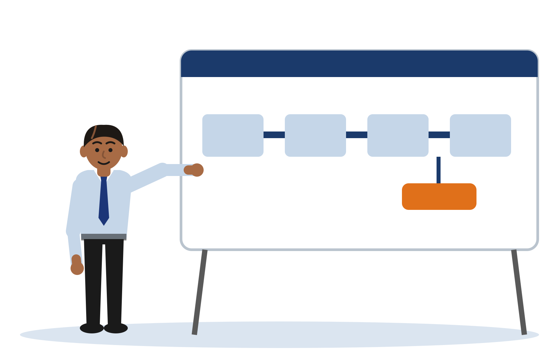
02 Designing the System
Notes:
Divider. The shift is from choosing a method to sketching something buildable, with the measurement point marked on it.

Slide 14
What implementation-ready means
Components are named by function, not by product.
Data flow is shown: what moves between components, and in which direction.
Trust boundaries are marked: where data crosses from one zone of control to another.
The point of measurement is identified: where the numbers in your evaluation are taken.
The test at Level 6: it is a design you could hand to someone else to build. Not a diagram of boxes.
Notes:
Four items only. The fourth is the one that matters for this session and it is the one students omit. Preview it here and prove it on the next slide. On the third, name zero trust (student notes Section 5): a boundary drawn as trusted is a claim the design must enforce and the evaluation should test.

Slide 15
A worked architecture sketch
Tharindu, Sevana Bank - detection of distributed credential stuffing
Traffic source
Feature extraction
Scoring model
Decision output
Measurement point
false positives
Measurement is not a stage of the pipeline. It is something you attach at a chosen point, and the choice is an argument you have to make. Here it sits where scores become decisions, because that is where a false positive is created and can be counted.
Notes:
Build the pipeline left to right, one component at a time, then pause before the callout. Ask the room where they would take the measurement. Most will say at the output; some will say at the model. Then reveal the callout on the boundary between scoring and decision, and make the argument: a false positive only exists once a score has become a decision, so that is where it can be counted. Cap this layout at five components if it is ever reused; six or more will not fit a label at the accessibility floor.

Slide 16
Common architecture failures
A diagram with no data flow. Boxes with no arrows describe an inventory, not a design.
A design that cannot be built in the time available. Feasibility is assessed under Criterion 3 and again under Criterion 4.
A component named after a product rather than a function. Products change; functions are what you are designing.
A sketch with no point of measurement. This is the one that silently kills the evaluation.
Only the last one is invisible to the student. The other three get spotted in supervision; that one survives to the marking.
Notes:
Run these fast. The fourth is the one to dwell on, and it links straight back to the callout on the previous slide.

Slide 17
The testbed as a controlled room
A testbed is not a scale model of the target network, and it is not trying to be.
Reproducibility is the point: another person, given your description, should be able to rebuild it and get a comparable number.
Everything in this module runs in a self-built virtualised testbed or laboratory. Nothing is directed at a live third-party system.
Analogy
A testbed is not a smaller version of the real network. It is a room where you have removed everything you are not measuring, so that when the number changes you know why.
Notes:
The analogy is the point of the slide; the bullets are setup. The last bullet is the ILO3 link: controlled, authorised testing is taught here as a methodology constraint, and the legal and ethical treatment of it belongs to Session 4.

Slide 18
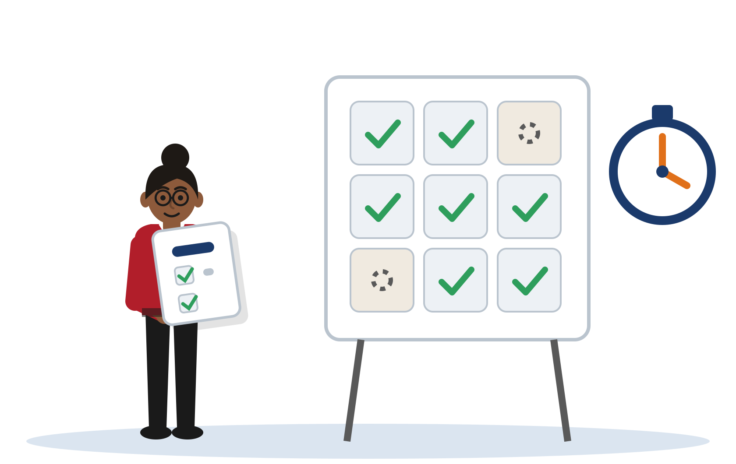
03 Designing the Evaluation
Notes:
Divider. This is where the session spends its remaining time. Everything from here is Criterion 3 evaluation strategy.

Slide 19
Choosing domain-appropriate metrics
Detection work: detection rate, false-positive rate, precision and recall. Report the pair, never one alone.
Hardening work: technique success rate against a defined technique set, and coverage of that set.
Performance and response work: throughput, latency, time-to-containment.
Testing methodology work: proportion of known flaws found, and which classes were missed.
Accuracy alone is almost never the right answer in security. Ask the degenerate-case question of any metric you propose: what would a system that does nothing score? If it scores well, the metric is wrong.
Notes:
The degenerate-case question is the transferable move on this slide. On an imbalanced detection problem a detector that flags nothing scores highly on accuracy, which is why accuracy alone fails. Make the room apply the question to their own proposed metric.

Slide 20
A worked evaluation design
Dilini, Suwa Sevana Teaching Hospital - object-level authorisation testing [Illustrative example - do not cite]
Ground truth: a fixed set of authorisation flaws seeded before testing begins, horizontal and vertical cases, not visible to the tester during the run.
Metric: the proportion of seeded flaws detected.
Baseline: unstructured manual testing.
Controlled condition: a comparable time budget for both arms, so the comparison measures the methodology and not the effort.
Secondary observation: which flaw classes each approach missed, which makes even a null result informative.
Read the chain backwards and it lands on the question. Full statement, with its three stated threats to validity: student notes, Section 4.
Notes:
This is the Distinction-band exemplar. Name why it earns the band: it establishes ground truth deliberately rather than assuming it, it reports a secondary observation that makes a null result interesting, and it states what claim the result will and will not support. The deck carries an abbreviation; the full canonical text is in the notes and in the guide at 5.3.

Slide 21
Threats to validity, and how to state them
The testbed does not resemble the target environment. State the divergence and scope the claim to the testbed.
The baseline was chosen because it is easy to beat. Choose the baseline the target environment would actually use, and say why it is the fair comparison.
The metric rewards the wrong behaviour. Check the degenerate case; if doing nothing scores well, the metric is wrong.
The seeded set or dataset leaks the answer. Fix it in advance, keep it out of sight during the run, and disclose how it was built.
State them. Do not hide them. Naming a limitation is a mark of rigour, not a confession.
Notes:
Students believe naming a limitation costs marks. It does the opposite at Level 6. Each threat here comes with its one-line correction, and the corrections are the useful half.

Slide 22
Grade this methodology
The excerpt is in your notes at Section 4.5.
Four rounds, judged against Criterion 3:
1. Which method family does it name?
2. Which tool is justified, and on what grounds?
3. Which metric, baseline and environment?
4. Name the single edit that moves it up a band.
Hold the room on round 3. The evaluation gap is the session thesis; the tool gap is not.
Notes:
The excerpt itself lives in the student notes at Section 4.5 and in the lecturer guide at 5.5, byte-identical between them. Band verdict is Pass, close to the Fail boundary on the evaluation dimension. The room finds the tool problem quickly and the evaluation problem slowly: hold them on round 3 even when the energy is in round 2. Do not accept "use a bigger dataset", "try more algorithms" or "add more graphs" as the one edit; none is a Criterion 3 lever. Full answer key in the guide at 5.5.

Slide 23
The Criterion 3 yardstick
Criterion 3, Methodology & Technical Rigour - Distinction (70 - 100%)
"Research approach is clearly justified and appropriate for the cybersecurity or network engineering context. Proposed solution is concrete, technically credible, and extends beyond generic description. Tools and technologies are named, compared, and selected with domain-specific justification. System or architecture design is coherent and credibly implementation-ready. Evaluation strategy is defined with measurable, domain-appropriate criteria."
Criterion 3, Methodology & Technical Rigour - Pass (40 - 59%) - the diagnostic mirror
"Methodology is present but justification is weak or generic. Solution is described at a high level without sufficient technical depth. Tools may be listed without comparison or domain-specific justification. Evaluation strategy is vague or underdeveloped."
Quoted whole from the assessment rubric. Everything else said about the rubric today is paraphrase.
Notes:
Both descriptors are quoted whole and attributed, because here the descriptor is itself the teaching object. Read the Distinction band first as the target, then the Pass band, and make the observation plainly: the Pass descriptor names this cohort characteristic failure almost exactly. Tools listed without comparison, evaluation left underdeveloped. That is not a coincidence; it is the cohort profile written into the marking standard. Commentary around these quotes is paraphrased.

Slide 24
Bridge, and the ethics trigger
The Week 8 proposal draft now carries a methodology chapter: method, justified tools, architecture, evaluation design.
Run your question and your draft evaluation through the Evaluation Design Mirror before you write it up.
Fixing the method is what makes the Week 7 ethics application possible. The window opens straight after this session; approval is targeted around Week 10, and the evidence becomes Appendix A.
The one load-bearing dependency: no fixed method, no ethics application.
Session 4: framing boundaries and consequences, including ethics.
Notes:
Close on the dependency, not on the tool. Students who leave without understanding that the ethics window opens next week will lose time they cannot recover before the Week 12 submission. One line of Session 4 preview and stop.

Slide 25

Questions &
Discussion
Metric. Baseline. Environment. Bring a methodology section to the Week 8 draft.
NB6015CEM | Research Project Preparation | Level 6
Notes:
Take questions on the evaluation design first if there is a choice; that is where the room needs the most help. Point students at the Evaluation Design Mirror and the student notes before they leave.

Slide 26
Disclaimer & Copyrights
The information presented in this presentation is intended for general informational purposes only. It is not meant to be comprehensive or to constitute professional advice. Any reliance you place on such information is strictly at your own risk. While I strive to keep the information accurate and up-to-date, I make no representations or warranties of any kind, express or implied, about the completeness, accuracy, reliability, suitability, or availability concerning the content within this presentation.
This presentation may include references or links to third-party websites or content. I do not endorse the views expressed or the information provided on such external sites. I am not responsible for the content of any linked site or any link contained in a linked site.
Any action you take upon the information presented in this presentation is strictly at your own discretion. I will not be liable for any losses or damages in connection with the use of this information.
This disclaimer is subject to change without notice.
© 2026 Niranga Dharmaratna
School of Computing & Engineering
National Institute of Business Management
Licensed under CC BY-NC-ND 4.0, creativecommons.org/licenses/by-nc-nd/4.0
Last modified: 3 October 2026
Notes:
Standard module disclaimer. The last-modified date is generated at build time and is never hard-coded.

