Slide 1

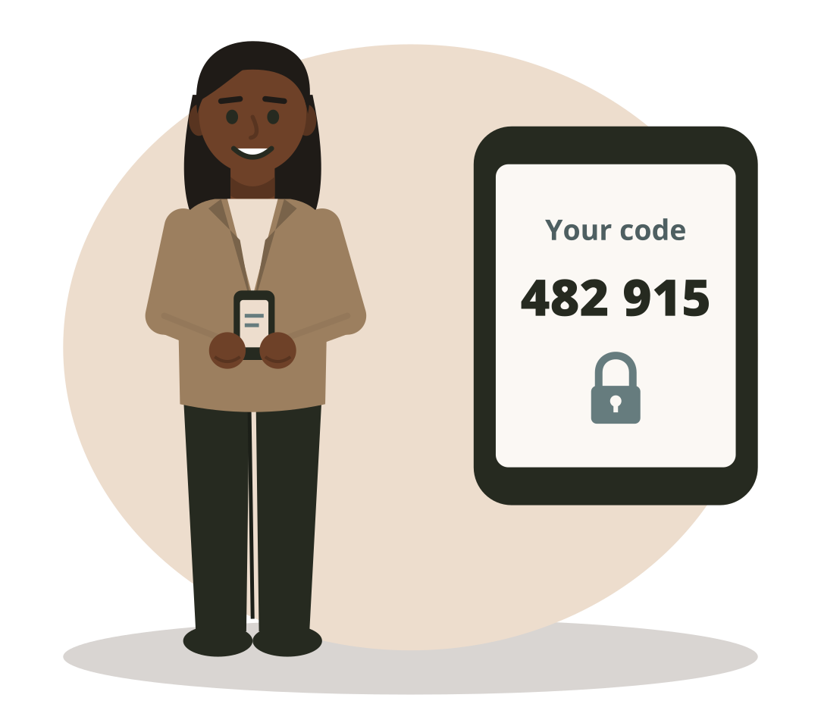
DBIS-11 | Day 2 | Session 11.4 | 1:00 to 4:00
Proving who you are
Cybersecurity and Cloud Computing
Test 2 at 3:00
© 2026 Niranga Dharmaratna, School of Computing & Engineering, National Institute of Business Management
Licensed CC BY-NC-SA 4.0. Icons: Font Awesome Free (CC BY 4.0). Illustrations: original, same licence.
DBIS-11 Cybersecurity and Cloud Computing | Day 2 | Session 11.4
1
Notes:
1:00. Remind students: Test 2 at 3:00 is only about today, morning and afternoon.

Slide 2
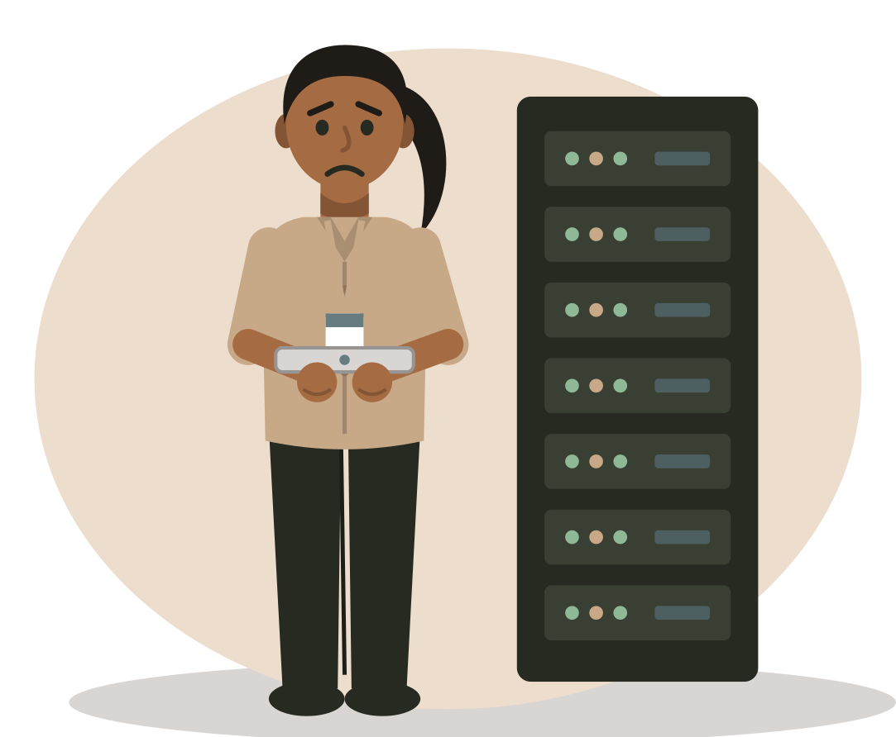
“
A customer order was deleted at 11:14 pm. Everyone in accounts uses the same login: accounts1. Who did it?
By 3:00 you will know why nobody can answer, and how to fix it.
DBIS-11 Cybersecurity and Cloud Computing | Day 2 | Session 11.4
2
Notes:
Hook. Let students guess names. The point: nobody can know. We return to this in the Access Office game.

Slide 3






Where we are on the map
Govern
Identify
Protect
Detect
Respond
Recover
Set the rules
Know what you have
Keep it safe
Spot attacks
Act fast
Get back to work
This afternoon: Protect our accounts
DBIS-11 Cybersecurity and Cloud Computing | Day 2 | Session 11.4
3
Notes:
Still Protect: this afternoon we protect accounts.

Slide 4


This afternoon you will learn
1. Extended CIA
CIA grows: authenticity and accountability.
2. Strong passwords
Passphrases and password managers.
3. MFA
Something you know, have or are.
DBIS-11 Cybersecurity and Cloud Computing | Day 2 | Session 11.4
4
Notes:
Three ideas only.

Slide 5
Extended CIA
1
What we know, and what we add today.
DBIS-11 Cybersecurity and Cloud Computing | Day 2 | Session 11.4
5
Notes:
1:10. Idea 1. The build-up from Day 1. Teaching point for this section: authenticity and accountability are easy to mix up. Separate them by TIME: authenticity is checked NOW (the door), accountability is traced LATER (the diary). Say door and diary every time you say the two words.

Slide 6
What we know: the CIA triad
C: Confidentiality
I: Integrity
A: Availability
Keep it secret. Was it SEEN by the wrong person?
Keep it correct. Was it CHANGED wrongly?
Keep it available. Could we NOT USE it?
This morning's tricks showed us two problems CIA does not name...
DBIS-11 Cybersecurity and Cloud Computing | Day 2 | Session 11.4
6
Notes:
Quick check. Point at each letter and ask the class for the plain meaning.

Slide 7


What we add today: two new goals
Authenticity: is it REAL?
Accountability: WHO did it?
Checked NOW, when a message arrives or someone logs in.
This morning: the fake supplier email, the fake MD voice.
Traced LATER, from records such as logs.
This afternoon: the deleted order nobody can trace.
CIA + Authenticity + Accountability = extended CIA
DBIS-11 Cybersecurity and Cloud Computing | Day 2 | Session 11.4
7
Notes:
Introduce each goal with its question AND its time. Do not rush to the definitions: the door and the diary on the next slide carry the idea.

Slide 8
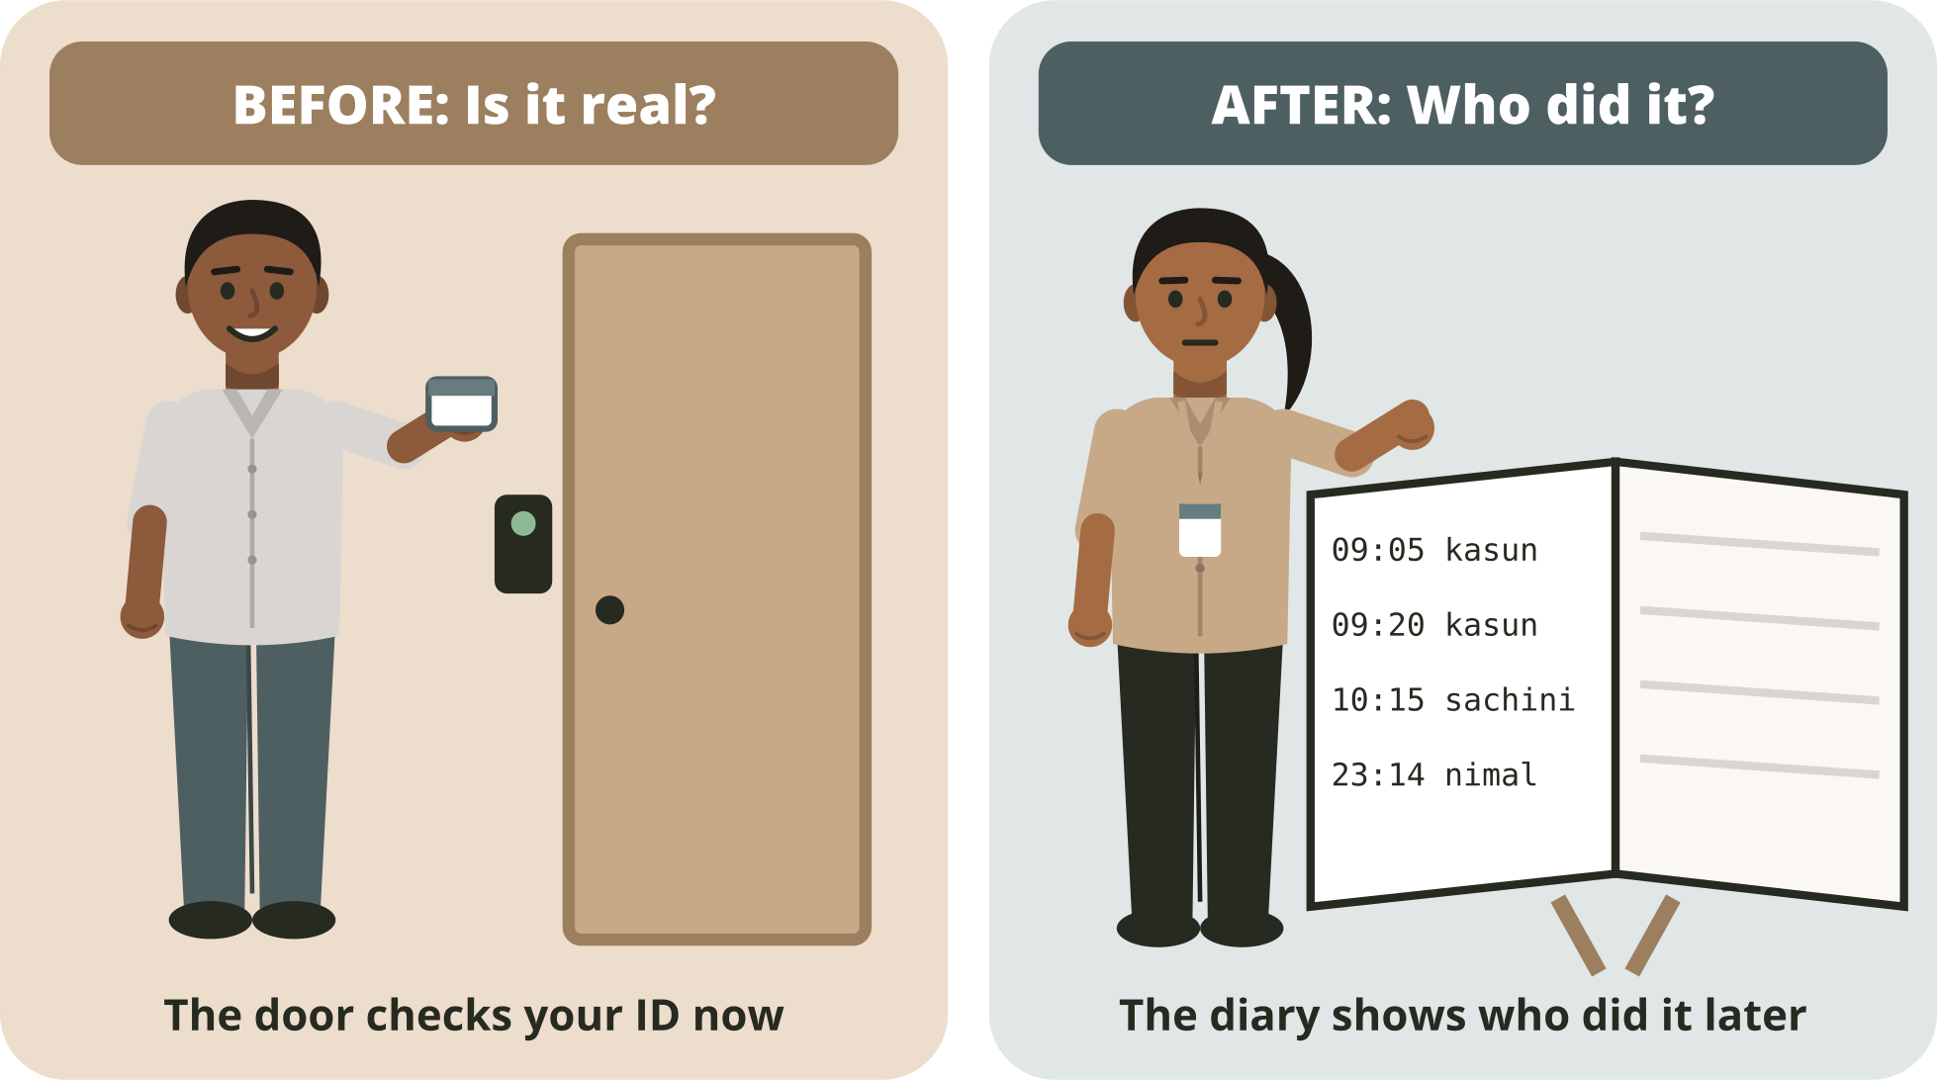

The door and the diary
Door: Authenticity
Is it real? Checked NOW.
Diary: Accountability
Who did it? Traced LATER.
One question decides
Are we checking now, or tracing later?
DBIS-11 Cybersecurity and Cloud Computing | Day 2 | Session 11.4
8
Notes:
The key image. Point at the left: the door checks your ID BEFORE you come in. Point at the right: the diary records what you did, so anyone can look it up AFTER. Ask door or diary about two quick examples before moving on.

Slide 9
Authenticity: the door
Authenticity
Checking that something is real, at the moment it happens: it is really you, or really from them.
At TeaLeaf
When it goes wrong
Before paying, Kasun checks that the email really comes from the supplier. The login asks for a password and a code.
A fake supplier email is believed. A deepfake call in the MD's voice is obeyed. A criminal logs in with Kasun's stolen password.
DBIS-11 Cybersecurity and Cloud Computing | Day 2 | Session 11.4
9
Notes:
Stress NOW. Every trick this morning attacked authenticity: something fake got through the door.

Slide 10
Accountability: the diary
Accountability
Being able to trace an action to the person who did it, later, from records.
At TeaLeaf
When it goes wrong
Every staff member has their own login. The log shows who changed each price, so a manager can check next week.
Everyone uses accounts1, so nobody knows who deleted the order. The log was switched off.
DBIS-11 Cybersecurity and Cloud Computing | Day 2 | Session 11.4
10
Notes:
Stress LATER. Accountability is not a check at the door; it is the record we read afterwards. It also protects honest staff: the diary proves what they did NOT do.

Slide 11
One story, before and after
9:05 am
9:20 am
Friday
Kasun logs in with his password and a phone code.
Kasun changes the price of order 4470.
The MD asks: who changed that price?
Door: is it really Kasun?
The system writes it in the log.
Diary: the log says kasun.p.
DBIS-11 Cybersecurity and Cloud Computing | Day 2 | Session 11.4
11
Notes:
Walk along the timeline. The same morning at TeaLeaf has a door moment and a diary moment. Ask the class to call out door or diary at each step.

Slide 12
Door or diary? Look-alike pairs
Situation | Door or diary?
A fake email pretends to be from TeaLeaf's bank. | Door: authenticity (is it real?)
Nobody can find out who sent the price list to a rival. | Diary: accountability (who did it?)
A criminal logs in with Kasun's stolen password. | Door: authenticity (not really Kasun)
The log shows kasun.p changed the price last week. | Diary: accountability (traced later)
A caller copies the MD's voice. | Door: authenticity (not really the MD)
Everyone uses accounts1, so nobody knows who deleted the order. | Diary: accountability (no names to trace)
DBIS-11 Cybersecurity and Cloud Computing | Day 2 | Session 11.4
12
Notes:
Each pair of rows looks similar. Cover the right column, read one situation at a time, and let the class answer. The deciding question is always: now or later?

Slide 13
The door and the diary need each other
The log says: 23:14 nimal.f DELETED order 4471
If the door worked
If the door failed
It really was Nimal. The diary is true. Accountability works.
A criminal used Nimal's stolen password. The diary blames the wrong person.
Weak authenticity breaks accountability. MFA helps both (section 3).
DBIS-11 Cybersecurity and Cloud Computing | Day 2 | Session 11.4
13
Notes:
The deepest point of the section, and the bridge to MFA. The Access Office log named Nimal. If his password was stolen, the diary lies. Strong authenticity is what makes accountability trustworthy.

Slide 14


How we get them
Authentication
Authorisation
Personal login + log
Who are you?
What may you do?
Who did it?
Password and a code prove it is really you.
Kasun may open Accounts, not Payroll.
Every action is recorded with a name.
Gives authenticity (the door)
Limits the harm
Gives accountability (the diary)
DBIS-11 Cybersecurity and Cloud Computing | Day 2 | Session 11.4
14
Notes:
Authentication sounds like authenticity. Authentication is the CHECK at the door; authenticity is the GOAL (being sure it is real). Personal logins plus logs build the diary.

Slide 15
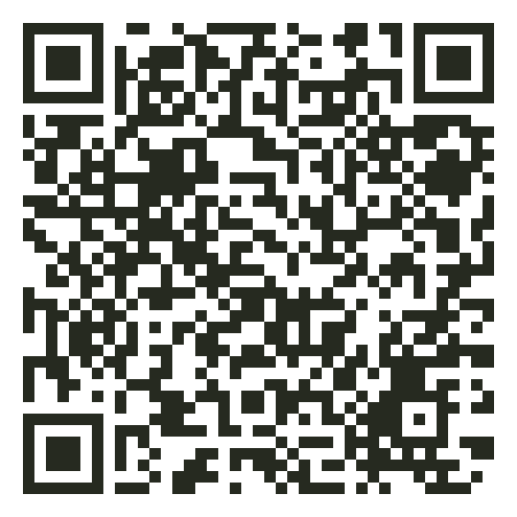
Play: A2.7
Door or Diary?
Read each situation.
Door (is it real, now) or diary (who did it, later)?
The situations come in look-alike pairs.
6 min
Open it: course site > Day 2 > Door or Diary?
Practises: telling authenticity from accountability
Scan to play
DBIS-11 Cybersecurity and Cloud Computing | Day 2 | Session 11.4
15
Notes:
1:40. Short and focused on the one confusion. Watch the Nimal pair: the stolen password is a door problem; the argument about the log afterwards is a diary problem.

Slide 16
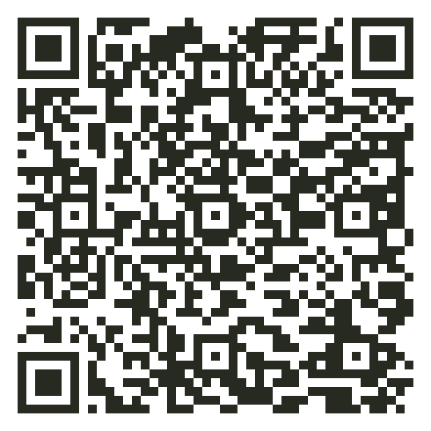
Play: A1.1+
Extended CIA Triage
The Day 1 game, with two new buttons.
Tap C, I, A, Au (door) or Ac (diary).
Ask: seen, changed, cannot use, real, or who?
7 min
Open it: course site > Day 2 > Extended CIA Triage
Practises: the five goals of extended CIA
Scan to play
DBIS-11 Cybersecurity and Cloud Computing | Day 2 | Session 11.4
16
Notes:
1:47. Now mix all five goals. Section 2 starts at about 1:55; trim the password slides if you run late.

Slide 17
Strong passwords
2
Length beats tricks.
DBIS-11 Cybersecurity and Cloud Computing | Day 2 | Session 11.4
17
Notes:
1:55. Idea 2. Keep this section brisk (about 15 minutes) to protect the time given to section 1.

Slide 18




Why passwords fail
Used everywhere
Easy to guess
Shared
Written down
One website is hacked, and the same password opens all your accounts.
Names, birthdays, "123456", "tealeaf123".
Shared passwords break accountability.
A sticky note on the screen is not a secret.
DBIS-11 Cybersecurity and Cloud Computing | Day 2 | Session 11.4
18
Notes:
Four common failures. Ask for a show of hands for each one, anonymously if needed.

Slide 19
A passphrase: long, and easy to remember
Password | Why | Time to guess (estimate)
tealeaf123 | Common and short | Less than a second
P@ssw0rd! | Symbols swapped into a common word | Less than a second
river-lamp-cloud-seven | Four random words | Years
river-lamp-cloud-seven-mango | Five random words | Hundreds of thousands of years
Estimates from the Password Lab: a fast computer guessing 10 billion a second.
DBIS-11 Cybersecurity and Cloud Computing | Day 2 | Session 11.4
19
Notes:
Show that swapping letters for symbols does not help: attackers try those swaps first. Length does help. Four or five random words.

Slide 20



A password manager remembers for you
One master passphrase
You remember one long passphrase.
A different password everywhere
The app makes a strong, different password for every site.
It fills them in for you
No typing, no sticky notes, no reuse.
DBIS-11 Cybersecurity and Cloud Computing | Day 2 | Session 11.4
20
Notes:
Password managers solve the 'used everywhere' problem. Students remember one strong passphrase; the app remembers the rest.

Slide 21
MFA
3
Your password gets a partner.
DBIS-11 Cybersecurity and Cloud Computing | Day 2 | Session 11.4
21
Notes:
2:10. Idea 3. Link back to the slide on the door and the diary needing each other: MFA makes the door stronger, which also makes the diary trustworthy.

Slide 22
What is MFA?
MFA: multi-factor authentication
Logging in with two or more DIFFERENT kinds of factor.
At TeaLeaf
Why it works
Kasun types his password, then a code from his phone. Both are needed.
A criminal buys Kasun's stolen password, but does not have his phone. The criminal is stopped.
DBIS-11 Cybersecurity and Cloud Computing | Day 2 | Session 11.4
22
Notes:
The key word is DIFFERENT. Next slide shows the three kinds.

Slide 23


Three kinds of factor
Something you know
Something you have
Something you are
A password, a passphrase, a PIN.
Your phone, a security key, a bank card.
Your fingerprint, your face.
A password + a PIN is NOT MFA: both are something you know.
DBIS-11 Cybersecurity and Cloud Computing | Day 2 | Session 11.4
23
Notes:
Ask for more examples of each kind. Common confusion: a PIN is something you know, not something you have.

Slide 24
Never share the code
A code from your phone is a key.
Anyone who asks for it is trying to break in.
The bank, IT and the MD will never ask for your code.
If someone asks, say no and report it.
DBIS-11 Cybersecurity and Cloud Computing | Day 2 | Session 11.4
24
Notes:
The code is the second key. Link back to the WhatsApp message in Phish or Legit this morning: 'send me the code you just received'.

Slide 25
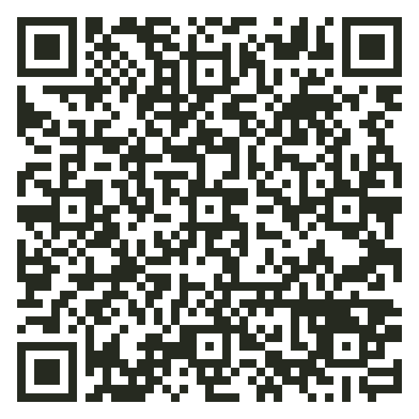
Play: A2.4
Password Lab and MFA Gauntlet
Test made-up passwords. Never a real one.
Sort factors: know, have or are.
Stop the attacker in the gauntlet.
12 min
Open it: course site > Day 2 > Password Lab
Practises: passphrases and MFA
Scan to play
DBIS-11 Cybersecurity and Cloud Computing | Day 2 | Session 11.4
25
Notes:
2:22. Remind students loudly: never type a real password. Nothing leaves the phone, but it is a good habit. Try P@ssw0rd! together on the projector first.

Slide 26



Good to know (not in the test)
Least privilege
Leavers
Zero trust
People get only the access their job needs.
Remove every login on a person's last day.
Check every time, even with the right password.
DBIS-11 Cybersecurity and Cloud Computing | Day 2 | Session 11.4
26
Notes:
Mention only. These ideas return later in the week. The Access Office game practises them.

Slide 27
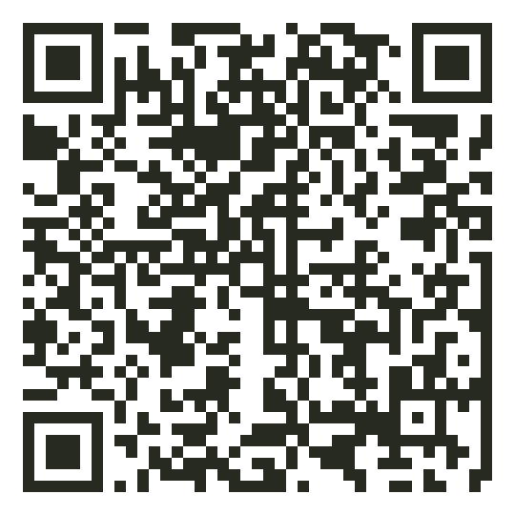
Play: A2.5
Access Office
Find who deleted the order.
Give each person only what they need.
Allow, deny or check each login.
10 min
Open it: course site > Day 2 > Access Office
Practises: accountability, with least privilege
Scan to play
DBIS-11 Cybersecurity and Cloud Computing | Day 2 | Session 11.4
27
Notes:
2:35. Round 1 answers the hook, and its second log shows the door-and-diary link again: with accounts1, 'we cannot tell'. After personal logins, the log names Nimal. That is accountability. Rounds 2 and 3 are mention-only ideas: do not test them.

Slide 28

What we learned today
People can be tricked
Extended CIA
Stronger logins
Phishing in four forms. Watch for hurry, boss, fear, strange senders. Check with a number you already have.
CIA plus authenticity (the door: is it real, now?) and accountability (the diary: who did it, later?).
Passphrases, a password manager, and MFA with two different factors.
DBIS-11 Cybersecurity and Cloud Computing | Day 2 | Session 11.4
28
Notes:
2:48. Full-day recap.

Slide 29
Words to know
Word | Simple meaning
Authenticity | The door: checking it is real, now (really you, or really from them)
Accountability | The diary: tracing who did something, later, from records
Authentication | Proving who you are, e.g. password and a code
Authorisation | What you are allowed to do after you log in
Passphrase | A password made of several random words
Password manager | An app that makes and remembers strong passwords
MFA | Logging in with two or more different kinds of factor
DBIS-11 Cybersecurity and Cloud Computing | Day 2 | Session 11.4
29
Notes:
Add these to the morning list.

Slide 30
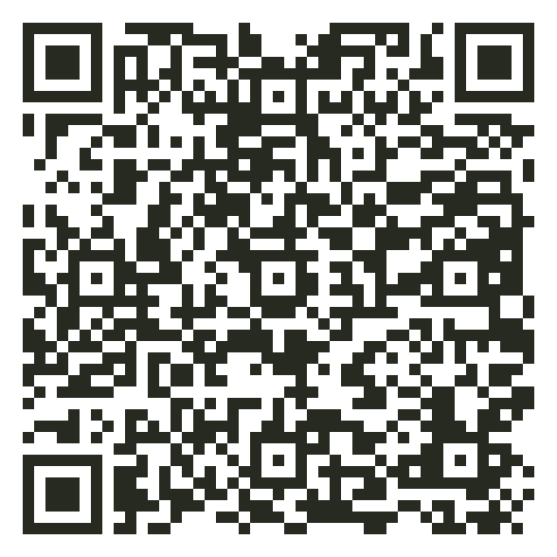
Play: A2.6
People Words Ladder
Study the words. Tap Hear it to hear each one.
Climb three rungs: meaning, example, right or wrong.
Relaxed mode first, then Challenge.
5 min
Open it: course site > Day 2 > People Words Ladder
Practises: all thirteen words of the day
Scan to play
DBIS-11 Cybersecurity and Cloud Computing | Day 2 | Session 11.4
30
Notes:
2:53. Last warm-up before the test. Watch for authentication and authorisation: the most confused pair.

Slide 31




Test 2: how it works
1. Write
2. Photo
3. Upload
4. Hand in
35 min
5 min
10 min
5 min
Answer both questions on paper. No books, no phones.
Take clear photos of your pages. Make one PDF.
Upload the PDF to the LMS. Use the file name below.
Give your paper to the lecturer before you leave.
File name: DBIS11_StudentID_Day2.pdf
We mark your ideas, not your grammar. A clear decision with a good reason gets full marks.
DBIS-11 Cybersecurity and Cloud Computing | Day 2 | Session 11.4
31
Notes:
3:00. Brief (5 min). Same procedure as yesterday.

