Slide 1

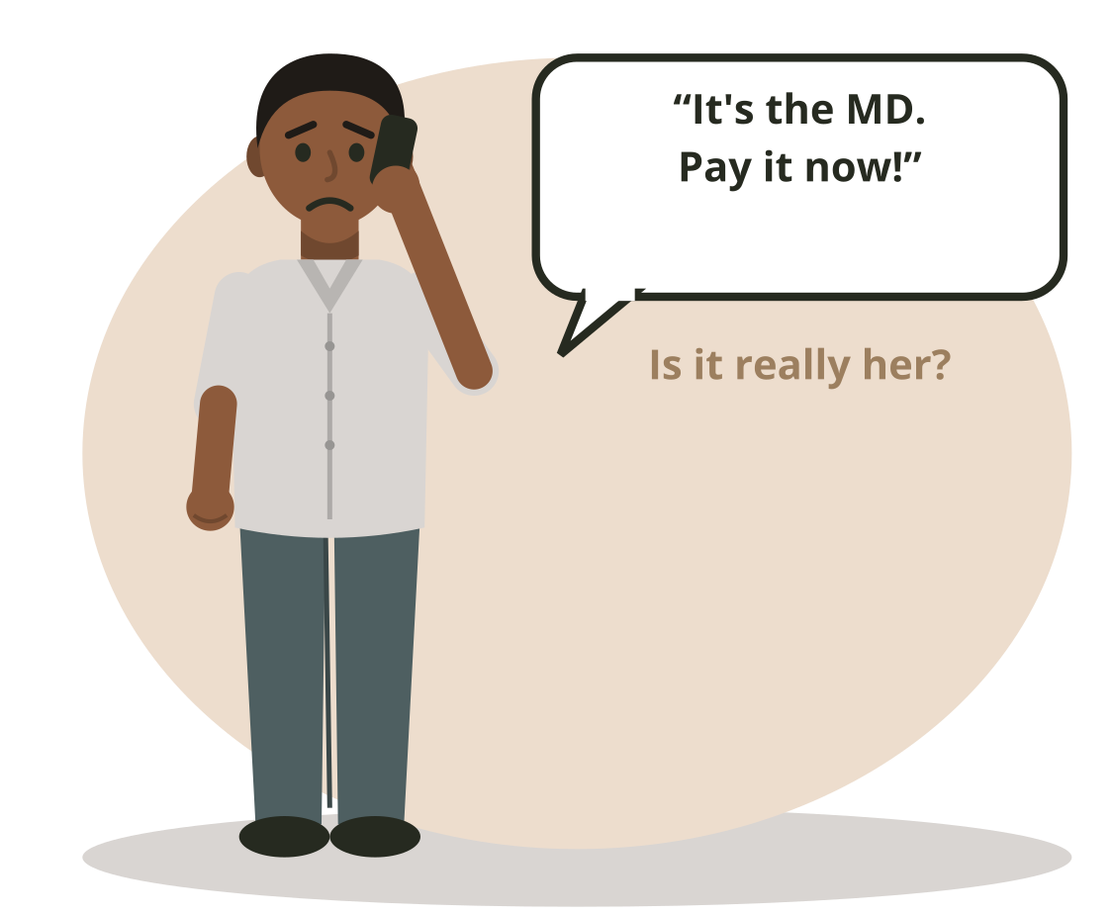
DBIS-11 | Day 2 | Session 11.3 | 9:00 to 12:00
Tricks that target people
Cybersecurity and Cloud Computing
Diploma in Business Information Systems
© 2026 Niranga Dharmaratna. Licensed CC BY-NC-SA 4.0. Icons: Font Awesome Free (CC BY 4.0). Illustrations: original, same licence.
DBIS-11 Cybersecurity and Cloud Computing | Day 2 | Session 11.3
1
Notes:
9:00. Welcome back. Collect any late Test 1 papers. Today is about people: first how they are tricked, then how they prove who they are.

Slide 2
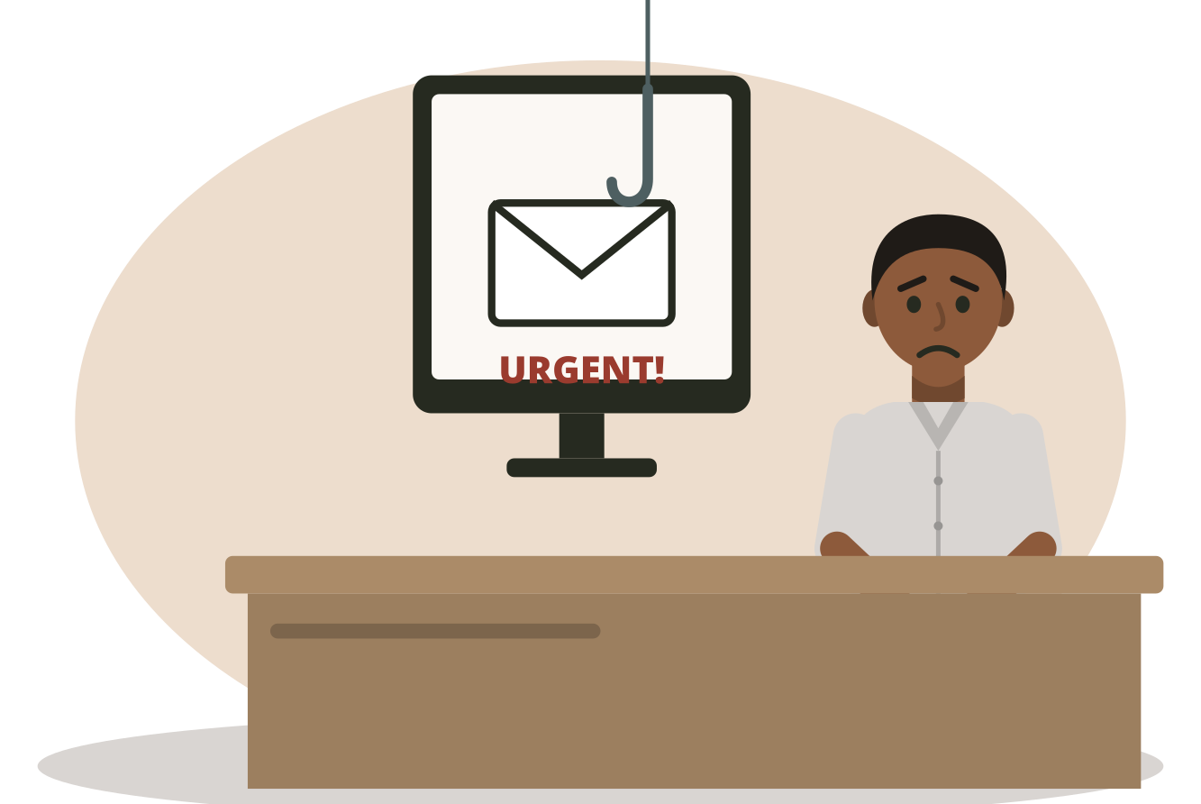
“
Monday, 9:10 am. An email from a supplier: "Our bank account has changed. Please pay today."
Would you pay? By 12:00 you will know exactly what to do.
DBIS-11 Cybersecurity and Cloud Computing | Day 2 | Session 11.3
2
Notes:
Hook. Take a quick show of hands: who would pay? Do not correct anyone yet. We return to this in section 4 and in the Bank Change Trap game.

Slide 3



What we know from Day 1
CIA
Threat, vulnerability, risk
Attackers
Keep information secret, correct and available.
A threat uses a weakness and causes harm.
Criminals, insiders and activists, each with a reason.
Today we add: people can be the weakness, and tricks can be the threat.
DBIS-11 Cybersecurity and Cloud Computing | Day 2 | Session 11.3
3
Notes:
Short recap from yesterday. Everything today builds on these words. Ask students to say each one aloud.

Slide 4





Where we are on the map
Govern
Identify
Protect
Detect
Respond
Recover
Set the rules
Know what you have
Keep it safe
Spot attacks
Act fast
Get back to work
Today: Protect
DBIS-11 Cybersecurity and Cloud Computing | Day 2 | Session 11.3
4
Notes:
Today is all Protect: protecting people and accounts.

Slide 5




This morning you will learn
1. Social engineering
Tricking people, not computers.
2. Four forms of phishing
Email, spear phishing, SMS and phone calls.
3. Warning signs
Hurry, boss, fear, and strange senders and links.
4. The fake bank change
The most expensive trick, now helped by AI.
DBIS-11 Cybersecurity and Cloud Computing | Day 2 | Session 11.3
5
Notes:
Four ideas only, one at a time.

Slide 6
Social engineering
1
Tricking people, not computers.
DBIS-11 Cybersecurity and Cloud Computing | Day 2 | Session 11.3
6
Notes:
9:10. Idea 1.

Slide 7
What is social engineering?
Social engineering
Tricking people into giving information, money or access.
At TeaLeaf
Why it works
A caller says he is from the bank and asks the finance clerk for the company PIN.
The clerk wants to help, so he gives the PIN. No computer was hacked at all.
DBIS-11 Cybersecurity and Cloud Computing | Day 2 | Session 11.3
7
Notes:
Stress: no computer was broken. The attacker went around the technology, through a person.

Slide 8



Why attack people?
We want to help
We obey bosses
We are busy
A polite request is hard to refuse.
An order from the MD feels safe to follow.
When we rush, we stop checking.
It is often easier to trick one person than to break one computer.
DBIS-11 Cybersecurity and Cloud Computing | Day 2 | Session 11.3
8
Notes:
People are not stupid. These are good human qualities that attackers use against us. Ask: which one describes you?

Slide 9
Building on Day 1: people and risk
Risk word | Today's example
Threat | A phishing email from a criminal
Vulnerability | A busy clerk who does not check before paying
Risk | The email could trick the busy clerk, and TeaLeaf could lose money
People can be a vulnerability. Tricks can be a threat.
DBIS-11 Cybersecurity and Cloud Computing | Day 2 | Session 11.3
9
Notes:
This is the build-up. The same risk sentence from yesterday, with a person as the weakness and a trick as the threat.

Slide 10
Four forms of phishing
2
The same trick, four different channels.
DBIS-11 Cybersecurity and Cloud Computing | Day 2 | Session 11.3
10
Notes:
9:30. Idea 2.

Slide 11
Phishing
Phishing
A fake email sent to many people to trick them.
At TeaLeaf
It is like...
An email to all staff: "Your password expires today. Click here."
a fisherman: throw out many hooks and wait for one bite.
DBIS-11 Cybersecurity and Cloud Computing | Day 2 | Session 11.3
11
Notes:
Phishing. Read the meaning, then the TeaLeaf example. Ask a student for a real example they have seen (no names).

Slide 12

Spear phishing
Spear phishing
A fake message made for one person, using real details about them.
At TeaLeaf
It is like...
An email to Kasun, signed with the MD's real name, asking him to buy gift cards.
a spear aimed at one fish, not a net.
DBIS-11 Cybersecurity and Cloud Computing | Day 2 | Session 11.3
12
Notes:
Spear phishing. Read the meaning, then the TeaLeaf example. Ask a student for a real example they have seen (no names).

Slide 13

Smishing
Smishing
Phishing by text message, such as SMS or WhatsApp.
At TeaLeaf
It is like...
"Your parcel is held. Pay LKR 150 here." with a strange link.
phishing that arrives in your pocket.
DBIS-11 Cybersecurity and Cloud Computing | Day 2 | Session 11.3
13
Notes:
Smishing. Read the meaning, then the TeaLeaf example. Ask a student for a real example they have seen (no names).

Slide 14

Vishing
Vishing
Phishing by phone call. AI can now copy a real person's voice.
At TeaLeaf
It is like...
A caller who sounds exactly like the MD asks for an urgent payment.
phishing you can hear. A voice can be fake too.
DBIS-11 Cybersecurity and Cloud Computing | Day 2 | Session 11.3
14
Notes:
Vishing. Read the meaning, then the TeaLeaf example. Ask a student for a real example they have seen (no names).

Slide 15
Four forms at a glance
Form | Channel | Sent to | TeaLeaf example
Phishing | Email | Many people | "Your password expires today"
Spear phishing | Email or message | One person | "Kasun, the MD needs gift cards"
Smishing | SMS, WhatsApp | Many or one | "Your parcel is held, pay here"
Vishing | Phone call | One person | A fake MD voice asks for payment
DBIS-11 Cybersecurity and Cloud Computing | Day 2 | Session 11.3
15
Notes:
Answer key for the next game.

Slide 16

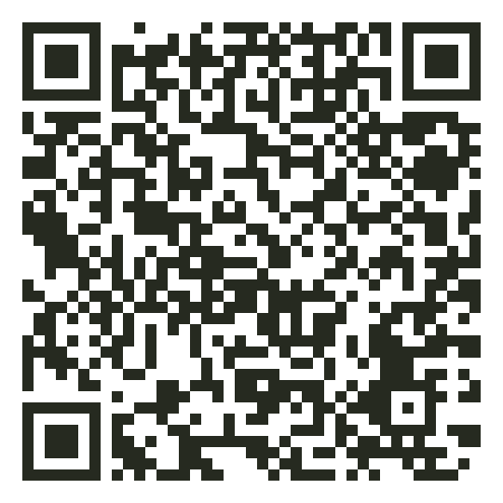
Play: A2.1
Phish or Legit
Read each message in TeaLeaf's inbox.
Tap anything that looks wrong.
Decide: Phish or Legit.
15 min
Open it: course site > Day 2 > Phish or Legit
Practises: spotting phishing
Scan to play
DBIS-11 Cybersecurity and Cloud Computing | Day 2 | Session 11.3
16
Notes:
9:55. Some messages are safe on purpose: students who call everything a phish lose points. Afterwards ask which warning sign was hardest to see (usually the lookalike address hi11country).

Slide 17
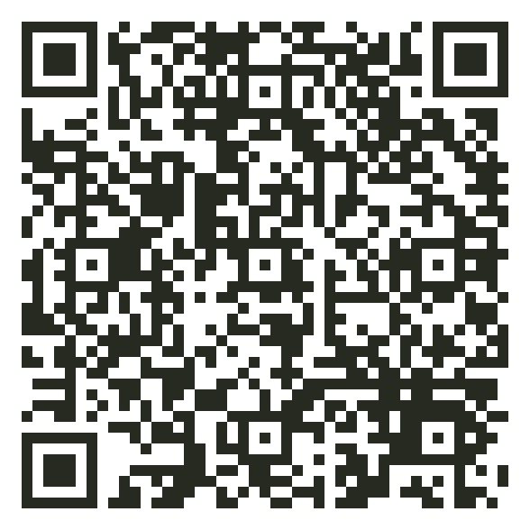
Play: A2.2
Pressure Tricks
Read each message.
Tap the trick: Hurry, Boss or Fear.
Read why.
10 min
Open it: course site > Day 2 > Pressure Tricks
Practises: how attackers push people
Scan to play
DBIS-11 Cybersecurity and Cloud Computing | Day 2 | Session 11.3
17
Notes:
10:10. This previews section 3. Let them play first, then explain. Ten minutes, then a short discussion until the break.

Slide 18

Break
Back at 11:00
Next: how to spot the trick before it works.
DBIS-11 Cybersecurity and Cloud Computing | Day 2 | Session 11.3
18
Notes:
10:30 to 11:00.

Slide 19
Warning signs
3
How to spot the trick before it works.
DBIS-11 Cybersecurity and Cloud Computing | Day 2 | Session 11.3
19
Notes:
11:00. Idea 3.

Slide 20

Three pushes, and two clues
Hurry
Boss
Fear
"Today." "In 10 minutes." "Final notice."
"This is the MD." "The bank." "Head of IT."
"Your account will be closed." "You will lose your files."
Clue: a strange sender
Clue: a strange link
An address that is almost right, or a free Gmail address.
A link to a website that is not the real one.
DBIS-11 Cybersecurity and Cloud Computing | Day 2 | Session 11.3
20
Notes:
Criminals push you so you do not stop and think. Learn the three pushes and the two clues. Together they are the warning signs.

Slide 21
Look closely at the sender
Real: accounts@hillcountrypackaging.lk
Fake: accounts@hi11countrypackaging.lk
The fake uses the number 1 in place of the letter l.
The name shown can be anything. Always read the real address.
A link can say one thing and go somewhere else. On a phone, press and hold to see where it goes.
DBIS-11 Cybersecurity and Cloud Computing | Day 2 | Session 11.3
21
Notes:
Use the real example from the game. Ask the class to find the difference before you reveal it.

Slide 22



What to do when you see a warning sign
1. Stop
2. Check
3. Report
4. Delete
Do not click, reply or pay.
Use a number you already have.
Tell the IT officer.
Only after you report it.
Never check using the phone number or link inside the message.
DBIS-11 Cybersecurity and Cloud Computing | Day 2 | Session 11.3
22
Notes:
Four actions. The first one is the most important: stop.

Slide 23
The fake bank change
4
The most expensive trick, now helped by AI.
DBIS-11 Cybersecurity and Cloud Computing | Day 2 | Session 11.3
23
Notes:
11:20. Idea 4. Back to the hook email from 9:10.

Slide 24



How the fake bank change works
1. Study
2. Copy
3. Ask
4. Push
The criminal learns who TeaLeaf pays.
They make an email address that looks like the supplier's.
"Our bank has changed. Pay the new account."
"Today, or there is a late fee."
The money goes to the criminal. The real supplier is still waiting to be paid.
DBIS-11 Cybersecurity and Cloud Computing | Day 2 | Session 11.3
24
Notes:
Walk through the four steps. Stress step 1: the criminal often studies the business for weeks before sending one email.

Slide 25


Now helped by AI
Perfect English
Fake voices
AI writes emails with no spelling mistakes. Bad English is no longer a reliable clue.
A few seconds of someone's voice is enough to copy it. A deepfake call can sound exactly like the MD.
DBIS-11 Cybersecurity and Cloud Computing | Day 2 | Session 11.3
25
Notes:
Two changes. Old advice said 'look for bad English'; AI has removed that clue. The voice clone is real and cheap. Link to vishing.

Slide 26
The golden rule
Check using a number you already have.
Never the one in the message.
Call the supplier on the number in TeaLeaf's own records.
Call the MD back on her usual number, even if the voice sounds real.
A second person approves every change to bank details.
DBIS-11 Cybersecurity and Cloud Computing | Day 2 | Session 11.3
26
Notes:
If students remember one thing from today, it is this slide.

Slide 27
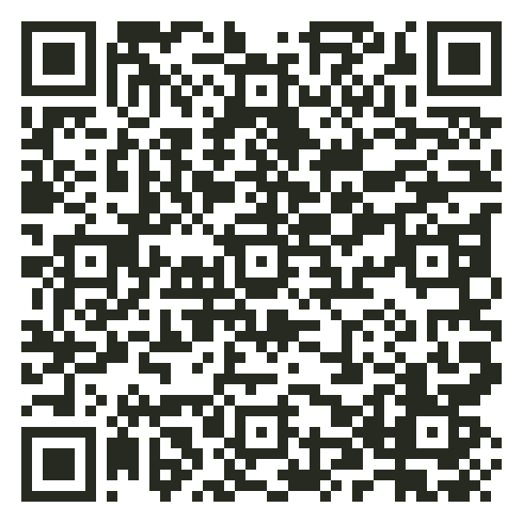
Play: A2.3
The Bank Change Trap
You are Kasun, the finance clerk.
Every choice changes the story.
Find the one path that wins.
12 min
Open it: course site > Day 2 > The Bank Change Trap
Practises: checking before paying
Scan to play
DBIS-11 Cybersecurity and Cloud Computing | Day 2 | Session 11.3
27
Notes:
11:35. Many students will 'check' by replying to the email or calling the number in it. That is the lesson: they checked in the wrong place. Discuss the endings for 3 minutes.

Slide 28
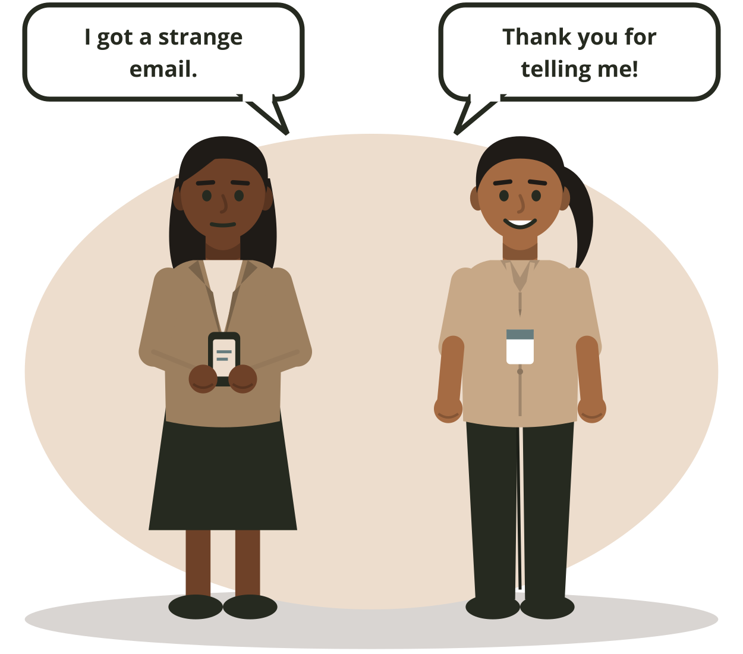
Good to know: report, do not hide
Clicked by mistake? Tell the IT officer at once.
A mistake reported in 5 minutes can be fixed. A mistake hidden for 5 days can cost TeaLeaf its money and its customers.
Good to know. Not in the test.
DBIS-11 Cybersecurity and Cloud Computing | Day 2 | Session 11.3
28
Notes:
Mention only. Not tested. A no-blame culture: staff who report quickly are thanked, not punished. Mistakes found early cost much less.

Slide 29
What we learned this morning
Social engineering tricks people
People can be the weakness; tricks can be the threat.
Four forms
Phishing, spear phishing, smishing, vishing.
Warning signs
Hurry, boss, fear, strange senders and links.
The fake bank change
Check using a number you already have.
DBIS-11 Cybersecurity and Cloud Computing | Day 2 | Session 11.3
29
Notes:
11:52. Recap.

Slide 30
Words to know
Word | Simple meaning
Social engineering | Tricking people into giving information, money or access
Phishing | A fake email sent to many people to trick them
Spear phishing | A fake message made for one person, using real details
Smishing | Phishing by text message (SMS, WhatsApp)
Vishing | Phishing by phone call
Deepfake | A fake voice or video made by AI to copy a real person
DBIS-11 Cybersecurity and Cloud Computing | Day 2 | Session 11.3
30
Notes:
Students copy new words. The People Words Ladder at the end of the afternoon uses these and the afternoon words.

Slide 31
After lunch
Proving who you are
CIA grows two new letters, and your password gets a partner. Back at 1:00.
DBIS-11 Cybersecurity and Cloud Computing | Day 2 | Session 11.3
31
Notes:
12:00. Lunch.

