Slide 1
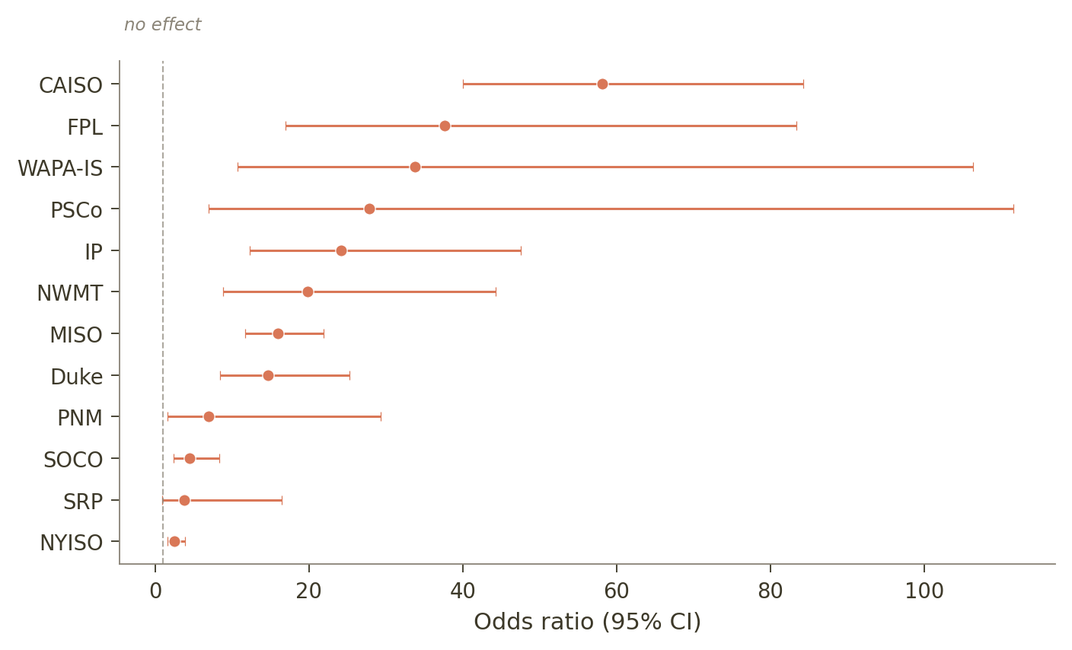
Withdrawal Contagion
Withdrawals cluster at interconnection points far beyond chance
A project whose neighbors have withdrawn is ~13x more likely to withdraw itself.
Theory: When a project drops out of the interconnection queue, the cost of grid upgrades it was assigned to pay for gets reallocated to the other projects at the same “Point of Interconnection” (POI). This makes their costs rise, which may cause more of them to withdraw, further increasing costs.
We wanted to empirically test this.
• Withdrawal clustering is 67% above what chance predicts (p < 10⁻¹⁵), confirmed by a permutation test 33 SDs above the null
• Peer withdrawal count is the #1 predictor in a machine learning model (AUC = 0.87), 1.5x more important than any other feature
• Effect is positive in all 19 grid regions tested, from NYISO (2.5x) to CAISO (58x) — see chart at right
• However: this proves correlation, not causation
Each dot shows the odds ratio for peer withdrawal in that grid region. All 19 are above the 'no effect' line at 1.
Notes:
This slide establishes the basic empirical pattern. Withdrawals cluster at POIs — points of interconnection — far more than we'd expect if each project's decision were independent. The odds ratio of 13 comes from a logistic regression controlling for resource type, capacity, entity, state, and queue cohort year. The forest plot on the right shows this isn't driven by any single region — it's positive and significant in 18 of 19 entities. The machine learning model (gradient boosting) confirms peer withdrawal count as the top predictor by a factor of 1.5x over the next feature. The key question is how much of this is causal contagion vs. shared POI characteristics.

Slide 2
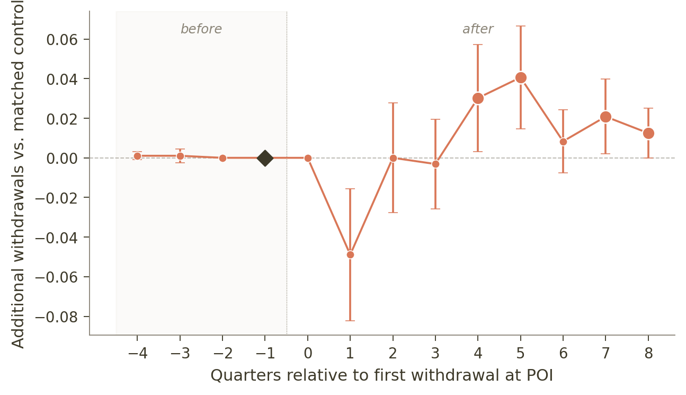
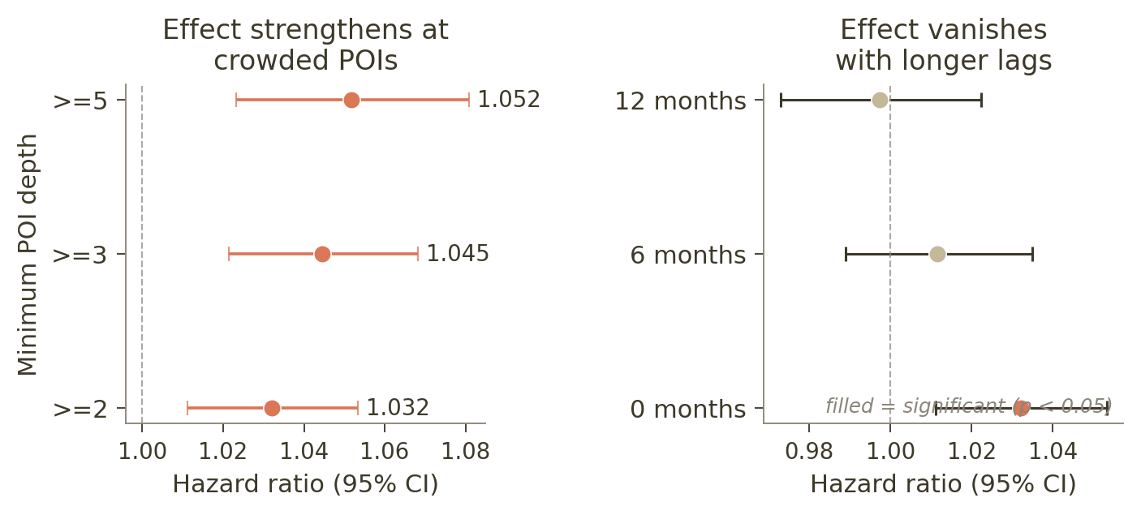
Withdrawal Contagion
Two independent tests confirm a semi-causal “cascade effect”
But they disagree on timing
Matched Difference in Differences
Cox Proportional Hazards Model
Left: risk increase per peer withdrawal grows at busier POIs. Right: effect is only significant at zero lag — vanishes at 6+ months.
Each dot = difference in withdrawals between matched treated and control POIs. Flat left side = groups were comparable before. Rise at Q4–8 = delayed contagion.
• 951 matched pairs, well-balanced (parallel trends p = 0.39). No immediate cascade, but a significant increase at 1–2 years — consistent with formal cost reallocation timelines
• Survival model: each peer withdrawal raises risk by 3.2% (p = 0.002), strengthening to 5.2% at crowded POIs. A zero-contagion simulation can’t reproduce this (0/1,000 replications)
Notes:
This slide presents our two temporal/causal tests side by side.
LEFT — Matched DiD event study: Our strongest causal test. We identify 951 POIs where a withdrawal occurs after two clean quarters, then match each to a control POI in the same entity with the same dominant technology and similar size. The flat pre-period confirms the groups were on parallel trajectories. The dip at quarter 1 is 'survivor selection' — projects that don't leave immediately are temporarily more resilient. Significant positive effects emerge at quarters 4–5 (~1 year) and persist through quarters 7–8. This timing matches formal restudy and cost reallocation cycles, which typically take 12–18 months. Result survives developer restrictions and batch exclusions.
RIGHT — Cox survival model: A complementary approach that tracks how each peer withdrawal changes the hazard (instantaneous risk) of withdrawal for remaining projects. Left panel shows the effect strengthens at crowded POIs: 3.2% at depth 2+, rising to 5.2% at depth 5+. Right panel shows the effect is only significant at zero lag — it vanishes at 6- and 12-month lags. This confirms the effect operates in real time, not through slow diffusion. A calibrated simulation under zero contagion cannot reproduce these magnitudes (0/1000 replications).

Slide 3
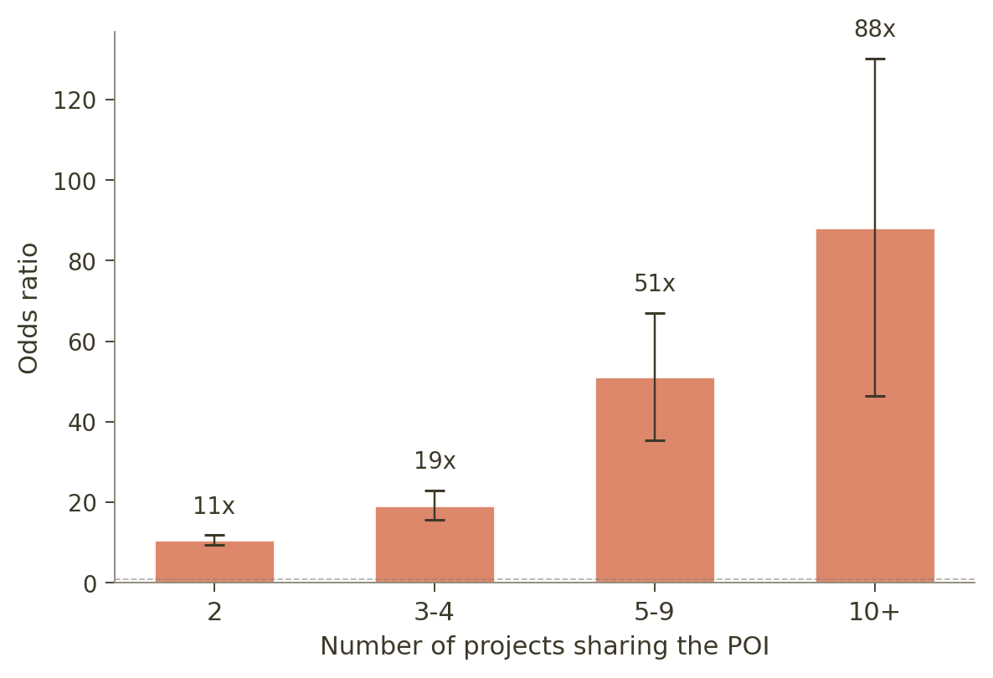
Withdrawal Contagion
The effect is second order and intensifies at crowded POIs
The chart shows how the contagion odds ratio grows with the number of projects sharing a POI.
Takeaways:
Shared infrastructure conditions at the POI (grid constraints, upgrade costs, location quality) account for the bulk of co-movement instead of the cascade effect.
However, cascades have a modest but real causal effect (∼3% per peer withdrawal) that operates on a 12–18 month delay, consistent with formal cost reallocation.
Confounding alone doesn’t explain the pattern — a simulation with zero contagion fails to reproduce our results in 0 out of 1,000 trials.
Bars = odds ratio for peer withdrawal rate at each POI size. The effect is 8x stronger at POIs with 10+ projects vs. 2 projects.
Additional evidence: 9% excess withdrawal clustering vs. operational outcomes · Effect strengthens at deeper POIs (3% → 5% hazard increase) · Robust to developer restrictions and batch exclusions
Notes:
The bar chart shows a dose-response pattern: the contagion effect gets dramatically stronger as more projects share a POI. At POIs with 10+ projects, the odds ratio is 88x. Part of this gradient is mechanical — measurement error attenuates more at small POIs — but a calibrated simulation under zero contagion can't reproduce these magnitudes at any depth.
Thus, withdrawal cascades cascades are real, empirically detectable, and operate through cost reallocation on a 12–18 month timeline. But they're second-order relative to the shared POI-level conditions (grid constraints, upgrade costs, location quality) that drive most of the clustering we observe.
One additional note on the placebo test: in the unrestricted sample, withdrawals cluster 9% more than operational successes, which mildly supports a withdrawal-specific mechanism. The restricted version of this test (terminal outcomes only) shows equal clustering, but that turns out to be a mathematical tautology — when you restrict to projects that either withdrew or succeeded, the two outcomes are complements and their variance ratios are identical by construction.

