Slide 1
Course Networking
Team DELTA
160050087
160050095
160050099

Slide 2
Abstract
• Social networking website for courses, with emphasis on notifications, discussion forums
and student feedback. Separate interfaces for instructors and students, profiles for all
users.
• Students
· maintain profile
· have a calendar containing events highlighted
· receive notifications for upcoming events such as exams, assignment deadlines and
feedback deadlines based on the events created by instructors.
· can view his weekly timetable for all courses.
· can post a question in the discussion forum, search the forum for a question, give answer to one, comment , upvote or downvote an answer.
Notes:
Notifications?

Slide 3
Abstract
An instructor
· can upload course material, make announcements.
· can put up a feedback form, view the responses(anonymous),
· answer a question in discussion forum.
· has the feature to signup using social media account

Slide 4
Problem Statement
Creating a social networking site for courses with a user friendly interface for instructors, students with a platform for Discussions, Timely notifications for important events, Feedback forms and Display of timetables.

Slide 5
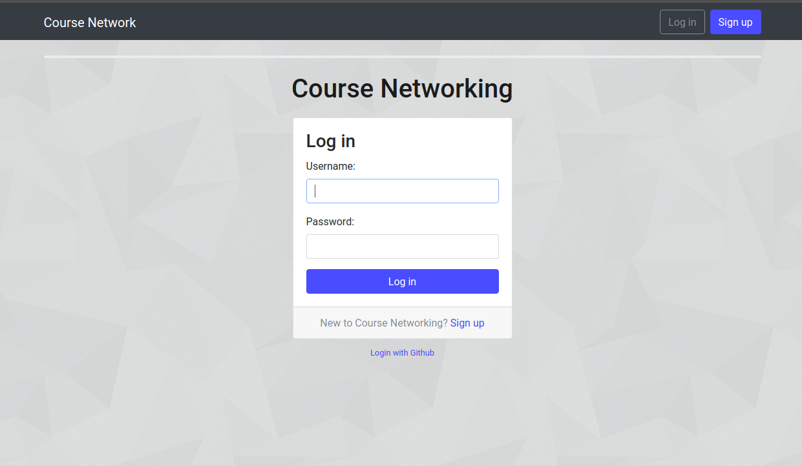
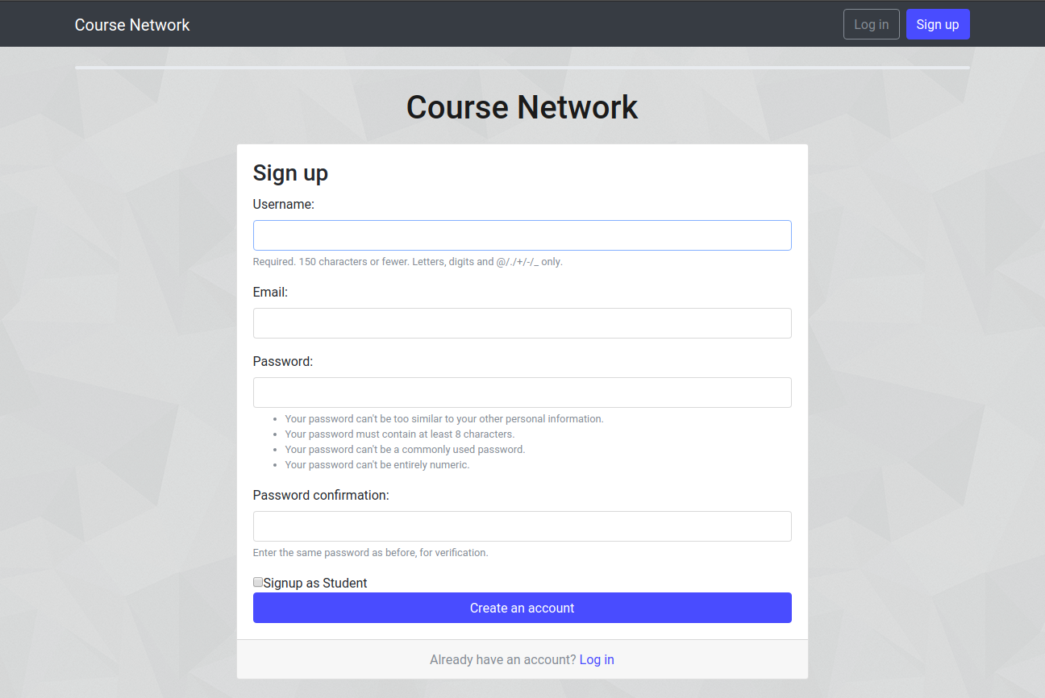
Login signup
We extended django’s default user model (one-one) to make Student and Instructor models. The Login (Figure 1) and Signup (Figure 2) pages are shown below.

Slide 6
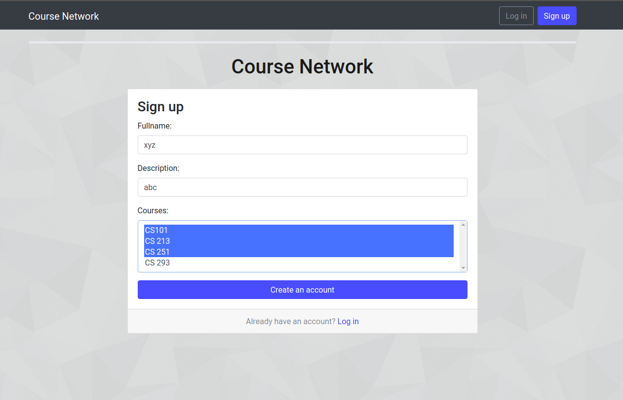
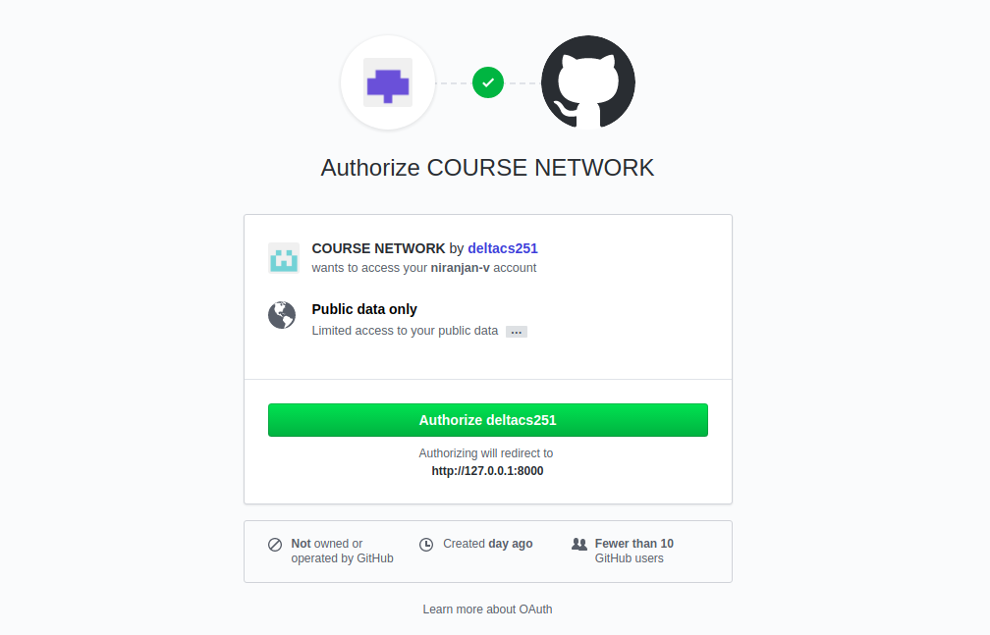
Login SIgnup
During signup after the above filling form user is shown a student or an instructor signup form after filling it he is redirected to homepage.There is also an option for Git-Signup/Login

Slide 7
Homepage
The homepages are different for student (Figure 5) and instructor(Figure 6). After login user is redirected to his corresponding home page. The courses taken (given) by student (instructor) are displayed.
In student home page, links to view his timetable, event calendar are displayed. Also notifications and links to feedback forms to be filled are displayed. When clicked on a notification, its detailed description is showed.

Slide 8
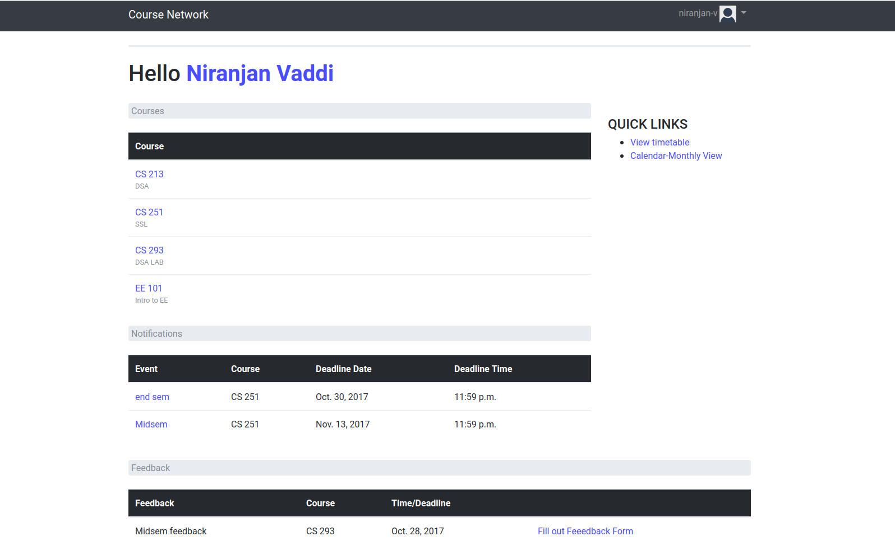
Student Homepage

Slide 9
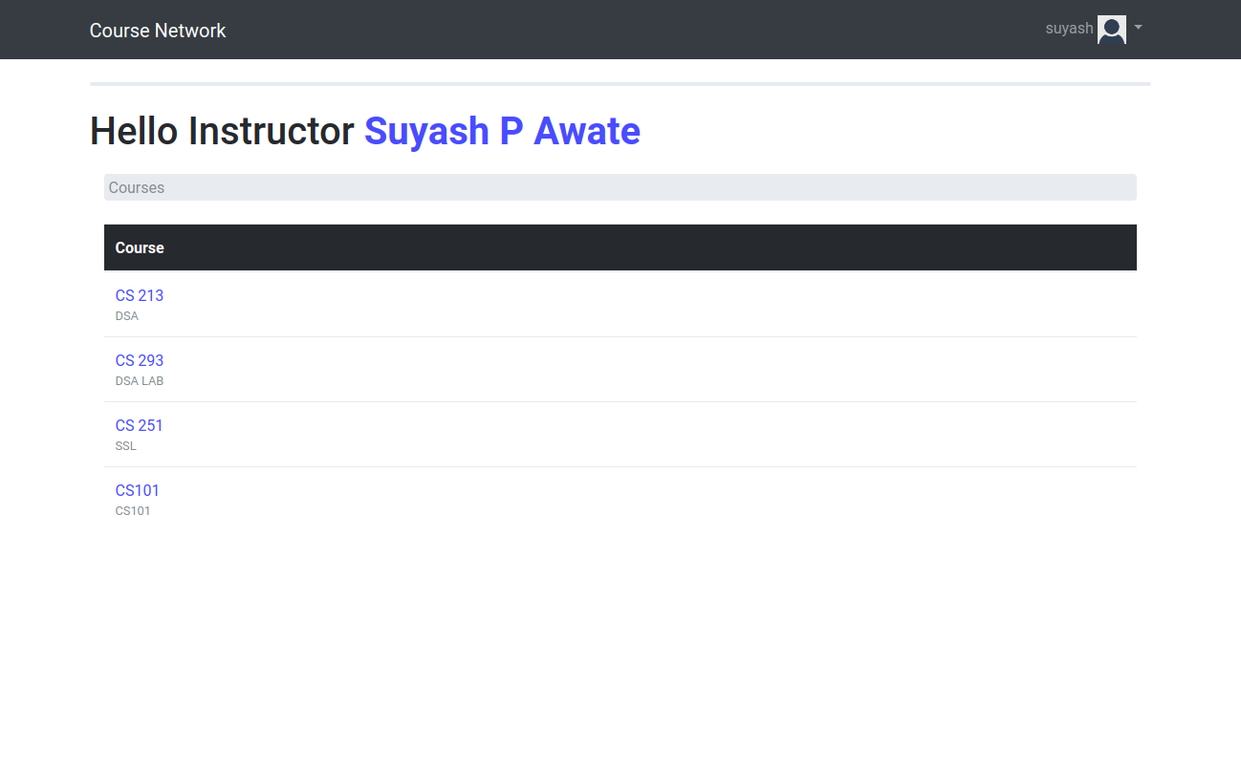
Instructor Homepage

Slide 10
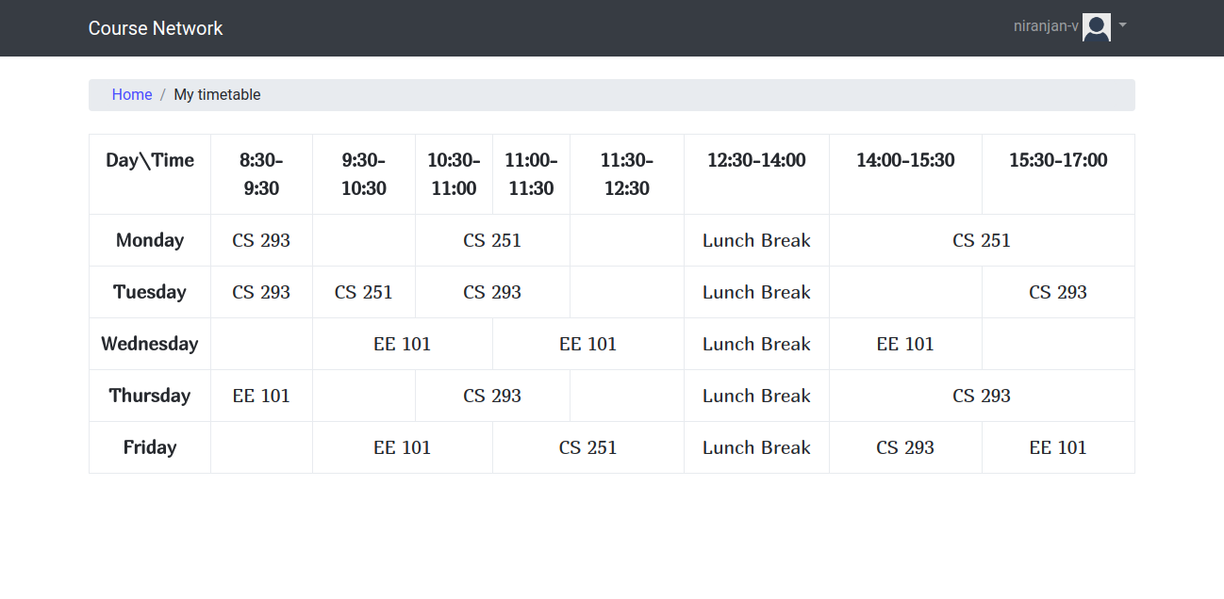
Student timetable
Student’s timetable (Figure 7) is generated from Slot field the Courses he has taken up.
Notes:
Change gnuplot to matplotlib’s pyplot

Slide 11
Course homepage
In course home page, the instructors for the course, the students who have taken up the course are shown(these are also links to their profiles). The events related to that course are displayed in this page.
There are links to discussion forum and course resources page. Similarly in instructor page there are also options to add/edit/delete an event. Add feedback form, view responses.
Notes:
Can’t approve student’s answer.

Slide 12
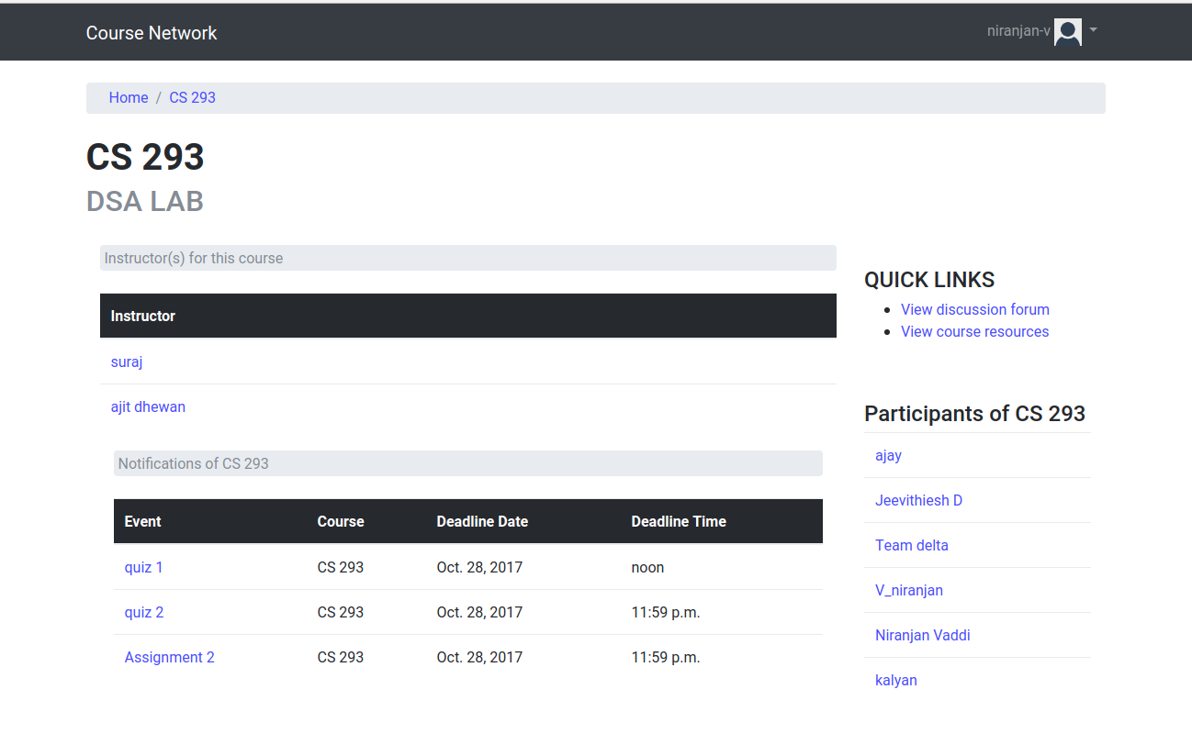
Student course home
Notes:
No filters yet. No personal messages.

Slide 13
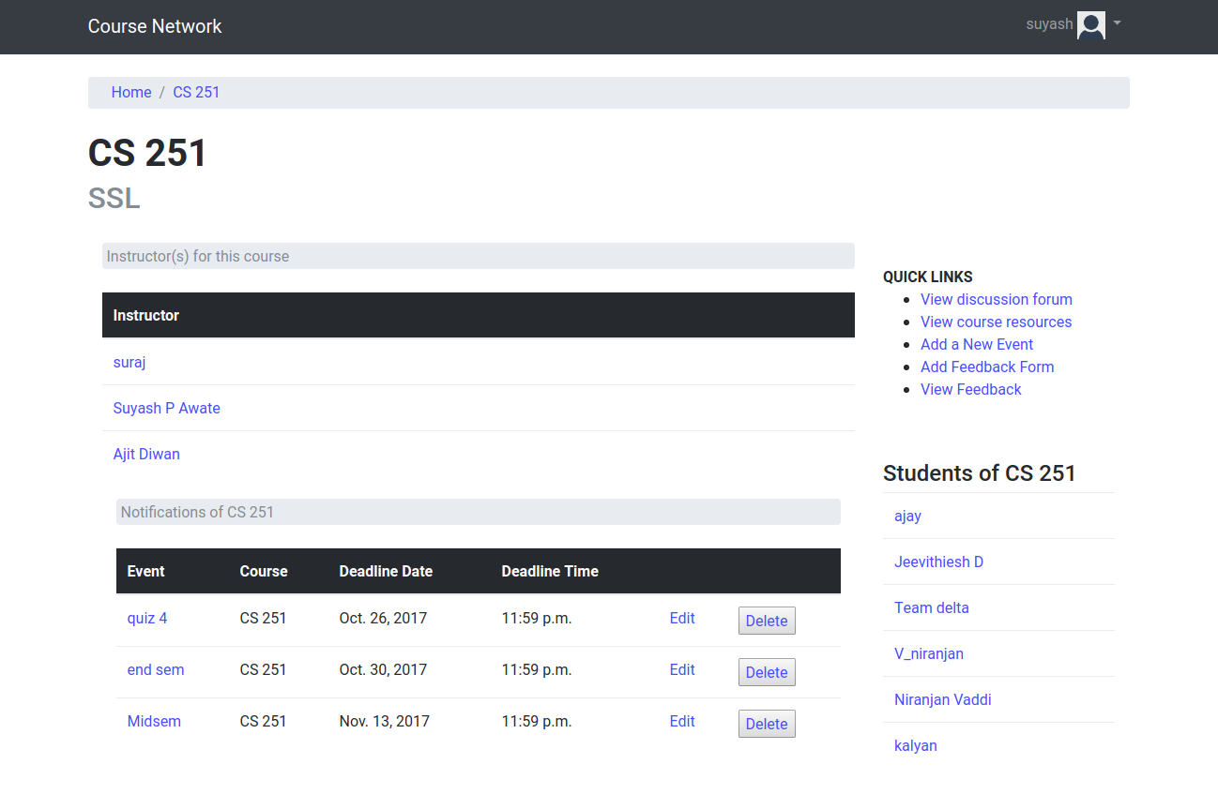
Instructor course home
Notes:
Instructor can’t choose best answers. Filters in forum? No search

Slide 14
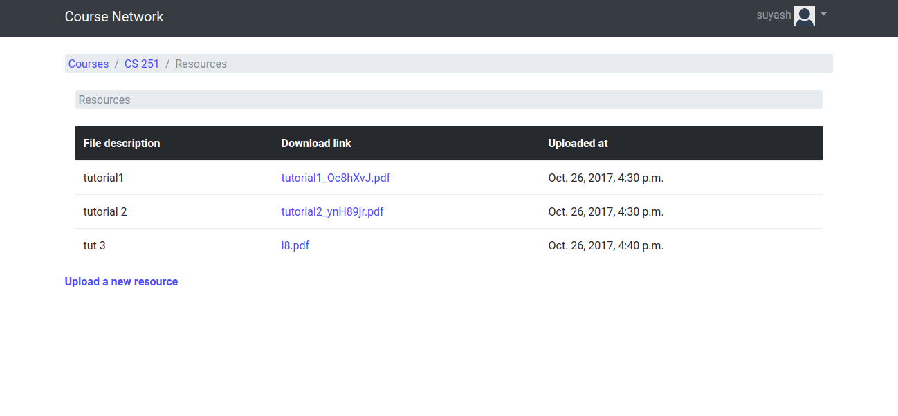
Course resources
Instructor’s course resources page is shown below. The download link for the resource is given in the table. Student’s page looks the same except that there is no upload a new resource link.
Notes:
Can’t do any of this.

Slide 15
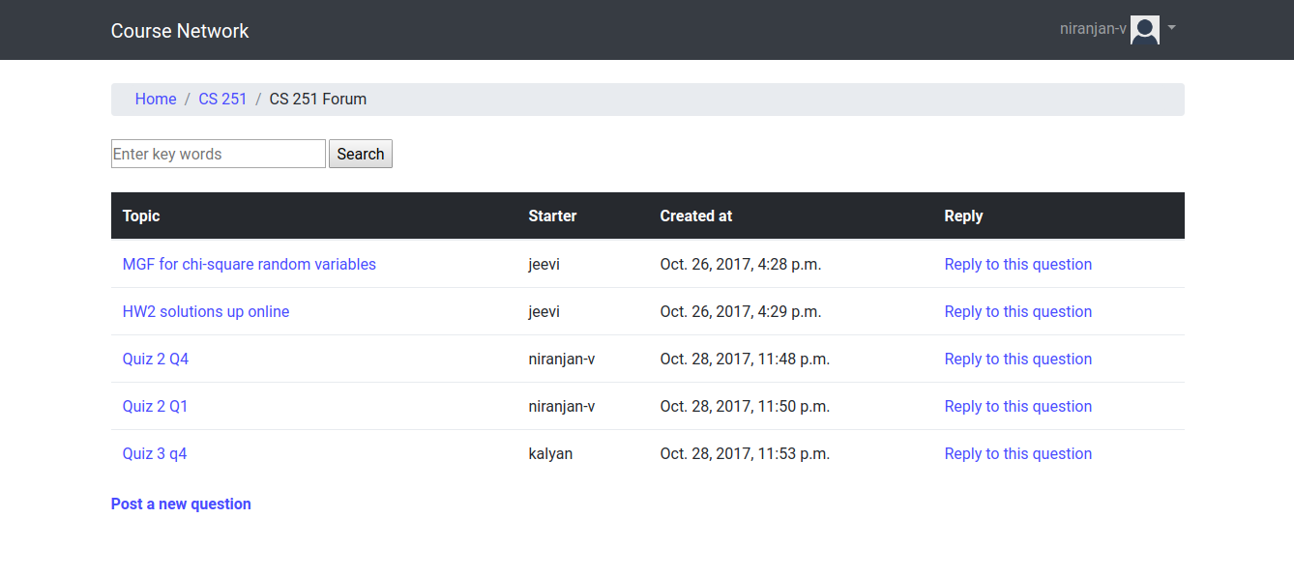
Discussion forum
In discussion forum page(Figure), the topics are displayed in a tabular format.

Slide 16
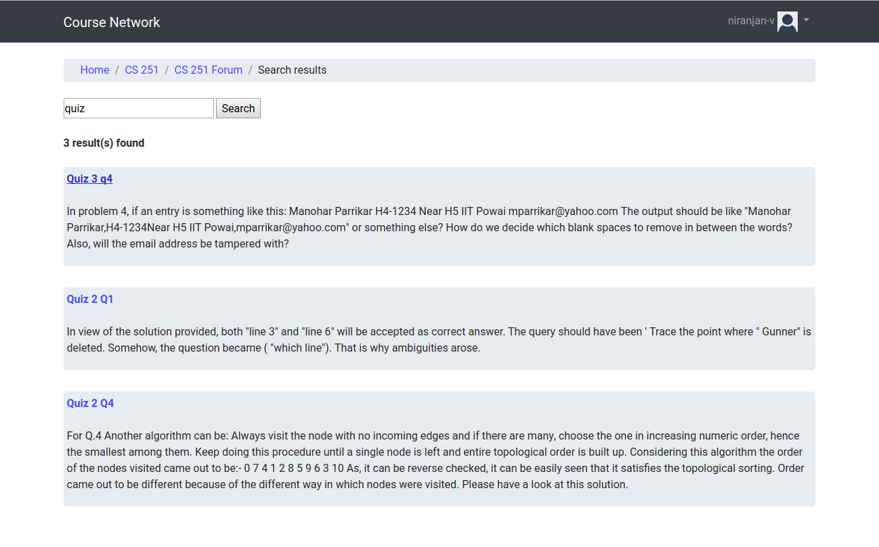
Discussion forum
There is a
search feature (implemented using django filter). The search results page (Figure) is shown below

Slide 17
Discussion forum
When clicked on a topic, it takes to the page of that topic. In that page the question and the replies for that question are displayed (sorted by the number of upvotes for the reply) are displayed.
And the instructor’s reply is shown first mentioning it as an instructor’s reply. For this page we have used Javascript to update the number of votes when user clicks on either of the buttons.
Also we dynamically update this page every 30 seconds(this interval can be changed in the JS function).

Slide 18
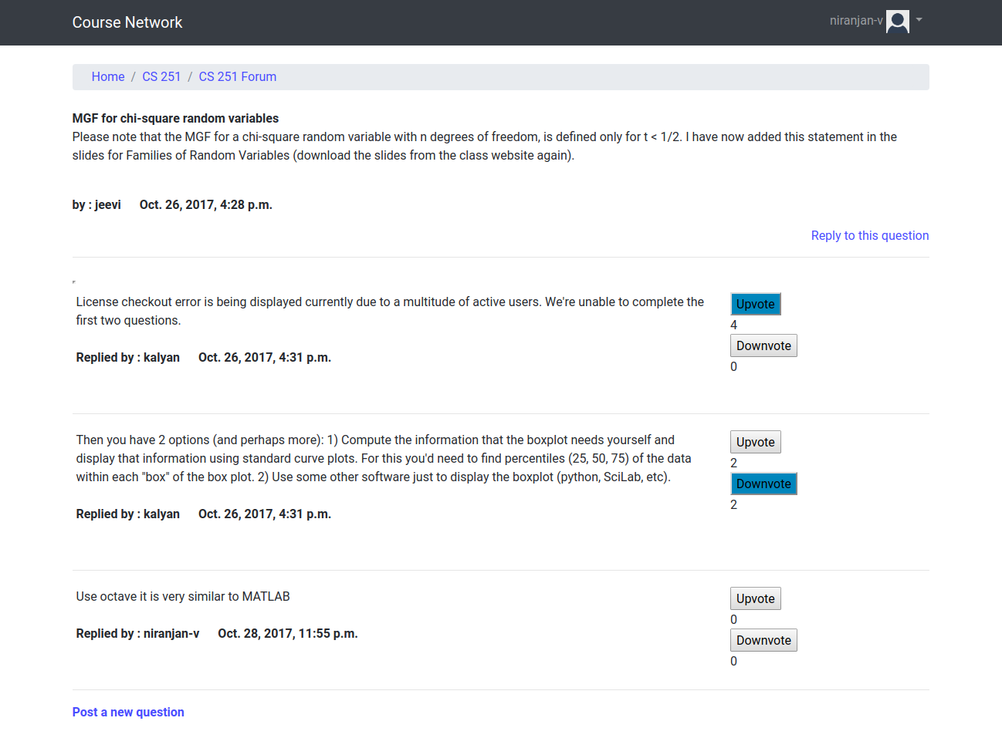
Discussion forum
Upvotes are
Shown

Slide 19
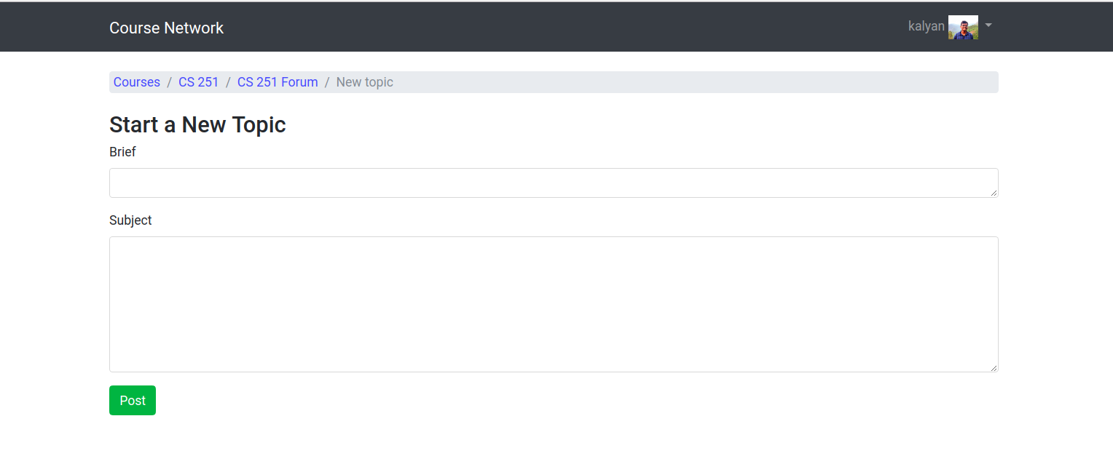
Discussion forum
Adding Topic

Slide 20
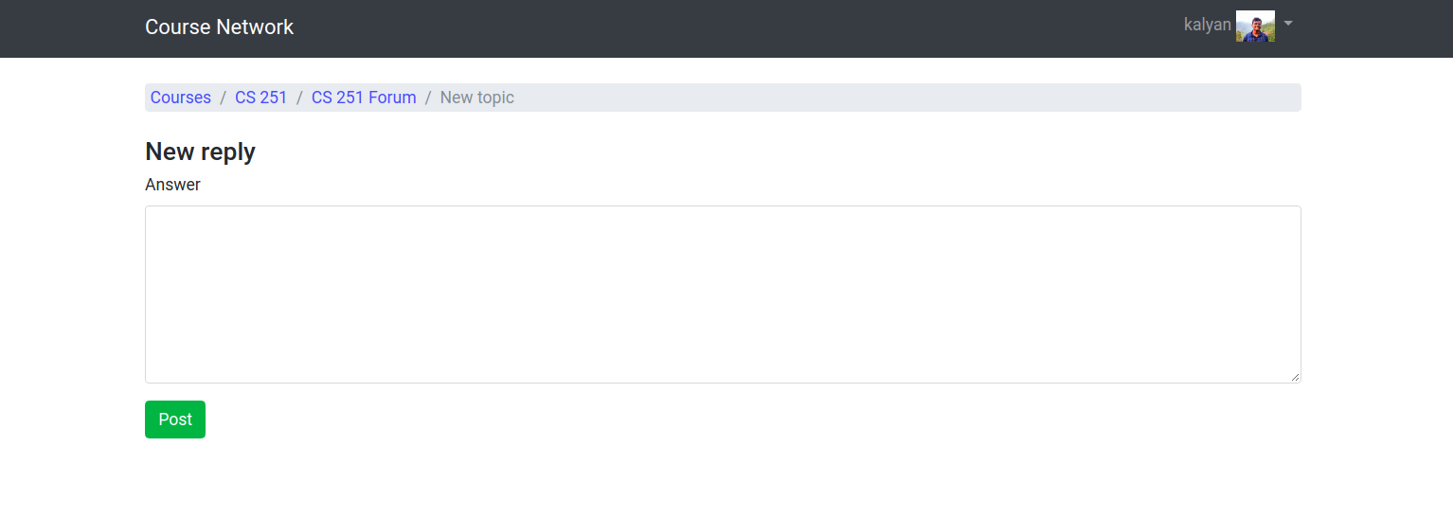
Discussion forum
Adding reply

Slide 21
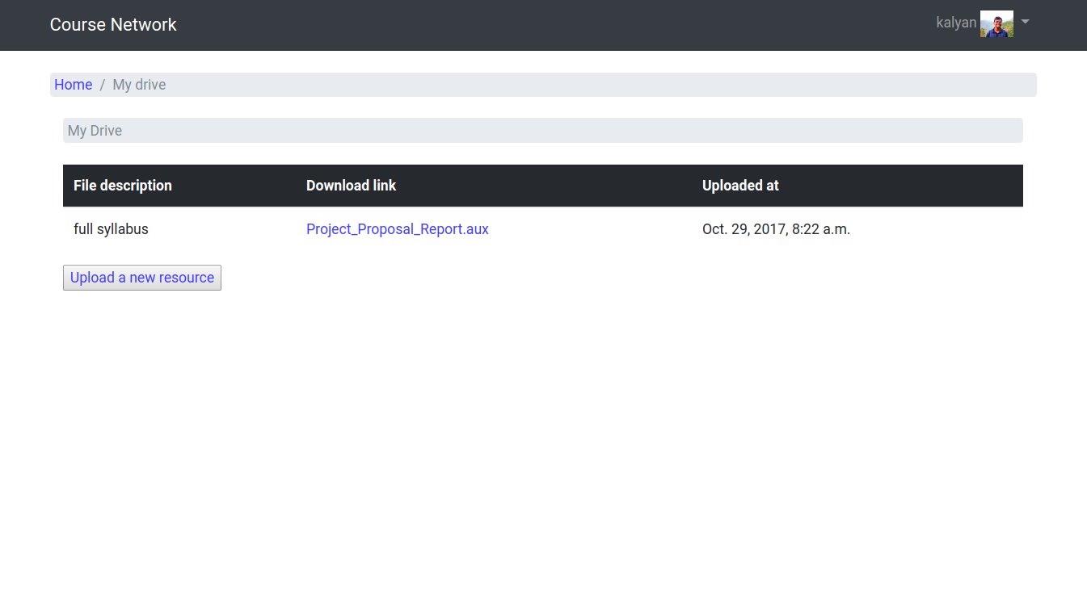
My drive
User’s My Drive page (Figure) and upload page (Figure) are shown.

Slide 22
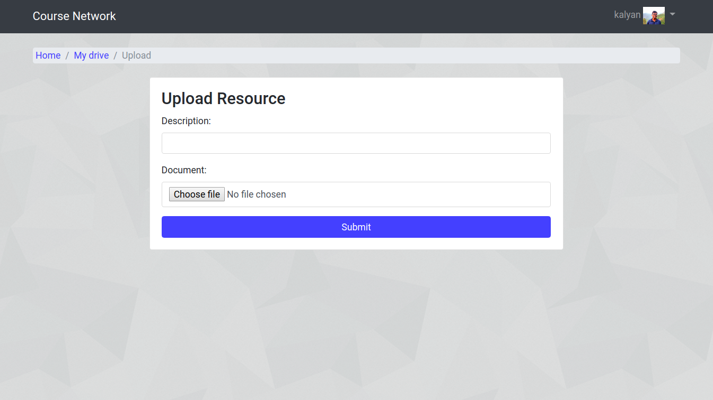
My drive
User’s My Drive page (Figure) and upload page (Figure) are shown.

Slide 23
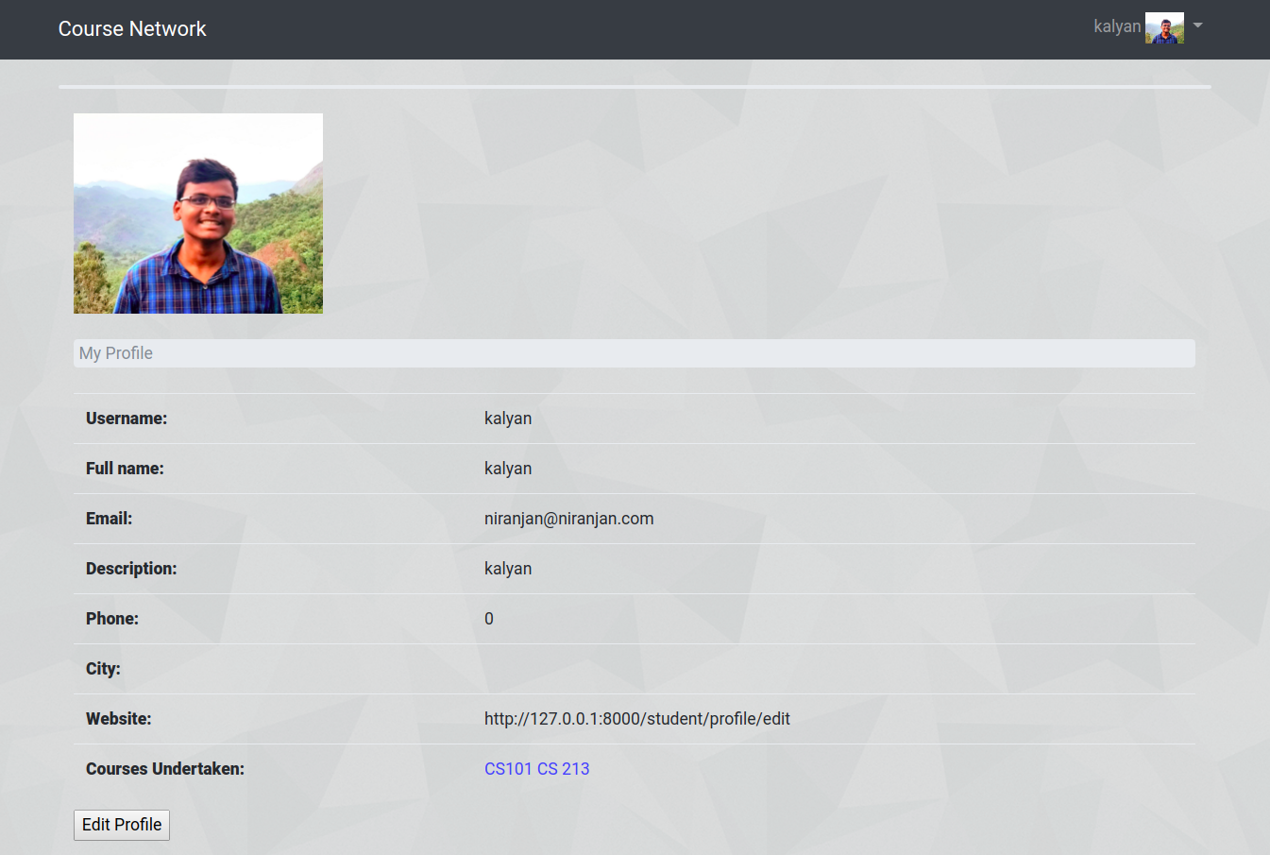
User profile
My Profile contains Fields of Username ,Full name, Email, Description,Phone,City,Website and Courses Undertaken

Slide 24
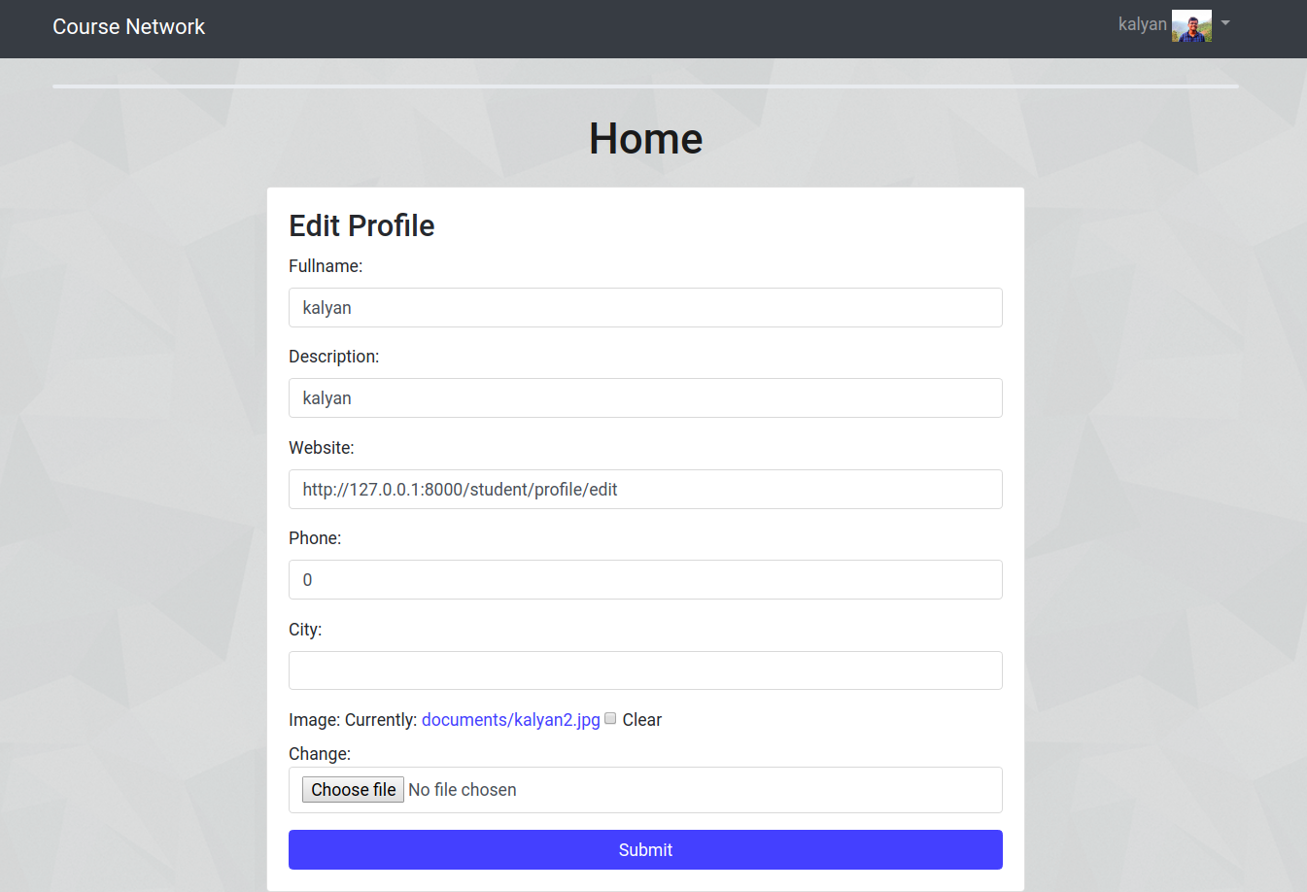
User profile
Edit Profile contains edit Fields of Fullname,website,description,phone,city and profile image

Slide 25
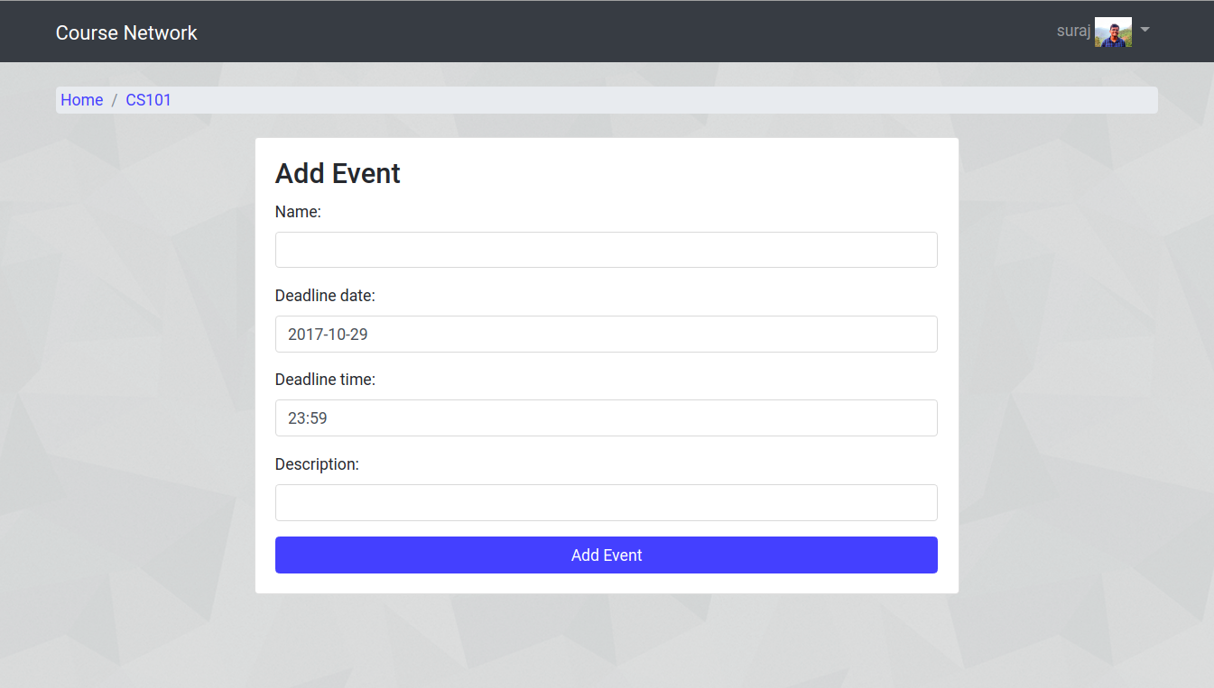
Events
Events of a Course are Created by it’s Instructor with name, description, deadline time and date,
and they appear in the notifications of students and also in instructor’s homepage

Slide 26
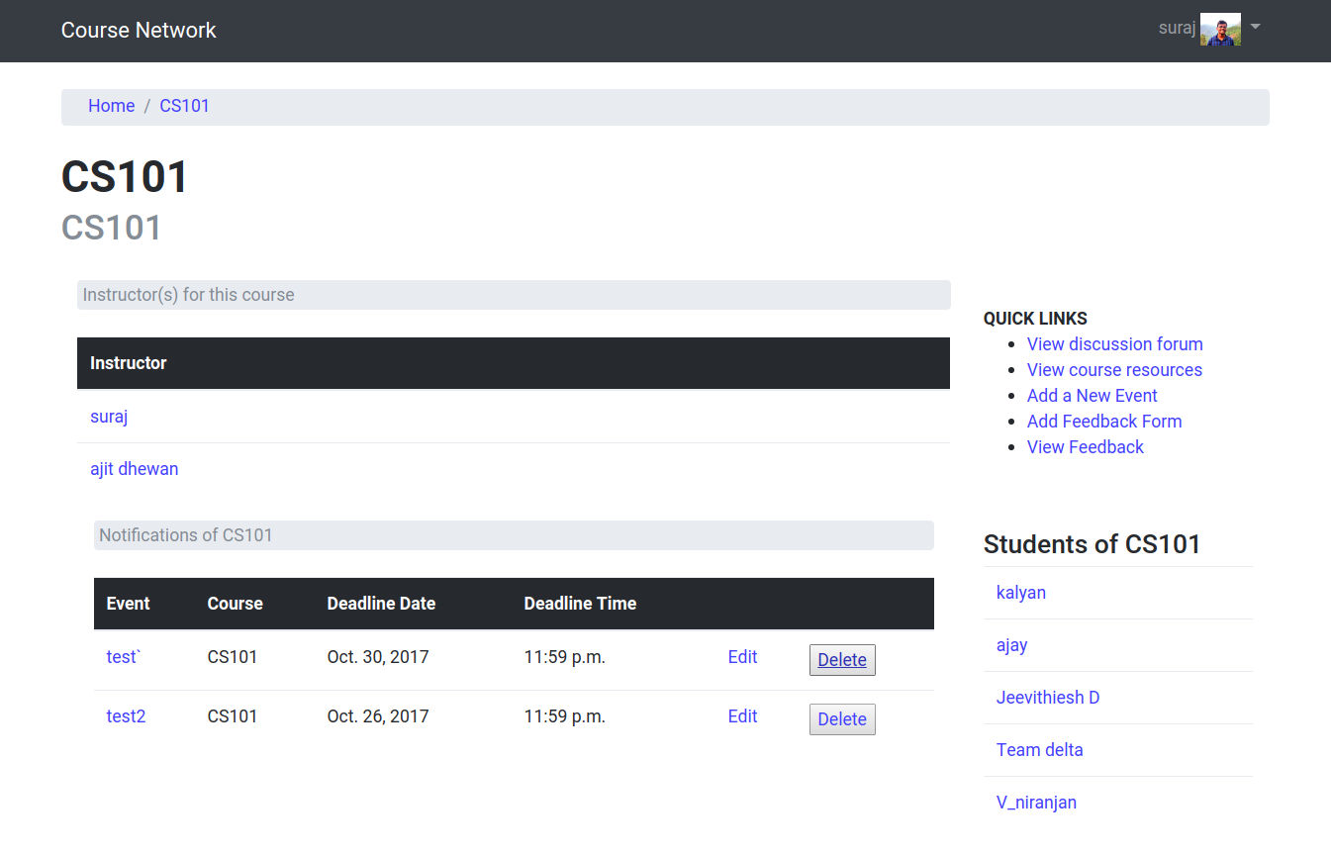
Events
Instructor can edit/delete the event in the course’s homepage and in same way events are displayed in student’s home page with no edit,delete option sorted in deadlinetime order

Slide 27
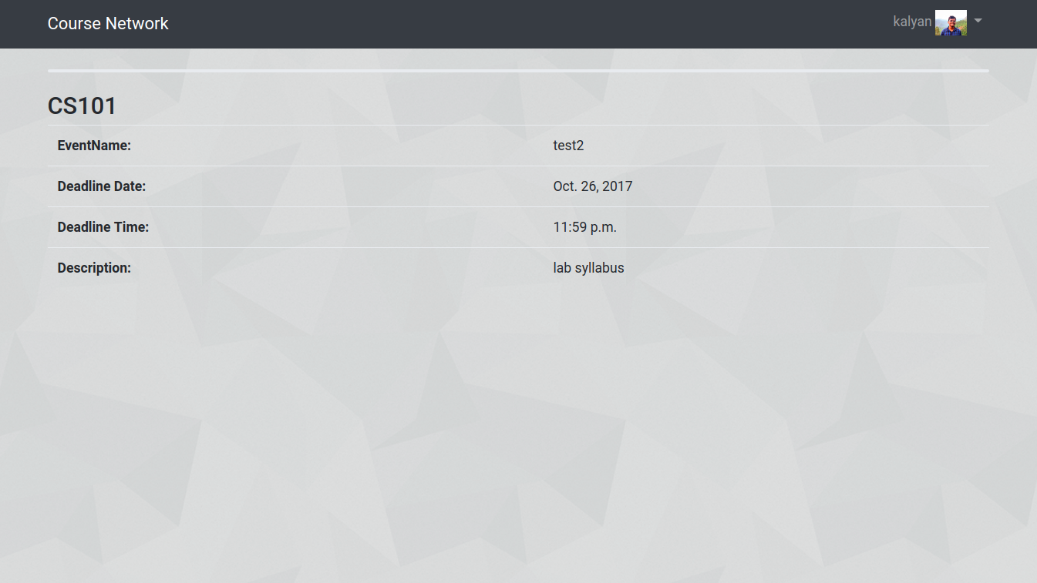
Events
Clicking on an event it redirects to event info containing information about event

Slide 28
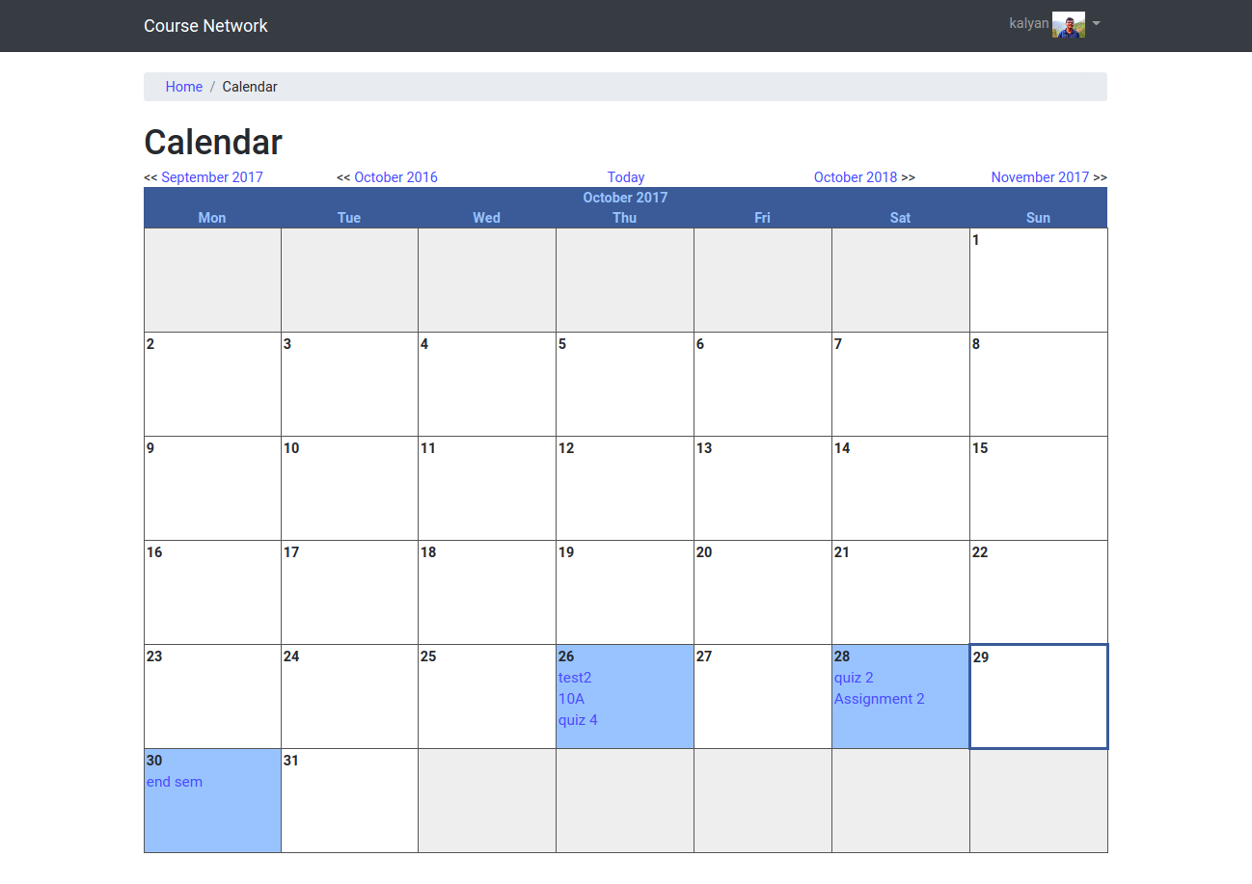
Calendar
• Each Day contain all its events listed
• On clicking an event we get redirected to event info page
• If a day contains events its highlighted in blue
• Today is bordered with blue as shown
• we can access other months events through navigation above

Slide 29
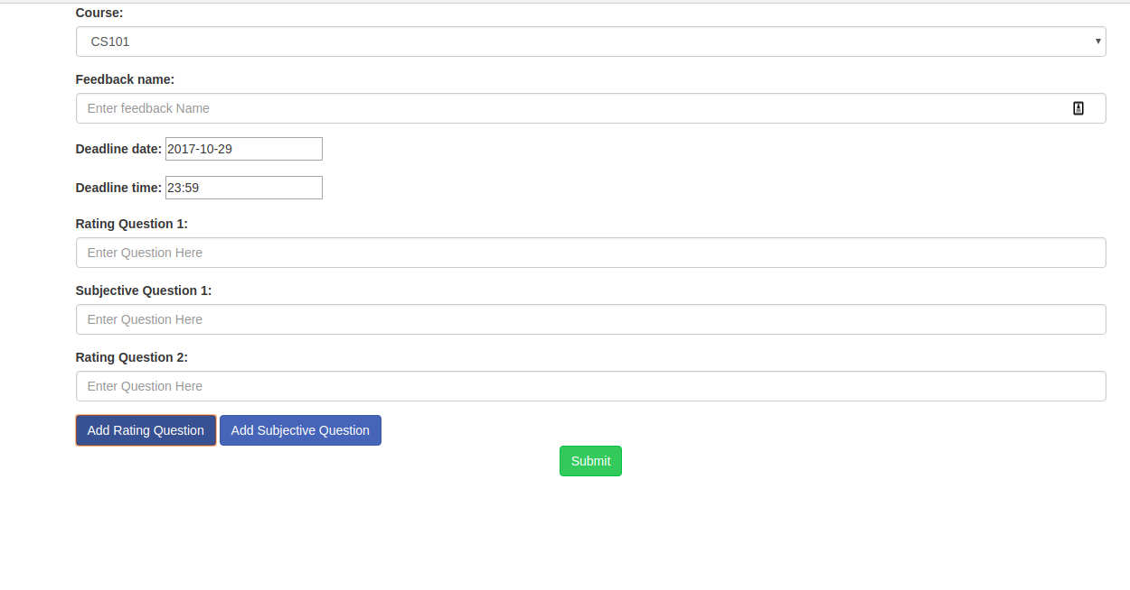
feedback
The instructor can add a feedback form with subjective and objective questions.

Slide 30
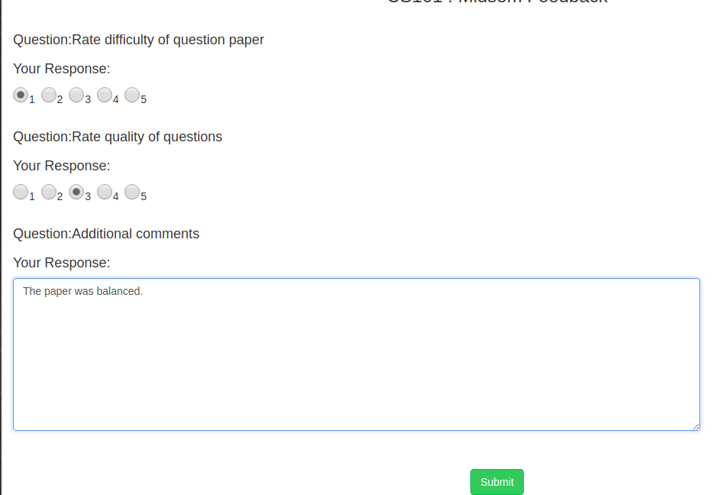
feedback
The student must fill the form and submit it. If a student submits a form more than once,
his/her responses will be overwritten.

Slide 31
feedback
The instructor can then view the collected responses. The answers are anonymous and the rating answers are shown in the form of a graph.

Slide 32
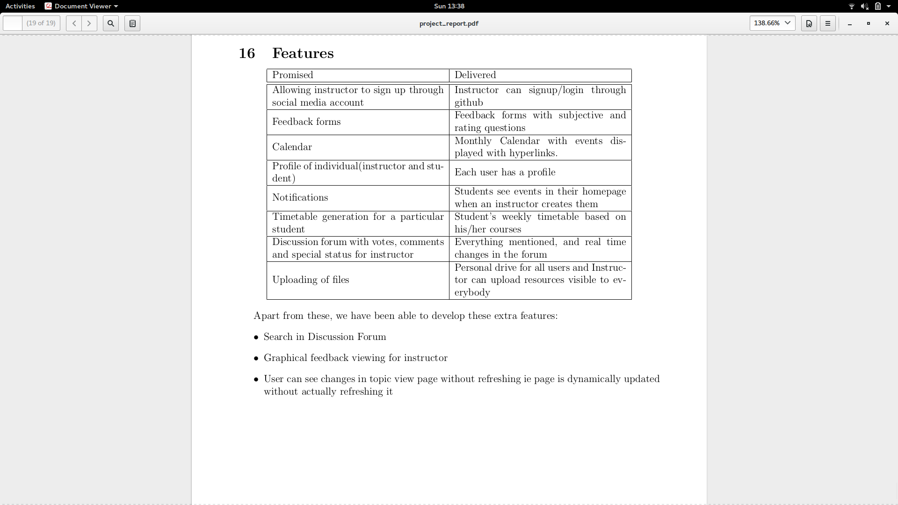
features

Slide 33
Thank you!!

