Slide 1
Deep Learning Solution to Detect Diabetic Retinopathy

Slide 2
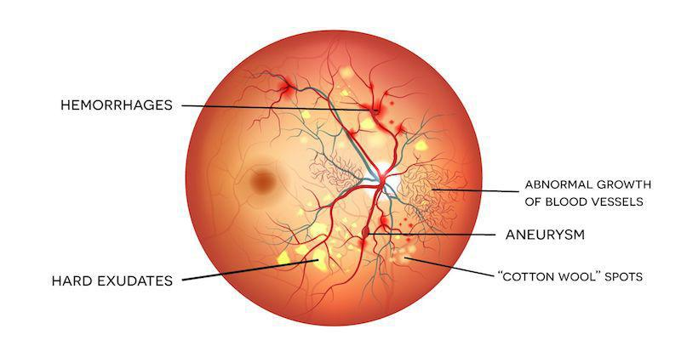
Executive Summary
Diabetic Retinopathy is an eye condition which leads to loss of vision and permanent blindness in people having diabetes
Our goal is to propose a deep learning solution to detect this disease at an early stage.
This can be deployed in rural areas where conducting medical screening is difficult. And a deep learning solution will be faster in giving out results

Slide 3
Problem Description
It leads to loss of vision and permanent blindness in diabetic patients.
Categorized into five categories:
No Diabetic Retinopathy
Mild Condition
Medium Condition
Severe Condition
Proliferative Diabetic Retinopathy
Traditional Method:
Capture images(fundus photography) and consult with a trained doctor.
Current Method:
Capture image and apply it into a deep learning model to determine category..

Slide 4
Description of data and source
Dataset used from APTOS 2019 Blindness Detection Challenge in Kaggle.
85% private dataset and 15% public dataset
Reference link:
https://www.kaggle.com/c/aptos2019-blindness-detection/overview.
Pretrained model ‘EfficienetB7’ used as base model
Front end library- Keras
Back end library- Tensorflow
Kaggle’ TPU accelerator used for training

Slide 5
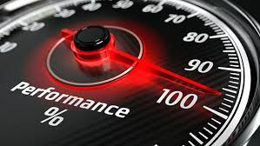
Key characteristics
High performance obtained because of model scaling
Correct and proper increment in width, height and depth of the images
Convolution and pooling based on mathematical scaling coefficients used

Slide 6
Key Approach
Notebook 1: Preparing the Training and Validation Dataset
Split up Training data into Training and Validation datasets
Dataset was unbalanced
Used oversampling
Notebook 2: Model Training
Preprocessing of Images
Faster Input Pipeline, using tensorflow.data library.
Model was trained in TPU, hence faster training was possible
And also because of using TPU, only the training of such a heavy model was possible
Training of Images without augmentation
Found out they were Overfitting
To overcome this Issue, used Image augmentation
Notebook 3: Submission
Predicted results saved to submission.csv and submitte
Notebook 4: Model Performance Statistics
Evaluating the model performance, through various visualization plots.

Slide 7
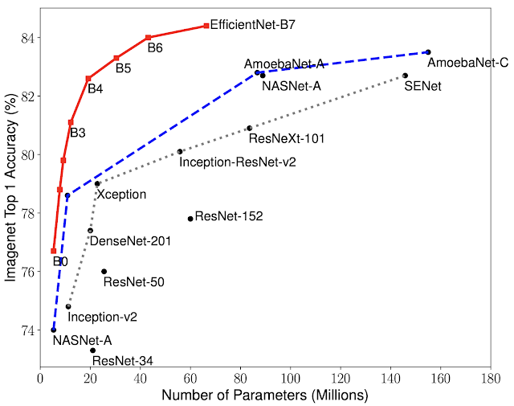
Different Methodologies Used
Pretrained model ‘EfficientB7’ used over ‘Densenet’ .
Trained the model without augmentation for 10 Epochs
Saved the weights
Loaded saved weights and trained the model with augmentation for 10 Epochs to improve the validation accuracy.

Slide 8
Results of Various Techniques
Without oversampling - Model was underfitting, because of unbalance in the dataset.
With oversampling - Underfitting changed to Overfitting.
With augmentation and oversampling - Optimal Performance was obtained.
With preprocessing - A slight increment in the performance was observed, as images became a bit clear
Used Dropout - As a solution to overcome overfitting, but the Model was underfitting.
Used Various Models like ResNet, DenseNet 201 to choose the best model - Compared the performance of models with few epochs, to predict how the model proceeds in the longer run, if we select it.

Slide 9
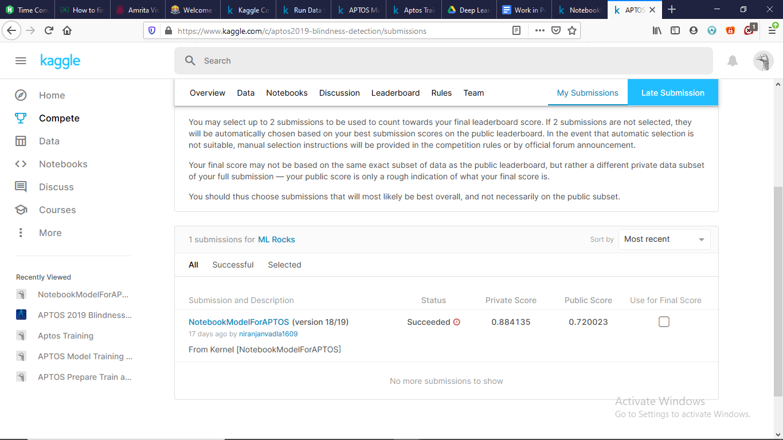
Conclusion
Score obtained on private dataset (85%) : 0.884135
Score obtained on public dataset (15%) : 0.720023

Slide 10
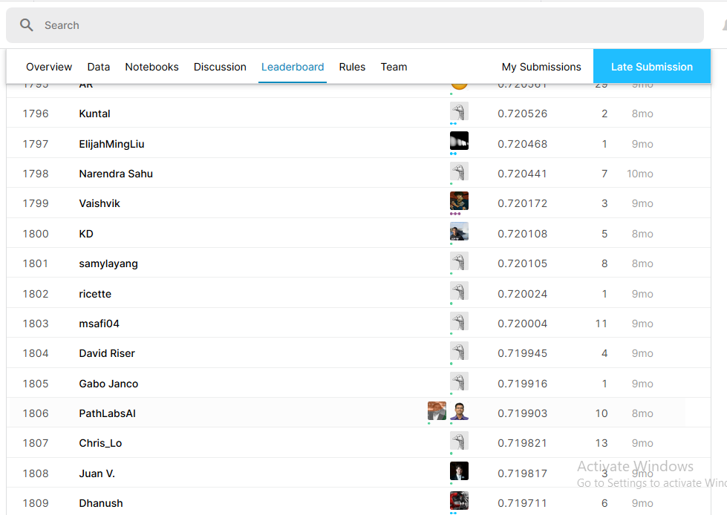
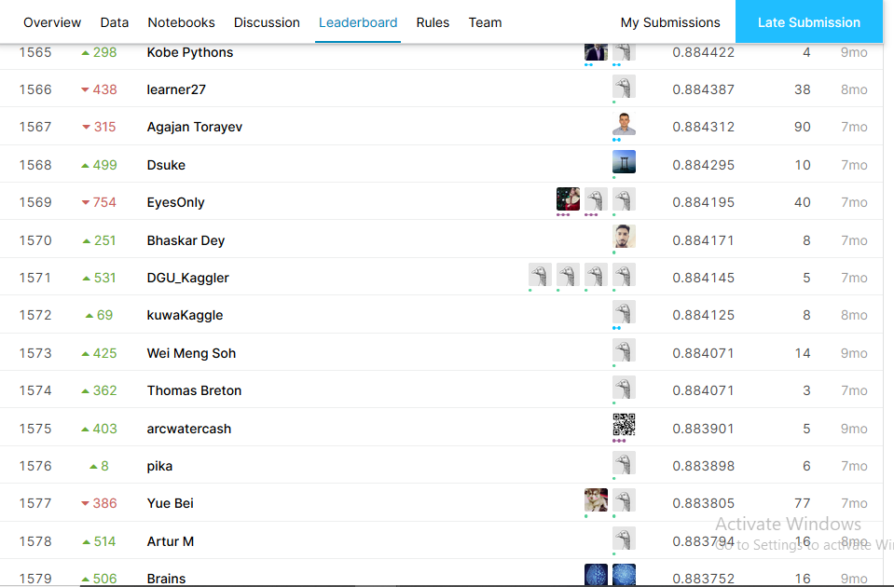
Public and Private Leaderboard approx position
This project results in fast screening of diabetic retinopathy over a large number of people in short amount of time

