Slide 1


ATLIQ PROPERTIES

Slide 3
CONTENTS
PROJECT OVERVIEW.
DATA OVERVIEW
OBJECTIVES.
KEY METRICS & INSIGHTS.
KPI’S.
RECOMMENDATIONS ON INSIGHTS.
DASHBOARDS ( “Excel” , “Tableau” , “Power BI”).
MY_SQL QUERY PART
CONCLUSION
TEAM DETAILS

Slide 4

PROJECT OVERVIEW
This project focuses on analyzing key performance metrics in the hospitality sector using data-driven insights. The goal was to visualize and interpret critical hospitality data, such as revenue, booking trends, cancellations, and platform-wise performance, to support better decision-making in the period of 3 months . Dashboards were created using Excel , Tableau and Power BI to provide a comprehensive view of business performance.

Slide 5
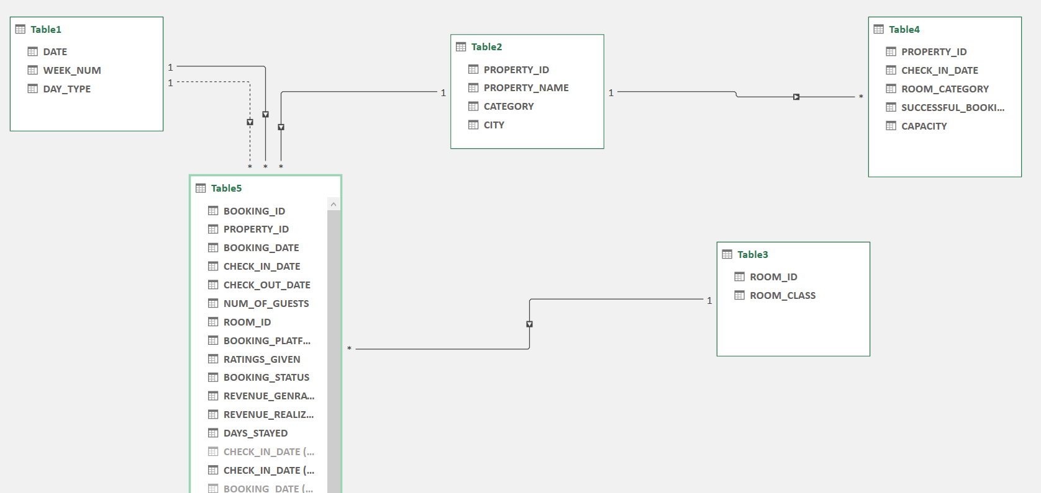
DATA OVERVIEW
We have collected data from five different sheets
we have created the relations between the tables and created a data model

Slide 6

OBJECTIVES
Analyze revenue distribution across room types, booking platforms, and cities.
Track booking trends and identify peak periods.
Evaluate the impact of cancellations and no-shows on overall business performance.
Understand platform-wise performance and customer preferences.
Identify patterns in customer booking behavior, including length of stay and booking status.
Provide actionable insights through interactive dashboards.

Slide 7
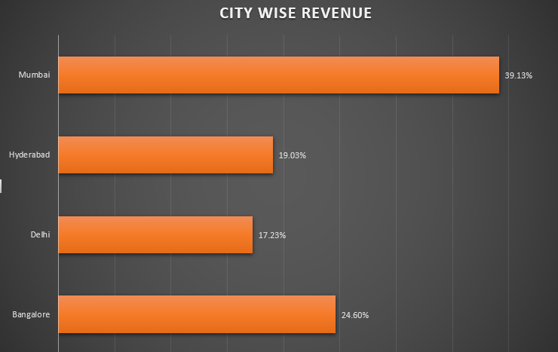
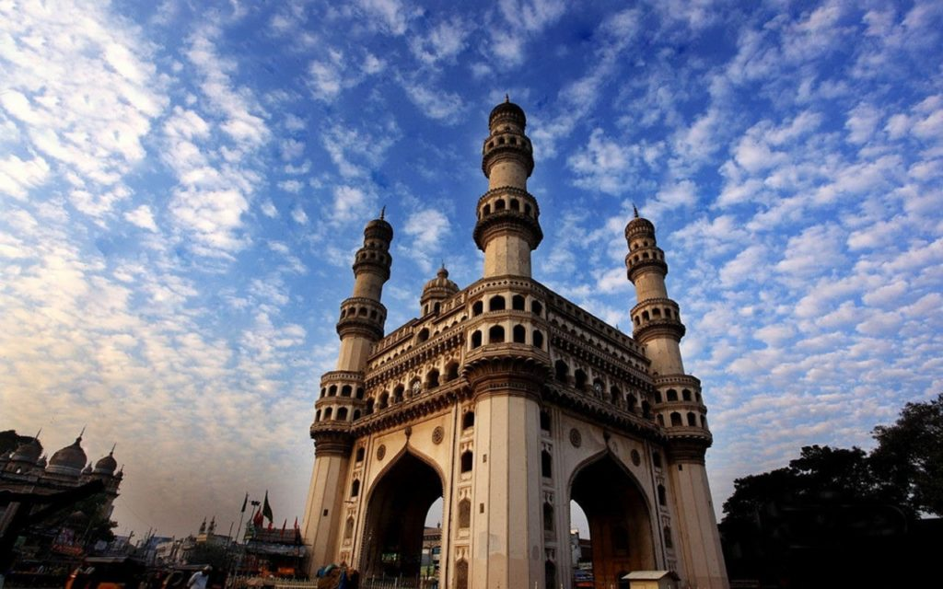
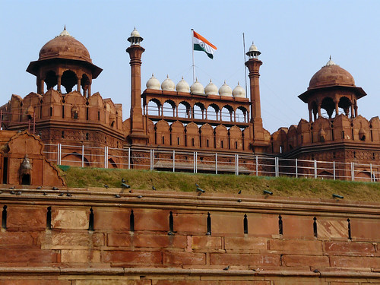
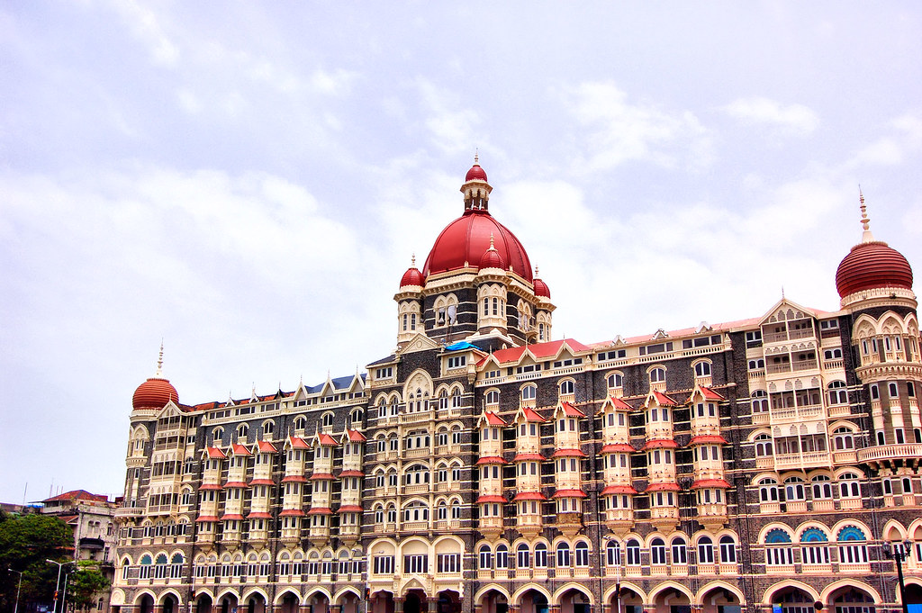
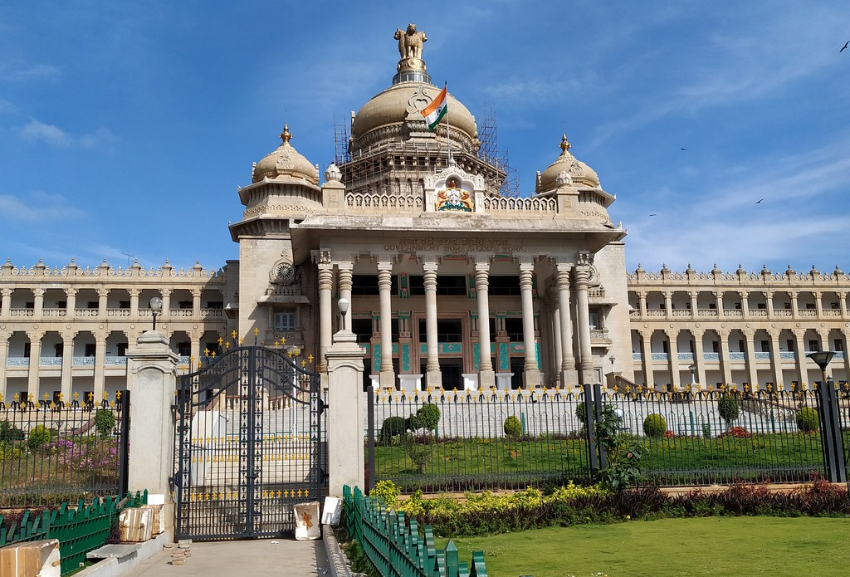
KEY METRICS & INSIGHTS
Properties Managed: 25
Successful Bookings: 13,54,590
Total Revenue: 170,87,71,229
Success Rate : 70.15%
Most Revenue-Generating Cities: Mumbai & Bangalore
HYDERABAD
DELHI
MUMBAI
BENGALURU

Slide 8
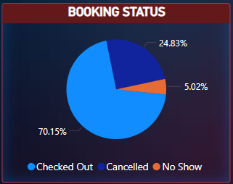
BOOKING STATUS BREAKDOWN
Checked Out: 70.15% ✅
Canceled: 24.83% ❌
No Shows: 5.02% ⚠️

Slide 9
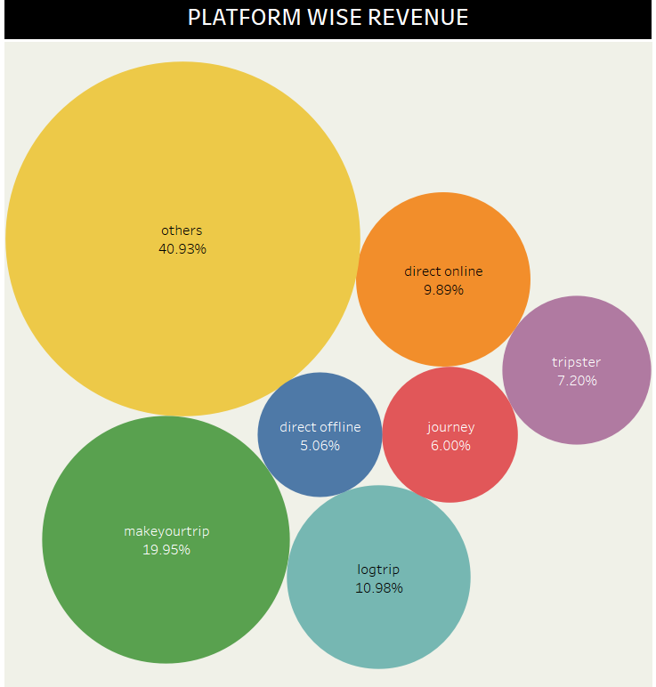
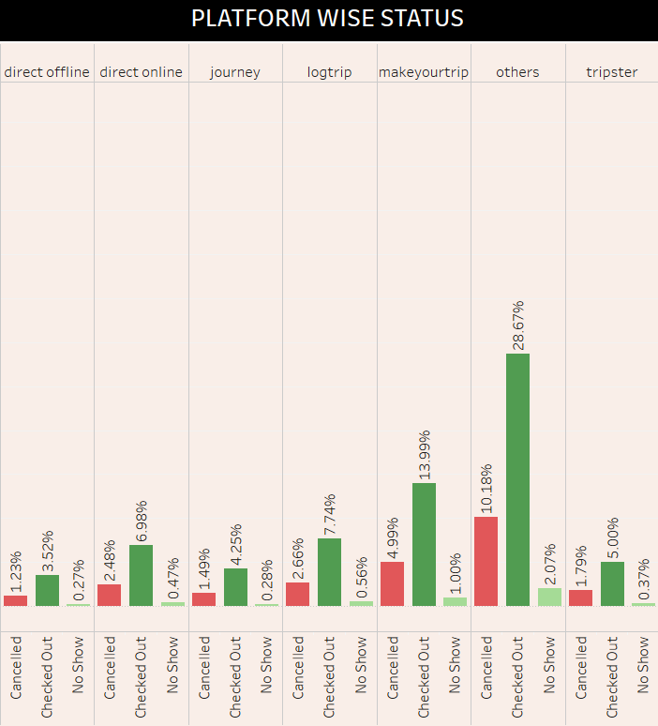
PLATFORM ANALYSIS
REVENUE WISE :
“OTHERS” Platform is generating the higher revenue
“DIRECT OFFLINE” Platform is generating lower revenue
STATUS WISE :
“OTHERS” Platform having high number of “CHECKED OUT” done.
“OTHERS” Platform having high number of “CANCELLATIONS”.
“DIRECT OFFLINE” Platform having less “CHECKED OUT” .
“DIRECT OFFLINE” Platform having less “CANCELLATIONS” .

Slide 10
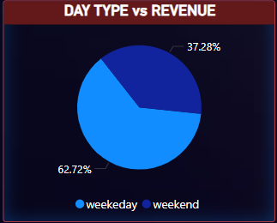
WEEKEND v/s WEEKDAYS
“ WEEKDAYS ” are generating more revenue than “ WEEKENDS ”.

Slide 11
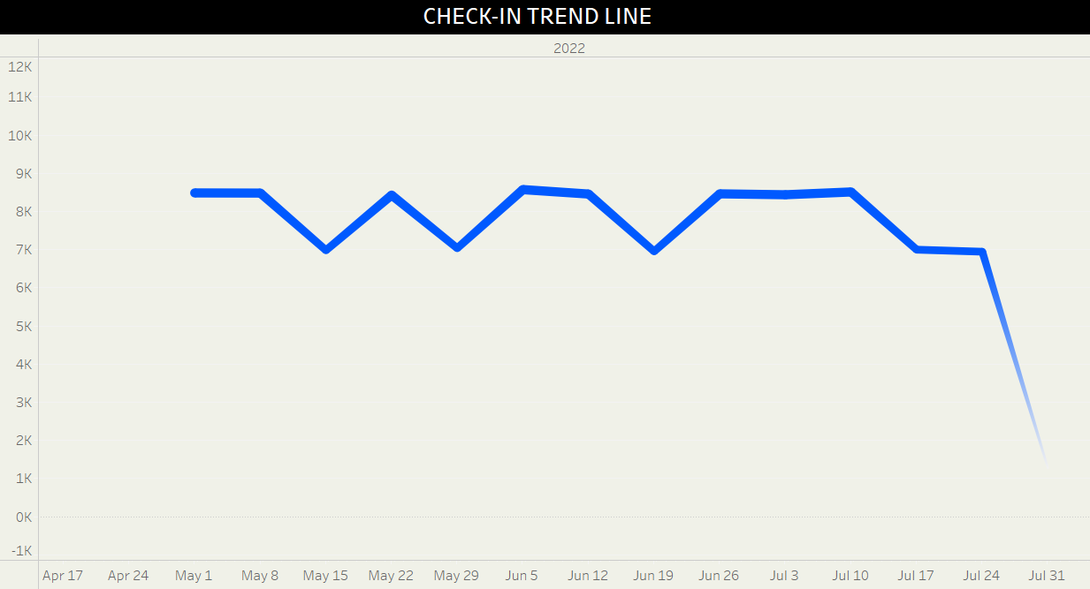
CHECK_IN TREND LINE
Steady Check-ins: Despite booking fluctuations, check-ins remained relatively stable.
Last Week Drop: Sudden decline in late July, possibly due to cancellations or no-shows.
Impact: Indicates a gap between bookings and actual check-ins, affecting revenue.

Slide 12
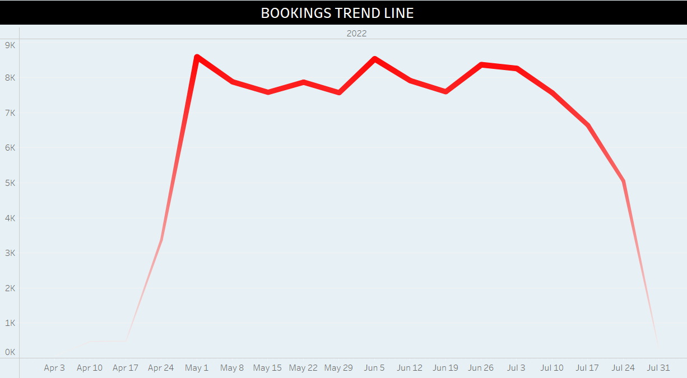
BOOKINGS TREND LINE
Peak Period: Late April to early July saw the highest number of bookings.
Decline: A sharp drop in bookings from mid-July onwards.
Possible Reasons: Seasonality, pricing changes, or market demand shifts.

Slide 13
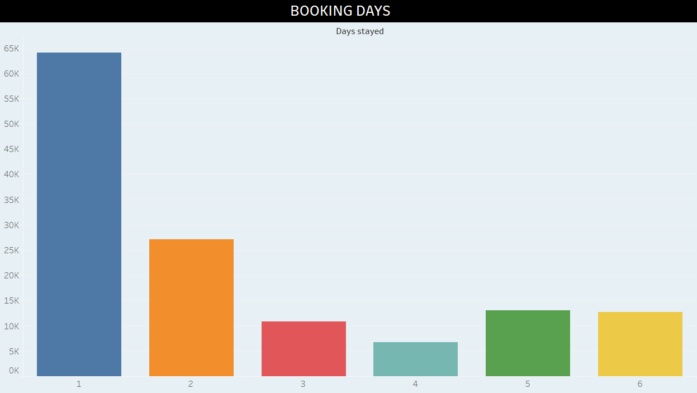
BOOKINGS DONE
Short Stays Dominate: The majority of bookings are for
1-day stay, significantly higher than other durations.
Gradual Drop-off: Bookings for longer stays (2+ days) decrease progressively.
Actionable Takeaway:
Increasing the average length of stay can boost overall revenue and optimize occupancy rates.

Slide 14
RECOMMENDATIONS ON INSIGHTS
1.City-Specific Strategy
Insight: Revenue distribution varies across different cities. ✅ Recommendation:
Identify high-revenue cities and expand inventory or premium offerings there.
Boost promotions and visibility in low-performing cities to increase demand.
Customize offers based on regional trends and customer preferences.

Slide 15
RECOMMENDATIONS ON INSIGHTS
2. Reduce Cancellations and No-Shows
Insight: A gap exists between bookings and actual check-ins, indicating cancellations or no-shows. ✅ Recommendation:
Introduce strict cancellation policies with penalties for last-minute cancellations.
Provide incentives (discounts, vouchers) for customers who confirm their stays in advance.
Implement automated reminders via email/SMS to reduce no-shows.

Slide 16
RECOMMENDATIONS ON INSIGHTS
3. Optimize Booking Platforms
Insight: Some platforms perform better than others in driving bookings. ✅ Recommendation:
Increase investment in top-performing platforms (ads, promotions, exclusive deals).
Improve visibility and offers on underperforming platforms or consider new channels.
Analyze customer preferences for each platform and tailor marketing strategies accordingly.

Slide 17
RECOMMENDATIONS ON INSIGHTS
4.Increase Peak Season Bookings
Insight: The booking trend peaks between May and July but declines sharply afterward. ✅ Recommendation:
Launch early bird discounts before peak seasons.
Implement dynamic pricing to maximize revenue during high-demand periods.
Run targeted marketing campaigns to extend peak-season demand into off-peak months.

Slide 18
RECOMMENDATIONS ON INSIGHTS
5.Encourage Longer Stays
Insight: Most bookings are for 1-night stays, with a sharp drop for longer stays. ✅ Recommendation:
Offer multi-night discounts to encourage extended stays.
Provide additional perks (free breakfast, spa access) for stays longer than 2 nights.
Target business travelers and vacationers, who are more likely to book longer stays.

Slide 19
FINAL TAKEAWAY
Implementing these strategies can increase bookings, reduce cancellations, and maximize revenue, leading to overall business growth.

Slide 20
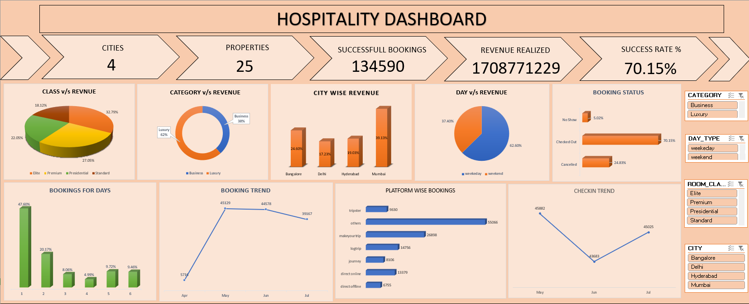
EXCEL DASHBOARD

Slide 21
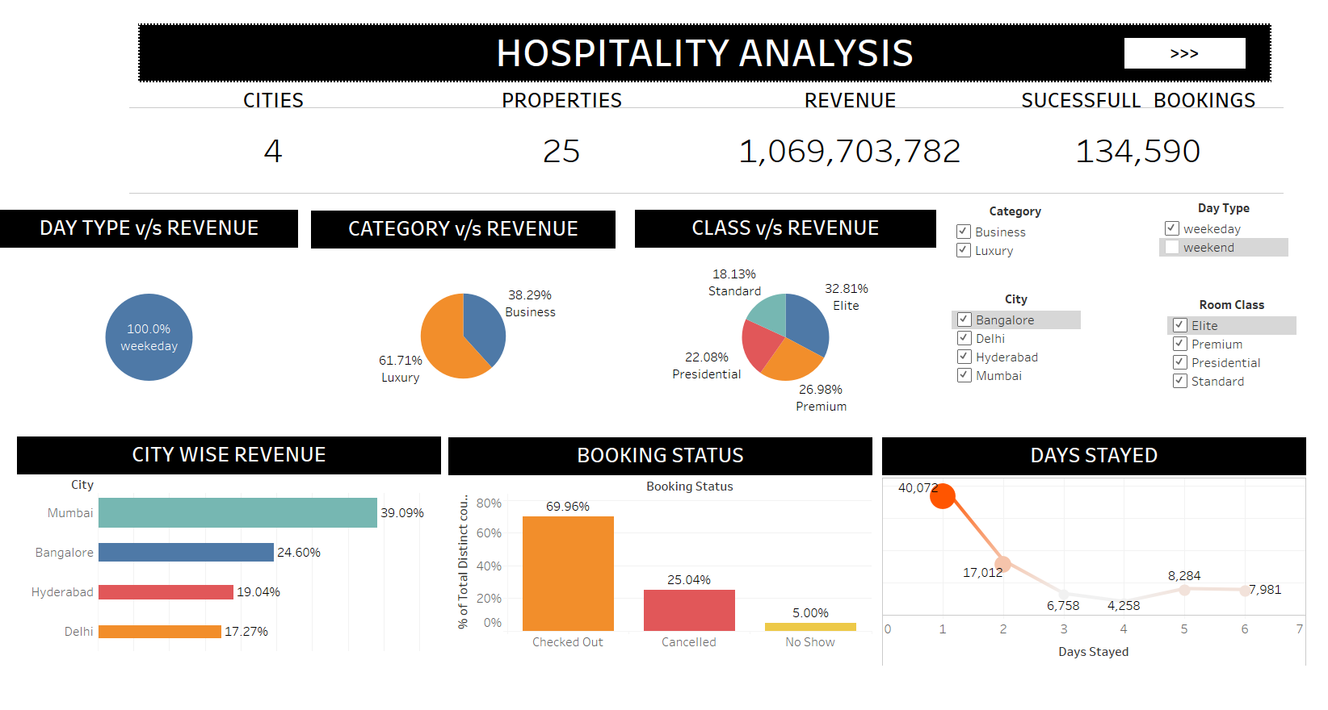
TABLEAU DASHBOARD - i

Slide 22
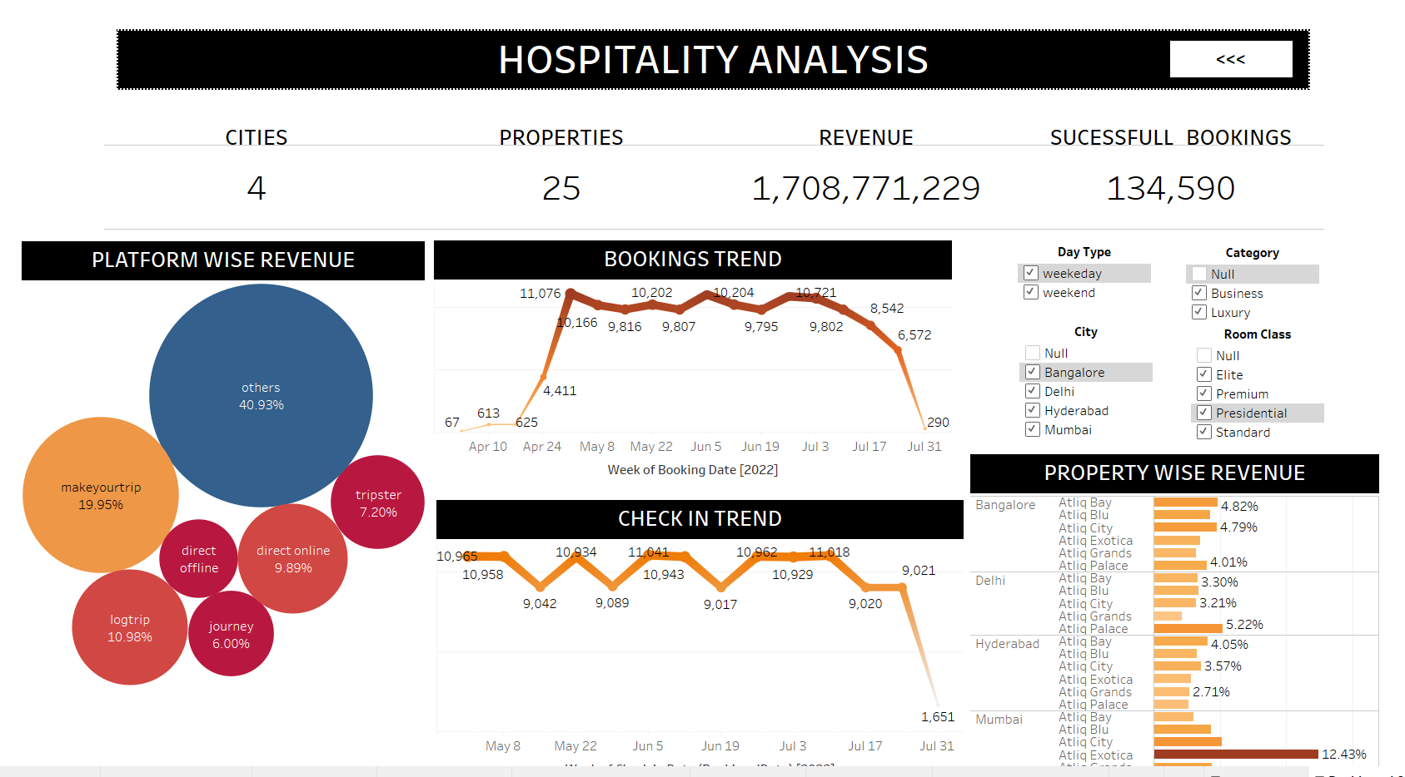
TABLEAU DASHBOARD - ii

Slide 23
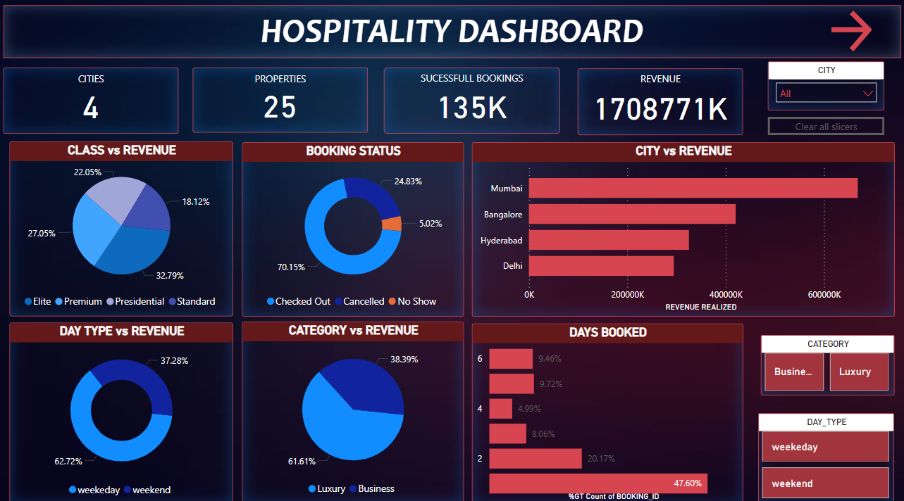
POWER_BI DASHBOARD - i

Slide 24
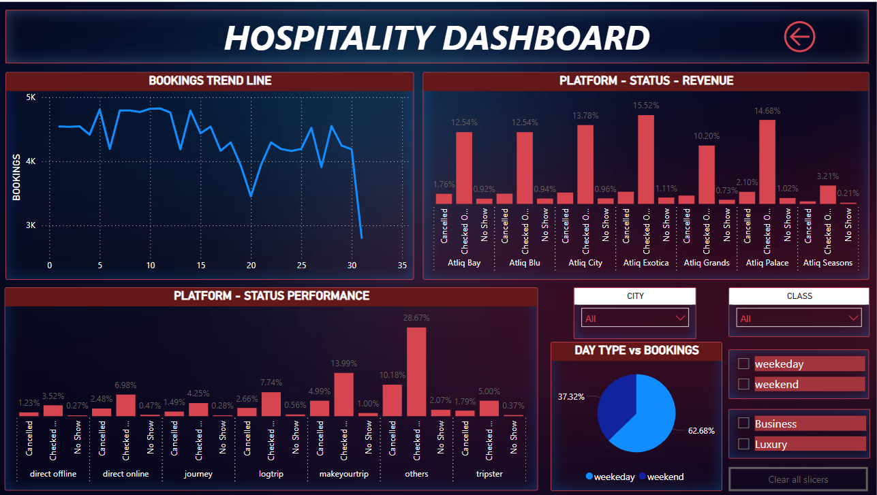
POWER_BI DASHBOARD - ii

Slide 25
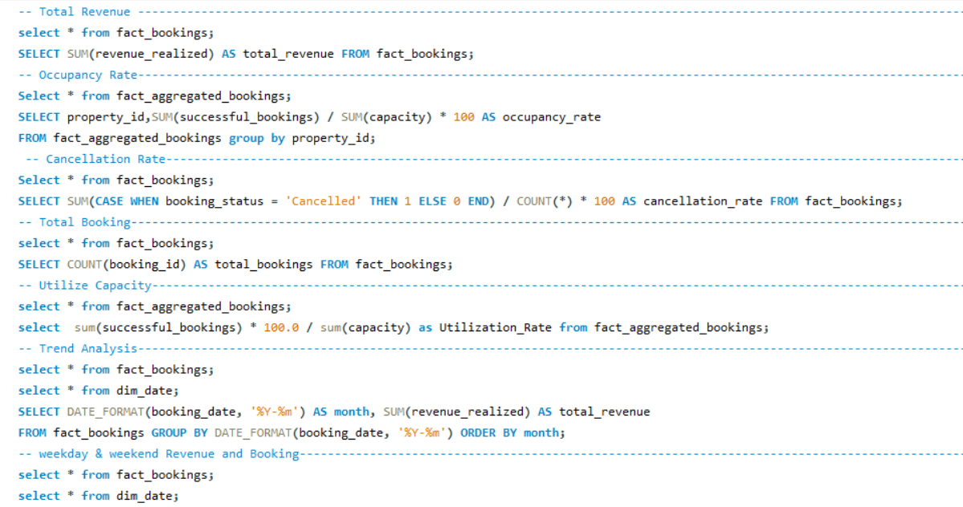
MY SQL QUERIES

Slide 26
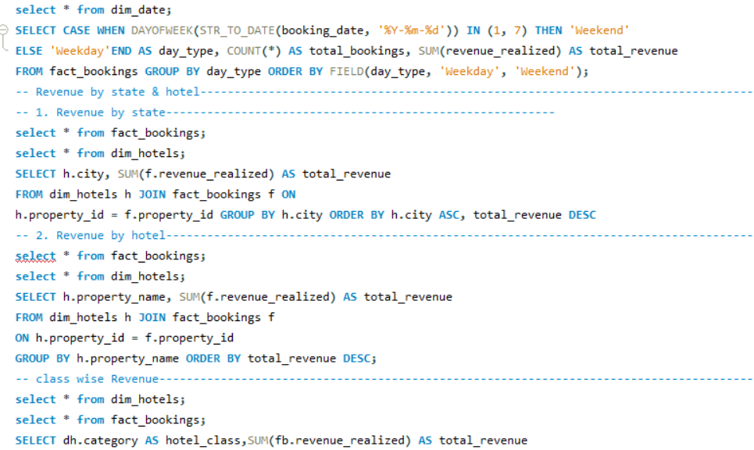
MY SQL QUERIES

Slide 27
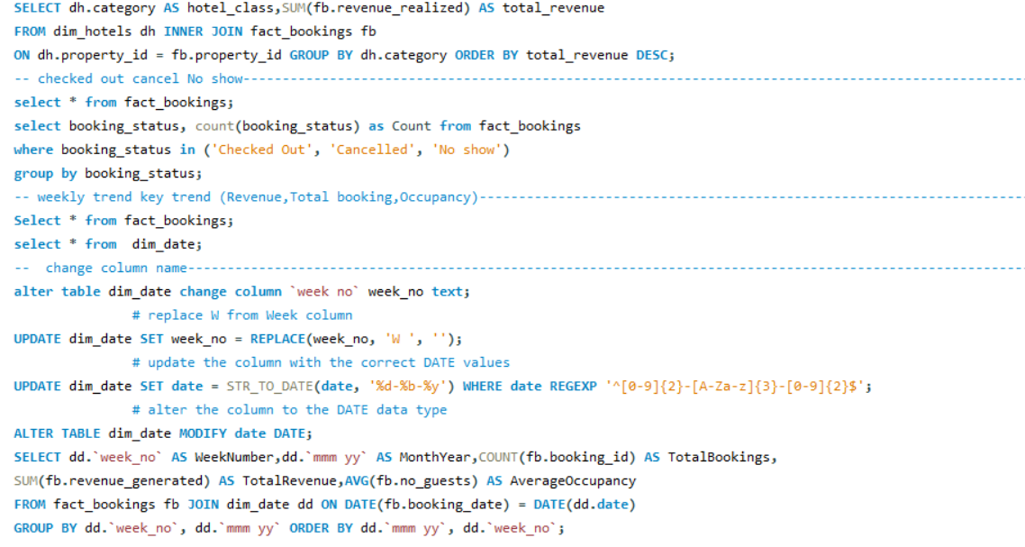
MY SQL QUERIES

Slide 28
CONCLUSION
The dashboard insights highlight key trends in bookings, check-ins, and customer behavior. While peak seasons drive high revenue, cancellations and short stays impact overall business performance. By implementing strategic pricing, targeted marketing, and platform optimization, the company can enhance bookings, reduce cancellations, and increase revenue. Focusing on city-specific demand and customer preferences will further drive growth, ensuring a sustainable and profitable future.

Slide 29
TEAM
Ravitheja T (ravitheja8587@gmail.com)
Niranjan Avulapati (niranjanavulapati4@gmail.com)
Nandini Sudhir Suryawanshi (nandiniss2404@gmail.com)
Aswanth Ok (aswanthnair518@gmail.com)
Sahil Rupchand Prasad (sahil9004542417@gmail.com)
Gangapuram Chandu Sagar (chandusagar647@gmail.com)
OM Sanjay Kharote (kharoteom071@gmail.com)

