Slide 1
INSURANCE DASHBOARD
Evaluating Business Performance
Group members:
Mansi S Gitte
Niranjan Avulapati
Praveen Patawakar
Sweksha Kumari Sharma

Slide 2
Key areas:
Analyze performance of the Ahmedabad branch.
Highlight areas for improvement and key insights.
Scope:
Focus on new and renewal business performance.
Individual and branch-level KPIs.
Introduction

Slide 3
OBJECTIVE
Assess branch performance against targets.
Drill down to individual contributions.
Align branch efforts with organizational goals.

Slide 4
Data Sources
Target Sheet: Individual business targets (New, Cross-Sell, Renewal).
Brokerage & Fees Sheets: Placed achievements.
Invoice Sheet: Invoiced achievements.
Opportunity Report: Open and Closed-Won Opportunities.
Meeting Sheet: Annual client interactions.

Slide 5
Key Performance Indicators
1. Number of Invoices by Account Executive.
2. Yearly Meeting Count.
3. New, Cross-Sell, and Renewal Business Targets vs Achievements.
4. Stage Funnel by Revenue.
5. Meetings by Account Executive.
6. Top Open Opportunities.

Slide 6
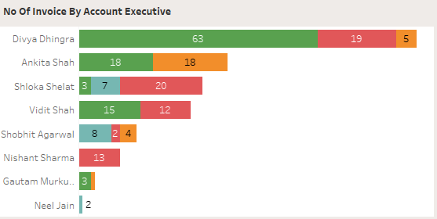
KPI 1
Number of Invoices by Account Executive.

Slide 7
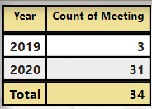
KPI 2
Yearly Meeting
Count

Slide 8
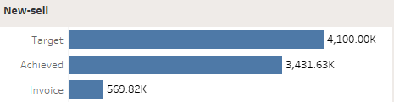
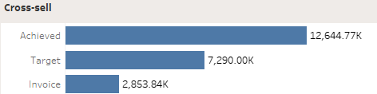
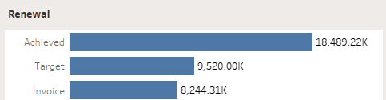
KPI 3
New, Cross-Sell, and Renewal Business Targets vs Achievements.

Slide 9
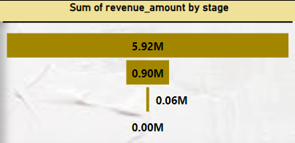
KPI 4
Stage Funnel by Revenue.

Slide 10
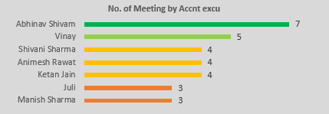
KPI 5
Meetings by Account Executive.

Slide 11
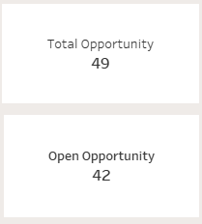
KPI 6
Top Open Opportunities.

Slide 12
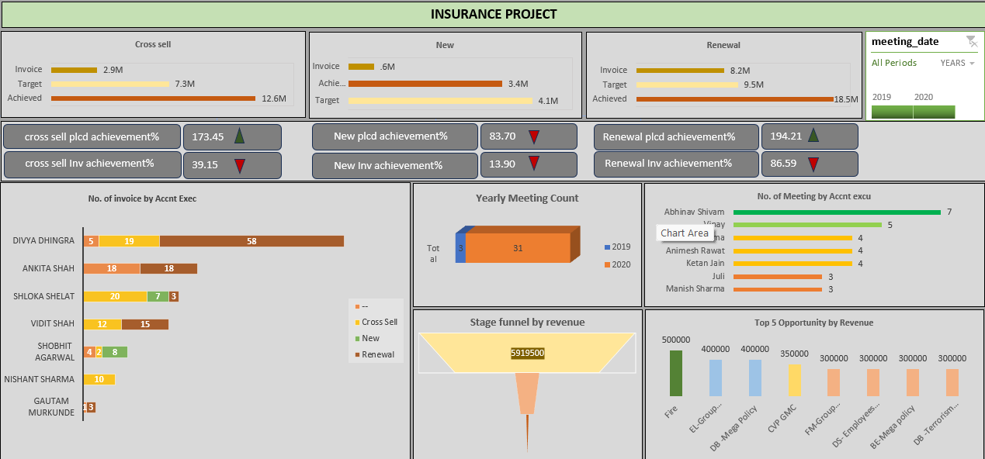
Microsoft Excel Dashboard

Slide 13
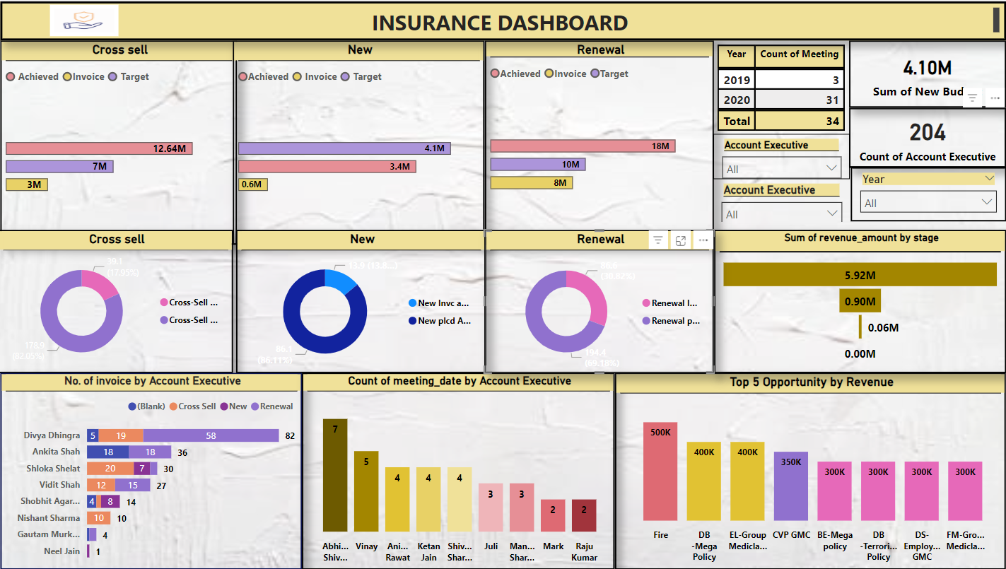
Microsoft PowerBI Dashboard

Slide 14
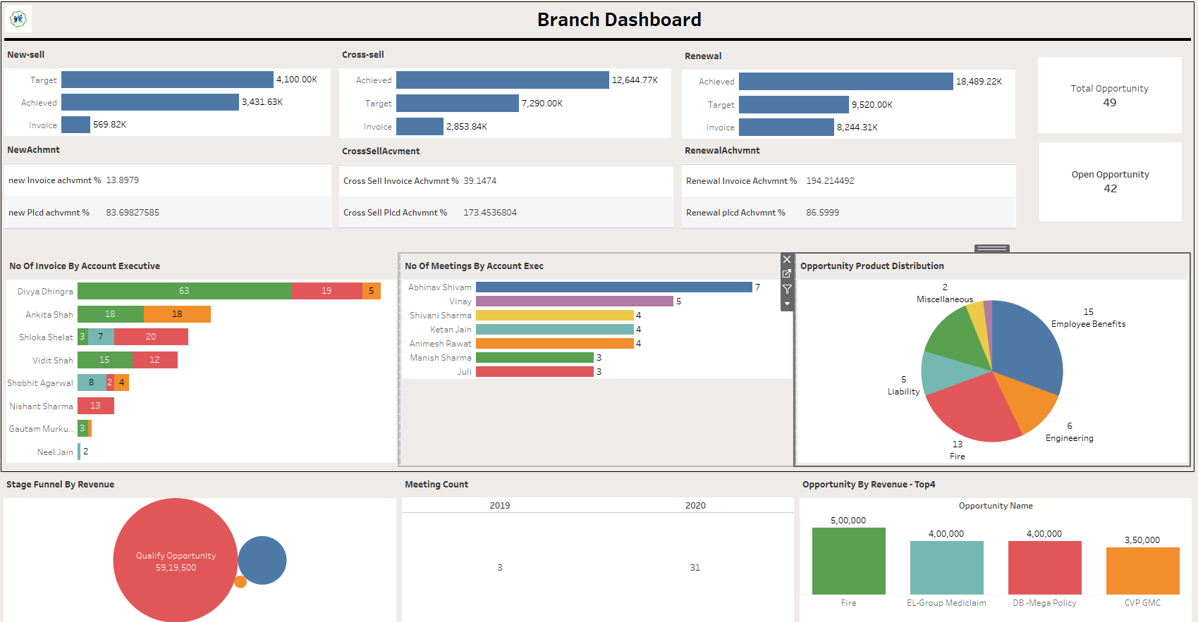
Tableau Dashboard

Slide 15
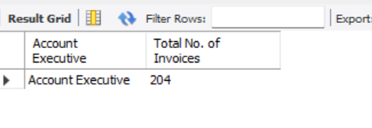
SQL QUERIES
use insuranceproject;
# KPI:1 - Number of Invoices by Account Executive:
SELECT 'Account Executive', COUNT (*) AS 'Total No. of Invoices'
FROM invoice;

Slide 16
# KPI2: Yearly Meeting Count:
SELECT
YEAR(STR_TO_DATE(meeting_date, '%Y-%m-%d')) AS year,
COUNT(*) AS meeting_count
FROM
meeting
WHERE
meeting_date IS NOT NULL
AND STR_TO_DATE(meeting_date, '%Y-%m-%d') IS NOT NULL
GROUP BY
YEAR(STR_TO_DATE(meeting_date, '%Y-%m-%d'))
ORDER BY
year;

Slide 17
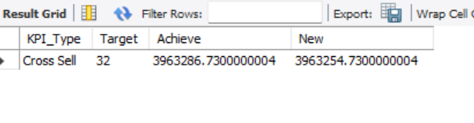
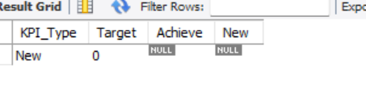
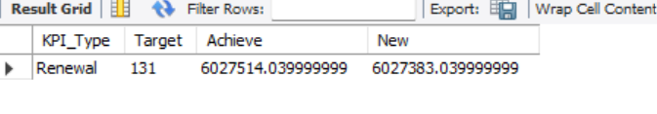
KPI3.1: Cross Sell--Target, Achive, new
SELECT
'Cross Sell' AS KPI_Type,
COUNT(DISTINCT policy_number) AS Target, -- Count of distinct policies for target
SUM(Amount) AS Achieve, -- Total amount achieved (revenue)
SUM(Amount) - COUNT(DISTINCT policy_number) AS New -- New calculation (difference between target and achieve)
FROM brokerage
WHERE renewal_status = 'Endorsement'; -- Cross Sell policies are typically marked as 'Endorsement'
KPI3.2: New-Target,Achive,new
SELECT
'New' AS KPI_Type,
COUNT(DISTINCT policy_number) AS Target, -- Count of distinct 'New' policies for target
SUM(Amount) AS Achieve, -- Total amount for 'New' policies
SUM(Amount) - COUNT(DISTINCT policy_number) AS New -- New calculation (difference between target and achieve)
FROM brokerage
WHERE renewal_status = 'New'; -- Filter for policies marked as 'New'
KPI3.3 Renewal-Target, Achive,new
SELECT
'Renewal' AS KPI_Type,
COUNT(DISTINCT policy_number) AS Target, -- Count of distinct 'Renewal' policies for target
SUM(Amount) AS Achieve, -- Total amount for 'Renewal' policies
SUM(Amount) - COUNT(DISTINCT policy_number) AS New -- New calculation (difference between target and achieve)
FROM brokerage
WHERE renewal_status = 'Renewal'; -- Policies marked as 'Renewal'

Slide 18
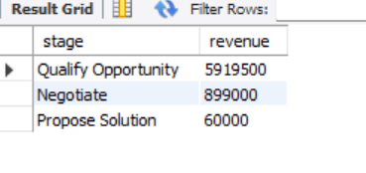
# KPI4: Stage Funnel by Revenue:
SELECT stage, SUM(revenue_amount) AS revenue
FROM opportunity
GROUP BY stage;

Slide 19
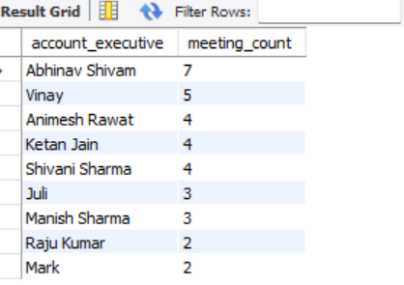
# KPI5: Number of Meetings by Account Executive
SELECT
`Account Executive` AS account_executive,
COUNT(*) AS meeting_count
FROM
meeting
WHERE
`Account Executive` IS NOT NULL
GROUP BY
`Account Executive`
ORDER BY
meeting_count DESC;

Slide 20
# KPI6: Top Open Opportunity:
SELECT opportunity_name, SUM(revenue_amount) AS 'Top_Opportunity'
FROM opportunity
WHERE stage = 'Qualify Opportunity' OR stage = 'Propose Solution'
GROUP BY opportunity_name
ORDER BY SUM(revenue_amount) DESC
LIMIT 5;

Slide 21
Thank You

