Slide 1


PERSONAL HEALTH CARE MANAGEMENT SYSTEM
USING MACHINE LEARNING
A. TEJA (209E1A0509) A. NIRANJAN (209E1A0511) C. POOJITHA (209E1A0544) G. MOUNIKA (209E1A0562) BATCH No : 04 UNDER THE ESTEEMED GUIDANCE OF Ms. I.Madhavilatha M.Tech., Assistant Professor DEPARTMENT OF COMPUTER SCIENCE AND ENGINEERING SRI VENKATESWARA ENGINEERING COLLEGE Karakambadi Road, Opp. LIC Training Center, Tirupati-517507

Slide 2
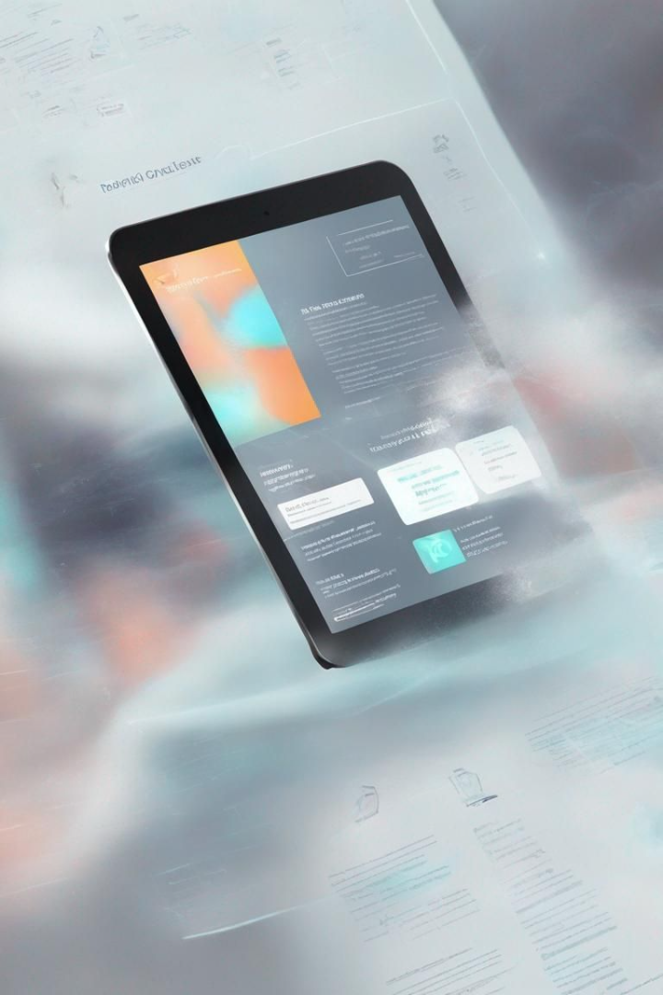
PERSONAL HEALTH CARE MANAGEMENT SYSTEM USING MACHINE LEARNING
A fusion of Machine Learning and health care spawns a revolutionary approach to personal health management. With a system designed to personalize health scores and provide actionable insights, we harness the potential of accessible technology for a healthier future.

Slide 3
Contents
Guiding you through the structure of our presentation, detailing every integral part of the machine learning healthcare management system.
Abstract
Introduction
A succinct overview of our innovative system.
Explicating the prevailing need for a ML-directed health approach.
Analysis
Conclusion
Dissecting the efficacy and results derived from the system.
Reflecting on the impactful outcomes and future potential.

Slide 4
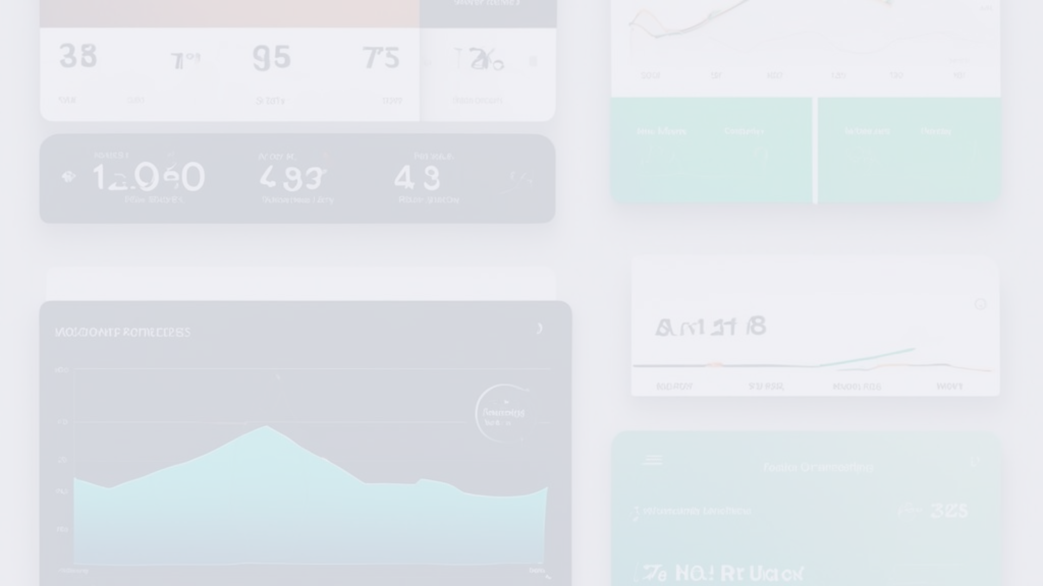
Abstract
With health increasingly sidelined in the tech era, our system emerges as a beacon of well-being, offering a seamless path to better health through everyday gadgets.
1
Accessibility
2
AI Health Scoring
3
Preventive Insights
Easy access to health management via ubiquitous devices.
Intelligent scoring system predicting health trends.
Actionable feedback to preempt health issues.

Slide 5
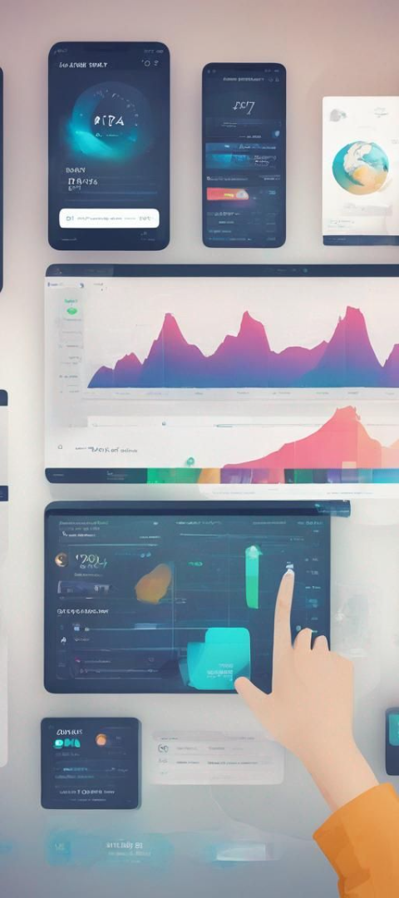



Introduction
Unveiling an ML-driven platform to empower individuals with proactive health management and timely medical intervention capabilities.
Data Entry
A portal for daily health metrics logging.
Analytic Insight
Invaluable health insights through ML analysis.
Timely Intervention
Enhanced decision-making to consult healthcare professionals efficiently.

Slide 6
Existing System:
Traditional health monitoring methods come with various challenges that underscore the necessity for an evolved system.
1
1K+
Yearly Checkups
Rising Costs
Incremental medical expenses over time.

Slide 7
Proposed System:
The proposed health management system is at the vanguard of marrying cost-efficiency with daily health vigilance powered by machine learning.
Consistent Tracking
Abnormality Alerts
Cost Savings
Real-time health score updates facilitate prompt awareness.
Immediate notifications to detect any health discrepancies.
An economical alternative to conventional health assessment.

Slide 8
Software Requirements Specification
Specifying the technical prerequisites to foster the system's operation on a wide array of devices and software environments.
Processor
I3 (min)
RAM
4GB (min)
Hard Disk
30GB
OS
Windows
Software Tools
Jupyter, VSCode

Slide 9
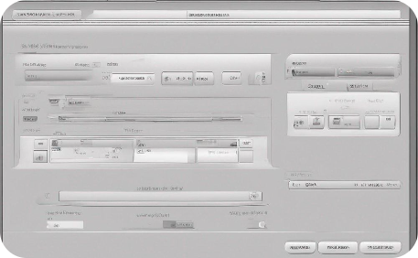


Architecture
Peering into the architectural blueprint, the system unifies user health inputs with a robust ML algorithm to dispense personalized health statuses.
User Data Collection
ML Analysis
Health Scoring
Inputs like BMI, height, and more are easily collected.
Real-time health metric analysis using ML algorithms.
A visual, intuitive star rating representing health.

Slide 10

Conclusion
The leverage of a machine learning-based health care management system on common personal devices heralds potential improvements in longevity and well-being.
1
Health Empowerment
2
Life Extension
Making health monitoring universally accessible.
Potentially raising the bar for life expectancy.
3
Future Outlook
Forecasting the future of health care as intimately integrated with technology.

Slide 11

Thank you

