Slide 1


Smart Classroom Energy Management
Occupancy-driven lighting and air-conditioning control on a two-laptop MQTT · Node-RED · ML system
Submitted by
Under the guidance of
NIRANJAN N S · AM.SC.U4CSE23338
SIVADEV SMIJITH · AM.SC.U4CSE23359
YALAMARTHI JYOTHI SRI KRISHNA CHAITANYA · AM.SC.U4CSE23370
PENUMALLU RAM DINESH REDDY · AM.SC.U4CSE23341
MANISH SHISHIRCHANDRA DORA ALURI · AM.SC.U4CSE23333
Dr. Sangeeth Kumar
Associate Professor
Center for Wireless Networks & Applications (Amrita WNA), Amritapuri
Amrita School of Computing · Amrita Vishwa Vidyapeetham, Amritapuri · B.Tech CSE · IoT project · 2026–2027
Notes:
Introduce the team and the one-line idea: we estimate whether a lecture room is occupied from its sensors and switch lights and AC accordingly, on the reference IoT architecture across two laptops.

Slide 2
Rooms sit empty, but lights and AC keep running
80%
923 kWh
85.6 kWh
of 5-minute intervals were EMPTY on Room 1's six test days (camera label [M])
chilled-water THERMAL energy recorded over those six days [M]
lighting ELECTRICAL energy over the same days [M] — reported separately, never added
Goal from the faculty brief: monitor occupancy, temperature, light and power; estimate occupied and empty periods; switch lighting and AC to cut energy when rooms are empty and prepare them before people arrive.
Notes:
All three numbers are measured ROBOD values for Room 1's test dates (results/savings_results.csv baseline, savings_comfort.csv occupied rows 344 of 1728). Stress that chilled water is thermal kWh and lighting electrical kWh.

Slide 3





Five objectives guided every design decision
O1 Reference architecture
O2 Fair model comparison
O3 Two research methods
O4 Safe, confirmed control
O5 Honest energy reporting
All 8 stages, split across a server laptop and an IoT-node laptop
Traditional, ensemble and deep models on held-out dates, plus cost and latency
Mamba (paper A family) and LSTM + Dueling DQN (paper B), honestly adapted
Every command has an id and an acknowledgement; safety rules always apply
Measured [M], predicted [P] and simulated [S] are labelled everywhere
Notes:
O1-O5 map to report sections 8, 15-17, 18/20, 19/21 and 24-25.

Slide 4
ROBOD: real lecture-room data with camera ground truth
2 rooms
8,352
29 days
SHA-256
NUS lecture rooms; Room 1 trains and tests, Room 2 checks transfer
5-minute rows × 28 columns per room
weekdays in Sep–Oct and Dec 2021, kept in +08:00
verified on download; licence unverified, so CSVs are not redistributed
Split by whole date (seed 42) — test dates never used for training, selection or tuning
19 training dates · 5,414 rows
4 validation · selection
6 test · reporting only
Inputs: Wi-Fi devices, CO₂, sound, humidity, temperature, illuminance, time of day. Label: camera occupant presence (never an input). Simulated: all light and AC states, because ROBOD has none.
Notes:
Two test dates (24 Sep, 22 Dec) have 0 and 1 occupied intervals, which matters later for the confidence intervals.

Slide 5
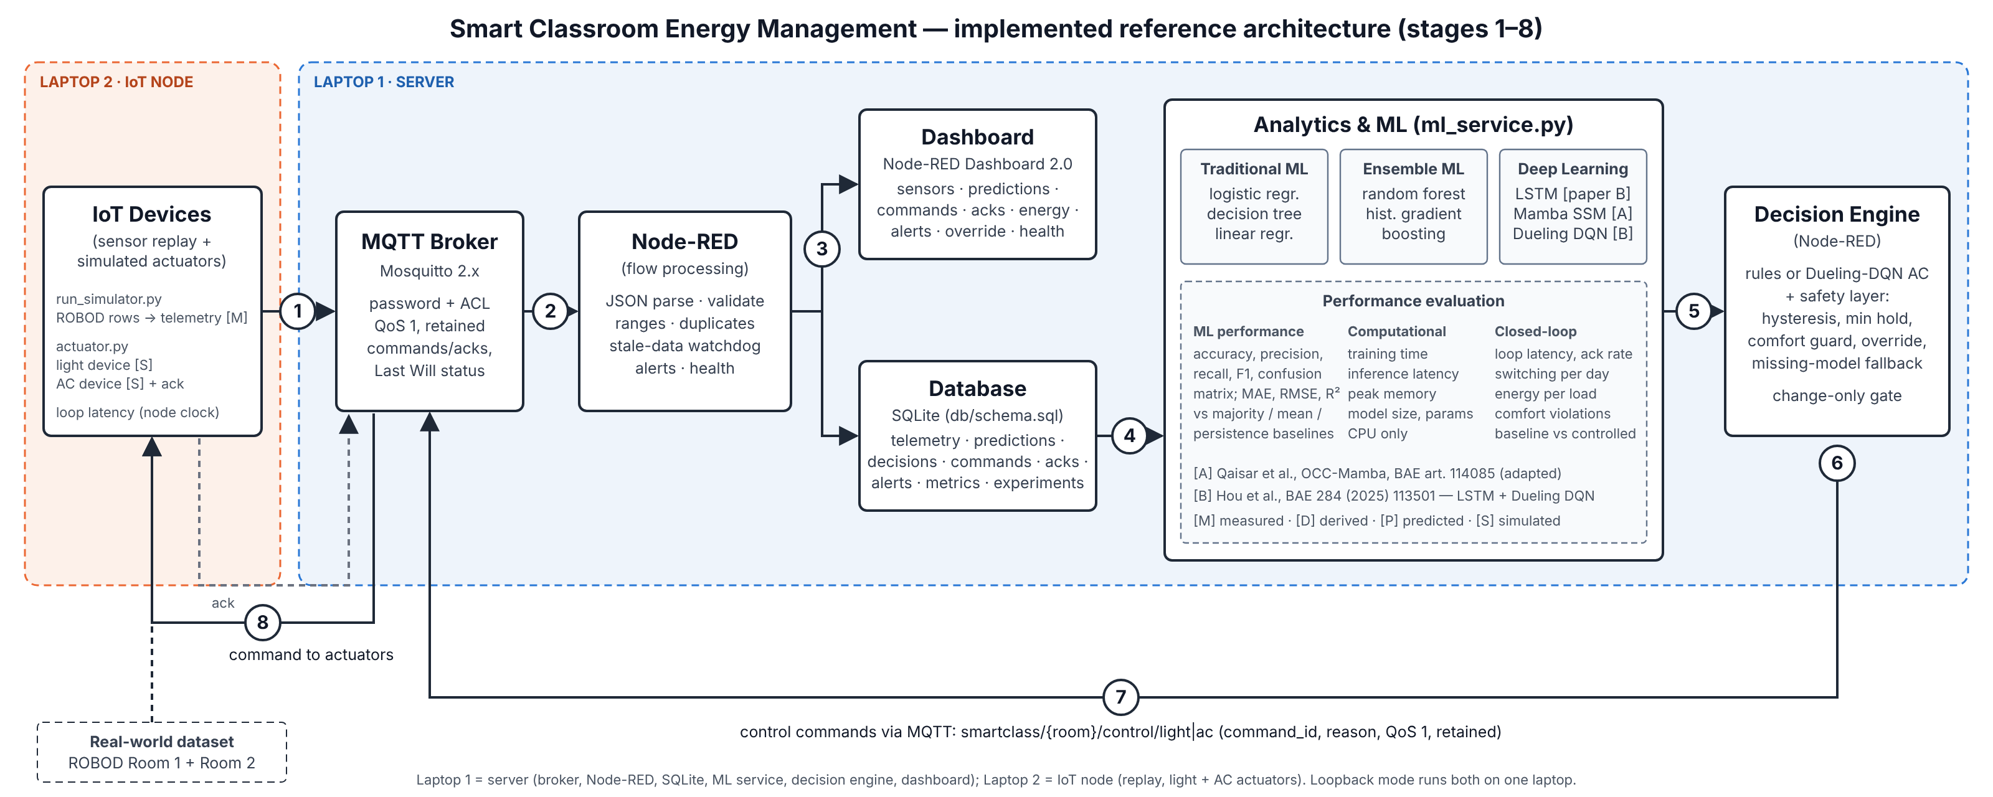
Eight reference stages across two laptops
Laptop 2 (IoT node): ROBOD replay + Room 1 and Room 2 light/AC actuators · Laptop 1 (server): Mosquitto, Node-RED, SQLite, Dashboard 2.0, ML service
Notes:
Walk the loop: telemetry -> validate -> store -> ML -> decision -> control -> actuator -> acknowledgement. The control logic exists once, in Node-RED; tests and experiments execute that same code.

Slide 6



MQTT: authenticated, role-restricted, acknowledged
Topic | Direction | Delivery
smartclass/{room}/telemetry | node → Node-RED | QoS 1
smartclass/{room}/analytics | ML → Node-RED | QoS 1
smartclass/{room}/control/{light,ac} | Node-RED → actuator | QoS 1 · retained
smartclass/{room}/actuator/{load} | actuator → Node-RED | QoS 1 · retained
…/status (Last Will) | every client | retained
No anonymous access
PBKDF2-hashed passwords; random credentials generated by tools/init_env.py
ACL per role
Node account can send readings and acks but can NOT publish commands — tested: “Denied PUBLISH”
No TLS: a LAN prototype. Firewall rules allow 1883/1880 only on the Private profile and the local subnet.
Survives outages
Reconnect 1–30 s, retained last command, Last Will → DEVICE_OFFLINE alert
Notes:
Evidence: tests/test_failures.py (wrong password, unknown user, ACL, broker restart, ML crash Last Will).

Slide 7
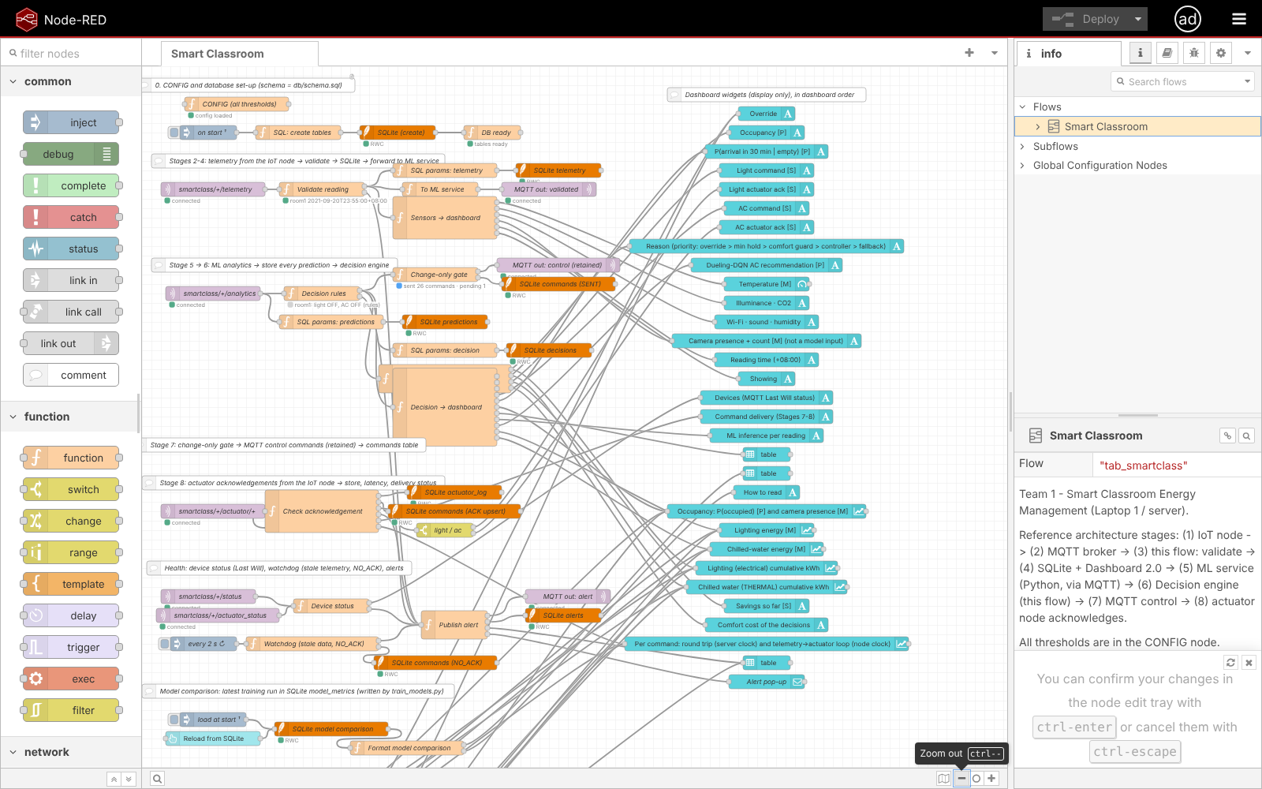
Node-RED integrates, validates, decides and tracks delivery
Validate
JSON, room, timestamp, ranges, required fields, duplicates → alert on reject
Decide
one Decision rules node; all thresholds in one CONFIG node
Deliver
change-only gate, command_id, ACK upsert, NO_ACK after 5 s, late ack recorded
Protect
editor needs a login (401 without); dashboard read-only on the LAN
Notes:
118 nodes, 22 function nodes, laid out by stage. Screenshot taken after logging in to the protected editor.

Slide 8
SQLite: eight tables, from live readings to registered results
telemetry
predictions
decisions
commands
every valid reading [M] · UNIQUE(room, ts)
6 model outputs per reading [P]
light, AC, reason, controller [S]
SENT → ACKED / REJECTED / NO_ACK / ACKED_LATE
actuator_log
alerts
model_metrics
experiment_results
every acknowledgement
invalid, stale, offline, no-ack, late-ack…
offline evaluation, imported read-only
registered experiments, imported read-only
Python writers wait up to 15 s on a lock and fail visibly after that — tested, never a silently dropped row.
Notes:
The amber tiles feed the dashboard's model-performance and offline-results tables: init_db.py imports the registered files once per run id without changing them.

Slide 9
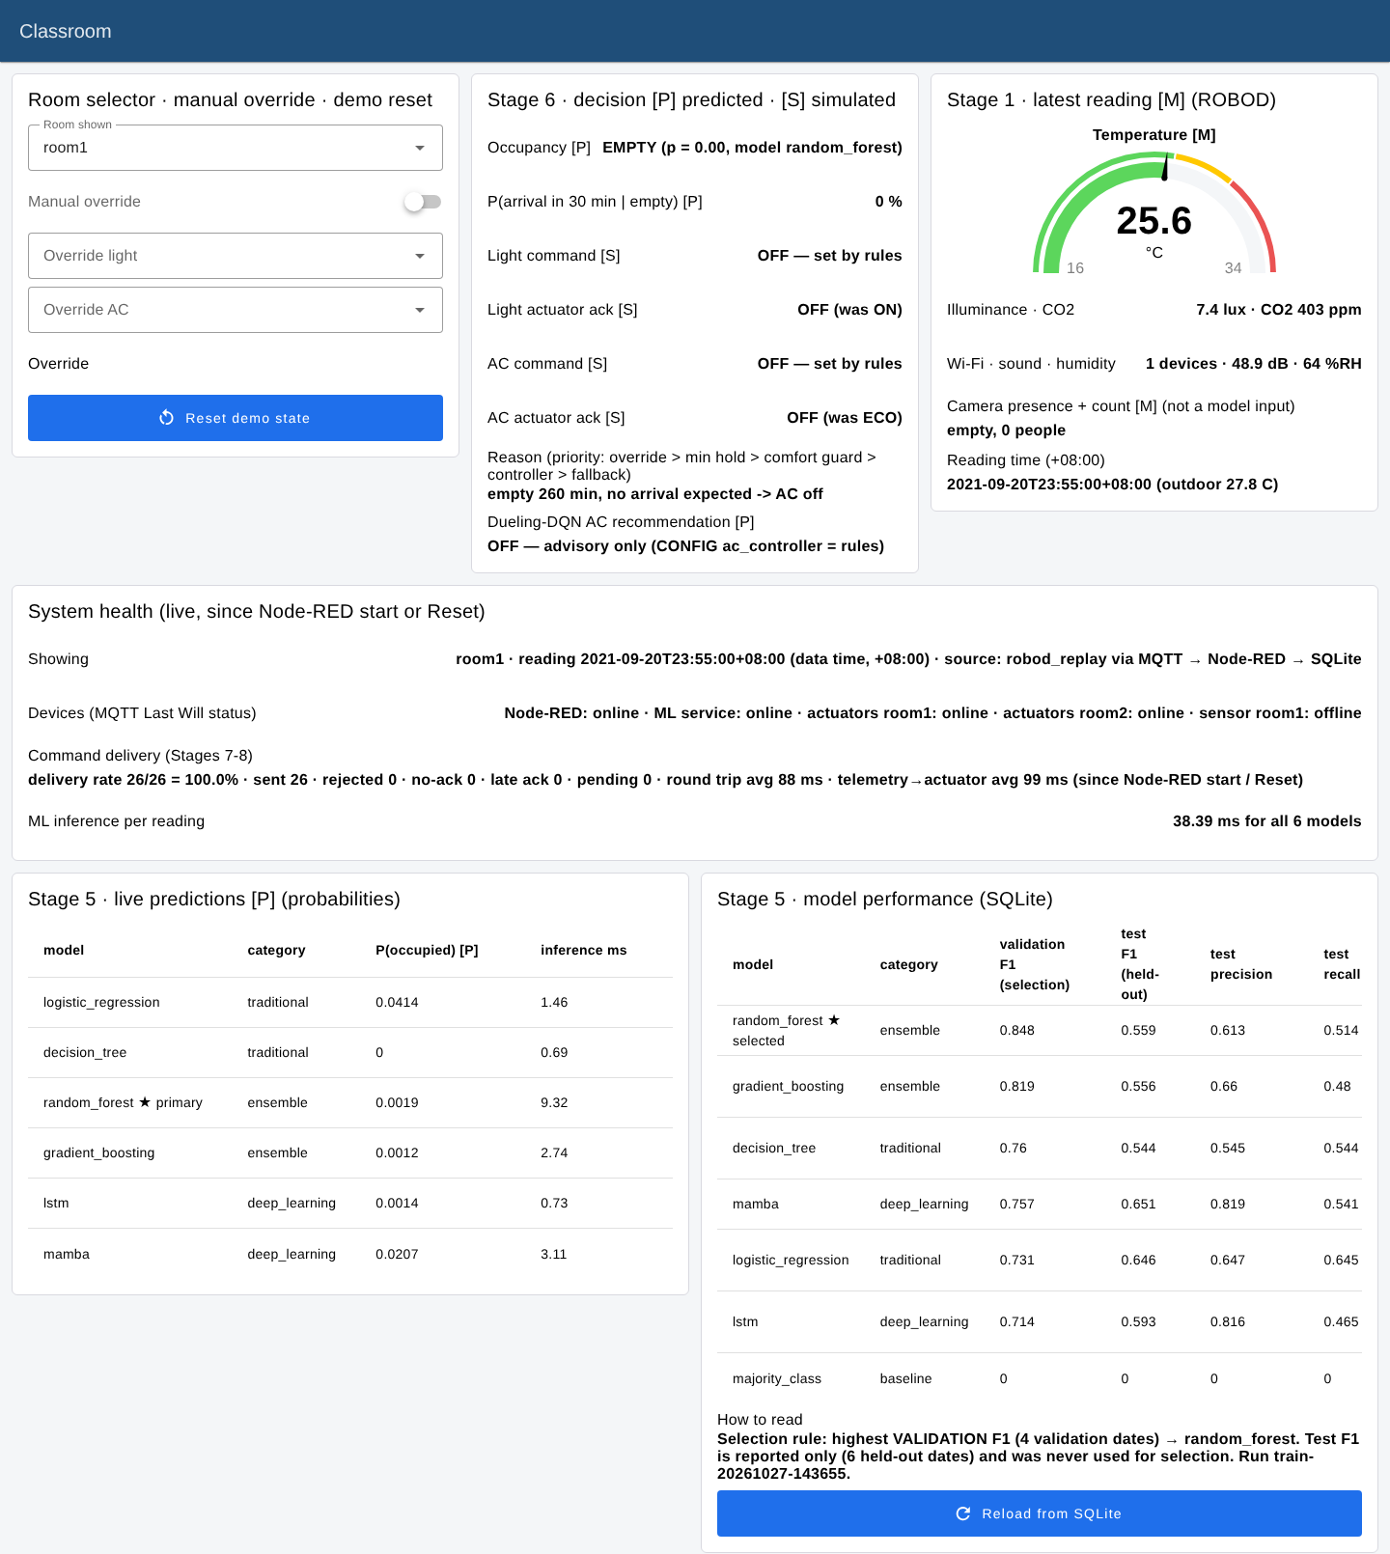




Dashboard: every value shows its kind and its source
[M] [P] [S] on every panel
measured, predicted, simulated; kWh electrical vs kWh THERMAL
Results read from SQLite
model performance and offline experiments — the old empty panel is fixed, nothing hard-coded
Who decided?
“BOOST — set by rules” · “DQN: OFF — advisory only”
Health and latency
Last Will status, delivery rate, round trip and loop per command
Notes:
All 20 required panels are present (report table §13). Empty data shows n/a or an instruction, never a misleading 0%.

Slide 10
All models beat the baseline; none clearly beats another
Why random forest is primary
Chosen by the rule fixed in advance: highest validation F1 (0.848); best 5-fold CV (0.73 ± 0.11).
Picking Mamba now because of its test score would be test-set selection.
Date-cluster bootstrap: Mamba − RF = +0.09 F1, 95% CI [−0.18, 0.38]. Every CI includes 0.
All models run in ≤ 15 ms per reading on one CPU thread.
Notes:
Numbers: models/training_report.json and results/supplementary/bootstrap_ci_*.csv. Two test days are nearly empty (0 and 1 occupied intervals), which widens the intervals.

Slide 11
Two research methods, adapted rather than copied
A · Mamba selective state space
B · LSTM + Dueling DQN
Qaisar et al., OCC-Mamba, Building & Environment (2025)
Hou et al., Building & Environment 284 (2025) 113501
Two Mamba blocks: input-dependent Δ, B, C; causal conv; selective scan
17,217 parameters, pure PyTorch, 2.2 ms per reading
Best test F1 0.651 · precision 0.82
LSTM, 32 units, 1-hour window of 6 sensors
Dueling DQN picks OFF / ECO / COMFORT / BOOST
Trained in our grey-box room model on out-of-fold LSTM output
Adapted: Full text not accessible: we implement the Mamba family, not OCC-Mamba's exact design
Adapted: Camera labels instead of CO₂ change points; our own state and reward; assumed plant parameters
Notes:
Be explicit in the viva: these are research-inspired adaptations, not reproductions. Paper B's reported results are theirs, not ours.

Slide 12
The decision engine: a clear priority, visible on screen
1 Manual override
Rules (thresholds tuned on VALIDATION dates)
Occupied at p ≥ 0.25, empty only below 0.15 (hysteresis)
Occupied: light ON; AC COMFORT, BOOST above 25.5 °C
Empty 15 min: light OFF, AC ECO; 30 min: AC OFF
Arrival likely and warm: PRECOOL
Never switches an empty room ON at start-up
2 Minimum hold (10 min)
3 Comfort safety guard
4 Selected controller: rules (default) or DQN
“AC BOOST while the DQN says OFF” explained: in rules mode the DQN is advisory only. The panel now shows “BOOST — set by rules” and “DQN: OFF — advisory only”. A test checks every case.
5 Missing-model fallback (timetable)
highest priority ↑
Notes:
Hysteresis 0.25/0.15 replaced 0.6/0.4: wrong lights-off on validation fell from 22.5% to 13.7%. Test dates were never used.

Slide 13
The Dueling DQN saves more, but rooms get too warm
The reward weight is the lever
1.7%
comfort violations (was 26.5%) when comfort_per_k goes 0.5 → 2.0
…for +5% cooling (115.7 → 121.6 kWh thermal). Shortened protocol, deterministic, separate file — the deployed model is unchanged. The default stays “rules”.
Six test days in our grey-box room simulator (assumed parameters); DQN with LSTM input as in paper B.
Notes:
Reward: -(cooling/COP 3.5 + fan) - 0.5 K outside 23-26 C - 0.3 per 100 ppm CO2 above 1000 (occupied only). Live exercise E reruns the weight change.

Slide 14
Energy and comfort: report the saving and its cost together
−52%
0.6%
38.7%
27.9%
simulated cooling vs always-on (405.5 vs 850.6 kWh thermal)
occupied intervals outside 23–26 °C
lighting saved on recorded energy, rules + RF [S]
occupied intervals with lights wrongly OFF (96 of 344)
Closed-loop room simulation, six test days
Recorded ROBOD energy re-scaled by our commands
Savings above the camera bound come from switching off occupied rooms — a comfort cost, not a real saving. Every number here is simulated; none is a metered saving.
Notes:
Sources: results/closed_loop_results.csv, savings_results.csv, savings_comfort.csv. Chilled water saved 39.5% for rules + RF, 43.1% for the camera bound.

Slide 15
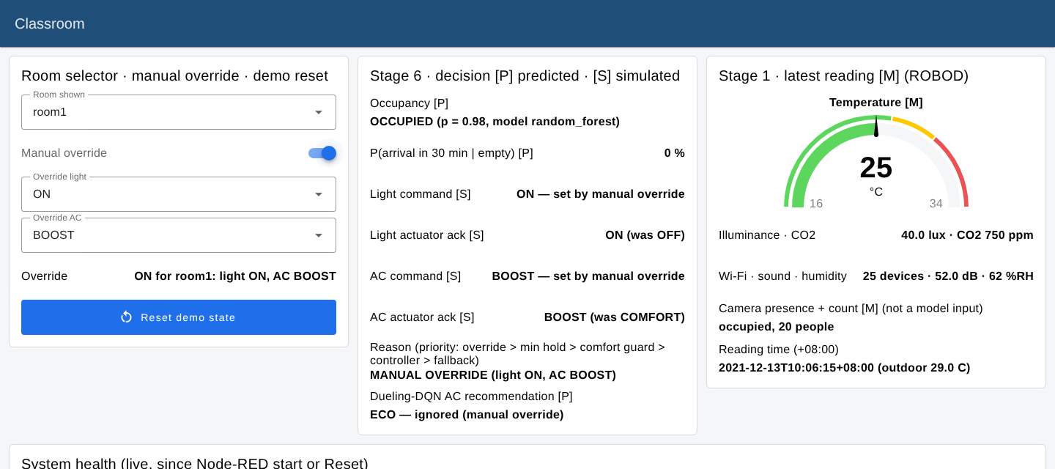
Live system: a full loop in under a tenth of a second
100%
of 29 commands acknowledged (full-day replay)
88 ms
94 ms
median round trip
median sensor-to-actuator loop
Manual override → MQTT → actuator → acknowledged in 87 ms
Live modification exercises, all rehearsed
A occupancy threshold
B AC comfort threshold
C grace period / minimum hold
D invalid MQTT message
E DQN reward weight
Notes:
Measured on one machine through its network interface (EVIDENCE/energy_results/live_run_v4_report.json). Two-laptop Wi-Fi latency is still to be measured.

Slide 16
97 automated tests pass, including 19 failure scenarios
Failure scenarios covered
Broker down / restart + reconnect
Wrong password, unknown user, ACL
ML service crash → Last Will
Missing model, DQN or sensor value
Database locked
Invalid, duplicate, stale telemetry
No ack, late ack, unknown ack
Weak credentials, tampered dataset
Testing found 4 real bugs: same-millisecond command ids, ignored late acks, the stop script racing a restart, and a tracked token file.
Notes:
python -m pytest -q: 97 passed, 1 skipped (opt-in e2e). SC_E2E=1: 1 passed. PowerShell scripts parsed with the real PowerShell 7.4 parser; Windows-only cmdlets not executed.

Slide 17


Limitations we report, and what we would do next
Limitations
Future work
Only 29 dates (6 test): rankings are not separable
Room simulator uses assumed parameters
Savings are counterfactual or simulated, never metered
Lights wrongly OFF in 8–28% of occupied intervals
No TLS; dataset licence unverified
Motion sensor or minimum-lighting fallback
Tune the DQN reward and switching penalty on validation dates
More rooms and dates; report intervals as standard
TLS for MQTT; login for the dashboard controls
Run the 15-point two-laptop checklist
Pilot with real relays and metered energy
Notes:
Say the two-laptop status plainly. If the team has run the checklist before the viva, update this slide with the date.

Slide 18
Conclusion and team contributions
Complete loop
Fair evaluation
Honest energy
8 stages, authenticated MQTT, 100% acknowledged commands, dashboard backed by SQLite
3 model families + 2 research adaptations, chosen on validation; differences within uncertainty
rules halve simulated cooling at < 1% comfort cost; DQN kept behind a safety layer
Member | Roll number | Subsystem
NIRANJAN N S | AM.SC.U4CSE23338 | Decision engine, Dueling DQN, energy & comfort evaluation (shared)
SIVADEV SMIJITH | AM.SC.U4CSE23359 | Decision engine, Dueling DQN, energy & comfort evaluation (shared); Node-RED, SQLite, dashboard
YALAMARTHI JYOTHI SRI KRISHNA CHAITANYA | AM.SC.U4CSE23370 | IoT node, MQTT broker, security, two-laptop deployment
PENUMALLU RAM DINESH REDDY | AM.SC.U4CSE23341 | Dataset, features, traditional and ensemble ML, evaluation
MANISH SHISHIRCHANDRA DORA ALURI | AM.SC.U4CSE23333 | LSTM and Mamba models, ML service
Notes:
Each member can introduce their own subsystem here. Close with: every number is traceable to a result file and every saving is a simulation result.

