Slide 1
CIS 468 / Final Project
Predicting Customer Campaign Response
Clustering and classification on the Customer Personality Analysis dataset
2,240
29
4
3
Customers
Variables
Clusters (K)
Classifiers
Towson University / Dr. McGuire / Spring 2026
Team: Sofia Foutzitzi / Niranjan K C / Jivitesh Marken / Oluwadamilola Bright-Awonuga

Slide 2
INTRODUCTION
The Business Problem
Marketing campaigns are expensive, and most of them fail.
OUR RESEARCH QUESTIONS
In our dataset, only 14.9% of customers accepted the campaign. If a business could predict who is likely to respond, it could:
1. Can we group customers into meaningful segments based on income, spending, and behavior?
Target the right people instead of everyone
Lower acquisition cost per converted customer
Build segments for personalized offers
Decide what to push to whom (wine vs. meat, web vs. catalog)
2. Can we predict whether a customer will accept a marketing campaign?
3. Which features matter most: income, recency, prior campaign acceptance, or product spending?
4. Which algorithm handles a 15/85 class imbalance best?

Slide 3
BACKGROUND
Meet the Dataset
Customer Personality Analysis / Kaggle, 2,240 records, 29 variables
WHO THEY ARE
WHAT THEY BUY
HOW THEY BUY
CAMPAIGN HISTORY
Year of birth
Education
Marital status
Income
Kids / teens at home
Wines
Meat products
Fish, fruits, sweets
Gold products
(in $ over 2 years)
Web purchases
Catalog purchases
Store purchases
Deal purchases
Web visits per month
AcceptedCmp 1–5
Recency (days)
Complain flag
Response (target)
TARGET VARIABLE Response = 1 if the customer accepted the most recent campaign offer, 0 otherwise.

Slide 4
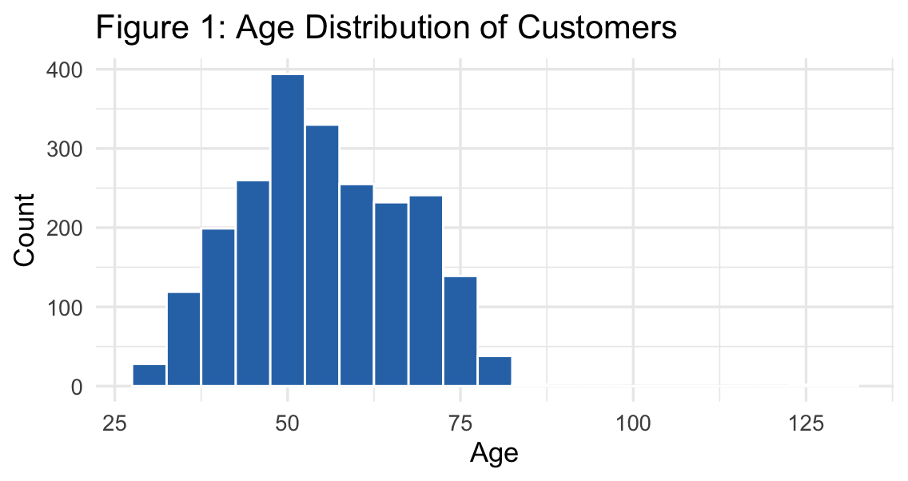
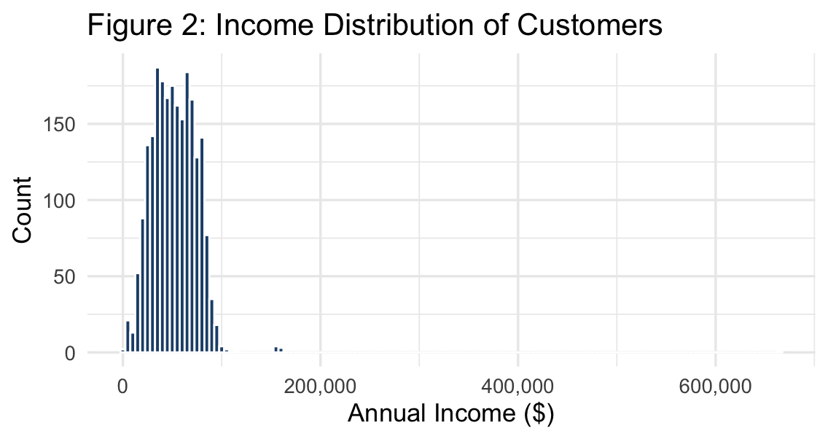
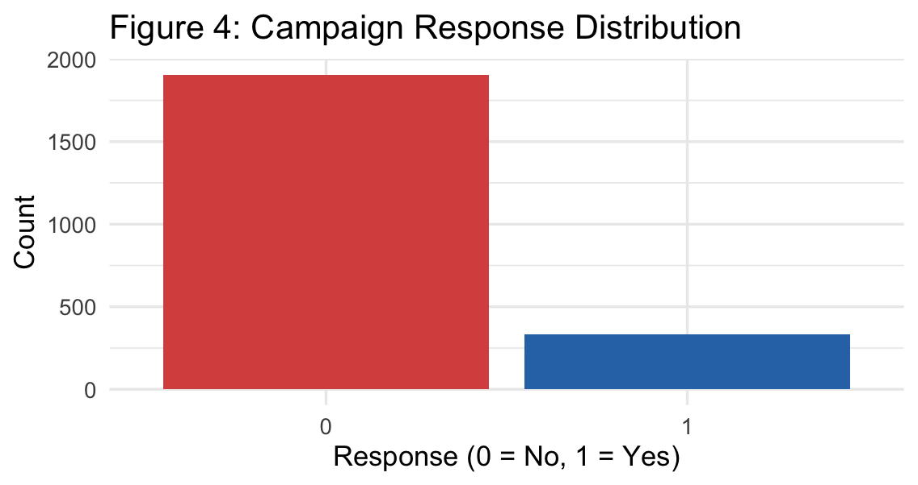
EXPLORATORY ANALYSIS
What the Customers Look Like
Most customers are 40–60. A few outliers from data-entry errors (max age 131).
Income peaks around $50K–$60K, with one $666K outlier worth noting.
Only 14.9% of customers responded. This class imbalance shapes everything later.
WHAT JUMPS OUT
14.9%
$52K
~$606
24
campaign response rate
median annual income
median total spend over 2 yrs
missing income values (median-imputed)

Slide 5
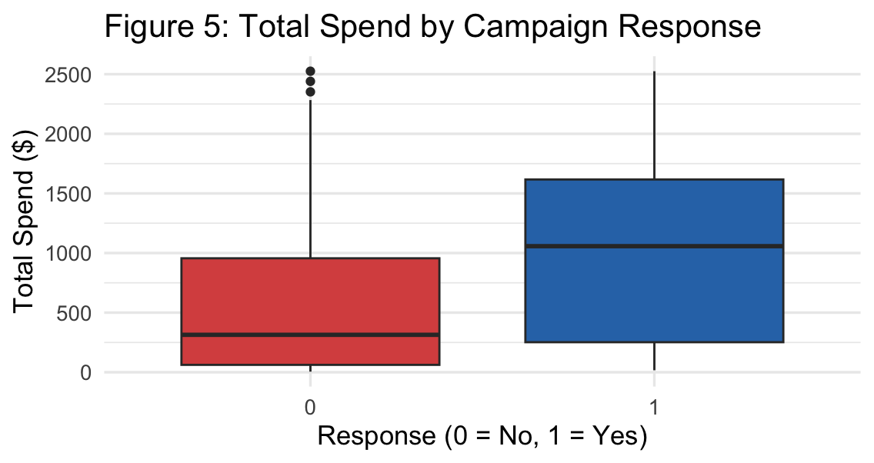
EXPLORATORY ANALYSIS
The Strongest Signal We Found
RESPONDERS SPEND ~3x MORE
$1,050
median spend for responders
~$310
median spend for non-responders
This told us TotalSpend would be a strong predictor, which the models later confirmed.

Slide 6
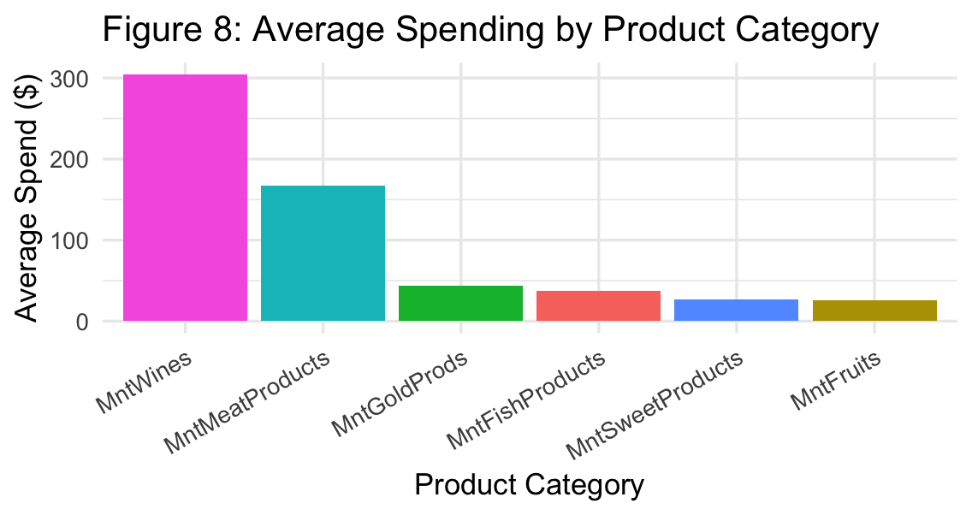
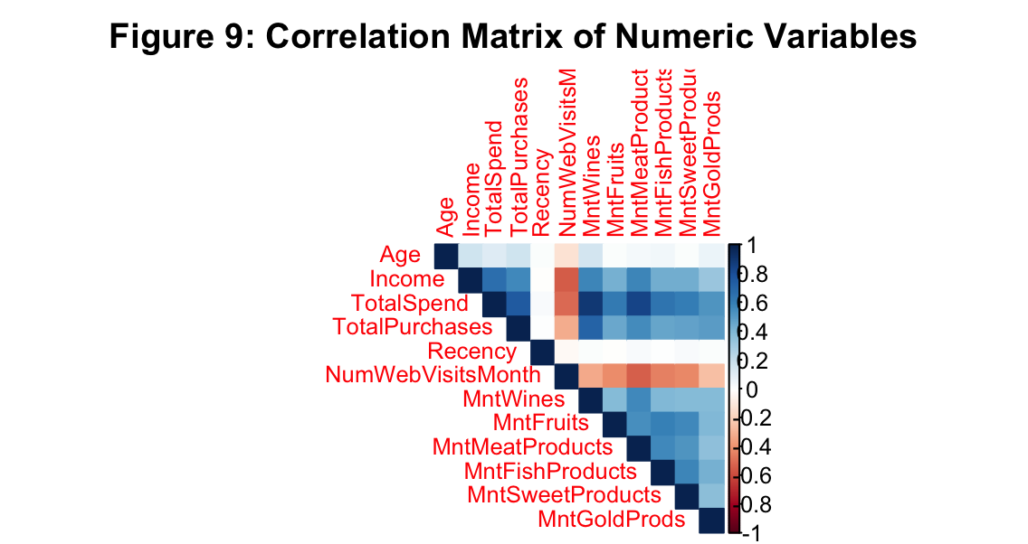
EXPLORATORY ANALYSIS
What They Buy and What Goes Together
Wines and meat dominate spending
Income tracks closely with all spending
Higher income shows strong positive correlation with every product category, especially wines and meat.

Slide 7
METHODS
Our Three-Step Approach
01
Preprocess + Feature Engineer
Median-impute 24 missing incomes. Build Age, TotalSpend, TotalCampaignsAccepted, TotalPurchases. Drop constants Z_CostContact, Z_Revenue, ID. Encode categoricals as factors.
02
K-Means Clustering (Unsupervised)
Scale 6 numeric features, then use elbow method + silhouette analysis to pick K. Result: K = 4 customer segments with distinct income, spend, and response patterns.
03
Classification (Supervised)
70/30 train/test split with 10-fold CV. Compare Decision Tree, KNN, and Logistic Regression on Accuracy, F1, Sensitivity, Specificity, Kappa. F1 matters more than Accuracy because of the 15/85 class imbalance.

Slide 8
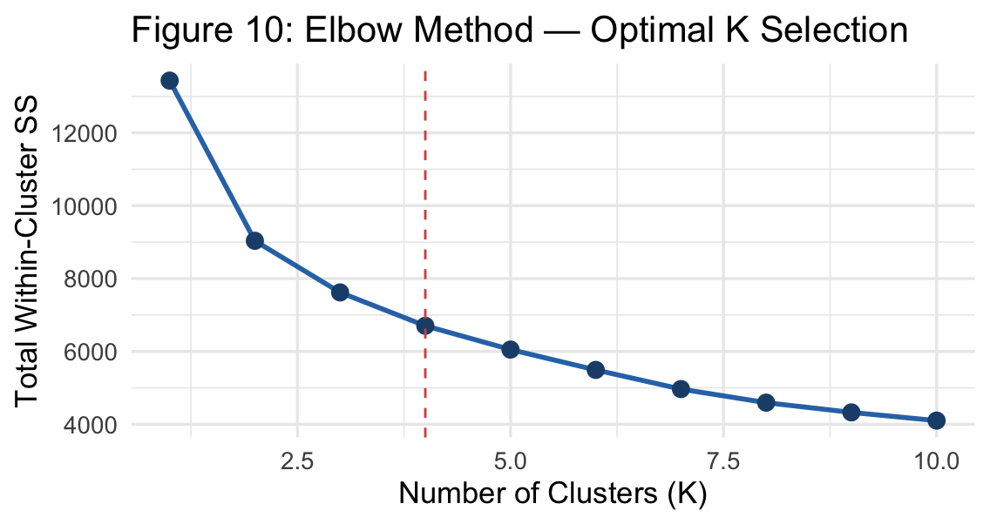
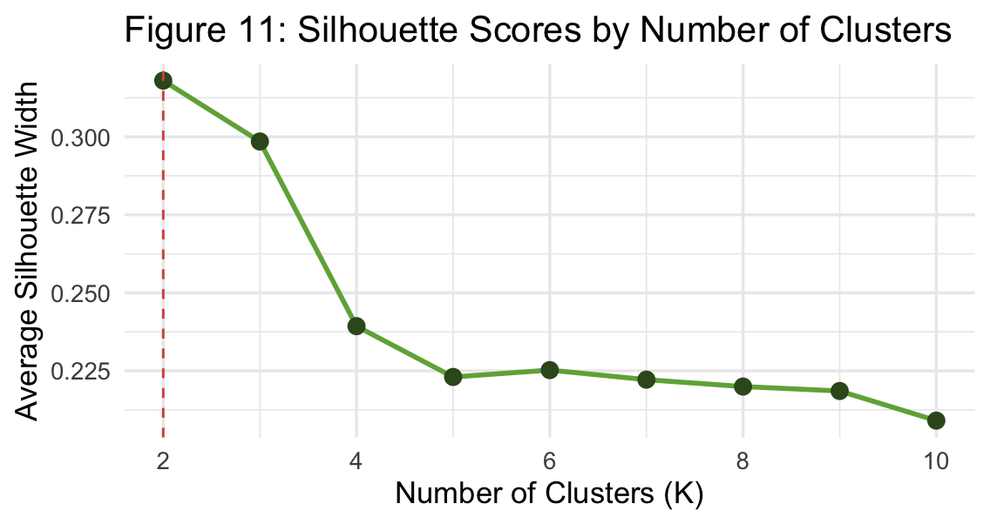
METHODS
K-Means in Plain Terms
HOW IT WORKS
HOW WE PICKED K = 4
Pick K random center points.
Assign every customer to the nearest center.
Move each center to the average of its customers.
Repeat until the centers stop moving.
Result: K groups where members are close to their own center and far from others.
Elbow Method
Silhouette Analysis
The elbow bends sharply at K = 4 and the silhouette score supports a clean separation. We also tried K-Medoids (PAM) but it gave noisier clusters with no real interpretation gain, so we stayed with K-Means.
WHY WE SCALED THE DATA
K-Means uses Euclidean distance. Without scaling, Income (in the thousands) would dominate Age (in tens), and clusters would essentially group by income alone.

Slide 9
METHODS
Three Classifiers, Three Philosophies
Decision Tree
KNN
Logistic Regression
rpart, tuneLength = 10
k tuned 3–21, scaled features
GLM with binomial link
Splits the data on the most informative feature, then splits again, then again, building a flowchart of yes/no questions. Easy to explain to a non-technical audience.
Looks at the K nearest customers in feature space and votes. Simple but distance-sensitive, so we centered and scaled every feature first.
Fits a probability curve to the data and outputs a likelihood of acceptance. Gives interpretable coefficients showing which features push acceptance up or down.
SHARED EXPERIMENTAL DESIGN
Split
Tuning
Metric
Target
70% train / 30% test, stratified
10-fold cross-validation on training set
ROC for tuning, F1 for model selection
Response (1 = accepted, 0 = not accepted)

Slide 10
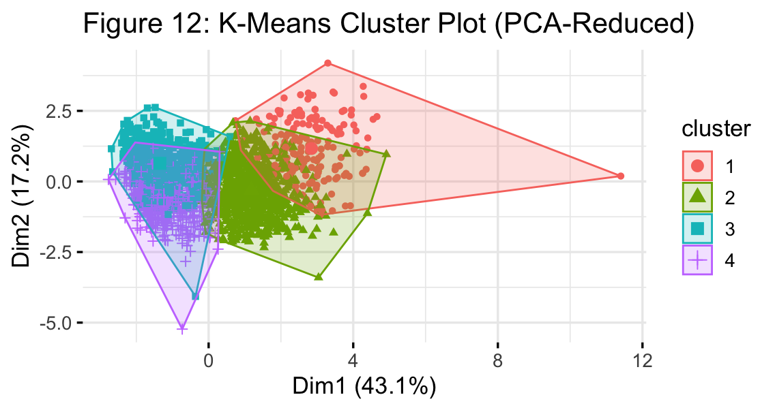
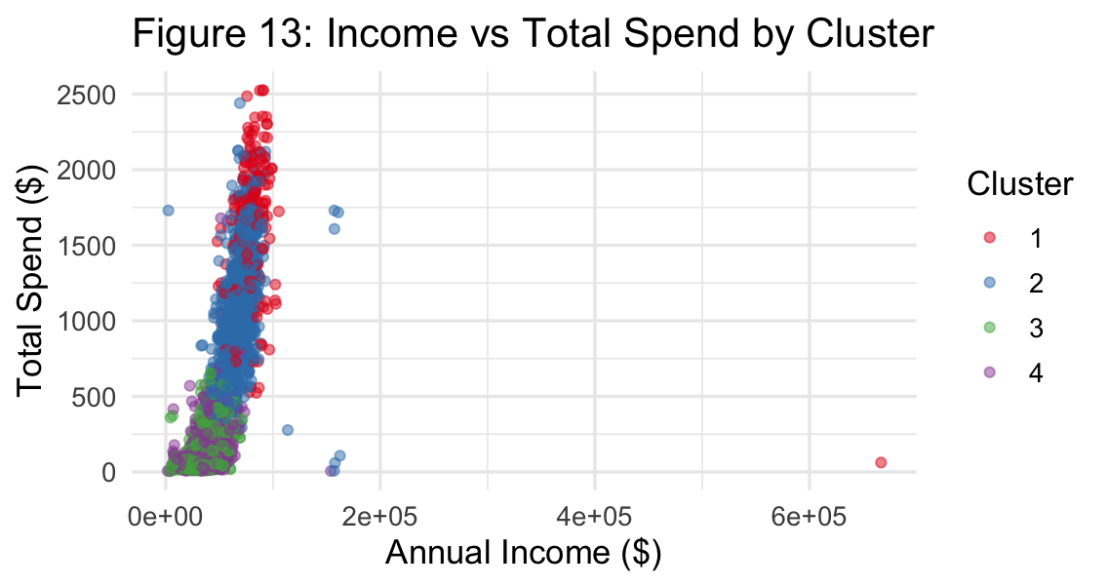
RESULTS
Four Customer Segments
Cluster 1
High value, high response
57.7%
n 189 inc $82,547 spend $1,612
response
Cluster 2
Affluent but cool
13.2%
n 854 inc $67,477 spend $1,036
response
Cluster 3
Lower income, modest spend
14.4%
n 604 inc $35,603 spend $131
response
Cluster 4
Disengaged
4.2%
n 593 inc $37,576 spend $148
response

Slide 11
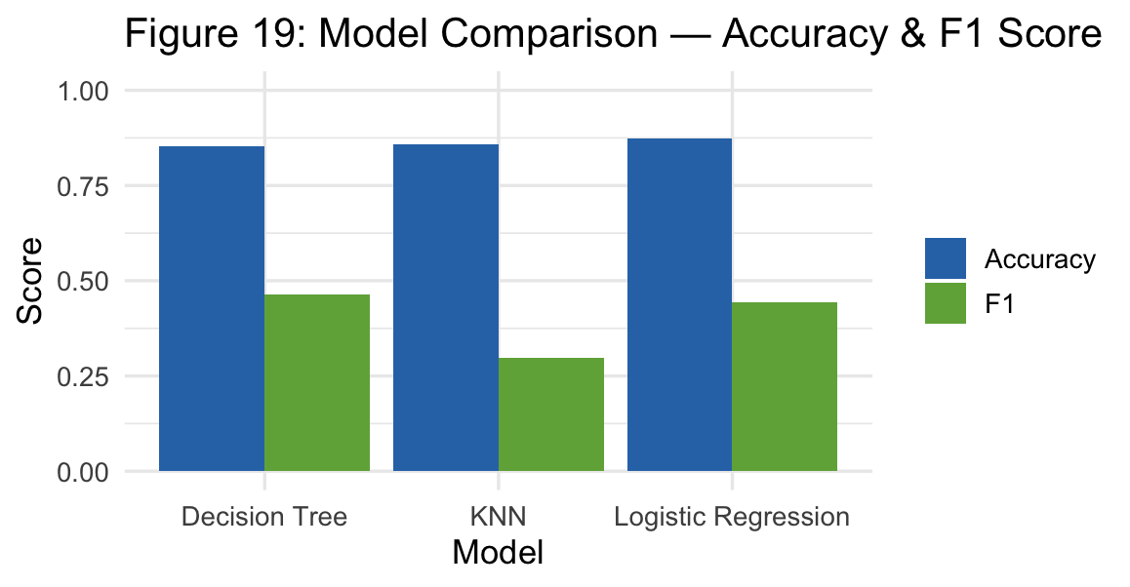
RESULTS
Model Comparison
WINNER BY F1 SCORE
Decision Tree
F1 = 0.465
WHY F1 AND NOT ACCURACY?
Because 85% of customers said no, a model that predicts no every single time would still score 85% accuracy. F1 balances precision and recall, so it rewards models that actually catch the few who would say yes.
Model | Accuracy | F1 | Sens. | Spec.
Decision Tree | 0.853 | 0.465 | 0.43 | 0.93
KNN | 0.858 | 0.296 | 0.20 | 0.97
Logistic Regression | 0.873 | 0.444 | 0.34 | 0.97

Slide 12
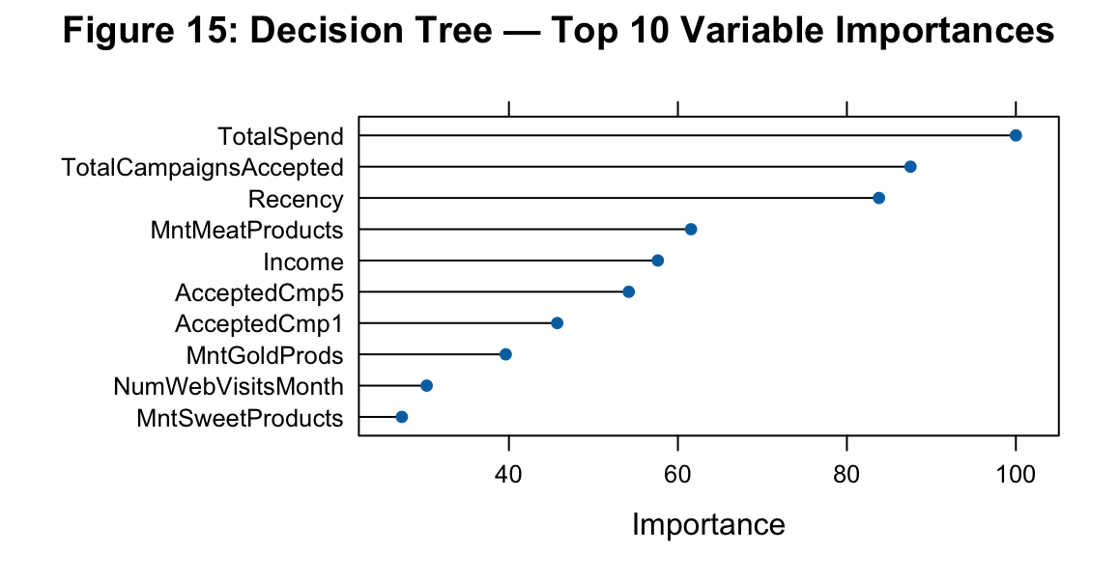
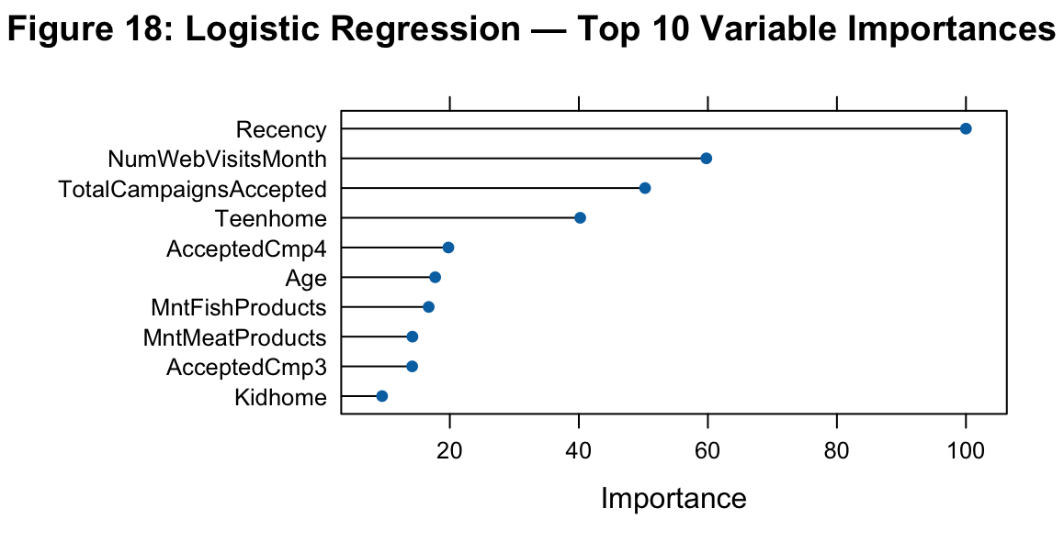
RESULTS
What Actually Drove the Predictions
Decision Tree top features
Logistic Regression top features
BOTH MODELS AGREE TotalSpend, TotalCampaignsAccepted, Recency, MntMeatProducts, and Income consistently rank near the top. Past acceptance is the strongest signal of future acceptance.

Slide 13
DISCUSSION
Three Things Worth Pausing On
?
Why does Cluster 1 respond at 57.7% but Cluster 4 at only 4.2%?
Cluster 1 customers earn more, spend more, and have accepted past campaigns. Cluster 4 customers have similar income to Cluster 3 but barely spend, which suggests low engagement overall. Income alone does not buy attention.
?
Why do all three models have high accuracy but low sensitivity?
The 15/85 class imbalance pushes models to predict 'No' as the safe default. They get most calls right but miss real responders. This is why we used F1 for model selection instead of accuracy.
?
Why is Recency the strongest predictor in Logistic Regression?
Customers who shopped recently are still actively engaged with the brand. Recent buyers respond. Dormant customers do not, no matter their income.

Slide 14
CONCLUSION
What We Found and Where to Go Next
WHAT WE FOUND
LIMITATIONS
Four clean customer segments emerged, and one of them responds at nearly 60%.
Decision Tree gave the best F1 score (0.465), beating KNN and Logistic Regression for catching real responders.
Spend, prior campaign acceptance, and recency are the predictors that matter most.
Income matters, but engagement matters more.
Class imbalance hurts sensitivity across every model.
Income and age outliers were left in for transparency, not adjusted.
Single dataset, single point in time, single retailer.
FUTURE WORK
Try SMOTE or class weights to fix the imbalance.
Test Random Forest and gradient boosting against the Decision Tree.
Use clusters as a feature inside the classifier.

Slide 15
TEAM
Thank you.
Sofia Foutzitzi
Niranjan K C
Jivitesh Marken
Oluwadamilola Bright-Awonuga
Questions?
CIS 468 / Spring 2026 / Dr. McGuire
Dataset: Customer Personality Analysis / Kaggle

