Slide 1
Text Analytics on British Airways Customer Reviews
✈
British Airways
D5 — Final Presentation
3,701 Reviews Analyzed
CIS 428: Text Analytics | Professor: Jinie Pak | May 2026
Naive Bayes ● KNN ● LDA Lexicon Sentiment Analysis
Sofia Foutzitzi ● Niranjan K C ● Pradip Raj Dhakal
Sofia — Introduction, EDA, Discussion
Niranjan — Dataset, Preprocessing, Sentiment Analysis, Results
Pradip — Classification Models, Topic Modeling, Conclusion
Kaggle Dataset ● R Programming

Slide 2
Introduction & Motivation
The Problem
British Airways receives thousands of written reviews annually. Manually analyzing this volume is impractical and prone to missing patterns.
Our Solution
Apply text analytics and NLP to automatically extract meaningful insight's themes, sentiment, and predictive models from 3,701 reviews.
Domain
Business & Customer Experience Analytics in the Airline Industry
Dataset
British Airways Reviews from Kaggle (Chaudhary & Risinahani, 2023) — 3,701 reviews, 20 columns, structured + unstructured data
Approach
Complete pipeline: preprocessing → EDA → classification (Naive Bayes, KNN, Lexicon) → clustering (LDA topic modeling)

Slide 3
Research Questions
RQ1
What topics and themes appear most frequently in British Airways customer reviews?
RQ2
Does traveler type (economy vs. business class) influence the positivity or negativity of reviews?
RQ3
How does textual sentiment relate to numerical review ratings?
RQ4
Which service factors (delays, staff behavior, comfort) are most associated with negative reviews?
RQ5
Can review text be used to predict customer satisfaction levels?

Slide 4
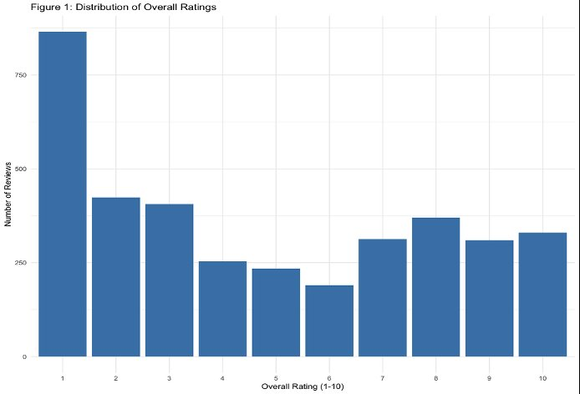
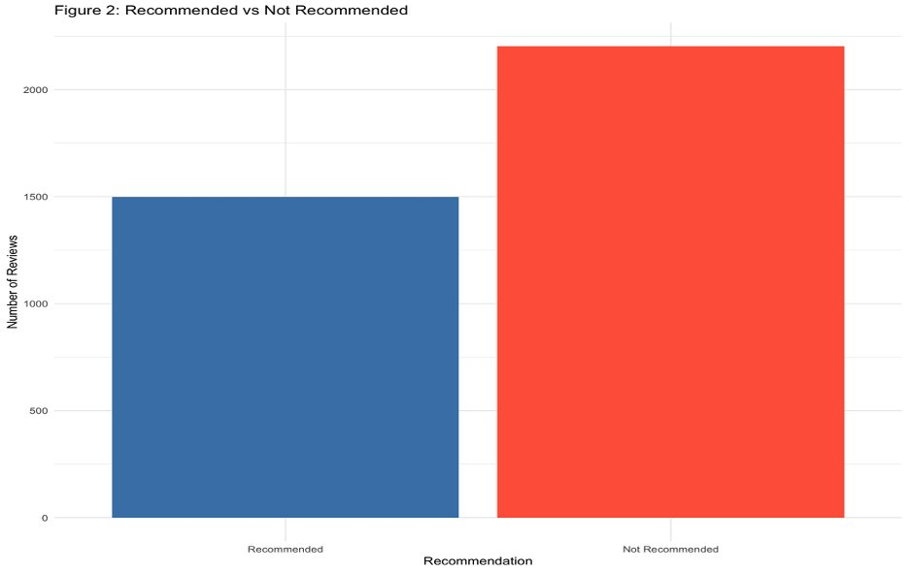
Dataset Overview
3,701
20
52.7%
59.5%
52.1%
Total Reviews
Columns
Negative Sentiment
Not Recommended
Economy Class
Fig 1: Distribution of Overall Ratings (1–10)
Fig 2: Recommended vs Not Recommended

Slide 5
Data Preprocessing Pipeline
1
Load & Inspect
5
Sentiment Variable
read.csv(), dim(), str(), summary()
Positive (7–10), Neutral (5–6), Negative (1–4)
2
Clean & Rename
6
Text Cleaning
Removed extra columns, renamed Rating & Review
Lowercase, remove punctuation, numbers, stopwords
3
Type Conversion
7
Tokenization
Sub-ratings to numeric, Seat/Traveller as factors
unnest_tokens() — individual word tokens
4
Date Formatting
8
DTM Construction
lubridate package — standardized DateFlown
DocumentTermMatrix → sparse term removal

Slide 6
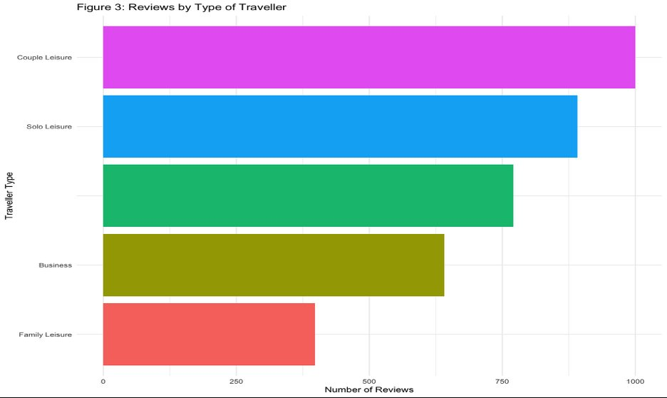
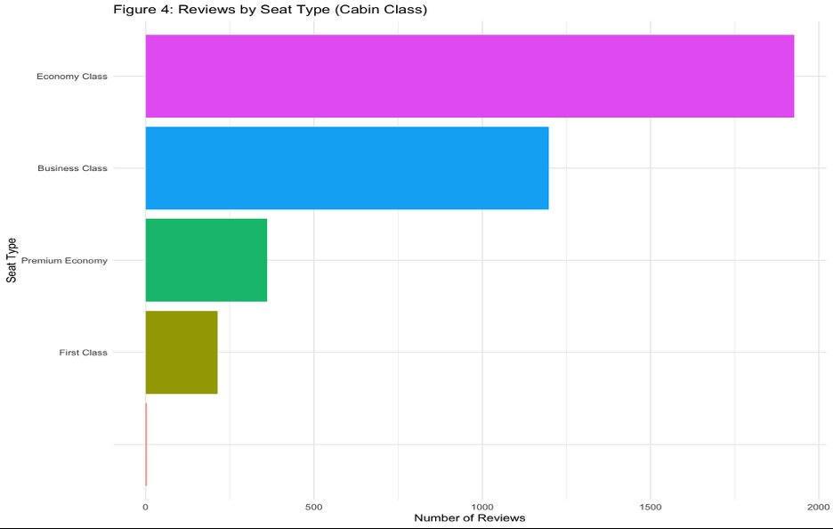
EDA — Traveler Type & Seat Class Distribution
Fig 3: Reviews by Traveler Type
Fig 4: Reviews by Seat Type (Cabin Class)
Key Findings — Addresses RQ2:
Couple Leisure (1,000) & Solo Leisure (891) are most represented — skewing toward personal/vacation travelers
Economy Class dominates with 1,927 reviews (52.1%) — over double Business Class (1,198)
Family Leisure has fewest reviews (398) — suggesting families are less likely to write reviews

Slide 7
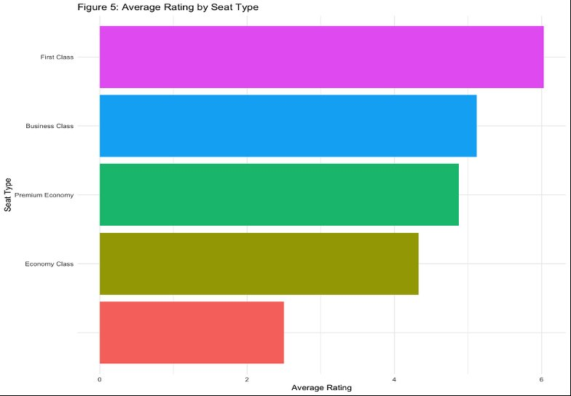
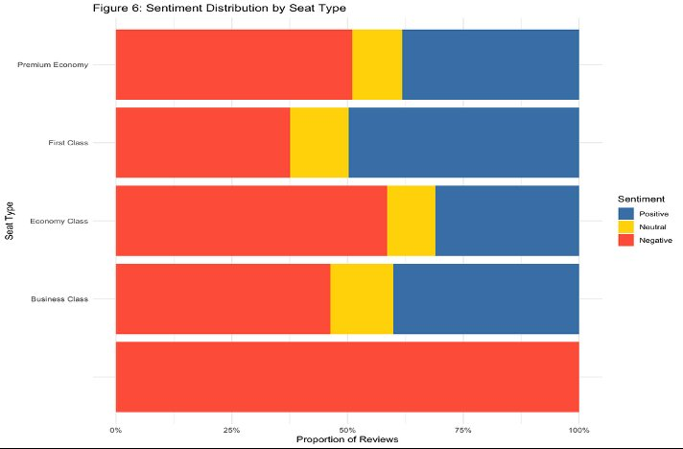
EDA — Average Rating & Sentiment by Seat Type
Fig 5: Average Rating by Seat Type
Fig 6: Sentiment Distribution by Seat Type
Key Findings — Addresses RQ2 & RQ4:
First Class gives highest avg rating (~6); Economy Class lowest (~4.3) — clear class-based satisfaction gap
Economy Class has the highest proportion of Negative reviews — confirms seat class as a key dissatisfaction driver
Business Class shows mixed results — some high satisfaction, but also significant negative feedback

Slide 8
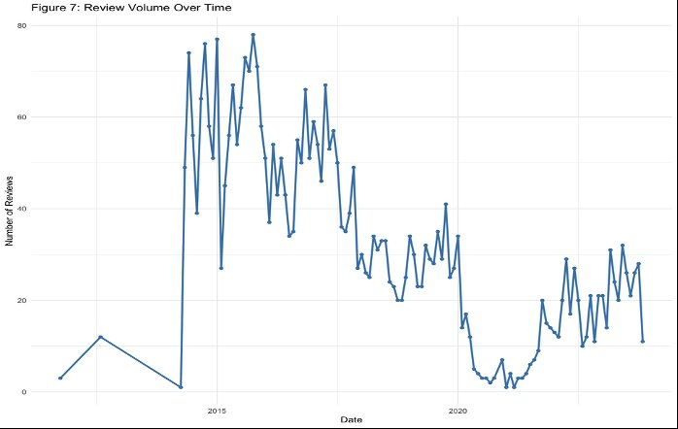
EDA — Review Volume Over Time
Fig 7: Number of Reviews Published Per Month Over Time
Key Observation:
Review volume peaked around 2014–2015, then declined significantly around 2020 — likely reflecting COVID-19 travel disruptions
Post-2021 volume remains lower than pre-pandemic levels — fewer flights = fewer reviews

Slide 9
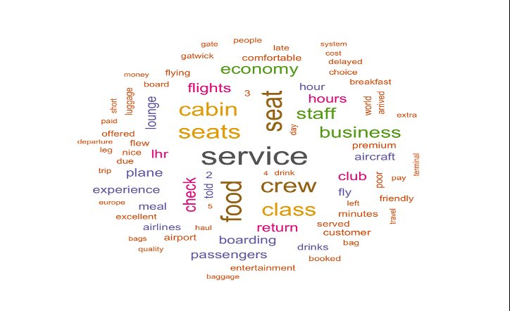
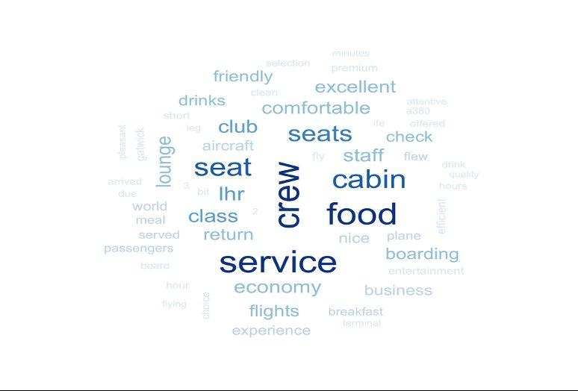
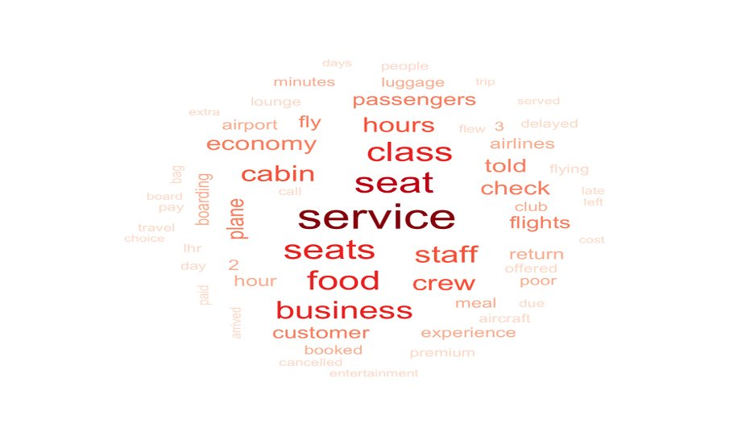
Text Analysis — Word Clouds by Sentiment
All Reviews
Positive Reviews (Rating 7–10)
Negative Reviews (Rating 1–4)
Key Findings — Addresses RQ4:
Positive reviews: 'excellent,' 'comfortable,' 'friendly,' 'crew,' 'food' — staff and comfort are praised most
Negative reviews: 'poor,' 'delay,' 'told,' 'cancelled,' 'class,' 'boarding' — delays and economy experience dominate
Both sets share 'seat,' 'service,' 'staff' — these are the core dimensions passengers evaluate regardless of sentiment

Slide 10
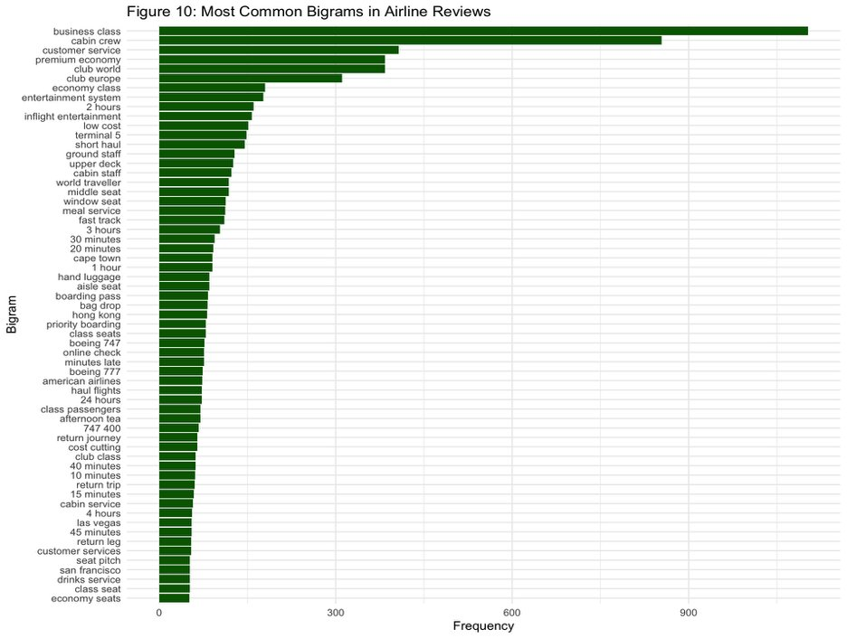
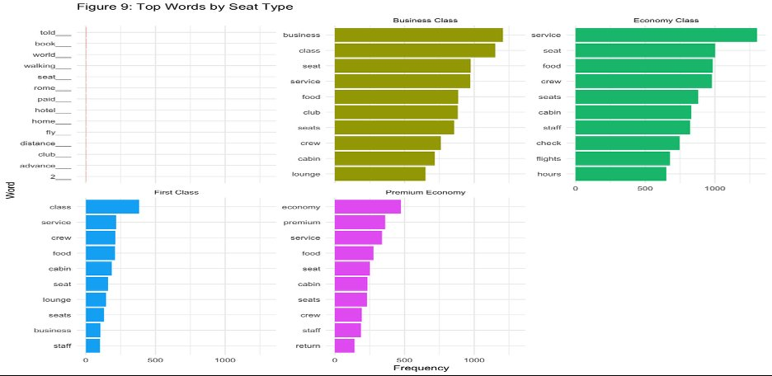
Text Analysis — Bigrams & Top Words by Seat Type
Fig 10: Most Common Bigrams in BA Reviews
Fig 9: Top Words by Seat Type

Slide 11
Text Mining Methods Applied
01
02
03
04
Naive Bayes
Classification
K-Nearest
Neighbors (KNN)
Lexicon-Based
Sentiment
LDA Topic
Modeling
Probabilistic classifier based on Bayes' Theorem. Binary DTM representation + Laplace smoothing.
Instance-based classifier using Euclidean distance. k=5 initial, cross-validation to find best k.
Bing, AFINN, NRC dictionaries applied to tokenized words. No labeled training data required.
Unsupervised probabilistic model. k=3 topics trained on DTM. Top terms per topic extracted & interpreted.
Addresses: RQ5
Addresses: RQ5
Addresses: RQ3
Addresses: RQ1, RQ4
Classification
Classification
Classification
Clustering

Slide 12
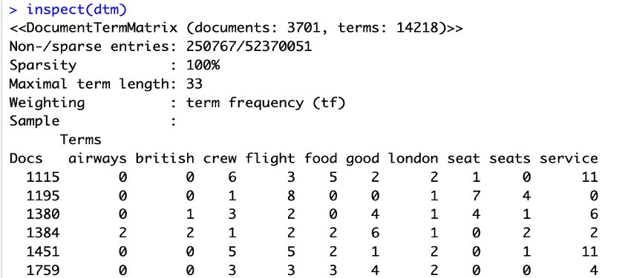
Document-Term Matrix (DTM) — Foundation for All Models
Fig 1a: Sample of DTM — 3,701 documents × 14,218 terms
What the DTM tells us:
3,701 documents (reviews) × 14,218 unique terms after stopword removal
Sparsity = 100% — most reviews only contain a small subset of all terms (expected for text data)
Sparse terms removed before modeling to reduce noise and improve classifier performance
Term frequency (tf) weighting used — each cell shows how many times a word appears in that review

Slide 13
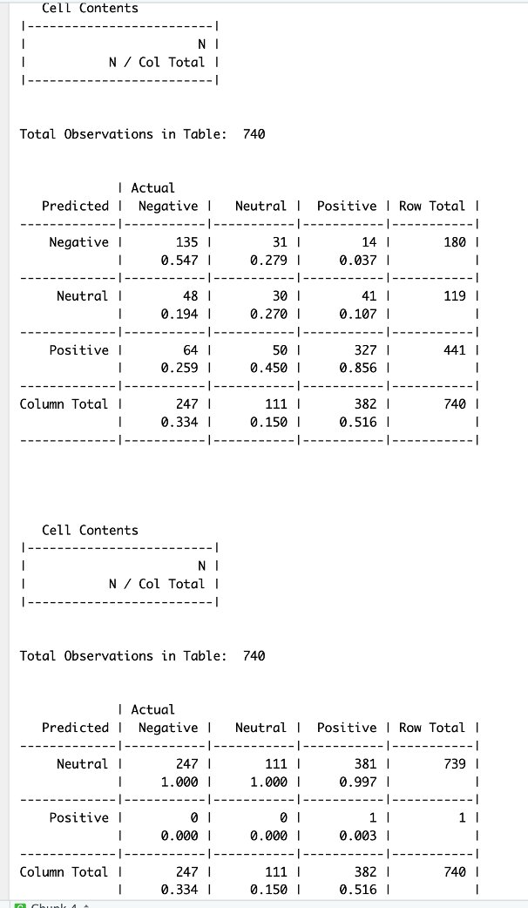
Results — Naive Bayes Classification
Addresses RQ5: Can review text predict customer satisfaction?
Model Performance
66.4%
Overall Accuracy
Positive class:
85.6% recall (327/382)
Negative class:
54.7% recall (135/247)
Neutral class:
27.0% recall — hardest
Laplace model:
Collapsed to Neutral — not useful
Conclusion:
Text CAN predict satisfaction for strong positive/negative cases
Fig 1b: Naive Bayes Confusion Matrix (top: standard, bottom: Laplace smoothing)

Slide 14
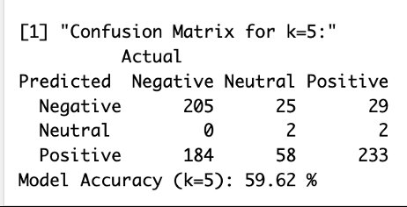
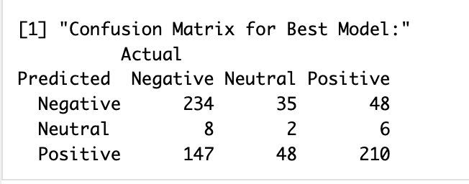
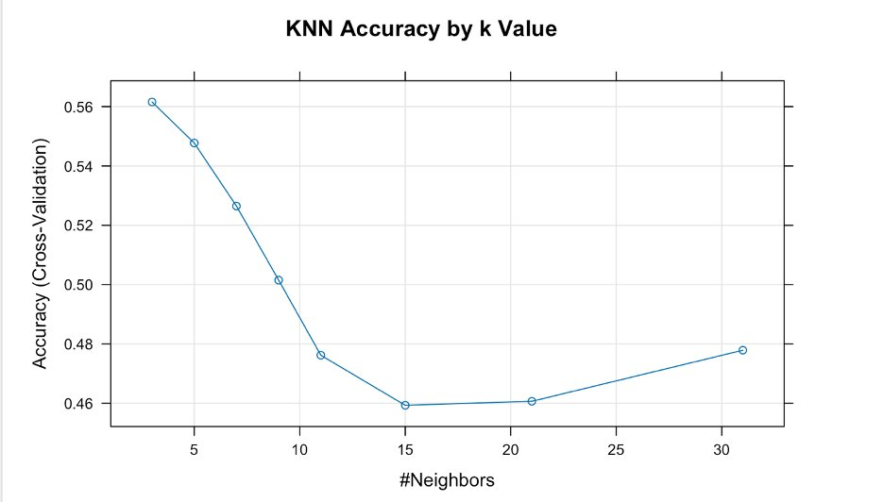
Results — KNN Classification
Addresses RQ5: Comparative classification performance
Fig 2a: KNN Confusion Matrix (k=5) — 59.62% accuracy
Fig 2c: Best Model Confusion Matrix
Key Findings:
k=5 selected as initial benchmark (standard starting value for text datasets)
Cross-validation tested k=1 to 30 — accuracy peaked near k=3 (~56.5%)
High-dimensional DTM (14,218 terms) hurts KNN — sparse space weakens distance metrics
Neutral class almost entirely misclassified (2/87 correct)
Naive Bayes (66.4%) outperforms KNN (59.62%) on this task
Fig 2b: KNN Accuracy by k Value (cross-validation)

Slide 15
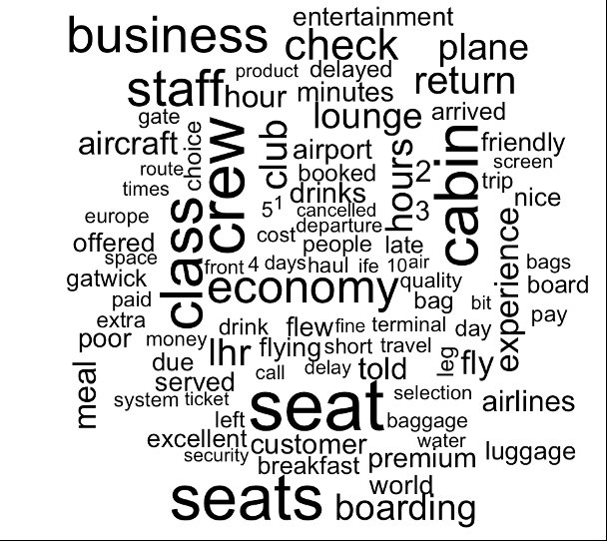
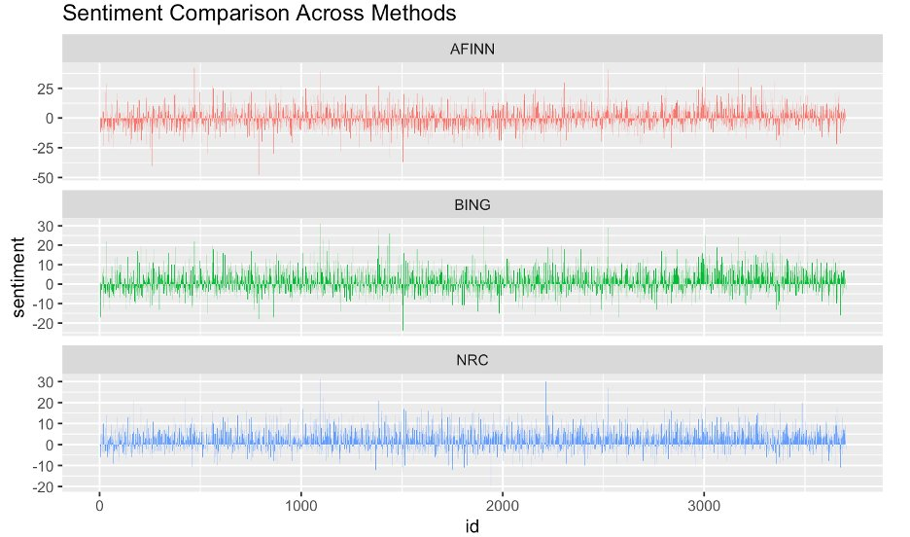
Results — Lexicon-Based Sentiment Analysis
Addresses RQ3: How does textual sentiment relate to numerical ratings?
Fig 3a: Word Cloud — Most Frequent Terms
Fig 3b: Sentiment Comparison — AFINN / Bing / NRC
Key Findings — Addresses RQ3 & RQ4:
AFINN & Bing: majority of reviews carry net negative sentiment — consistent with 45.8% of ratings being 1–3
Low ratings (1–4) → negative AFINN/Bing scores | High ratings (7–10) → positive scores
Mid-range ratings (5–6): mixed language — explains why Neutral class is hardest for all classifiers
NRC emotions: 'anger' and 'disgust' cluster in delay-related reviews; 'trust' and 'joy' in Business Class reviews

Slide 16
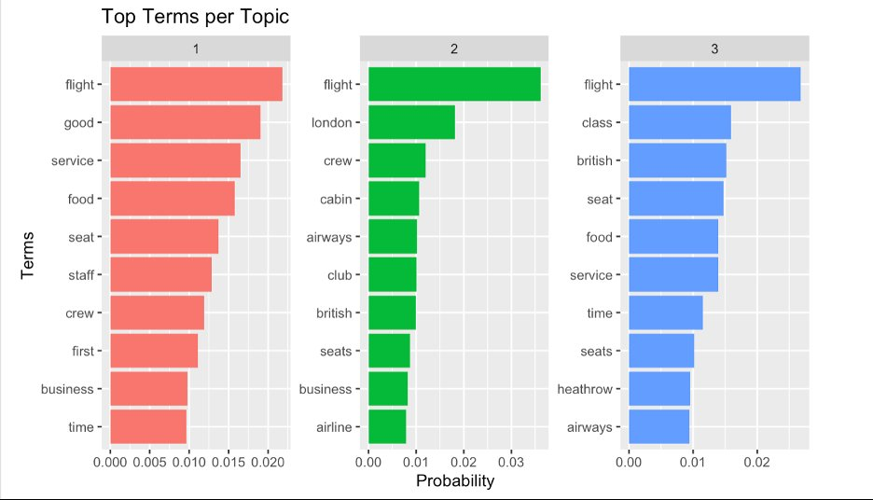
Results — LDA Topic Modeling
Addresses RQ1 & RQ4: What are the dominant themes? What drives negative feedback?
Topic 1
Overall, Flight Experience & Service Quality
flight, good, service, food, seat, staff, crew, first, business, time
Topic 2
Airline Operations & Business Class
flight, london, crew, cabin, airways, club, british, seats, business, airline
Topic 3
Airport, Seating & Travel Time
flight, class, british, seat, food, service, time, seats, heathrow, airways
'Heathrow' in Topic 3 = airport experience is a distinct complaint driver → directly answers RQ4
Fig 4: Top Terms per Topic (LDA, k=3 topics)

Slide 17
Summary of Findings — All Research Questions Answered
RQ1
3 dominant themes via LDA: Service Quality, Business Class Operations, Airport/Economy Experience
RQ2
Economy class passengers have highest proportion of negative reviews; First/Business class are more satisfied
RQ3
Textual sentiment (AFINN/Bing) broadly aligns with ratings; misalignment highest for mid-range (5–6) Neutral reviews
RQ4
Top negative drivers: delays, staff behavior, seat comfort, and Heathrow airport experience
RQ5
Naive Bayes (66.4%) and KNN (59.62%) both confirm review text can predict sentiment — especially for extreme cases

Slide 18
Discussion & Real-World Applications
Business Applications
Limitations & Future Work
Auto-classify incoming reviews by sentiment → route to the right service team in real time
Track sentiment trends after service changes to measure improvement
Flag high-priority negative reviews for executive attention
Economy Class identified as top investment priority for satisfaction improvement
Heathrow-specific complaints → target airport partnership improvements
Mid-range (Neutral) customers represent a conversion opportunity with targeted follow-up
This pipeline scales to any airline — not just British Airways
Bag-of-words ignores word order, context, sarcasm, and negation
Neutral class underrepresented (11.6%) → class imbalance hurts all classifiers
General lexicons miss airline-specific language nuances
Future: TF-IDF weighting to improve classifier performance
Future: BERT/Word2Vec embeddings for semantic understanding
Future: SMOTE oversampling to address class imbalance
Future: Multi-airline comparison (Delta, United, Ryanair) to generalize findings

Slide 19
Conclusion
Applied a complete text analytics pipeline to 3,701 British Airways customer reviews in R — from raw text to actionable insights
LDA topic modeling (k=3) identified 3 key themes: service quality, business class operations, and airport/economy experience — directly answering RQ1
Lexicon-based sentiment analysis (AFINN/Bing/NRC) confirmed textual sentiment broadly aligns with numerical ratings — answering RQ3
Naive Bayes achieved 66.4% accuracy; KNN achieved 59.62% — both demonstrating automated sentiment prediction from review text is feasible — answering RQ5
Economy Class passengers and Heathrow airport are the primary drivers of negative feedback — answering RQ2 & RQ4
Unstructured review text contains richer insights than star ratings alone — airlines can use this pipeline to monitor satisfaction at scale and make data-driven service improvements
Future work: deep learning models (BERT), larger multi-airline datasets, class balancing techniques

Slide 20
References
Chaudhary, A., & Risinahani, M. (2023). Airline reviews [Data set]. Kaggle. https://doi.org/10.34740/KAGGLE/DS/404107
Lacic, E., Kowald, D., & Lex, E. (2016). High enough? Explaining and predicting traveler satisfaction using airline reviews. arXiv:1604.00942.
Srinivas, S., & Ramachandiran, S. (2020). Discovering airline-specific business intelligence from online passenger reviews: An unsupervised text analytics approach. arXiv:2012.08000.
Wickham, H., & Grolemund, G. (2017). R for Data Science. O'Reilly Media.
Yakut, I., et al. (2015). Predicting airline customer satisfaction using online reviews. arXiv:1512.03632.
Skytrax. (n.d.). Airline customer reviews. https://www.airlinequality.com

