Slide 1

Exploratory Data Analysis on Credit Card Approval Understanding Patterns, Distributions, and Approval Decisions
Niranjan K C CIS 468 Dr. McGuire Spring 2026

Slide 2
Why Credit Card Approval Matters
Credit approval affects financial access and opportunity
Incorrect decisions can lead to financial risk or missed potential
Data-driven insights help improve decision-making
Understanding applicant data is critical for accurate approvals
How can we identify patterns that influence approval decisions?

Slide 3

Analysis Goals & Research Questions
Goals:
Understand distributions of key variables
Identify skewness and outliers
Explore relationships between variables
Analyze patterns in approval outcomes
Research Questions:
Are financial variables normally distributed?
Is there a relationship between Income and Debt?
Does Debt influence approval decisions?
Do approval rates vary across industries?

Slide 4
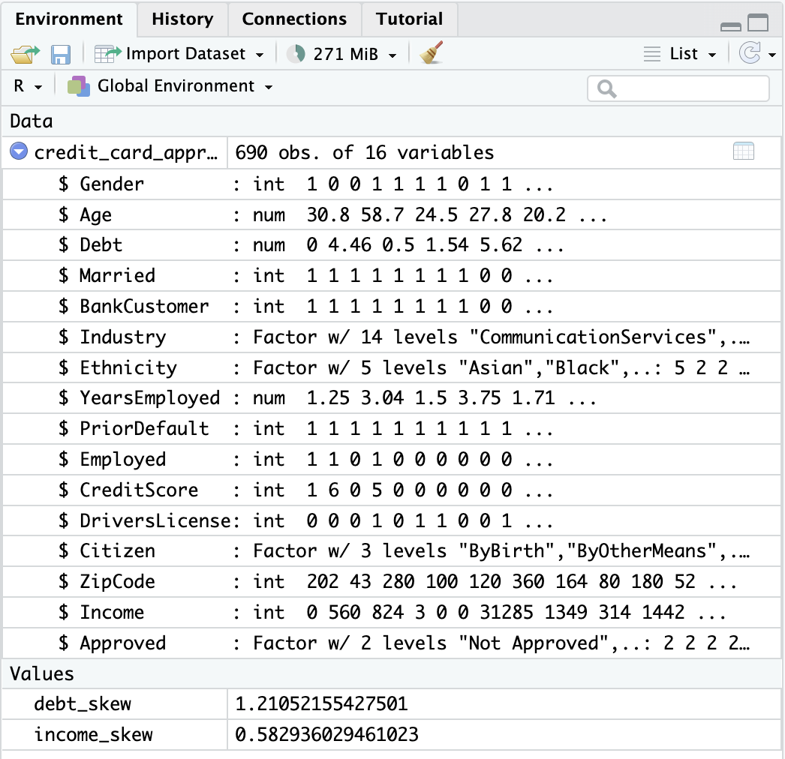
Dataset Overview
690 credit card applications
16 attributes (numeric + categorical)
Target variable: Approved (Approved / Not Approved)
Key Variables:
Debt (numeric – primary attribute)
Income (numeric)
Credit Score (numeric)
Industry (categorical)
Approved (categorical – binary outcome)
Focus: Understanding distributions and relationships

Slide 5
Methods
Descriptive Analysis
• Mean, median, and standard deviation
• Minimum and maximum values
• Histograms to examine shape
• Skewness to detect asymmetry
• Boxplots to identify outliers
Distribution Analysis
Relationship Analysis
• Scatter plot (Income vs Debt)
• Correlation analysis
Categorical Analysis
• Bar charts for frequency distribution
• Comparison across approval status

Slide 6
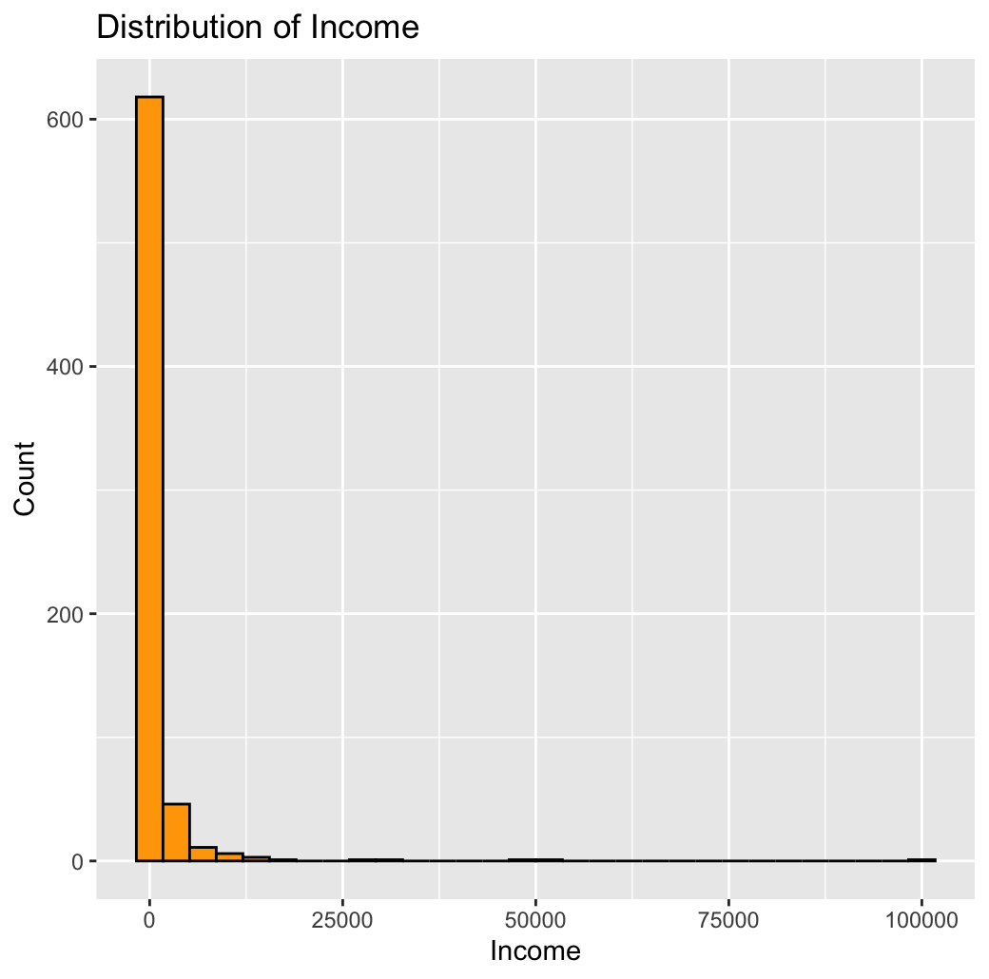
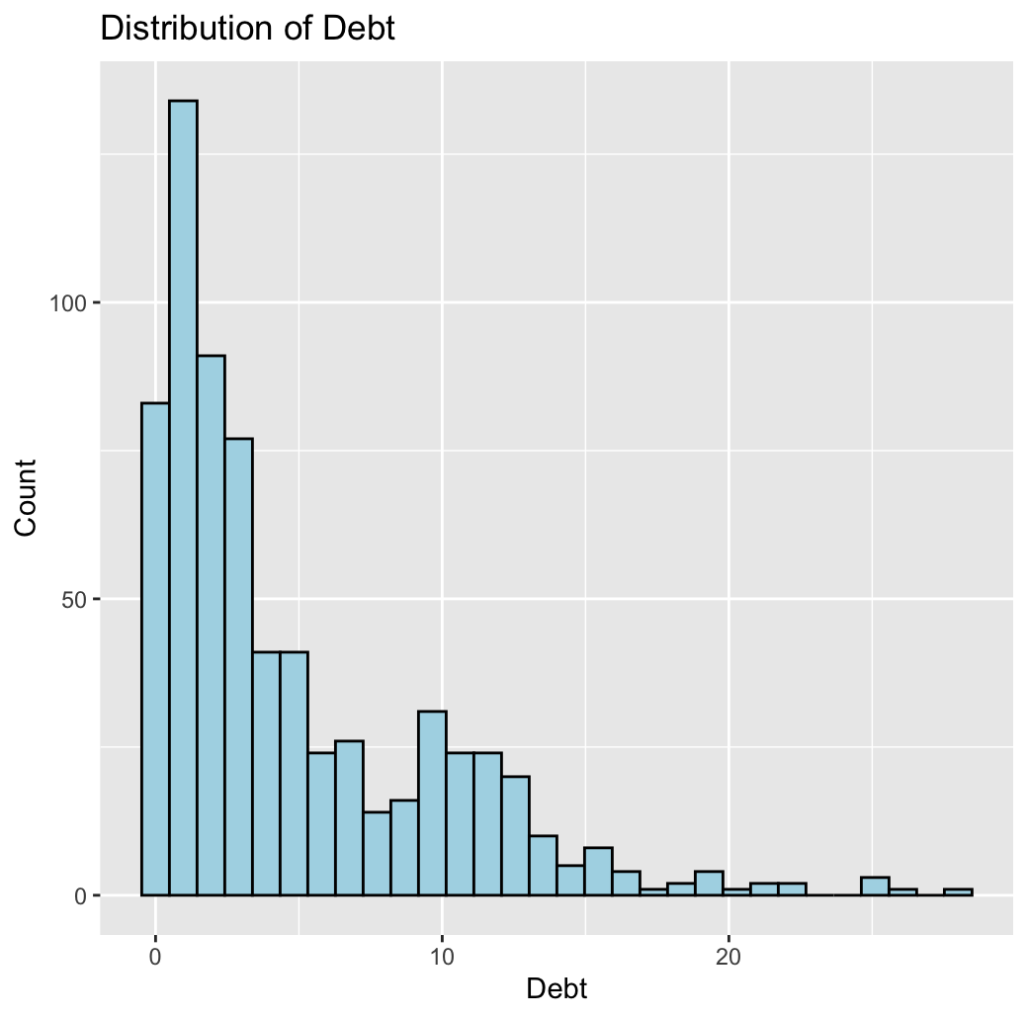
Data Characteristics & Quality Issues
Key Data Characteristics
Income is highly right-skewed
Debt shows moderate right-skew
Credit Score is heavily concentrated near zero
Presence of extreme outliers (e.g., Income up to 100,000)
Data Quality Considerations
Skewed distributions violate normality assumptions
Outliers may influence mean and correlation results
Some variables show limited variation (e.g., Credit Score)
Potential zero-inflation in financial attributes

Slide 7
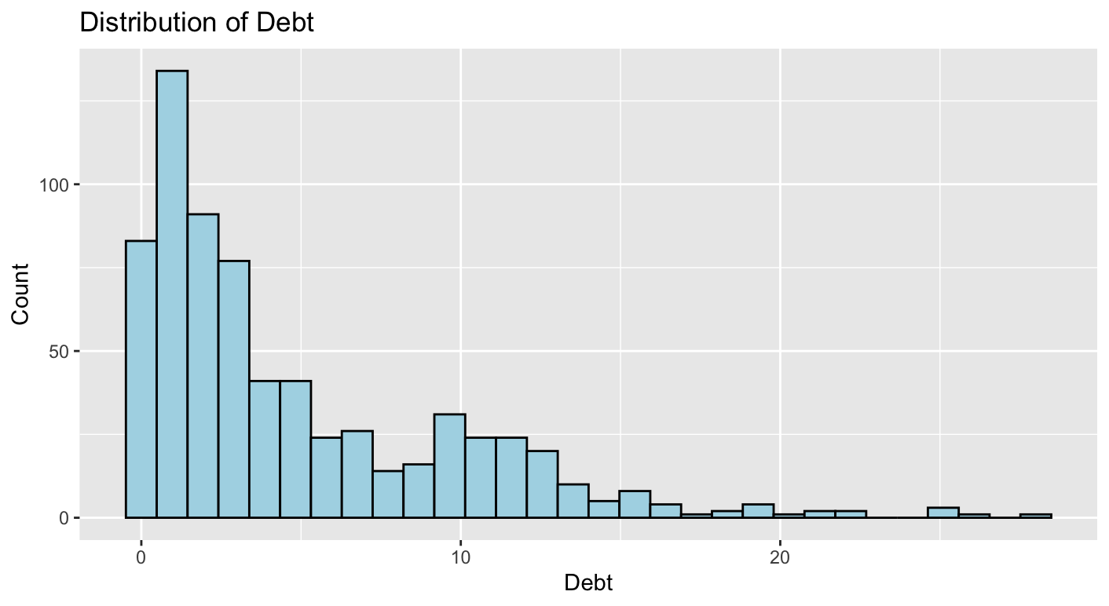
Univariate Analysis – Debt (Primary Attribute)
Key Statistics
Range: 0 to 28
Mean: 4.76
Median: 2.75
Skewness: 1.21 (right-skewed)
Key Insights
Mean > Median → indicates right-skewness
Most applicants have low debt values
Presence of high-value debt outliers
Mean may not represent typical applicants
Debt Distribution (Right-Skewed with Outliers)

Slide 8
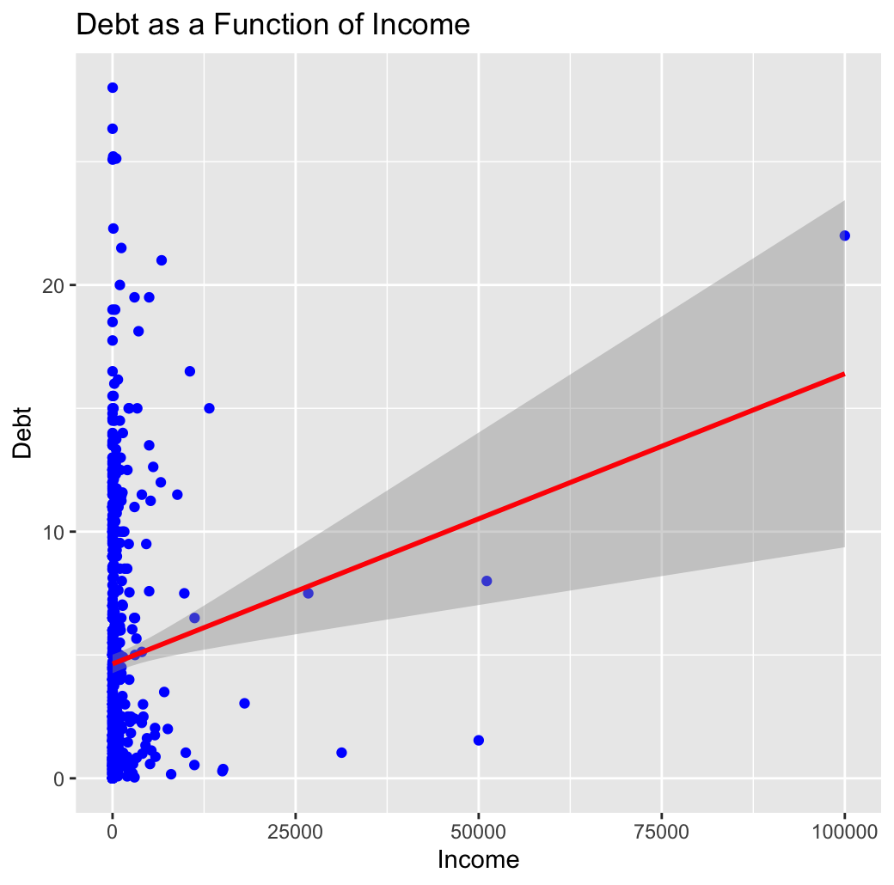
Bivariate Analysis – Income vs Debt
Key Observations
Weak relationship between Income and Debt
No clear linear pattern observed
High-income individuals do not always have low debt
Some low-income applicants also carry high debt
Statistical Insight
Correlation appears weak (near 0)
Indicates Income alone is not a strong predictor of Debt
Interpretation
Debt behavior varies across individuals
Other factors (e.g., employment, credit history) may play a role
Simple linear assumptions may not hold

Slide 9
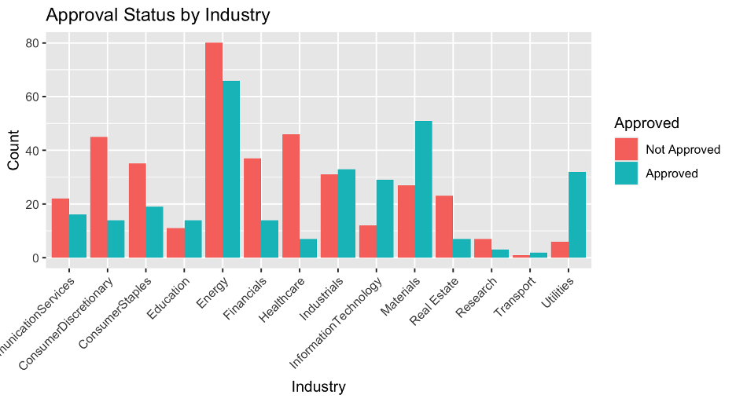
Categorical Analysis – Approval by Industry
Key Observations
Approval rates vary significantly across industries
Some industries show higher approval counts
Others have more rejections than approvals
Pattern Insight
Industry appears to influence approval outcomes
Certain sectors may be considered lower risk
Others may have higher financial uncertainty
Interpretation
Approval decisions are not uniform across applicants
Industry can be an important factor in risk assessment
Suggests the need for industry-aware decision models

Slide 10


Key Findings
Income and Debt distributions are right-skewed
Outliers affect statistical measures (e.g., mean and correlation)
Weak relationship between Income and Debt
Industry significantly influences approval outcomes
Credit decisions depend on multiple factors, not a single variable

Slide 11

Conclusion & Takeaways
Credit approval decisions are complex and multifactorial
No single variable fully explains approval outcomes
Combining multiple factors improves decision accuracy
Data-driven approaches are essential for risk assessment
Insights can support better financial decision-making

Slide 12

Thank you !! you!

Slide 13
Reference
Kaggle. (n.d.). Credit card approval dataset. https://www.kaggle.com/datasets/samuelcortinhas/credit-card-approval-clean-data
Stock image from pptx

