Slide 1
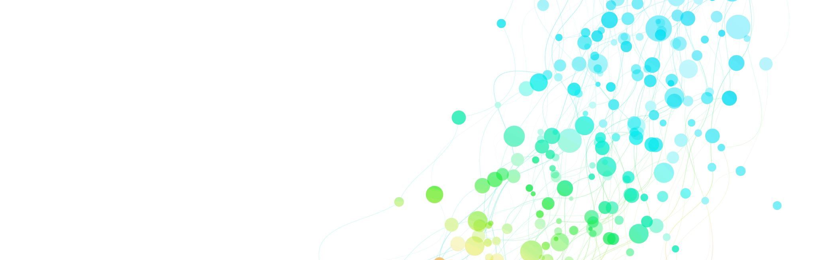
CIS 328
Team Project Final Presentation
Topic: Exercise Behavior and Body Metrics Analysis
Team Members:
Jivitesh
Niranjan
Pradip Date: May 9, 2025 Instructor: Prof. Jinjuan Feng

Slide 2
Project Introduction & Dataset Overview
This project explores how different workout routines, member demographics, and fitness habits influence health outcomes like BMI, fat percentage, and resting heart rate.
Understanding these relationships can help:
Personalize fitness plans
Improve training outcomes
Reduce health risks through targeted workouts
Goal: Use data to uncover trends and recommend more effective workout strategies for diverse gym members.

Slide 3
Dataset Description
Source: Kaggle – Gym Members Exercise Dataset
Size: ~973 entries
Key Attributes:
Demographics: Age, Gender
Body Metrics: BMI, Fat Percentage
Workout Habits: Type, Frequency, Duration
Outcomes: Calories Burned, Resting Heart Rate, Active BPM
Useful for analyzing how behavior (workouts) links to physical outcomes

Slide 4

Summary Statistics
| **Feature** | **Mean** | **Median** | **Std Dev** | **Min** | **Max** |
| **Age** | 38.68 | 40.00 | 12.18 | 18.00 | 59.00 |
| **Weight (kg)** | 73.85 | 70.00 | 21.21 | 40.00 | 129.90 |
| **Height (m)** | 1.72 | 1.71 | 0.13 | 1.50 | 2.00 |
| **Max\_BPM** | 179.88 | 180.00 | 11.53 | 160.00 | 199.00 |
| **Avg\_BPM** | 143.77 | 143.00 | 14.35 | 120.00 | 169.00 |
| **Resting\_BPM** | 62.22 | 62.00 | 7.33 | 50.00 | 74.00 |
| **Session hours | 1.26 | 1.26 | 0.34 | 0.50 | 2.00 |
| **Calories\_Burned** | 905.42 | 893.00 | 272.64 | 303.00 | 1783.00 |
| **Fat\_Percentage** | 24.98 | 26.20 | 6.26 | 10.00 | 35.00 |
| **Water\_Intake (liters) | 2.63 | 2.60 | 0.60 | 1.50 | 3.70 |
| **Workout(days/week) | 3.32 | 3.00 | 0.91 | 2.00 | 5.00 |
| **Experience\_Level** | 1.81 | 2.00 | 0.74 | 1.00 | 3.00 |
| **BMI | 24.91 | 24.16 | 6.66 | 12.32 | 49.84 |

Slide 5
Research Questions
Research Question:
Does the number of calories burned significantly differ based on the type of workout?
Hypotheses:
• Null (H₀): There is no significant difference in mean calories burned across workout types (Cardio, HIIT, Strength, Yoga).
• Alternative (H₁): At least one workout type has a different mean number of calories burned.
Research Question:
Is there a significant difference in body fat percentage based on how many days per week someone works out?
Hypotheses:
• Null (H₀): There is no significant difference in mean fat percentage across workout frequencies (2, 3, 4, or 5 days/week).
• Alternative (H₁): At least one frequency group has a different mean fat percentage.

Slide 6
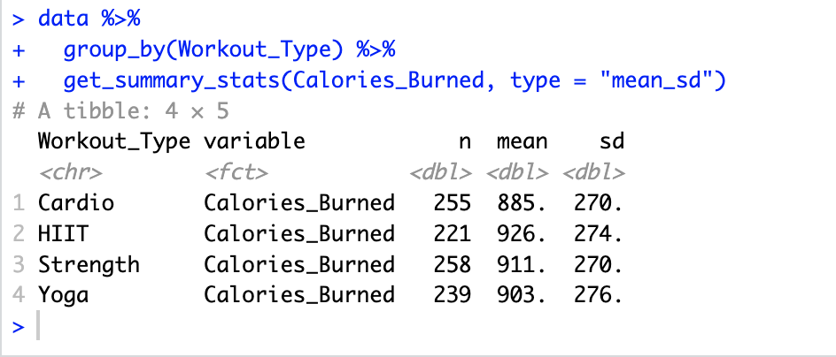
R Code and Slide Content for Presentation - (ANOVA Testing) ANOVA Test 1 – Calories Burned by Workout Type
# Descriptive statistics data %>% group_by(Workout_Type) %>% get_summary_stats(Calories_Burned, type = "mean_sd")
Displays the mean and standard deviation of calories burned for each workout type.
Output Summary:
The mean calories burned were highest in the HIIT group (926 kcal), followed by Strength (911 kcal), Yoga (903 kcal), and Cardio (885 kcal). Although there are differences in the group means, the standard deviations are similar across all groups, indicating relatively consistent variation.

Slide 7
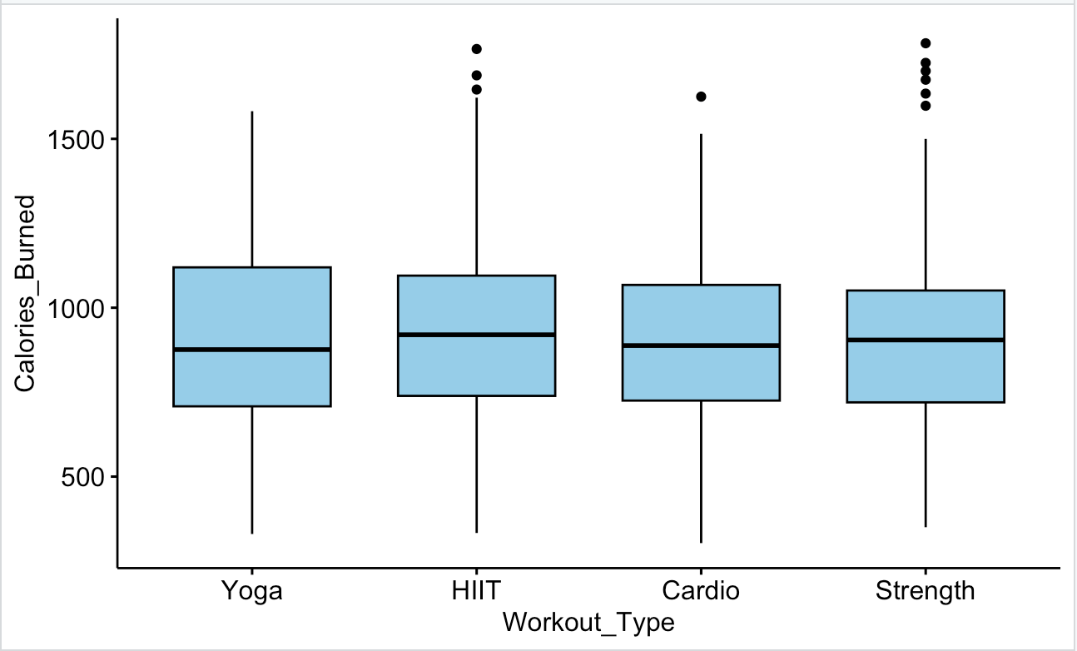
# Boxplot ggboxplot(data, x = "Workout_Type", y = "Calories_Burned", fill = "skyblue") Boxplot showing distribution of calories burned by workout type. Outlier detection within each workout group. Most were not extreme.
Output Summary
· Boxplot shows median, and variation of calories burned by workout type
· Median calories burned is slightly higher for HIIT and Strength groups
· All workout types have a similar spread (IQR), with visible outliers
· HIIT and Strength have more upper outliers (burning high calories)
· Suggests variation in performance within those groups

Slide 8
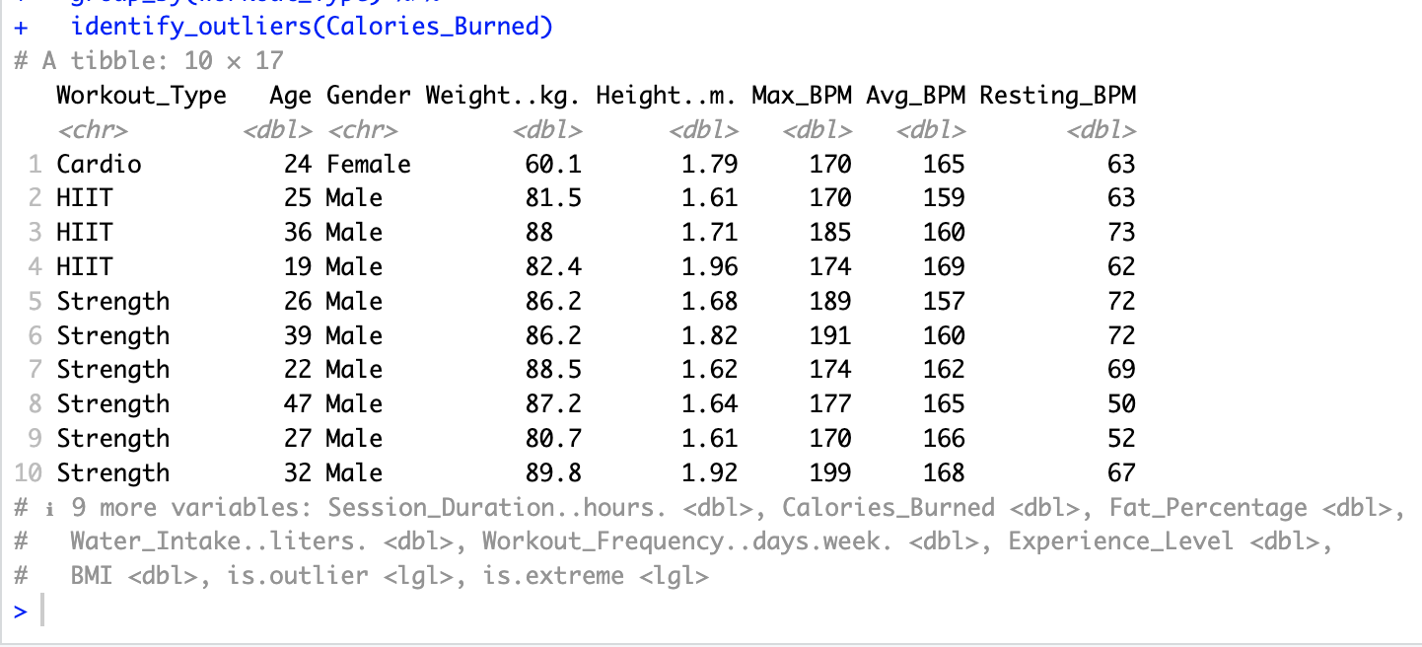
# Outliers data %>% group_by(Workout_Type) %>% identify_outliers(Calories_Burned). Outliers may reflect higher individual performance or reporting variation
Output Summary
Outliers were identified in all workout groups
Strength group showed the highest number of outliers
Most outliers were not extreme, so assumption is still considered valid

Slide 9
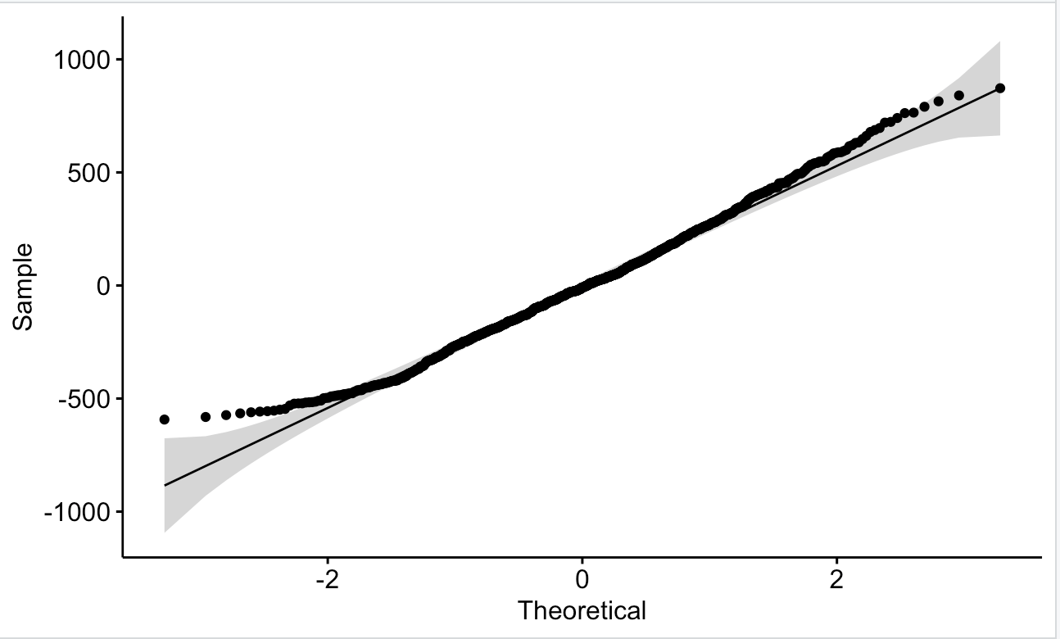
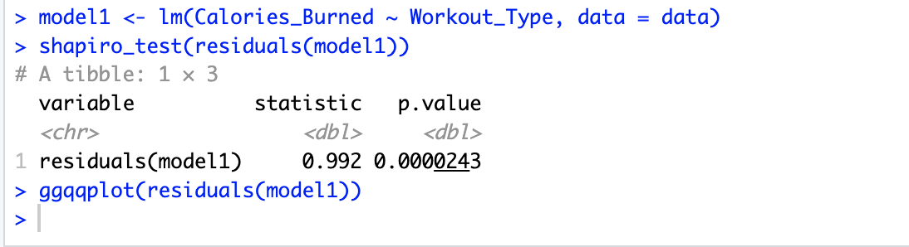
# Normality model1 <- lm(Calories_Burned ~ Workout_Type, data = data) shapiro_test(residuals(model1)) ggqqplot(residuals(model1)) Shapiro-Wilk test and QQ plot used to assess normality of ANOVA residuals.
Summary Output:
The p-value from the Shapiro-Wilk test is less than 0.05, suggesting the residuals are not perfectly normal.
However, the QQ plot shows that the residuals align reasonably well with the theoretical normal line, so the assumption is approximately met, and we can proceed with caution.

Slide 10
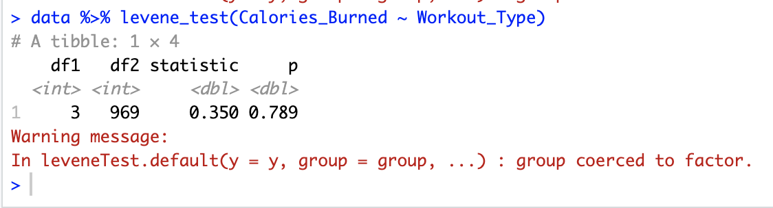
# Levene's Test data %>% levene_test(Calories_Burned ~ Workout_Type) Levene’s test used to check for homogeneity of variance. p = 0.789.
Summary Output:
p > 0.05 → Variances are equal across groups.
Assumption of homogeneity of variances is met.

Slide 11
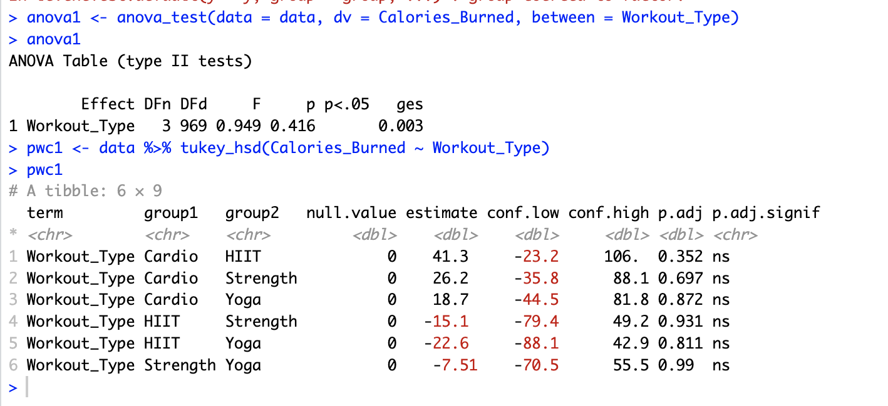
# ANOVA and Post-hoc anova1 <- anova_test(data = data, dv = Calories_Burned, between = Workout_Type) pwc1 <- data %>% tukey_hsd(Calories_Burned ~ Workout_Type) ANOVA test showed no significant difference (p = 0.416). Post-hoc Tukey’s test showed no significant pairwise differences. Though not needed to test.
Output Summary:
ANOVA Table:
F(3, 969) = 0.949
p = 0.416
ges = 0.003 → Not statistically significant (p > 0.05)
Tukey’s Post-Hoc Comparison:
All pairwise comparisons show p.adj > 0.05 → Not significant → Confirms no meaningful differences between any workout types

Slide 12
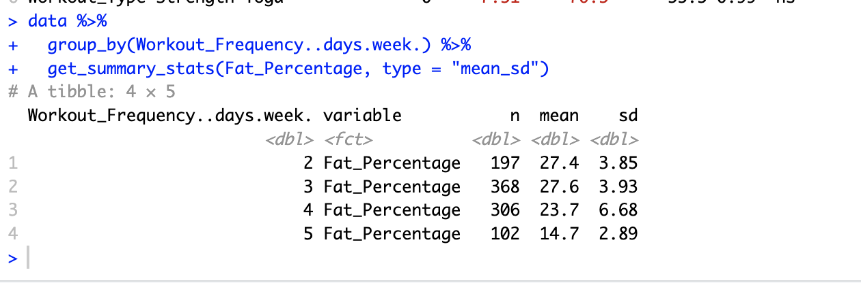
ANOVA Test 2 – Fat % by Workout Frequency
# Descriptive statistics data %>% group_by(Workout_Frequency..days.week.) %>% get_summary_stats(Fat_Percentage, type = "mean_sd")
Displays the mean and standard deviation of fat percentage by workout frequency.
Output Summary:
The average fat percentage decreases with increased workout frequency.
2–3 days/week: ~27.5% body fat
4 days/week: ~23.7%
5 days/week: ~14.7%
The standard deviation is slightly higher for 4 days/week, suggesting more variability in that group.
This descriptive summary suggests that working out more frequently may be associated with lower body fat.

Slide 13
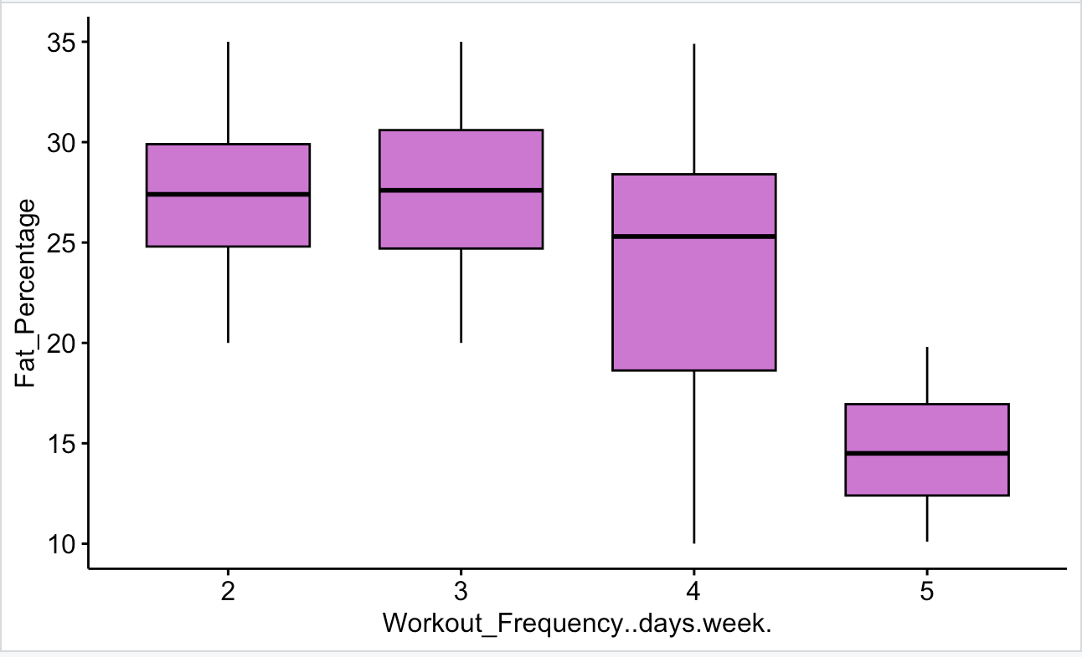
# Boxplot ggboxplot(data, x = "Workout_Frequency..days.week.", y = "Fat_Percentage", fill = "orchid") Boxplot of fat percentage grouped by workout frequency.
Output Summary:
Median body fat percentage decreases as workout frequency increases.
The lowest median is observed in those who work out 5 days/week.
The spread (IQR) for 4 days/week is wider, indicating more variability.
Outliers are minimal, suggesting that most data fall within a consistent range.
This visual reinforces the idea that higher workout frequency may lead to lower body fat.

Slide 14
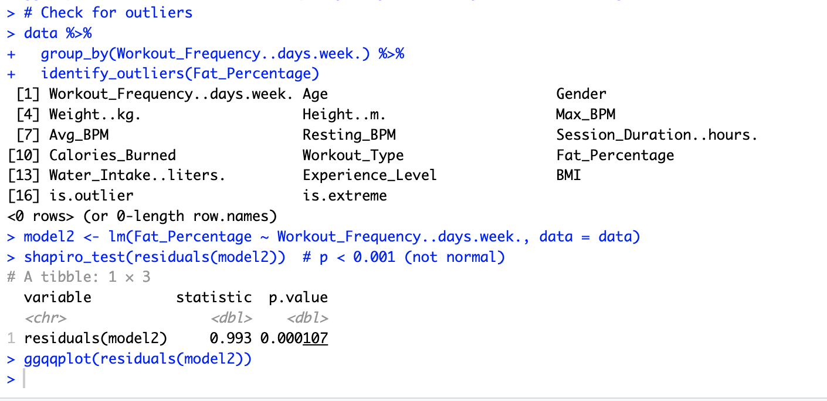
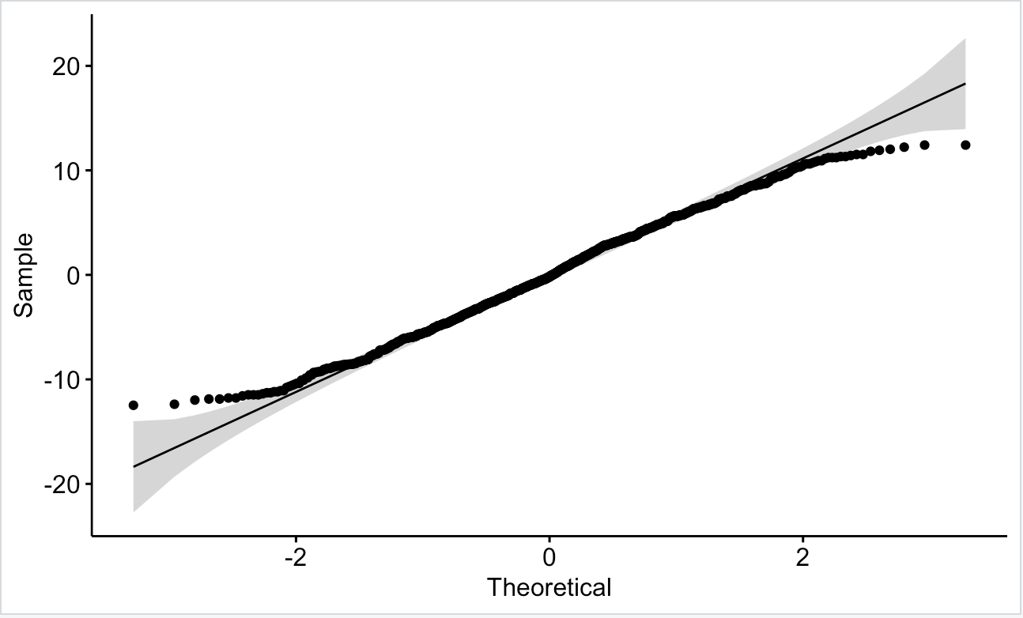
# Outliers & Normality data %>% group_by(Workout_Frequency..days.week.) %>% identify_outliers(Fat_Percentage) model2 <- lm(Fat_Percentage ~ Workout_Frequency..days.week., data = data) shapiro_test(residuals(model2)) ggqqplot(residuals(model2)) No extreme outliers found. Normality tested with Shapiro-Wilk and QQ plot.
Output Summary
Outliers Check: No extreme outliers were found for fat percentage across workout frequencies.
Normality Test (Shapiro-Wilk): The p-value was < 0.001, indicating the residuals are not normally distributed.
QQ Plot: Despite the low p-value, the data points follow the trend line fairly -well, suggesting that normality is approximately met visually.

Slide 15
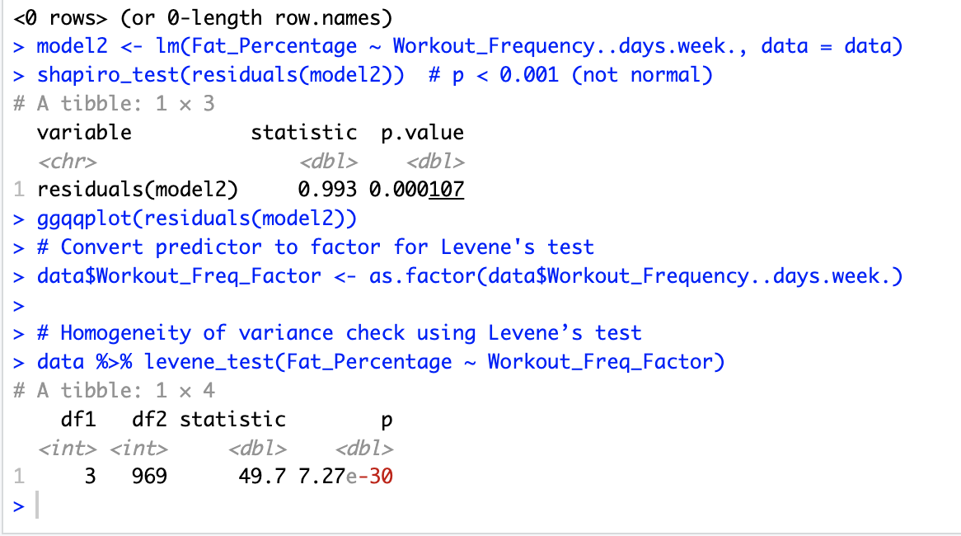
# Levene's Test data$Workout_Freq_Factor <- as.factor(data$Workout_Frequency..days.week.) data %>% levene_test(Fat_Percentage ~ Workout_Freq_Factor) Levene’s test showed p < 0.001, indicating variance inequality. Proceeded with caution.
Normality and Homogeneity of Variance Check
Levene’s Test (Homogeneity of Variance):
p-value = 7.27e-30 → This is far less than 0.05, meaning equal variances cannot be assumed.
This violates the ANOVA assumption of homogeneity.

Slide 16
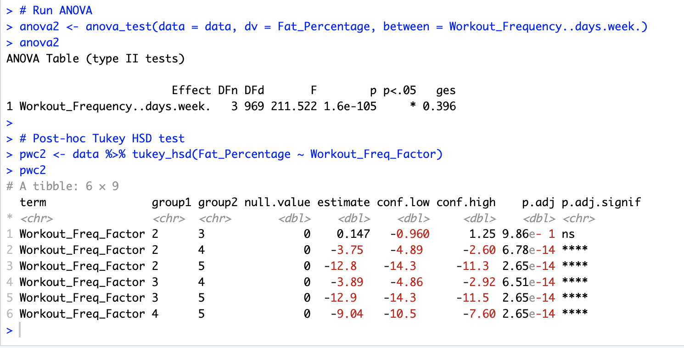
# ANOVA and Post-hoc anova2 <- anova_test(data = data, dv = Fat_Percentage, between = Workout_Frequency..days.week.) pwc2 <- data %>% tukey_hsd(Fat_Percentage ~ Workout_Freq_Factor) ANOVA found significant differences (p < 0.001). Tukey’s test revealed pairwise differences in fat percentage based on workout frequency.
Output Summary:
· ANOVA showed a significant difference in fat percentage across workout frequencies (F(3, 969) = 211.52, p < 0.001).
· Post-hoc tests revealed that those working out 4–5 days/week had significantly lower fat % than those working out 2–3 days/week.
· No difference found between 2 and 3 days/week (p = 0.986).

Slide 17
Anova Conclusion Comparison of ANOVA Results: Calories Burned vs. Fat Percentage
Calories Burned by Workout Type
• ANOVA Test Result: F(3, 969) = 0.949, p = 0.416
• Conclusion: Not statistically significant
• No meaningful difference in calories burned across different workout types.
Fat Percentage by Workout Frequency
• ANOVA Test Result: F(3, 969) = 211.52, p < 0.001
• Conclusion: Statistically significant
• Fat percentage varied significantly based on how frequently participants exercised.
Key Takeaway:
Workout type does not significantly affect calories burned.
However, workout frequency has a strong effect on body fat percentage.
Fat percentage is more clearly impacted by group differences than calories burned.

Slide 18
Multiple Regression test research question:
What predictors most significantly affect the session duration of people at the gym?
The method and all predictors used:
Method: Multiple Linear Regression Test.
All Predictors:
"Age" "Gender" "Weight_kg" "Height" "Max_BPM"
"Avg_BPM" "Resting_BPM" "Session_Duration" "Calories_Burned"
"Workout_Type" "Fat_Percentage" "Water_Intake"
"Workout_Frequency" "Experience_Level" "BMI"

Slide 19
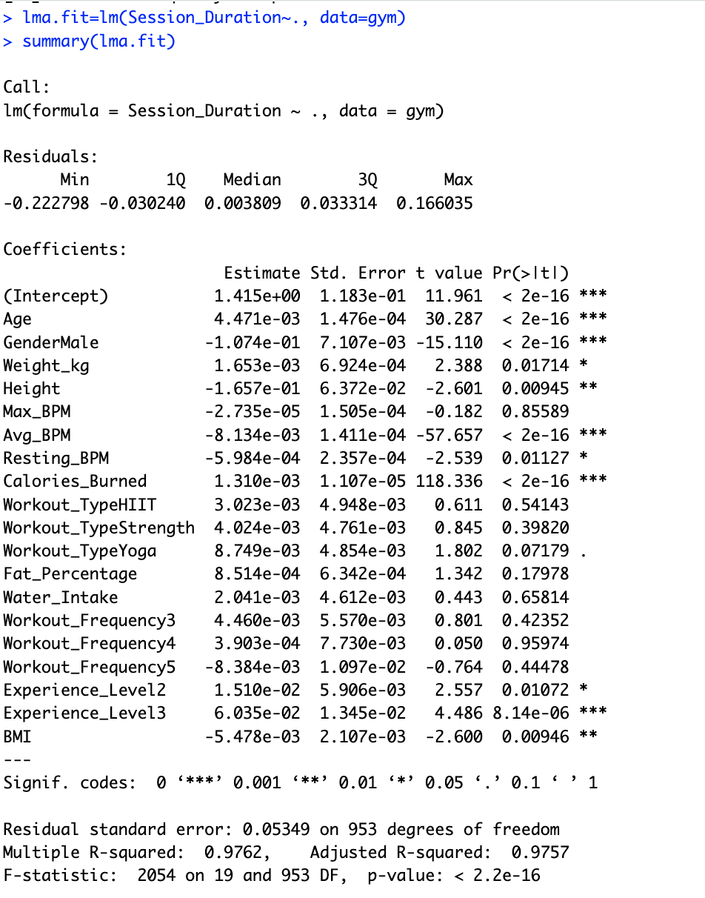
Regression equation, model summary table
Regression Equation:
Session_Duration = 1.415 + .004*Age -.1*GenderMale -.0016*Weight_kg -.16*Height -.000027*Max_BPM
-.00813*Avg_BPM -.00059*Resting_BPM + .0013*Calories_Burned +.003*Workout_TypeHITT +.004*Workout_TypeStrength
+.0087*WorkoutTypeYoga +.00085*Fat_Percentage + .002*Water_Intake + .00446*Workout_Frequency3 + .00039*Workout_Frequency4
-.0083*Workout_Frequency5 + .015*Experience_Level2 + .06*Experience_Level3 - .0054*BMI.
F-stat & R: F-stat(19, 953) = 2054 & Required = .9757
All 14 predictors combined explain 97.57% of variance in Session_Duration.

Slide 20
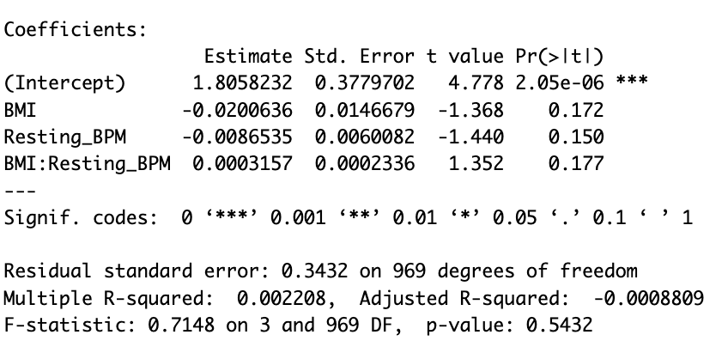
Interaction terms and their R² and F
First Interaction Terms used:
BMI & Resting_BPM on Session_Duration
# The regression model shows that neither of BMI and Resting_BPM have any relationship with Session_Duration.
# There is no significant interaction effect between Resting_BPM and BMI on Session_Duration (p-value = .17)
# F(3, 969)=.7, p-value = .54 Adjusted R-Squared = -.088%

Slide 21
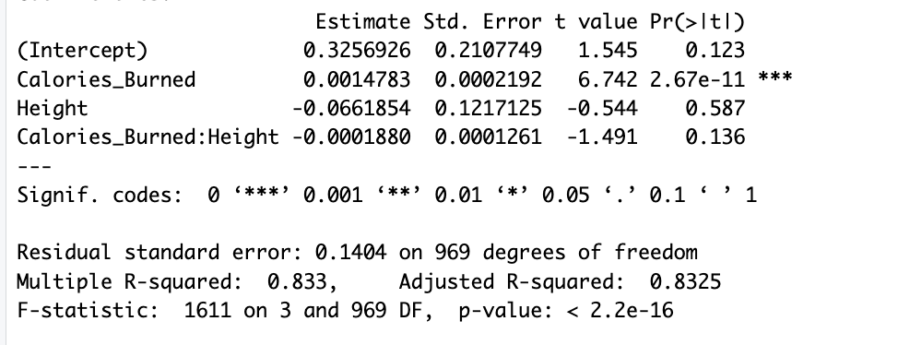
Second Interaction Terms used:
Calories_Burned & Height on Session_Duration
lmi2.fit = lm(Session_Duration~Calories_Burned*Height, data = gym)
summary(lmi2.fit)
# Height doesn't have relation with Session_Duration however Calories_Burned does with(0.0001<p-value).
# There is no significant interaction effect between Height and Calories_Burned on Session_Duration. p-value = .13
# Together Adjusted r squared is .8325 and F-statistic: (3, 969)=1611
# p <0.0001. The model explains 83.25% of variance in Session_Duration.

Slide 22
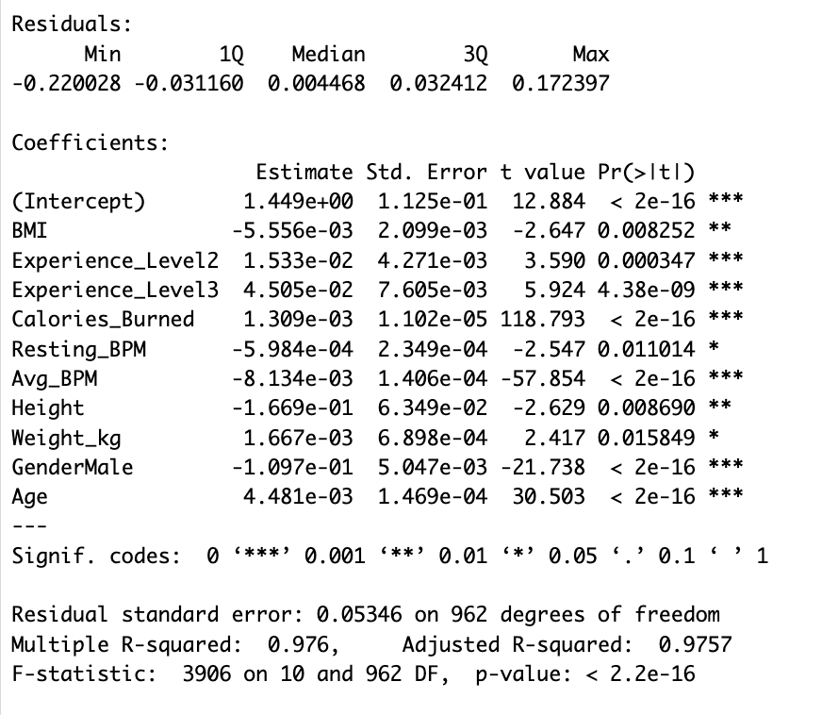
2nd Model with significant predictors:
F-stat & R:
F statistics (10, 962) = 3906
Adjusted R-squared = .975
All significant predictors combined explain 97.57% of variance in Session_Duration.
Equation:
Session_Duration = 1.449 -.0055*BMI + .-15*Experience_Level2 + .045*Experience_Level3 + .0013*Calories_Burned -.00059*Resting_BPM -.008*Avg_BPM -.16*Height +.0016*Weight_kg -.1*GenderMale +.0044*Age

Slide 23
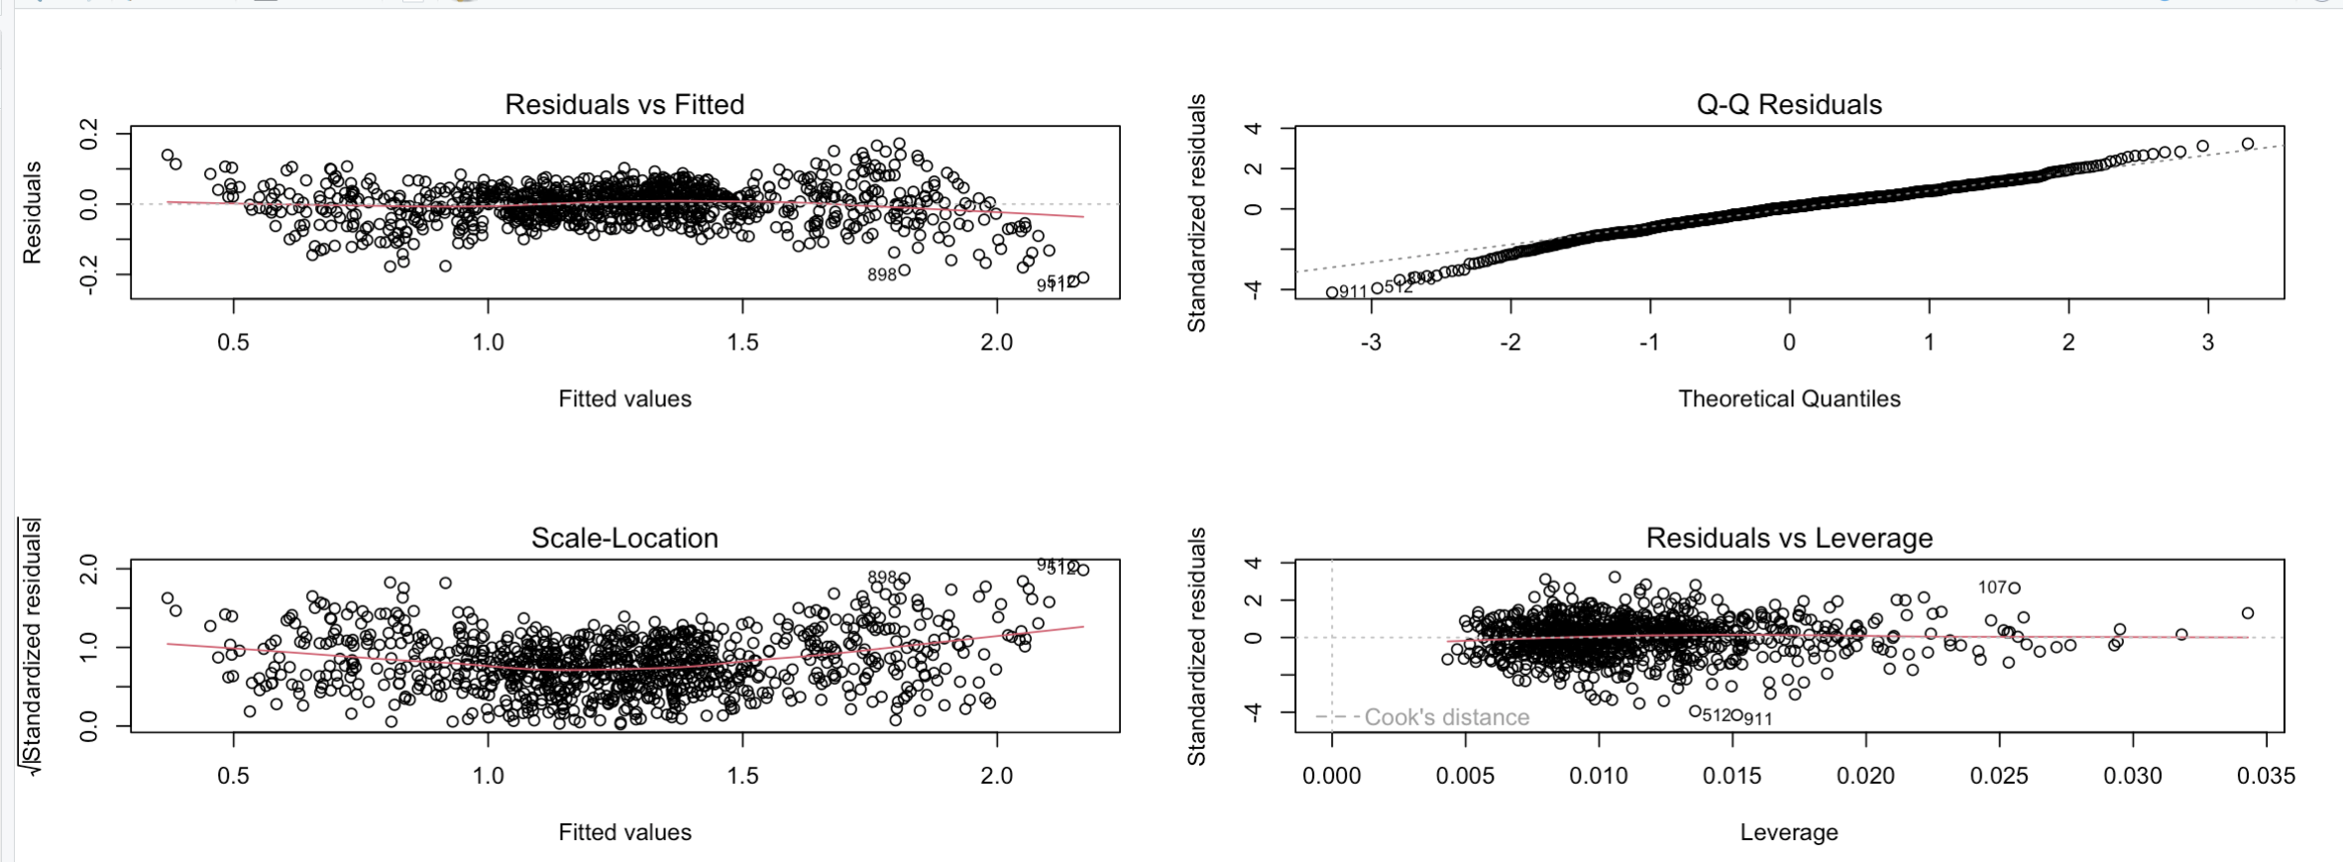
Model 2 diagnostics.
Scale-Location plot shows the the realtionship is linear because red line is close to horizontal.
Q-Q plots shows the data is normally distributed because the data points don't deviate from reference line.
The red residual line is not curved in residuals vs Fitted plot, so data is linear.
Some data points are influential, but there are fewer outliers.

Slide 24
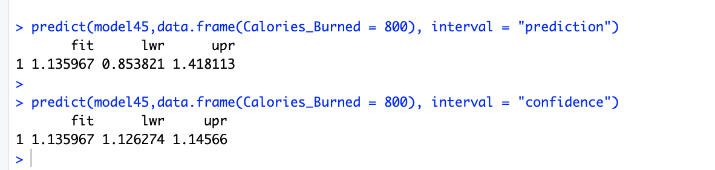
Prediction outputs with confidence & prediction intervals for session duration with calories burned.
What would be the 95% confidence interval for session_duration with calorie burned of 800?
The predicted Session_Duration with Calories_Burned of 800 is 1.135 hours.
We are 95% confident that the Session_Duration of a gym goer with Calories_Burned of 800 is between (.85, 1.418)hours. (Prediction Interval)
We are 95% confident that the average Session_Duration of all people with Calories_Burned of 800 is between (1.126, 1.146) hours. (Confidence Interval)

Slide 25
For decision making:
The gym goers and owners can utilize this information for their benefits.
Trainers can identify factors that reduce gym session duration and adjust training plans to encourage longer workouts.
Gym owners can use this information to target customer groups that tend to spend more time at the gym.

Slide 26
🧠 Lessons Learned & Recommendation
Learned to apply ANOVA and MLR with real-world data in R
Understood the importance of checking assumptions (normality, variance)
Gained experience using visuals for interpretation (boxplots, QQ plots)
Took lead on our section due to uneven team effort
Improved skills in data storytelling and reporting
Recommendations:
Always check assumptions before trusting results
Use clear visuals and standardized reporting
When teamwork is unbalanced, communicate early and step up if needed

