Slide 2
Apache Performance Tuning
Part 2: Scaling Out
Sander Temme <sander@temme.net>

Slide 3
Agenda
Introduction
Redundancy in Hardware
Building Out: Separate Tiers
Building Out: Load Balancing
Caching Content
Conclusion

Slide 4
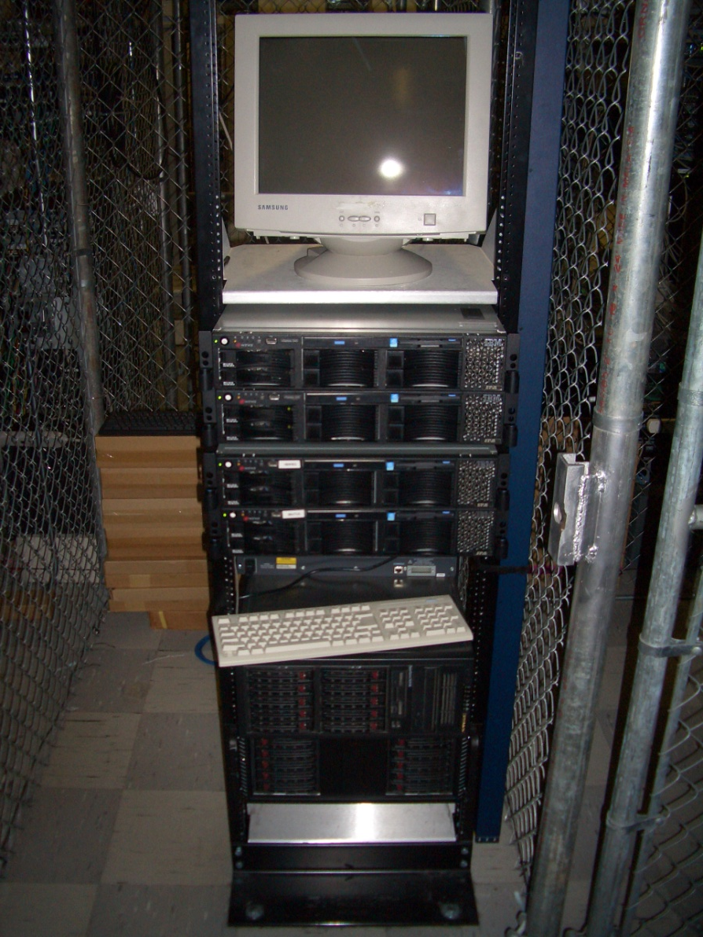
Introduction
Why do This?
Scalability (Oh my gosh, I’m so popular!)
Reliability (We need five nines!)
Why NOT do This?
It costs money

