Slide 1
Climate Change
What do you know?
and what are you going to do about it?

Slide 2
Climate Change?
What do you know about it?
What are the causes?
What are greenhouse gases?
What are C0₂ equivalents?
What can you do to make a difference?

Slide 3
What is Climate Change?
In a nutshell, climate change occurs when long-term weather patterns are altered — for example, through human activity. Global warming is one measure of climate change, and is a rise in the average global temperature.
davidsuzuki.org

Slide 4
Causes of Climate Change?
Our atmosphere is like a blanket
Adding greenhouse gases makes the blanket thicker
Human Activity
~32% increase in CO2 since 1900
Methane - CH₄ (25x), Nitrous Oxide - N₂O (300x), +…
We can consider the overall effect by considering CO₂e
Natural Causes and Variation
“Levels of methane and carbon dioxide are the highest they have been in nearly half a million years.”

Slide 5
What can you do?
Become informed
Examine how you contribute to climate change
Can you reduce your carbon footprint?

Slide 6
Transportation
Typical car contributes ~5 T of CO₂equivalents/year
What portion of that are you responsible for – through your choices?

Slide 7
Shower
L/min shower, input temp, output temp?
0.00116 kW-h of electricity to heat 1 L of water 1°C
Estimate 1kW-h in Canada is 0.2 kg of CO₂e
Similar to natural gas emissions for the same amount
Recovery of energy (heat)?

Slide 8
Electronics
Game systems
Computer systems
TV systems
Range from 100-400 watts in use, 1-20 watts standby
Estimate 1kW-h in Canada is 0.2 kg of CO₂e

Slide 9
Food
The food system is responsible for 1/3 of global greenhouse emissions and about 60% of that is linked to meat production – How?
High impact foods
(beef, lamb, shrimp, farmed salmon cheese, tofu?)
Medium impact foods?
(pork, chicken, imported fish, eggs, butter, imported/hh fruits and vegetables)
Low impact foods?
(local fruits and vegetables, wild fish, grains, beans, margarine, milk?)

Slide 10
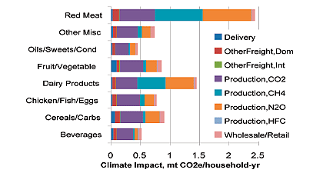

Slide 11
Reference points
Canada produces ~600 000 000 t of CO₂e/year (1990)
~20 t per person (significant portion is industry)
~5-10 t per person for home and lifestyle choices

