Slide 1
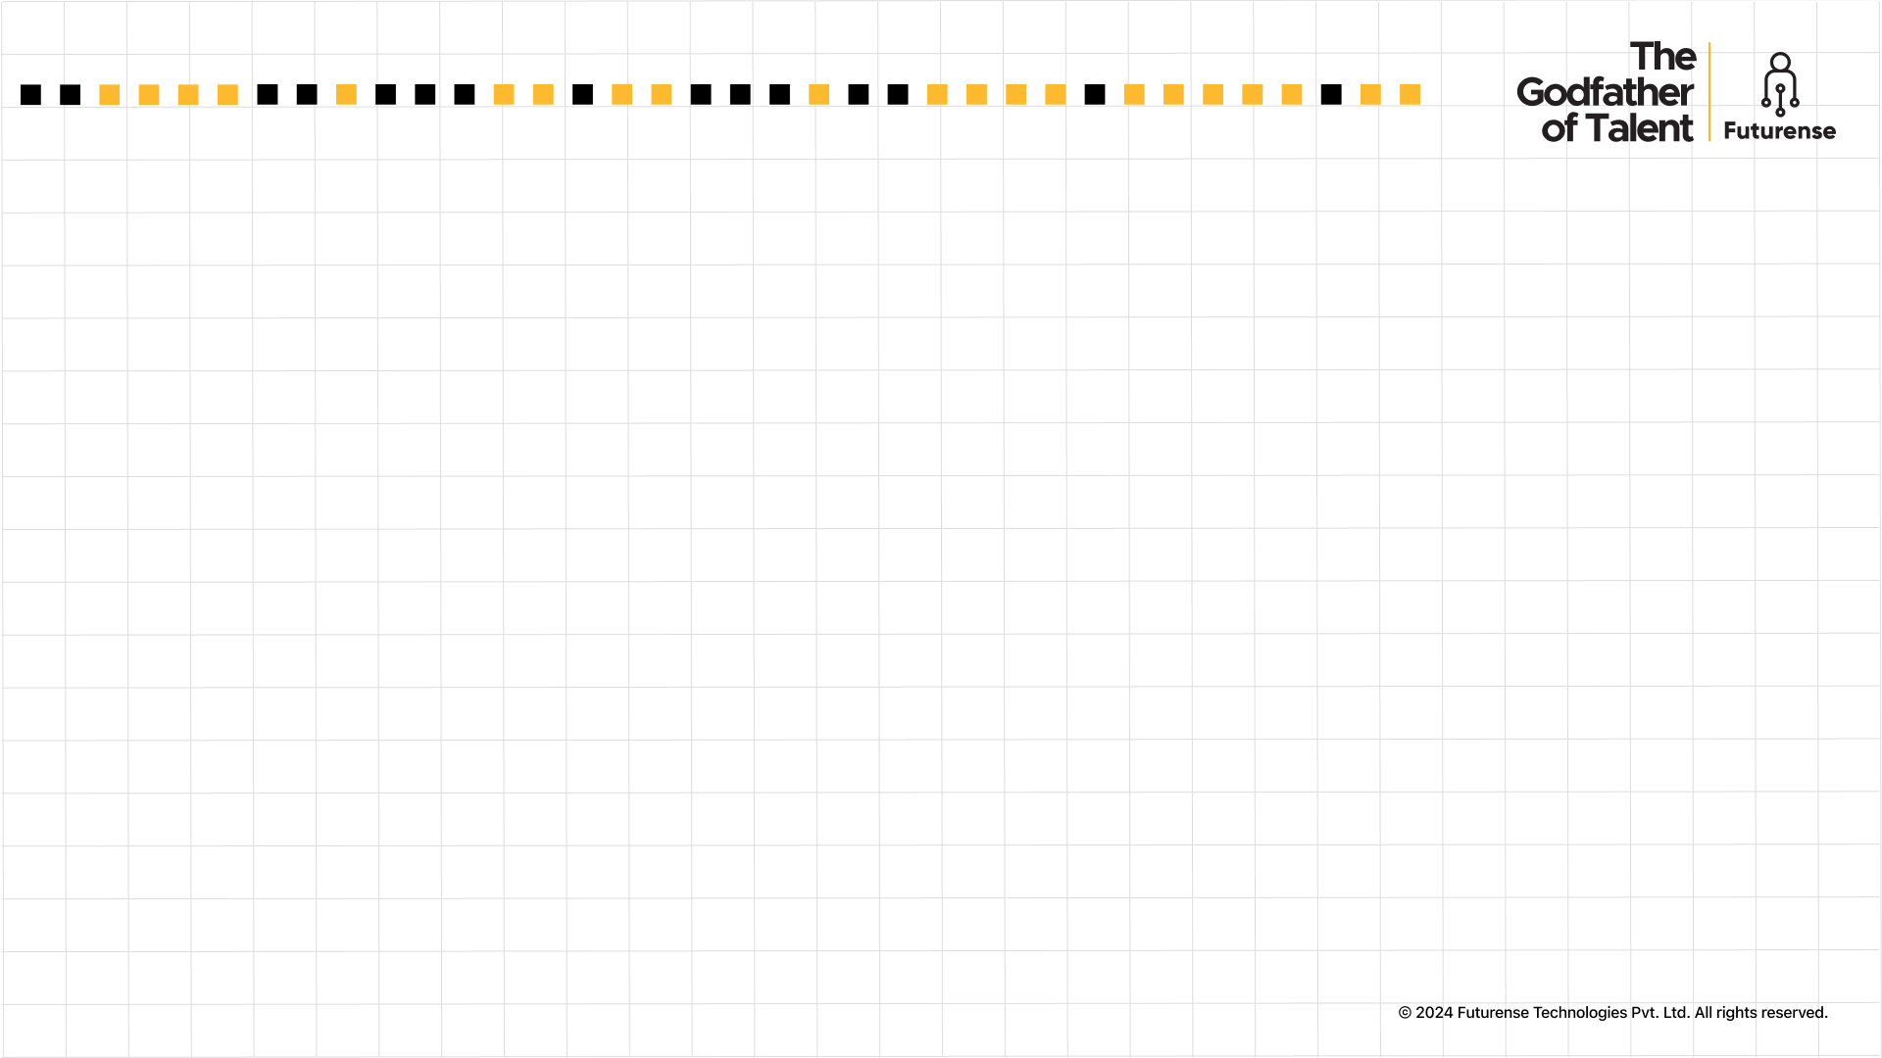

Futurense Technologies
Beyond the Scoreboard: Insights from Football Data Analysis
Project Report
Group 1: Innovation Pioneers
Group Members:
1. Ayushi Tawari (22BTRAD008)
2.Mutta Datta Sai Vishnu Mohan (22BTRAD026)
3.Niranjana J (22BTRAD027)

Slide 2


Index
Problem Statements
2. Nature of Dataset
3. Figure/ Graph
4. Results
5. Challenges
6. Conclusion
7. Code
8. References

Slide 3
Problem Statements
Data Cleaning and Augmentation
Identify and handle missing values using advanced imputation techniques. Correct anomalies by identifying outliers using statistical methods and domain knowledge. Standardize data formats and ensure consistency across the dataset. Augment the dataset by generating synthetic data using data augmentation techniques and collecting additional data from public sports databases. Integrate this data into a unified dataset.
2. Position Analysis
Analyze player positions to identify the highest and lowest number of players. Use statistical analysis to determine if the distribution of players across positions is significantly different from a uniform distribution. Create a plot showing the count of players for each position and a pie chart for distribution.

Slide 4
Problem Statements
3. Data Ingestion Strategies
Design and implement a data ingestion pipeline that supports incremental data loading. Optimize storage by using data partitioning and indexing strategies. Implement logging and monitoring to track the performance and reliability of the ingestion process. Utilize Python, pandas, and SQL for implementation.
4. Pass Completion Rate vs. Assists
Analyze the relationship between pass completion rate and assists. Create a scatter plot and identify outliers using advanced outlier detection methods like DBSCAN or Isolation Forest. Plot a line of best fit and use regression analysis to model the relationship. Evaluate the model using appropriate metrics.

Slide 5
Problem Statements
5. Advanced Data Transformations
Perform complex transformations on the dataset, including feature engineering to create new meaningful features. Implement additional strategies for data optimization, such as data normalization and dimensionality reduction.
6. Data Warehousing
Design and implement a data warehouse schema using advanced SQL features like window functions and CTEs (Common Table Expressions). Store the transformed data efficiently and ensure it supports complex analytical queries. Implement data security and access control mechanisms.

Slide 6
Problem Statements
7. Team Goals Analysis
Identify the team with the highest number of goals. Create a horizontal bar plot and a stacked bar chart. Perform a time series analysis to understand trends in goal scoring over the season. Identify the top goal scorer in that team and analyze their performance metrics over time.
8. Reporting and Visualization
Develop interactive dashboards and visualizations using tools like Power BI, Tableau, or custom web applications using Dash or Streamlit. Create reports that provide insights into player performance, team strategies, and potential areas for improvement. Incorporate advanced analytics like clustering and predictive modeling to forecast future performance.

Slide 7
Nature of dataset
The sports dataset comprises 20,000 records with 25 columns capturing detailed information about players across different teams spanning the seasons from 2019 to 2022.
Key columns include player-specific details such as 'Player', 'Team', 'Age', 'Height', 'Weight', 'Position', Goals', 'Assists', 'YellowCards', 'RedCards', 'PassCompletionRate', 'DistanceCovered', 'Sprints', 'ShotsOnTarget', 'TacklesWon', 'CleanSheets', 'PlayerFatigue', 'MatchPressure', 'InjuryHistory', 'TrainingHours', 'FatigueInjuryCorrelation', 'PressurePerformanceImpact', 'EffectiveTraining', 'Season'.
The dataset offers insights into the dynamics of player performance and well-being amidst the competitive landscape of professional sports.

Slide 8
Results
Data Cleaning and Augmentation
Through the process of removing duplicate records, imputing null values, looking for anomalies, and other tasks, the original dataset was cleaned. This was a critical step since meaningful data analysis requires an accurate and trustworthy dataset.
Duplicate rows: 3372
Null value imputation
Inconsistency checking
Outlier detection

Slide 9
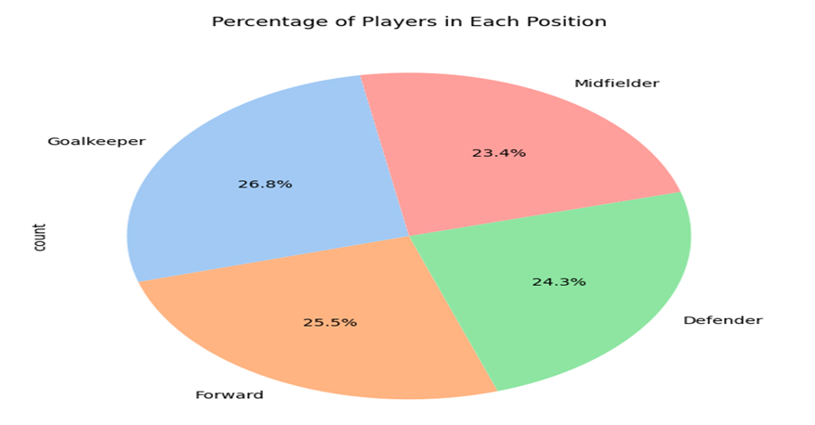
2. Position Analysis
After the dataset was analyzed, it was discovered that the four positions are defender, forward, midfielder, and goalkeeper.
There are 16628 players in total, with 4398 in goalkeeper position and 3962 in midfielder position being the greatest and lowest numbers, respectively. The distribution of players across positions is considerably different from a uniform distribution, according to a chi-square test that was performed.
Player Vs Position analysis

Slide 10
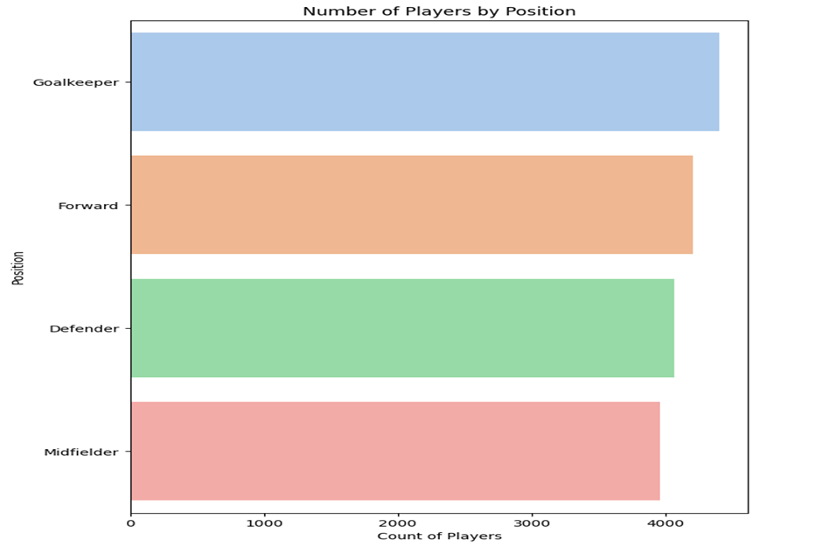
2. Position Analysis
Number of players by position

Slide 11
3. Data Ingestion Strategies
The data ingestion pipeline was created for this task using python. Additionally, activities related to incremental loading, logging, indexing, and monitoring were carried out.

Slide 12
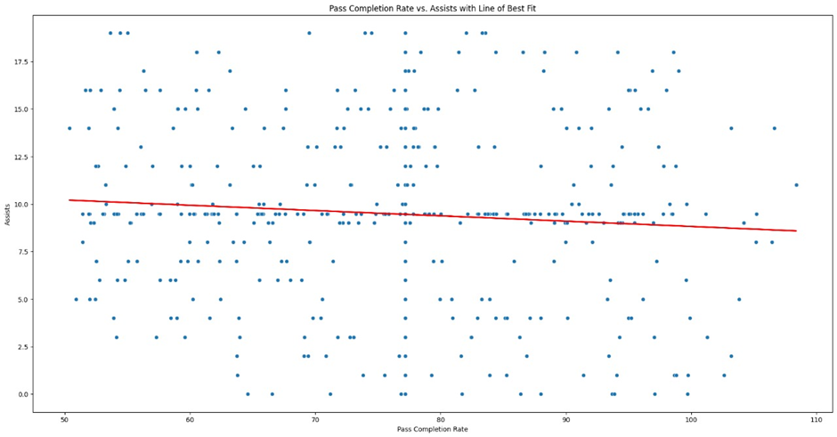
4. Pass Completion Rate vs. Assists
Assessing player performance and formulating wise training and strategy decisions were made easier with an understanding of the connection between assist rate and pass completion rate. The basis for estimating assists based on pass completion rate was established via linear regression, which has applications in player development and game strategy. The isolation forest approach shows that 1661 rows include outliers.
Pass completion rate Vs assists - best fit line

Slide 13
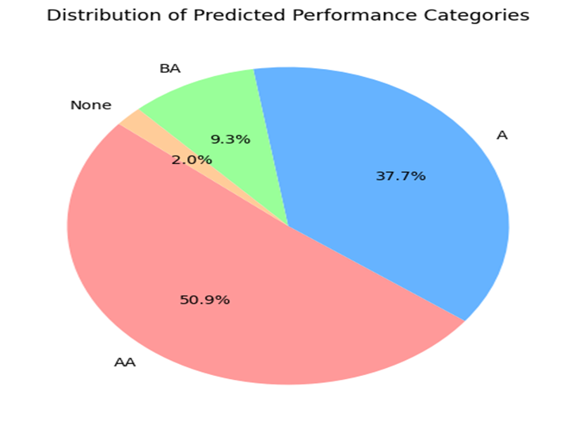
5. Advanced Data Transformations
Using feature engineering, new features were produced for this task. To evaluate player performance based on training hours and efficiency, a new feature called PredictedPerformanceCategory and to determine if players are impacted by the combination of match pressure and exhaustion, a new feature called PredictedInteractionCategory has been included.
A: Average
AA: Above Average
BA: Below Average
Distribution of predicted_performance_categoriy

Slide 14
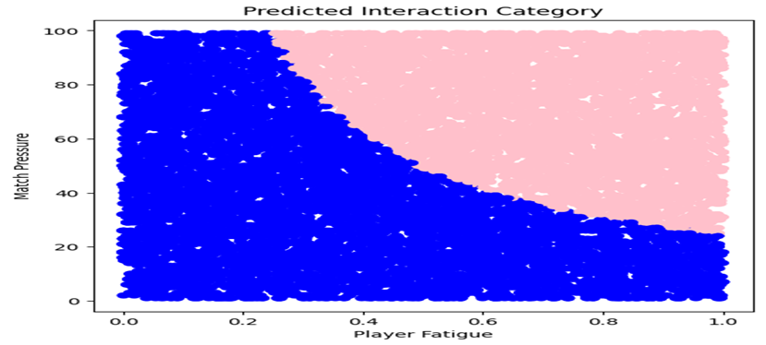
5. Advanced Data Transformations
Blue : Not effected
Pink: Effected
Predicted Interaction Categories

Slide 15
6. Data Warehousing
The database schema for the project was created and setup for use on the MySQL workbench platform. Subsequently the database and tables were created, the data was loaded, and the security and access control measures were implemented.

Slide 16
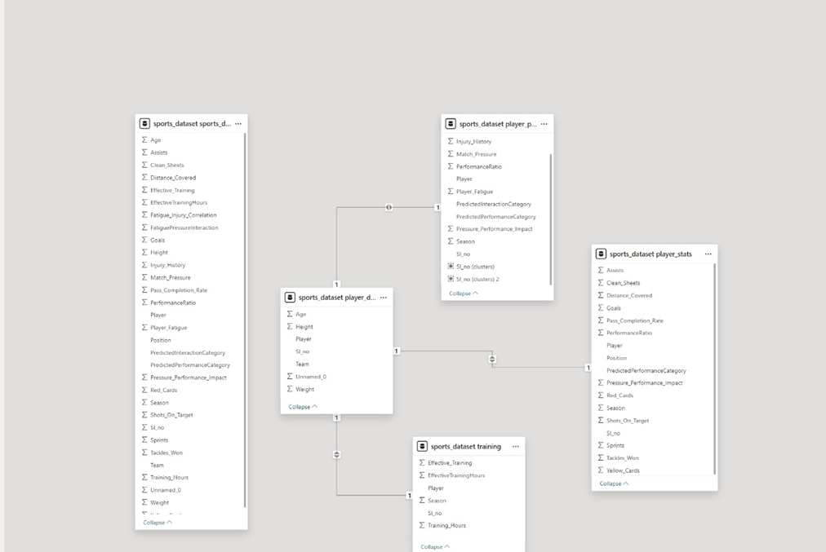
6. Data Warehousing

Slide 17
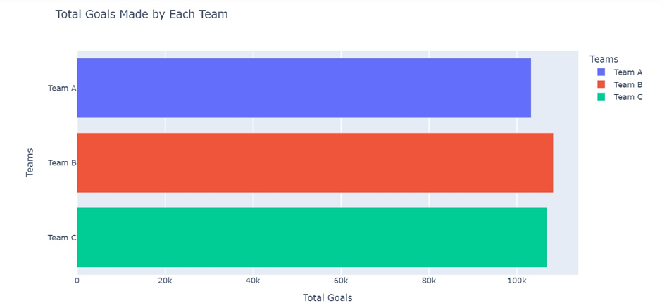
7. Team Goals Analysis
The task was completed by using several Python libraries for the analysis. With a cumulative goal score of 108266, Team B has the most goals of any team. Along with it, a wealth of other information on the goals scored during the season by various clubs, players, positions, etc. were also examined.
Total goals made by each team

Slide 18
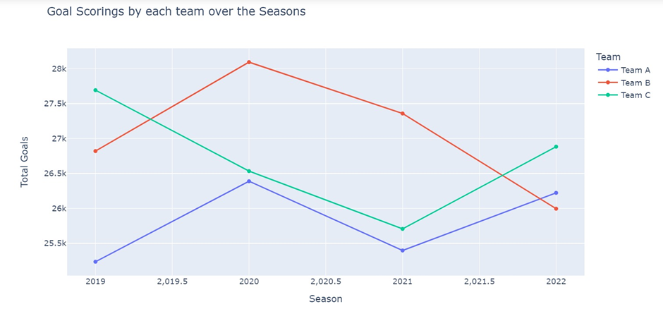
7. Team Goals Analysis
Goals scored by teams throughout the seasons

Slide 19
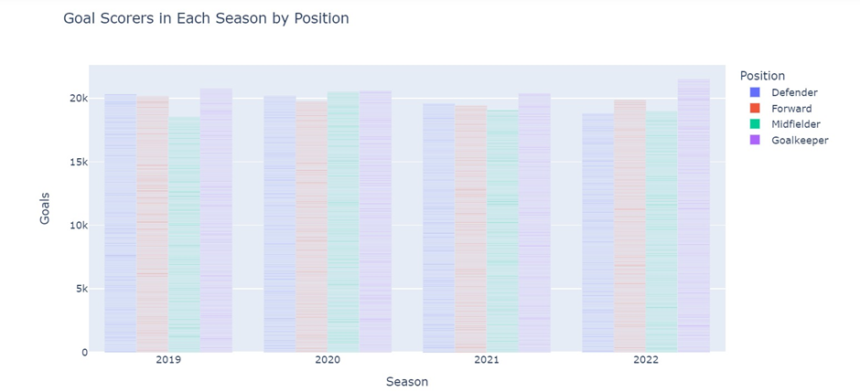
7. Team Goals Analysis
Total goals made by positions in each season

Slide 20
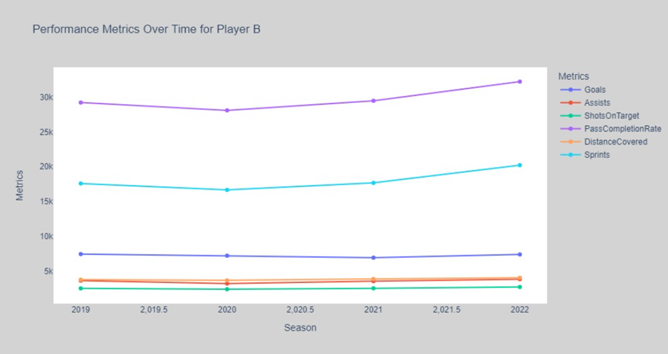
7. Team Goals Analysis
Performance metrics of top player of top team

Slide 21
8. Reporting and Visualization
Interactive dashboards and visualizations that offer insights into player performance, team tactics, and possible areas for growth are created with Power BI.

Slide 22
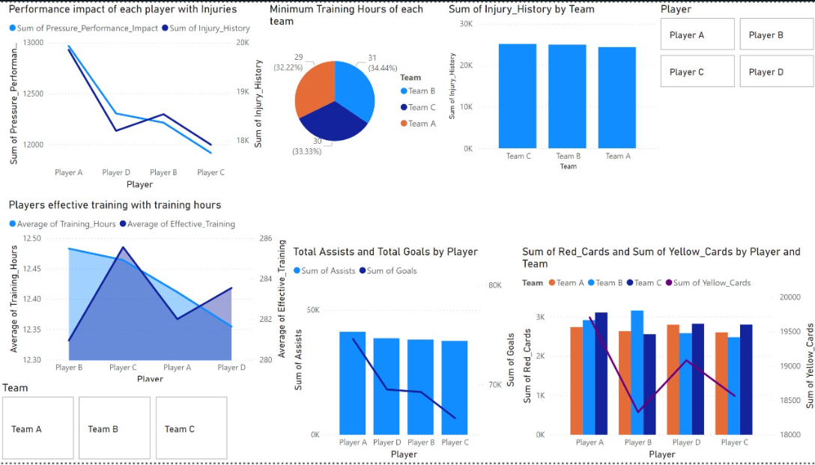
8. Reporting and Visualization
Interactive dashboard using Power BI

Slide 23
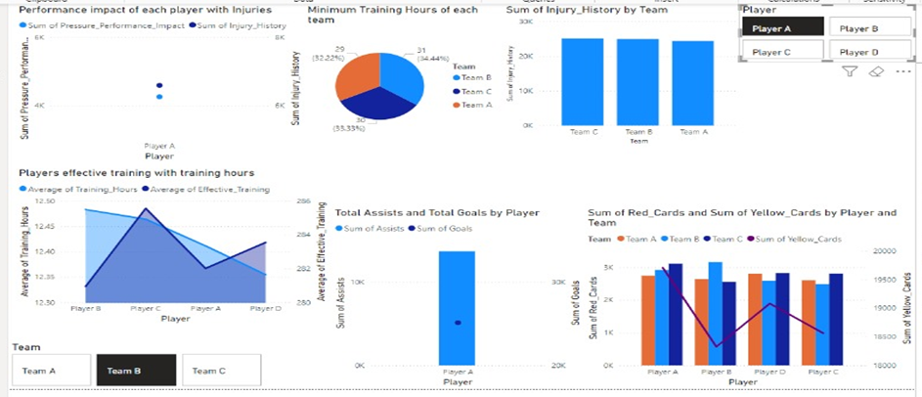
8. Reporting and Visualization
Team B- Player A

Slide 24
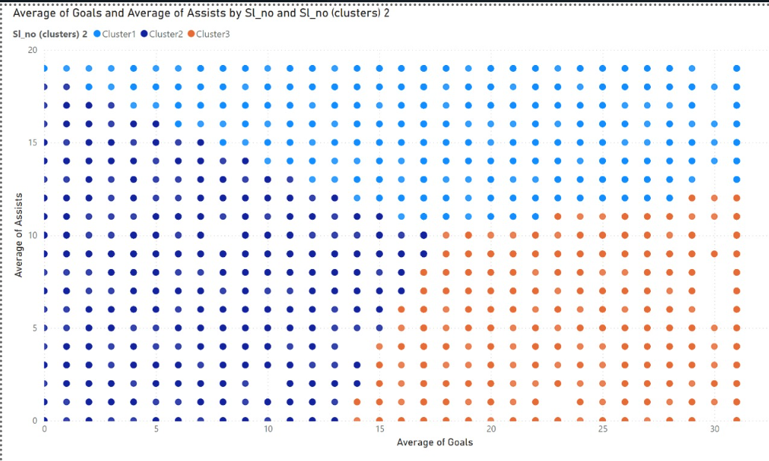
8. Reporting and Visualization
Clustering Using PowerBI

Slide 25
Challenges
Performing outlier analysis on the 'goals' attribute presented challenges due to the wide range of values. The lack of realistic data further complicated the analysis process.
The absence of unique ID values for features complicated both data distinction and the data warehousing process.
The separation of data ingestion and data warehousing problem statements heightened the overall complexity of the project.
Deciding on the appropriate alternative to replace missing values or outliers posed a significant challenge.

Slide 26
Conclusion
This data engineering project, which includes a strong infrastructure for player analysis and team plan assessment, is a prime example of the effectiveness of data-driven insights in sports. By utilizing sophisticated methods such as data imputation and statistical analysis, significant discoveries were made, highlighting the need of effective data administration. These findings, when combined with ongoing refinement of analytical methodologies, can spur innovation and performance gains in the sports sector.

Slide 27
Code
Problem statement 5
Problem statement 1
Problem statement 2
Problem statement 6
Problem statement 3
Problem statement 7
Problem statement 4
Problem statement 8
Github repository

Slide 28
References
Problem statement 1
Problem statement 2
Problem statement 3
Problem statement 4
Problem statement 5
Problem statement 6
Problem statement 7
Problem statement 8

Slide 29
Thank you!!!

