Slide 1
Automatic Generation of Topic Pages
Niranjan Balasubramanian
Silviu Cucerzan
Microsoft Research

Slide 2
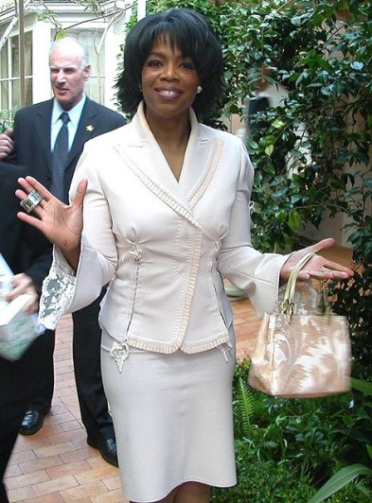
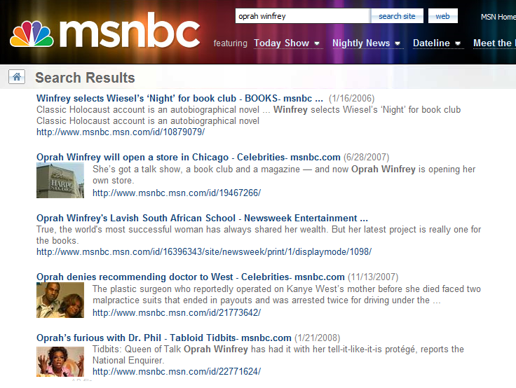
Task – Automatically generating topic pages for entities in news
Topic Page for Oprah Winfrey
Profile: Biography
Oprah Gail Winfrey (born January 29, 1954), often referred to simply as Oprah, is an Americantelevision host, media mogul, and philanthropist. Her internationally-syndicatedtalk show, The Oprah Winfrey Show, has earned her multiple Emmy Awards and is the highest-rated talk show in the history of television.^{[2]} She is also an influential book critic, an Academy Award-nominated actress, and a magazine publisher. She has been ranked the richest African American of the 20th century,^{[3]} the most philanthropic African American of all time,^{[4]} and the world's only black billionaire for three straight years.^{[5][6][7][8][9]} She is also, according to some assessments, the most influential woman in the world.^{[10][11][12]}Born in rural Mississippi to a poor unwed teenaged mother, and later raised in an inner cityMilwaukee neighborhood, Winfrey was raped at the age of nine, and at fourteen, gave birth to a son who died in infancy.^{[13]} Sent to live with the man she calls her father, a barber in Tennessee, Winfrey landed a job in radio while still in high school and began co-anchoring the local evening news at the age of 19.^{[14]} Her emotional ad-lib delivery eventually got her transferred to the daytime talk show arena, and after boosting a third-rated local Chicago talk show to first place,^{[6]} she launched her own production company and became internationally syndicated.
Credited with creating a more intimate confessional form of media communication,^{[15]} she is thought to have popularized and revolutionized^{[16][17][18][19]} the tabloid talk show genre pioneered by Phil Donahue,^{[18]} which a Yale study claimed broke 20th century taboos and allowed gays, transsexuals, and transgender people to enter the mainstream.^{[20]} By the mid 1990s she had reinvented her show with a focus on literature, self-improvement, and spirituality. Though criticized for unleashing confession culture^{[19]} and promoting controversial self-help fads, she is generally admired for overcoming adversity to become a benefactor to others.^{[21]}
In the news
Our focus

Slide 3
In a slide
Motivation
Why ?
Aspect Models
Self, related and general models
Sentence Extraction
Junk sentences.
Extracting sentences that cover aspects.
Ordering sentences
Learning Wikipedia style ordering of sentences.
Evaluation and Results

Slide 4



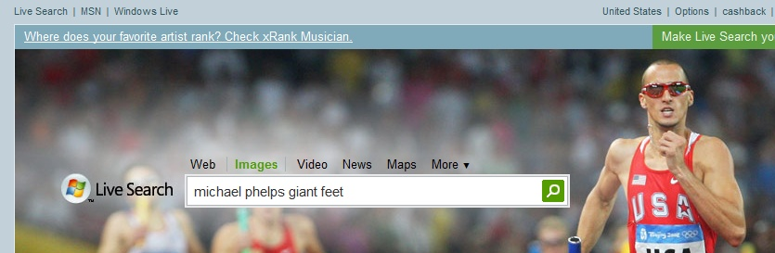
Motivation – Users, Web, and Wikipedia
Wikipedia vs. Web based summaries
User interests vs. Wikipedia

Slide 5
Motivation - Query Log Evidence
Michael Phelps
George Clooney
Oprah Winfrey
michaelphelps
michaelphelps sport
michaelphelps girlfriend
michaelphelps photos
pictures michaelphelps
...
michaelphelps biography
...
michaelphelps workout
...
michaelphelps house
...
michaelphelps feet
...
michaelphelps records
michaelphelps times
...
michaelphelps height
...
michaelphelps college
...
michaelphelps butterfly
michaelphelps swim
georgeclooney
georgeclooney movies
pet georgeclooney
georgeclooney pictures
georgeclooney biography
...
batman georgeclooney
...
georgeclooney
...
sarahlarsongeorgeclooney
...
georgeclooney accident
...
georgeclooney motorcycle accident
...
george clooney's pet
georgeclooney height
...
george clooney filmography
...
george clooney fan club
george clooney married
oprahwinfrey
oprahwinfrey show
oprah winfrey tv show
the oprah winfrey show
oprah winfrey website
...
oprah winfrey biography
...
oprah winfrey foundation
...
oprah winfrey leadership academy
...
oprah winfrey montecito home
oprah winfrey book list
...
oprah winfrey illness
oprah winfrey books
...
oprah winfrey school
...
oprah winfrey scholarship fund
...
oprah winfrey life

Slide 6
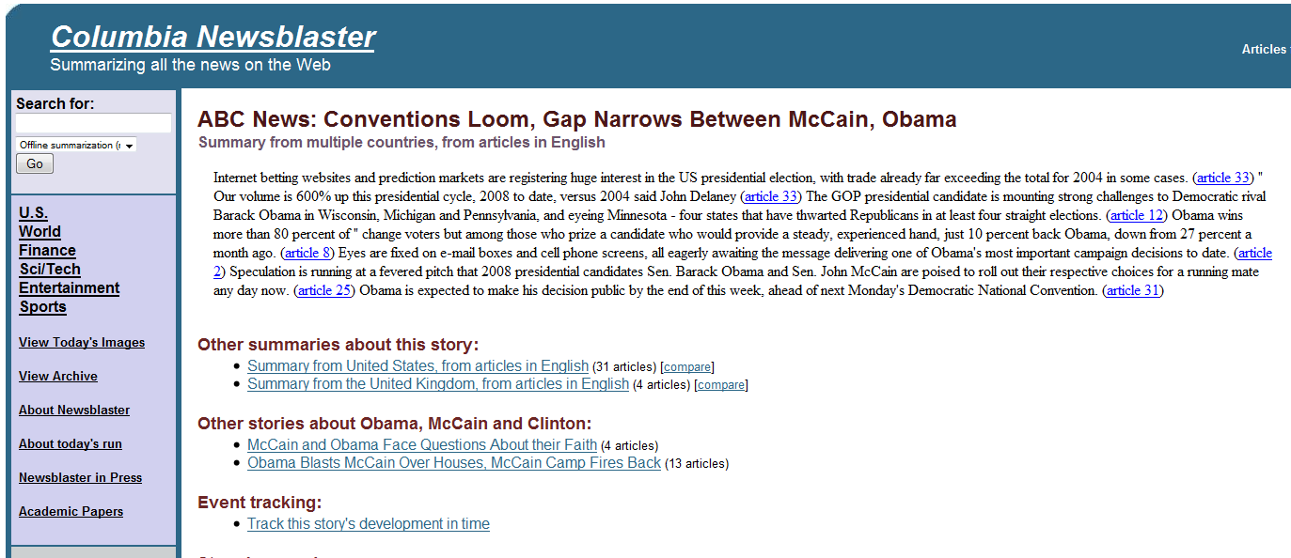
Motivation – Browsing Paradigm
A summary from multiple sources is an interesting paradigm for topic exploration

Slide 7
Main Idea
Query Logs
Extract Aspects
Retrieve
Web Docs
Extract
Relevant Sentences
Order Sentences
Britney Spears
Britney Spears weight
Britney Spears hair
Britney Spears
Britney height
…
…
Britney Spears babies
…
…
Britney Spear albums
Britney Spears age
…
…
Tom Cruise Nicole Kidman
Nicole Kidman pregnant
Nicole Kidman Keith Urban
Nicole Kidman movies Nicole Kidman United
Height
Age
Babies
Weight
Albums
Music
http://www.
Tom Cruise
pregnant
Keith Urban
United
movies
http://www.

Slide 8
Aspect Models
Self
movie names, awards…
Related
movies, music, albums…
senator, congressman,…
General
spouse, other relationships…
height, age, weight,…
General Aspects
Related Aspects
Specific Aspects
Born
Parents
Wife
Husband
Children
…
Movies
Films
Debut
…
Scientology
Nicole Kidman
Katie Holmes
…
Tom Cruise
Senator
Senate
President
presidential
…
Al Gore
Global warming
An inconvenient truth
Oscar
…

Slide 9
Self Aspect Models
Query Logs
Self Aspects Model
Johnny Depp actor
…
Johnny Depp movies
…
Johnny Depp wedding
…
Johnny Depp sweeney todd
…
Johnny Depp pirates
…
…
…
…
actor
movies
wedding
sweeney todd
pirates
…
…
…
…

Slide 10
Related Aspect Models
Query Logs
Related Aspects Model
Self Aspects Model
Search Sessions
…
…
…
Johnny Depp
Pirates of the Caribbean
Nicolas Cage
Google
John Cusack
Walmart
Joe Pesci
Johnny Depp birthday
…
actor
film
movie
wife
…
…
…
Top 10
Related Topics
Self Aspects Model
…
…
…
John Cusack
Joe Pesci
Denzel Washington
Scott Glen
Nicolas Cage
…
…
Nicolas Cage movies
Nicholas Cage pics
…
Nicolas Cage actor
…
…
Self Aspects Model
…
…
…
=
Johnny Depp actor
Johnny Depp pics
…
Johnny Depp movies
…

Slide 11
General Aspect Model
Self Aspects Model
Top 20 General Aspects Model
…
…
…
All Topics
John Cusack
Oprah Winfrey
Michael Phelps
Hillary Clinton
Joe Pesci
John Fowles
Nicolas Cage
…
…
family
born
home
married
young
age
awards
career
…
…
Self Aspects Model
…
…
…
Manual Filtering
…
Self Aspects Model
…
…
…

Slide 12
Comparison with Wikipedia Concepts
Surface forms mapped to Wikipedia concept space
Self model – Time specific
Wikipedia is exhaustive
Precision
Recall
# of Aspects
Surface Forms
lead singer
Singers
Vocalists
Pop singer
Wikipedia Concept
singer
# of Aspects

Slide 13

Sentence Extraction
“Michael Phelps” giant feet
“Michael Phelps” records
…
“Michael Phelps” pizza
http://www.
http://www.
http://www.
Sentence segmented documents cache

Slide 14
What are good sentences ?
Grammaticality
Well formed sentences
Relevance
Relevant to the topic and the aspects
Diversity
Cover as many aspects as possible
Low Redundancy
Eliminate redundancy as much as possible

Slide 15
Grammaticality
Punt ~ Avoid sentences that do not appear to be “well formed”
Examples
Flag Rate It: Select Rating 1 - Worst 2 - Bad 3 - Average 4 - Good 5 - Best Rating: 0/5 From: valobol Views: 743 Category: Music, Bands,
November December Day 01 02 03 04 05 06 07 08 09 10 11 12 13 14 15 16 17 18 19 20 21 22 23 24 25 26 27 28 29 30 31 Label Album Description Users Say 0 ratings You Say click on a star to rate La Mia Storia, Vol. 3 Released:
Music: Sheryl Crow Principal Cast: Billy Burke, Kathy Griffin, Lauren Graham, David Koechner, Henry Winkler, Peter Berg, Jason Preistly, Roger Wagner, Willie Nelson Pompadoured country crooner

Slide 16
Grammaticality
Logistic Regression to classify sentences: Good / Junk.
Features | +/-
Perplexity | <
Unigram Likelihood | >
Bigram Likelihood | >
Alphabet to special chars ratio | >
Alphabet to numbers ratio | >
Caps to Lower case ratio | >
Contains URLs | <
Link patterns ( - - -, | | |, . . .) | <
Trained on 100 hand labeled sentences.
Accuracy on 100 test sentences: ~ 80%

Slide 17
Relevance
Given a topic and an aspect, how to pick a relevant sentence ?
Topic: Adrien Brody
Aspect: The Pianist
After The Pianist Adrien Brody has appeared in four very different movies.
Adrien Brody, best known for his Oscar-winning performance in “The Pianist,” was in the audience Friday at the opening.
2008 Academy Award winner Rachel Weisz (The Constant Gardener), Academy Award winner Adrien Brody (The Pianist), Mark Ruffalo (Zodiac), and Academy Award nominee ...
Adrien Brody received widespread recognition when he was cast as the lead in Roman Polanski’s The Pianist (2002).
Adrien Brody is a New York actor who is known to international audiences as the star of Roman Polanski’s 2002 film, The Pianist.

Slide 18
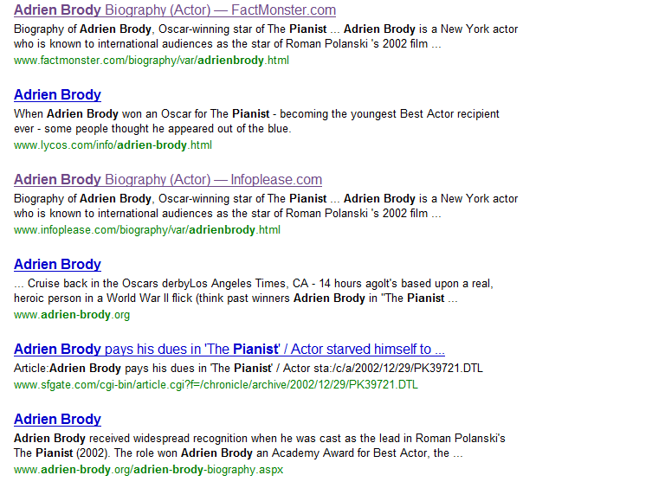
Relevance
Exploit redundancy on the web
Oscar
New York
Roman
Polanski
star
won
role

Slide 19
Diversity
Drop aspects that are already covered!
Aspect Vector
Initial Ranking
Diversity Ranking

Slide 20
Novelty
Iteratively:
Pick sentences that are novel and relevant!
µ (relevance) + (1- µ) novelty
Aspect Vector
Initial Ranking
Novelty Ranking

Slide 21
Sentence Rankers
Full Aspect
similarity(A, S) - cosine, KLD, Dice, Jaccard…
Novelty
Full aspect for initial ranking
Typical Example
For each aspect a in A, pick “typical” S.
Diversity
Full aspect as base ranker
Diversity + Typical (DS-Typical)
Re-rank sentences retrieved by Typical

Slide 22
Test Collection
Train/Dev/Test – 100 Topics each
Randomly sampled from Wikipedia living people category
Eliminated topics which do not have query log support
Topics chosen such that they are equally split amongst
Actors, Politicians, Music and Sports (loosely defined categories)

Slide 23
Evaluation
Comparison with Wikipedia
Concept Level
Surface forms to concepts
Precision, Recall
Sentence Level
Diversity Precision, Diversity Recall, Diversity AP
Sentence similarity threshold - Dice of 0.30
Wikipedia vs. Web vs. Automatic Summaries
3-way comparison to establish expectation
Surface Forms
lead singer
Singers
Vocalists
Pop singer
Wikipedia Concept
singer

Slide 24
Web vs. Wikipedia
10 Topics
Selected best non-Wikipedia biography from web
Compared top 30 sentences to Wikipedia text
Best Web Bio vs. Wikipedia

Slide 25
Issues with Sentence Similarity
He is known for his starring role in the television series Mission: Impossible from 1967 to 1973 (and again from 1988 to 1990).
In 1967, Graves was recruited by Desilu Studios to replace Steven Hill as the lead actor on Mission: Impossible. Graves played Jim Phelps, the sometimes gruff leader of the Impossible Missions Force or IMF, for the remaining six seasons of the series.
In 1966, Peter Graves replaced Steven Hill as head honcho of the force on the weekly TV adventure seriesMission: Impossible, a stint that lasted until 1973.
The move from "star" to "superstar" came when DiCaprio played Jack Dawson in the 1997 blockbuster Titanic.
Leonardo DiCaprio’s role of Jack Dawson in "Titanic" made him the biggest star worldwide as "Titanic" went on to become a huge blockbuster hit worldwide.
DiCaprio shot to international stardom for his role in 1997’s seaborne epic "Titanic" and has been one of Hollywood’s top male stars ever since.
In an unsuccessful attempt to win the role as Catwoman (which ultimately went to Michelle Pfeiffer) in the sequel Batman Returns, Young constructed a homemade Catwoman costume and attempted to confront director Tim Burton and actor Michael Keaton during production.
And in 1992, Young raised eyebrows by attempting to storm the set of “Batman Returns” in a homemadeCatwomancostume in order to influence Warner Bros. studio executives to cast her in the role.
0.29
0.34
0.46
0.18
0.32

Slide 26
Results
Comparison between full Wikipedia Articles and summaries of up to 30 sentences
Typical and DS-Typical
perform the best
Diversity by itself is worse
Greedy strategy
Removes context
Full context
ranks sentences individually
does not maximize coverage
Novelty
No clear gains
Dev Results

Slide 27
Results
Subset of Wikipedia sentences that contain some query log-based aspect

Slide 28
Topic Example
DS Typical
1] In the latest Priceline ads, Shatner bursts forth as the Priceline Negotiator, a mashup of James Bond and Ron Popeil who will do anything to help people broker better deals.
2] Description William Alan Shatner (born on March 22, 1931) is a Canadian actor who gained fame for playing Captain James TiberiusKirk, captain of the starship USS Enterprise in the television show Star Trekfrom 1966 to 1969 and in seven of the subsequent movies.
3] In 1999, Shatner suffered public personal tragedy when his third wife, Nerine , accidentally drowned in their swimming pool.
4] Shatner’s Star Trek sidekick Leonard Nimoy will be the only original cast member on board for the prequel – he’ll reprise his role as Mr. Spock in portions of the film.
5] On TV, Shatner made several guest appearances on The Practice and is featured in the spin-off series, Boston Legal, playing Denny Crane.
6] Decades after his much-maligned album, "The Transformed Man," boldly took "Lucy in the Sky With Diamonds" into strange new worlds, Shatner performed songs from "Has Been" before 4,000 cheering fans.
7] Actor William Shatner has sold his kidney stone for $25,000, with the money going to a housing charity, it was announced Tuesday.
8] William Shatner has signed up to host a celebrity-interview show on the Biography Channel titled "Shatner"s Raw Nerve" which will premiere sometime next year, reports Daily Variety.
9] Some of the best known actors of all time played on different episodes of the Twilight Zone, including William Shatner and Burgess Meredith.
10] Maybe that is William Shatner’s best birthday gift.

Slide 29


Ordering Sentences
Wikipedia Order
Natalie Louise MainesPasdar (born October 14, 1974) is an Americansinger-songwriter who achieved success as the lead vocalist for the female alternative countryband, the Dixie Chicks.
Born in Lubbock, Texas, Maines considers herself a rebel who "loved not thinking in the way I knew the majority of people thought."
In 1995, after leaving the Berklee College of Music, Maines was recruited by the Dixie Chicks to replace their lead singer, Laura Lynch.
With Maines as lead vocalist, the band earned ten Country Music Association Awards and thirteen Grammy Awards for their work between 1998 and 2007.
Natural Time Line

Slide 30
Learning Problem: Pair-wise Ordering of Sentences
Can we learn word precedence ?
Use Wikipedia abstracts to extract word pairs from ordered sentences
ab = # of times word a occurs in a sentence that precedes a sentence containing b
a | b | ab | ba
born | award | 10 | 1
born | won | 8 | 3
singer | grammy | 10 | 1
composer | won | 7 | 4

Slide 31






Precedence Scoring
Given word order evidence, how to assign pair-wise precedence ?
Binary
Binary Back-off
Frequency
Likelihood

Slide 32


Precedence Scoring
Given pair-wise precedence scores, how to order sentences?
Average
Product of Ratios

Slide 33
Results – Ordering Wikipedia Abstracts
Spearman Rank Correlation Co-efficient
Spearman for abstracts of different sizes

Slide 34
Conclusions
Framework for generating topic pages automatically
General method that covers actual users interests
Provides a paradigm for exploring information
Aspect models
Self, Related and General
Sentence extraction techniques that address
Diversity, redundancy, relevance and grammaticality.
Timeline Order
Vocabulary-based sentence ordering techniques

Slide 35

Pending…

Slide 36
Pending …
Manual evaluation of summaries
Comparative and Absolute evaluation
Sentence Ordering
Investigate more back-off methods
Better ranking methods based on pair-wise precedences.
User information needs w.r.t topics and aspects
Analyze session data and toolbar logs

Slide 37
Questions ?

