Slide 1
Generating Coherent Event Schemas
at Scale
Niranjan Balasubramanian
Stephen Soderland, Mausam¹, Oren Etzioni²
Turing Center
University of Washington
¹Indian Institute of Technology, Delhi
²Director, Allen Institute for Artificial Intelligence (AI2)

Slide 2
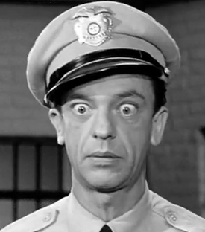


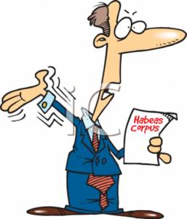
Event Schemas
A set of actors and the roles they participate in.
Actor
Relation
Actor
arrest
charge
sentence
represent
Notes:
We define schemas as set of actors and the roles they play
Here is an example, an arrest schema.
Key actors are a suspect who is arrest by an agent say police, and a lawyer who represents the suspect and a judge who sentences or acquits the suspect.
Note there is no notion of temporal (or causal ordering) among the relations here. Not within the scope of this work.

Slide 3
Event Schemas
A set of actors and the roles they participate in.
Actor
Relation
Actor
A1
arrest
charge
A2
A3
sentence
A2
A4
represent
A2
Notes:
In this work we target building schemas that look like this table:
We view a schema as a list of [Actor Relation Actor] tuples, represented as rows here.
The Roles are represented via relations.
We have Numbered actors.

Slide 4
Event Schemas
A set of actors and the roles they participate in.
Actor
Relation
Actor
[Person]
Police
FBI
…
[Person]
John Gotti
man
…
A1
arrest
charge
A2
[Person]
Judge
US District Judge
…
A3
A2
sentence
[Person]
Ben Coates Attorney Morgan
…
A4
represent
A2
Notes:
In this work we target building schemas that look like this table:
We view a schema as a list of [Actor Relation Actor] tuples, represented as rows here.
The Roles are represented via relations.
We have Numbered actors.

Slide 5
Applications
Templates for information extraction [Patwardhan&Riloff, EMNLP’09]
As world-knowledge for co-reference [Irwin et al, CoNLL’11]
Summarization [TAC Summarization’10]

Slide 6
Outline
Prior work
Coherence issues
Our approach
Representation
Rel-grams
Building schemas
Evaluation
Mechanical Turk

Slide 7
Prior Work
Manually authored e.g.. MUC Templates
Laborious
Limited domains.
Automatically induced from text.
Narrative schemas [Chambers and Jurafsky, 2009]
Event templates [C & J, 2011] and [Chambers, 2013]
Probabilistic Frames [Cheung et al., 2013]
Notes:
Chambers and Jurafsky in their seminal work showed an automatic method.
Chambers and one other recent work has followed up with probabilistic induction

Slide 8

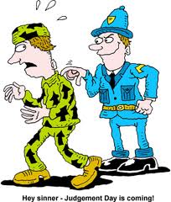

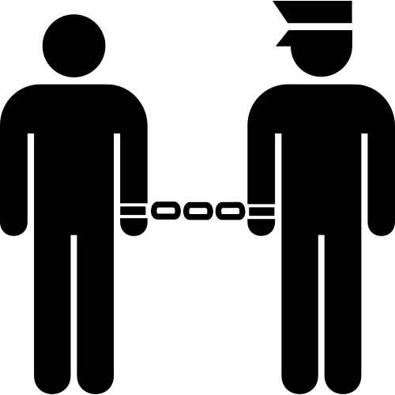
Inducing Schemas from Text
Notes:
Go from large number of news articles – see enough number of arrests – figure out who the key actors are and the roles they play.

Slide 9
Narrative Schemas
Method:
Extract (subj-verb) and (verb-obj) pairs that have a co-referrent entity.
Use a greedy algorithm to cluster pairs.
Pros:
Fully automatic
Scales to arbitrary domains
Cons:
Coherence issues!
Notes:
Extract subj, verb and verb-obj dependency pairs

Slide 10
Mixing Distinct Events
Actor
Relation
Actor
A1
A2
caused
A2
A1
spread
A1
broke out
extinguished
A1
Notes:
We have a schema here that has two actors.
A1 causes A2
A2 spread
It turns out that this schema mixes two distinct events.

Slide 11
Mixing Distinct Events
Actor
Relation
Actor
infection
fire
A1
A2
disease
caused
disease
A2
A1
infection
fire
spread
infection
fire
A1
broke out
extinguished
A1
infection
fire
Notes:
… of infection spreading and fire spreading.
What is wrong with mixing distinct events?
Relations that don’t fit in one event.
Example: extinguishing doesn’t fit infection event.
Can result in triples that make no sense (disease, spread, fire)
There are plenty of other examples:
airlines scheduling flights,
government scheduling meetings,
nba, scheduling games
Why does this happen

Slide 12
Mixing Distinct Events
Dependency pair representation ignores useful context.
The disease broke out in Canton and spread very quickly to Sudbury.
(disease, broke out)
(disease, spread)
…
The fire broke out in the bedroom and spread quickly to the roof.
(fire, broke out)
(fire, spread)
…
Notes:
We argue that this is because the representation ignores essential context.
In this case there is important information following broke out and spread that could help keep separate these two events.
However,

Slide 13
Mixing Distinct Events
Dependency pair representation context.
The disease broke out in Canton and spread very quickly to Sudbury.
(X, broke out)
(X, spread)
…
The fire broke out in the bedroom and spread quickly to the roof.
(X, broke out)
(X, spread)
…
Actor X : { fire, infection, …, }
Roles : { subj(broke out), subj(spread), …, }
Notes:
However, the pairwise representation leads the clustering algorithm to believe that the
subj of broke out is the same as the subject of spread which is fine but it also results
in clustering of the tuples from both fire and infection together.

Slide 14
Mixing Distinct Actors
Actor
Relation
Actor
house
president
bill
A1
A2
bill
measure
law
pass
house
president
bill
A1
A2
sign
Why?
Number of actors guided by a splitting parameter in clustering.
Restrictive settings can cause conflation.
Notes:
The second issue is that of mixing distinct actors.
In this legislation schema, we have two actors: the law/bill/measure is the thing that get passed or signed
However, A1 clearly mixes actors.
House can pass a bill, But a president does not.
Similarly president can sign a bill but the house cannot.

Slide 15
Outline
Prior work
Coherence issues
Our approach
Representation
Rel-grams
Building schemas
Evaluation
Mechanical Turk
Notes:
Next I am going to describe our approach for addressing these issues using Open IE.

Slide 16
Our Solution
Retain more context to reduce ambiguity in relations.

Slide 17
Our Solution
Retain more context to reduce ambiguity in relations.
The disease broke out in Canton and spread very quickly to Sudbury.
(disease, broke out, Canton)
(disease, spread, Sudbury)
…
The fire broke out in the bedroom and spread quickly to the roof.
(fire, broke out, the bedroom)
(fire, spread, the roof)
…
Notes:
Retain more context.
So we are going to use triples instead of pairs.

Slide 18
Our Solution
Retain more context to reduce ambiguity in relations.
The disease broke out in Canton and spread very quickly to Sudbury.
(X, broke out, Canton)
(X, spread, Sudbury)
…
The fire broke out in the bedroom and spread quickly to the roof.
(X, broke out, the bedroom)
(X, spread, the roof)
…
Notes:
This representation would avoid clustering these tuple pairs.

Slide 19
Our Solution
Retain more context to reduce ambiguity in relations.
The disease broke out in Canton and spread very quickly to Sudbury.
(disease, broke out, Canton)
(disease, spread, Sudbury)
…
The fire broke out in the bedroom and spread quickly to the roof.
(fire, broke out, the bedroom)
(fire, spread, the roof)
…
Notes:
However, we get sparsity.

Slide 20
Our Solution
Retain more context to reduce ambiguity in relations.
Generalize using semantic classes.
In some cases type compatibility improves actor coherence.
The disease broke out in Canton and spread very quickly to Sudbury.
(disease, broke out, [location])
(disease, spread, [location])
…
The fire broke out in the bedroom and spread quickly to the roof.
(fire, broke out, [structure])
(fire, spread, [structure])
…
Notes:
We generalize.

Slide 21
Representation
Open IE relation triples in place of dependency pairs.
Scales easily to arbitrary domains.
More expressive (Verb + Preposition)
Semantic classes as arguments
Addresses sparsity
Improves actor coherence
Notes:
We use Open IE triples to represent events.
Apart from reducing ambiguity, they also scale easily to arbitrary domains and are more expressive than using verbs alone.
Further, we augment the triples with semantic classes as arguments to address sparsity and improve actor coherence.
Let’s get a bit more specific about the representation.

Slide 22
Generalized Tuples
Use Ollie an Open IE system.
(Arg1, Relation, Arg2) format.
Normalize relation strings
Stem, remove modifiers.
Extract lexical heads for arguments
Assign classes to argument heads
29 semantic types from WordNet
Record co-reference information
Stanford Co-reference system
Text: “He cited a new study that was released by UCLA in 2008.”
Tuples:
1. (He, cited, a new study)
2. (a new study, was released by, UCLA)
3. (a new study, was released in, 2008)
Generalized Tuples:
T1. (He, cite, study)
T2. (He, cite,[activity])
T3. ([person], cite, study)
T4. ([person], cite,[activity])
T5. (study, be release by, UCLA)
T6. (study, be release by,[org])
T7. (study, be release in, 2008)
T8. (study, be release in,[timeunit])
T9. ([activity], be release by, UCLA)
Notes:
1) Use Ollie a state of the art Open IE system to extraction relation triples in the form (Arg1, Relation, Arg2)
2) For the text He cited a new study…, Ollie extracts three tuples …
3) We stem and drop modifiers to normalize relation strings.
4) For arguments we extract lexical heads and assign semantic classes to generalize beyond the specific instances
5) We selected 29 classes based on manual analysis
NE Types: person, organization, location, time unit,
Quantities: number, amount, group,
Titles: business, executive, leader,
Activities: effect, activity, game, sport,
Instruments: device, equipment, structure, building,
Substance: substance, nutrient, drug, illness,
Animals: organ, animal, bird, fish, art,
Publications: book, and publication.
Finally we also record co-referring entities. In the example, the arg1 in T5 and T6 refer to the same “study”.
We use Stanford co-reference system to identify co-referring entities when pronouns are used.

Slide 23
Rel-grams Model
A model of co-occurrence between relation tuples.
Delta smoothed conditional probabilities
Estimates for different co-occurrence windows combined
Estimated from large corpus (1.8 M NYT)
Database with 320 K tuples with 1.1M Rel-grams (above a frequency cut-off).
Rel-grams are noisy!
74% both tuples valid.
83% of valid rel-grams were an implication.
90% of valid rel-grams were on common topic.
Enough signal to construct high quality schemas.

Slide 24
Building Schemas
Create a graph from Rel-grams
Nodes = tuples
Edge = Rel-gram probability
2. Identify seed tuples to build schemas from high connectivity nodes
3. Use Personalized PageRank to find related tuples.

Slide 25
Building Schemas
Collect actor candidates from arguments.
e.g. (A1:[person], suspended by, A2:[org])
(A3:[person], used, A4:[substance])
Use equality constraints to merge actors.
e.g., (A1:[person], suspended by, A2:[org])
(A1:[person], used, A4:[substance])
Merge actors that perform same roles
Do not merge actors with incompatible classes
Do not merge actors with a relation between them.
Output the top actors and the top K relations as the schema.

Slide 26
Example output
Actor
Relation
Actor
[person]
Murray,
Morgan,
Gov. Bush,
...
A1
A2
[none]
test
failed
A1
A3
[time]
season, week, month,,…
suspended for
A1
A4
[substance] [drug]
cocaine, drug, gasoline, …
used
A1
A5
[game] [activity]
violation, game, abuse, …
suspended for
A1
A6
[location]
desert, Simsbury, Albany, …
was in
A1
A7
[person] [organization]
Fitch, NBA, Bud Selig, …
suspended by
Notes:
Many actors and useful relations.

Slide 27
Outline
Prior work
Coherence issues
Our approach
Representation
Rel-grams
Building schemas
Evaluation
Mechanical Turk

Slide 28
Experimental Results
From 1.8 M NYT articles:
1.1 M Rel-grams with minimum support 3
(10-fold increase by using semantic types)
Over 1 K distinct Event Schemas
Mechanical Turk evaluation
Do schemas have coherent relations?
Do schemas have coherent actors?
Do schemas have relational triples that make sense?

Slide 29

Mechanical Turk Evaluation
Create simpler instantiations of schemas.
Ground tuples in schema by sampling instances.
Estimate schema quality by evaluating instantiations.
Valid On Topic
Subject => Action => Object
bomb => explode in => city
bomb => explode kill => people
bomb => explode on => Friday
… => … => …

Slide 30
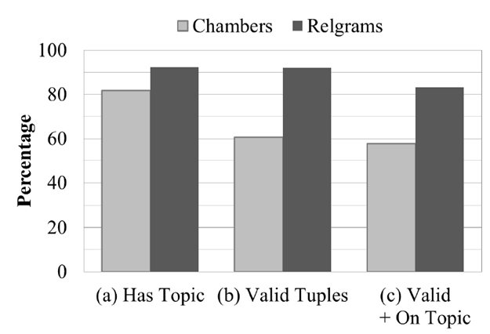
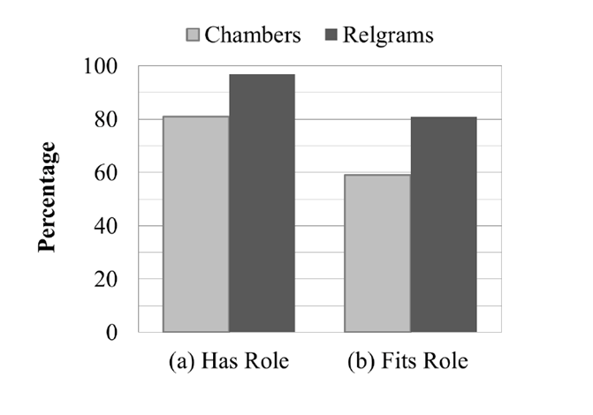
Comparison with Chambers & Jurafsky
More coherent sets of relations and actors
Topic coherence
Actor coherence
Balasubramanian et al., Generating Coherent Event Schemas at Scale, EMNLP 2013

Slide 31
Comparison: Chambers
A1
oppose
sign
approve
veto
support
pass
A2
A1
A2
bill
president
house
A1
A2
bill
measure
legislation
A1
A2
A1
A2
A1
A2
Conflates actors:
bill, president, and house.

Slide 32
Comparison: Rel-grams
Carey
Anthony
Volpe
A1
veto
sign by
pass by
sign into
to sign
governor of
A2
legislation
bill
law
A2
A1
Sate senate
Senate
House
A2
A3
A1
A4
law
bill
A1
A5
Mass.
state
S. Carolina
A1
A6
Open IE provides nice benefits over SVO:
- Able to distinguish distinct actors.
- Noun mediated relations captured.

Slide 33
Errors
Extraction errors: truncating n-ary tuples
(Mr. Diehl, spend than, commissioner)
Mr. Diehl spends more time …. than the commissioner on …
Mismatched actors
(A1:[person], graduate from, A2:[org])
A2 = {James High School, church, …}

Slide 34
Moving toward Event Extraction
Build extractors for each learned schema
Match schemas to a document
Schemas set up expectations
Actively look for relations and actors to fill the schema
Bombing schema:
Look for (<person>, plant|detonate, <device>)
Look for (<org>, claim|deny, responsibility)
…
Available at:
http://relgrams.cs.washington.edu

Slide 35
Personalized Page Rank
Higher score for nodes connected to query and query’s neighbors.
([person], use, [drug])
([person], use, [substance])
([person], suspended by, [org])
([person], suspended for, [time])
([person], fail, test)
([person], suspended for, [activity])
([person], be member of, [org])
([person], be member of, [org])
([person], be director of, [org])

Slide 36
Personalized Page Rank
Higher score for nodes connected to query and query’s neighbors.
([person], use, [drug])
([person], use, [substance])
([person], suspended by, [org])
([person], suspended for, [time])
([person], fail, test)
([person], suspended for, [activity])
([person], be member of, [org])
([person], be member of, [org])
([person], be director of, [org])

Slide 37
Summary
Addresses coherence issues in schema generation.
Developed Open IE based representation for events.
Graph analysis based approach for generating schemas.
Evaluation shows Rel-grams produce more coherent schemas.
Resources available for download.
Rel-grams and schemas.
http://relgrams.cs.washington.edu

Slide 38
Future Work
Enhancements to Schemas
Causality and temporal ordering.
Improving scope of semantic classes.
Addressing redundancy.
Applications
Building extractors for Open event schemas.
Co-reference
Single-document summarization

Slide 39
Graph Analysis: Personalized Page Rank
Page Rank “personalized” to a query [Haveliwala, 2002]
Higher score for nodes with connections to
query
query’s neighbors

Slide 40
Finding Seeds
High connectivity nodes are good seeds.
Sort nodes by the sum of top 50 SCP edges.

Slide 41
Extracting Neighborhood
For each seed:
Select the top neighbors up to two hops away.

