Slide 1
Graph Analysis in Rel-grams

Slide 2
Rel-grams
Model for relation co-occurrence
P(T’|T) – Probability of seeing tuple T’ in the vicinity of tuple T.
1.1 M rel-grams from large corpus of 1.8M news stories.
Represent relations using Open IE relation tuples
Relation phrases and semantic types for arguments.
Applications
Common sense knowledge e.g., What happens when X gets arrested?
Event schemas
T | T’ | #(T, T’)
(bomb, explode in, <location>) | (group, claimed, responsibility) | 8
(x:<person>, arrested by, <org>) | (x:<person>, charged with, <activity>) | 17
(x:<person>, failed, test) | (x:<person>, suspended for, <activity>) | 23
Available at: http://relgrams.cs.washington.edu

Slide 3
Rel-graph: A graph of relations
Extension of pairwise co-occurrences.
Relation tuples vertices.
Co-occurrence based weighted edges.
Can help with finding tuples related to an event for building event schemas.
Tuples related to an event often found in tightly connected clusters.
Two approaches for exploiting graph structure
Markov clustering
Personalized Page Rank

Slide 4
Markov Clustering
A partitioning approach for finding tight clusters in the relation graph.
Score the clusters based on some measure of their connectivity.
Output the top scoring clusters as related tuples.
Simulates random walks
Based on the intuition that longer paths more likely to be within cluster
An iterative two step process
Expansion step diffuses flow within cluster (computes powers of adj. matrix)
Inflation step restricts flow between clusters (powers of entries)
Efficient implementation
Uses pruning techniques to enforce sparsity.
In practice converges in a small number of iterations.

Slide 5
Personalized Page Rank
Find nodes well connected to a “query” node.
Identify good seed nodes.
Run Personalized Page Rank on the neighborhood of the seed nodes.
Page Rank adapted to reflect the notion of a query node.
Nodes close to the query node and with high connectivity have high PR.
Converges fast if the neighborhood is limited to a small number of hops from the query.

Slide 6
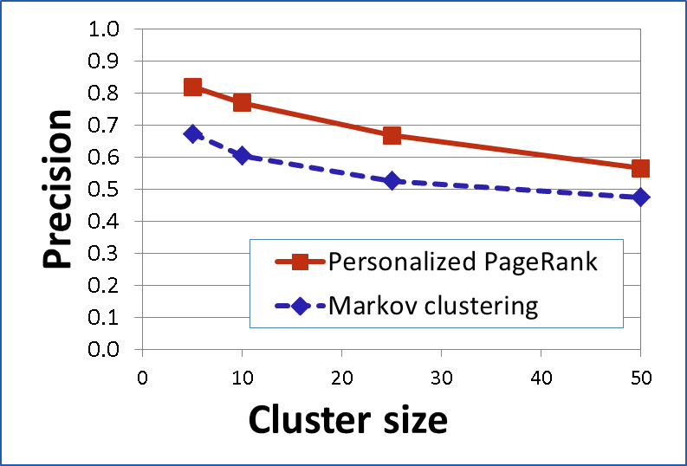
Evaluation: Find Related Tuples
Manual evaluation on 20 clusters to see if tuples in a cluster are related.
For each cluster determine an implicit topic.
For each tuple in the cluster assess if it belongs to the implicit topic.
Take away:
Hard partitioning not good.
Good seeds result in good clusters.

Slide 7
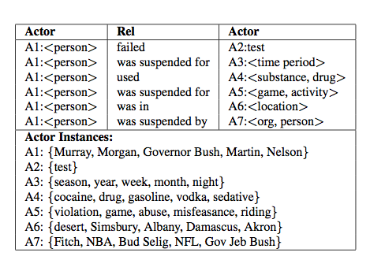
Application: Event Schemas
Event schemas contain actors and the roles they play within an event.
Chambers et al., 2009 automatically induced event schemas using SVO tuples.
Our approach:
Create relation graph using Rel-grams.
Find high connectivity nodes within the relation graph as seeds.
For each seed find related tuples using personalized page rank.
Use equality constraints on arguments in the related tuples to identify/merge actors.

Slide 8
Example: Arrest Schema
(<person>, charged by, <org>)
(<person>, arrested by, <org>)
(<person>, be in, <location>)
(<person>, arrested for , <activity>)
(<person>, is father of, <location>)
(<person>, is director of, <org>)
Find neighborhood for query tuple

Slide 9
Example: Arrest Schema
(<person>, charged by, <org>)
(<person>, arrested by, <org>)
(<person>, be in, <location>)
(<person>, arrested for , <activity>)
(<person>, is father of, <location>)
(<person>, is director of, <org>)
Use Personalized Page Rank to find related tuples.

Slide 10
Example: Arrest Schema
(<person>, charged by, <org>)
(<person>, arrested by, <org>)
(<person>, be in, <location>)
(<person>, arrested for , <activity>)
Use equality constraints to identify and merge actors.

Slide 11
Example: Arrest Schema
A2:<org>: {police, FBI, Secret service, …}
arrested by
charged by
A1:<person>:
{suspect, man, he, …}
arrested on
A3: {charge, suspicion,…}
be in
A4: <location>{jail, prison, apartment, …}

