Slide 1
Lending Case Study Submission
Name:
Sukanya Desikan
Niranjan Harpale

Slide 2
Context & Approach

Slide 3
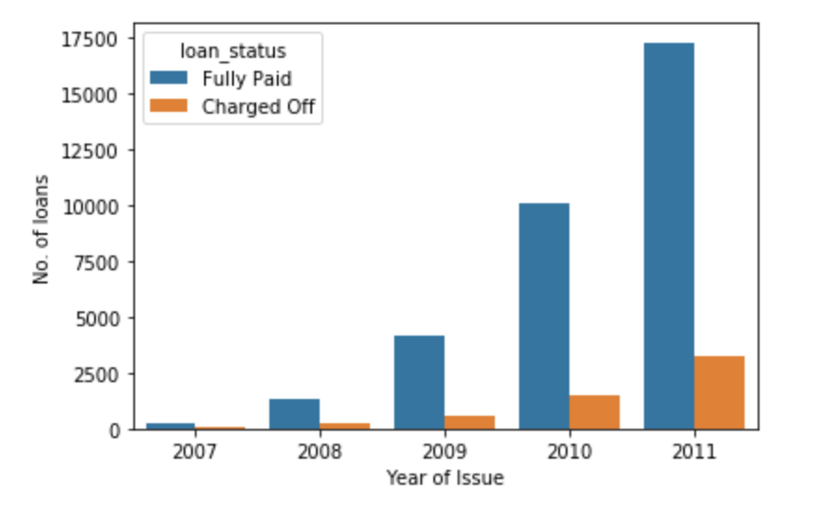
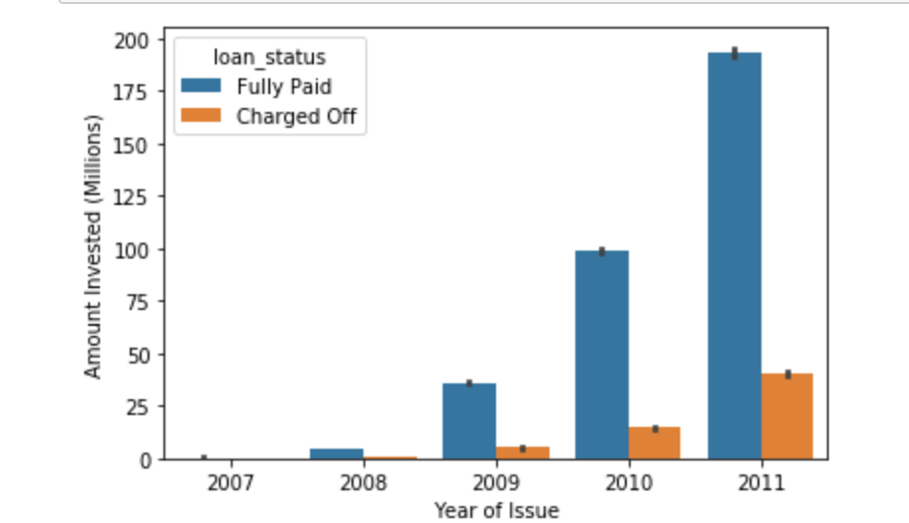
Defaults are rising across the years along with increase in loans
Number of loans across years – Split by Loan Status
Amount Invested across years– Split by Loan Status

Slide 4
Approach to identify factors affecting default
Data Understanding & Cleaning
1. Find Categorical and Quantitative
Variables.
2. Analyze, check distribution of each
of these variables.
3. Add derived columns if required.
4. Plot graphs and take insights.
Univariate Analysis
Data Frames
Data For
Analysis
Data Cleaning
1. Driving factors behind
loan default.
2. Observations from
Analysis.
2. Recommendations to
Lenfing Club.
Bivariate Analysis
Results
1. Analyze two attributes together.
2. Find the correlation between
different variables.
3. Perform correlation analysis with
plotting correlation matrix.
4. Add derived columns if required.
5. Plot graphs of two variables
and observe the how they
effect each other.
1. Analyze each categorical and
quanitative variables according
to the segments of values.
2. Add derived columns if required.
3. Plot graphs of the segments
and take insights.
Segmented Univariate Analysis

Slide 5
Factors driving default rates

Slide 6
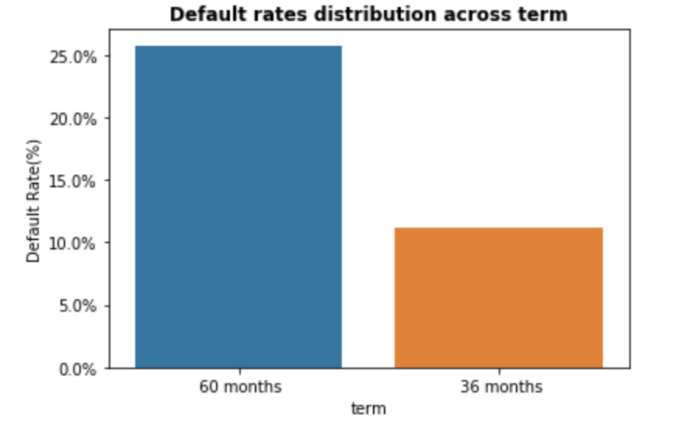
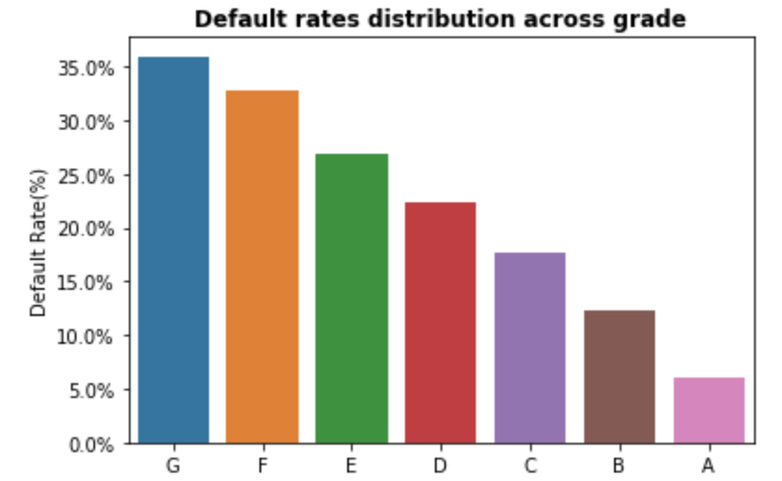
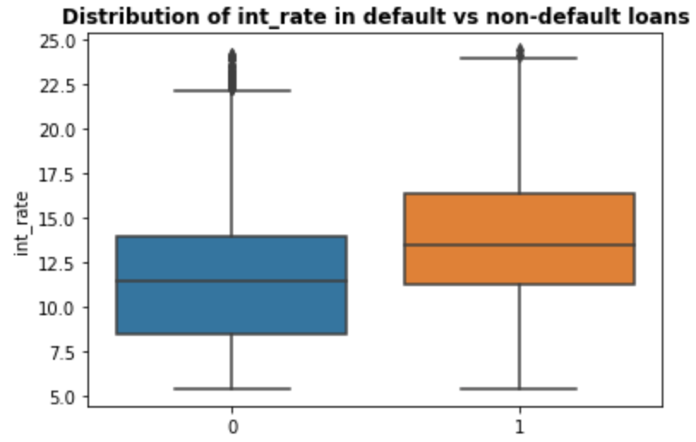
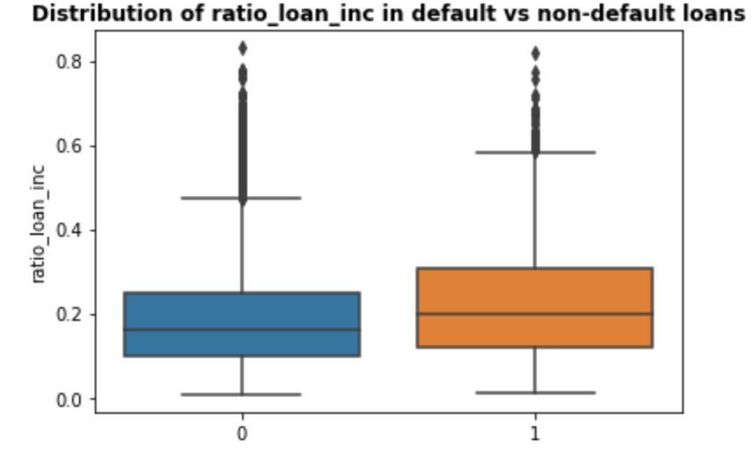
Significant influencers of default (1/2)
Term
”60 months” has higher default rate
Grade
Default rates increases as grade of loan decreases
Interest Rate
Default loans have higher interest rates
Loan to Income Ratio
Default loans have higher loan to income ratios

Slide 7
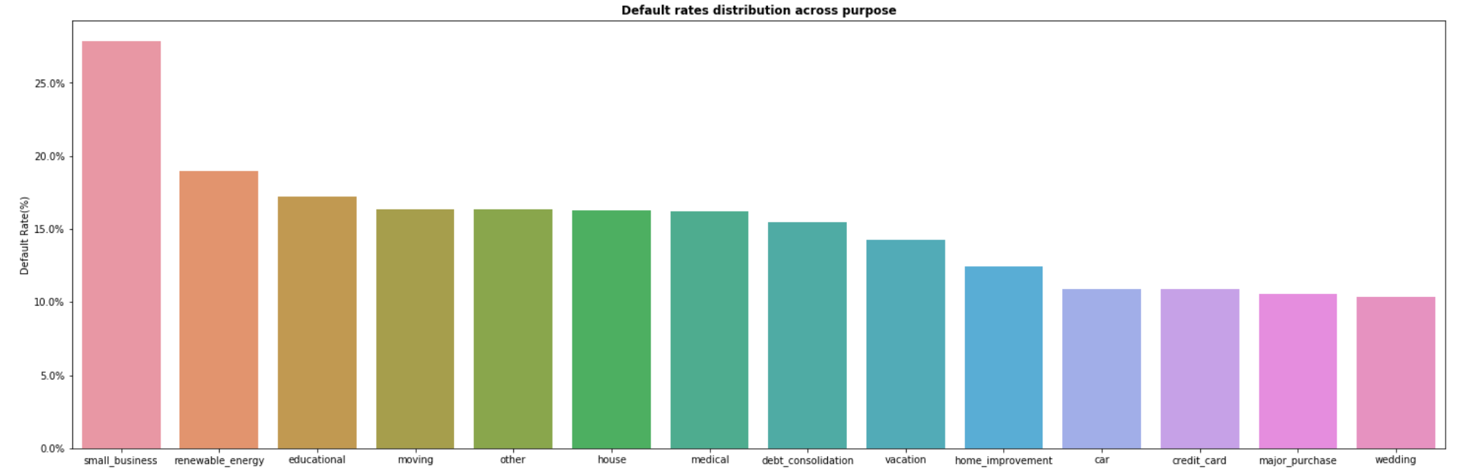
Significant influencers of default (2/2)
Purpose
”Small business” has higher default rate than other purposes

Slide 8
Recommendations to reduce default rates

Slide 9
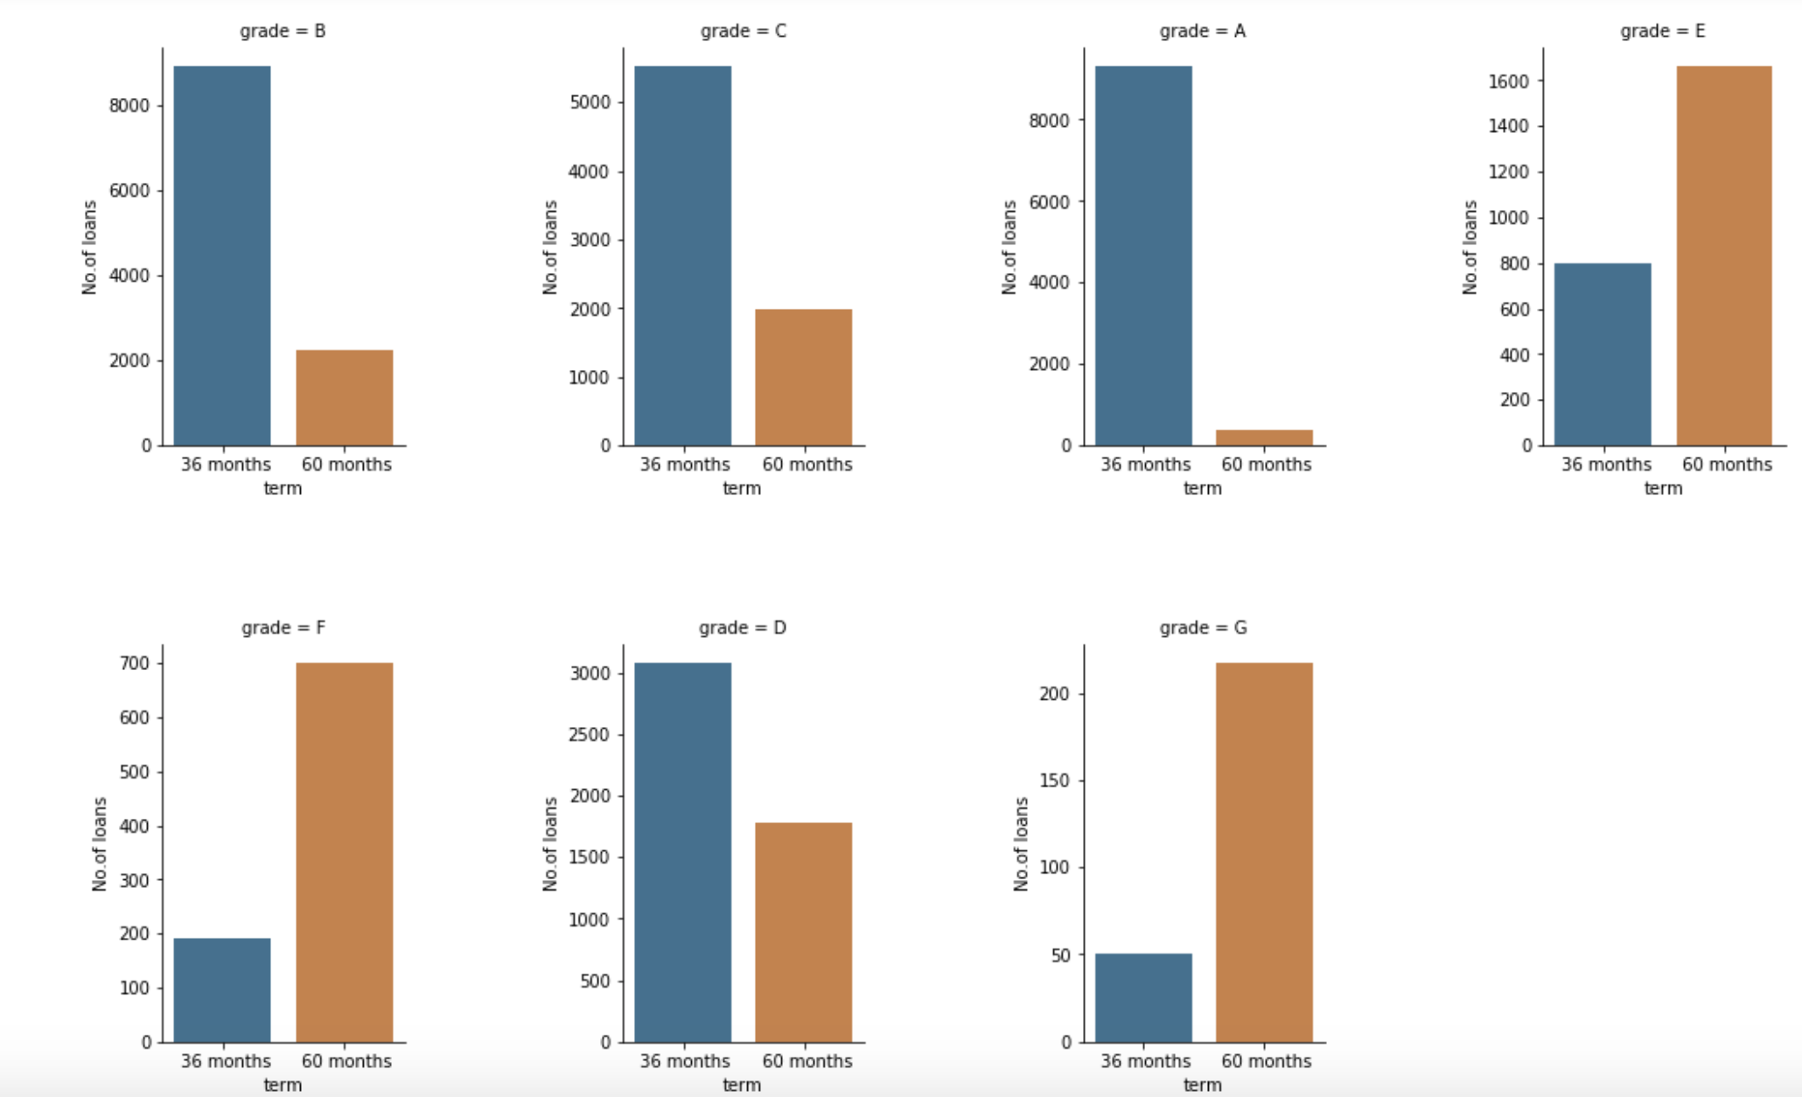
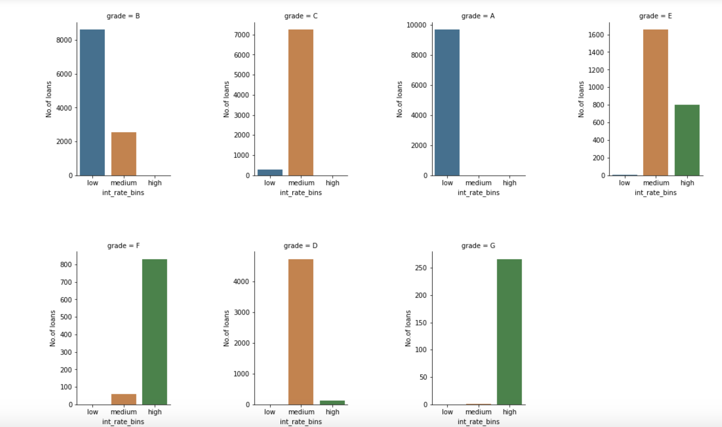
Reduce loan sanctions to lower grades instead of increasing interest rate and term length
Number of loans for each term split by grade
Observation : More loans are assigned with term 60 months as grade decreases
Number of loans for each interest rate bins split by grade
Observation: Lesser grades are assigned higher interest rates
Recommendation:
Since we see that 60 month term and higher interest rates increases the chances of default, reducing loan approval to grades less than ‘D’ should be considered

Slide 10
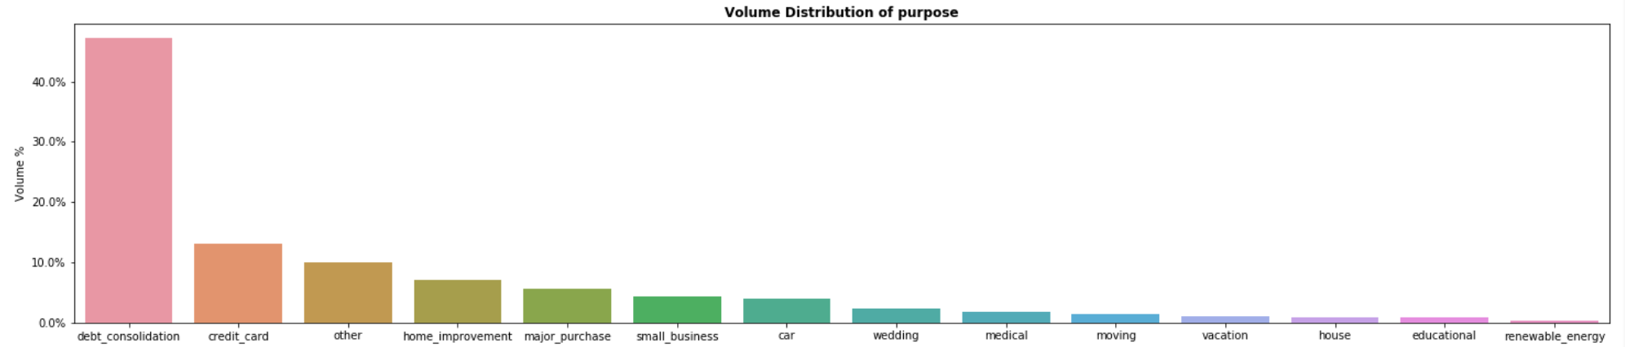
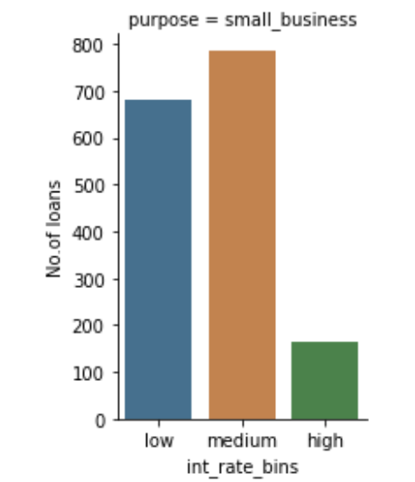
Reduce the interest rates for good quality loans with purpose ‘small business’
Distribution of % loans across purposes
Small business contributes to ~10% of total loans
For Small Business - Number of loans across interest rate bins
There are more loans existing for high interest rate
For Small Business - Loans across interest rate bins for every grade
Medium & High interest rates are assigned even for good quality loans in grade C and D
Grade | Interest Rate Bins | # Loans | % Loans
A | low | 329 | 100%
B | low | 340 | 81%
B | medium | 81 | 19%
C | low | 11 | 4%
C | medium | 301 | 96%
D | medium | 263 | 98%
D | high | 5 | 2%
E | medium | 133 | 77%
E | high | 40 | 23%
F | medium | 7 | 9%
F | high | 74 | 91%
G | high | 45 | 100%

Slide 11
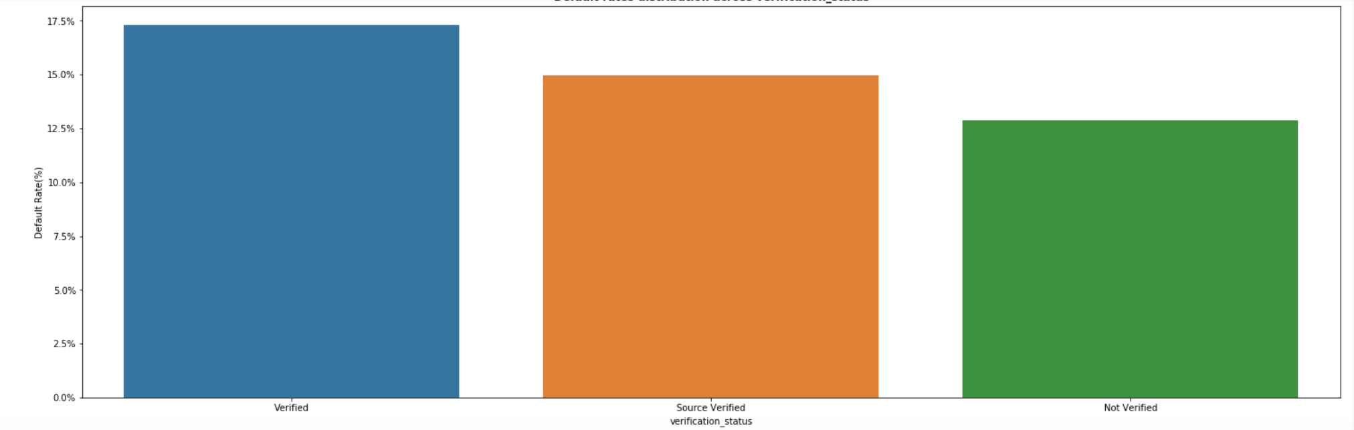
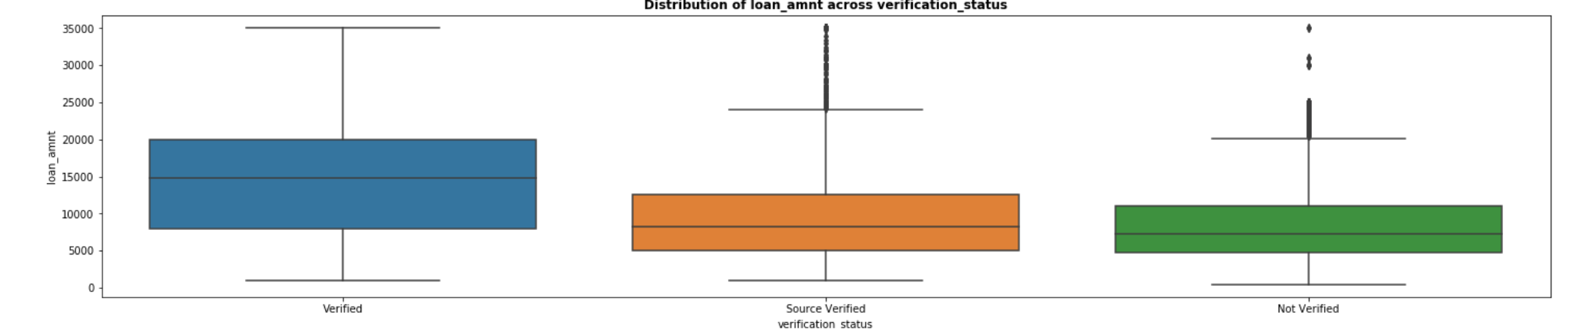
Scope to improve verification process
Default rates across verification status
Observation : Verified loans have comparatively higher default rates. Since it is expected that if a loan is verified the chances of default decreases, this data suggests an improvement to the process is required
Loan amount across verification status
Observation: This suggests that verified loans have higher loan amounts. The process can be made more thorough by verifying even lesser loan amounts

