Slide 1
INVESTMENT ASSIGNMENT
SPARK FUNDS INVESTMENT ANALYSIS
SUBMISSION
by Niranjan Harpale

Slide 2
Business Objective:
To make investment in companies by identifying best sector, counties and a suitable investment type.
Strategy is to invest where others are investing.
Constraint:
1. To invest between 5 to 15 million USD per round of investment.
2. Invest only in English-speaking countries because of the ease of communication.

Slide 3
Problem solving methodology
Data Understanding
Data Preparation
Merging data
sets
Data
Cleaning
Data
For Analysis
Data sets
(companies.txt,
rounds2.csv,
mapping.csv)
Data Analysis
Funding Type Analysis
1. Average funding raised for venture, seed,
angel and private equity type
2. Selecting best funding typefrom results
1. Suggesing best
funding type
2. Suggesting best
Sector
3. Suggesting best
country
Results
1. Correcting data
2. Mapping category list
with main sector
3. Fnding main top 3
main sectors for
each country
Sector Analysis
Country wise Analysis
1. Finding top 9 counties according to
funding raised
2. Choosing top 3 Engish-speaking counties
from selected top9 countries

Slide 4
ANALYSIS
Data Sets:
1. comapies.txt: a text file containing information related to companies
2. rounds2.csv: a csv file having all information about funding round types and raised funding
3. mapping.csv: a csv file where all categories are mapped to 8 main sectors
Data source:
1. We have taken real investment data from crunchbase.com.
2. Wikipedia page of English speaking countries information
Data Cleaning:
1. We merged data from companies.txt and rounds2.csv file into one file
2. On this file we performed cleaning by performing:
Removing missing values
Correcting wrong values

Slide 5
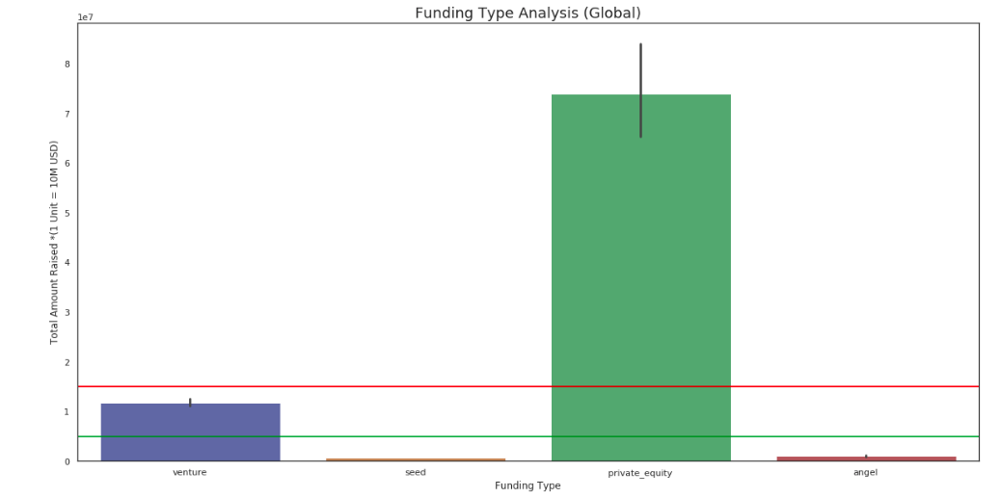
FUNDING TYPE ANALYSIS

Slide 6
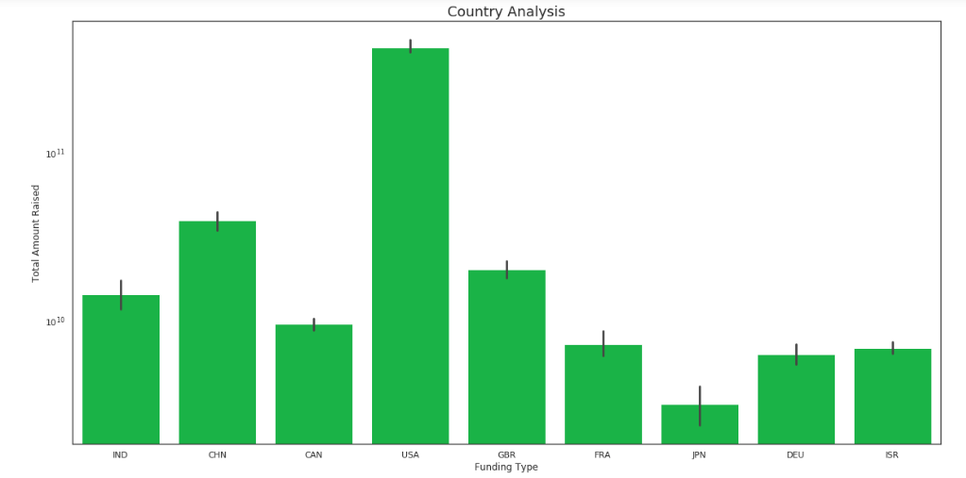
COUNTRY ANALYSIS

Slide 7
SECTOR ANALYSIS
Country | TOP 3 Sectors | Investment Count | Best Company
USA | Others | 2950 | virtustream
 | Social, Finance, Analytics, Advertising | 2714 | shotspotter
2350
GBR | Others | 147 | electric-cloud
133 | celltick-technologies
130
IND | Others | 110 | firstcry
60 | manthan-systems
52

Slide 8
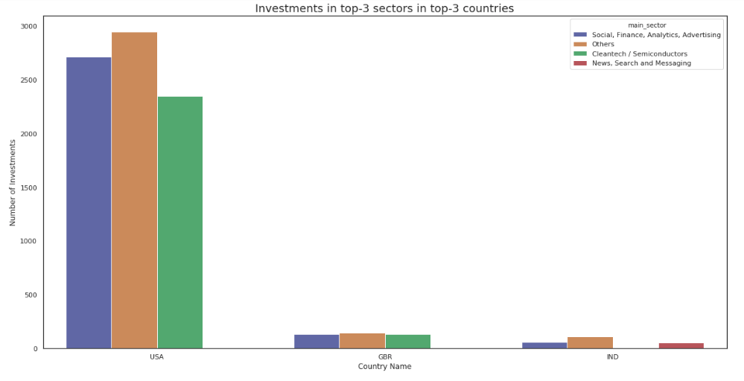
Number of Investment in
top 3 countries in top 3 sectors

Slide 9
CONCLUSION
Results of the analysis to choose an company to invest 5 million to 15 million USD in companies from most invested sectors are:
1. Spark Funds has top 3 counties to invest in USA, GBR, and IND.
2. Spark Funds can choose virtustream or shotspotter company in USA.
3. Spark Funds can choose electric-cloud or celltick-technologies in GBR.
4. Spark Funds can choose firstcry or manthan-systems in IND.
Best Investment type for Spark Fund is: Venture.

