Slide 1
RPA
RPA stands for Robotic Process Automation

Slide 2
A robot is a machine that mimics the human user in performing various tasks, such as clicks, navigations, typing, etc. Sequence of meaningful activities that may involve multiple systems or applications make up a process. Automation is the sequence of steps which are performed without any human interference (once configured).
Robotic process automation (RPA) allows using software robots instead of people to drive the business.

Slide 3
RPA Tools
We have the following popular tools available in market for RPA
Blue Prism
Automation Anywhere
Ui Path
Work Fusion
Open Span

Slide 4
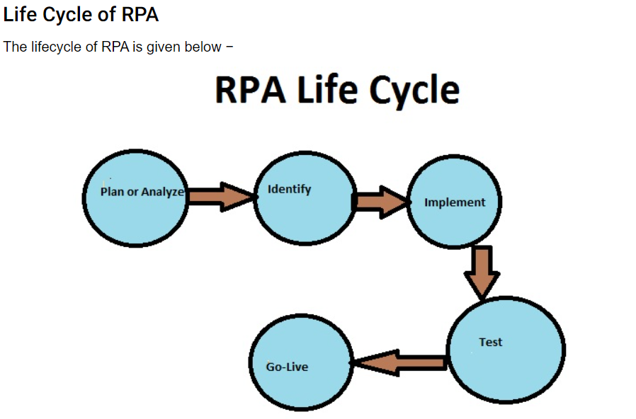
Life Cycle of RPA

Slide 5
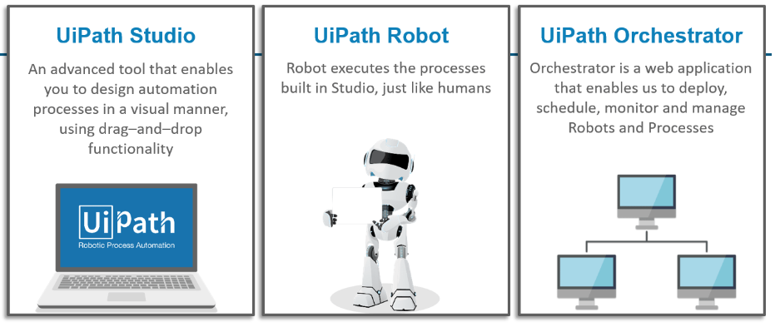
Components

Slide 6
Repetative task handler
it will create a bots for the process and scheduled in schedular.
UIpath is a first tool in RPA.
it is having both community and enterprise tool.
UI path components:UIPath studio,UI path Robot,UIpath orchestator-cloud platform(it will act as a database ).
https://cloud.uipath.com/ -install
two language -VB and C# -it will create the application backend language

