Slide 1
SERIAL COMMUNICATION USING LORA RF96
Course Based Project
Microcontroller and ARM Processor
Applications
Guide: ANIL KUMAR CS
Group Members
R22EN130 – Niranjan Meti
R22EN155 – Shashank Reddy V
R22EN157 – Shreya R
R22EN166 – A Sahithya

Slide 2
Contents
Abstract
Introduction
Literature Review
Problem statement
Objectives
Methodology
Result
Conclusion
References

Slide 3
Abstract
This project demonstrates a robust and efficient communication system using LoRa (Long Range) technology. The system comprises a transmitter and receiver, both interfaced with Arduino Uno, enabling wireless data transfer over long distances. LoRa technology offers a low-power solution with excellent range and penetration capabilities, making it suitable for IoT applications, remote monitoring, and communication in areas with limited infrastructure. By adhering to the provided pin configuration, this project successfully implements a LoRa-based communication system that is scalable, reliable, and energy-efficient.

Slide 4
Introduction
LoRa (Long Range) is a wireless communication technology designed for long-distance, low-power, and low-data-rate communication. It is widely used in Internet of Things (IoT) applications where devices need to communicate over long distances with minimal power consumption.
In an increasingly interconnected world, long-range communication technologies play a vital role in applications such as environmental monitoring, smart cities, and industrial automation. LoRa, a modulation technique for long-range, low-power wireless communication, is particularly advantageous due to its capacity to transmit data over several kilometres with minimal power consumption. This project utilizes LoRa RF96 modules connected to Arduino Uno boards to create a basic communication setup. It highlights the feasibility of LoRa in developing cost-effective and reliable communication systems, showcasing its potential for various real-world applications.

Slide 5
LITRATURE SURVEY
An alternative communication system is essential for areas without telecommunication services or during disasters. Technologies like LoRa WAN, with low energy consumption and long-range coverage, are suitable for such scenarios. The proposed instant messaging system uses two TTGO LoRa 32 devices, one for transmission (TX) and the other for reception (RX), configured on separate channels to avoid interference. Energy consumption was evaluated by sending messages every 5 seconds, averaging 0.048A with a median of 0.04A. Transmission mode consumes more energy. Tests conducted on the ground successfully sent and received messages. This system is invaluable in disasters, enabling users to send help or warning messages. It is also useful in remote rural areas and for communication between vessels in oceans and large lakes [1].
With the advancement of China's agricultural reforms, the demand for Chinese herbal medicines is growing, with artificial cultivation becoming a trend. However, challenges persist, including natural disasters, unsuitable planting environments, and growers' limited experience in managing conditions like drought, waterlogging, and frost. To address these issues, this paper proposes an IoT-based environmental control system for herbal medicine cultivation. The system ensures optimal growing conditions for various herbs and their growth stages by using sensors, LoRa communication, and actuators. It monitors and regulates temperature, humidity, soil moisture, and light intensity in greenhouses in real time. Growers can remotely manage these parameters, defending against natural disasters and achieving automation, intelligence, and digitization in herbal medicine farming [2].

Slide 6
To address short communication range and high power consumption in manhole cover monitoring, LoRa technology is introduced for its long-range, low-power capabilities. The application architecture of LoRa in an intelligent manhole cover monitoring system is analyzed and tested. Results show LoRa achieves a communication range of 700 meters and battery life exceeding 3 years. This ensures low power consumption and long-range performance, providing an effective solution for urban manhole cover safety management. The system offers a new approach to interconnecting IoT devices under similar conditions, advancing the development of smart city infrastructure [3].
This paper explores the use of Long Range (LoRa) technology for requesting pressure and temperature (P&T) sensor data and retrieving measurements over the 2.4 GHz ISM band. Using LoRa development kits (SX1280), a network comprising one Master board and multiple Sensor boards (slaves) was implemented, with each slave interfacing with P&T sensors. The quality and performance of the LoRa network were evaluated under varying parameter settings. Despite significant electromagnetic activity in the 2.4 GHz band, data transmission tests were successful. The study analyzed the communication range across different scenarios, focusing on the impact of the spreading factor (SF) parameter on network performance [4].

Slide 7
PROBLEM STATEMENT
Traditional wireless communication systems often face challenges such as limited range, high power consumption, and interference in urban or remote environments.
Existing solutions, such as Wi-Fi or Bluetooth, either lack the necessary range or are unsuitable for applications requiring low-power operation over vast areas. The absence of a reliable, energy-efficient long-range communication framework hinders the progress of IoT-based systems and remote data monitoring.
This project addresses this gap by implementing a LoRa-based communication system, providing an effective alternative for low-power, long-distance data transmission.

Slide 8
Objective
Design and Implementation: To design and implement a LoRa-based communication system using LoRa RF96 modules interfaced with Arduino Uno, ensuring accurate and reliable data transmission between a transmitter and receiver
Establish a Wireless Data Link: To establish a stable and efficient wireless communication link for transmitting and receiving data over significant distances without relying on existing communication infrastructure.

Slide 9
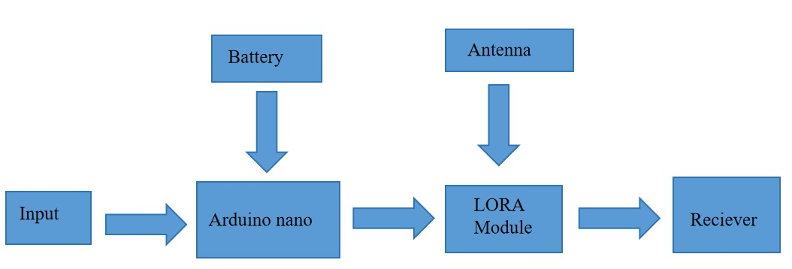
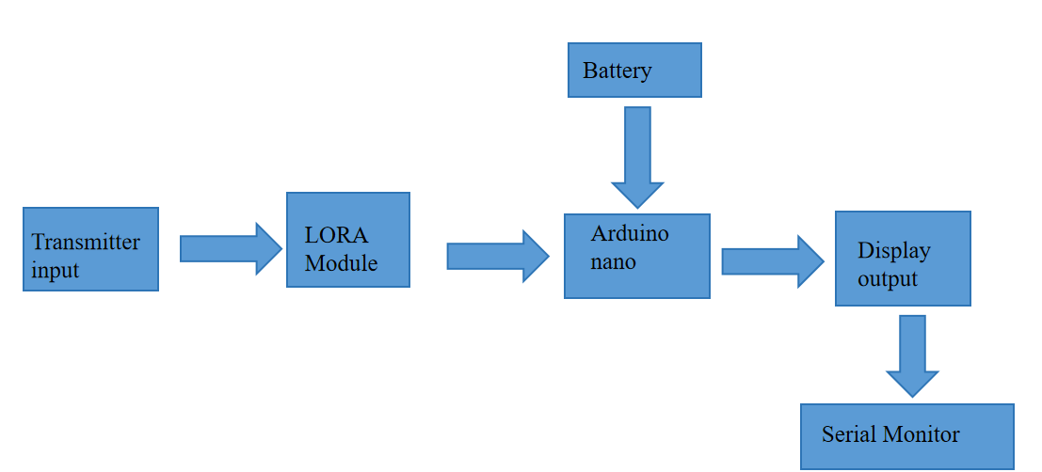
BLOCK DIAGRAM
TRANSMITTER
RECIEVER

Slide 10
BLOCK DIAGRAM explanation
The transmitter collects input data, processes it via Arduino Nano, and transmits it wirelessly using a LoRa module and antenna.
The receiver captures the data through the LoRa module, processes it using another Arduino Nano, and displays the output for monitoring.
This system is useful for long-range wireless communication, typically applied in IoT (Internet of Things), remote monitoring, and sensor networks.

Slide 11
Expected Outcome
Functional Long-Range Communication System: A fully functional LoRa-based communication system capable of transmitting and receiving data over long distances (up to several kilometers) with minimal power consumption.
Reliable Data Transmission: Consistent and error-free wireless data transmission between the transmitter and receiver, even in environments with physical obstructions or interference.
Low-Power Operation: Demonstration of the energy efficiency of the LoRa technology, making it suitable for battery-powered or solar-powered IoT devices in remote locations.
Versatile System for IoT Applications: A scalable and flexible communication setup that can be adapted for various real-world IoT applications such as environmental monitoring, smart agriculture, industrial automation, and remote sensing.

Slide 12
References
[1]J. E. Cruz De La Cruz, C. A. Romero Goyzueta, E. V. Sagua Machaca and W. A. Mamani Machaca, "LoRaWAn Instant Messaging System For Areas Without Telecommunication Services and Disaster Environment," 2021 International Conference on Electrical,
[2]N. S. Kumar, C. R, N. S. M, P. R and P. V. P, "Wearable IoT Life Jacket: Utilizing LoRa Technology to Combat Hypothermia," 2024 International Conference on Smart Systems for Electrical, Electronics, Communication and Computer Engineering (ICSSEECC), Coimbatore, India, 2024, pp. 23-27, doi: 10.1109/ICSSEECC61126.2024.10649536.
[3] R. Tanaka, D. Nobayashi, K. Tsukamoto, T. Ikenaga, G. Sato and K. Takizawa, "Dynamic Transmission Parameter Settings Based on Data Transmission and Reception Performance for 920MHz LoRa Communication," 2024 IEEE 21st Consumer Communications & Networking Conference (CCNC), Las Vegas, NV, USA, 2024, pp. 1102-1103, doi: 10.1109/CCNC51664.2024.10454734.
[4] L. Xuan, Z. Hesheng and L. Lei, "Research on LoRa Communication Performance in Manhole Cover Monitoring," 2019 IEEE International Instrumentation and Measurement Technology Conference (I2MTC), Auckland, New Zealand, 2019,

Slide 13
Thank You…..

