Slide 1
Neural Network-Based Image Steganography Using Autoencoders
Research-Based Project - Phase 1
Team No: ECE_3YP_T051
Guide: Dr.Raghu K
Group Members
R22EN130 – Niranjan Meti
R22EN155 – Shashank Reddy V
R22EN157 – Shreya R
R22EN166 – A Sahithya

Slide 2
Contents
Abstract
Introduction
Problem formulation and Objectives
Methodology
Applications
References

Slide 3
Abstract
Image steganography is used to hide secret information within a cover image, ensuring secure communication. This project employs Convolutional Neural Networks (CNNs) for feature extraction and embedding.
The Encoder integrates the secret image into the cover image, generating a stego-image, while the Decoder retrieves the hidden data. CNNs analyze spatial features, learning patterns for effective embedding and extraction.
The Kelner filter aids in feature refinement, enhancing the embedding process. This approach ensures high imperceptibility and security in steganographic systems.
Additionally, the model is evaluated using Peak Signal-to-Noise Ratio (PSNR) and Structural Similarity Index (SSIM) to measure the quality and accuracy of the extracted data. The deep learning-based approach improves robustness against steganalysis, making it a promising solution for secure digital communication.

Slide 4
Introduction
With the rise of digital communication, secure data transmission has become crucial. Image steganography conceals secret information within digital images, ensuring discreet and protected data exchange. It embeds data in image pixels without visibly altering the cover image, making detection difficult.
Traditional methods like Least Significant Bit (LSB) substitution and Discrete Cosine Transform (DCT)-based techniques are prone to detection and modifications, making them less secure.
To enhance imperceptibility and robustness, Convolutional Neural Networks (CNNs) are used for feature extraction. CNNs analyze spatial features, learn complex patterns, and adaptively embed hidden data, making steganographic systems more secure and resistant to attacks.
Deep learning-based steganography enables adaptive data hiding by training CNN models to optimize feature extraction and embedding. Unlike fixed-rule techniques, CNNs dynamically adjust based on image content, ensuring better security, imperceptibility, and resistance to steganalysis while preserving the visual integrity of the stego-image. Additionally, this approach automates embedding optimization, reducing human intervention and enhancing adaptability across various image types, making it more reliable for real-world applications.

Slide 5
Problem formulation and objectives
Traditional image steganography techniques, such as Least Significant Bit (LSB) substitution and Discrete Cosine Transform (DCT)-based methods, often suffer from limited capacity, poor robustness, and vulnerability to attacks. Furthermore, these methods rely on handcrafted features and predefined rules, making them less adaptable to varying image structures.
This project aims to develop an end-to-end image steganography system that utilizes Deep Convolutional Autoencoders to hide a secret image within a cover image while ensuring high imperceptibility, robustness, and retrieval accuracy.
The objectives are:-
To design and implement a deep convolutional autoencoder that can efficiently embed and extract a secret image within a cover image.
To evaluate the system's performance using Peak Signal-to-Noise Ratio (PSNR), Structural Similarity Index (SSIM), and Bit Error Rate (BER).

Slide 6
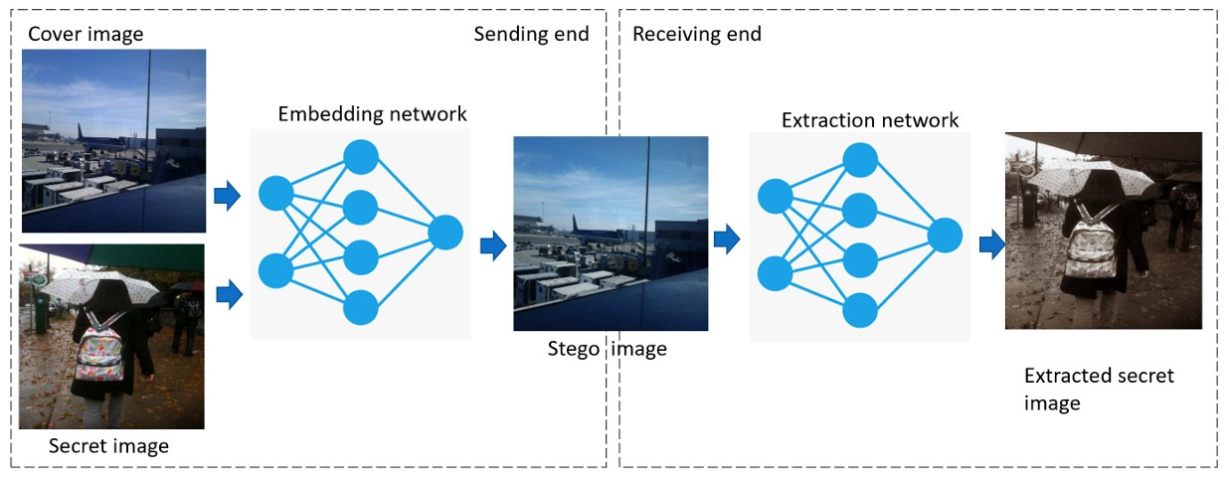
methodology
Overall workflow of the proposed method. The sending end consists of the preprocessing module and the embedding network. The preprocessing module extracts features from the cover image and the secret image and merges them using the concatenation layer. The embedding network reconstructs the stego image from the fused features. Finally, at the receiving end is the extraction network to extract the secret image from the stego image.

Slide 7
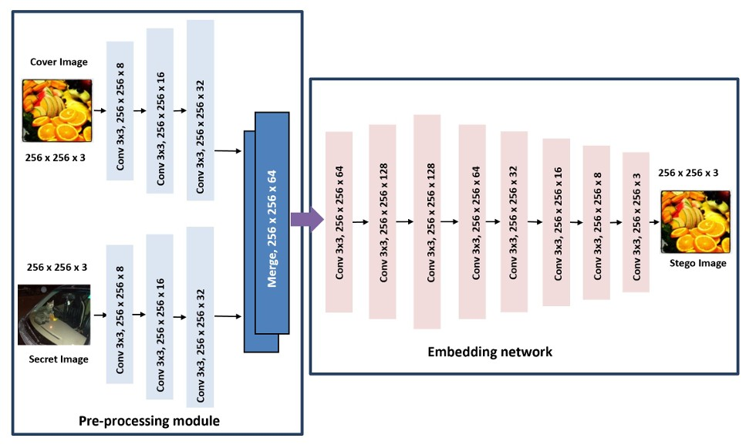
Embedding network
The architecture of the preprocessing module and the embedding network of the proposed method.

Slide 8
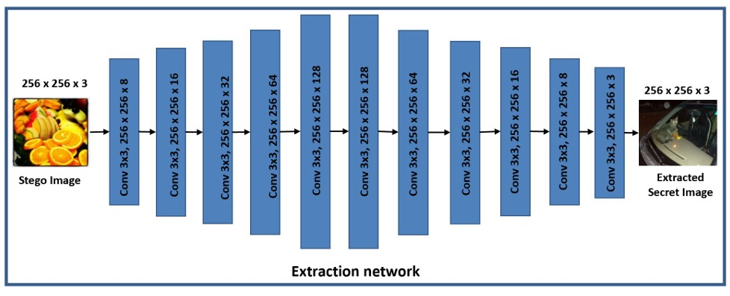
extraction network
The architecture of the extraction network of the proposed method.

Slide 9
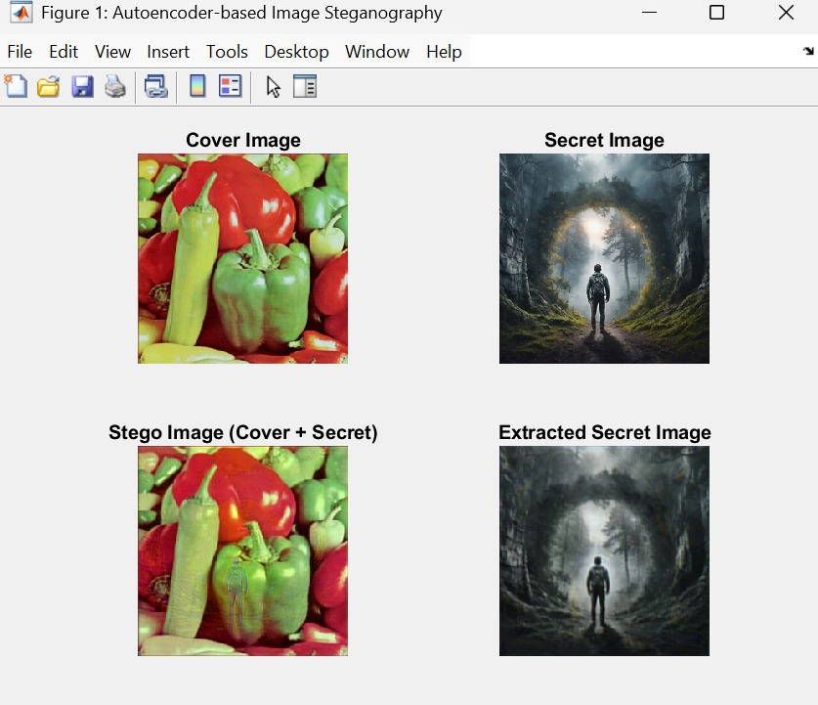
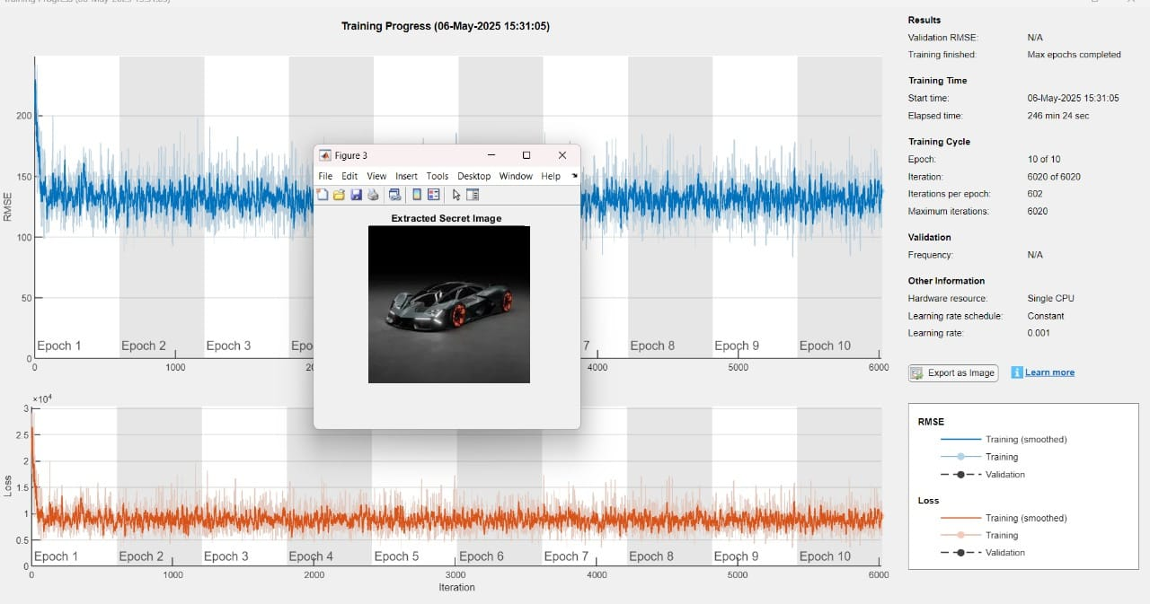
RESULTS AND DISCUSSION
Output image
Output after Model Training

Slide 10
Method | Embedding Capacity | Imperceptibility (Cover vs Stego) | Robustness (Secret Recovery) | PSNR (Stego) | PSNR (Extracted Secret)
LSB Substitution | High | Low | Low | 30–35 dB | ~25–30 dB
DCT-Based Steganography | Moderate | High | Moderate | 35–45 dB | ~30–35 dB
QVD-LSB Hybrid | High | Moderate | High | 40–50 dB | ~32–36 dB
Autoencoder-Based (Ours) | Moderate–High | Very High | Very High | 38.75 dB | 36.42 dB
Performance Comparison Table

Slide 11
CONCLUSION
The proposed neural network-based image steganography method using autoencoders demonstrates an effective and secure approach for hiding and retrieving secret images. By leveraging deep learning, the model achieves high imperceptibility in the stego image and accurate reconstruction of the hidden image, as evidenced by strong PSNR values. Compared to traditional techniques like LSB and DCT, the autoencoder-based approach offers superior robustness, adaptability, and visual quality. This work lays a foundation for future advancements in intelligent, data-driven steganographic systems suitable for modern secure communication applications.

Slide 12
applications
Forensic and Intelligence Applications
Medical Image Security
Espionage and Cybersecurity (Ethical and Unethical Uses)

Slide 13
References
N. Subramanian, I. Cheheb, O. Elharrouss, S. Al-Maadeed and A. Bouridane, "End-to-End Image Steganography Using Deep Convolutional Autoencoders," in IEEE Access, vol. 9, pp. 135585-135593, 2021, doi: 10.1109/ACCESS.2021.3113953.
O. Elharrouss, N. Almaadeed, and S. Al-Maadeed. An image steganog raphy approach based on k-least significant bits (k-lsb). In 2020 IEEE International Conference on Informatics, IoT, and Enabling Technologies (ICIoT), pages 131–135, 2020.
Hsiao-Shan Huang. A combined image steganographic method using multi-way pixel-value differencing. In Yulin Wang, Xudong Jiang, and David Zhang, editors, Sixth International Conference on Graphic and Im age Processing (ICGIP 2014), volume 9443, pages 267–271.International Society for Optics and Photonics, SPIE, 2015.
X. Duan, D. Guo, N. Liu, B. Li, M. Gou, and C. Qin. A new high capacity image steganography method combined with image elliptic curve cryptography and deep neural network. IEEE Access, 8:25777–25788, 2020.

Slide 14
Thank You…..

