Slide 1
Data Science Capstone Project
Niranjan N
23 August 2021

Slide 2

Outline
Executive Summary
Introduction
Methodology
Results
Conclusion
Appendix

Slide 3

Executive Summary
Summary of methodologies
Many methodologies were used to predict whether a SpaceX rocket would land successfully, including data collection, wrangling and visualization, logarithmic regression and machine learning
Summary of all results
The best performing machine learning algorithm is the decision tree classifier and the rocket most likely to land are those with lower-weighted payloads in the orbits of GEO, HEO, SSO and ES-L1

Slide 4

Introduction
Project background and context
SpaceX is an innovative company seeking to democratize space travel through competitive pricing and the reuse of certain launch materials. This project aims to help predict which types of rockets will land successfully. Since SpaceX spends $62 million per launch (compared to $162 million from competitors), accurate predictions will help further drive costs down, eventually making space travel more accessible to more people and companies
Problems you want to find answers
The problems the research set out to answer were:
What factors have the most weight in determining whether a rocket will land successfully or not
Which machine learning algorithms perform the best in helping us make those predictions

Slide 5

Methodology
Data collection methodology:
Data was collected via the SpaceX Rest API and also via web
scraping from wikipedia
Perform data wrangling
Data was processed using One Hot Coding fields for machine learning. Data was also standardized, Means were added to rows without values and Irrelevant data columns were removed from the data set
Perform exploratory data analysis (EDA) using visualization and SQL
Perform interactive visual analytics using Folium and Plotly Dash
Perform predictive analysis using classification models
These included evaluating model type and performance

Slide 6
Methodology

Slide 7

Data collection
Describe how data sets were collected.
Data sets were collected by using the GET command to collect and parse json files from the SpaceX API. Then a dataset was created combining data from different tables
You need to present your data collection process use key phrases and flowcharts

Slide 8
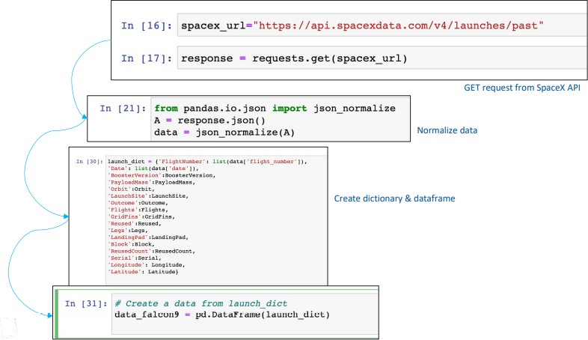
Data collection – SpaceX API
DataScienceCapstone/Data Collection API Notebook(1).ipynb at main · Nirin13/DataScienceCapstone (github.com)

Slide 9
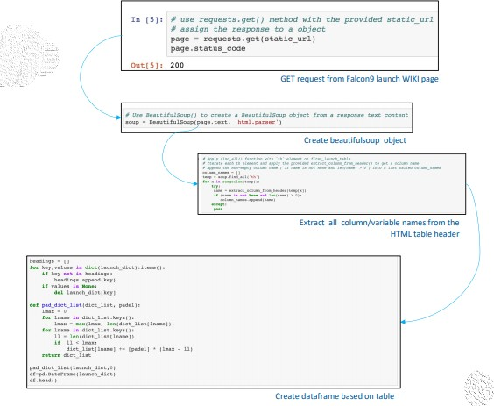
Data collection – Web scraping
DataScienceCapstone/Data Collection with Web Scraping Notebook(2).ipynb at main · Nirin13/DataScienceCapstone (github.com)

Slide 10
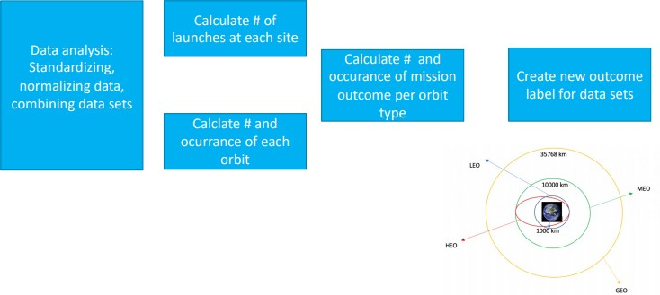
Data wrangling
DataScienceCapstone/Data Wrangling EDA Notebook(3).ipynb at main · Nirin13/DataScienceCapstone (github.com)

Slide 11
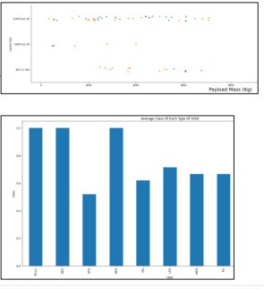
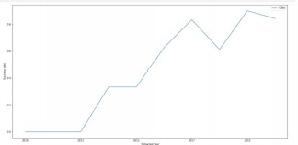
EDA with data visualization
Various chart types were plotted to
visualize the SpaceX launch data
A scatterplot was used to visualize the
and
relationships between flight number
launch site and payload and launch site
Scatterplots are useful chart types because it is relatively easy to see relationships and clusterings between variables
A bar chart was used to compare the success rate of each orbit type. Bar charts are effective as showing comparisons between variables
Lastly, a line chart was used to show average success rate over time. Line charts are effective at presenting performance over time
DataScienceCapstone/EDA with Data Visualization Notebook(5).ipynb at main · Nirin13/DataScienceCapstone (github.com)
11

Slide 12
EDA with SQL
Various queries were used to obtain information about the data set, including retrieving the following data points
Names of unique launch site
Total payload mass carried by boosters launched by NASA
Date of successful landing outcome in drone ships
Names of successful boosters with mass greater than 4000 but less than
600
Total number of successful and failed mission outcomes
12

Slide 13
Build an interactive map with Folium
To build the folium map, the following map objects were used:
The circle object was added to show define the launch site
Dataframe launch_outcomes were assigned to colors with green red to show success or failure
A line object was added to measures the distance between landmarks
DataScienceCapstone/Visual Analytics with Folium Notebook(6).ipynb at main · Nirin13/DataScienceCapstone (github.com)
13

Slide 14
Build a Dashboard with Plotly Dash
Built a dashboard using Flash and Dash web framework
Interactions and features include dropdown menu, slider function for ease of data manipulation
2 types of graphs were built: pie chart and scatterplot
Piechart shows the total launches (and percentage of all launches) by launch site
Scatterplot displays the correlative relationship between outcome
(success/failure) and payload mass for different booster versions
14

Slide 15
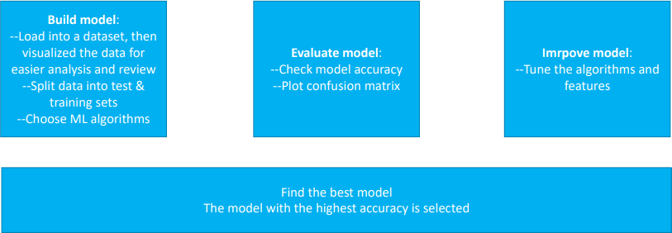
Predictive analysis (Classification)
DataScienceCapstone/ Machine Learning Prediction Notebook(8).ipynb at main · Nirin13/DataScienceCapstone (github.com)
15

Slide 16
Results
Exploratory data analysis results
Interactive analytics demo in screenshots
Predictive analysis results

Slide 17
EDA with Visualization

Slide 18
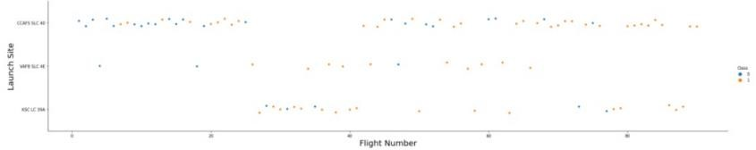
Flight Number vs. Launch Site
This graph shows the correlations between flight number and the launch site. CCAFS SLC 40 has the most successful launches

Slide 19
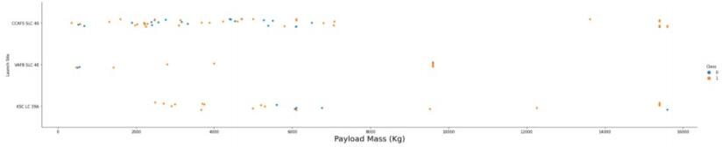
Payload vs. Launch Site
This graph shows the correlations between payload and launch site. There is not enough data to draw a conclusion

Slide 20
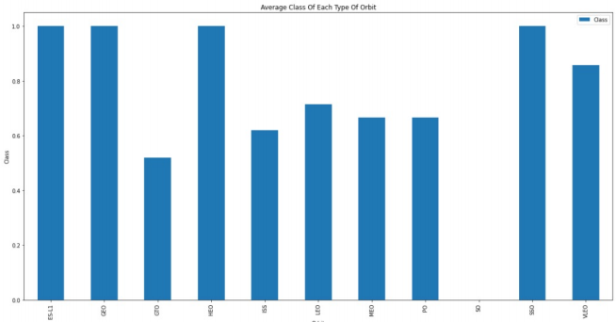
Success rate vs. Orbit type
This graph compares the success rate of various orbit types. ESL, GEO, HEO and SSO have the highest success rates

Slide 21
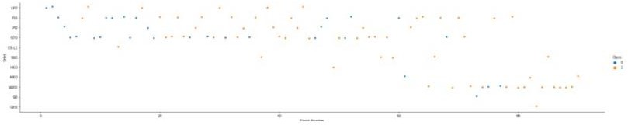
Flight Number vs. Orbit type
The LEO orbit success is related to the number of flights, but there is little correlation between flight number and GTO orbit

Slide 22
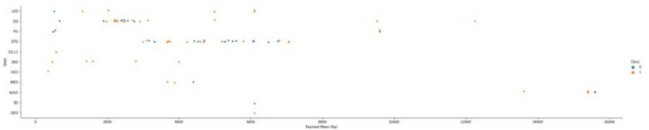
Payload vs. Orbit type
The heavier the payload the more negative the influence on success rates for orbits except GTO and Polar LEO
22

Slide 23
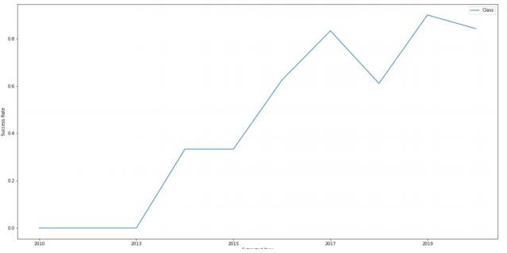
Launch success yearly trend
As time goes on, the more successful the launches are, wit the exception of a period between 2017 and 2019

Slide 24
EDA with SQL

Slide 25
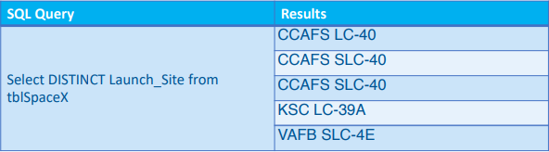
All launch site names
This query only returns unique values for launch sites, via “:distinct”

Slide 26
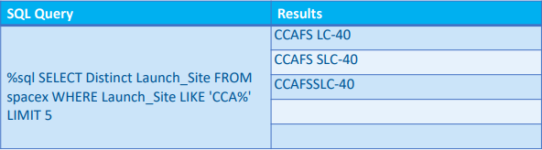
Launch site names begin with `CCA`
This query only returns unique values for launch sites, that start with CCA and limits to 5 responses

Slide 27

Total payload mass
This query sums the payload mass from spacex table where NASA is the customer

Slide 28

Average payload mass by F9 v1.1
This query finds the average payload mass from SpaceX table for the Boostr f9 v1.1

Slide 29

First successful ground landing date
This query finds the first successful launch landing

Slide 30
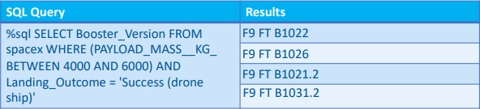
Successful drone ship landing with payload
between 4000 and 6000
This query finds the list of successful boosters within the specified payload weight range

Slide 31
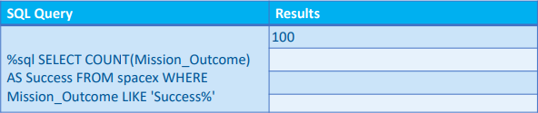
Total number of successful and failure mission
outcomes
This query finds the counts the number of successful missions where the outcome contains success

Slide 32
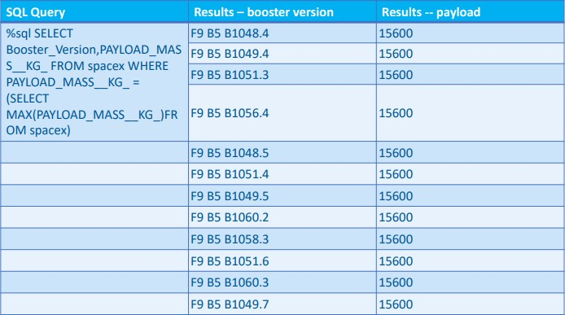
Boosters carried maximum payload
This query finds the booster versions that have the maximum payload, using a subquery to find the max payload

Slide 33
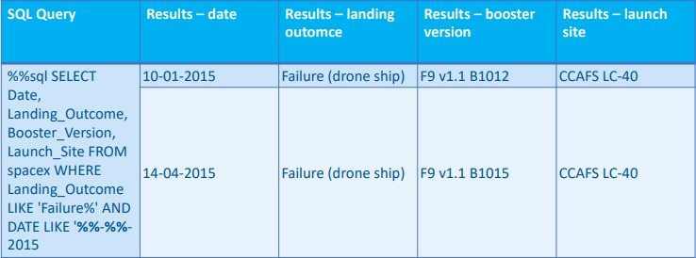
2015 launch records
This query combines the landing outcome, booster version and launchsite into a single reuslts where the landing outcome has failed

Slide 34
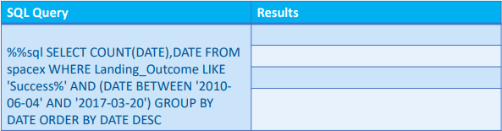
Rank success count between 2010-06-04 and
2017-03-20
This query did not return any results

Slide 35
Interactive map with Folium

Slide 36
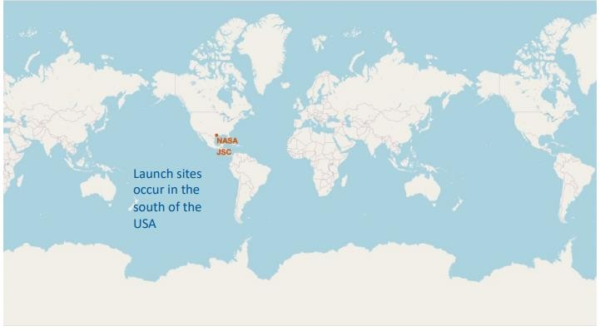
Launch site global map

Slide 37
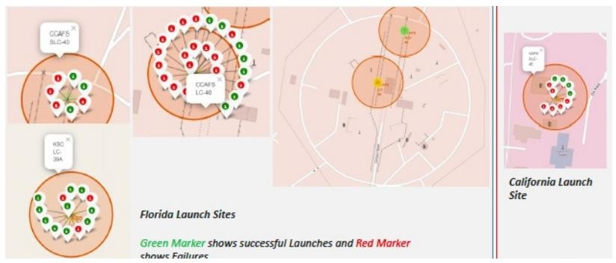
Successful and failed launches

Slide 38
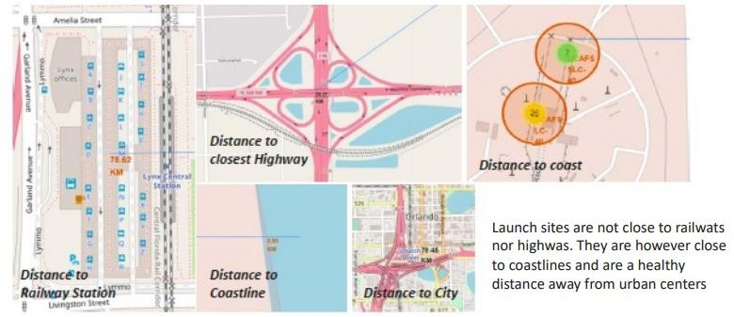
railway

Slide 39
Build a Dashboard with Plotly Dash

Slide 40
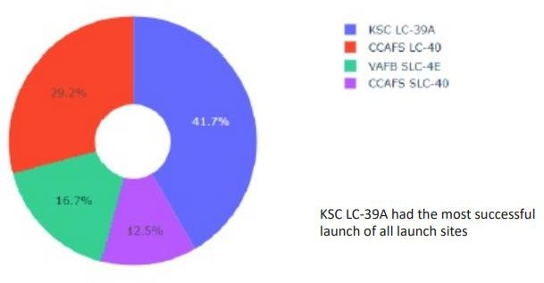
Launch success dashboard

Slide 41
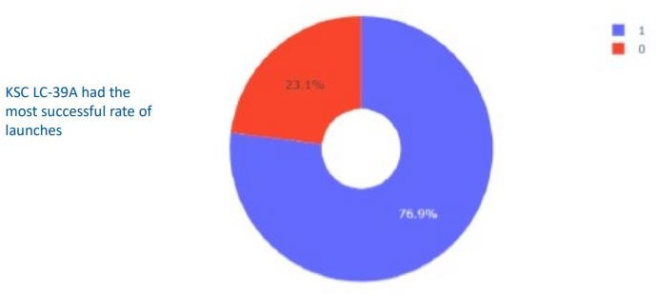
Most successful launch site

Slide 42
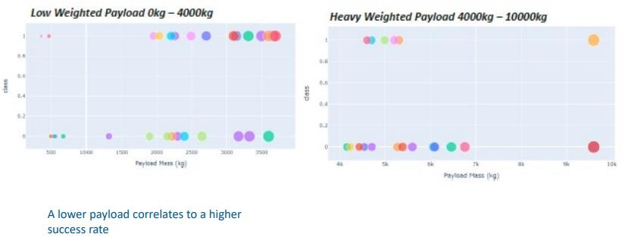
payload

Slide 43
Predictive analysis (Classification)

Slide 44
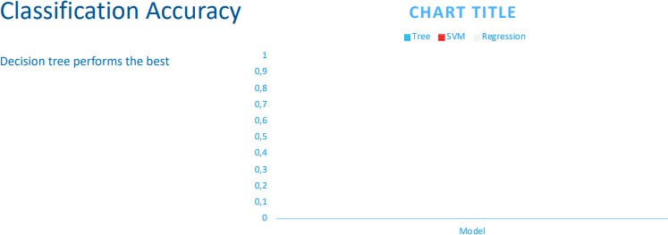

Slide 45
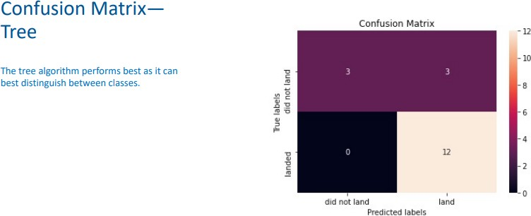

Slide 46

CONCLUSION
For future launches, lighter payloads would more likely be successful when in a GEO, HEO, SSO or ES-L1 Orbi
SpaceX will be more successful as time goes on
For this particular data set, the decision tree algorithm was the best suited

