Slide 1

CAPSTONE PROJECT · NIRANJAN | PGDA 46
F1 World Championship — Performance Intelligence Dashboard
75 seasons of data distilled into three analytical pillars: Driver Analytics, Constructor Dominance, and Circuit Intelligence. Source: F1 World Championship 1950–2024 | 14 tables | 1,128 race wins.
75
Seasons
14
Tables
1,128
Wins
860+
Drivers
77
Circuits
Niranjan | PGDA 46 | Capstone Project 1 | May 2026

Slide 2

PROBLEM STATEMENT
Formula 1 produces a huge amount of data every season, including race results, lap times, pit stops, and qualifying performance. However, understanding this data in a meaningful way can be difficult without proper analysis and visualization.
OBJECTIVE
Build a Power BI Performance Intelligence Dashboard integrating all 14 relational tables from the F1 World Championship dataset (1950–2024) into a unified, interactive, multi-page analytical tool.
SCOPE
75 seasons · 1,125+ Grand Prix · 860+ drivers · 210 constructors · 77 circuits · 35+ countries · 6 analytical dashboard pages
BUSINESS VALUE
Replicate a real-world sports analytics use case used by F1 teams, broadcasters, and race strategists to make data-driven performance decisions.

Slide 3
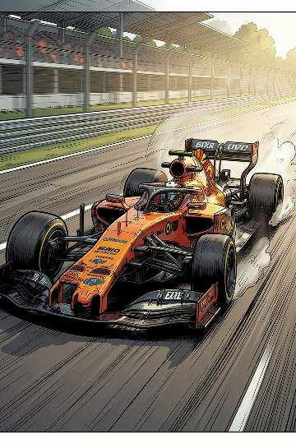
DATASET OVERVIEW — 14 TABLES
Formula 1 World Championship 1950–2024 · Kaggle · CC0 Public Domain · 14 CSV Files · 120 Columns · 21.99 MB
Table (CSV)
Rows
Key Columns
results.csv
26,000+
resultId, raceId, driverId, constructorId, position, points, laps
races.csv
1,125+
raceId, year, round, name, date, circuitId
drivers.csv
860+
driverId, forename, surname, nationality, dob
constructors.csv
210
constructorId, name, nationality
circuits.csv
77
circuitId, name, location, country, lat, lng
qualifying.csv
9,600+
qualifyId, raceId, driverId, q1, q2, q3 times
lap_times.csv
538,000+
raceId, driverId, lap, position, time (ms)
pit_stops.csv
10,000+
raceId, driverId, stop, lap, duration (ms)
driver_standings.csv
34,000+
raceId, driverId, points, position, wins
constructor_standings.csv
13,000+
raceId, constructorId, points, position
constructor_results.csv
20,000+
raceId, constructorId, points, status
status.csv
139
statusId, status (Finished/Engine/Accident...)
seasons.csv
75
year, url
sprint_results.csv
200+
Sprint race results from 2021 onwards

Slide 4

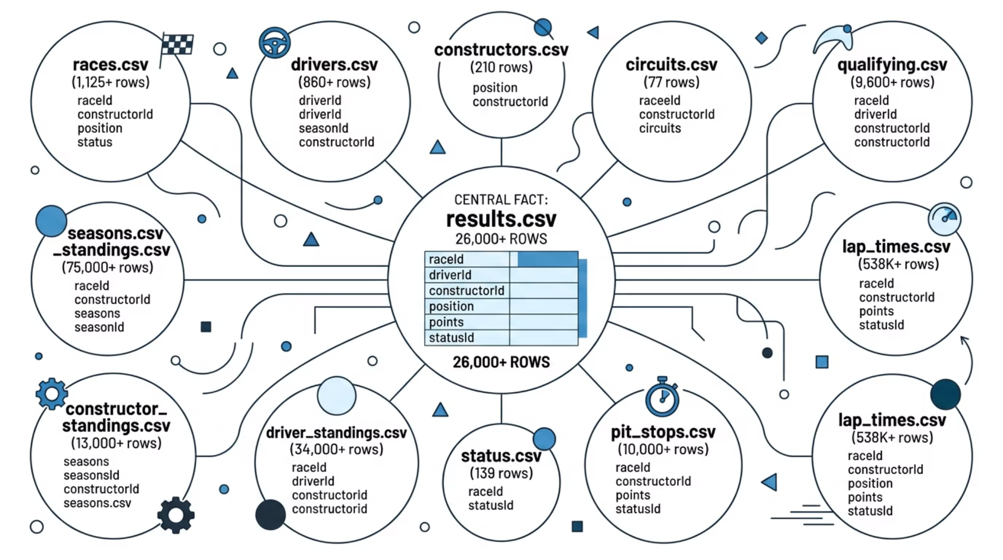

DATA MODEL — STAR SCHEMA
results.csv is the central FACT table — 13 dimension tables connect via foreign keys (raceId, driverId, constructorId, circuitId, statusId)
Note: All relationships defined and validated in Power BI Model View before building visuals

Slide 5

DASHBOARD STRUCTURE — 5 PAGES
1
2
HOME
SEASON COMMAND CENTER
Navigation hub with action buttons linking to all dashboard pages. F1 car hero image. Project title and branding.
5 KPI cards (Total Races, Wins, Podiums, DNFs, Win Rate%) · Year slicer (1950–2024) · Top 10 All-Time Drivers bar chart · Wins by Decade chart · Driver Nationality donut
3
4
DRIVER ANALYTICS
CONSTRUCTOR DOMINANCE
Driver slicer (select any driver) · 5 dynamic KPI cards · Top 10 Drivers bar · Career Win Progression line chart · Wins vs Podiums column chart · Win Efficiency bar chart
Constructor slicer · Top 10 All-Time Wins bar · Constructor Dominance by Decade line · Wins vs DNFs Reliability chart · Most Unreliable Constructors bar
5
CIRCUIT INTELLIGENCE
Country slicer · 4 KPI cards (77 circuits, 35 countries) · World Map (77 circuits plotted) · Most Used Circuits bar · Race Wins by Host Country donut

Slide 6

KEY INSIGHTS & FINDINGS
105
Lewis Hamilton All-Time Race Wins
249
Ferrari All-Time Constructor Wins
29.49%
Hamilton Win Rate %
11.66%
Mercedes Lowest DNF Rate %
01
02
1950s–1960s
1980s–1990s
Ferrari dominated early F1 — 30 wins in the 1950s, establishing the most decorated constructor record in history with 249 all-time wins.
McLaren and Williams rivalry defined the era. McLaren's 85 wins in the 1980s remains their peak decade performance.
03
04
2000s Era
2010s Era
Ferrari's Schumacher years — 5 consecutive championships (2000–2004) produced 61 wins in a single decade.
Mercedes absolute dominance — 93 wins in the 2010s. Hamilton's peak seasons: 11 wins in both 2014 and 2015.
05
2020s Era
Red Bull surge begins — Verstappen era already at 60 wins in just 4 seasons (2021–2024). Championship dynasty forming.

Slide 7

DAX MEASURES & TECHNICAL IMPLEMENTATION
8 DAX Measures Built:
8 Technical Skills Demonstrated:
Total_wins
⚡ Star Schema Data Modelling
14 relational tables with active relationships in Power BI Model View
⚡ Power Query (ETL)
Null handling, type conversion, calculated columns (Decade, DecadeSort, Driver_Full_Name)
⚡ DAX Time Intelligence
Year/Decade filtering, DISTINCTCOUNT, TOPN, AVERAGEX functions
⚡ Calculated Columns
Decade = created using FLOOR(races[year], 10) to avoid circular dependency
⚡ Geospatial Mapping
77 circuits plotted on world map using lat/lon coordinates from circuits.csv
⚡ Cross-filter Slicers
Year, Driver, Constructor, Country slicers updating all page visuals dynamically
⚡ Conditional Formatting
Data color rules on bar charts for visual hierarchy and impact
⚡ Navigation Buttons
Action buttons on HOME page for professional UX navigation between 5 pages
= CALCULATE(COUNT(results[resultId]), results[positionOrder] = 1)
Total_podiums
= CALCULATE(COUNT(results[resultId]), results[positionOrder] <= 3)
Win Rate %
= DIVIDE([Total_wins], [Total_Races], 0)
DNF count
= CALCULATE(COUNT(results[resultId]),
FILTER('status', NOT('status'[status] IN
{"Finished", "+1 Lap", "+2 Laps"... "+26 Laps"})))
DNF Rate %
= DIVIDE([DNF count], [Total_Races], 0)
Avg Win Rate %
= AVERAGEX(VALUES(drivers[driverId]), [Win Rate %])
Races_Held
= DISTINCTCOUNT(races[raceId])
Total_Circuits
= DISTINCTCOUNT(circuits[circuitId])

Slide 8

METHODOLOGY — 6-STEP PROCESS
01
Step 01 — Data Collection
Downloaded all 14 CSV files from Kaggle (Formula 1 World Championship 1950–2024, Version 24). Reviewed data dictionary. Verified row counts and identified all primary and foreign key relationships.
02
Step 02 — Data Preparation
Power Query ETL — handled null values in pre-1980 records, standardized data types, created Decade column, DecadeSort column (FLOOR formula to avoid circular dependency), and Driver_Full_Name concatenated column.
03
Step 03 — Data Modelling
Built 14-table star schema in Power BI Model View. Set results.csv as the central fact table. Defined and validated all table relationships before building any visuals.
04
Step 04 — DAX Measures
Wrote 8 custom DAX measures: Total_wins, Total_podiums, Win Rate%, DNF count (with +1 Lap exclusion fix), DNF Rate%, Avg Win Rate%, Races_Held, and Total_Circuits.
05
Step 05 — Dashboard Build
Developed 5 pages: HOME (navigation) → Season Command Center → Driver Analytics → Constructor Dominance → Circuit Intelligence. Applied dark F1 theme throughout.
06
Step 06 — Validation & Testing
Cross-verified all KPIs against known F1 statistics (Hamilton=105 wins, Ferrari=249 wins, Schumacher=91). Tested all slicers for cross-filter accuracy across all pages.

Slide 9

RISKS, CHALLENGES & MITIGATIONS
Risk
Likelihood
Mitigation
Large file sizes (lap_times.csv: 538K+ rows) may slow Power BI performance
Medium
Used Power Query aggregations. Imported only required columns to optimize model size
Missing values in older race records (pre-1980 seasons) affect data quality
High
Filtered analysis to post-1980 where data is complete. Flagged pre-1980 gaps clearly
Complex multi-table relationships causing incorrect DAX results
Medium
Validated every DAX measure against known F1 statistics before finalising dashboard
Circular dependency error in DecadeSort calculated column
Occurred & Fixed
Resolved by rewriting using FLOOR(races[year], 10) instead of referencing Decade column
DNF Rate % inflated by lapped cars being counted as DNFs
Occurred & Fixed
Updated DNF measure to explicitly exclude +1 Lap through +26 Laps status values

Slide 10
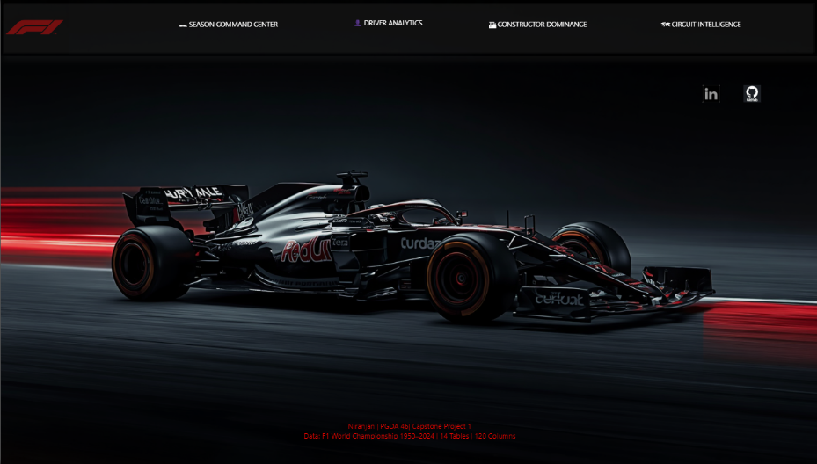
HOME PAGE

Slide 11
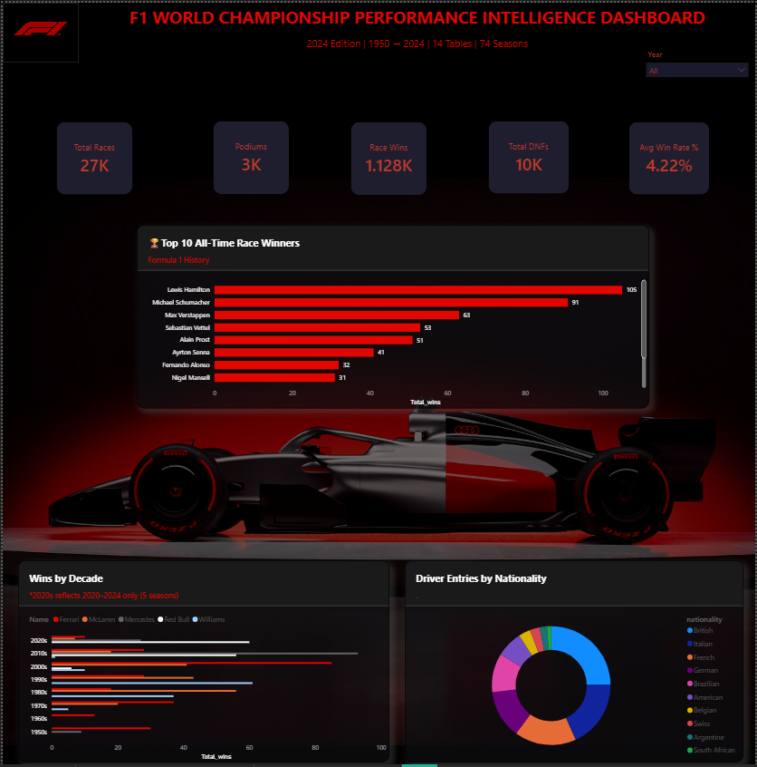
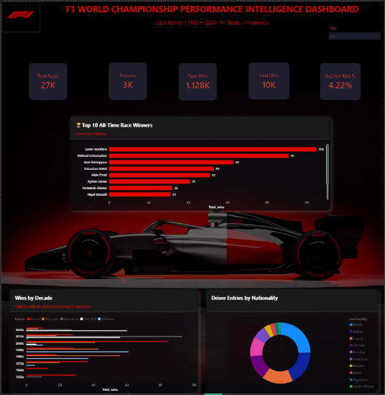
SEASON COMMAND CENTER

Slide 12
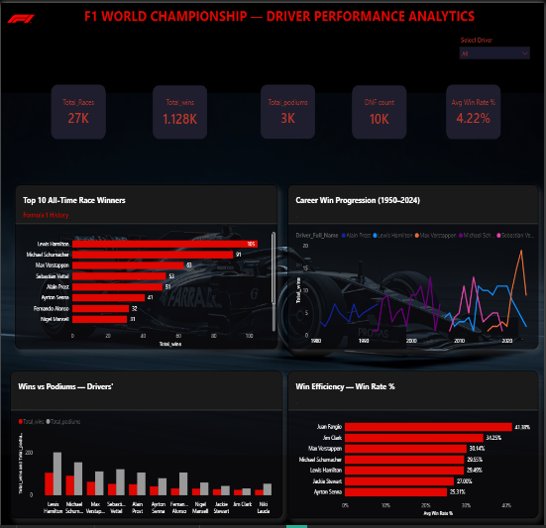
DRIVER ANALYTICS

Slide 13
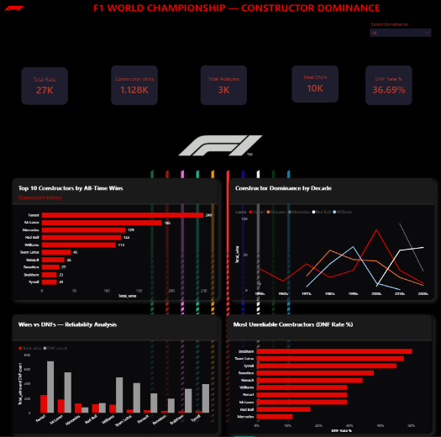
CONSTRUCTOR DOMINANCE

Slide 14
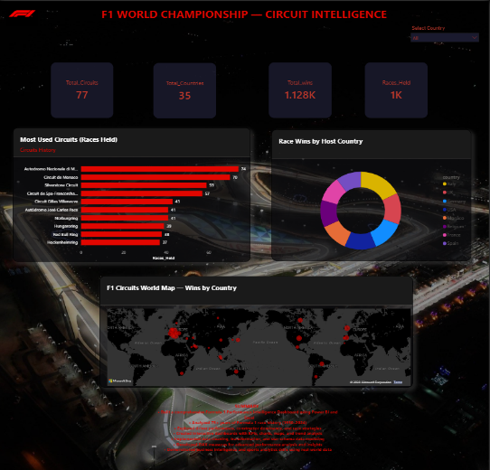
CIRCUIT INTELLIGENCE

Slide 15

CONCLUSION
Unified 14 relational tables into one analytical model
Built an interactive performance intelligence dashboard
Reduced manual analysis of 75 years of F1 history
Enabled driver, constructor, and circuit performance evaluation through self-service analytics
5
Dashboard Pages
14
Relational Tables
8
DAX Measures
55+
Total Visuals
75
Seasons Covered
"Races are won at the track. Championships are won at the factory."
Presented by: Niranjan | PGDA 46 | Capstone Project 1 | May 2025
THANK YOU

