Slide 1

US Airlines Performance
& Delay Analysis
Large-Scale Data Analytics using MySQL & Power BI
PROJECT
PRESENTATION
Dataset: 5.8M Records
Tools: MySQL | Power BI | Git Bash
Domain: Aviation Analytics

Slide 2
Project Overview
Objective
Analyze large-scale retail sales data
Clean and transform raw transaction data
Perform business analysis using SQL
Build interactive dashboards in Power BI
Key Deliverables
SQL-based retail analysis
Power BI dashboard
Customer and product insights
Geographic sales analysis

Slide 3
Problem Statement
Why this project matters
The Challenge
5.8M
~$33B
US airlines generate millions of flight records daily — manually analyzing this data is impossible
Delays & cancellations cost airlines and passengers billions of dollars annually
No clear visibility into which airlines, routes, or seasons perform worst
The raw dataset (5.8M rows) cannot be processed in Excel or loaded directly into databases
Delay root causes (weather, NAS, security, airline) are not easily distinguishable without proper analytics
Flight Records
Annual Delay Cost (US)
3 CSVs
5 Types
Raw Source Files
Delay Categories
Speaker Note: Explain that this project solves a real-world big data problem faced by aviation analytics teams.

Slide 4






Project Objectives
What this project aims to achieve
Analyze Airline Performance
Identify Delay Patterns
Study flight operations, punctuality, and performance KPIs across all US airlines
Detect delay trends by airline, month, route, and classify by delay cause
Handle Large-Scale Data
Build Interactive Dashboards
Efficiently process 5.8M records using Git Bash splitting and MySQL optimizations
Create Power BI reports with KPI cards, charts, maps, and slicers
Data Relationship Modeling
Derive Business Insights
Link flights, airports & airlines tables using one-to-many cardinality in Power BI
Surface actionable insights on cancellations, peak delay seasons, and worst performers

Slide 5



Tools & Technologies Used
Technology stack for this project
Git Bash
Split 5.8M row CSV into 6 parts of ~1M rows each using shell commands
CSV File Splitting
MySQL Server
MySQL 9.6 — stored and queried the entire 5.8M row dataset
Data Storage & Querying
MySQL Workbench
Visual SQL editor with timeout configuration for large queries
DB Management UI
Power BI
DAX measures, data modeling, KPI cards, charts, and map visuals
Dashboard & Visualization
CSV Files
flights.csv (5.8M rows), airports.csv, airlines.csv as raw inputs
Source Data Format

Slide 6
Dataset Information
Source data used in this project
flights.csv
airports.csv
airlines.csv
Rows: ~5.8 Million
Cols: 31 Columns
Rows: ~322 Airports
Cols: 7 Columns
Rows: ~14 Airlines
Cols: 2 Columns
Key Columns:
Key Columns:
Key Columns:
YEAR, MONTH, DAY
AIRLINE, FLIGHT_NUMBER
ORIGIN / DESTINATION
DEPARTURE / ARRIVAL DELAY
CANCELLATION_REASON
DELAY TYPES (5 categories)
IATA_CODE
AIRPORT Name
CITY, STATE
COUNTRY
LATITUDE
LONGITUDE
IATA_CODE
AIRLINE Name (Full)
⚠ Primary challenge: flights.csv (5.8M rows) could NOT be opened in Excel or directly imported into MySQL — required Git Bash preprocessing

Slide 7
Project Architecture & Workflow
End-to-end data pipeline
01
02
03
04
05
06
07
08
Raw CSV Files
›
Git Bash
›
MySQL Server
›
Data Cleaning
›
SQL Analysis
›
Export CSV
›
Power BI
›
Dashboard
flights.csv
airports.csv
airlines.csv
Split + Header
Processing
Table Design
& LOAD DATA
NULL Handling
Date Conversion
Queries +
VIEW Creation
INTO OUTFILE
with headers
Data Model
+ DAX Measures
KPIs + Charts
+ Map Visuals
3 CSVs (5.8M rows)
6 × 1M row files
31-column table
Clean & enrich
Analysis queries
flightsoutput.csv
DAX + relations
Business insights
Technologies:
Git Bash
MySQL
SQL Queries
Power BI + DAX
Speaker Note: Walk through each step — emphasize that Git Bash was needed because Excel/MySQL couldn't handle 5.8M rows natively.

Slide 8
Data Preprocessing — Git Bash
Handling the 5.8M row CSV file
1
Install Git Bash
2
Move CSV to MySQL Uploads
Download from https://git-scm.com
C:/ProgramData/MySQL/MySQL Server 9.6/Uploads/
Required to run Unix-style shell commands on Windows
Required for secure MySQL LOAD DATA INFILE access
3
Split CSV into 1M-row chunks
4
Add .csv extension
split -l 1000000 flights.csv flights_part_
for file in flights_part_*; do mv "$file" "$file.csv"; done
Generates: flights_part_aa, ab, ac, ad, ae, af
Renames all split files with .csv extension
5
Extract & add header row
6
Remove duplicate header (first chunk)
head -n 1 flights.csv > header.csv
for file in flights_part_*.csv; do cat header.csv "$file" > temp && mv temp "$file"; done
tail -n +2 flights_part_aa.csv > temp && mv temp flights_part_aa.csv
Each chunk needs column headers for MySQL import
aa already had header — this removes the duplicate

Slide 9
Database Design & Data Import
MySQL table creation and LOAD DATA INFILE
CREATE TABLE flights
LOAD DATA INFILE
CREATE DATABASE airline_project;
USE airline_project;
CREATE TABLE flights (
YEAR INT, MONTH INT, DAY INT,
DAY_OF_WEEK INT,
AIRLINE VARCHAR(10),
FLIGHT_NUMBER INT,
TAIL_NUMBER VARCHAR(20),
ORIGIN_AIRPORT VARCHAR(10),
DESTINATION_AIRPORT VARCHAR(10),
DEPARTURE_DELAY VARCHAR(10),
ARRIVAL_DELAY VARCHAR(10),
CANCELLED INT,
CANCELLATION_REASON VARCHAR(5),
AIR_SYSTEM_DELAY VARCHAR(10),
SECURITY_DELAY VARCHAR(10),
AIRLINE_DELAY VARCHAR(10),
LATE_AIRCRAFT_DELAY VARCHAR(10),
WEATHER_DELAY VARCHAR(10),
DISTANCE INT,
...31 columns total
);
LOAD DATA INFILE
'C:/ProgramData/MySQL/...
/flights_part_aa.csv'
INTO TABLE flights
FIELDS TERMINATED BY ','
IGNORE 1 ROWS;
-- Repeated for: aa ab ac ad ae af
Key Implementation Notes
31-column schema designed to match CSV headers exactly
All delay columns stored as VARCHAR to handle empty strings
LOAD DATA INFILE used for bulk import performance
secure_file_priv verified before import
Process repeated 6 times (aa → af) for all chunks

Slide 10
Data Cleaning Process
Ensuring data quality for accurate analysis
1. Add FLIGHT_DATE Column
2. Handle NULL Values
3. Duplicate Record Check
ALTER TABLE flights
ADD COLUMN FLIGHT_DATE DATE;
UPDATE flights
SET FLIGHT_DATE = STR_TO_DATE(
CONCAT(YEAR,'-',MONTH,'-',DAY),
'%Y-%m-%d'
)
WHERE MONTH = 1 AND DAY BETWEEN 1 AND 3;
UPDATE flights
SET DEPARTURE_DELAY = NULL
WHERE DEPARTURE_DELAY = '';
-- Repeated for:
-- ARRIVAL_DELAY
-- AIRLINE_DELAY
-- WEATHER_DELAY
-- SECURITY_DELAY
-- AIR_SYSTEM_DELAY
SELECT YEAR, MONTH, DAY,
AIRLINE, FLIGHT_NUMBER,
ORIGIN_AIRPORT,
DESTINATION_AIRPORT,
SCHEDULED_DEPARTURE,
COUNT(*) AS cnt
FROM flights
GROUP BY YEAR,MONTH,DAY,...
HAVING COUNT(*) > 1;
Run in monthly chunks to avoid timeout. Settings changed: read timeout → 600s
6 delay columns had blank strings — converted to proper SQL NULLs
No duplicates found — dataset confirmed clean for analysis

Slide 11
SQL Queries & Analysis
Key analytical queries performed on the dataset
Total Flights
Avg Departure Delay
Cancellation Rate
SELECT COUNT(*) AS total_flights
FROM flights;
SELECT AVG(DEPARTURE_DELAY)
AS avg_delay
FROM flights;
SELECT
(COUNT(CASE WHEN CANCELLED=1
THEN 1 END)*100.0)/COUNT(*)
AS cancellation_rate
FROM flights;
CREATE VIEW flight_analysis — Core Analysis View
CREATE VIEW flight_analysis AS
SELECT *,
CASE WHEN DEPARTURE_DELAY <= 0 THEN 'On Time'
WHEN DEPARTURE_DELAY BETWEEN 1 AND 15 THEN 'Minor Delay'
ELSE 'Major Delay' END AS DELAY_STATUS,
CASE CANCELLATION_REASON
WHEN 'A' THEN 'Airline' WHEN 'B' THEN 'Weather'
WHEN 'C' THEN 'NAS' WHEN 'D' THEN 'Security'
ELSE 'Not Cancelled' END AS CANCELLATION_REASON_TEXT
FROM flights;

Slide 12
Power BI — Data Modeling & DAX Measures
Building the analytical model in Power BI
Data Relationship Model
DAX Measures Created
airports.csv
airlines.csv
Total Flights = COUNT(flightsoutput[id])
IATA_CODE (PK)
AIRPORT
CITY, STATE
LATITUDE, LONGITUDE
IATA_CODE (PK)
AIRLINE (Full Name)
Cancelled Flights =
CALCULATE(COUNT(flightsoutput[id]),
flightsoutput[CANCELLED] = 1)
Avg Departure Delay =
AVERAGE(flightsoutput[DEPARTURE_DELAY])
▼
▼
Avg Arrival Delay =
AVERAGE(flightsoutput[ARRIVAL_DELAY])
flightsoutput.csv (FACT TABLE — 5.8M rows)
On Time Flights =
CALCULATE(COUNT(flightsoutput[id]),
flightsoutput[DEPARTURE_DELAY] <= 0)
ORIGIN_AIRPORT → airports[IATA_CODE] | AIRLINE → airlines[IATA_CODE]
One-to-Many cardinality | Cross-filter enabled
Flights_date =
DATE(flightsoutput[YEAR],
flightsoutput[MONTH], flightsoutput[DAY])

Slide 13
Power BI Dashboard — KPIs & Visuals
What the dashboard displays and how it was built
Total Flights
Avg Departure Delay
Avg Arrival Delay
On-Time Flights
Cancelled Flights
5.8M+
~11 min
~6 min
> 55%
~1.5%
COUNT of all flight records
AVERAGE(DEPARTURE_DELAY)
AVERAGE(ARRIVAL_DELAY)
DEPARTURE_DELAY ≤ 0
CANCELLED = 1 count
Dashboard Visuals Built
Interactive Features
KPI Cards — Total Flights, Delays, Cancellations, On-Time %
Bar Chart — Airline-wise average departure delay comparison
Pie / Donut Chart — Cancellation reason breakdown (A/B/C/D)
Line Chart — Monthly flight count and delay trends
Map Visual — Airport locations using Latitude / Longitude
Slicers — Filter by Airline, Month, Year, Origin Airport
Stacked Bar — Delay type distribution (Weather / NAS / Security / Airline)
Cross-filtering — clicking a chart filters all other visuals
Airline name lookup via airlines table relationship
Airport geo-mapping via airports latitude/longitude
Date hierarchy — drill down by Year → Month → Day
Custom date column Flights_date for time intelligence

Slide 14



Key Insights & Analysis Results
Business findings from the dashboard
Airline Performance
Delay Root Causes
Significant variation in on-time performance across airlines
Some carriers show consistently higher avg departure delays (> 15 min)
Low-cost carriers tend to have higher delay frequencies
Airlines with fewer routes show better punctuality metrics
Weather delays: uncontrollable but seasonally predictable
Airline operational issues: the largest controllable delay cause
NAS (National Airspace System): air traffic control related
Late aircraft cascades — one delayed flight causes downstream delays
Monthly & Seasonal Trends
Cancellation Analysis
Summer months (June–August) show peak delay rates
Winter weather months (December–January) cause cancellations
Spring and Fall show relatively better on-time performance
Holiday seasons correlate with higher passenger volumes & delays
~1.5% overall cancellation rate across 5.8M flights
Weather (B) and Airline ops (A) are top cancellation causes
NAS cancellations (C) represent air traffic management failures
Security cancellations (D) are extremely rare outliers

Slide 15
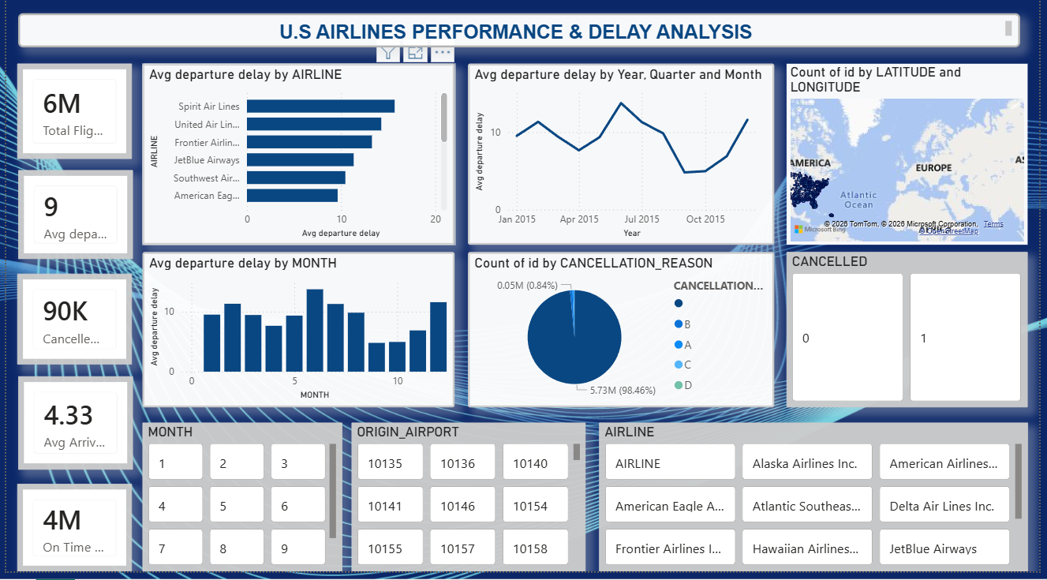

Slide 16
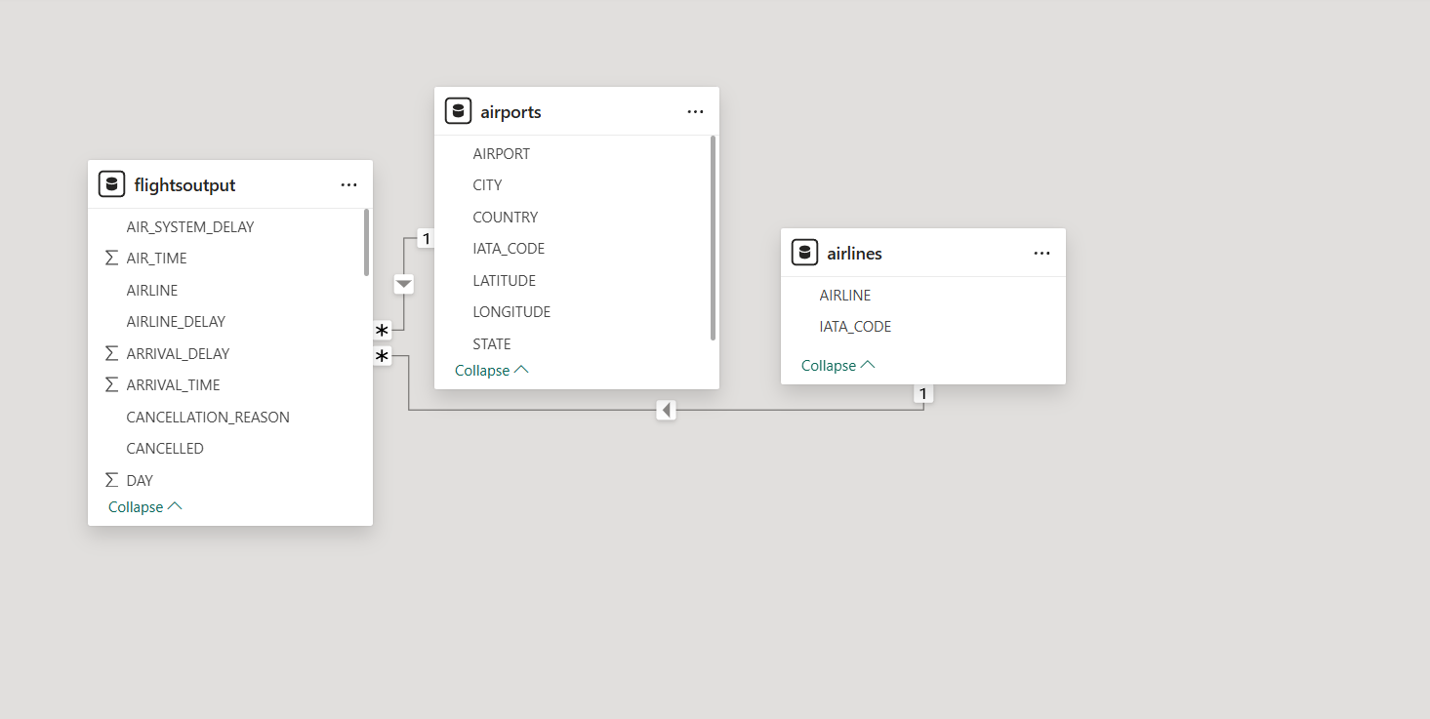

Slide 17


Results & Outcomes
What was successfully achieved in this project
5.8M
31
6
Records
Processed
Column Schema
Designed
DAX Measures
Created
5
3
100%
Dashboard
Visual Types
Datasets
Linked
Clean Dataset
Delivered
✓ Successfully transformed 5.8M raw flight records into actionable business intelligence using MySQL + Power BI

Slide 18
Future Enhancements
Roadmap for extending this project further
Phase 1
Hadoop / Big Data Integration
Phase 2
Python & Advanced Analytics
Load the 5.8M dataset into HDFS (Hadoop Distributed File System)
Use Apache Hive for SQL-like querying on distributed data
Compare performance: MySQL vs Hive query execution times
Use Pandas & NumPy for in-depth statistical delay analysis
Build ML models (Linear Regression, Random Forest) to predict delays
Apply time series forecasting (ARIMA) for seasonal delay prediction
Phase 3
Real-Time & Cloud Integration
Phase 4
Dashboard & Reporting Improvements
Integrate real-time flight data via FAA / FlightAware APIs
Deploy MySQL on AWS RDS or Azure for cloud scalability
Build automated data refresh pipelines in Power BI Service
Add passenger satisfaction and baggage delay correlations
Implement row-level security in Power BI for multi-airline access
Build a public-facing web dashboard using Power BI Embedded

Slide 19
Conclusion
Successfully analyzed 5.8 million US airline flight records end-to-end
Overcame real-world data engineering challenges (timeouts, large files, nulls)
Git Bash used innovatively to split oversized CSV beyond Excel/MySQL limits
MySQL provided robust storage and SQL-based analytical capabilities
Power BI transformed raw data into an interactive, insightful dashboard
Project demonstrates industry-level proficiency in SQL, BI, and data pipelines
PROJECT
CONCLUSION
SQL
Data Engineering
Power BI
DAX
Big Data
Data Visualization
Git Bash

Slide 20
Thank You!
US Airlines Performance & Delay Analysis

