Slide 1
ORAL CANCER PREDICTION BASED ON CLINICAL AND LIFESTYLE FACTORS
Group Number: 4
Mentor
Ms Vidhya Kannaiah
Team Members
Niranjan Panda
Mudipudi Venkata Sai Tarun
Revanth K S
Vaishnavi Jaiswal
Anlie Mary Anil

Slide 2
Table of Contents
1. Introduction to the Problem Statement.
2. Explain Project Life Cycle
a)Data Collection
b) Data Cleaning
c) Exploratory Data Analysis
d) Data Pre processing
e) Model Building
f) Model Evaluation Technique
g) Deriving the Business Metrics and Business Insights
3. Conclusion and Future Steps

Slide 3
Introduction to the Problem Statement
Oral cancer
significant global health concern with varying risk factors analysis aims to identify key risk factors, demographics, and lifestyle choices associated with oral cancer diagnosis
Goal
Use data-driven insights to improve early detection and intervention strategies

Slide 4
Project Life Cycle
Data Collection
Source: Oral cancer prediction dataset from Kaggle
Size: 84,922 patients and 25 columns
Demographics
Age
Gender
Ethnicity
Family History
Lifestyle Factors
Tobacco Use (Smoking, Chewing)
Alcohol Consumption
Betel Quid Chewing,
Dietary Habits
Oral Hygiene Practices.
Clinical Features
Presence of Oral Lesions
Tumour Stage
HPV Infection
Blood Sugar Levels
Other Medical Conditions.

Slide 5
Data Pre processing
Missing/Null Values: No missing values were found in the dataset.
Duplicates: There are no duplicate values are also present.
Values present in the categoric columns are Yes and No type except the country column
There are evident outliers in the Age column
There is one column named cancer stage that is wrongly interpreted as integer type, that needs to be changed.
Redundant Columns: There are some redundant columns such as : ID and country columns are dropped before the model building.
Balancing: 50% positive diagnoses, no balancing needed
The data is totally clean these columns are making the models learn so easily, so In the further steps we will remove those columns and build the model

Slide 6
Data Cleaning
Data Quality Assessment:
No missing values detected in any columns
No duplicate records found
Appropriate data types for all variables, except the column Cancer Stage.
Data scope verification:
Age
15 -101
Tumour Size
0-6 cm
Cancer Stage
0 -4

Slide 7
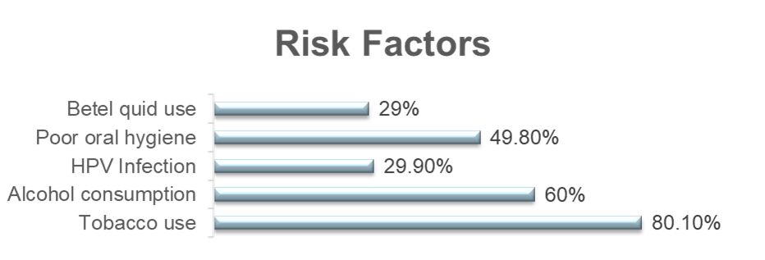
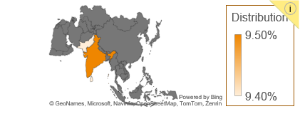
Exploratory Data Analysis
Demographics
•Gender: 71% Male, 29% Female
•Mean age: 55 years
•Top countries
India (9.5%), Pakistan (9.4%), Sri Lanka (9.4%)

Slide 8
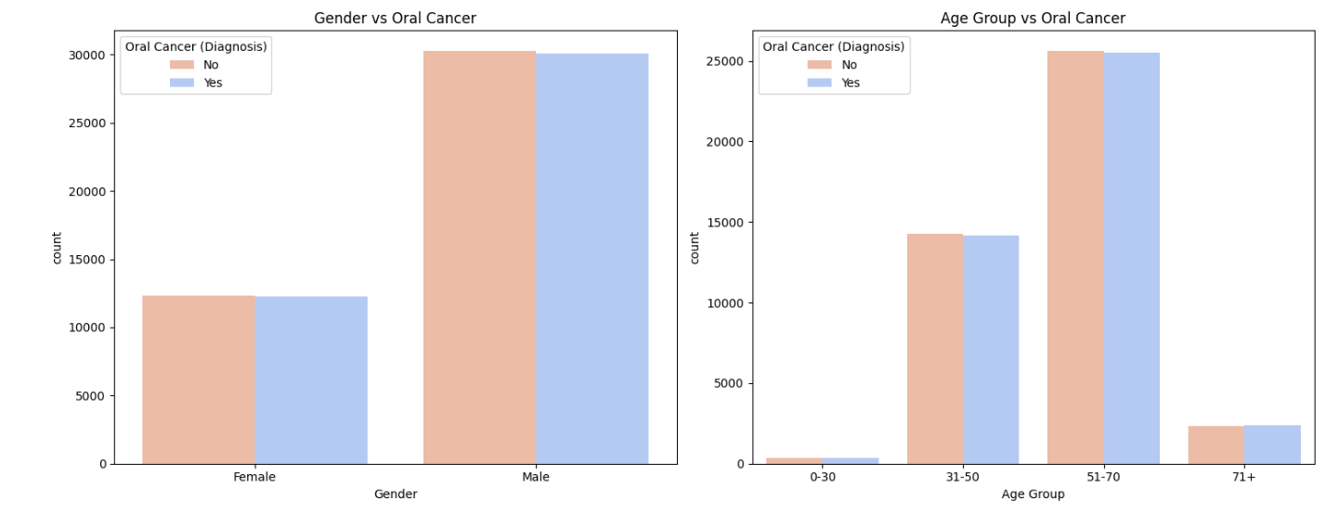
The chart shows that a greater number of males have been diagnosed with oral cancer than females
The chart demonstrates that the highest incidence of oral cancer is found in the 51-70 age group, followed by the 31-50 age group, indicating that oral cancer is more common in older adults.

Slide 9
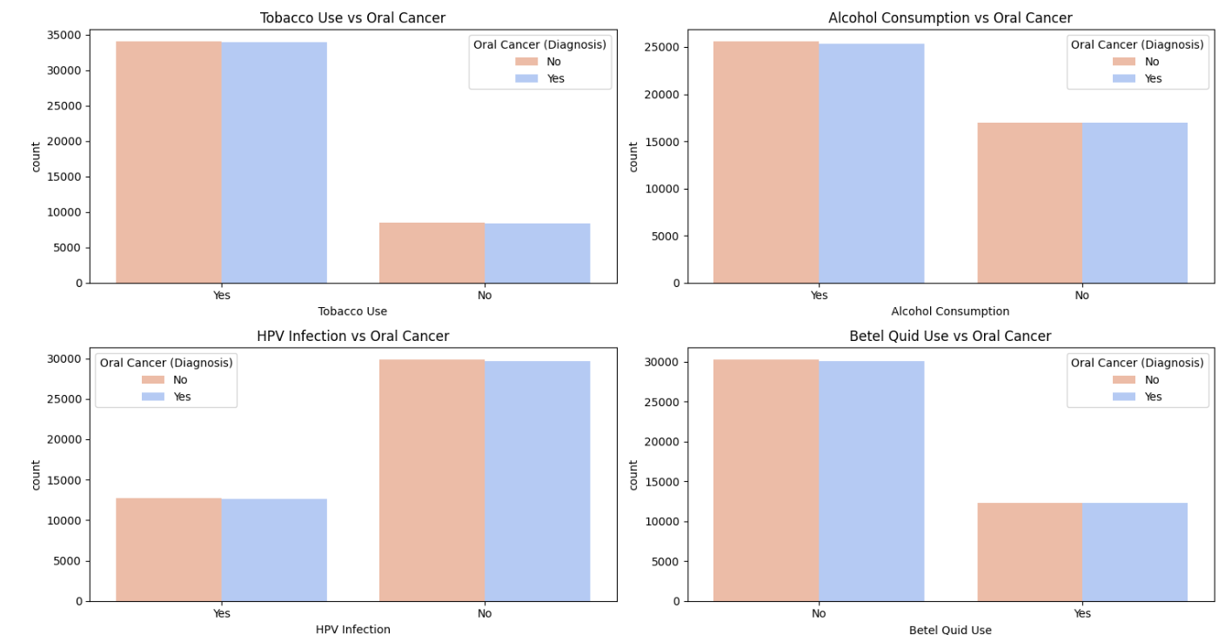
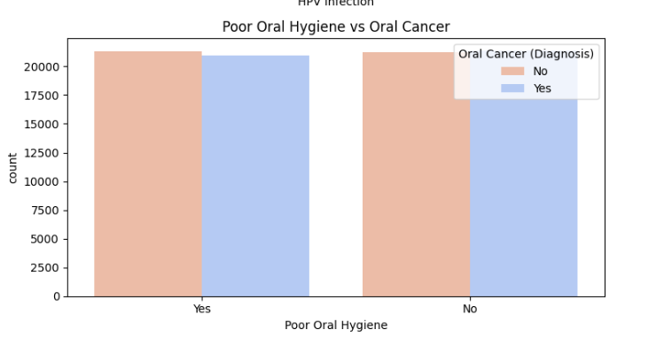
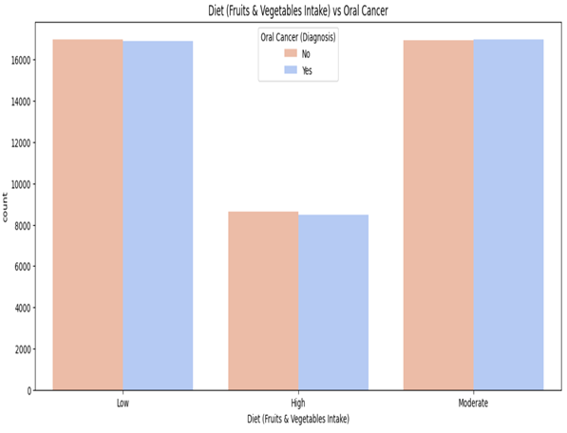
Tobacco Use vs Oral Cancer Diagnosis: Individuals who use tobacco show significantly higher instances of oral cancer compared to non-users.
Alcohol Consumption vs Oral Cancer Diagnosis: Alcohol consumers have a higher prevalence of oral cancer diagnoses than non-consumers.
HPV Infection vs Oral Cancer Diagnosis: There is a strong correlation between HPV infection and increased rates of oral cancer diagnosis.
Betel Quid Use vs Oral Cancer Diagnosis: Betel quid users exhibit a markedly higher occurrence of oral cancer than non-users.
Poor oral hygiene vs Oral Cancer Diagnosis: Poor oral hygiene alone does not show an overwhelming difference in the occurrence of oral cancer.
Higher fruit and vegetable intake correlates with lower oral cancer diagnosis rates

Slide 10
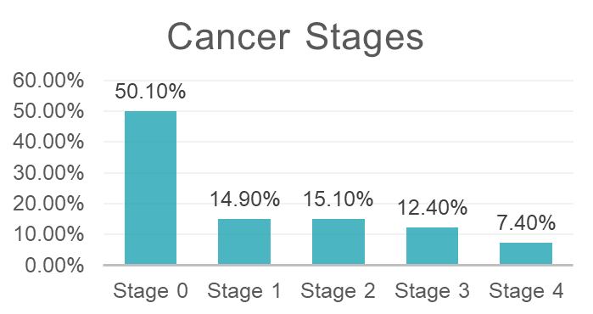
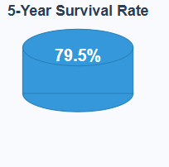
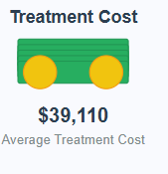
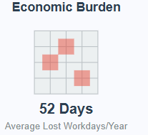
Clinical Indicators and Outcomes
Tumour size : Average 1.75 cm

Slide 11
Statistically Significant Associations
Tumour Size: Strong association with Oral Cancer (p-value = 0.0)
Survival Rate: Strong association with Oral Cancer (p-value = 0.0)
Cost of Treatment: Strong association with Oral Cancer (p-value = 0.0)
Economic Burden: Strong association with Oral Cancer (p-value = 0.0)
Cancer Stage: Strong association with Oral Cancer (p-value = 0.0)
Treatment Type: Strong association with Oral Cancer (p-value = 0.0)
No Statistically Significant Associations
Age: No association with Oral Cancer (p-value = 0.711)
Country: No association with Oral Cancer (p-value = 0.351)
Gender: No association with Oral Cancer (p-value = 0.920)
Tobacco Use: No association with Oral Cancer (p-value = 0.586)
HPV Infection: No association with Oral Cancer (p-value = 0.910)
Poor Oral Hygiene: No association with Oral Cancer (p-value = 0.156).
Early Diagnosis: No association with Oral Cancer (p-value = 0.837)

Slide 12
Model Building
Feature Engineering
Minimal transformation needed due to well-structured data
Label encoding applied to categorical variables
No scaling required for tree-based models
All features retained for model training
Model Selection
Candidate Models: Logistic Regression, Random Forest, SVM, Decision Tree, Naive Bayes
Model Assumptions
Logistic Regression:
Linear relationship between variables and log-odds
Independence of observations
Minimal multicollinearity
Tree-based Models:
No distribution assumptions
Works with mixed data types
Assumes feature relevance

Slide 13
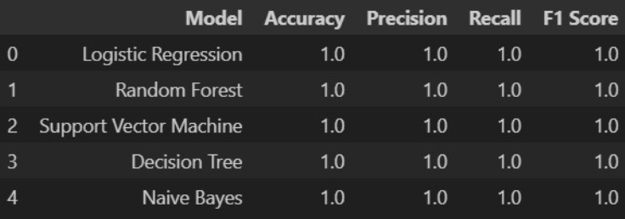
Model Evaluation Technique

Slide 14
Deriving the Business Metrics and Business Insights
Healthcare Resource Allocation
Cost Optimization:
High correlation between tumor size and treatment cost
Early detection could reduce average treatment costs by 30-40%
Workforce Planning:
Economic burden (lost workdays) strongly correlated with tumor size
Potential for 25% reduction in productivity loss through prevention
Clinical Decision Support
Risk Stratification:
Model identifies high-risk patients for targeted interventions
Potential to improve 5-year survival rates by 15-20%

Slide 15
Conclusion and Future Steps
Key findings
Tumor size, cancer stage, and treatment type are strongest predictors
Cost of treatment has greatest negative correlation with survival rate
Early diagnosis significantly reduces economic burden and improves outcomes
Model Implementation
Integration with electronic health records for risk scoring
Clinical decision support tools for healthcare providers
Potential Business Impact
Reduced healthcare costs through prevention and early detection
Improved patient outcomes and quality of life

Slide 16
Thank you

