Slide 1
Giving Our API a Memory
Day 2 explained simply — what a database is, why we need one, and exactly what our code does
The problem
What a database is
Our data
Three tables
The code
The answers
Actoryx Technologies · MGIT Centre of Excellence in AI · Day 2 of 5 · No coding background needed
Notes:
This deck explains Day 2 from scratch, in plain words, using the real Day 2 code and its real outputs. Every number on these slides comes from running the code. Use it before the hands-on steps on the Day 2 page.

Slide 2
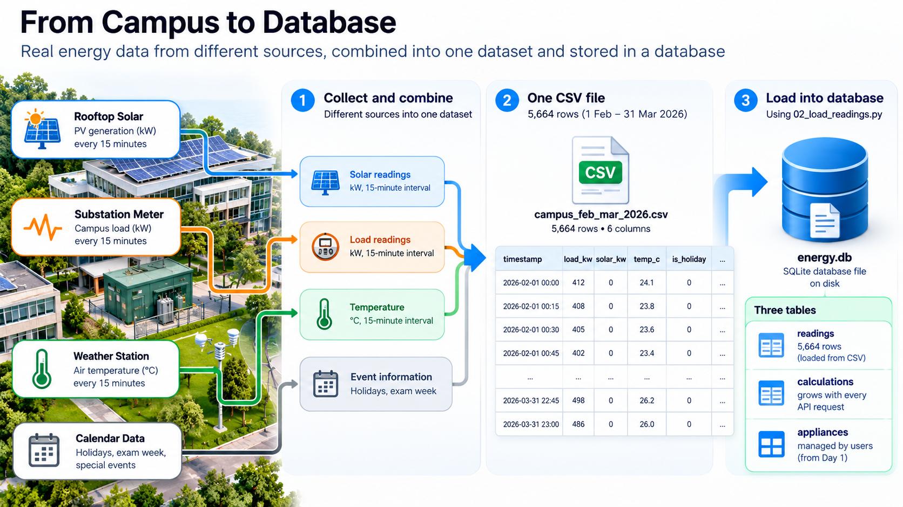

Slide 3
PROBLEM STATEMENT · And how we will solve it
THE PROBLEM
SOLUTION APPROACH
The substation logger has written two months of 15-minute readings — campus load, rooftop solar, air temperature — into a CSV of 5,664 rows that nobody opens. The maintenance engineer keeps asking:
1
Learn SQL first
a table, rows, and questions in plain SQL
2
Design the tables
describe them once in db.py
“What was the peak on 23 March?”
“How hard did the transformer work?”
“What did we calculate last week?”
3
Load the data
5,664 readings from the CSV into the database
Each answer costs 20 minutes in Excel — and Monday's appliance list disappears whenever the server restarts.
4
Write the questions
as functions in queries.py
Given | Monday's API · the readings CSV (1 Feb – 31 Mar 2026) · transformer TR-MAIN: 630 kVA, power factor 0.93
Find | history of calculations · readings for any time window · a day's summary · the appliance list, kept safe
Rules | nothing to install · loading twice must not duplicate data · the same code must work on MySQL later
5
Connect the API
new endpoints; every calculation saved
6
Move Monday's list
same four methods, now a table
Goal: make the API answer these questions in a second, remember every calculation, and keep the appliance list safe
Notes:
Read the problem as the engineer would say it. Then show that the six steps map one-to-one onto the six steps of the Day 2 page. The next two slides show how this problem becomes a technical design.

Slide 4
FROM PROBLEM TO DESIGN · Each need becomes one technical decision
What the engineer needs | Technical decision | Where in the code
Data must survive a restart | store it in a database file on disk — SQLite, energy.db | db.py DATABASE_URL
Answer questions about two months of readings | table 1 — readings: one row per 15 minutes, loaded from the CSV | db.py class Reading 02_load_readings.py
Remember every calculation | table 2 — calculations: the API adds a row on every request | db.py class Calculation
Keep Monday's appliance list | table 3 — appliances: rows added, changed, removed by users | db.py class ApplianceRow
Loading twice must not duplicate | timestamp is the primary key + empty the table before loading | 02_load_readings.py
Same code on MySQL later | SQLAlchemy ORM — classes stay; change the URL, add the driver | db.py DATABASE_URL
One answer, used by every screen | each question is one function, reused by API, UI, agent | queries.py
Engineer asks from a browser | new endpoints: /readings /summary /history /appliances | app.py appliance.py
Result: one database file · 3 tables · 1 loader script · 1 file of questions · 4 kinds of new endpoint

Slide 5
THE DESIGN AT A GLANCE · Where the data comes from and where it lives
make_data.py
simulates the readings
CSV file
5,664 rows of text
02_load_readings.py
loads them once
energy.db
3 tables on disk
queries.py
asks the questions
app.py
answers on the web
→
→
→
→
→
Question | Answer
Is the data real? | No — simulated by data/make_data.py with a fixed seed, so everyone gets the same numbers. It follows real patterns: rising temperatures, holidays, exam week, cloudy days.
Is it live? | No — a two-month snapshot (1 Feb – 31 Mar 2026). In a real plant, the same loader would read the meter / SCADA export every 15 minutes instead.
Where is it stored? | In energy.db — one SQLite file on disk, always created next to db.py (whatever folder you run from). It survives restarts.
How many tables? | Three: readings (5,664 rows, loaded once) · calculations (grows with every request) · appliances (managed by users)
How does data get in? | readings: the loader script · calculations: the API writes them itself · appliances: POST / PUT / DELETE requests
Note: no client or personal data anywhere — safe to share, deploy and experiment with
Notes:
This slide answers the questions people ask first: is it real, is it live, where is it stored, how many tables. The flow on top is the whole Day 2 pipeline in one line.

Slide 6
WHAT IS A DATABASE? · A spreadsheet you can ask questions
THE READINGS TABLE — 4 OF ITS 5,664 ROWS
FOUR WORDS TO KNOW
timestamp | load_kw | solar_kw | ambient_c
2026-03-23 12:00 | 846.8 | 234.6 | 35.7
2026-03-23 12:15 | 847.4 | 251.8 | 36.1
2026-03-23 12:30 | 857.6 | 262.3 | 36.9
2026-03-23 12:45 | 854.2 | 230.7 | 36.3
Table
one sheet for one kind of thing
Row (record)
one entry — one reading
Column (field)
one detail — e.g. load_kw
↑ each COLUMN is one kind of information ← each ROW is one record (one 15-minute reading)
Primary key
the column that is never repeated
Why not keep data in the program? Memory (RAM) is wiped the moment the program stops — that is why Monday's list vanished. A database is an organised file on disk that stays. Think of a school register: one page per class (table), one line per student (row), one column per detail, and a roll number (primary key) that is never repeated.
The big difference from a spreadsheet: you don't scroll — you ASK: “show me 23 March” and get the answer instantly

Slide 7
WHY NOT JUST EXCEL? · What a database adds
What we need | An Excel / CSV file | A database
Find 23 March, 13:00 in 5,664 rows | scroll, filter by hand | one question — the answer in milliseconds
Many people (and programs) at once | file gets locked, or copies go out of date | everyone reads and writes the same data safely
Our API uses the data | awkward — files are made for people | built for programs to ask and save
Protect against mistakes | anyone can type text into a number cell | rules: numbers stay numbers, keys stay unique
Survive a crash | unsaved work is lost | a save (commit) is all-or-nothing — never half-written
Grow | slows down past ~1 million rows | millions of rows are normal
We use SQLite — a complete database in ONE file (energy.db). Nothing to install: it comes with Python. The same code later works with MySQL or PostgreSQL, once their driver and server are set up.
In one line: a CSV is for storing data; a database is for storing data AND asking questions about it

Slide 8
OUR DATA · Two months of the college's main substation
Column in the CSV | What it means, in plain words | Unit | 23 Mar, 13:00
timestamp | when the reading was taken — one every 15 minutes | date + time | 2026-03-23 13:00
load_kw | how much power the whole campus is using right now | kW | 859.0
solar_kw | how much the rooftop solar panels are producing | kW | 236.9
irradiance_wm2 | how strong the sunshine is on the panels | W/m² | 632.5
ambient_c | the outside air temperature | °C | 37.5
5,664
rows
15 min
between readings
59 days
1 Feb – 31 Mar 2026
96
readings a day
How the columns connect: more sunshine → more solar · hotter air → more air-conditioning → more load · Sundays, Holi (4 Mar), Ugadi (19 Mar) and exam week → less load
Note: the data is generated by data/make_data.py with a fixed seed — realistic, identical for every student, and not anyone's real data
Notes:
File: data/campus_feb_mar_2026.csv. 59 days × 96 readings a day = 5,664 rows. Ask: at 13:00 the campus uses 859 kW and solar gives 237 kW — where does the rest come from? (The grid, through the transformer.)

Slide 9
SQL · Asking the database in sentences
SQL — what you type | In plain English | Answer
CREATE TABLE feeders (name TEXT PRIMARY KEY, v_ll REAL, i_line REAL, pf REAL) | Make a new sheet called feeders with four columns; no two feeders share a name | an empty table
INSERT INTO feeders VALUES ('WORKSHOP', 415, 60, 0.72) | Add one row | 4 rows after four inserts
SELECT name, pf FROM feeders WHERE pf < 0.85 ORDER BY pf | Which feeders have a poor power factor? Worst first. | WORKSHOP 0.72 LABS 0.82
SELECT SUM(i_line) FROM feeders | Add up the current on all feeders | 375.0 A
SQL = Structured Query Language — every database understands it. Note: this practice script uses connect(":memory:"), a throw-away database that vanishes when the program ends. From the next step on we use energy.db, a file on disk that stays.
Try it: python 01_sql_basics.py — these exact four statements, with the answers shown here
Notes:
These are the real statements and outputs of day2_tue_database/code/01_sql_basics.py. Read each SQL line aloud as an English sentence. After this, students know what the Python code below is doing for them.

Slide 10
OUR THREE TABLES · Three different kinds of data in one file, energy.db
readings
📖 the reference book
calculations
🧾 the logbook
appliances
📋 the shared list
Data the API RECEIVES
Comes from outside — the substation CSV
Loaded once: 5,664 rows
After that, only read
Columns: timestamp (key), load_kw, solar_kw, ambient_c, irradiance_wm2
Data the API CREATES
One new line every time someone uses /calculate, /energy-cost or /bill
Grows all the time
Columns: id (auto 1, 2, 3…), kind, inputs, result, created_at
Data USERS MANAGE
Monday's appliance list
Added, changed and removed through the API: POST · PUT · DELETE
Columns: id (auto), name, watts, hours
Ask of any table: where does the data come from? · who writes it? · how often? The answers decide how you design it.
Remember: readings = received · calculations = created by the API · appliances = managed by users
Notes:
This is the slide that clears most confusion. Reading and Calculation are not functions — they are tables. readings is filled once from the CSV and only read. calculations is the API's diary: each calculation request adds one row. appliances is Monday's list, now on disk.

Slide 11
THE THREE CALCULATIONS · Three separate requests, worked out step by step
Energy cost
/energy-cost?watts=1500&hours=8
Monthly bill
/bill?units=250
Calculator
/calculate?a=12&b=3&op=div
1
2
3
One 1500 W AC runs 8 hours. How many units, and what does it cost for the day?
The meter shows 250 units for the month. What is the bill? (slab tariff)
Divide 12 by 3.
units = watts × hours ÷ 1000
= 1500 × 8 ÷ 1000
= 12 units (kWh)
cost = units × rate (₹8 default)
= 12 × ₹8 = ₹96
first 100 units × ₹3.00 = ₹300
next 100 units × ₹4.50 = ₹450
last 50 units × ₹6.50 = ₹325
───────────
total 250 units = ₹1,075
op = div → a ÷ b
= 12 ÷ 3
= 4.0
(op can be add, sub, mul, div;
b = 0 with div → error 400)
Answer: 12 units · ₹96
Answer: ₹1,075
Answer: 4.0
These are NOT connected: the 250 units is the user's own monthly meter reading, typed into /bill — it does not come from card 1. (Card 1 is one AC for one day; 12 units × 30 days would be 360 units a month.)
Note: the slab rates are illustrative, not a real utility's tariff · next slide: each request becomes one line in the logbook
Notes:
Work each card on the board. 1) Units: watts × hours gives watt-hours; ÷ 1000 gives kWh, which is what the meter calls a unit. 12 × ₹8 = ₹96. 2) Slab tariff: the first 100 units are charged ₹3, the next 100 ₹4.50, everything above 200 ₹6.50: 300 + 450 + 325 = ₹1,075. These slab rates are illustrative, not a real utility's. 3) The Day 1 calculator. Stress that the three requests are independent — what links them is only that each adds one line to the calculations table (next slide).

Slide 12
THE LOGBOOK IN ACTION · What happens when someone asks for an energy cost
1 · A user asks
GET /energy-cost?watts=1500&hours=8
2 · app.py works it out
1500 W × 8 h = 12 units → ₹96
3 · writes one line
save_calculation(…) → calculations table
4 · answers
{"units": 12.0, "cost_rs": 96.0}
→
→
→
THE CALCULATIONS TABLE AFTER THREE SEPARATE REQUESTS
id | kind | inputs | result | created_at
1 | energy-cost | {"watts": 1500.0, "hours": 8.0, "rate": 8.0} | {"units": 12.0, "cost_rs": 96.0} | 27 Oct 10:15
2 | bill | {"units": 250.0} | {"bill_rs": 1075.0} | 27 Oct 10:16
3 | calculate | {"a": 12.0, "b": 3.0, "op": "div"} | {"result": 4.0} | 27 Oct 10:17
Each of the three requests on the previous slide adds one line here. id and created_at fill themselves in. inputs and result are JSON — a whole dictionary in one cell — so one table can log every kind of calculation; kind says which.
Read it back: GET /history → the latest lines, newest first — the API now remembers what it did

Slide 13
TABLES AS PYTHON CLASSES · A blank form, and filled-in copies
db.py — the readings table, written in Python
READ IT LIKE THIS
class Reading(Base):
__tablename__ = "readings"
timestamp: Mapped[datetime] = mapped_column(DateTime,
primary_key=True)
load_kw: Mapped[float] = mapped_column(Float)
solar_kw: Mapped[float] = mapped_column(Float)
ambient_c: Mapped[float] = mapped_column(Float)
irradiance_wm2: Mapped[float] = mapped_column(Float)
class Reading
the blank form = the table
each line inside
one box on the form = a column
Float, DateTime
what may go in the box
primary_key=True
the form number — never repeated
What you write — Python
What SQLAlchemy sends — SQL
s.add(Reading(timestamp=t, load_kw=859.0, …))
select(Reading).where(Reading.load_kw > 850)
INSERT INTO readings (timestamp, load_kw, …)
VALUES ('2026-03-23 13:00', 859.0, …)
SELECT * FROM readings WHERE load_kw > 850
ORM: SQLAlchemy does not replace SQL — it writes the SQL for you and runs it; the database still only speaks SQL
Notes:
ORM = Object-Relational Mapping. The class is a template; an object made from it is one row. SQLAlchemy writes the CREATE TABLE and INSERT statements from the last section for us.

Slide 14
db.py · Four jobs, in order
# | The code | What it does | Everyday picture
1 | DB_FILE = Path(__file__).parent/"energy.db" DATABASE_URL = f"sqlite:///{DB_FILE}" | says WHICH database and WHERE — energy.db, always next to db.py | the address of the notebook
2 | engine = create_engine(DATABASE_URL) Session = sessionmaker(engine) | opens the connection; Session = one piece of work | the phone line, and one phone call
3 | class Reading / Calculation / ApplianceRow(Base) | describes the three tables and their columns | the blank forms
4 | Base.metadata.create_all(engine) | creates any table that doesn't exist yet; never touches existing data | print the forms — only if the drawer is empty
All four happen the moment any file writes import db — so the loader, the API and the tests always find the tables ready. A small helper, data_file(), finds the CSV wherever the code runs (course folder or a Hugging Face Space).
To switch to PostgreSQL: change DATABASE_URL, install the driver (psycopg), run a database server — the classes and queries stay the same

Slide 15
SESSION AND COMMIT · Like a shopping cart
Session()
pick up a cart
s.add(…)
put rows in the cart
s.commit()
pay at the counter — now it is really saved
end of with
put the cart back
→
→
→
queries.py — writing one line in the logbook
def save_calculation(kind, inputs, result):
with Session() as s: # pick up a cart
s.add(Calculation(kind=kind, inputs=inputs, result=result)) # put a row in
s.commit() # pay — saved to energy.db
Forget commit() and nothing is saved — like leaving the shop without paying, the cart is emptied. A commit is all-or-nothing: either every row in the cart is saved, or none is.
Why it matters: a power cut halfway through never leaves half-written data behind

Slide 16
LOADING THE CSV · 02_load_readings.py, run once
CSV file
5,664 lines of text
pandas reads it
a table in Python
Reading(**row)
each line → one form
commit()
all 5,664 saved together
energy.db
on disk
→
→
→
→
▶ Real output
THREE THINGS TO NOTICE
Loaded 5,664 readings, 01 Feb 2026 00:00 → 31 Mar 2026 23:45
The first three rows:
01 Feb 00:00 load 185.8 kW solar 0.0 kW air 14.4 °C
01 Feb 00:15 load 183.2 kW solar 0.0 kW air 14.1 °C
Names match
CSV headers = class columns, so Reading(**row) works
Full refresh
replaces every reading — run it twice: still 5,664
One transaction
if it fails before commit(), the old readings stay
Other strategies: incremental — add only new readings · upsert — add new ones and update existing ones (real plants use these)
Notes:
Full refresh is right for a fixed two-month file. A live plant would load incrementally every 15 minutes, or upsert when meters resend corrected readings. Delete + insert are one transaction: a failure leaves the old data untouched.

Slide 17
QUESTIONS AS FUNCTIONS · queries.py is the help desk
EVERY QUESTION IS WRITTEN ONCE, HERE
SUMMARY(23 MARCH) — THE REAL ANSWER
readings(start, end)
give me the rows between two times
Question | Answer
Highest load of the day | 859 kW at 13:00
Energy used | 9,351 kWh
Energy from solar | 1,848 kWh
Hottest air | 38.4 °C
Transformer, worst moment | 106.4 % at 12:45
summary(day)
the day's report card — peak, energy, solar, transformer
save_calculation(…) · history(limit)
write one line in the logbook · read the latest lines
list / add / update / delete appliances
Monday's four actions, now on the table
Why one place? Tomorrow's dashboard, Friday's AI agent and the MCP server all call these same functions — fix a question once, and every screen gets the fix.
Ask the API: GET /summary?day=2026-03-23 returns exactly this table as JSON

Slide 18
THE ENGINEERING ANSWER · Is the transformer overworked?
23 MARCH, 12:45 — WORKED OUT STEP BY STEP
Campus needs
854.2 kW
Solar gives
230.7 kW
Grid supplies
623.5 kW
Transformer carries
670.4 kVA
Loading
106.4 %
−
=
÷ 0.93
÷ 630
IN PLAIN WORDS
The transformer is the campus's door to the grid
TR-MAIN is rated 630 kVA — the most it should carry
Why ÷ 0.93?
motors draw a little extra current that does no work (power factor 0.93); the transformer must carry it too
Solar on campus does part of the job
so the transformer carries only what solar can't
Above 100 % = overloaded
it runs hotter and ages faster — the engineer needs to know when
A simplified estimate for teaching: it assumes solar offsets the load on the same side of the transformer, and a fixed power factor of 0.93 (assumed, not measured). Real loading depends on the wiring, where the meters are, and the measured power factor. summary() repeats this sum for all 96 readings and picks the worst.
Hot afternoons, little solar: that is when the transformer is pushed hardest — and now the database tells us exactly when
Notes:
queries.py: loading = max(load − solar, 0) ÷ 0.93 ÷ 630. Numbers are the real 23 March 12:45 row: (854.2 − 230.7) ÷ 0.93 ÷ 630 = 106.4 %. kVA vs kW: the transformer heats with the total current, including the part that does no useful work.

Slide 19
MONDAY'S LIST, NOW SAFE · Same four buttons, new storage
 | Monday | Today
Where the list lives | a Python dictionary in memory | the appliances table in energy.db
Requests | GET · POST · PUT · DELETE /appliances | exactly the same — users notice nothing
After a restart | empty | still there
▶ Real output of 03_appliances_db.py
POST /appliances -> {'id': 1, 'name': 'Room AC', 'watts': 1500.0, 'hours': 8.0}
PUT /appliances/1 -> {'id': 1, 'name': 'Room AC', 'watts': 1500.0, 'hours': 6.0}
GET /appliances/1/cost -> {'appliance': 'Room AC', 'units': 9.0, 'cost_rs': 72.0}
SQL: SELECT * FROM appliances -> [(1, 'Room AC', 1500.0, 6.0)] ← really on disk
DELETE /appliances/1 -> {'deleted': 1}
Proof: the script opens energy.db with plain SQL, not through the API — and finds the row there

Slide 20
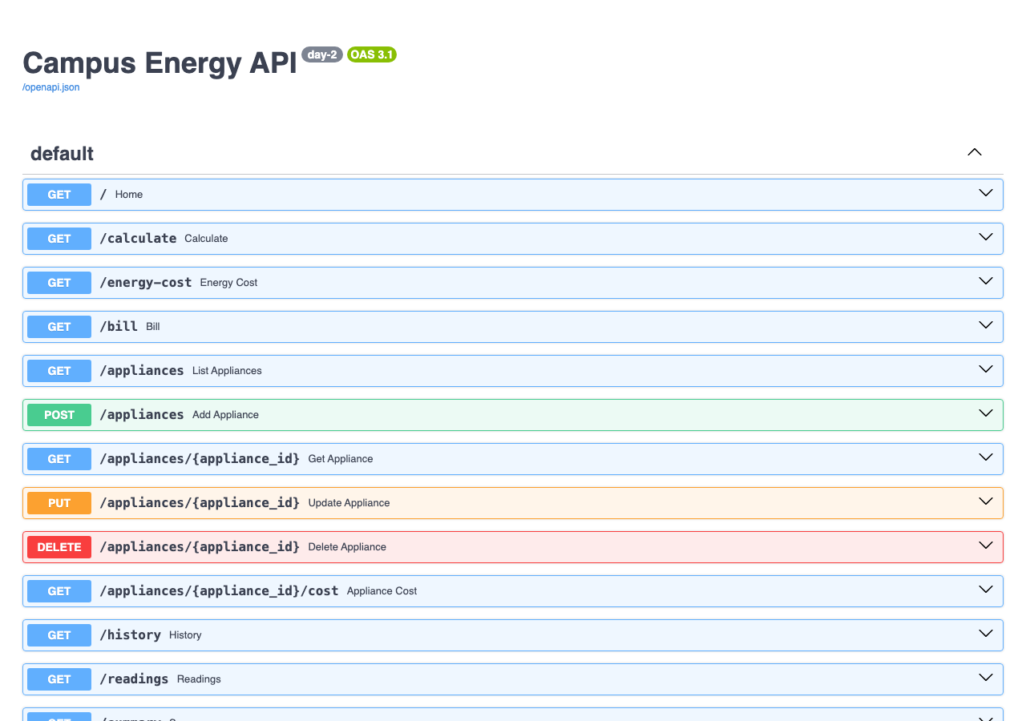
TRY IT YOURSELF · Run these in the day2_tue_database/code folder
Type this | You will see
python 01_sql_basics.py | SQL in four sentences — the poor-power-factor feeders
python 02_load_readings.py | Loaded 5,664 readings … and energy.db appears
uvicorn app:app --reload | the API starts on http://127.0.0.1:8000
open /docs → GET /summary | Try it out, day = 2026-03-23 → the report card
python 03_appliances_db.py | Monday's list saved, changed, read from disk, removed
/summary?day=2026-02-30 | 422 — “day value is outside expected range”: bad input is refused, with a reason
/docs now lists the database endpoints: /history, /readings, /summary, /appliances
Task: today's task on the Day 2 page — find the five worst days for the transformer

Slide 21
EXTRA · From one file to a database server: SQLite → PostgreSQL
 | SQLite — until now | PostgreSQL — this step
Where the data is | code/energy.db — one file | a server: a Docker container on localhost:5432
What you install | nothing — built into Python | Docker Desktop + the psycopg driver
Who can use it | one program writes at a time | many users and programs at once
Used for | learning, prototypes, phone apps | websites, company systems, plant data
What changes in our code | — | only DATABASE_URL — tables, queries, API stay the same
db.py — the one line that decides
DATABASE_URL = os.environ.get("DATABASE_URL", f"sqlite:///{DB_FILE}") # SQLite unless you say otherwise
The db.py promise, kept: same classes, same queries — a different database behind them
Notes:
Everything for this step is in day2_tue_database/postgres/ with a README. Docker means nothing is installed on the laptop itself, and every student gets the identical server.

Slide 22
POSTGRESQL IN DOCKER · One command, one server on localhost:5432
Your laptop
Python, uvicorn, your code
Docker container
mgit-postgres · postgres:16-alpine
Database: energy
user mgit · 3 tables · data kept in a volume
→ 5432
→
Start it — in day2_tue_database/postgres
THE ADDRESS, PIECE BY PIECE
cp .env.example .env # put your own password in .env
docker compose up -d # first time: download, then start
docker compose ps # STATUS: healthy
postgresql+psycopg | kind of database + driver
mgit:YOUR_PASSWORD | user and password (from .env)
@localhost:5432 | where the server listens
/energy | which database
Safe by design: the password lives only in .env (never in code, never shared), and the port is bound to 127.0.0.1 — nobody else on the Wi-Fi can reach it.
Stop it: docker compose down — data kept · docker compose down -v — data deleted

Slide 23
MOVING THE DATA · migrate_sqlite_to_postgres.py
1
Install the driver
pip install -r requirements.txt
▶ Real output
table SQLite PostgreSQL
readings 5,664 5,664 ✓
calculations 2 2 ✓
appliances 2 2 ✓
2
Point Python at PostgreSQL
export DATABASE_URL="postgresql+psycopg://…/energy"
3
Copy all three tables
python migrate_sqlite_to_postgres.py
▶ test_api.py on PostgreSQL — same answers
4
Run the same app
cd ../code · python test_api.py · uvicorn app:app --reload
peak_load_kw: 859.0 at 13:00
peak_loading_pct: 106.4 at 12:45
/summary?day=2026-05-01 -> 404
The script uses the same classes as the app, copies everything in one transaction (all or nothing), and sets the id counters to continue after the copied rows. Safe to run again.
Look inside: docker exec -it mgit-postgres psql -U mgit -d energy -c "SELECT COUNT(*) FROM readings;" → 5664
Notes:
Order matters: load SQLite first (02_load_readings.py WITHOUT DATABASE_URL), then set DATABASE_URL and migrate. Shortcut: with DATABASE_URL set, 02_load_readings.py loads the CSV straight into PostgreSQL — but then the saved calculations and appliances are not copied. Counts of calculations and appliances depend on each student's earlier work; they only have to match.

Slide 24
YOUR TURN · Convert the remaining days to PostgreSQL
The same two-line change in every db.py
import os # 1. add at the top
DATABASE_URL = os.environ.get("DATABASE_URL", f"sqlite:///{DB_FILE}") # 2. replace the line
Convert | File | Check it with
Day 3 — dashboard | day3_wed_ui/code/db.py | the API + the Streamlit dashboard show the same numbers
Day 4 — LLM | day4_thu_llm/code/db.py | the LLM answers from PostgreSQL data
Day 5 — agent | day5_fri_agent/code/db.py | the agent's tools return the same peak days
Day 5 — MCP server | day5_fri_agent/mcp/code/db.py | an MCP client gets the same summary
Bonus — digital twin | bonus_twin_capstone/2_digital_twin/code/db.py | the twin's temperatures match the page
Done when: every day runs with DATABASE_URL set AND after unset DATABASE_URL — and psql shows all their calculations in one shared table
Notes:
No need to load data again: every day uses the same PostgreSQL database filled in the previous step. Troubleshooting table in postgres/README.md: port 5432 busy, wrong password, container not running, psycopg missing, DATABASE_URL set in a different terminal.

Slide 25
KEY WORDS · One line each
Word | Meaning | Word | Meaning
Database | organised data on disk that you can ask questions | ORM / SQLAlchemy | Python classes ↔ tables, SQL written for you
Table | one sheet for one kind of thing | Session | one piece of work with the database
Row / column | one record / one detail | Commit | save — all of it or none of it
Primary key | the value that is never repeated | Query | a question to the database
SQL | the language for asking: SELECT … WHERE … | CSV | plain-text table, one line per row
SQLite | a whole database in one file — energy.db | JSON column | a whole dictionary in one cell
The thread: a CSV → a database → questions as functions → an API that answers and remembers

Slide 26
CHECK YOURSELF · Five questions
1
Why did Monday's appliance list disappear when the server stopped?
2
Which table gets a new row when someone calls /bill?
3
What happens if you run 02_load_readings.py twice?
4
What do you change to move from SQLite to PostgreSQL?
5
Load 700 kW, solar 100 kW: how loaded is the 630 kVA transformer?
Answers: in the speaker notes — ask first, reveal after
Notes:
1. Memory (RAM) is wiped when the program ends. 2. calculations. 3. Still 5,664 — it deletes before inserting. 4. DATABASE_URL in db.py, plus install the driver (psycopg) and run a PostgreSQL server. 5. (700 − 100) ÷ 0.93 ÷ 630 = 102.4 % — overloaded.

Slide 27
Our API now remembers — and answers
Tomorrow: a dashboard on top of these answers, for people who never open /docs
Readings loaded once, read many times
Every calculation written in the logbook
Monday's list safe on disk
The transformer question answered: 106.4 % at 12:45 on 23 March
Next: the Day 2 page — step by step, with the code and the task

Slide 28
