Slide 1
From a REST API to MCP Tools
MGIT Workshop v2 · build two REST APIs, then open the same logic to AI apps (Cursor, Claude Code)
Part 1 · Calculator API
Part 2 · Readings API
Part 3 · MCP server
Cursor · Claude Code
Actoryx Technologies · MGIT Centre of Excellence in AI · everything runs on a laptop; every screen in this deck is a real run
Notes:
One idea all session: write the logic once, give it many doors. REST is the door for people and programs; MCP is the door for AI apps.

Slide 2
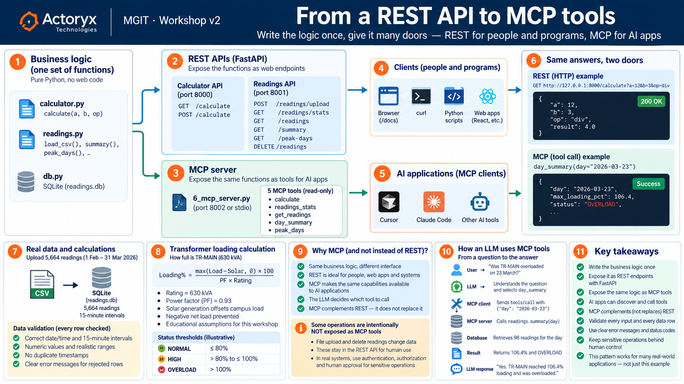

Slide 3
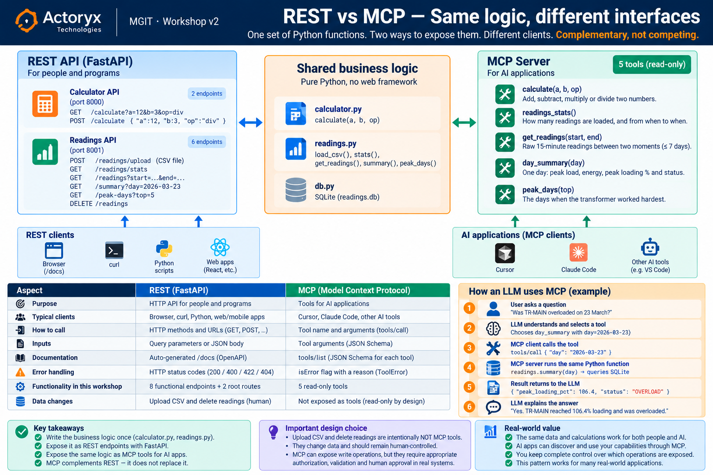

Slide 4
PROBLEM STATEMENT · And how we will solve it
THE PROBLEM
SOLUTION APPROACH
Everyone needs quick calculations, and the substation's meter readings arrive as a CSV. People — and now AI apps — need answers without opening a spreadsheet:
1
Calculator API
GET / POST /calculate · status codes
“What is 12 divided by 3?”
“Was transformer TR-MAIN overloaded on 23 March 2026?”
2
Readings API
upload the CSV through the API
Given | a calculator function · campus_feb_mar_2026.csv (5,664 readings, every 15 min, 1 Feb – 31 Mar 2026)
Find | a REST API for each (people and programs), then the same functions as MCP tools (Cursor, Claude Code)
Rules | logic in plain functions · every input checked · every CSV row checked · AI gets read-only tools
3
Ask questions
/summary · /peak-days · /readings
4
MCP server
the same functions as 5 tools
5
AI apps
Cursor and Claude Code call them
Notes:
Read the problem. Ask: who reads /docs? (a person). Who can't? (an AI app) — that's why Part 3 exists.

Slide 5
THE PLAN · Write the logic once, give it many doors
calculator.py
readings.py — the logic
1_ · 3_ …_api.py
REST: /docs
6_mcp_server.py
MCP: 5 tools
Browser · Cursor
Claude Code · programs
→
→
→
Part | What we build | The new idea
1 · Calculator API | two numbers + one operation → the answer | GET and POST, query vs JSON body, /docs, 200 · 400 · 422
2 · Readings API | upload 5,664 readings through the API, then ask | file upload, checking every row, SQLite, 404
3 · MCP | the same two APIs as MCP tools, in Cursor and Claude Code | tools an AI app discovers and calls
Architecture clarification: REST and MCP are PARALLEL adapters. Both call calculator.py / readings.py directly. The MCP server does NOT call the REST API; the business logic is shared, not chained.
Set up once: pip install -r requirements.txt (fastapi, uvicorn, python-multipart, sqlalchemy, pandas, httpx, mcp) · then cd code
Notes:
Show the three columns of the flow: logic, REST door, MCP door. Nothing in the logic changes when we add a door.

Slide 6
WHICH FILE DO I RUN? · One folder, code/ — the numbers are the order
File | What it is | Run
1_calculator_api.py | Part 1 · the calculator REST API — port 8000 | python 1_calculator_api.py
2_test_calculator.py | Part 1 · every case, against the running API | python 2_test_calculator.py
3_readings_api.py | Part 2 · the readings REST API — port 8001 | python 3_readings_api.py
4_upload_csv.py | Part 2 · uploads the CSV to the running API | python 4_upload_csv.py
5_test_readings.py | Part 2 · every endpoint, including refusals | python 5_test_readings.py
6_mcp_server.py | Part 3 · the same logic as 5 MCP tools — port 8002 | python 6_mcp_server.py http
7_ · 8_ · 9_ · 10_ | Part 3 · the two lists · test every tool · the wire · a UI | streamlit run 10_mcp_ui.py
calculator.py, readings.py, db.py | the logic — imported, so no number (Python can't import 1_…) | read them
Ports: calculator 8000 · readings 8001 · MCP 8002 — all three can run at once. Busy? python 1_calculator_api.py 8010 and API_URL=… for its test.
Notes:
A file name can't start with a digit for `import`, so the imported logic files keep plain names. uvicorn and importlib can load the numbered ones.

Slide 7
PART 1 · The logic, then a web address for it
calculator.py — the logic, no web code
1_calculator_api.py — the REST door
def calculate(a: float, b: float, op: str) -> float:
if op == "add":
return a + b
if op == "sub":
return a - b
if op == "mul":
return a * b
if op == "div":
if b == 0:
raise ValueError("cannot divide by zero")
return a / b
raise ValueError(f"unknown operation '{op}' — use one of {', '.join(OPERATIONS)}")
@app.get("/calculate")
def calculate_get(a: float, b: float, op: Operation):
try:
return {"a": a, "b": b, "op": op, "result": calculator.calculate(a, b, op)}
except ValueError as e:
raise HTTPException(status_code=400, detail=str(e))
@app.get("/calculate") gives the function an address. op: Literal[...] allows only four words. A ValueError from our function becomes HTTP 400 with its reason.
Run: python 1_calculator_api.py → http://127.0.0.1:8000/calculate?a=12&b=3&op=div and /docs
Notes:
POST /calculate takes the same inputs as a JSON body {"a":12,"b":3,"op":"div"} — the exact shape an MCP tool's arguments will have in Part 3.

Slide 8
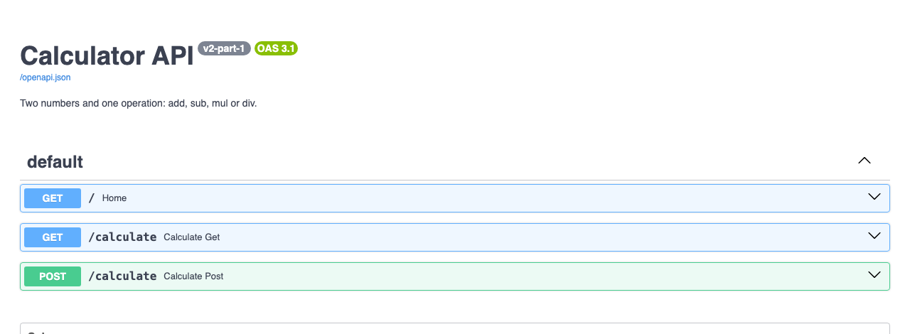
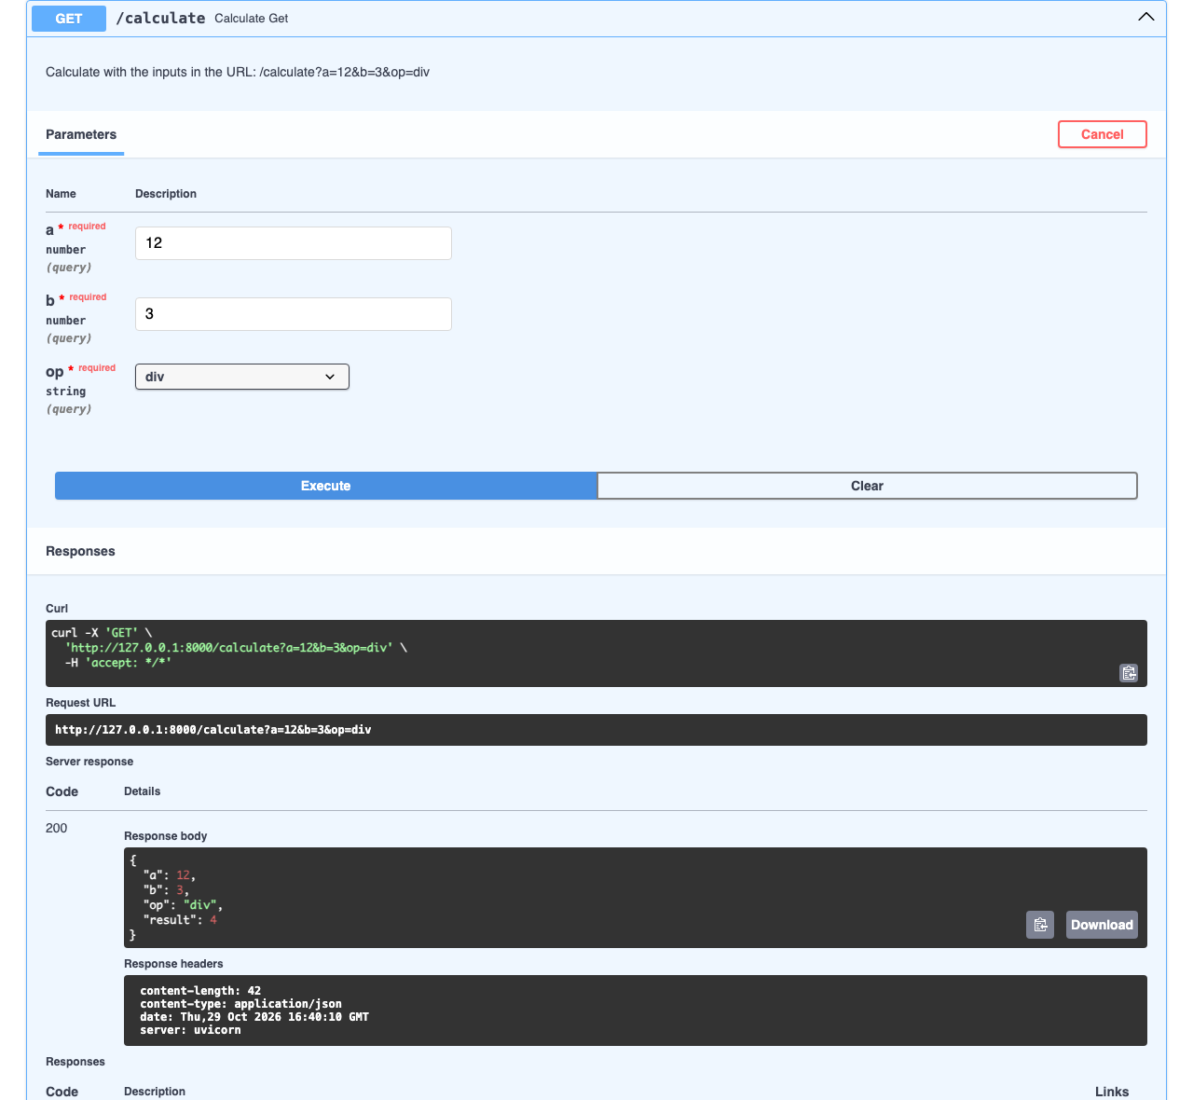
PART 1 · /docs — FastAPI wrote it from the code; Try it out
http://127.0.0.1:8000/docs — GET and POST /calculate
Try it: GET /calculate → Try it out → a = 12, b = 3, op = div → Execute → 200, "result": 4
Notes:
Point out the curl line Swagger prints — the same request a program would send.

Slide 9
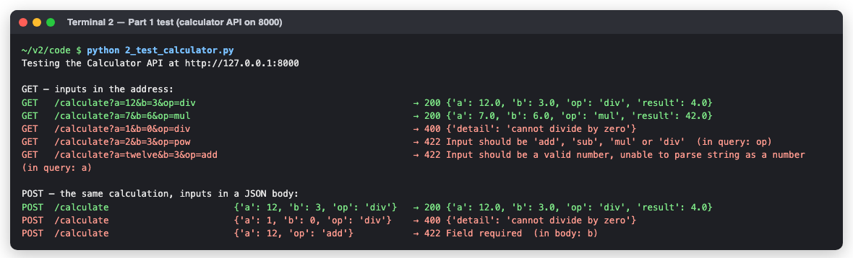
PART 1 · Three answers: 200, 400, 422 — and who said no
Status | Means | Who said no
200 OK | here is the answer | —
400 Bad request | the request was fine; the values can't be done (1 ÷ 0) | our function (ValueError → HTTPException)
422 Unprocessable | the request broke the rules (op=pow, a=twelve, b missing) | FastAPI — our code never ran
Notes:
Run it live in a second terminal with the API running. The first line proves which API it is testing.

Slide 10
PART 2 · The data — and the upload checks every row
Column | Meaning | Range
timestamp | every 15 minutes | 1 Feb – 31 Mar 2026
load_kw | the whole campus | 162 – 891 kW
solar_kw | rooftop solar | 0 – 384 kW
ambient_c | air temperature | 11.5 – 38.9 °C
irradiance_wm2 | sunlight on the panels | 0 – 1,049 W/m²
READINGS_WITH_PROBLEMS.CSV: 9 ROWS → 3 LOADED, 6 REFUSED
line 4 · solar_kw 'abc' is not a number
line 5 · 2026-02-30 is not a real date
line 6 · solar_kw −15 is outside 0–500
line 7 · ambient_c 80 is outside −10–55
line 8 · duplicate time
line 9 · load_kw is empty
Workshop assumption: loading = max(load − solar, 0) ÷ 0.93 ÷ 630 kVA × 100. Fixed PF 0.93; solar offsets campus load. NORMAL ≤ 80% · HIGH > 80% to 100% · OVERLOAD > 100%. Illustrative thresholds, not a universal operating standard.
Whole-file refusals (400): not a .csv · missing columns. replace=false appends new timestamps. Caution: replace=true (the default) deletes existing readings before loading the new file.
Notes:
Every row is checked; good rows are stored, every refused row comes back with its line number and reason.

Slide 11
PART 2 · Six readings routes — upload, delete, and four that answer
Method | Endpoint | Inputs | What it does
POST | /readings/upload | a CSV file, replace | load the file — every row checked; returns a report
GET | /readings/stats | — | how many readings, from when to when
GET | /readings | start, end | the raw rows — at most 7 days
GET | /summary | day | one day: peak load, energy, solar, loading %, status
GET | /peak-days | top (1–31) | the hardest-working days
DELETE | /readings | — | remove everything
3_readings_api.py — the upload endpoint (descriptions folded: …)
@app.post("/readings/upload", status_code=201)
async def upload(file: UploadFile = File(description=…),
replace: bool = Query(True, description=…)):
if not (file.filename or "").lower().endswith(".csv"):
raise HTTPException(status_code=400, detail=f"'{file.filename}' is not a .csv file")
return answer(readings.load_csv, await file.read(), replace)
Safety note: replace=true is destructive; the test script also clears the database before testing.
Run: python 3_readings_api.py → http://127.0.0.1:8001/docs (port 8001, next to the calculator on 8000)
Notes:
404 = no data that day (readings.NotFound); 400 = the request can't be done (ValueError) — the answer() helper maps them.

Slide 12
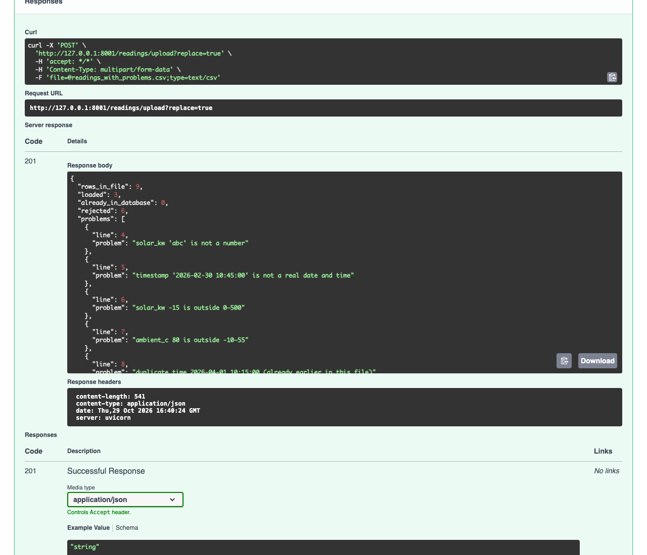
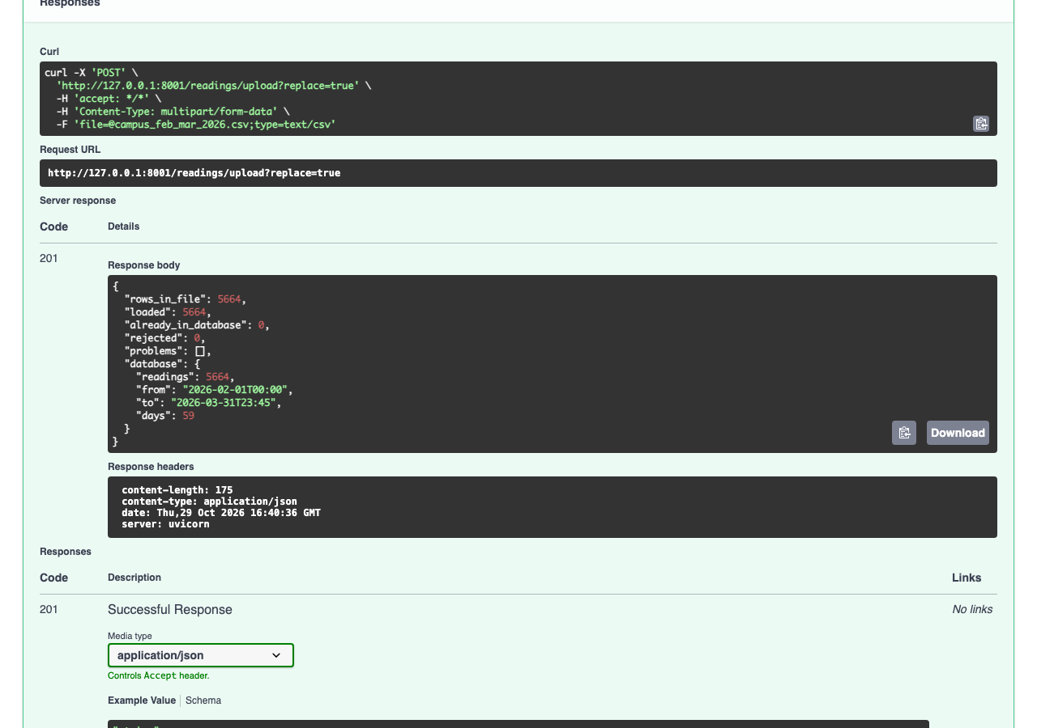
PART 2 · Load the data THROUGH the API — Choose file in /docs
Left: the problem file → 201, 3 loaded, 6 refused with reasons. Right: the real file → 5,664 loaded, 1 Feb → 31 Mar.
Notes:
Also from a program: python 4_upload_csv.py — or curl -F "file=@campus_feb_mar_2026.csv" http://127.0.0.1:8001/readings/upload

Slide 13
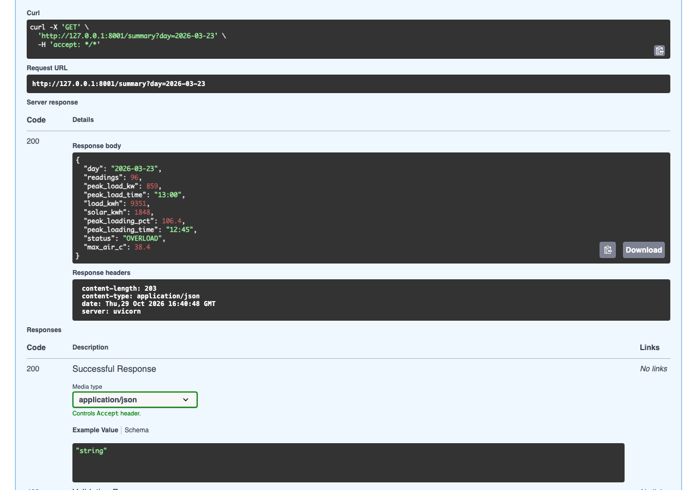
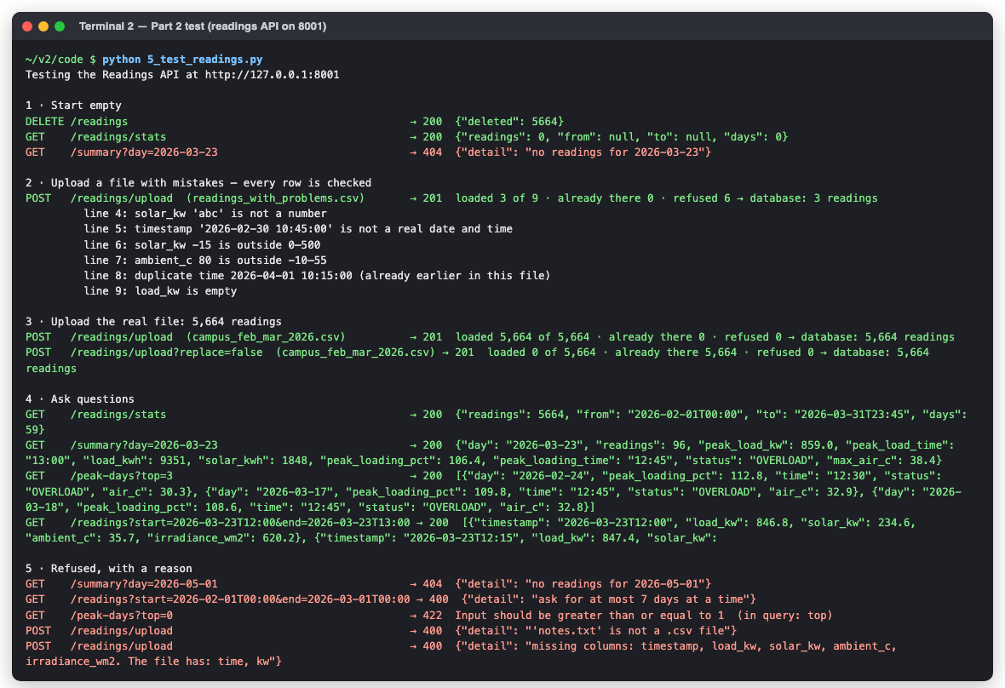
PART 2 · Ask: 23 March → 106.4 %, OVERLOAD — and test every endpoint
Statuses here: 201 upload accepted · 400 not .csv / wrong columns / > 7 days · 404 no readings that day · 422 top=0
Notes:
5_test_readings.py empties the database first and ends with the 5,664 readings loaded again.

Slide 14
PART 3 · What we ADD to make it MCP — one file, one library
 | REST (1_, 3_) | MCP (6_mcp_server.py)
Library | fastapi · uvicorn | + mcp
Server object | app = FastAPI(...) | mcp = MCPServer("campus-energy-v2")
Publish a function | @app.get("/summary") — method + URL | @mcp.tool() — just a name
Inputs and limits | type hints · Query · Literal | the SAME type hints + Field(description)
What a client reads | /docs — for a person | tools/list — name, docstring, JSON Schema
The docstring | optional | essential: all the AI knows
Saying “no” | HTTPException(400 / 404) | ToolError → isError + reason
Start the web server | uvicorn.run(app, port=8001) | mcp.run(transport="streamable-http", port=8002)
Unchanged: calculator.py, readings.py, db.py. The MCP server imports them — nothing is copied.
Notes:
The question: what does an AI app need that a person reading /docs doesn't? A way to ASK the server what it can do. That's MCP. Last row: transport="streamable-http" is what opens port 8002 at /mcp. mcp.run() alone means stdio: no port, the AI app starts the server and talks through stdin/stdout.

Slide 15
PART 3 · Each read endpoint becomes a named tool — the two that change data don't
REST endpoint | MCP tool | Same function
GET · POST /calculate | calculate | calculator.calculate
GET /readings/stats | readings_stats | readings.stats
GET /readings | get_readings | readings.get_readings
GET /summary | day_summary | readings.summary
GET /peak-days | peak_days | readings.peak_days
POST /readings/upload · DELETE /readings | — REST only | they change data: a person does that
6_mcp_server.py — the server and how it says no
mcp = MCPServer("campus-energy-v2",
instructions="A calculator, and the campus substation's readings (1 Feb – 31 Mar 2026) for transformer TR-MAIN.",
log_level="WARNING")
def refused_as_tool_error(fn, *args):
try:
return fn(*args)
except (ValueError, readings.NotFound) as e:
raise ToolError(str(e))
Why ToolError? any other error reaches the AI only as “Error executing tool” — without the reason.
Notes:
REST says WHAT with the method and WHICH with the URL; MCP says both with the tool's name.

Slide 16
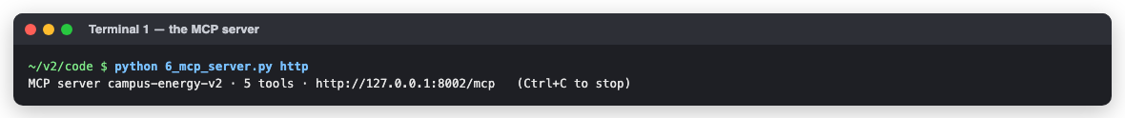
PART 3 · Same function, two doors — /summary and day_summary
3_readings_api.py — REST
6_mcp_server.py — MCP
@app.get("/summary")
def summary(day: date = Query(examples=["2026-03-23"])):
return answer(readings.summary, day)
def day_summary(day: Annotated[date, Field(description="the day, YYYY-MM-DD, e.g. 2026-03-23")]) -> dict:
return refused_as_tool_error(readings.summary, day)
Both call readings.summary(day). REST turns NotFound into 404; MCP turns it into a ToolError the AI can read: “no readings for 2026-05-01”.
Run: python 6_mcp_server.py (or PyCharm ▶) → http://127.0.0.1:8002/mcp · python 6_mcp_server.py stdio is only for an AI app that starts it
Notes:
Start the MCP server in terminal 1 and leave it running for the next slides. Load the data first (Part 2): the tools read the same readings.db.

Slide 17
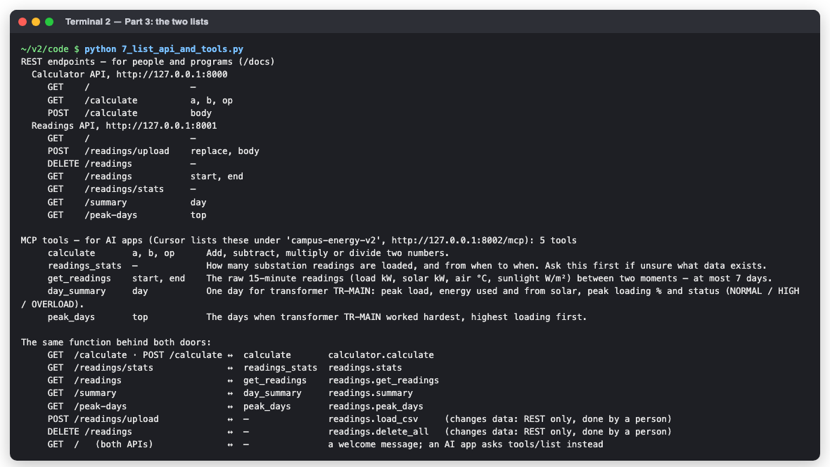
PART 3 · Endpoint inventory — 8 functional REST routes + 2 root routes; 5 MCP tools
Count: calculator 2 + readings 6 = 8 functional routes; plus one / root route per API.
Notes:
7_list_api_and_tools.py reads both lists from the code itself — app.openapi() for REST, tools/list for MCP — so they can't go out of date.

Slide 18
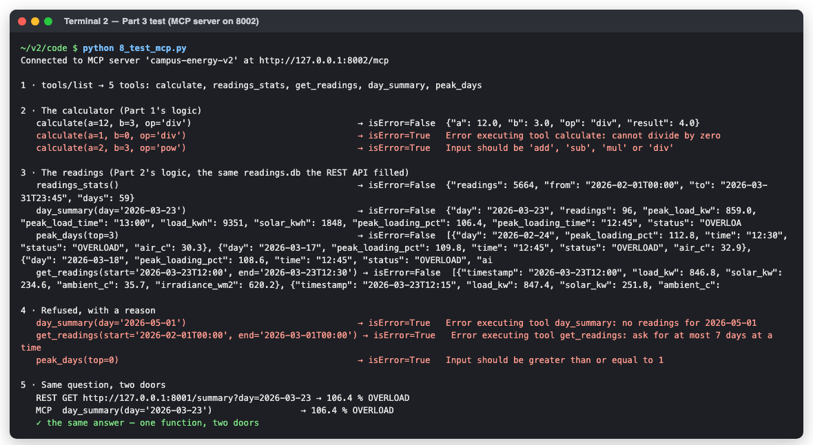
PART 3 · Test every tool, as an AI app would — REST and MCP agree
REST says | MCP says
200 + JSON | isError: false + result
400 / 404 — our function refused | isError: true + the reason
422 — broke the rules | isError: true — the schema refused
Last line: REST /summary and MCP day_summary give 106.4 % OVERLOAD — one function, two doors.
Notes:
8_test_mcp.py first checks the server's name is campus-energy-v2 — the old Day 5 server on 8002 is refused with a clear message.

Slide 19
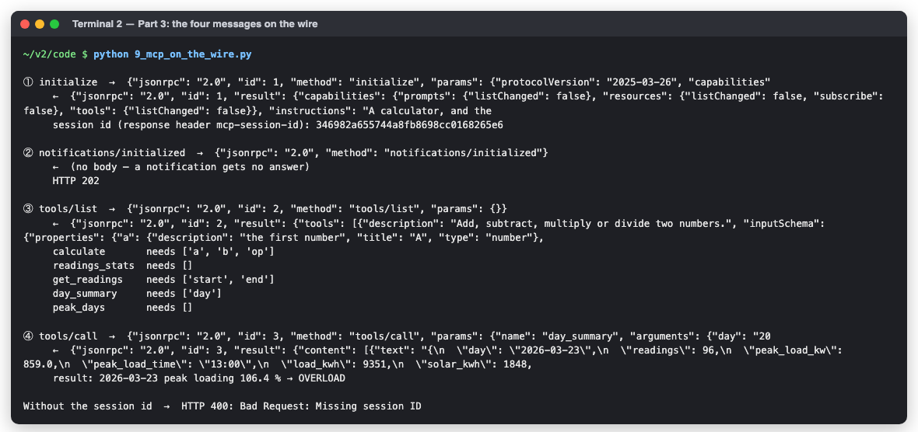
PART 3 · MCP on the wire — four JSON-RPC messages in this Streamable HTTP example
① initialize
agree the protocol; get mcp-session-id (a response HEADER)
② initialized
a notification — no id, HTTP 202
③ tools/list
every tool's name, description, JSON Schema
④ tools/call
run one tool with its arguments → result + isError
This demo sends these messages as HTTP POSTs. Streamable HTTP is not limited to POST-only communication.
Notes:
Client(...), Cursor and Claude Code all send exactly these four. Without the session id the server answers HTTP 400. Over stdio there's no session header: the process is the session.

Slide 20
AI APPS · Connect Cursor — and see all five tools
1
Start python 6_mcp_server.py http (and load the data in Part 2)
.cursor/mcp.json
{
"mcpServers": {
"campus-energy-v2": {
"url": "http://127.0.0.1:8002/mcp"
}
}
}
2
Config .cursor/mcp.json is already in code/ → url http://127.0.0.1:8002/mcp
3
See the tools Settings → Tools & MCP (or Customize): campus-energy-v2 ● green, 5 tools
No terminal? cursor_mcp_stdio.json: Cursor starts 6_mcp_server.py itself (stdio). Red dot? The server isn't running, or the URL isn't exactly /mcp. Logs: Cmd+Shift+U → MCP Logs.
4
Ask Agent chat: “Was the transformer overloaded on 23 March 2026?” → day_summary → approve → 106.4 %, OVERLOAD
5
Can't “Delete all the readings” — no such tool, so Cursor can't. On purpose.
Students capture: the Tools & MCP list · the day_summary call card (click the arrow for its arguments) · the answer
Notes:
Cursor asks before running a tool by default — the approval step is where students see the arguments the model filled in.

Slide 21
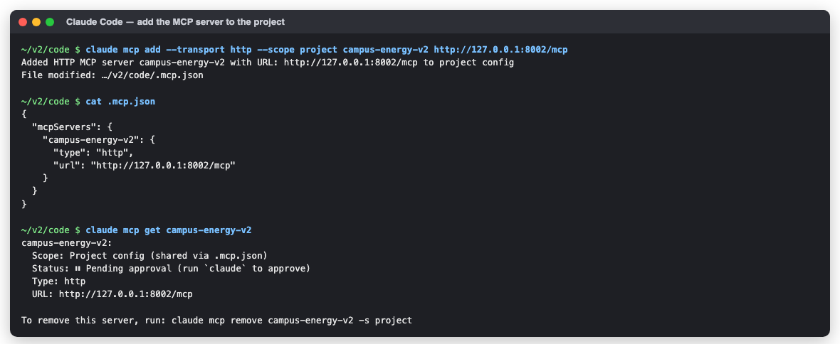
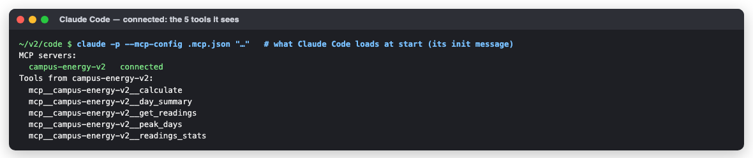
AI APPS · Claude Code — the same server, from a project .mcp.json
THREE COMMANDS, IN CODE/
claude mcp add --transport http --scope project campus-energy-v2 http://127.0.0.1:8002/mcp
claude mcp list → Pending approval (a project's .mcp.json could point anywhere, so it asks once)
claude → approve → “Was the transformer overloaded on 23 March 2026?” → allow day_summary
Tools appear as mcp__campus-energy-v2__day_summary etc. .mcp.json ships with the folder, so every student gets the server.
Notes:
The answer screenshot needs a signed-in Claude Code; students capture it after approving the server.

Slide 22
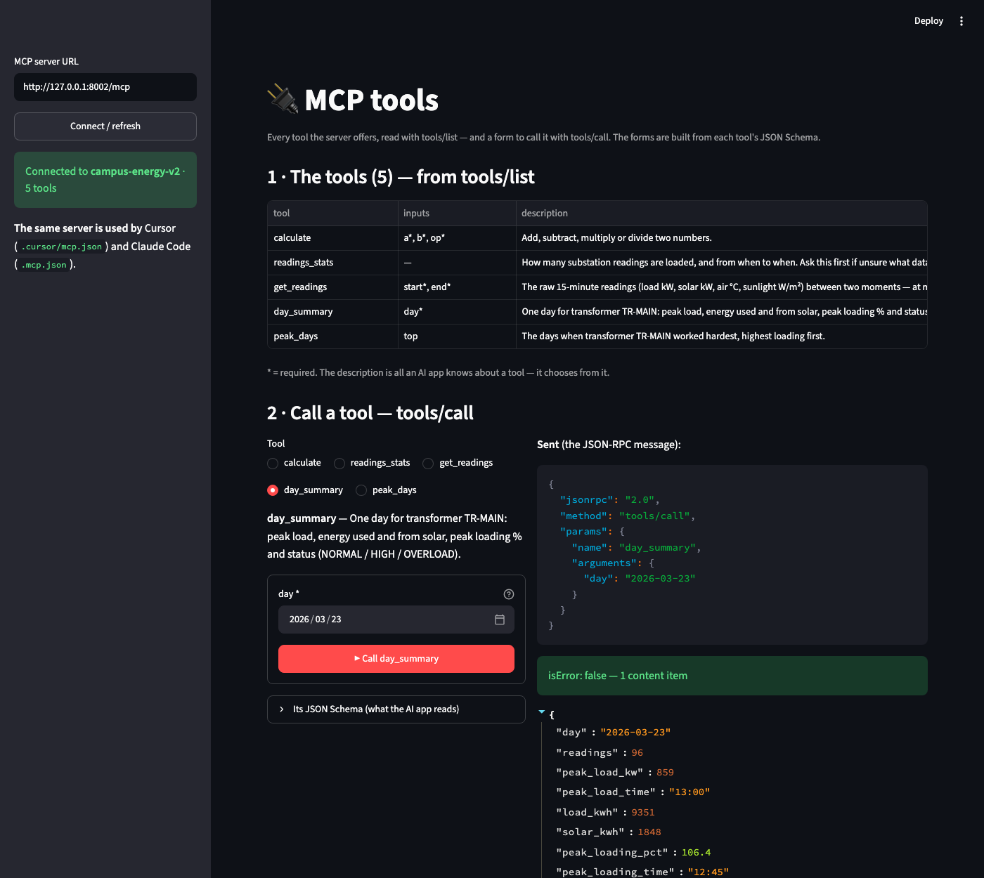
A UI FOR THE TOOLS · 10_mcp_ui.py — discover tools and call supported schemas
STREAMLIT RUN 10_MCP_UI.PY
Lists tools with tools/list — names, inputs and descriptions. Builds forms for supported JSON Schema types (enum, integer, number, boolean, date, date-time, object/array). Calls tools/call and displays results or errors. Connects to compatible Streamable HTTP servers; not every MCP capability or authentication flow is implemented.
Cursor: the MODEL selects a tool. This page: YOU select it. The SDK handles the protocol exchange.
Notes:
Start 6_mcp_server.py http first. Try a refusal live: calculate with b = 0, or get_readings for more than 7 days.

Slide 23
REST vs MCP · The difference in the UI — you pick the endpoint, or the model picks the tool
REST · /docs (Swagger)
for people and programs
MCP · Cursor / Claude Code
for AI apps
The list: endpoints by URL and method
YOU pick the endpoint, fill the boxes, press Execute
Back: a status code (200 · 400 · 404 · 422) and JSON
Clients: browser, Streamlit, React, curl, any program
The list: tool names + descriptions (tools/list)
YOU type a sentence; the MODEL picks the tool and fills it; you approve
Back: a result with isError; the model puts it in words
Try it without an AI: MCP Inspector → http://127.0.0.1:8002/mcp
MCP does NOT replace REST. It adds an AI-friendly interface to existing capabilities. Both adapters call the same functions (23 Mar = 106.4% either way).
Notes:
That is why the docstring matters so much in MCP: the model chooses from it.

Slide 24
ACTORYX
HOW THE LLM USES MCP · From a question to a tool result
1 USER
“Was TR-MAIN overloaded
on 23 March?”
2 LLM
Understands intent;
selects day_summary
3 MCP CLIENT
tools/call + arguments
(day = 2026-03-23)
4 MCP SERVER
Validates arguments;
invokes Python function
5 BUSINESS LOGIC
readings.summary(day)
queries SQLite
→
→
→
→
RETURN PATH · Tool result returns to the MCP client, then to the LLM for a natural-language answer
TOOL RESULT
peak_loading_pct: 106.4 · status: OVERLOAD
LLM RESPONSE
“Yes. TR-MAIN reached 106.4% loading.”
→
Key point: the LLM chooses the tool and arguments; the MCP server executes the Python function and returns the result.
22

Slide 25
TROUBLESHOOTING · What you see, why, and the fix
You see | Why | Fix
✗ Nothing is running at …:8001 | the API isn't started | python 3_readings_api.py (terminal 1)
✗ … is not the Readings API | another program is on that port | stop it, or use another port + API_URL
✗ MCP server … is 'campus-energy', not campus-energy-v2 | an older MCP server holds 8002 | stop it; python 6_mcp_server.py http
Console says “stdio”; :8002 not reachable | started as stdio — it waits on stdin, no port | run it with no argument (or http); stdio is for AI apps
No module named 'mcp' | this Python lacks the library | pip install -r requirements.txt (in the Python you run)
Claude Code: Pending approval | project servers need a one-time yes | run claude, approve campus-energy-v2
readings_stats → 0 | the data isn't loaded | Part 2: python 4_upload_csv.py
First move, always: read the terminal and the browser console (F12). The red line names the problem.
Notes:
Every client checks WHO is on the port before sending anything — read its one-line message first.

Slide 26
KEY WORDS · And check yourself
WORDS YOU NOW KNOW
CHECK YOURSELF (ANSWERS IN THE NOTES)
REST API | functions at web addresses, for people & programs
/docs | FastAPI's page to try every endpoint
Status code | 200 ok · 400 business refusal · 404 no data · 422 request validation error
Upload | a file sent with POST (multipart)
MCP | how an AI app discovers and calls tools
Tool | a function with a name, description, schema
ToolError | MCP's “no, because…”
JSON-RPC | the 4 messages: initialize … tools/call
1
What do we ADD to make REST logic available to Cursor?
2
GET /calculate?a=1&b=0&op=div → 400. Who said no?
3
Why are upload and delete NOT MCP tools?
4
day_summary for 2026-05-01 — what comes back?
5
23 March via REST and via MCP?
Notes:
Answers:
1. One file (6_mcp_server.py) and the mcp library; the logic is imported, not copied.
2. Our calculate() function (ValueError → HTTPException 400).
3. They change data — give an AI only what it needs.
4. isError: true and “no readings for 2026-05-01” (a ToolError).
5. 106.4 %, OVERLOAD — the same function behind both.

Slide 27
One Logic, Two Doors
REST for people and programs · MCP for AI apps — the same calculator.py and readings.py behind both
Part 1: a calculator API — GET and POST, /docs, 200 · 400 · 422
Part 2: 5,664 readings uploaded through the API, every row checked; /summary, /peak-days
Part 3: the same functions as 5 MCP tools — tested, on the wire, in Cursor and Claude Code
Notes:
Student page: v2/index.html (17 steps, ending with the testing screens).

