Slide 1
<number>
Data Set
Improving Video Activity Recognition using Object Recognition and Text Mining
Tanvi S. Motwani and Raymond J. Mooney
The University of Texas at Austin
Notes:
<number>

Slide 2


<number>
What is Video Activity Recognition?
Input
Output
TYPING
LAUGHING

Slide 3
<number>
What has been done so far?
There has been a lot of recent work in activity recognition:
Pre defined set of activities are used and recognition is treated as a classification problem
Scene context and Object context in the video is used and correlation between the context and activities are generally predefined
Text associated with the video in the form of scripts or captions are used as “bag of words” to improve performance

Slide 4
<number>
Our Work
Automatically discover activities from video descriptions because we use real world YouTube dataset with unconstrained set of activities
Integrate video features and object context in video
Use general large text corpus to automatically find correlation between activities and objects
Use deeper natural language processing techniques to improve results over “bag of words” methodology.

Slide 5
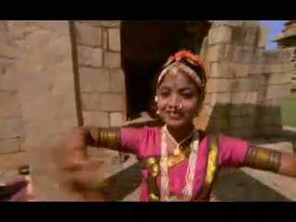
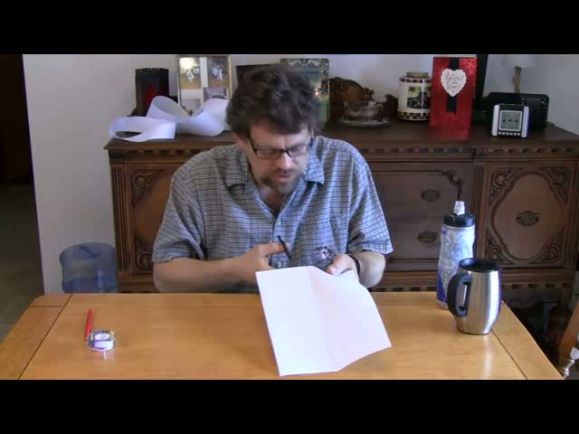
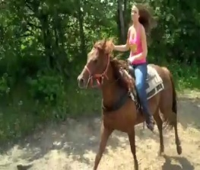
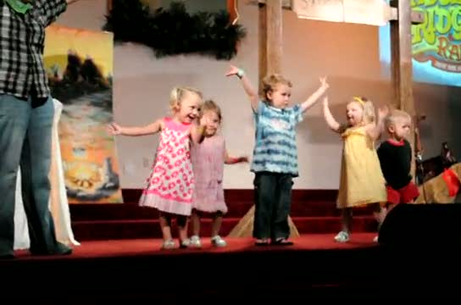
<number>
Data Set
A girl is dancing.
A young woman is dancing ritualistically.
An indian woman dances.
A traditional girl is dancing.
A girl is dancing.
A man is cutting a piece of paper in half lengthwise using scissors.
A man cuts a piece of paper.
A man cut the piece of paper.
A woman is riding horse on a trail.
A woman is riding on a horse.
A woman rides a horse
Horse is being ridden by a woman
A group of young girls are dancing on stage.
A group of girls perform a dance onstage.
Kids are dancing.
small girls are dancing.
few girls are dancing.
Data Collected through Mechanical Turk by Chen et al. (2011)
1,970 YouTube Video Clips
85k English Language Descriptions
YouTube videos submitted by workers
Short (usually less than 10 seconds)
Single, unambiguous action/event

Slide 6
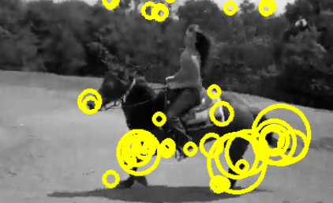

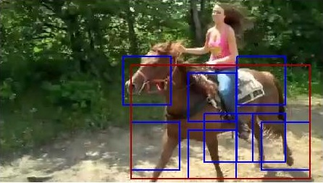
<number>
Overall Activity Recognizer
using video features
Video Feature Extractor
Training Input
Activity Recognizer using
Video Features
Predicted Activity
Activity Recognizer
using
Object Features
Pre-Trained Object Detectors
Training Input
using object features

Slide 7
Overall Activity Recognizer
Video Feature Extractor
Training Input
Activity Recognizer using
Video Features
Predicted Activity
Activity Recognizer
using
Object Features
Pre-Trained Object Detectors
Training Input
<number>

Slide 8
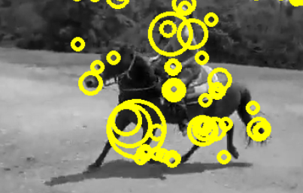
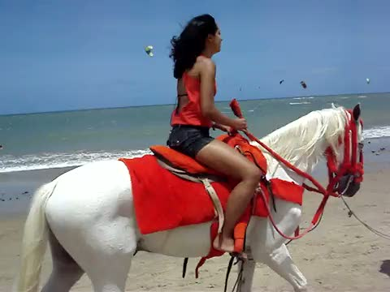
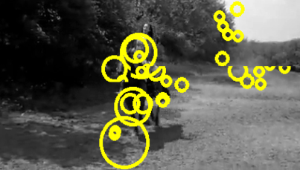
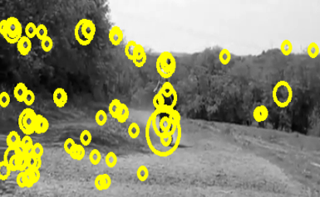
<number>
Activity Recognizer using Video Features
Training Video
Classifier Trained on input features as STIP features and classes as activity cluster labels
STIP features
A woman is riding horse in a beach.
A woman is riding on a horse.
A woman is riding on a horse.
ride, walk, run, move, race
NL description
Discovered Activity Label

Slide 9
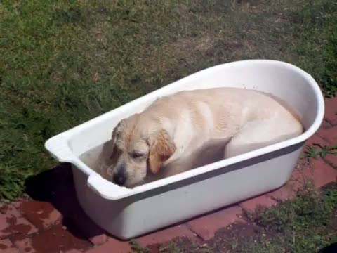
<number>
Automatically Discovering Activities and Producing Labeled Training Data
….Video Clips
A puppy is playing in a tub of water.
A dog is playing with water in a small tub.
A dog is sitting in a basin of water and playing with the water.
A dog sits and plays in a tub of water.
A puppy is playing in a tub of water.
A dog is playing with water in a small tub.
A dog is sitting in a basin of water and playing with the water.
A dog sits and plays in a tub of water.
A girl is dancing.
A young woman is dancing ritualistically.
Indian women are dancing in traditional costumes.
Indian women dancing for a crowd.
The ladies are dancing outside.
A girl is dancing.
A young woman is dancing ritualistically.
Indian women are dancing in traditional costumes.
Indian women dancing for a crowd.
The ladies are dancing outside.
A man is cutting a piece of paper in half lengthwise using scissors.
A man cuts a piece of paper.
A man is cutting a piece of paper.
A man is cutting a paper by scissor.
A guy cuts paper.
A person doing something
A man is cutting a piece of paper in half lengthwise using scissors.
A man cuts a piece of paper.
A man is cutting a piece of paper.
A man is cutting a paper by scissor.
A guy cuts paper.
A person doing something
…. NL Descriptions
play
throw
hit
dance
jump
cut
chop
slice
.… 265
Verb Labels
play
throw
hit
dance
jump
cut, chop, slice
Hierarchical
Clustering
play
throw, hit
dance, jump
play # throw # hit # dance # jump # cut # chop # slice # …..

Slide 10
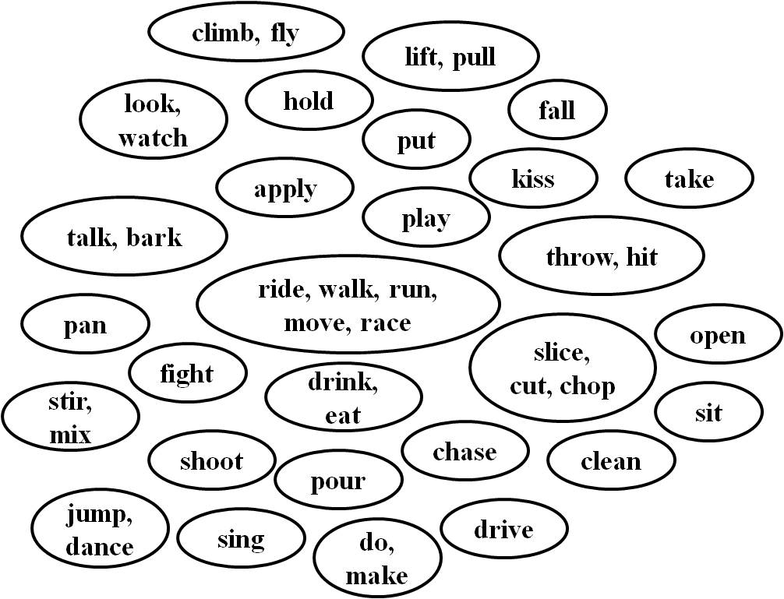
<number>
Automatically Discovering Activities and Producing Labeled Training Data
Hierarchical Agglomerative Clustering
WordNet::Similarity
(Pedersen et al.), 6 metrics:
Path length based measures: lch, wup, path
Information Content based measures: res, lin, jcn
Cut the resulting hierarchy at a level
Use clusters at that level as activity labels
28 discovered clusters in our dataset

Slide 11
<number>
Automatically Discovering Activities
and Producing Labeled Training Data
climb, fly
ride, walk, run, move, race
ride, walk, run, move, race
cut, chop, slice
cut, chop, slice
A man is cutting a piece of paper in half lengthwise using scissors.
A man cuts a piece of paper.
A man is cutting a piece of paper in half lengthwise using scissors.
A man cuts a piece of paper.
A woman is riding horse on a trail.
A woman is riding on a horse.
A girl is dancing.
A young woman is dancing ritualistically.
A woman is riding horse on a trail.
A woman is riding on a horse.
A girl is dancing.
A young woman is dancing ritualistically.
A group of young girls are dancing on stage.
A group of girls perform a dance onstage.
A group of young girls are dancing on stage.
A group of girls perform a dance onstage.
A woman is riding a horse on the beach.
A woman is riding a horse.
A woman is riding a horse on the beach.
A woman is riding a horse.
dance, jump
dance, jump
throw, hit
play

Slide 12
Overall Activity Recognizer
Video Feature Extractor
Training Input
Activity Recognizer using
Video Features
Predicted Activity
Activity Recognizer
using
Object Features
Pre-Trained Object Detectors
Training Input
<number>

Slide 13
<number>
Spatio-Temporal Video Features
STIP:
A set of Spatial temporal interest points (STIP) are extracted using motion descriptors developed by Laptev et al.
HOG + HOF:
At each point, HOG (Histograms of oriented Gradients) feature and HOF (Histograms of optical flow) feature are extracted
Visual Vocabulary:
50000 motion descriptors are randomly sampled and clustered using K-means (k = 200), to form visual vocabulary
Bag of Visual Words:
Each video is finally converted into a vector of k values in which ith value is number of motion descriptors corresponding to ith cluster.

Slide 14
Overall Activity Recognizer
Video Feature Extractor
Training Input
Activity Recognizer using
Video Features
Predicted Activity
Activity Recognizer
using
Object Features
Pre-Trained Object Detectors
Training Input
<number>

Slide 15
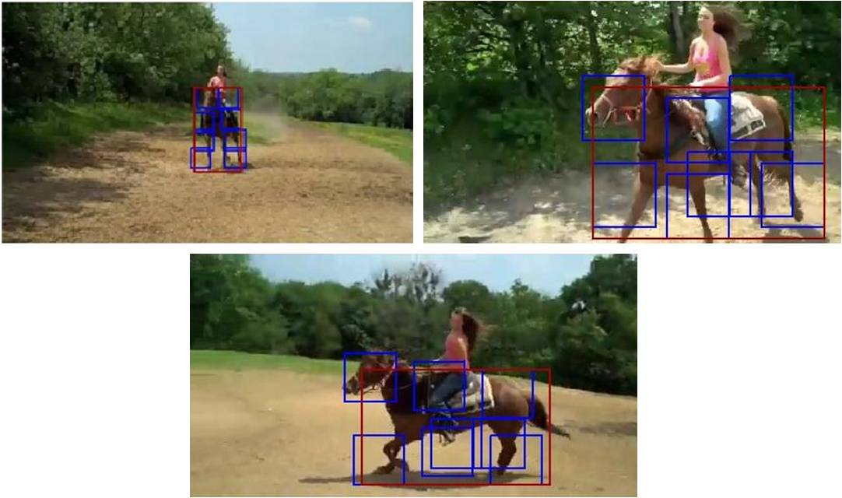
<number>
Object Detection in Videos
Discriminatively Trained Deformable Part Models (Felzenszwalb et al): Pre-trained object detector for 19 objects
Extract one frame per second
Run object detection on each frame, and compute maximum score of an object over all frames, and use that to compute probability of each object for each video

Slide 16
Overall Activity Recognizer
Video Feature Extractor
Training Input
Activity Recognizer using
Video Features
Predicted Activity
Activity Recognizer
using
Object Features
Pre-Trained Object Detectors
Training Input
<number>

Slide 17
<number>
Learning Correlations between Activities and Objects
English Gigaword corpus 2005 (LDC), 15GB of raw text
Occurrence counts:
of an activity Ai: occurrence of any of the verbs in the verb cluster
of an object Oj: occurrence of object noun Oj or its synonym.
Co-occurrence of an Activity and an Object:
Windowing
Occurrence of the object with w or fewer words of an occurrence of the activity. Experimented with w of 3, 10 and entire sentence.
POS Tagging
Entire corpus is POS Tagged using Stanford tagger. Occurrence of the object tagged as noun with w or fewer words of an occurrence of the activity tagged as verb.

Slide 18
<number>
Learning Correlations between Activities and Objects
Parsing
Parse the corpus using Stanford Statistical Syntactic Dependency Parser
Parsing I
Object is the direct object of the activity verb in the sentence.
Parsing II
Object is syntactically attached to activity by any grammatical relation (eg, PP, NP, ADVP etc.)
Example:
“Sitting in café, Kaye thumps a table and wails white blues”
Windowing: “sit” and “table” co-occur
POS Tagging: “sit” and “table” co-occur
Parsing I and II: No co-occurrence

Slide 19
<number>
Learning Correlations between Activities and Objects
Probability of each activity given each object using Laplace (add-one) smoothing:

Slide 20
Overall Activity Recognizer
Video Feature Extractor
Training Input
Activity Recognizer using
Video Features
Predicted Activity
Activity Recognizer
using
Object Features
Pre-Trained Object Detectors
Training Input
<number>

Slide 21
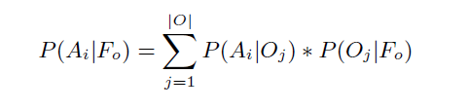
<number>
Activity Recognizer using Object Features
Probability of an Activity Ai using object detection and co-occurrence information:

Slide 22
Overall Activity Recognizer
Video Feature Extractor
Training Input
Activity Recognizer using
Video Features
Predicted Activity
Activity Recognizer
using
Object Features
Pre-Trained Object Detectors
Training Input
<number>

Slide 23



<number>
Integrated Activity Recognizer
Final recognized activity =
Videos on which object detector detected at least one object
(applying Naïve Bayes independence assumption between features given activity)
Videos on which there were no detected objects

Slide 24
<number>
Experimental Methodology
Ideally we would have trained detector for all objects, but because we just have 19 object detectors we included videos containing at least one of 19 objects in test set
(128 videos).
From the rest we discovered activity labels and found 28 clusters in 1190 training video set.
Training set is used to construct activity classifier based on video features.
We do not use description of test videos, they are only used to obtain gold standard labels for calculating accuracy. For testing only the video is given as input and we obtain activity as output.
We run the object detectors on the test set.
For activity-object correlation we compare all the methods: Windowing, POS tagging, Parsing and their types.
All the pieces are then combined in the final activity recognizer to obtain the predicted label.

Slide 25
<number>
Experimental Evaluation
Final Results using Different Text Mining Methods
Accuracy

Slide 26
<number>
Experimental Evaluation
Result of System Ablations
Accuracy

Slide 27
<number>
Conclusion
Three important contributions:
Automatically discovering activity classes from Natural Language descriptions of videos.
Improve existing activity recognition systems using object context together with correlation between objects and activities.
Natural language processing techniques can be used to extract knowledge about correlation of objects and activities from general text.

Slide 28
<number>
Questions?

Slide 29
<number>
Abstract
We present a novel combination of standard activity classification, object recognition and text mining to learn effective activity recognizers which does not require any manual labeling of training videos and uses
“world knowledge” to improve existing systems.

Slide 30
<number>
Related Work
There has been a lot of recent work in video activity recognition.: Malik et al.(2003), Laptev et al.(2004)
They all have defined set of activities, we automatically discover the set of activities from textual descriptions.
Work on context information to aid activity recognition:
Scene context: Laptev et al (2009)
Object context: Davis et al (2007), Aggarwal et al.(2007), Rehg et al.(2007)
Most have constraint set of activities, we address diverse set of activities in real world YouTube videos.
Work using text associated with video in form of scripts or closed captions: Everingham et al.(2006), Laptev et al.(2007), Gupta et al.(2010)
We use large text corpus to automatically extract correlation between activities and objects.
We display the advantage of deeper natural language processing specifically parsing to mine general knowledge connecting activities and objects.

