Slide 1
Incorporating Object and People Information to Improve Video Activity Recognition
Niranjan Viladkar Under the guidance from Dr. Parag Singla Department of Computer Science, IIT Delhi
M.Tech Project Presentation – June, 2014

Slide 2
Outline
Problem Definition
Background
Video recognizer, Object Detector, MLN
Approach
MLN Model details
Results

Slide 3
Problem Definition
Existing Frameworks
Pure HoGHoF features ( Laptev, CVPR’08 )
HoGHoF + Scene context ( Laptev, CVPR’09 )
HoGHoF + Object detection( Mooney, ECAI’12)
Problem with low level features
Partial or full occlusion
Noisy training data
To capture semantic relationship between Activity and object & people information.

Slide 4
Background - schematic
Video Features
Object Detection
People Information
Probabilistic Inference using MLN
Predictions

Slide 5
Background – Data set
Hollywood2 data set
823 Training and 884 Testing video clips
12 Activity Classes
Labeled data

Slide 6
Background - schematic
Video Features
Object Detection
People Information
Probabilistic Inference using MLN
Predictions

Slide 7
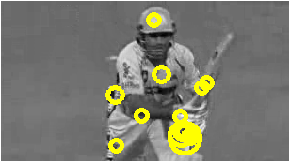
Background - Video Features
HoGHoF features at STIPs.

Slide 8
Background - Video Features
HoGHoF features at STIPs.
Describe a video clip as bag-of-features.
Cluster all HoGHoF feature descriptors using k-means.
Represent clip as a histogram over these clusters
Train a SVM classifier
Supervised - Dataset is pre labeled
Output – For each clip, confidence value for all 12 activities.

Slide 9
Background - schematic
Video Features
Object Detection
People Information
Probabilistic Inference using MLN
Predictions

Slide 10
Background – Object Detection
Using Discriminatively Trained Deformable Part Models (Felzenszwalb - PAMI’10)
Pre-trained object detector for 20 objects
aeroplane, bicycle, bird, boat, bottle, bus, car, cat, chair, cow, dining table, dog, horse, motorbike, potted plant, person, sheep, sofa, train, tv monitor
Application to videos
Output – Confidence of object being present in selected frames from the video

Slide 11
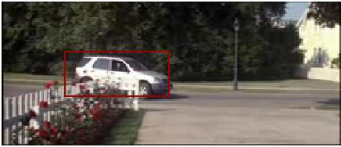
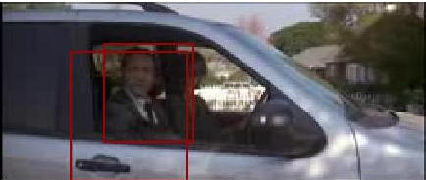
Output of Object Detector
FRAME 1 car -0.181786 . . .
FRAME 151 person 0.579786 person -0.593087

Slide 12
Background - schematic
Video Features
Object Detection
People Information
Probabilistic Inference using MLN
Predictions

Slide 13
Background – People Information
Object “Person”
Average number of persons per frame

Slide 14
Background - schematic
Video Features
Object Detection
People Information
Probabilistic Inference using MLN
Predictions

Slide 15
Background - Inference Using MLN
Capture the relationship between Activities and Object & People information
First-order Logic
ObjPresent(clip, chair) => HasActivity(clip, SitDown)
Hard constraints => Soft Constraints(weights)

Slide 16
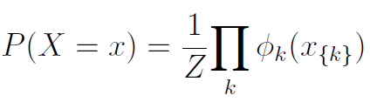
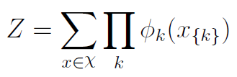
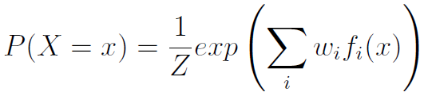
Background - Inference Using MLN
Undirected Graphical models to represent the joint distribution of a set of random variables.
Graph has a node for each variable, and the model has a potential function for each clique in the graph.

Slide 17
Background - Inference Using MLN
Framework to form Markov networks
MLN :- A set of pairs and set of constants C.
:- formula in first-order logic
:- real valued weight
Contains binary node for each possible grounding.

Slide 18

Background - Inference Using MLN
Probability calculated as :-
F : - number of formulas in the MLN.
:- is the number of true groundings.

Slide 19
Approach
MLN Evidence
Partitioning confidence into bins
Threshold for object detection confidence
True labels from data set
HasActivity("actioncliptrain00001","SitUp")
ActivityConf_N2_TO_N15("actioncliptrain00001","AnswerPhone")
ActivityConf_N15_TO_N1("actioncliptrain00001","DriveCar")
ObjPresent("actioncliptrain00001","person")
NumPersons_1_TO_15("actioncliptrain00001")
MLN Query made on “HasActivity”

Slide 20
Approach
MLN Rules
Positive and Negative
ActivityConf_P1_TO_P15(c,a) => HasActivity(c,a)
ActivityConf_P15_TO_P2(c,a) => HasActivity(c,a)
ObjPresent(c,“chair") => HasActivity(c,"Eat")
ObjPresent(c,“car") => HasActivity(c,“DriveCar")
ObjPresent(c,"bus") => HasActivity(c,“StandUp")
ObjPresent(c,"car") => HasActivity(c,“HandShake")
NumPersons_1_TO_15(c) => HasActivity(c,+a)
NumPersons_15_TO_2(c) => HasActivity(c,+a)

Slide 21
Approach
TF-IDF features
Appending 10 tf-idf features – one per object
And 1 feature corresponding to number of people

Slide 22
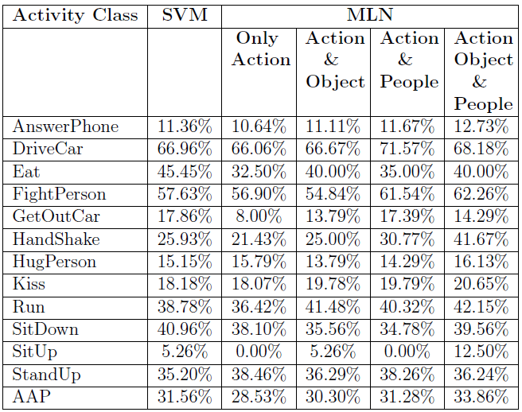
Results
MLN Experiments

Slide 23
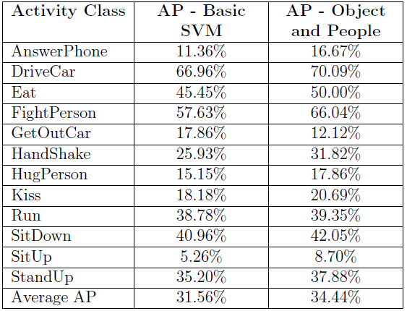
Results
TF-IDF Experiments

Slide 24
References
Actions in Context by M. Marszalek, I. Laptev and C. Schmid; in Proc. CVPR-2009
Improving Video Activity Recognition using Object Recognition and Text Mining by Tanvi Motwani and Raymond J. Mooney, ECAI-2012
Markov Logic by Pedro Domingos, Parag Singla, et.al., Probabilistic Inductive Logic Programming (pp. 92-117), 2008. New York: Springer.
Learning realistic human actions from movies by Laptev et.al., Conference on Computer Vision & Pattern Recognition, Jun 2008.
Object Detection with Discriminatively Trained Part-Based Models by Pedro F. Felzenszwalb, et.al., PAMI-2010

