Slide 1

Bank Loan Analysis Report
Comprehensive analysis of 38,576 loan records to evaluate lending performance, borrower behavior, and credit risk patterns.

Slide 2
Dataset Overview
38,576
24
3
Total Records
Features
Loan Status
Complete loan dataset analyzed
Data points per loan
Fully Paid, Current, Charged Off
Key categories include loan information (amount, interest rate, term), borrower details (income, employment, ownership), and performance metrics (payments, verification status).

Slide 3
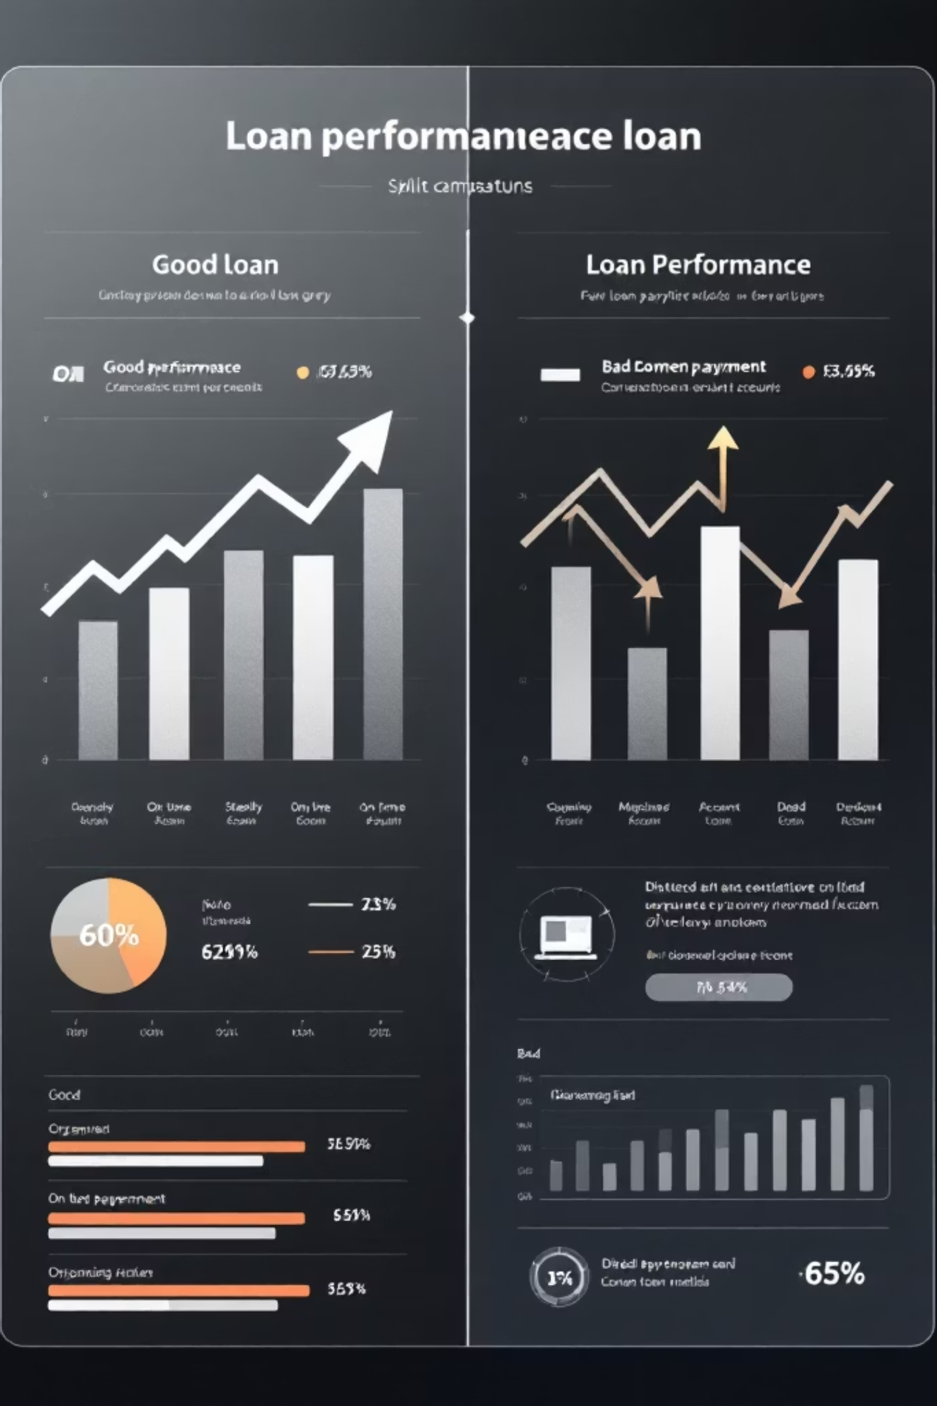
Good vs Bad Loan Performance
Good Loans
Bad Loans
86.2% of total loans
13.8% of total loans
33,243 applications approved
$370.2M funded amount
$435.8M received in payments
11.64% average interest rate
5,333 charged off applications
$65.5M funded amount
$37.3M received in payments
13.88% average interest rate

Slide 4
Monthly Trends & Seasonality
January
November
2,332 applications
$25.0M funded
4,035 applications
$47.8M funded
1
2
3
4
June
December
3,184 applications
$34.2M funded
4,314 applications
$54.0M funded
Loan applications show consistent monthly growth, with December showing strongest performance. Month-over-month growth of 6.9% in applications and 13% in funding.

Slide 5
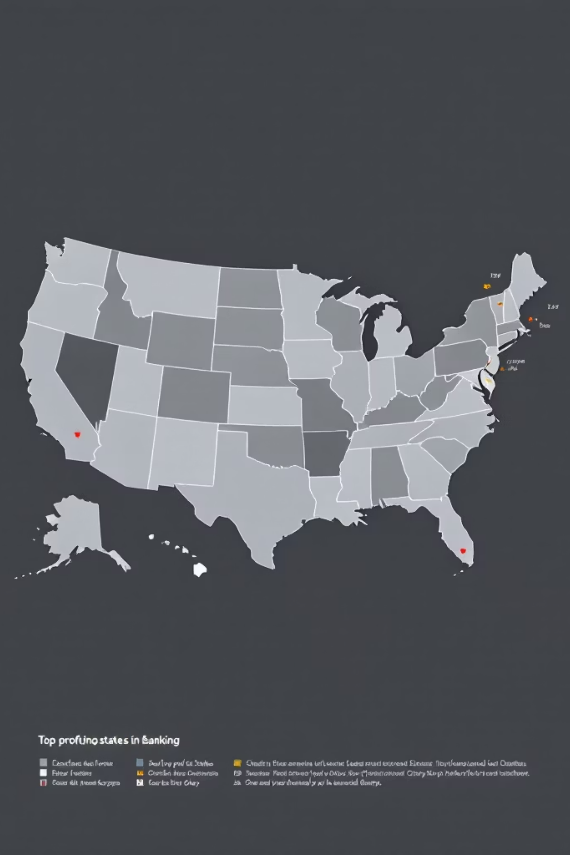
Top Performing States
California
$78.5M funded
6,894 applications
New York
$42.1M funded
3,701 applications
Texas
$30.0M funded
2,773 applications
Florida
$15.5M funded
1,355 applications

Slide 6
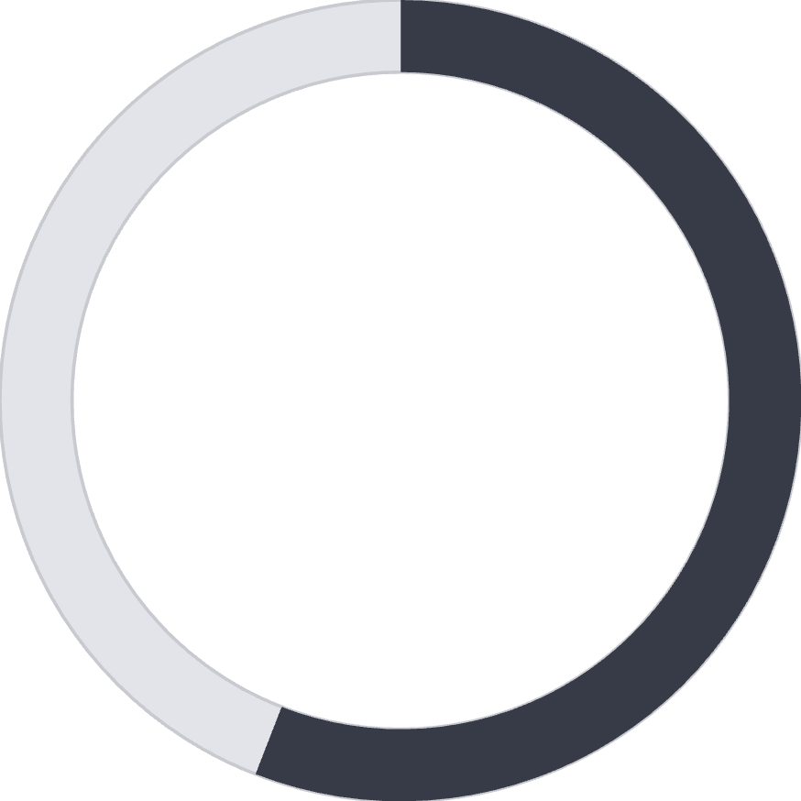

Loan Term Analysis
55.9%
44.1%
36-Month Terms
60-Month Terms
$273M funded across 28,237 loans
$162.7M funded across 10,339 loans
Key Insight
Shorter 36-month terms dominate the portfolio with higher funding amounts and lower risk profiles.

Slide 7
Employment Length Impact
23%
11%
10+ Years
2 Years
8,870 applications, $116M funded
4,382 applications, $45M funded
8%
12%
3 Years
0 Years
4,088 applications, $44M funded
4,575 applications, $44M funded
Employment length significantly influences loan performance, with longer tenure correlating to better repayment behavior.

Slide 8

Loan Purpose Distribution
Debt Consolidation
18,214 applications
$232.5M funded
55.8% of portfolio
Credit Card
4,998 applications
$58.9M funded
14.3% of portfolio
Home Improvement
2,876 applications
$33.4M funded
8.2% of portfolio
Other Purposes
3,824 applications
$31.2M funded
7.6% of portfolio

Slide 9
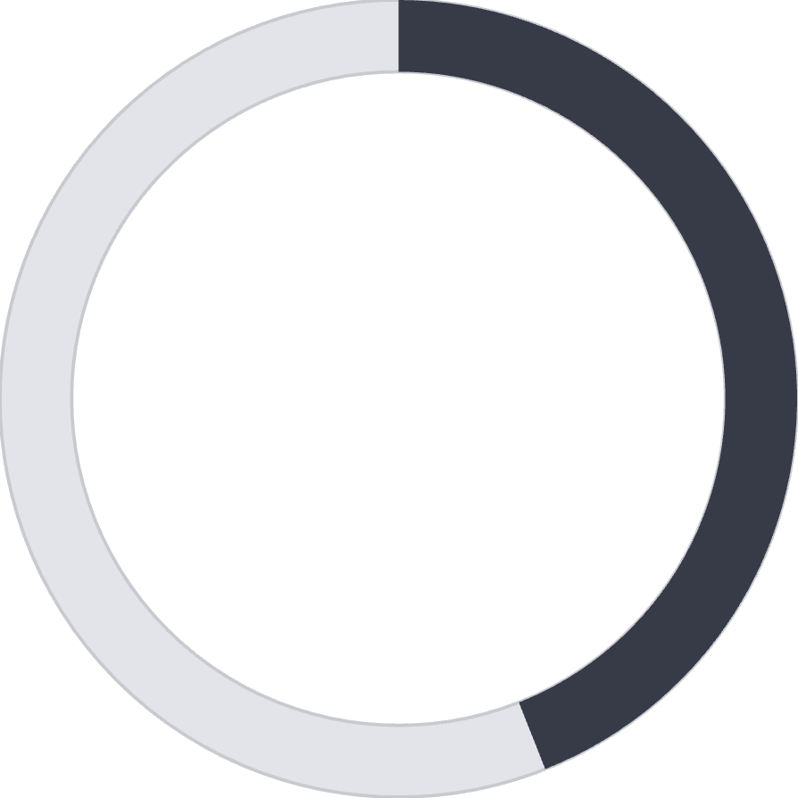
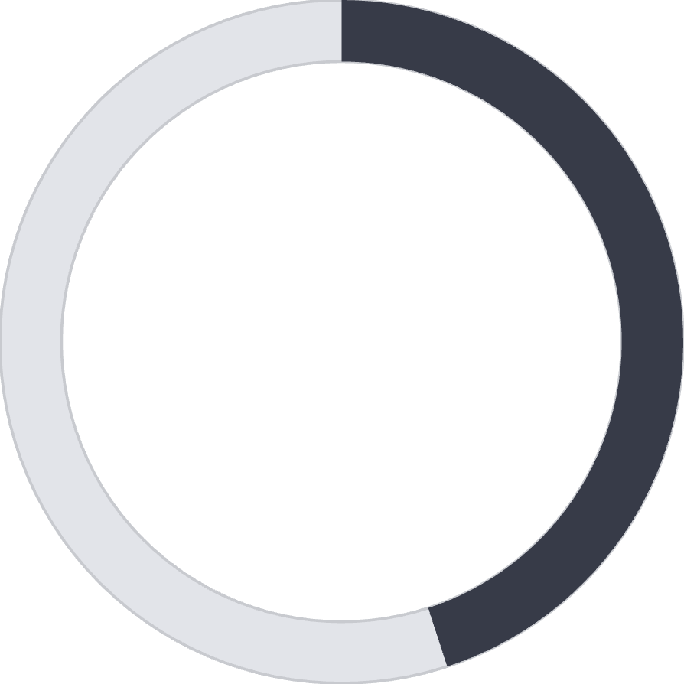
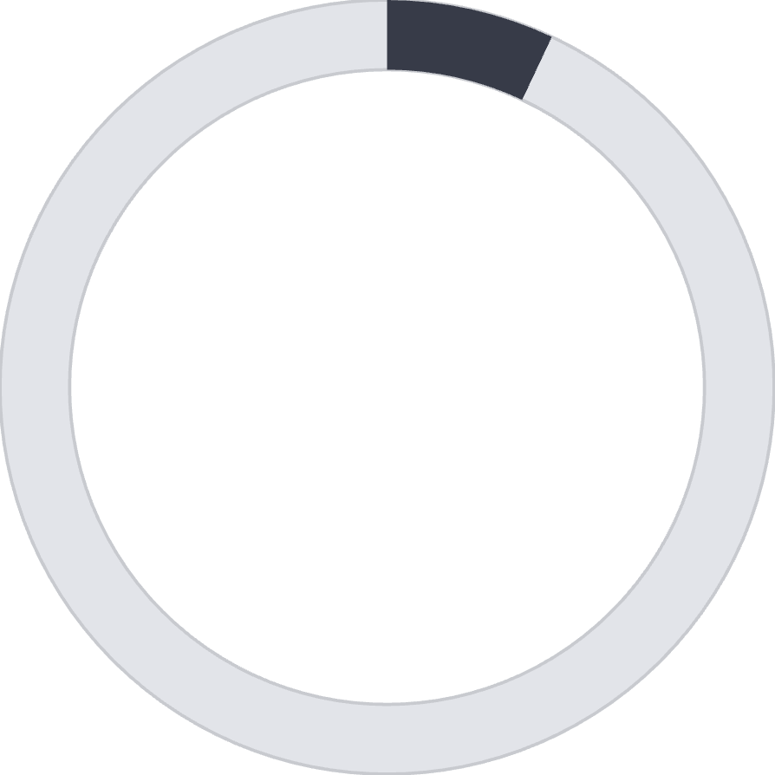
Home Ownership Analysis
44%
45%
7%
Rent
Mortgage
Own
18,439 borrowers renting homes
17,198 borrowers with mortgages
2,838 homeowners with no mortgage
Home ownership status shows correlation with loan performance, with mortgage holders showing strongest repayment rates.

Slide 10

Key Business Recommendations
Risk Management
Lending Strategy
Implement stricter approval criteria for high DTI borrowers and monitor charged-off loans for early warning signals.
Focus on low-risk segments with stable employment and lower DTI ratios. Optimize interest rates based on risk profiles.
Portfolio Optimization
Operational Improvements
Diversify across purposes and regions. Reduce exposure to high-risk loan categories.
Enhance data collection for better risk modeling. Automate loan monitoring using real-time dashboards.

