Slide 1
Project name: Bus Route Tracking
Presented by: 9185 – saynam Sharma
9195 – nirata Sinha
9196 – shivani Shukla
9198 – saksham inde
Mentor: Ms. Pradnya shende

Slide 2
Problem Statement: to understand the reason behind bus delay and to find out the most efficient bus route.
Given Data:
1. School_Year : Indicates the year the record refers to 2. Run_Type : Designates whether a breakdown or delay occurred on a specific category of bus services 3. Bus_No 4. Route_Number 5. Reason : Reason for the delay as entered by the staff employed by the reporting bus vendor 6. Occurred_On 7. Number_Of_Students_On_The_Bus

Slide 3
Technology Used: Spark sql
Why spark sql ?
Features : manage structured data, data description is possible and sql commands can be executed to obtain meaningful insights.
Fast - It provides high performance for both batch and streaming data.
Easy to Use - It facilitates to write the application in Java, Scala, Python, R, and SQL.
Generality - It provides a collection of libraries including SQL and DataFrames, MLlib for machine learning, GraphX, and Spark Streaming.
Lightweight - It is a light unified analytics engine which is used for large scale data processing.
Runs Everywhere - It can easily run on Hadoop, Apache Mesos, Kubernetes, standalone, or in the cloud.

Slide 4
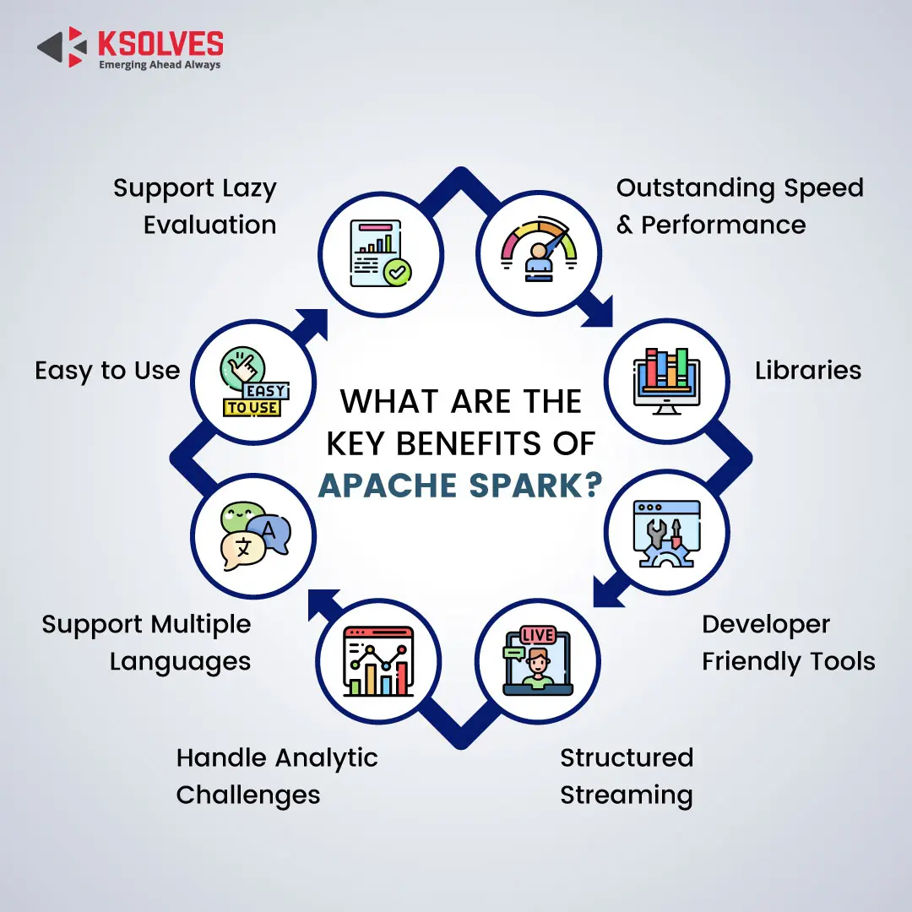
Advantages of spark sql

Slide 5
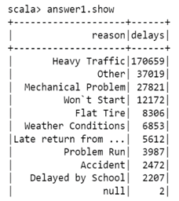
Solutions to the given problem statement:
Use case – 1:
Most common reasons for either a delay or breaking down of the bus
scala> val query = """Select * from (Select reason,count(run_type) as delays from caseData group by reason) sub order by delays desc""“
scala> val answer1 = spark.sql(query)
scala> answer1.show

Slide 6
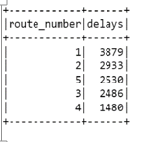
Use case-2:Top five route numbers where the bus was either delayed or broke down
scala> val query = """Select * from (Select route_number,count(run_type) as delays from caseData group by route_number) sub order by delays desc limit 5"""
scala> val answer2 = spark.sql(query)
scala> answer2.show

Slide 7
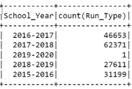
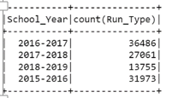
Use Case 3 - The total number of incidents, year-wise, when the students 3.1 were not in the bus
scala> val query = """Select School_Year,count(Run_Type) from caseData where No_Of_Students_On_The_Bus=0 group by School_year"""
scala> val answer3 = spark.sql(query)
scala> answer3.show
3.2 when students were in the bus
scala> val query = """Select School_Year,count(Run_Type) from caseData where No_Of_Students_On_The_Bus!=0 group by School_year"""

Slide 8
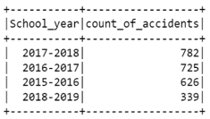
Use Case 4 - The year in which accidents were less
scala> val query = """ Select * from (Select School_year,count(run_type) as count_of_accidents from caseData where Reason="Accident" group by School_year) sub order by count_of_accidents desc"""
scala> val answer4 = spark.sql(query)
scala> answer4.show

