Slide 1
Localstack
Develop and test your cloud & Serverless apps offline!

Slide 2
Agenda
Introduction
Why use LocalStack?
What is LocalStack?
Installing LocalStack
Using LocalStack
Demo
Case Study
What’s Next?
Q & A

Slide 3
introduction
My Name is Nirav Chotai and I am a Senior Software Engineer working at Sophos
I have completed my Bachelor of Engineering in Computer Science in 2010
Total 9 years of experience in Software Development and Operations
In past, I worked for eClinicalWorks, InfoStretch, Crest Data Systems and eInfochips
I am comfortable with AWS, Linux, Terraform, Ansible, Jenkins, Docker and Python
I possess AWS Certified DevOps Engineer – Professional certification
I also teach Ansible for automation on Udemy having 15,000+ students worldwide
My hobbies include reading books, learning new technologies and help others

Slide 4
Why use LocalStack?

Slide 5
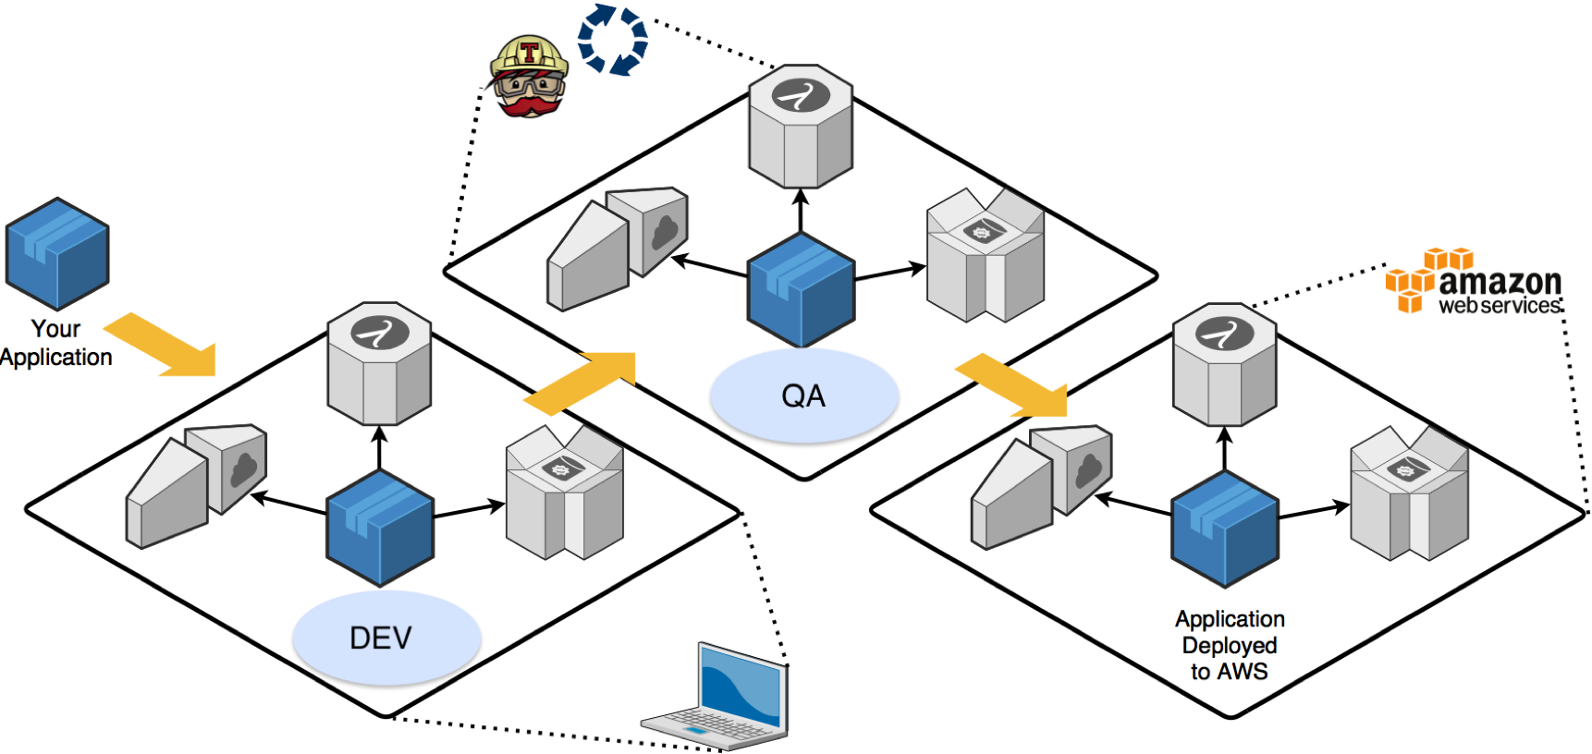
Development QA Production

Slide 6
challenges
It is hard to create, manage, synchronize, and test development changes
Having a cost associated with each test can definitely introduce some sort of 'stress’
It encourage people to not test incrementally
Increased feedback loop time in a shared environments
Huge blast radius while working on new development
Having services like S3, Lambda and SQS available locally sounds super interesting!

Slide 7
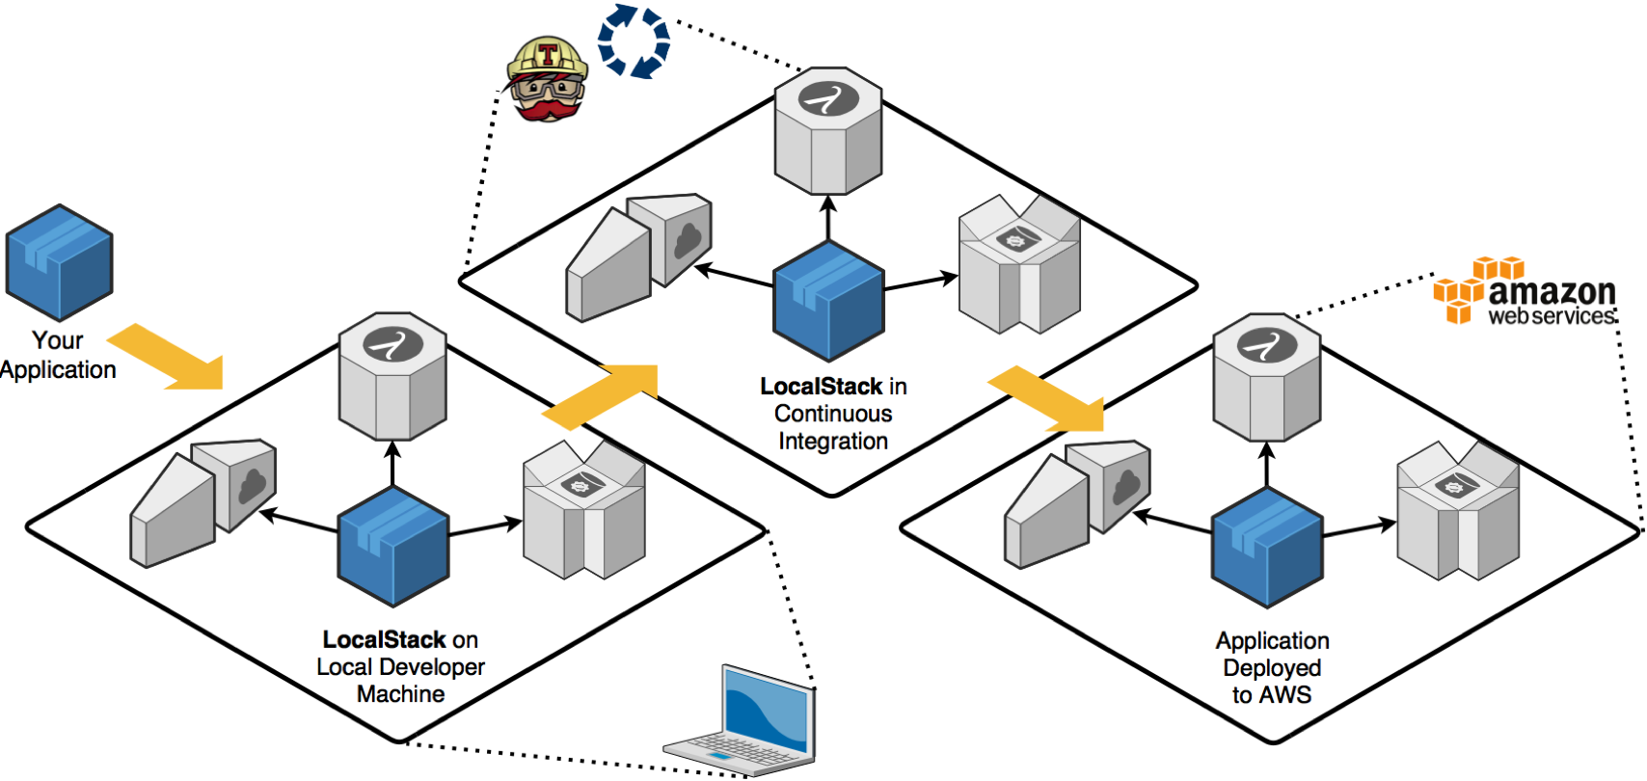
Local CI (Development QA Production)

Slide 8
What is localstack?

Slide 9
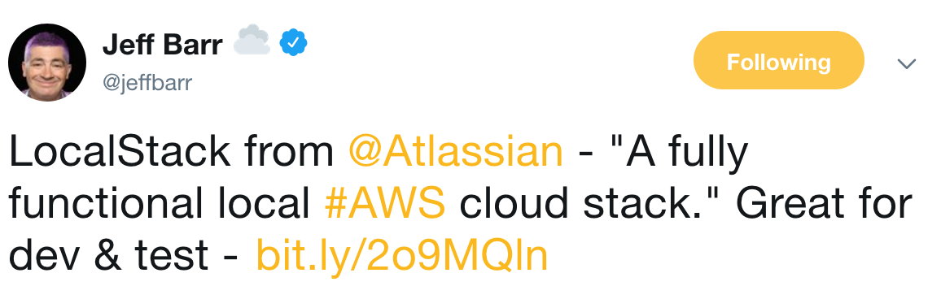
About localstack
LocalStack is a project developed by Atlassian in late 2016
LocalStack provides an easy-to-use test/mocking framework for developing Cloud applications.
It spins up a testing environment on your local machine that provides the same functionality and APIs as the real AWS cloud environment.
Saying that - you can run your Lambda functions, store data to DynamoDB tables, feed events through Kinesis streams, put your application behind an API Gateway, and much more. And all this happens on your local machine, without ever talking to the cloud.

Slide 10
Aws services
API Gateway at http://localhost:4567
Kinesis at http://localhost:4568
DynamoDB at http://localhost:4569
DynamoDB Streams at http://localhost:4570
Elasticsearch at http://localhost:4571
S3 at http://localhost:4572
Firehose at http://localhost:4573
Lambda at http://localhost:4574
SNS at http://localhost:4575
SQS at http://localhost:4576
Redshift at http://localhost:4577
ES at http://localhost:4578
SES at http://localhost:4579
Route53 at http://localhost:4580
CloudFormation at http://localhost:4581
CloudWatch at http://localhost:4582
SSM at http://localhost:4583
SecretsManager at http://localhost:4584
StepFunctions at http://localhost:4585
CloudWatch Logs at http://localhost:4586
CloudWatch Events at http://localhost:4587
STS at http://localhost:4592
IAM at http://localhost:4593
EC2 at http://localhost:4597

Slide 11
benefits
Error Injection
LocalStack allows to inject errors frequently occurring in real Cloud environments
For instance, ProvisionedThroughputExceededException for DynamoDB
Actual HTTP REST Services
All LocalStack AWS service implementations are exposed through a REST API
Language Agnostic
As LocalStack exposes HTTP services, you can use them with any languages.
Isolated Processes
All services in LocalStack run in separate processes.
Pluggable Services
All services in LocalStack are easily pluggable (and replaceable)

Slide 12
Installing localstack

Slide 13
Localstack docker image
docker pull localstack/localstack
docker run localstack/localstack
docker-compose up
pip install awscli-local

Slide 14
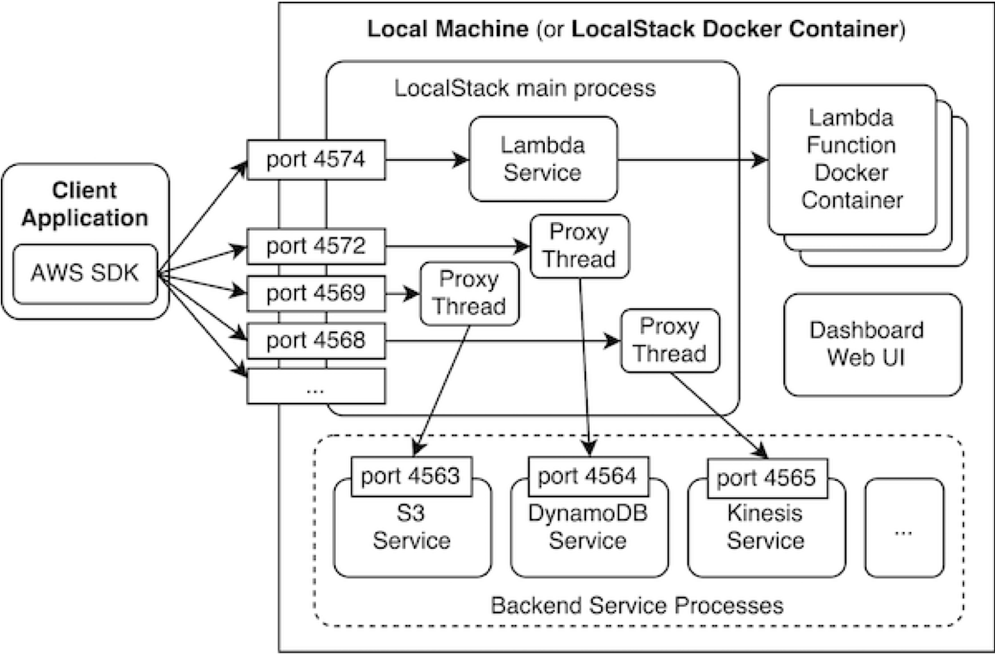
architecture

Slide 15
ports
# backend service ports, for services that are behind a proxy (counting down from 4566)
DEFAULT_PORT_APIGATEWAY_BACKEND = 4566
DEFAULT_PORT_KINESIS_BACKEND = 4565
DEFAULT_PORT_DYNAMODB_BACKEND = 4564
DEFAULT_PORT_S3_BACKEND = 4563
DEFAULT_PORT_SNS_BACKEND = 4562
DEFAULT_PORT_SQS_BACKEND = 4561
DEFAULT_PORT_ELASTICSEARCH_BACKEND = 4560
DEFAULT_PORT_CLOUDFORMATION_BACKEND = 4559
DEFAULT_PORT_STEPFUNCTIONS_BACKEND = 4558
DEFAULT_PORT_IAM_BACKEND = 4557
DEFAULT_PORT_EC2_BACKEND = 4556

Slide 16
serverless
$ env SERVICES=serverless TMPDIR=./localstacktemp localstack start
Starting local dev environment. CTRL-C to quit. Starting mock S3 (http port 4572)... Starting mock SNS (http port 4575)... Starting mock IAM (http port 4593)... Starting mock API Gateway (http port 4567)... Starting mock DynamoDB (http port 4569)... Starting mock Lambda service (http port 4574)... Starting mock CloudWatch Logs (http port 4586)... Ready.

Slide 17
Using localstack

Slide 18
CLI
aws kinesis list-streams
vs
aws --endpoint-url=http://localhost:4568 kinesis list-streams
OR
awslocal kinesis list-streams

Slide 19
SQS example
awslocal sqs create-queue --queue-name my_queue
awslocal sqs send-message --queue-url http://localhost:4576/queue/my_queue --message-body 'hello world’
awslocal sqs receive-message --queue-url http://localhost:4576/queue/my_queue

Slide 20
Code
def get_lambda_client(): return boto3.client( 'lambda', aws_access_key_id='', aws_secret_access_key='', region_name='eu-west-2', endpoint_url='http://localhost:4574' )

Slide 21
profile
def get_s3_client():
if IS_PROD:
return boto3.client('s3')
else:
return boto3.client( 's3', aws_access_key_id='', aws_secret_access_key='', region_name='eu-west-2', endpoint_url='http://localhost:4572’ )
S3_CLIENT = get_s3_client()

Slide 22
Demo

Slide 23
Demo
cat lambda.js
ls api-handler.zip
vim setup.sh
./setup.sh

Slide 24
Case study

Slide 25
microservice
./gradlew clean build integration
config/extendsBuild.gradle
scripts/create_bucket.py
scripts/create_bucket.py

Slide 26
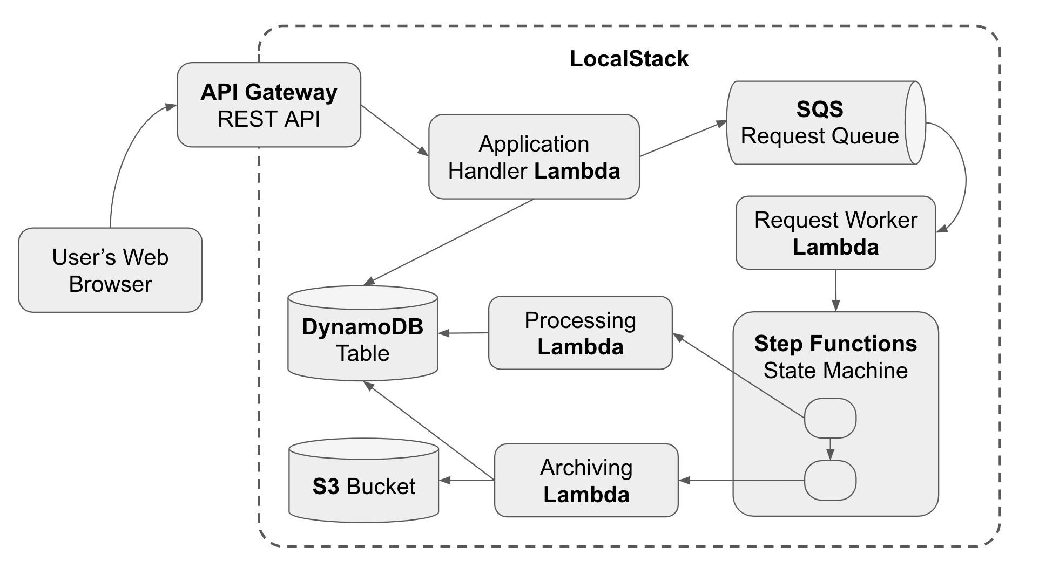
example

Slide 27
What is next?

Slide 28


Integration testing
Terraform
Terratest

Slide 29
Q & A

