Slide 1
BLOCKCHAIN

Slide 2
Digital Gold?
(Some intro about bitcoin or probably show a video!!)

Slide 3
Be your own bank!
“The blockchain is an incorruptible digital ledger of economic transactions that can be programmed to record not just financial transactions but virtually everything of value.”

Slide 4
Distributed database that acts as a ledger for all transactions for Bitcoins
continuously-growing list of ordered recordscalled blocks. Each block contains a timestamp and a link to a previous block.^{[6]:6} By design blockchains are inherently resistant to modification of the data - once recorded, the data in a block cannot be altered retroactively.
Decentralized concensus
Solves the “double-spending” problem
The blockchain database isn’t stored in any single location, meaning the records it keeps are truly public and easily verifiable. No centralized version of this information exists for a hacker to corrupt. Hosted by millions of computers simultaneously, its data is accessible to anyone on the internet.

Slide 5
Peer to peer – no Single point of failure
Not controlled by any single identity
Enhanced security

Slide 6
Transparent and incorruptible
The blockchain network lives in a state of consensus, one that automatically checks in with itself every ten minutes. A kind of self-auditing ecosystem of digital value, the network reconciles every transaction that happens in ten minute intervals. Each group of these transactions is referred to as a “block”. Two important properties result from this:
Transparency data is embedded within network as a whole, by definition it is public.
It cannot be corrupted altering any unit of information on the blockchain would mean using a huge amount of computing power to override the entire network.

Slide 7
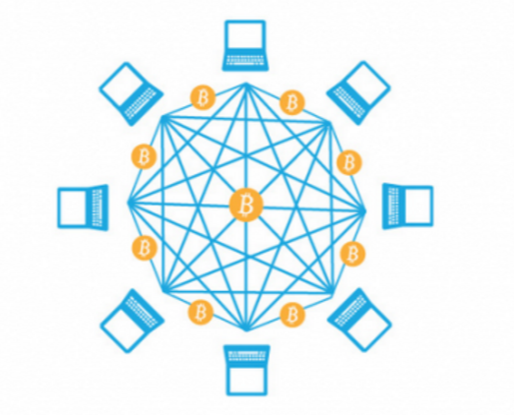
A network of nodes
A network of so-called computing “nodes” make up the blockchain.
(computer connected to the blockchain network using a client that performs the task of validating and relaying transactions) gets a copy of the blockchain, which gets downloaded automatically upon joining the blockchain network.
Every node is an “administrator” of the blockchain, and joins the network voluntarily (in this sense, the network is decentralized). However, each one has an incentive for participating on the network: the chance of winning Bitcoins.
Nodes are said to be “mining” Bitcoin, but the term is something of a misnomer. In fact, each one is competing to win Bitcoins by solving computational puzzles.

Slide 8
Who will use the blockchain?
As web infrastructure, you don’t need to know about the blockchain for it to be useful in your life.
Currently, finance offers the strongest use cases for the technology. International remittances, for instance. The World Bank estimates that over $430 billion US in money transfers were sent in 2015.
The blockchain potentially cuts out the middleman for these types of transactions. Personal computing became accessible to the general public with the invention of the Graphical User Interface (GUI), which took the form of a “desktop”. Similarly, the most common GUI devised for the blockchain are the so-called “wallet” applications, which people use to buy things with Bitcoin, and store it along with other cryptocurrencies.
Transactions online are closely connected to the processes of identity verification. It is easy to imagine that wallet apps will transform in the coming years to include other types of identity management.

Slide 9
Enhanced security
By storing data across its network, the blockchain eliminates the risks that come with data being held centrally.
Its network lacks centralized points of vulnerability that computer hackers can exploit. Today’s internet has security problems that are familiar to everyone. We all rely on the “username/password” system to protect our identity and assets online. Blockchain security methods use encryption technology.
The basis for this are the so-called public and private “keys”. A “public key” (a long, randomly-generated string of numbers) is a users’ address on the blockchain. Bitcoins sent across the network gets recorded as belonging to that address. The “private key” is like a password that gives its owner access to their Bitcoin or other digital assets. Store your data on the blockchain and it is incorruptible. This is true, although protecting your digital assets will also require safeguarding of your private key by printing it out, creating what’s referred to as a paper wallet.

Slide 10
A second-level network
With blockchain technology, the web gains a new layer of functionality.
Already, users can transact directly with one another — Bitcoin transactions in 2016 averaged over $200,000 US per day. With the added security brought by the blockchain new internet business are on track to unbundle the traditional institutions of finance.
Goldman Sachs believes that blockchain technology holds great potential especially to optimize clearing and settlements, and could represent global savings of up to $6bn per year.

Slide 11
https://bitcoin.org/en/
https://www.blockchain.com/
http://blockgeeks.com/guides/what-is-blockchain-technology-a-step-by-step-guide-than-anyone-can-understand/

