Slide 1
BLOCKCHAIN
Nirav Aga
Praneeta Jhanwar

Slide 2
Agenda
Introduction
Motivation
Technical Overview
Detailed Feature Descriptions
Strengths/Weaknesses
Future scope

Slide 3
Agenda
Introduction
Motivation
Technical Overview
Detailed Feature Descriptions
Strengths/Weaknesses
Future scope

Slide 4
One line introduction!
“The blockchain is an incorruptible digital ledger of economic transactions that can be programmed to record not just financial transactions but virtually everything of value.”

Slide 5
Agenda
Introduction
Motivation
Technical Overview
Detailed Feature Descriptions
Strengths/Weaknesses
Future scope

Slide 6
DIGITAL GOLD
“BITCOIN”

Slide 7
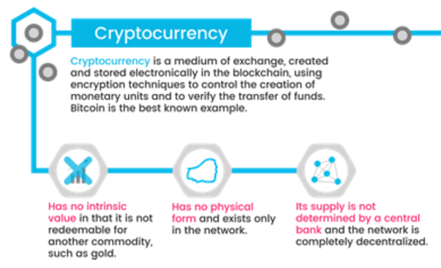
Cryptocurrency
Make money flow as freely as data are flowing already.
No physical currency
You don’t literally have it in your hands, or even in your bank account
Ability to transfer “ownership” to someone else simply by creating a record in the blockchain
Owning bitcoin is merely having a claim on a piece of information sitting on the blockchain.

Slide 8
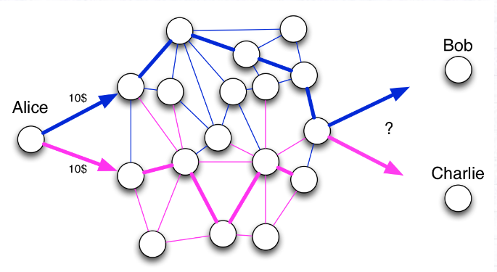
Double Spending Problem
Alice has 10$, and she sends twice 10$ to Bob and Charlie. Who will have the 10$ eventually? To answer this question, the best way is to order the facts. If two incompatible facts arrive in the network, the first one to be recorded wins.

Slide 9
Agenda
Introduction
Motivation
Technical Overview
Detailed Feature Descriptions
Strengths/Weaknesses
Future scope

Slide 10
Two Basic Distributed Database Architectures
Master-Slave
Single point of failure
Single copy of data
Peer to Peer
Updates propagate to replicas
Masterless: all copies equal
Design choices!!

Slide 11
Features
Distributed database
Peer to Peer
Enhanced security
No single point of failure
Decentralized consensus
(not controlled by any single identity)
Transparent & Incorruptible

Slide 12
Distributed database that acts as a ledger for all transactions for Bitcoins
continuously-growing list of ordered recordscalled blocks. Each block contains a timestamp and a link to a previous block.^{[6]:6} By design blockchains are inherently resistant to modification of the data - once recorded, the data in a block cannot be altered retroactively.
The blockchain database isn’t stored in any single location, meaning the records it keeps are truly public and easily verifiable. No centralized version of this information exists for a hacker to corrupt. Hosted by millions of computers simultaneously, its data is accessible to anyone on the internet.

Slide 13
Transparent and incorruptible
The blockchain network lives in a state of consensus, one that automatically checks in with itself every ten minutes. A kind of self-auditing ecosystem of digital value, the network reconciles every transaction that happens in ten minute intervals. Each group of these transactions is referred to as a “block”. Two important properties result from this:
Transparency data is embedded within network as a whole, by definition it is public.
It cannot be corrupted altering any unit of information on the blockchain would mean using a huge amount of computing power to override the entire network.

Slide 14
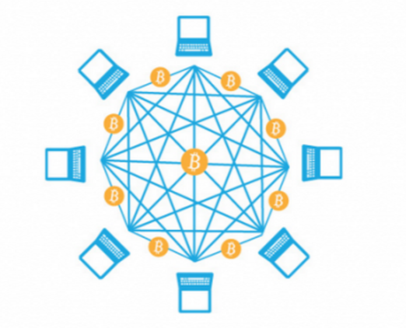
A network of nodes
A network of so-called computing “nodes” make up the blockchain.
(computer connected to the blockchain network using a client that performs the task of validating and relaying transactions) gets a copy of the blockchain, which gets downloaded automatically upon joining the blockchain network.
Every node is an “administrator” of the blockchain, and joins the network voluntarily (in this sense, the network is decentralized). However, each one has an incentive for participating on the network: the chance of winning Bitcoins.
Nodes are said to be “mining” Bitcoin, but the term is something of a misnomer. In fact, each one is competing to win Bitcoins by solving computational puzzles.

Slide 15
Miners collect transactions and put them into a single block. A block generally contains four pieces of information: a reference to the previous block, a summary of included transaction, a time stamp, and Proof of Work that went into creating the secure block. The blocks are strung together into a chain—a fluid chain that does not allow for any inconsistencies; this means there are no “bad cheques” in the system, and transactions entered are necessarily valid and can be processed. By checking the blockchain and confirming transactions, the entire system is effectively self-regulated and fully secure. No, that doesn’t mean some kid cooped up in a basement can just click “okay” and confirm a billion dollar transfer. Blocks generally need numerous independent confirmations, and the equations are intended to be hard to crack. Not to mention, the hardware required is far more specialized than the average laptop. Finally, what’s to stop someone from simply going back and editing existing blocks? Each block is securely hashed—meaning it is rendered into seeming gibberish and nearly impossible to invert or undo. Once it’s in the blockchain, it’s there forever.

Slide 16
Who will use the blockchain?
As web infrastructure, you don’t need to know about the blockchain for it to be useful in your life.
Currently, finance offers the strongest use cases for the technology. International remittances, for instance. The World Bank estimates that over $430 billion US in money transfers were sent in 2015.
The blockchain potentially cuts out the middleman for these types of transactions. Personal computing became accessible to the general public with the invention of the Graphical User Interface (GUI), which took the form of a “desktop”. Similarly, the most common GUI devised for the blockchain are the so-called “wallet” applications, which people use to buy things with Bitcoin, and store it along with other cryptocurrencies.
Transactions online are closely connected to the processes of identity verification. It is easy to imagine that wallet apps will transform in the coming years to include other types of identity management.

Slide 17
Enhanced security
By storing data across its network, the blockchain eliminates the risks that come with data being held centrally.
Its network lacks centralized points of vulnerability that computer hackers can exploit. Today’s internet has security problems that are familiar to everyone. We all rely on the “username/password” system to protect our identity and assets online. Blockchain security methods use encryption technology.
The basis for this are the so-called public and private “keys”. A “public key” (a long, randomly-generated string of numbers) is a users’ address on the blockchain. Bitcoins sent across the network gets recorded as belonging to that address. The “private key” is like a password that gives its owner access to their Bitcoin or other digital assets. Store your data on the blockchain and it is incorruptible. This is true, although protecting your digital assets will also require safeguarding of your private key by printing it out, creating what’s referred to as a paper wallet.

Slide 18
A second-level network
With blockchain technology, the web gains a new layer of functionality.
Already, users can transact directly with one another — Bitcoin transactions in 2016 averaged over $200,000 US per day. With the added security brought by the blockchain new internet business are on track to unbundle the traditional institutions of finance.
Goldman Sachs believes that blockchain technology holds great potential especially to optimize clearing and settlements, and could represent global savings of up to $6bn per year.

Slide 19
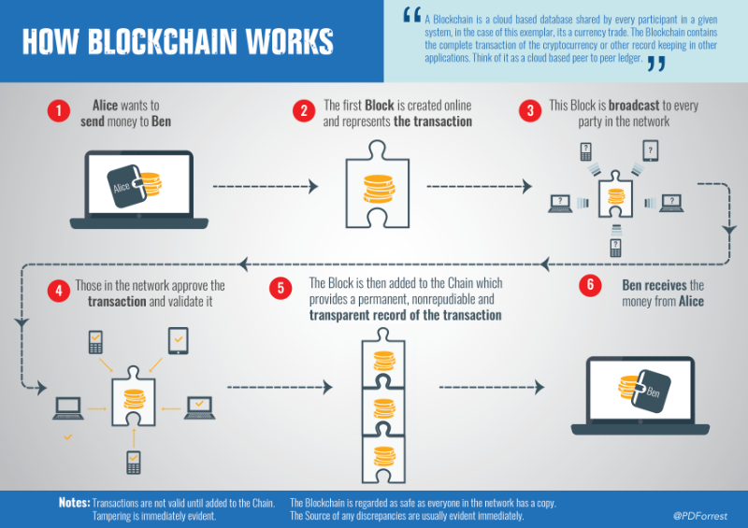

Slide 20
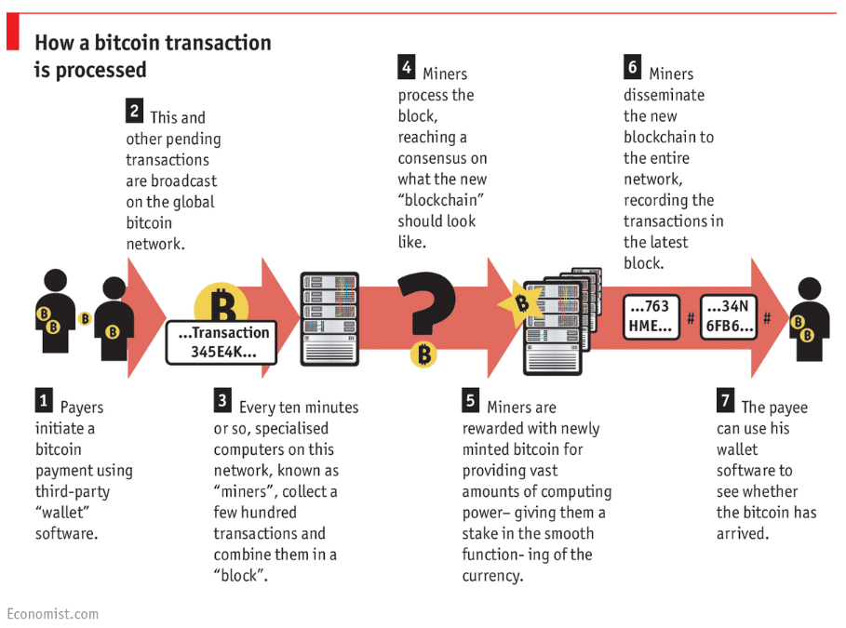

Slide 21
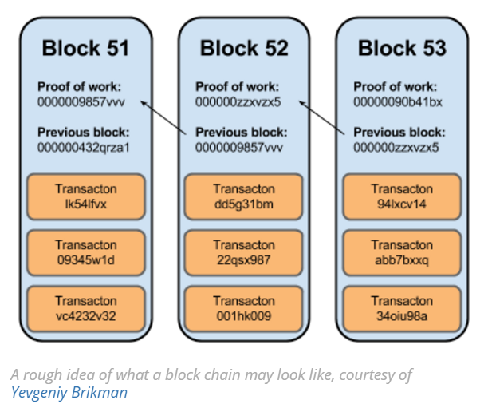

Slide 22
Future?
However, it is public knowledge that nine major banks (including JP Morgan and Goldman Sachs) recently joined a partnership to develop blockchain technologies.

Slide 23
A brief summary of some use cases gaining momentum
Document and contract digitisation, management and exploitation
Secure tracking of data exchange in Internet of Things activity
Securing and creating trust in escrow and custodian services
Decentralised and cloud services including patient records and healthcare support
Electronic voting and voter authentication
Cloud based learning and student authentication
Counterfeit prevention for digital assets and proof of ownership
Digital identity management and providing trust as to authenticity of digital reviews, brands and reputation
Facilitation of sales and trading of digital assets and digital rights management

Slide 24
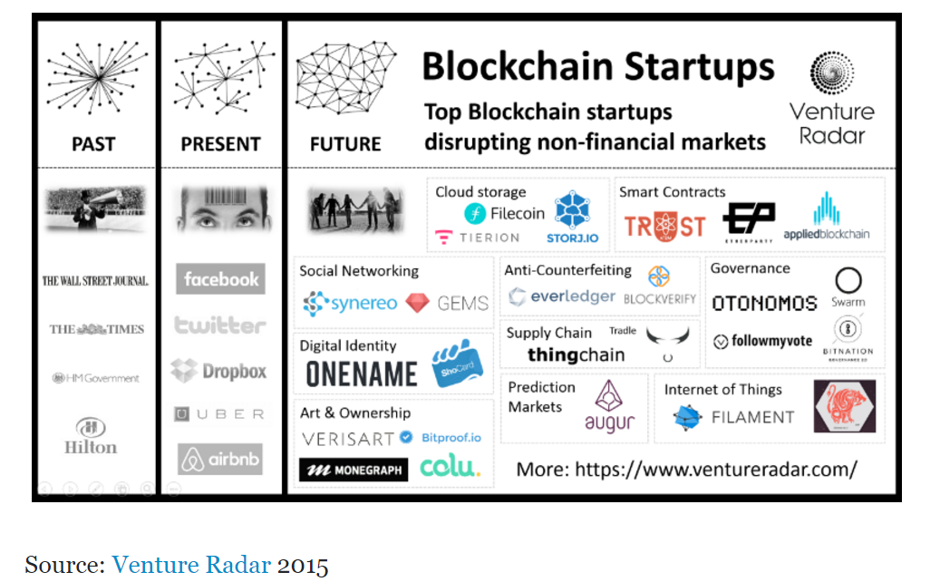

Slide 25
https://bitcoin.org/en/
https://www.blockchain.com/
http://blockgeeks.com/guides/what-is-blockchain-technology-a-step-by-step-guide-than-anyone-can-understand/
https://www.linkedin.com/pulse/blockchain-non-financial-services-use-cases-paul-forrest

Slide 26
http://scet.berkeley.edu/wp-content/uploads/BlockchainPaper.pdf
http://marmelab.com/blog/2016/04/28/blockchain-for-web-developers-the-theory.html

Slide 27
THANK YOU

Slide 28
Be your own bank!
“The blockchain is an incorruptible digital ledger of economic transactions that can be programmed to record not just financial transactions but virtually everything of value.”
The real defining feature is not what it does or how it does it, instead, it holds value based on how much users can trust it to perform those services impartially.

Slide 29
(Some intro about bitcoin or probably show a video!!)
Proponents envisage an “internet of value” that can make money flow as freely as data are flowing already.
Cryptocurrencies, like bitcoin, are currencies that exist solely in digital. There are no physical golden coins with a big “B” on them. Moreover, owning these non-real coins entails a new idea of “ownership.” You don’t literally have it in your hands, or even in your bank account, but you have the ability to transfer “ownership” to someone else simply by creating a record in the blockchain. Rather than using bills, your transfer is pure data.
owning bitcoin is merely having a claim on a piece of information sitting on the blockchain.

