Slide 1
BLOCKCHAIN
Nirav Aga
Praneeta Jhanwar

Slide 2
Agenda
Introduction
Motivation
Technical Overview
Detailed Feature Descriptions
Strengths/Weaknesses
Future scope

Slide 3
Agenda
Introduction
Motivation
Technical Overview
Detailed Feature Descriptions
Strengths/Weaknesses
Future scope

Slide 4
One line introduction!
“The blockchain is an incorruptible digital ledger of economic transactions that can be programmed to record not just financial transactions but virtually everything of value.”

Slide 5
Agenda
Introduction
Motivation
Technical Overview
Detailed Feature Descriptions
Strengths/Weaknesses
Future scope

Slide 6
DIGITAL GOLD
“BITCOIN”

Slide 7
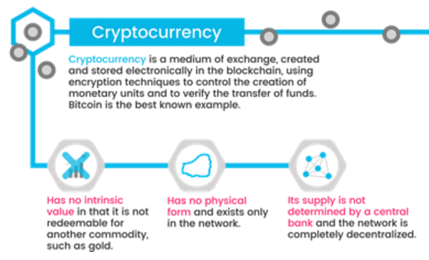
Cryptocurrency
Make money flow as freely as data are flowing already.
No physical form
You don’t literally have it in your hands, or even in your bank account
Ability to transfer “ownership” to someone else simply by creating a record in the blockchain
Owning bitcoin is merely having a claim on a piece of information sitting on the blockchain.

Slide 8
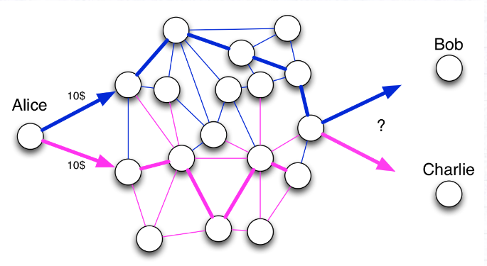
Double Spending Problem
Alice has 10$, and she sends twice 10$ to Bob and Charlie. Who will have the 10$ eventually? To answer this question, the best way is to order the facts. If two incompatible facts arrive in the network, the first one to be recorded wins.

Slide 9
Agenda
Introduction
Motivation
Technical Overview
Detailed Feature Descriptions
Strengths/Weaknesses
Future scope

Slide 10
Two Basic Distributed Database Architectures
Master-Slave
Single point of failure
Single copy of data
Peer to Peer
Updates propagate to replicas
Masterless: all copies equal
Design choices!!

Slide 11
Features
Distributed database
Peer to Peer
Transparent & Incorruptible
No single point of failure
Decentralized consensus
(not controlled by any single identity)
Enhanced security

Slide 12
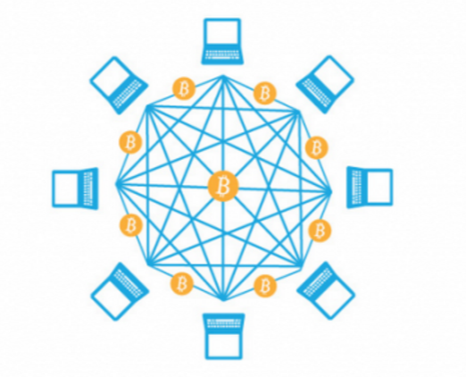
Peer to Peer Distributed Database
A network of computing “nodes” make up the blockchain.
Computer connected to the blockchain network using a client gets a copy of the blockchain, which gets downloaded automatically upon joining the blockchain network.
Every node is an “administrator” of the blockchain, and joins the network voluntarily (in this sense, the network is decentralized).
Nodes perform the task of validating and relaying transactions
Incentive for participating?
the chance of winning Bitcoins.
Nodes are said to be “mining” Bitcoin. In fact, each one is competing to win Bitcoins by solving computational puzzles.

Slide 13
Transparent and incorruptible
A kind of self-auditing ecosystem of digital value, the network reconciles every transaction that happens in ten minute intervals. Two important properties result from this:
Transparency Data is embedded within network as a whole, by definition it is public. Everyone knows about everyone else’s transactions.
It cannot be corrupted Altering any unit of information on the blockchain would mean using a huge amount of computing power to override the entire network. Not impossible, but impractical!

Slide 14
Enhanced security
Deal with anonymous strangers, the system is designed using mathematical functions. And this aspects removes the need for trust.
Blockchain security methods use encryption technology.
The basis for this are the so-called public and private “keys”. A “public key” (a long, randomly-generated string of numbers) is a users’ address on the blockchain. Bitcoins sent across the network gets recorded as belonging to that address. The “private key” is like a password that gives its owner access to their Bitcoin or other digital assets.
Protecting your digital assets will also require safeguarding of your private key by printing it out, creating what’s referred to as a paper wallet.

Slide 15
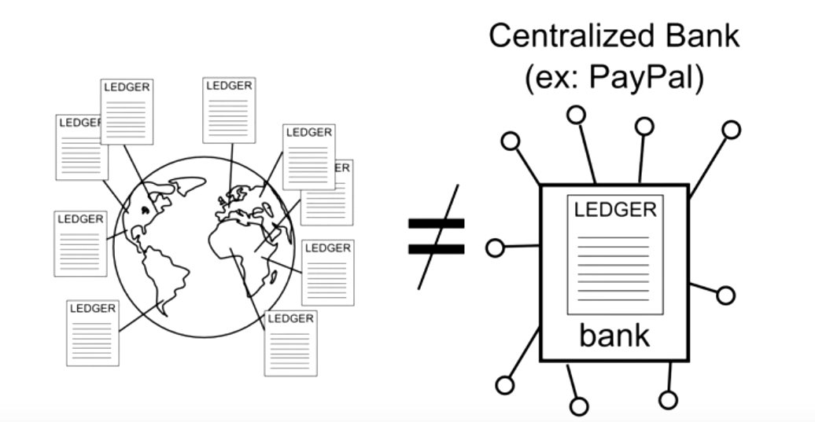
Decentralized Consensus

Slide 16
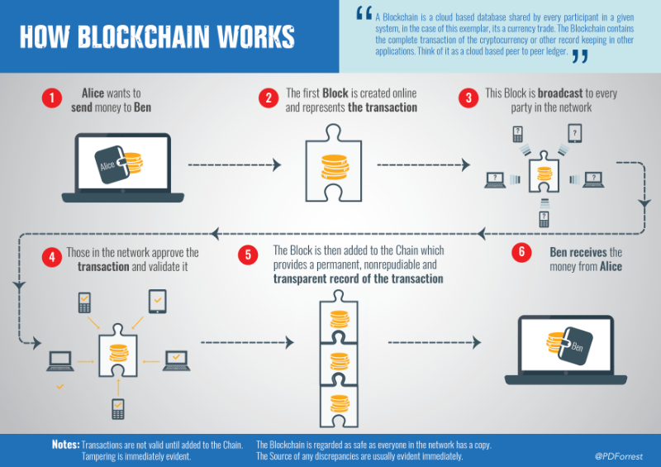

Slide 17
Agenda
Introduction
Motivation
Technical Overview
Detailed Feature Descriptions
Strengths/Weaknesses
Future scope

Slide 18
How can a random group of strangers manage each other’s financial transactions?

Slide 19
Sending
Every node that receives this information, will update their copy of the ledger and pass along the information!
Broadcast transaction to network
Alice → Bob 5.0 BTC
How does authentication take place??
Alice should be Alice!

Slide 20
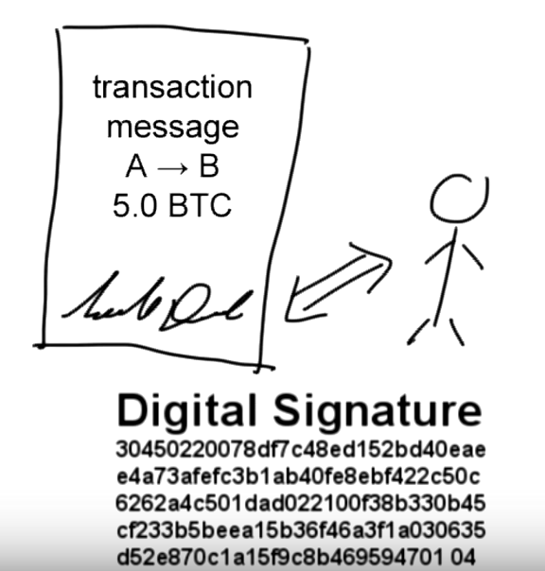
Authentication
Need password to unlock and send funds
“Digital Signatures”
Digital Signatures created by using sender’s private key and transaction, and thus every transaction has a different signature
This also prevents any modification of messages in the network. Because, if the message is modified, the digital signature will become invalid.

Slide 21
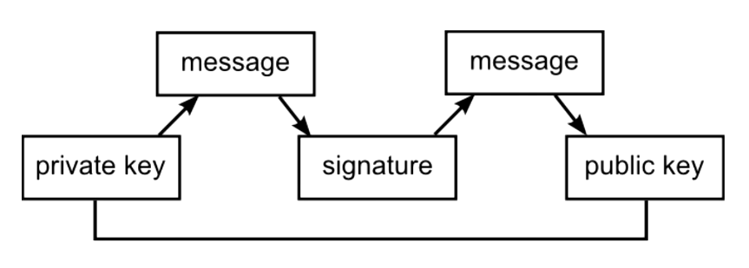
Digital Signatures
Create the signature using the private key.
True password.
Intermediary that proves the sender has a password without revealing the actual password
Verifiers use public key to authenticate.

Slide 22
How do you know how much account balance a user has?

Slide 23
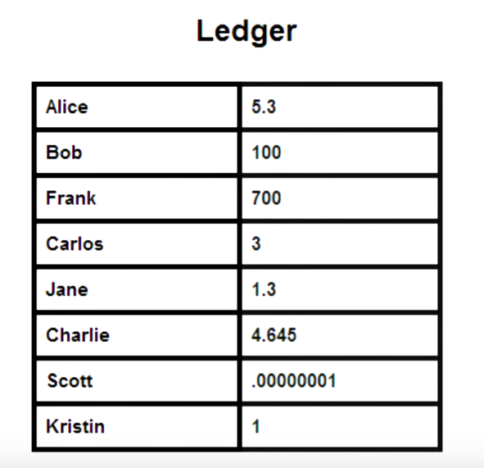
Account Balances?
Ledger stores only transactions!!
Ownership of funds are verified using links to previous transactions!!

Slide 24
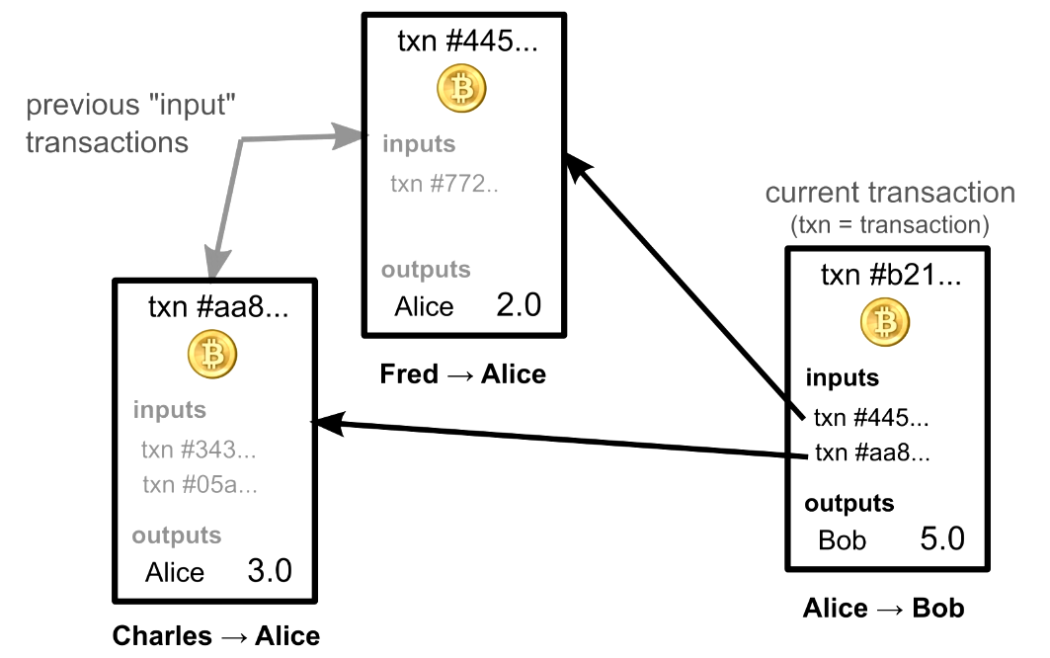

Slide 25
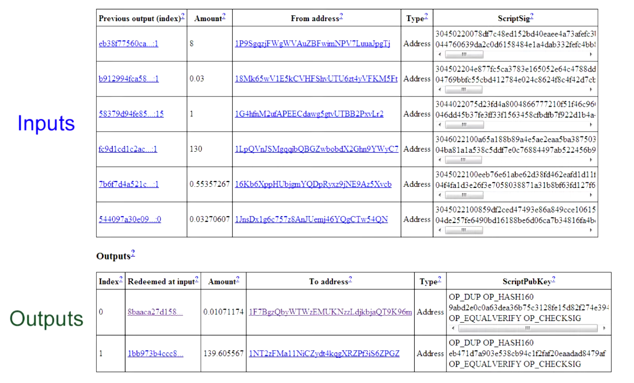

Slide 26
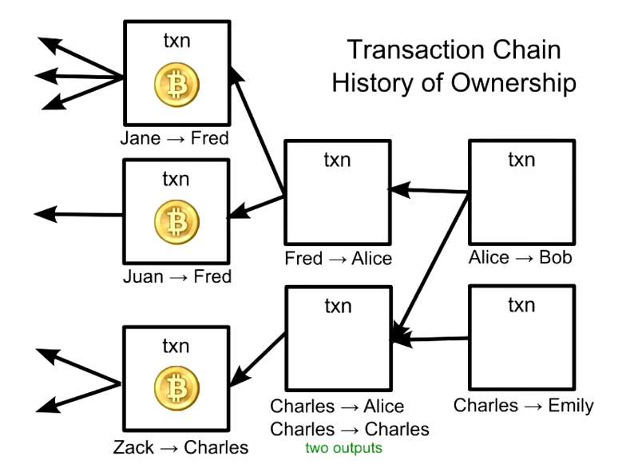
Validity of each transaction depends on the validity of previous one!
The first time you install a Bitcoin Wallet Software, it downloads any transaction ever made and it checks each one’s validity all the way back to the very first transaction! (Can take upto 24 hours, but only needs to be done once!)

Slide 27
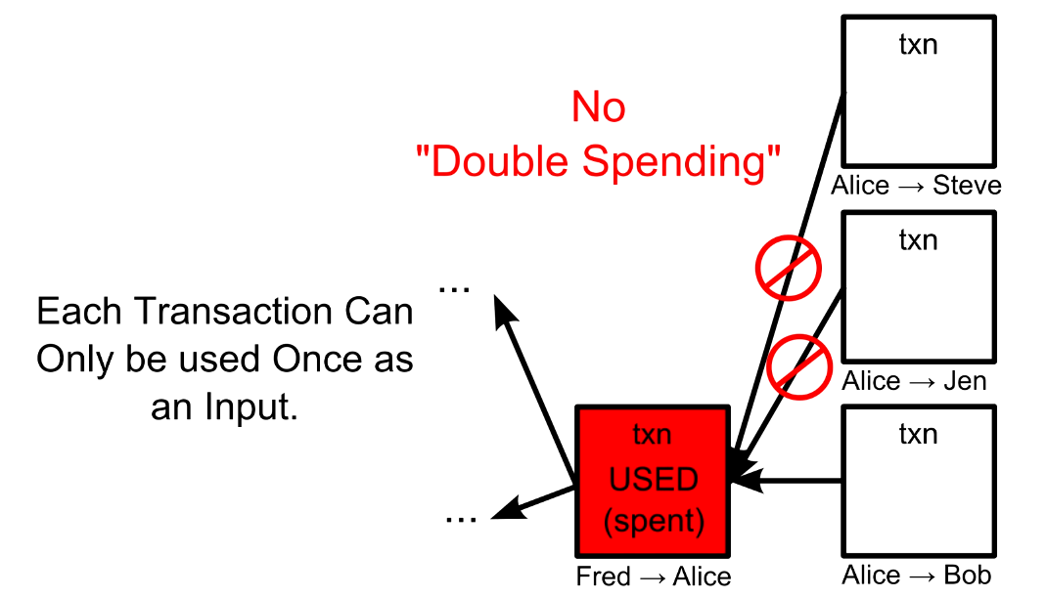
Transaction Verification
Verification:
Inputs are sender’s
Sufficient balance
Inputs unspent
For each input, nodes check every other transaction ever made to make sure that input hasn’t already been used before. This may seem time consuming, over 20m transactions. Made fast by using an index of unspent transactions.

Slide 28
Agenda
Introduction
Motivation
Technical Overview
Detailed Feature Descriptions
Strengths/Weaknesses
Future scope

Slide 29
Weaknesses
Decentralization leads to “No trust”!
We trust our banks or if something goes wrong, we can sue our bank. In bitcoin we deal with anonymous strangers, so one cannot trust anyone.

Slide 30
Agenda
Introduction
Motivation
Technical Overview
Detailed Feature Descriptions
Strengths/Weaknesses
Future scope

Slide 32
continuously-growing list of ordered recordscalled blocks. Each block contains a timestamp and a link to a previous block.^{[6]:6} By design blockchains are inherently resistant to modification of the data - once recorded, the data in a block cannot be altered retroactively.

Slide 33
Miners collect transactions and put them into a single block. A block generally contains four pieces of information: a reference to the previous block, a summary of included transaction, a time stamp, and Proof of Work that went into creating the secure block. The blocks are strung together into a chain—a fluid chain that does not allow for any inconsistencies; this means there are no “bad cheques” in the system, and transactions entered are necessarily valid and can be processed. By checking the blockchain and confirming transactions, the entire system is effectively self-regulated and fully secure. No, that doesn’t mean some kid cooped up in a basement can just click “okay” and confirm a billion dollar transfer. Blocks generally need numerous independent confirmations, and the equations are intended to be hard to crack. Not to mention, the hardware required is far more specialized than the average laptop. Finally, what’s to stop someone from simply going back and editing existing blocks? Each block is securely hashed—meaning it is rendered into seeming gibberish and nearly impossible to invert or undo. Once it’s in the blockchain, it’s there forever.

Slide 34
Who will use the blockchain?
As web infrastructure, you don’t need to know about the blockchain for it to be useful in your life.
Currently, finance offers the strongest use cases for the technology. International remittances, for instance. The World Bank estimates that over $430 billion US in money transfers were sent in 2015.
The blockchain potentially cuts out the middleman for these types of transactions. Personal computing became accessible to the general public with the invention of the Graphical User Interface (GUI), which took the form of a “desktop”. Similarly, the most common GUI devised for the blockchain are the so-called “wallet” applications, which people use to buy things with Bitcoin, and store it along with other cryptocurrencies.
Transactions online are closely connected to the processes of identity verification. It is easy to imagine that wallet apps will transform in the coming years to include other types of identity management.

Slide 35
A second-level network
With blockchain technology, the web gains a new layer of functionality.
Already, users can transact directly with one another — Bitcoin transactions in 2016 averaged over $200,000 US per day. With the added security brought by the blockchain new internet business are on track to unbundle the traditional institutions of finance.
Goldman Sachs believes that blockchain technology holds great potential especially to optimize clearing and settlements, and could represent global savings of up to $6bn per year.

Slide 36
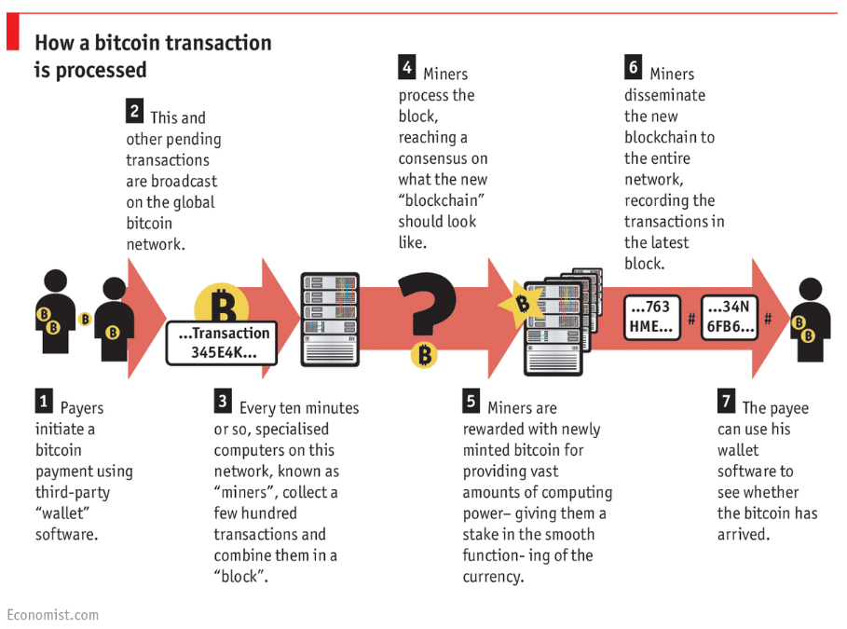

Slide 37
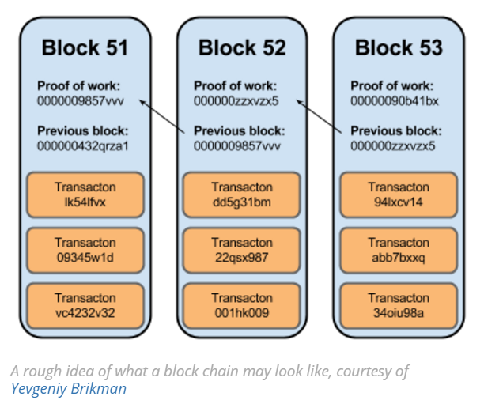

Slide 38
Future?
However, it is public knowledge that nine major banks (including JP Morgan and Goldman Sachs) recently joined a partnership to develop blockchain technologies.

Slide 39
A brief summary of some use cases gaining momentum
Document and contract digitisation, management and exploitation
Secure tracking of data exchange in Internet of Things activity
Securing and creating trust in escrow and custodian services
Decentralised and cloud services including patient records and healthcare support
Electronic voting and voter authentication
Cloud based learning and student authentication
Counterfeit prevention for digital assets and proof of ownership
Digital identity management and providing trust as to authenticity of digital reviews, brands and reputation
Facilitation of sales and trading of digital assets and digital rights management

Slide 40
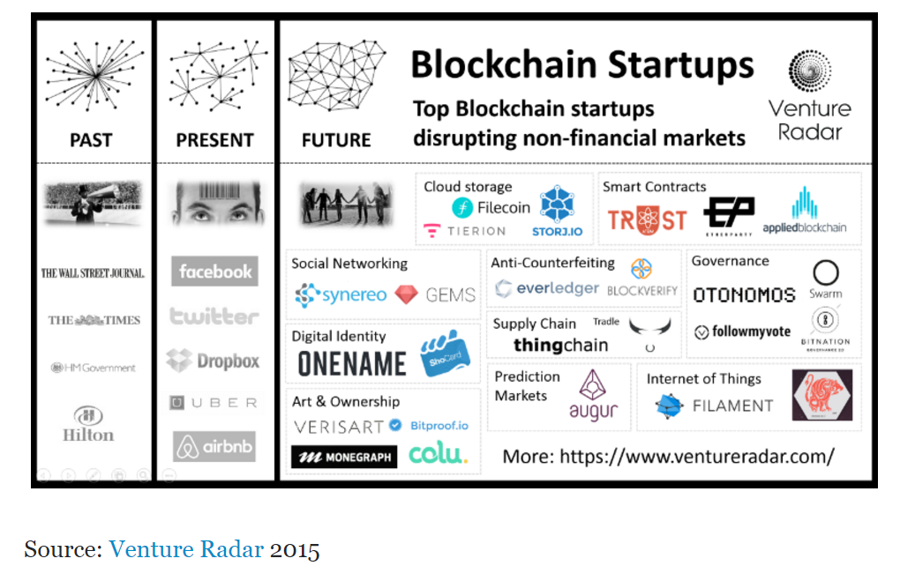

Slide 41
https://bitcoin.org/en/
https://www.blockchain.com/
http://blockgeeks.com/guides/what-is-blockchain-technology-a-step-by-step-guide-than-anyone-can-understand/
https://www.linkedin.com/pulse/blockchain-non-financial-services-use-cases-paul-forrest

Slide 42
http://scet.berkeley.edu/wp-content/uploads/BlockchainPaper.pdf
http://marmelab.com/blog/2016/04/28/blockchain-for-web-developers-the-theory.html

Slide 43
THANK YOU

Slide 44
Be your own bank!
“The blockchain is an incorruptible digital ledger of economic transactions that can be programmed to record not just financial transactions but virtually everything of value.”
The real defining feature is not what it does or how it does it, instead, it holds value based on how much users can trust it to perform those services impartially.

Slide 45
(Some intro about bitcoin or probably show a video!!)
Proponents envisage an “internet of value” that can make money flow as freely as data are flowing already.
Cryptocurrencies, like bitcoin, are currencies that exist solely in digital. There are no physical golden coins with a big “B” on them. Moreover, owning these non-real coins entails a new idea of “ownership.” You don’t literally have it in your hands, or even in your bank account, but you have the ability to transfer “ownership” to someone else simply by creating a record in the blockchain. Rather than using bills, your transfer is pure data.
owning bitcoin is merely having a claim on a piece of information sitting on the blockchain.

Slide 46
Transparent and incorruptible
The blockchain network lives in a state of consensus, one that automatically checks in with itself every ten minutes. A kind of self-auditing ecosystem of digital value, the network reconciles every transaction that happens in ten minute intervals. Each group of these transactions is referred to as a “block”. Two important properties result from this:
Transparency data is embedded within network as a whole, by definition it is public.
It cannot be corrupted altering any unit of information on the blockchain would mean using a huge amount of computing power to override the entire network.

