Slide 1
BLOCKCHAIN
Nirav Aga
Praneeta Jhanwar

Slide 2
Agenda
Introduction
Motivation
Technical Overview
How does it work?
Strengths/Weaknesses
Future scope

Slide 3
Agenda
Introduction
Motivation
Technical Overview
How does it work?
Strengths/Weaknesses
Future scope

Slide 4
One line introduction!
“The blockchain is an incorruptible digital ledger of economic transactions that can be programmed to record not just financial transactions but virtually everything of value.”

Slide 5
Agenda
Introduction
Motivation
Technical Overview
How does it work?
Strengths/Weaknesses
Future scope

Slide 6
DIGITAL GOLD
“BITCOIN”

Slide 7


Slide 8
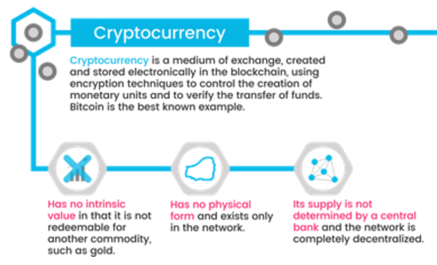
Cryptocurrency
Make money flow as freely as data are flowing already.
No physical form
You don’t literally have it in your hands, or even in your bank account
Ability to transfer “ownership” to someone else simply by creating a record in the blockchain
Owning bitcoin is merely having a claim on a piece of information sitting on the blockchain.

Slide 9
Agenda
Introduction
Motivation
Technical Overview
How does it work?
Strengths/Weaknesses
Future scope

Slide 10
Two Basic Distributed Database Architectures
Master-Slave
Single point of failure
Single copy of data
Peer to Peer
Updates propagate to replicas
Masterless: all copies equal
Design choices!!

Slide 11
Features
Distributed database
Peer to Peer
Transparent & Incorruptible
No single point of failure
Decentralized consensus
(not controlled by any single identity)
Enhanced security

Slide 12
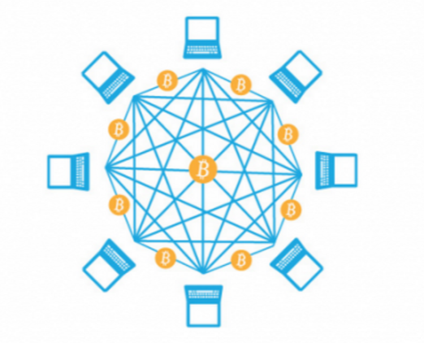
Peer to Peer Distributed Database
A network of computing “nodes” make up the blockchain.
Computer connected to the blockchain network using a client gets a copy of the blockchain, which gets downloaded automatically upon joining the blockchain network.
Every node is an “administrator” of the blockchain, and joins the network voluntarily (in this sense, the network is decentralized).
Nodes perform the task of validating and relaying transactions
Incentive for participating?
the chance of winning Bitcoins.
Transaction Fees (minimal)
Nodes are said to be “mining” Bitcoin. In fact, each one is competing to win Bitcoins by solving computational puzzles.

Slide 13
Transparent and incorruptible
A kind of self-auditing ecosystem of digital value, the network reconciles every transaction that happens in ten minute intervals. Two important properties result from this:
Transparency Data is embedded within network as a whole, by definition it is public. Everyone knows about everyone else’s transactions.
It cannot be corrupted Altering any unit of information on the blockchain would mean using a huge amount of computing power to override the entire network. Not impossible, but impractical!

Slide 14
Enhanced security
Deal with anonymous strangers, the system is designed using mathematical functions. And this aspects removes the need for trust.
Blockchain security methods use encryption technology.
The basis for this are the so-called public and private “keys”. A “public key” (a long, randomly-generated string of numbers) is a users’ address on the blockchain. Bitcoins sent across the network gets recorded as belonging to that address. The “private key” is like a password that gives its owner access to their Bitcoin or other digital assets.
Protecting your digital assets will also require safeguarding of your private key by printing it out, creating what’s referred to as a paper wallet.

Slide 15
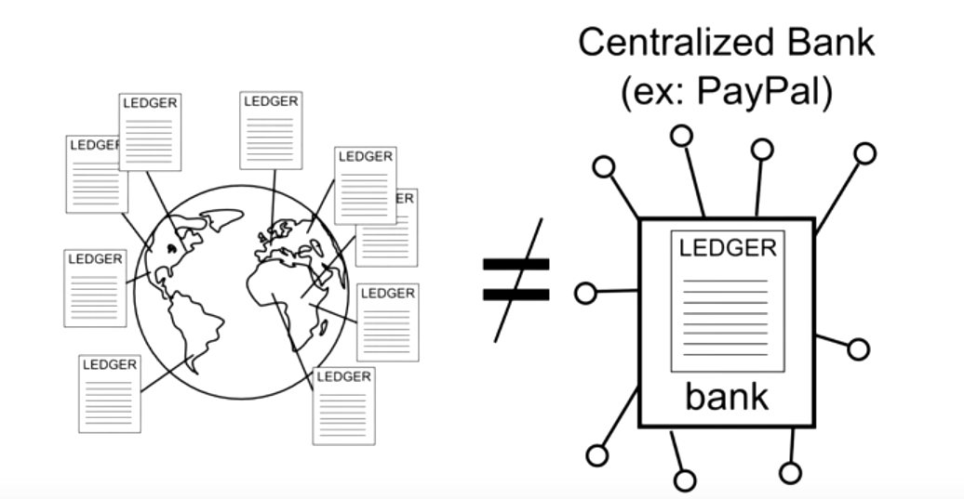
Decentralized Consensus
With the absence of a central authority, it is crucial for all the nodes to be in consensus
If a transaction is validated by a majority of the nodes in the network, it is considered valid

Slide 16
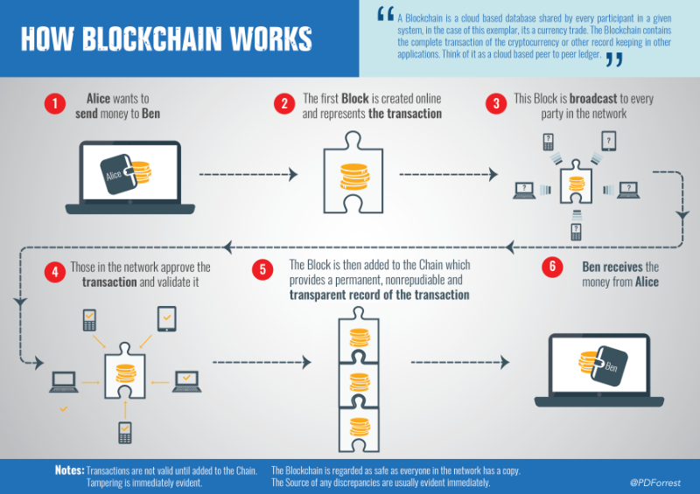

Slide 17
Agenda
Introduction
Motivation
Technical Overview
How does it work?
Strengths/Weaknesses
Future scope

Slide 18
How can a random group of strangers manage each other’s financial transactions?

Slide 19
Sending
Every node that receives this information, will update their copy of the ledger and pass along the information!
Broadcast transaction to network
Alice → Bob 5.0 BTC
How does authentication take place??
Alice should be Alice!

Slide 20
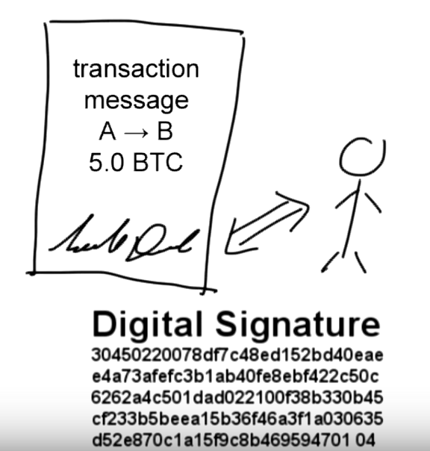
Authentication
Need password to unlock and send funds
“Digital Signatures”
Digital Signatures created by using sender’s private key and transaction, and thus every transaction has a different signature
This also prevents any modification of messages in the network. Because, if the message is modified, the digital signature will become invalid.

Slide 21
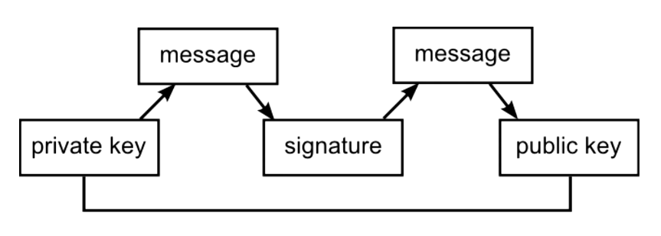
Digital Signatures
Create the signature using the private key.
True password.
Intermediary that proves the sender has a password without revealing the actual password
Verifiers use public key to authenticate.

Slide 22
How do you know how much account balance a user has?

Slide 23
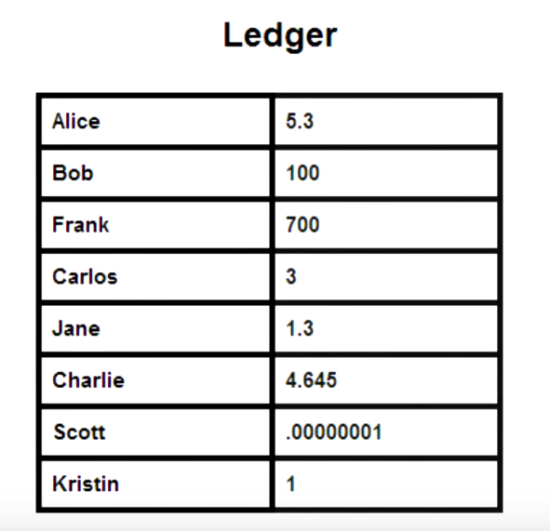
Account Balances?
Ledgers store only transactions!!
Ownership of funds are verified using links to previous transactions!!

Slide 24
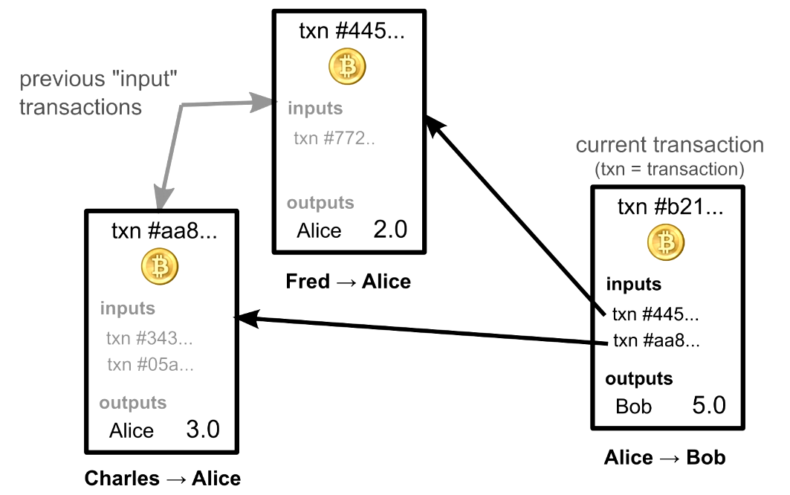

Slide 25
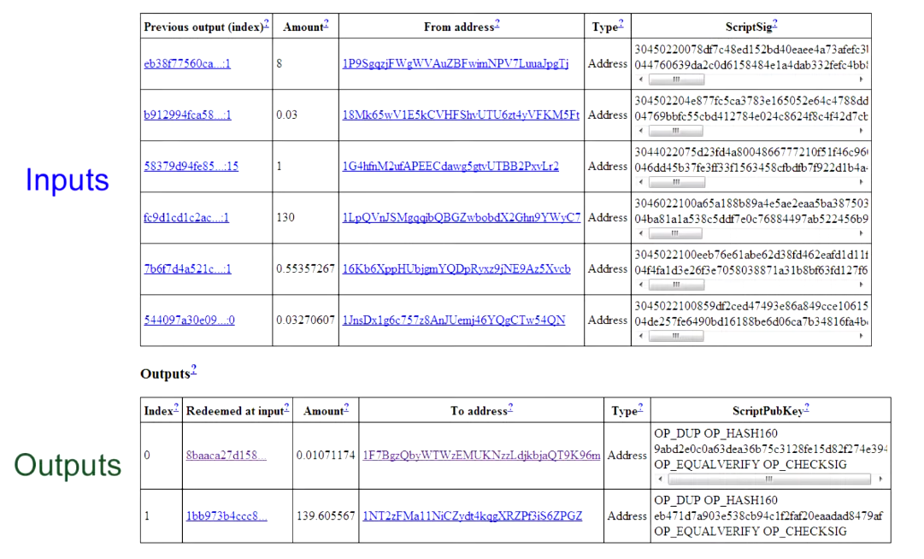

Slide 26
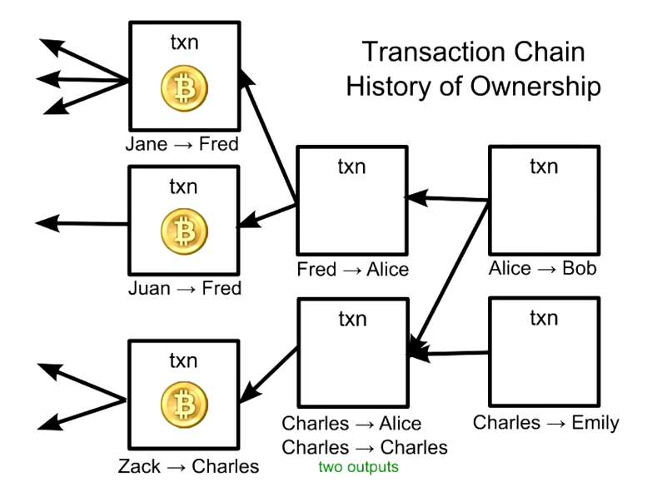
Validity of each transaction depends on the validity of previous one!
The first time you install a Bitcoin Wallet Software, it downloads any transaction ever made and it checks each one’s validity all the way back to the very first transaction! (Can take upto 24 hours, but only needs to be done once!)

Slide 27
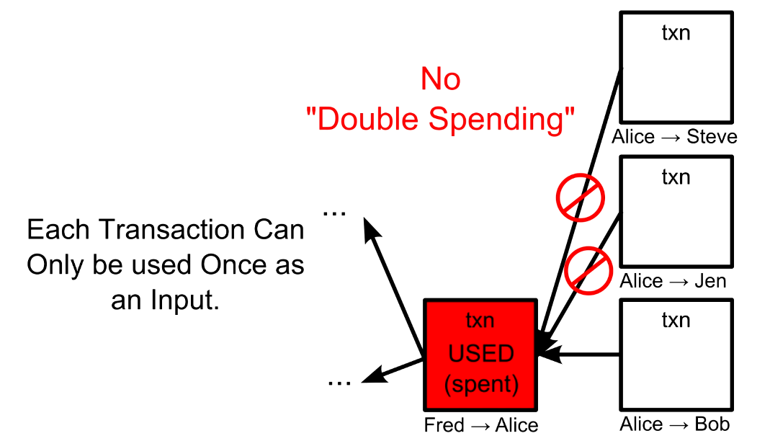
Transaction Verification
Verification:
Inputs are sender’s
Sufficient balance
Inputs unspent
For each input, nodes check every other transaction ever made to make sure that input hasn’t already been used before. This may seem time consuming, over 20m transactions. Made fast by using an index of unspent transactions.

Slide 28
Security Hole: Transaction Ordering
Order in which transactions arrive at a node
Order in which transactions were created
1.
Timestamps cannot be trusted as someone could lie
2.
Double Spending Fraud

Slide 29
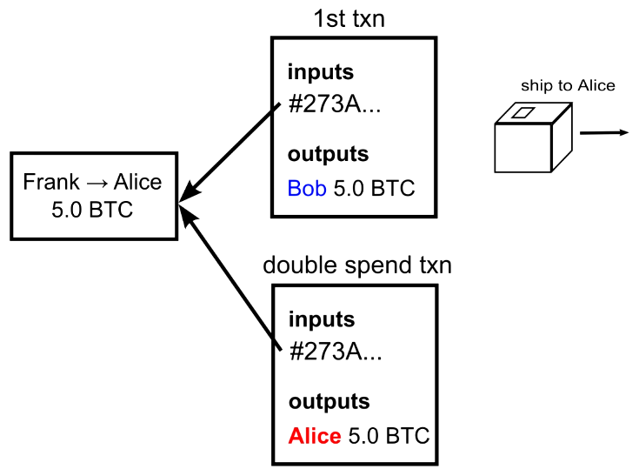

Double Spending Fraud
If the second transaction is received first, (by when if Bob would have already shipped the product) then first transaction would be invalidated.
Bob would be out of the product as well as would not receive the payment

Slide 30
Nodes need to agree on transaction order!

Slide 31
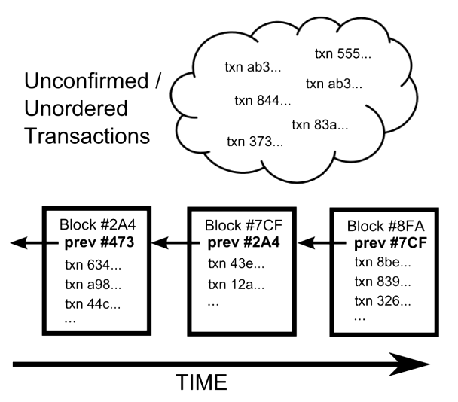
Ordering Solution
Transaction are grouped together as blocks!
Transactions in the same block are considered to have happened at the same time
Each block also has a reference to the previous block.
This is how order is maintained historically
Transaction Chain
History of ownership
Block Chain
Transaction ordering

Slide 32
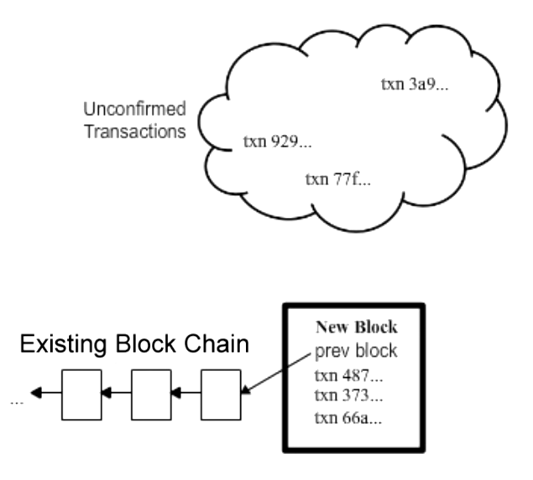
Block Creation (1/2)
Any node can collect a set of unconfirmed transactions into a block and broadcast it to the network as a suggestion for what the next block in the chain could be.

Slide 33
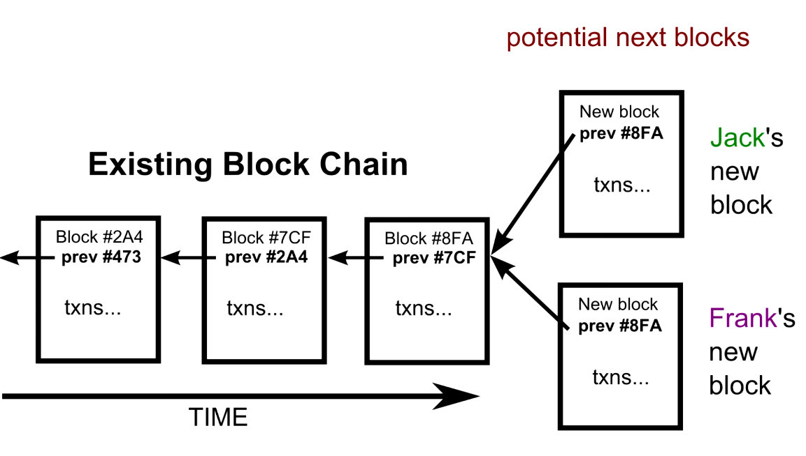
Block Creation (2/2)
How to decide which one of the potential next blocks to chose from?
Cannot rely on the order in which the blocks arrive.

Slide 34
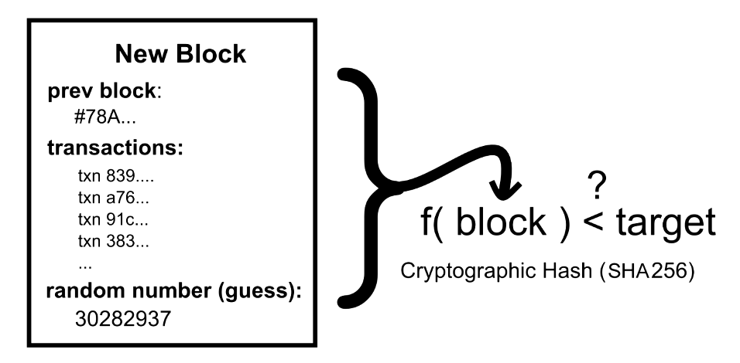
Block Puzzle
Each valid block must contain answer to a very special mathematical problem.
Computers run the entire text of a block plus an additional random guess through something called a “Cryptographic Hash” until the output is below a certain value!

Slide 35
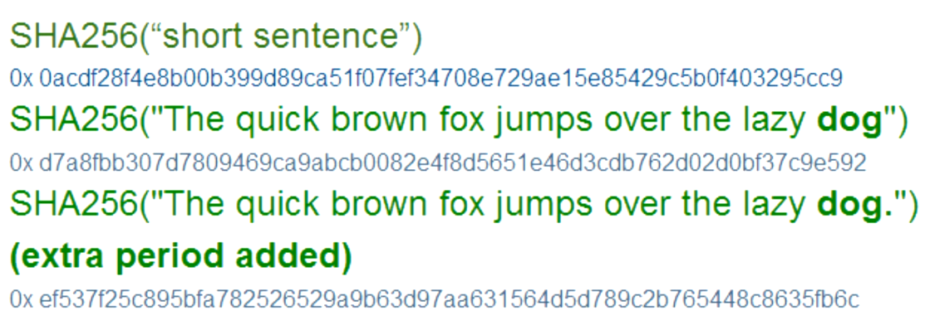
Cryptographic Hash
Text → Short Digest

Slide 36
Block Puzzle
Completely unpredictable output
The only way to find out a particular output value is to make random guesses
Like guessing a combination to a lock
In bitcoin, it will take a typical computer several years to solve a block
But with distributed peer to peer network, it takes on an average ten minutes, for someone to find a solution
The first person to solve the puzzle broadcasts their block and gets to have their block accepted to be added to the block chain

Slide 37
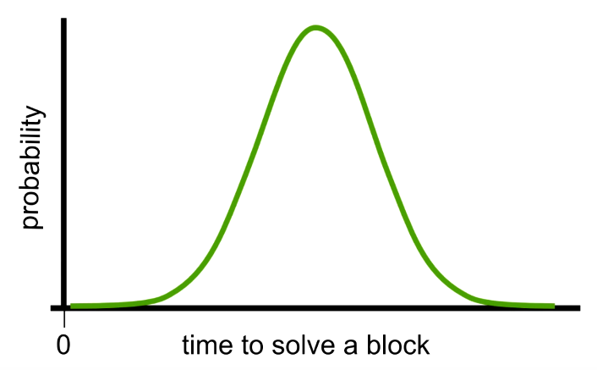
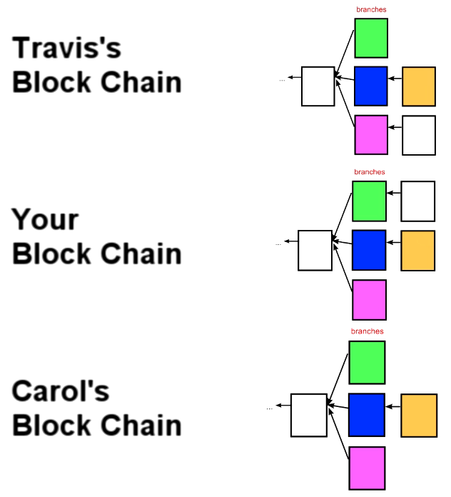
Occasional Conflicts
Unlikely for two people to solve the block at the same time
Occasionally however, two nodes can solve the block at the same time, leading to several possible branches
In this case, build on top of the branch you receive, other nodes may have received the blocks in different order
The tie is broken when someone solves the next block
Immediately switch to the longest chain
Extremely rare for multiple blocks to have been solved at the same time in a row
Quick stabilization

Slide 38
Block Chain Reordering Implications
Sometimes transactions can lose their place in the chain
Will be returned to the unprocessed pool and will be grabbed again later

Slide 39
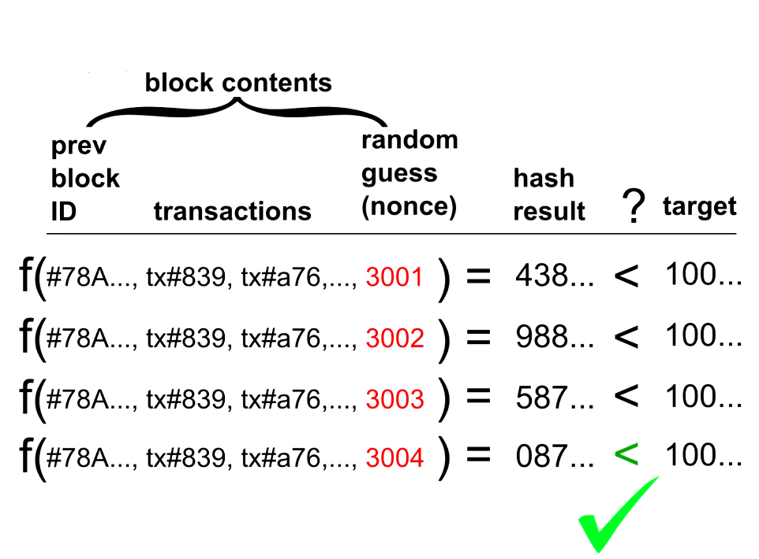
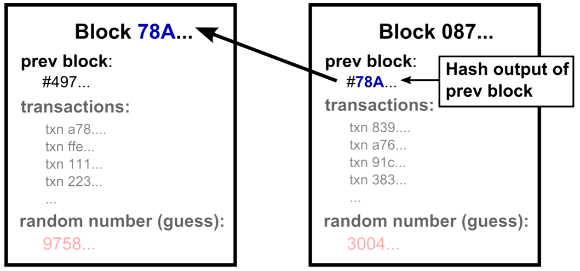
Cryptographic Hash Locks Blocks in Place (1/2)
Solving a block involves trying to get the cryptographic hash of the block to be below a certain value
This can be done by guessing random numbers
The hash output is the unique identifier of a block
This hash will be the next block’s previous reference

Slide 40
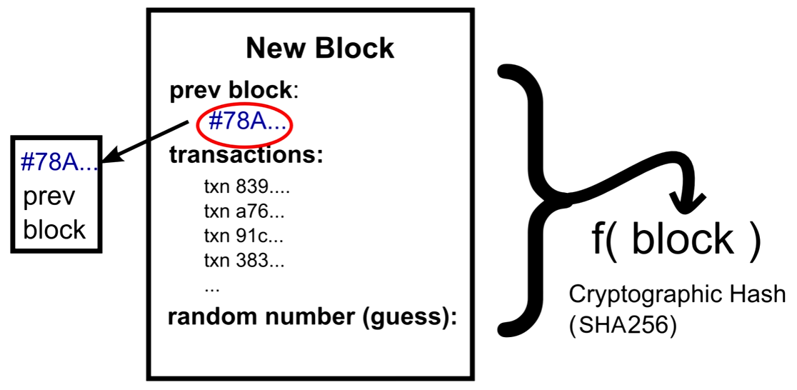
Cryptographic Hash Locks Blocks in Place (2/2)
There is no way to switch out a block in the middle of the chain
A block cannot be solved before the previous block is solved, because the previous block’s hash will also go through the current’s block hash function

Slide 41
Agenda
Introduction
Motivation
Technical Overview
How does it work?
Strengths/Weaknesses
Future scope

Slide 42
Strengths
No government control
Lower global transaction costs
Complex mathematical computations make the system very secure and immutable
Anyone can join the blockchain network as a node/miner
Transparency, every node has an entire copy of all the transactions ever made
Peer to peer means no single point of failure

Slide 43
Weaknesses
Difficult to exchange for other currencies
No government control leads to illegal activities
Mining/Solving blocks uses huge processing power
Decentralization leads to “No trust”!
We trust our banks or if something goes wrong, we can sue our bank. In bitcoin we deal with anonymous strangers, so one cannot trust anyone.
DIY bitcoin = Risky
Bitcoin software hides the scripting layer, one could write their own
Over 2600 bitcoins were lost in a single batch of transactions due to malformed address
Since there is no central authority, any user error mistakes can cause permanent loss of bitcoins from the economy
If a user loses their private key, any funds associated with the corresponding public key will be lost forever
And because users will likely lose their private keys due to technical glitches, bitcoin currency will eventually be a deflationary one.
Notes:
System is vulnerable to double spend attack towards the end of the chain. Thus it is recommended to wait out a few blocks to be solved to ensure that the transaction is complete.

Slide 44
Agenda
Introduction
Motivation
Technical Overview
How does it work?
Strengths/Weaknesses
Future scope

Slide 45
A brief summary of some use cases gaining momentum
Document and contract digitization, management and exploitation
Secure tracking of data exchange in Internet of Things activity
Securing and creating trust in escrow and custodian services
Decentralized and cloud services including patient records and healthcare support
Electronic voting and voter authentication
Cloud based learning and student authentication
Counterfeit prevention for digital assets and proof of ownership
Digital identity management and providing trust as to authenticity of digital reviews, brands and reputation
Facilitation of sales and trading of digital assets and digital rights management
Nine major banks (including JP Morgan and Goldman Sachs) recently joined a partnership to develop blockchain technologies.

Slide 46
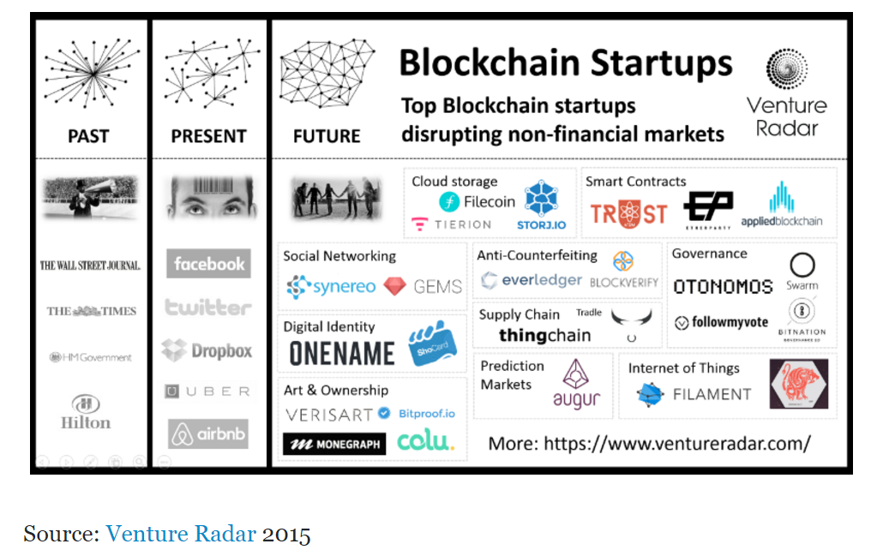
Blockchain Startups

Slide 47
References
https://bitcoin.org/en/
https://www.blockchain.com/
http://blockgeeks.com/guides/what-is-blockchain-technology-a-step-by-step-guide-than-anyone-can-understand/
https://www.linkedin.com/pulse/blockchain-non-financial-services-use-cases-paul-forrest
https://www.youtube.com/watch?v=Lx9zgZCMqXE
http://scet.berkeley.edu/wp-content/uploads/BlockchainPaper.pdf
http://marmelab.com/blog/2016/04/28/blockchain-for-web-developers-the-theory.html

Slide 48


Slide 49
Who will use the blockchain?
As web infrastructure, you don’t need to know about the blockchain for it to be useful in your life.
Currently, finance offers the strongest use cases for the technology. International remittances, for instance. The World Bank estimates that over $430 billion US in money transfers were sent in 2015.
The blockchain potentially cuts out the middleman for these types of transactions. Personal computing became accessible to the general public with the invention of the Graphical User Interface (GUI), which took the form of a “desktop”. Similarly, the most common GUI devised for the blockchain are the so-called “wallet” applications, which people use to buy things with Bitcoin, and store it along with other cryptocurrencies.
Transactions online are closely connected to the processes of identity verification. It is easy to imagine that wallet apps will transform in the coming years to include other types of identity management.

Slide 50
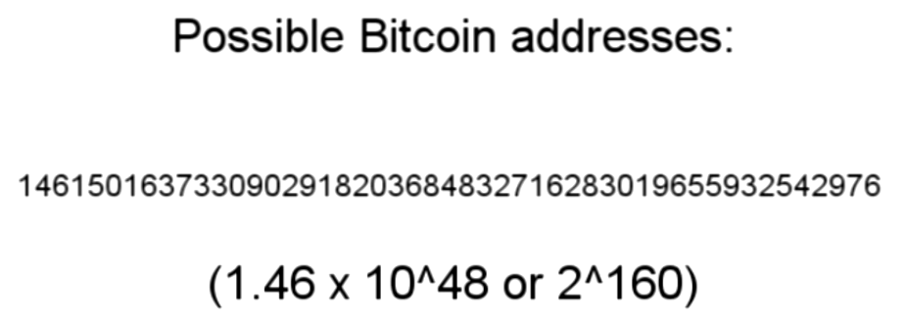
Anonymity
Use bitcoin network without ever revealing more than public key
TOR networks hides the IP address
Avoid linking public keys together by generating a new public key for every incoming transaction using the wallet software

Slide 51
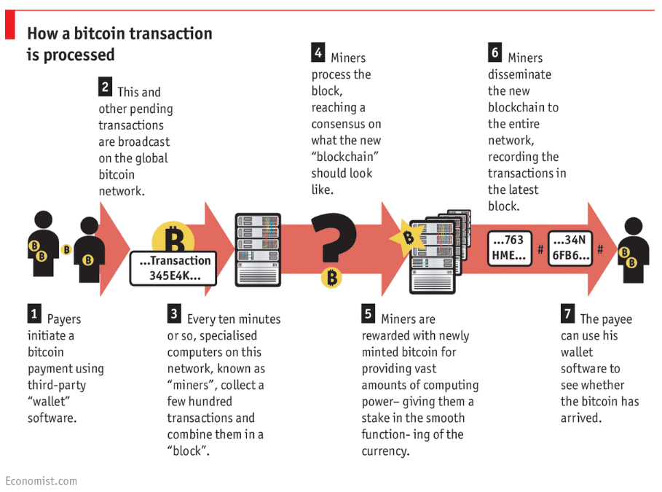

Slide 52
Be your own bank!
“The blockchain is an incorruptible digital ledger of economic transactions that can be programmed to record not just financial transactions but virtually everything of value.”
The real defining feature is not what it does or how it does it, instead, it holds value based on how much users can trust it to perform those services impartially.

Slide 53
(Some intro about bitcoin or probably show a video!!)
Proponents envisage an “internet of value” that can make money flow as freely as data are flowing already.
Cryptocurrencies, like bitcoin, are currencies that exist solely in digital. There are no physical golden coins with a big “B” on them. Moreover, owning these non-real coins entails a new idea of “ownership.” You don’t literally have it in your hands, or even in your bank account, but you have the ability to transfer “ownership” to someone else simply by creating a record in the blockchain. Rather than using bills, your transfer is pure data.
owning bitcoin is merely having a claim on a piece of information sitting on the blockchain.

Slide 54
Transparent and incorruptible
The blockchain network lives in a state of consensus, one that automatically checks in with itself every ten minutes. A kind of self-auditing ecosystem of digital value, the network reconciles every transaction that happens in ten minute intervals. Each group of these transactions is referred to as a “block”. Two important properties result from this:
Transparency data is embedded within network as a whole, by definition it is public.
It cannot be corrupted altering any unit of information on the blockchain would mean using a huge amount of computing power to override the entire network.

Slide 55
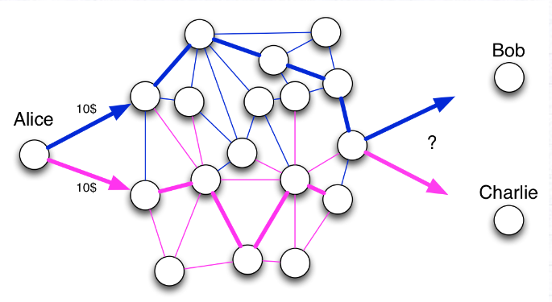
Double Spending Problem
Alice has 10$, and she sends twice 10$ to Bob and Charlie. Who will have the 10$ eventually? To answer this question, the best way is to order the facts. If two incompatible facts arrive in the network, the first one to be recorded wins.

