Slide 1
Domain Knowledge assisted Requirements Evolution (K-RE)
CONSEG 09

Slide 2
Redefining the way we do requirements today
Motivation - To bring about sizeable efficiency, improved quality and enhanced customer confidence by offering knowledge assisted requirements definition
Domain knowledge edge is crucially important while defining requirements
  Requirement analysts are not necessarily domain experts
  Domain knowledge is not easily available and accessible
Requirements Engineering (RE) methods presume a ‘clean slate’ approach
  Start with ‘nothing’ in place and outline a series of steps to define, analyze, specify and validate requirements collaboratively with relevant stakeholders
  BUT do not provide for a way to incorporate domain knowledge as an integral part of requirements definition exercise
  Gaps
- <number> -

Slide 3
Redefining the way we do requirements today
Approach
Starts with a seed specification in place
  Seed contains domain knowledge elements
    Business events, actions and decisions (as captured in business processes)
    business constraints
    analysis patterns
    …
We ‘evolve’ the seed by altering and adding to the core to get to the final requirement specification
  Each new exercise of requirements definition thus is treated as an evolution of a pre-existing structured domain knowledge base
Move from Requirements Engineering (RE) to Knowledge Assisted Requirements Evolution (K-RE)
- <number> -

Slide 4
Architecture
Web Browser
The Application Security
Content Processor
Collaboration
Tools.
User Input Based
Text Search Based
…….
Guidance Enabler
Plug-Ins for
Document Generation,
Model Population …
Text Search
Engine
Generic RE
Guidance
Domain
Guidance
WordNet
OpenNLP
…..
Database
Knowledge Reference Layer
Environmental
context ontology
Problem
Domain Ontology
Requirements Definition
Ontology
- <number> -

Slide 5
Knowledge Reference Layer
Comprises of knowledge repository of knowledge elements specific to (1)environmental
context (2)requirements definition and (3) problem domain of the system to be developed
Environmental Context Ontology
Environmental Context Ontology consists of concepts like Domain, Line of business, Geography, Customer and Project type.
Requirements Definition Ontology
Based on MAPAGILE- contains concepts for improved requirements definition
Domain Ontology
Contains concepts and relationships required to build the problem domain specific ‘seed requirements specification’ presented to the requirements analyst.
- <number> -

Slide 6
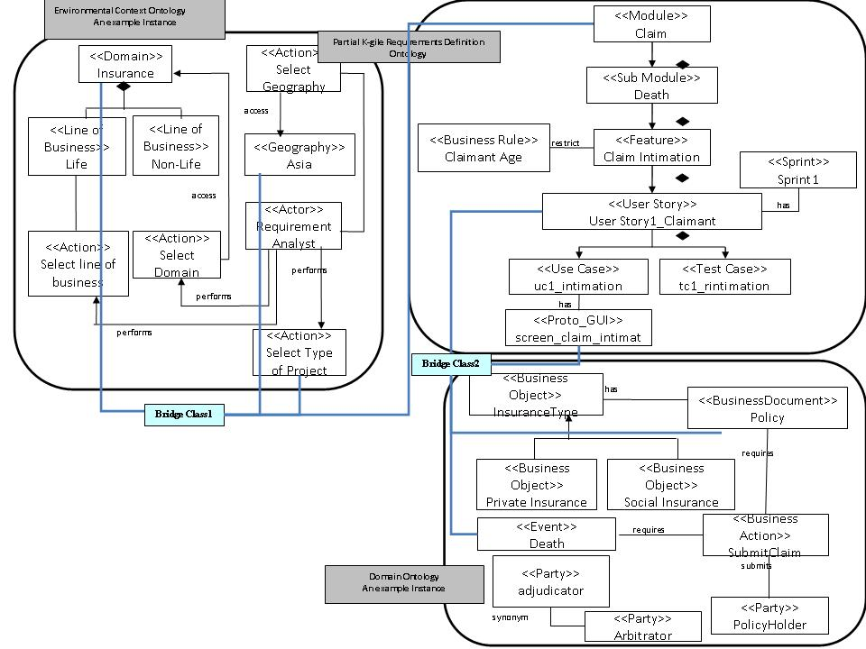
Underlying ontologies
- <number> -

Slide 7
How do the three ontologies work together?
Bridge Class does the mappings
Sensing user input, referring ontologies, drawing logical conclusions and
enabling context-specific guidance
It traverses the ontologies and reasons over them to draw logical conclusion. It evaluates ontological relationships as well as SWRL rule .The conclusions are reflected in the tool’s behavior accordingly.
If the rules corresponding to user inputs, are evaluated to true , the bridge class will map the appropriate concepts to user inputs. These mapped concepts and their related necessary concepts are either presented to the user ( context specific guidance) or are used for further processing .
Based on the mappings , bridge class is responsible for selecting the appropriate ‘SEED’ to the user.
- <number> -

Slide 8
Bridge Class- Example- How does it work?
Finding conflicting artifacts
For example, the calling class passes conceptName as “Claim_Death_due_to_unnatural_cause_Intimation_and_Booking” and OntologyFileName as “DeathDomainOnology”.
It will find conflicting rules related to “Claim_Death_due_to_unnatural_cause_Intimation_and_Booking” and store it in variable conceptRelatedRules. This variable is internally used by isConflciting and findConflicting functions
The flow checks if there are any conflicting concepts related to “Claim_Death_due_to_unnatural_cause_Intimation_and_Booking” ”. If not found, null is returned to calling class. Otherwise conflicting concepts are stored in mappedConcept using findConflicting function. In this case, “Document_ Waiver_ Management” is returned to the calling class.
If a user tries to select “Claim_Death_due_to_unnatural_cause_Intimation_and_Booking” feature together with “Document_ Waiver_ Management” , there will an alert regarding their conflicting nature
Start
Read conceptName
Read ontologyFileName
conceptRelatedRules = conceptRelatedRules(“Conflicting”, conceptName )
isConflicting(conceptName)
No
Return null
Yes
mappedConcept =findConflicting(conceptName)
Return mappedConcept
End
Finding Conflicting Artifacts using Bridge Class
- <number> -

Slide 9


What it Means to Projects?
Customers
Requirement Analyst
Project Managers
Will get what they expect
Subject matter Experts (SME) will spend less time educating the requirement analyst
Reduced number of iterations in preparing the specifications
Considerable time savings in SDLC phases
No project overruns due to timely delivery resulting reduction in cost
Re-use of available repository and customize to meet client requirement
Less number of iterations ensures timely delivery
Significant improvement in quality of deliverables due to effective & meaningful collaboration
Effective usage of available domain related guidance as and when required
Jump-start projects with optimum use of domain artifact
Quality delivery of project artifact within the agreed timelines
Increases customer trust and confidence which results in new initiatives
TIME
Confidence & Trust
QUALITY
- <number> -
- <number> -

Slide 10

Thank you
- <number> -

Slide 11
Appendix 1.
Related Works - Gaps
Two different Categories –
  Methods/techniques to Structure Knowledge
  Use in Requirements Elicitation
Domain Knowledge structure is available but Environmental Parameters are not considered.
All methods require certain amount of learning.
No Online Recommendations and Real Time Guidance.
Process Centric View not available.
No Seamless integration with RE Structure.
back
- <number> -

Slide 12
Appendix 2.
Experimental Evaluation
Completeness
Consistency
Unambiguity
SEED Correctness
- <number> -

