Slide 1
A Semantic and Collaborative platform for Agile Requirements Evolution
Nirav Ajmeri

Slide 2
Introduction
Agile Requirements are collaboration-intensive
Social Platforms are valuable but not sufficient
Requirements pose challenge in agile projects
Geographic separation within the team leads to minimal or no opportunity for co-located discussion
Communication ‘using the same language’ is difficult to achieve
Need for a platform that, in addition to supporting collaboration, also seamlessly incorporates domain knowledge
Notes:
Everyone of us have used social softwares, web-based softwares → relevant to Soft Engg, Req Engg
Collaboration Mechanism and Feedback mechanism → Agile Requirements.
Agile Prioritization , which stories to be taken up first, story splitting, sprint planning → Domain Knowledge
Achieved by empowering stakeholders with Domain Knowledge
It is not good enough to treat domain knowledge as something external to Agile Requirements. We want to seamlessly weave it into Agile Requirements Exercise.

Slide 3
Agenda
KgileRE
  Approach
  Knowledge Classification in KgileRE
  KgileRE Model
KgileRE Effectiveness
Usage Illustration
Conclusion

Slide 4
KgileRE
Domain knowledge edge is crucially important while defining agile requirements
  Requirement analysts are not necessarily domain experts
  Domain knowledge is essential for eg. while prioritizing
  Communication in “same language” - topmost problem in Agile.
Requirements Engineering (RE) methods presume a ‘clean slate’ approach
  Start with ‘nothing’ in place and outline a series of steps to define, analyze, specify and validate requirements collaboratively with relevant stakeholders
  BUT do not provide for a way to incorporate domain knowledge as an integral part of agile requirements definition exercise
Combine useful concepts of Web2.0 and Semantic web with an aim to enable agile requirements identification, discussion and definition.
Notes:
Domain knowledge is important in defining high quality requirements, Very important in large scale projects where teams are not collocated.
Requirement Analyst not expert, very few domain experts, sending expert to cater every project – not scalable model.
Domain knowledge even if available, is not visible and not easily accessible … tacit, in experts head, or in project documents .. Not in a format that make it (machine) reusable.

Slide 5
KgileRE Approach
Requirement Analyst presented with Domain Knowledge Corpus comprising Core Business Elements
  User Stories
  Business Rules
  Processes
  Usecases
  Data Models
  Prototypes
  Possible Sprint Plans etc..
Core Business Elements modified/enhanced as per project needs
Knowledge assisted agile Requirements Evolution (KgileRE) in contrast to clean slate Requirements Engineering (RE)

Slide 6
Knowledge Classification
KgileRE platform classifies knowledge using Ontologies –
Environmental Context Ontology
  Capture the environment in which software requirements are to be defined
Problem Domain Ontology
  Provide abstraction to capture essence of problem domain
Generic Requirements Ontology
  Provide abstraction to capture requirements definition elements
Agile Requirements Ontology
  Provide abstraction specific to agile requirements
Notes:
Environmental Context Ontology is a formal specification of ethnic groups to which the user belongs. It consists of concepts like Domain, Line of business, Geography, Customer and Project type.
Problem Domain ontology refers to abstractions in a given problem domain such as banking, insurance and contains business concepts, their inter-relations and constraints
Requirements Ontology – capture Correct Complete Consistent and Unambiguous requirements
Agile Requirements Ontology – abstraction to capture agile requirements – user stories, tasks, features, sprints, prototype etc.

Slide 7
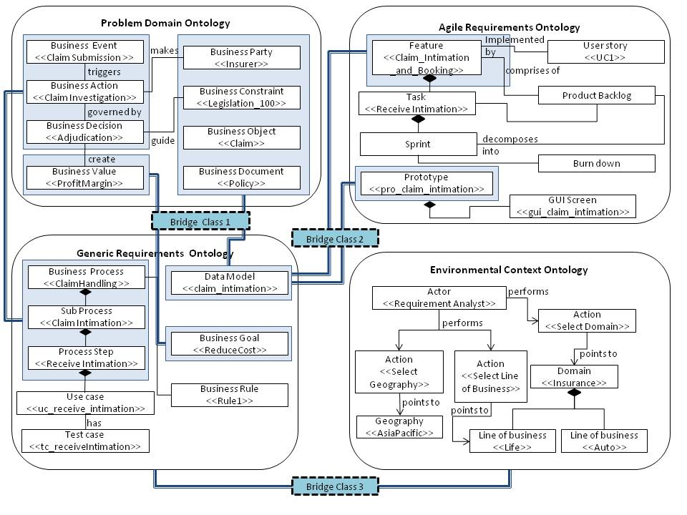
KgileRE Model
Notes:
Examples of mappings between the elements of different ontologies
- The BusinessEvents (e.g. Claim submission), BusinessActions (e.g. Investigate Claim) and BusinessDecisions (e.g. Adjugation) in the Problem Domain Ontology are represented as BusinessProcess (e.g. Claims Handling) in the ‘Generic Requirements Ontology’.
- BusinessGoals (e.g. Reduce Costs) in the Generic Requirements Ontology are designed to deliver BusinessValue, ( e.g. Profit margin) a concept in ‘Problem Domain Ontology’
- BusinessConstraint (e.g. a New legislation) in the Problem Domain Ontology in maps to Validation (e.g. Verify conformance to rule) in Generic Requirements Ontology.
- The BusinessParty (e.g. Insurer), BusinessObject (e.g. Claim), BusinessDocument (e.g. Policy) from the Problem Domain Ontology contribute to DataElement in the Generic Requirements Ontology.
- Feature (e.g. Claim intimation and booking) in Agile Requirements Ontology maps to SubProcess (Claim Intimation process) in Generic Requirements Ontology.
UserStory and Task in Agile Ontology map to UseCase in Generic Requirements Ontology
The ontologies discussed above have been a result of an iterative and a continual process that involves (1) exploring available resources such as documents, web-sites, (2) identifying and extracting various knowledge elements from the resources (3) Analyzing the extracted knowledge and (4) representing the knowledge in the form of instances of the concepts and their relationships in the ontologies in a machine readable format.

Slide 8
Agenda
KgileRE
  Approach
  Knowledge Classification in KgileRE
  KgileRE Model
KgileRE Effectiveness
Usage Illustration
Conclusion

Slide 9
KgileRE Effectiveness
Taxonomies and Folksonomies
Social Platform supporting self organization and moderation via non-intrusive recommendations.
Social Feedbacks
  Weighted voting
  Discussions
Semantically enabled collaboration
  More than just a wiki
  Generate and refine artifacts iteratively
Notes:
Semantically enabled collaboration → want to contribute new feature but unsure… post in forum to initiate discussion, show other relevant features, business rules, also show other post related to the new feature.
Ontologies result of top-down … predefined taxonomies. Folksonomies evolve collaboratively into Taxonomies.
Social platform – but not highly democratic, suggestive mechanism, guidance, soft alerts.
Social Feedbacks – weighted voting, but it may result in junior analyst being unheard, transparent discussion mechanism.
Not just wiki … Generate and refine requirements models – usecase and class model, partial domain models, business process maps, and structured requirements specification

Slide 10
Agenda
KgileRE
  Approach
  Knowledge Classification in KgileRE
  KgileRE Model
KgileRE Effectiveness
Usage Illustration
Conclusion

Slide 11
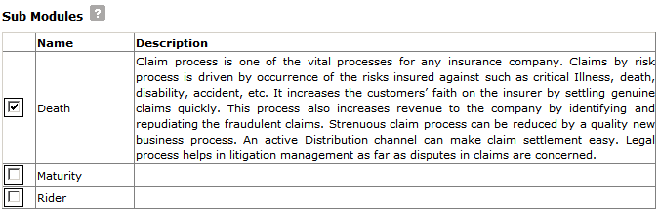
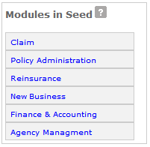
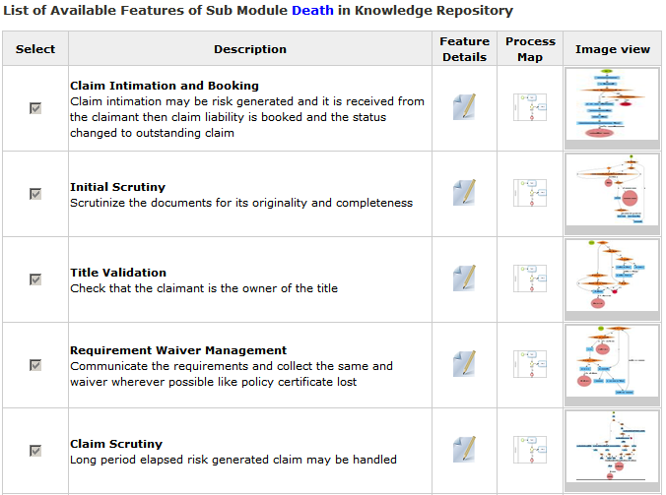
Usage Illustration: Knowledge Corpus based on Environment Parameters

Slide 12
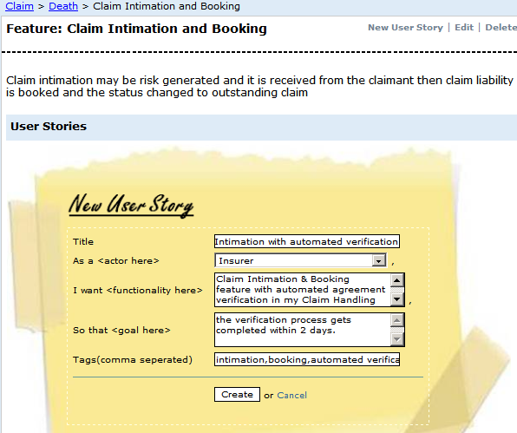
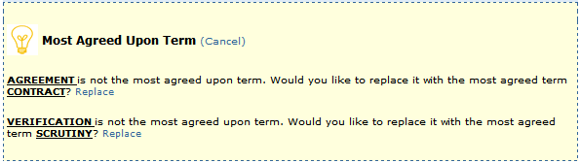
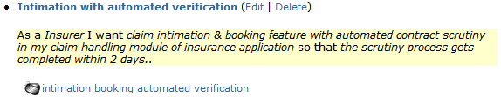
Usage Illustration: Terminology Guidance

Slide 13
Usage Illustration Table 1. Requirements definition and domain-specific assistance
Requirements definition activities | Domain- specific assistance | Example(s)
Select environmental parameter | A KC relevant to the selected parameters is presented | Parameters: Domain (e.g. Insurance), line of business (e.g. life), geography (e.g. Asia) and customer (e.g. ABC), KC presents Modules such as Claims, Riders, Maturity
Editing elements such as User Story from the KC | Recommendations to include Features that would help in implementing the user story, adherence to terminology, detection of new terms and recommendations to include them in glossary and data models, recommendations to specify associations between terms . | User story text: “As an Insurer, I want to have Claim Intimation & Booking feature with automated agreement verification in my Claim Handling module of Insurance application so that the verification process gets completed within 2 days.” Features: Claim intimation and booking, Claim review and inspection New Terms detected: Verification, Recommended synonym : Scrutiny
Select features ( from the KC) relevant to project | Recommendations to include business rules/policies relevant to features,, Business Glossary, Business Process, , Include Closely Related Terms | Selected Feature: Claim intimation and booking Business Terms : Assignee, Rules: Laws of the land with respect to claims, in Asia, Policies of the selected company (ABC) ,conflicting features
Form product backlog and sprints thereafter | Recommendations to include inter-dependant features in the same sprints, Splitting of a feature | Recommendations: ‘Claim intimation’ and ‘Claim review and inspection’ may be included in the same Sprint.
Generate prototype | Typical screens, partial data models , use cases | Recommendations: Sample screens depicting the ‘Claim intimation’ activities, data models ( e.g. consisting of Claim, Policy, Agent)
TABLE 1. REQUIREMENTS DEFINITION AND DOMAIN-SPECIFIC ASSISTANCE

Slide 14
Agenda
KgileRE
  Approach
  Knowledge Classification in KgileRE
  KgileRE Model
KgileRE Effectiveness
Usage Illustration
Conclusion

Slide 15
Conclusion
Kgile-RE bridges the democratic aspects of web 2.0 platform and meritocratic aspects the semantic web
  Taxonomies and Folksonomies.
  Not just a Wiki – provide semantically enriched collaboration.
Approach has the potential to improve several desirable properties in a requirement specification.
Notes:
All agile methods strongly advocate close communication and collaboration. Using the collaboration mechanisms in K-gileRE, interactions among dispersed teams happen informally, in keeping with the agile culture and doctrines of trust and care for individuals
Experimental results proves that this approach has the potential to improve several desirable properties in requirements specification.

Slide 16
THANK YOU

Slide 17
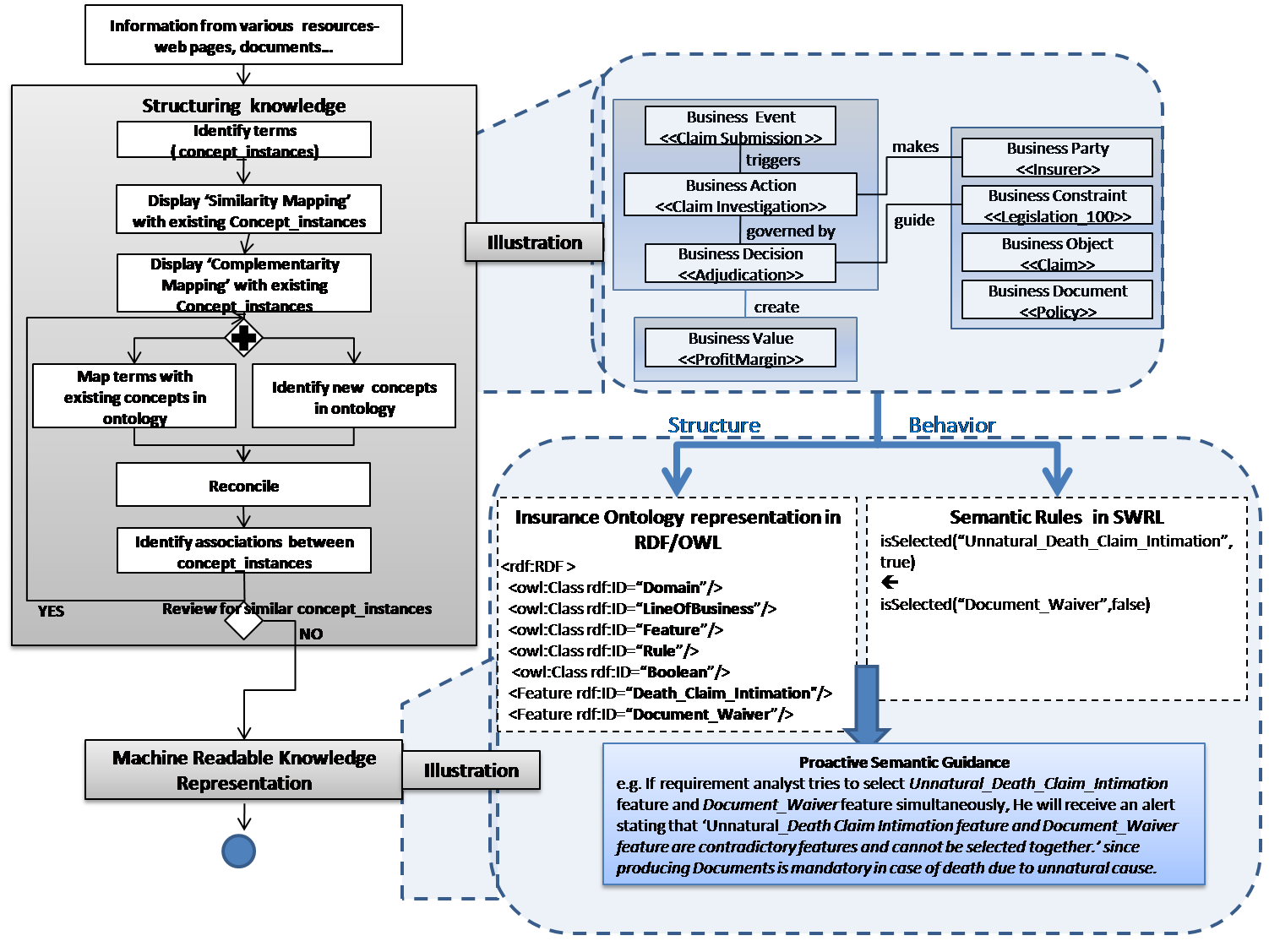
Appendix 1: Knowledge Creation Process

Slide 18
Appendix 2: Domain specific assistance enablement
Requirements definition activities | Domain- specific assistance | Examples | Formalized/Human intervention | Remark
Select Project Environment Parameter Set | 1.List of Available Domains from Knowledge Repository is presented 2. List of Available Geographies from Knowledge Repository is presented | 1. Insurance, Banking, Healthcare... 2. Europe, Asia-Pacific... | Formalized | Environment Ontology +SWRL
Select Domain | List of related Line of Business is presented. | Life Insurance, Auto insurance... | Human intervention based | Requirement Analyst is required to select relevant Line of Business as per her project needs.
Select Geography | List of related Customers is presented. | ABC Life, XYZ Auto... | Human intervention based | Requirement Analyst is required to select the appropriate Customer as per her project needs.
Select Customer | A KC relevant to selected parameters is presented | Claim Handling | Formalized | Ontology +SWRL
TABLE 2. DOMAIN SPECIFIC ASSISTANCE ENABLEMENT - FORMALIZATION+ HUMAN INTERVENTION

Slide 19
Appendix 3A: Experimental Results
Knowledge Base comprising of
  300 ‘Claims’ features,
  3269 business concepts and relations,
  822 business rules along with exceptions and over-rider scenarios and a glossary explaining the concepts was created.
3 domain experts
2 domain curators
Experiment Project – “Claims Application”
  Product Backlog – 170 features
  1 sprint of 10 features considered
Notes:
We used as our reference for this validation, a requirements document the requirement analysts had prepared for a ‘Claims’ application. The project had a product-backlog of 170 features organized into sprints in consultation with customers. We selected one of the Sprints consisting of 10 features for our experiment. We compared these with the ones present in the knowledge base incorporated in K-gileRE. We selected 10 features that matched closely in functionality from the knowledge base and modified these to match the project needs (with the document as our reference) While we did this exercise, we received several recommendations from the K-gileRE framework. To understand the effectiveness of the framework, we recorded recommendations related to (1) missing elements such as business rules corresponding to a feature (2) inconsistencies (such as conflicting features) (3) terminology suggestions (4) corrections (such as modifications, deletions and additions) to the KC presented. This was done in order to identify possible gaps in a seemingly complete requirements document.
We accepted and acted on some of the recommendations and had to reject some in consultation with the requirement analysts who had actually interacted with the customers. The elements mentioned in recommendations were displayed for inclusion and could be edited to suit the specifics of the project. For example, if a recommendation was regarding business rules relevant to a selected feature, then the corresponding rules were displayed and one could select to include some (or none) from these depending upon the project specifics. Table III summarizes the observations.

Slide 20
Appendix 3B: Experimental Results
  Recorded recommendations related to
  missing elements such as business rules corresponding to a feature
  inconsistencies (such as conflicting features)
  terminology suggestions
  corrections (such as modifications, deletions and additions) to the KC presented.
Knowledge element selected/ edited | Number of recommendations displayed by K-gileRE | Recommendation details | Number of recommendations accepted and acted upon
Features | 40 | Complementary features, conflicting features, missing business rules, suggestions for Sprint formations | 28
Use cases | 12 | Relevant business rules | 7
Business concepts | 20 | Relationships between the concepts suggested | 15
Synonym usage | 15 | Most accepted term in place of the synonym | 12
Business term to be included in project glossary | 75 | Related terms to be included along with selected term | 50
TABLE 3. KGILE-RE EFFECTIVENESS

