Slide 1
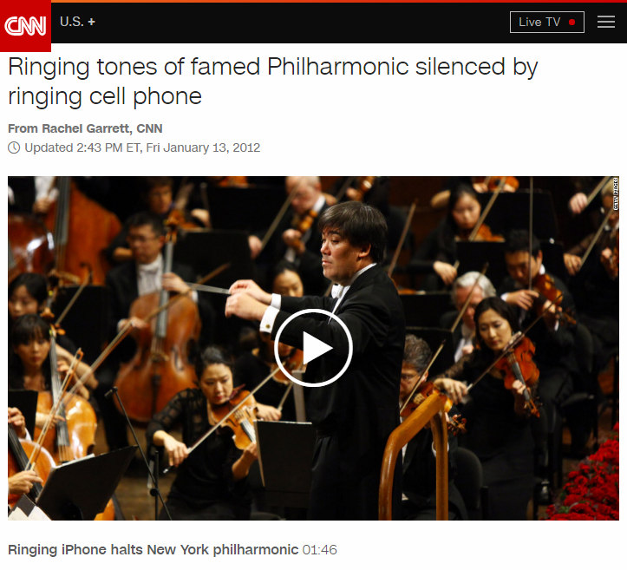

Developing Socially Intelligent Applications
Arnor
Goal
Social Experience
Expectation
Context

