Slide 1
INVESTMENT ASSIGNMENT SUBMISSION
Name: Nirav Doshi

Slide 2
Problem Statement and Background
Problem Statement Identify the most suitable investment type, countries and sectors for investment Above parameter depends on the number of investments made over years
Goals Investment type analysis : Analysing and choosing best investment type for Spark Funds among venture, seed, angel and private equity Country Analysis : Analyse the most suitable country to invest as per the constrains Sector Analysis : Analyse the investment performed on 8 main sectors and propose the most suited sector to invest.
Business Constrains Invest between 5 to 15 million USD per round of investment Invest only in English speaking countries

Slide 3
Problem Solving Methodology
Importing Files: Import the below datafiles from various format using pandas: Company.txt Rounds2.csv Mapping.csv
Data Exploration: Knowing the dataset Check the data type of all the fields Check for unique values and identify primary column/(s)
Data Cleaning & Transformation Identify redundant column and remove Convert all the data to required data type Check for null/NAN values and either impute or remove observations as necessary Merge the data frames using proper join techniques viz – inner, left, right and outer
Plotting Graph: Using matplotlib and seaborn library plot the results of analysis carried earlier
Data Analysis: As per business requirement perform below analysis: Best Investment Type Best Countries to Invest Best Sector to Invest

Slide 4
Assumptions
Below are the certain Assumptions made during the process of Data Cleaning and Data Analysis :
Removed all the companies from companies.txt file whose status is “closed” as it is not possible to invest in a company which no longer exists
Removed unwanted columns like founded_at, state, region, etc as these columns were of no use as far as data analyses is concerned.
Imputing the NAN values of investment made by the company with median value of raised_amount_usd
While mapping the primary sector to mapping sector, in case of primary sector not present in mapping.csv file, we are assuming the value of Main sector as BLANKS

Slide 5
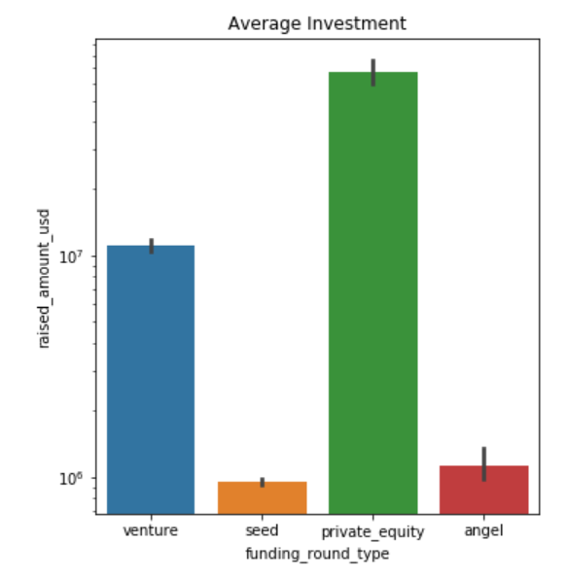
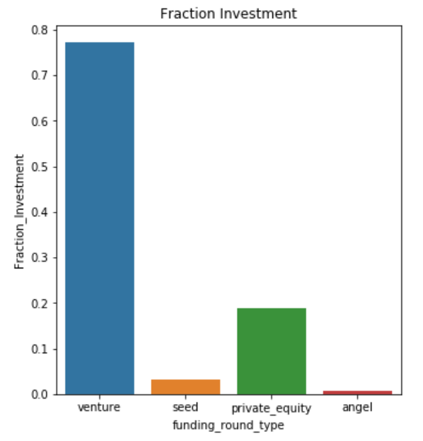
Funding Type Analysis
After carrying out the data analysis to find the most suitable funding type for investment by calculating the mean/average of amount of investment for each type , below were the observations:
Venture - $11054170
Seed - $946911.9
Angel – 1124873
Private Equity – 67226420
Considering the Spark Funds constrain of making investment between $5 millions to $15 millions - VENTURE is the most suited funding type.

Slide 6
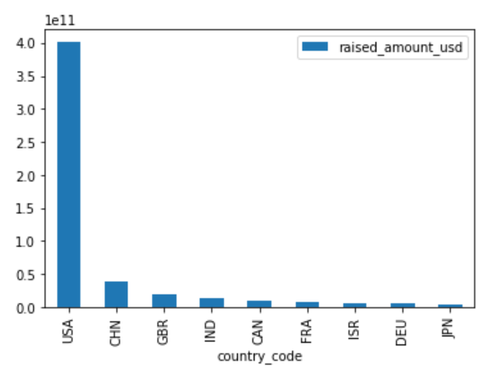
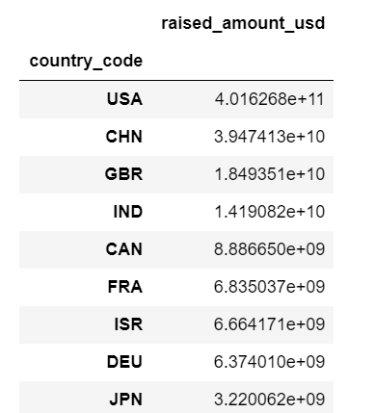
Country Analysis
Top 9 countries with highest investment made for funding type as venture –
Since, CHN is not the English speaking country, top 3 countries for investment in venture type are USA, GBR and IND

Slide 7
Sector Analysis
Below table clearly shows the country-wise sector analysis
Questions | USA | GBR | INF
Total no. of investment | 11287 | 582 | 315
Amount Invested | $101010153708 | $5053293406 | $2820673602
Top Sector | Others | Others | Others
Second Sector | Cleantech / Semiconductors | Cleantech / Semiconductors | News, Search and Messaging
Third Sector | Social, Finance, Analytics, Advertising | Social, Finance, Analytics, Advertising | Social, Finance, Analytics, Advertising

Slide 8
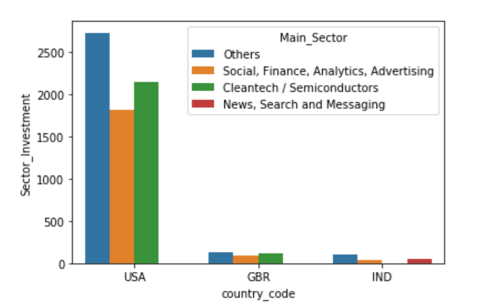
Sector Analysis
The graph shows the exact investment done in the top three sectors for top three countries
In USA, maximum investment is done in Others sector followed by Cleantech/Semiconductors and Social, Finance, Analytics, Advertising sector
In GBR, maximum investment is done in Others sector followed by Cleantech/Semiconductors and Social, Finance, Analytics, Advertising sector
In IND, maximum investment is done in Others sector followed by News, Search, Messaging and Social, Finance, Analytics, Advertising sector

Slide 9
Conclusion
Preferred Funding Type – VENTURE
Top 3 countries to Invest in are
USA (United States of America)
GBR (Great Britain)
IND (India)
Preferred Sector to Invest in are
For USA and GBR, Others, Cleantech/Semiconductors and ‘Social, Finance, Analytics, Advertising’ sector
For IND, Others, ‘News, Search, Messaging’ and ‘Social, Finance, Analytics, Advertising’ sector

