Slide 1

Unit-2 Simplification of Logic function
Digital Fundamentals (DF)
DU #2101CS303
Prof. Krunal D Vyas
Computer Science & Engineering
krunal.vyas@darshan.ac.in
9601901005

Slide 2

Outline
Standard representation of logic function: SOP and POS
Boolean algebra laws - De Morgan’s theorem
K-map representation
Simplification using K-map
K-map with Don’t care conditions
Variable Entered Map (VEM) method
Tabulation (Q-M) method of function realization
Realize logic function using gates
Looping

Slide 3
Standard representation of logic function: SOP and POS
Section - 1

Slide 4

Boolean functions & representation
Sum-of-products (SOP) form (Disjunctive Normal Form)
$$f(A,B,C)=(A\overline{B}+\overline{B}C)$$
Products-of-sums (POS) form (Conjunctive Normal Form)
$$f(A,B,C)=(\overline{A}+\overline{B})(B+C)$$

Slide 5

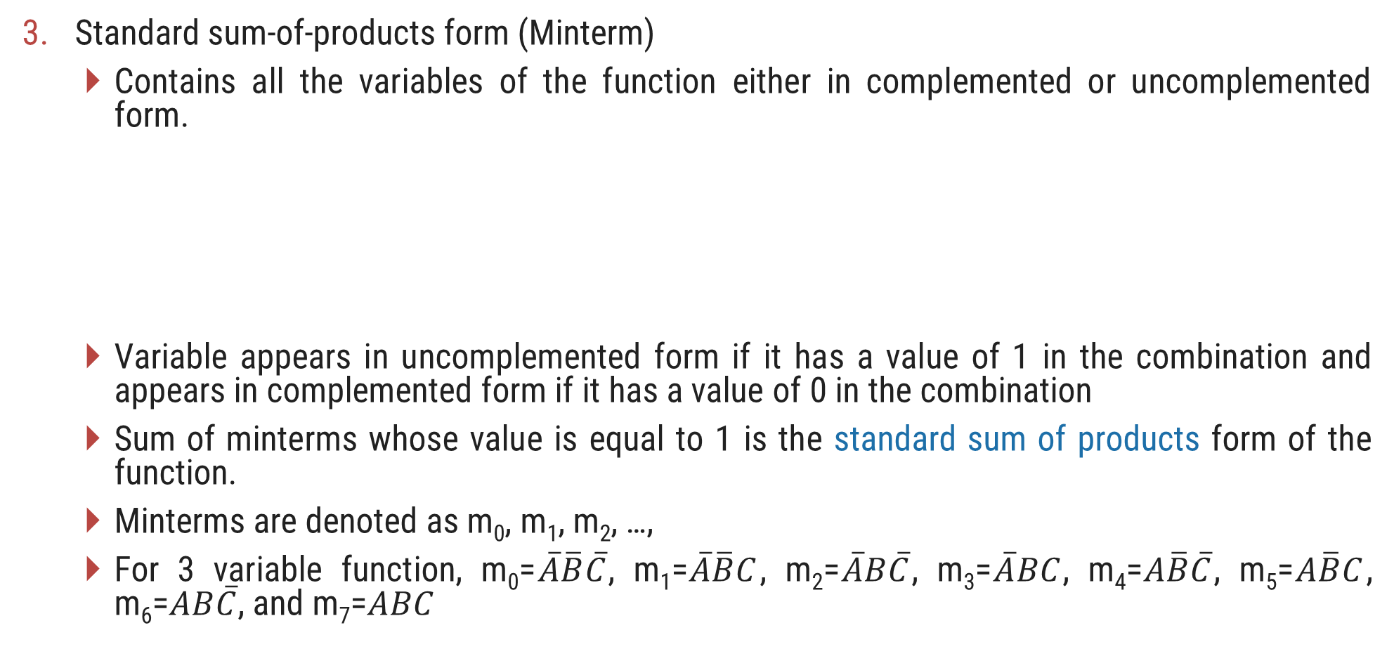


Boolean functions & representation
Standard sum-of-products form (Minterm)
Contains all the variables of the function either in complemented or uncomplemented form.
Variable appears in uncomplemented form if it has a value of 1 in the combination and appears in complemented form if it has a value of 0 in the combination
Sum of minterms whose value is equal to 1 is the standard sum of products form of the function.
Minterms are denoted as m₀, m₁, m₂, …,
For 3 variable function, m₀=$\overline{A}\overline{B}\overline{C}$, m₁=$\overline{A}\overline{B}C$, m₂=$\overline{A}B\overline{C}$, m₃=$\overline{A}BC$, m₄=$A\overline{B}\overline{C}$, m₅=$A\overline{B}C$, m₆=$AB\overline{C}$, and m₇=$ABC$
$$f\left(A,B,C\right)=\overline{A}B+\overline{B}C$$
$$=\overline{A}B\left(C+\overline{C}\right)+\overline{B}C\left(A+\overline{A}\right)$$
$$=\overline{A}BC+\overline{A}B\overline{C}+A\overline{B}C+\overline{A}\overline{B}C$$
Value of Minterm = 1

Slide 6
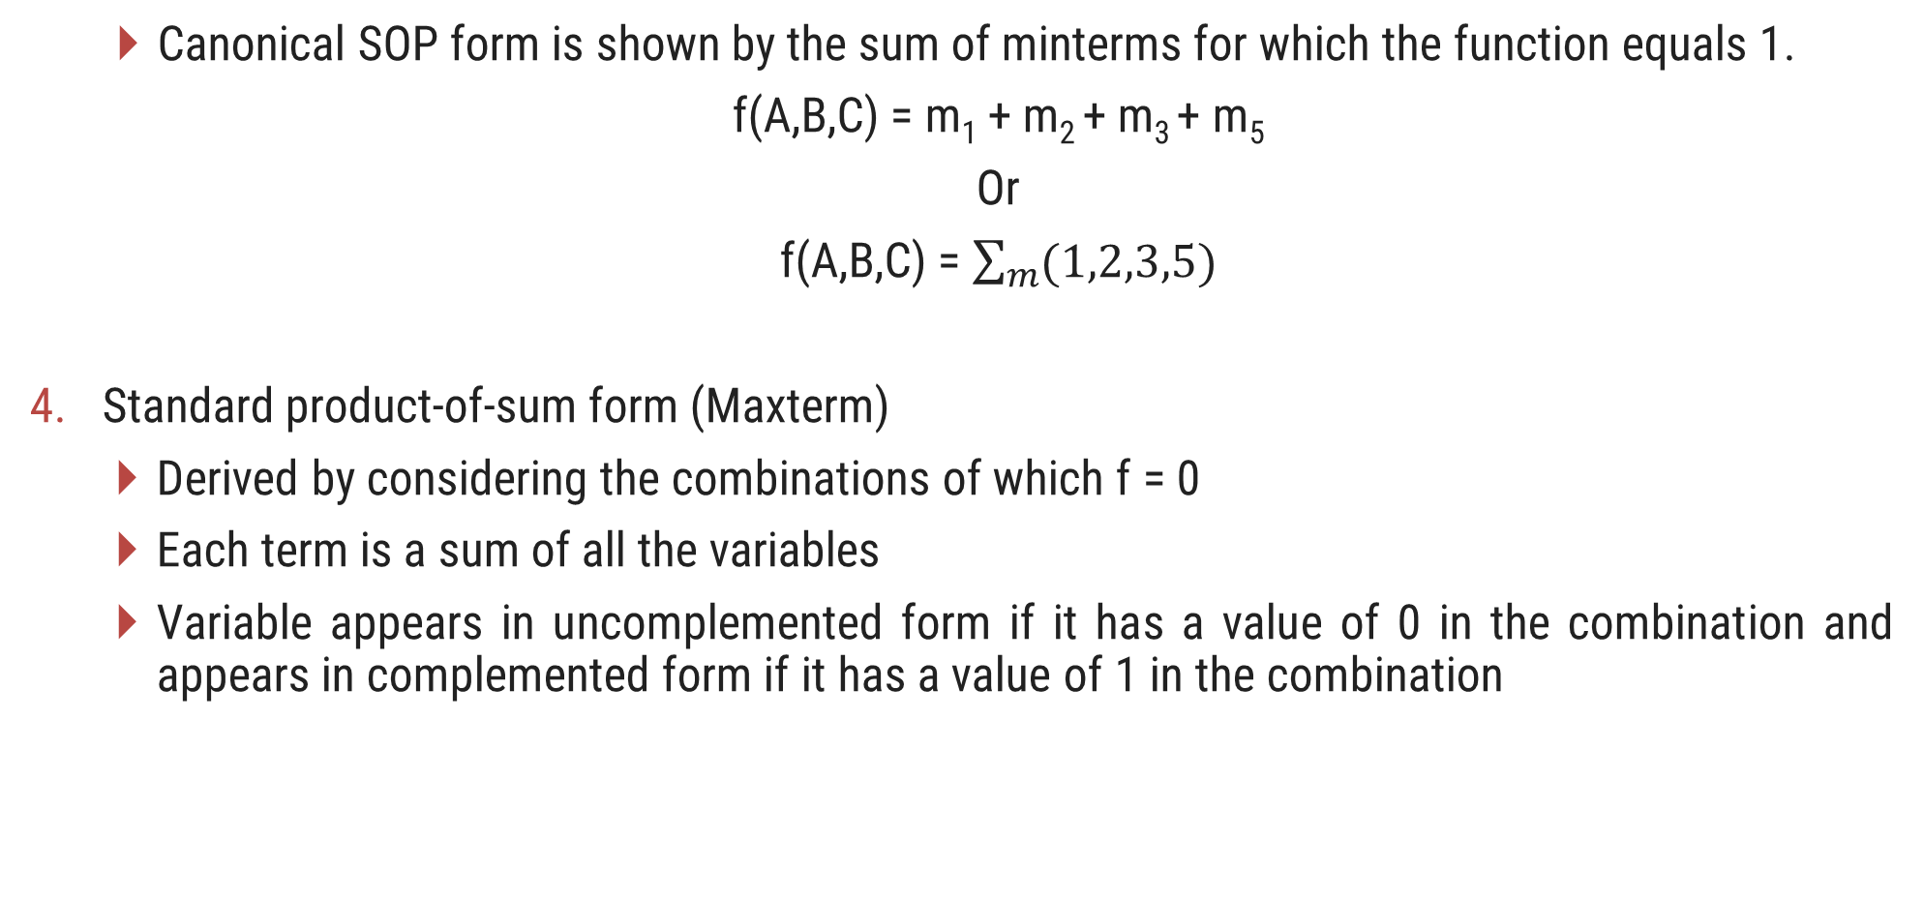
Boolean functions & representation
Canonical SOP form is shown by the sum of minterms for which the function equals 1.
f(A,B,C) = m₁ + m₂ + m₃ + m₅
Or
f(A,B,C) = $\sum_{m}{(1,2,3,5)}$
Standard product-of-sum form (Maxterm)
Derived by considering the combinations of which f = 0
Each term is a sum of all the variables
Variable appears in uncomplemented form if it has a value of 0 in the combination and appears in complemented form if it has a value of 1 in the combination

Slide 7



Boolean functions & representation
A sum term which contains each of the n variables in either complemented or uncomplemented form is called a maxterm.
Maxterms are denoted as M₀, M₁, M₂, …,
f(A,B,C) = M₀M₁M₆M₇
Or
f(A,B,C) = $\prod_{M}{(0,1,6,7)}$
$$f\left(A,B,C\right)=(\overline{A}+\overline{B})(A+B)$$
$$= (\overline{A}+\overline{B}+C\overline{C})(A+B+C\overline{C})$$
$$= (\overline{A}+\overline{B}+C)(\overline{A}+\overline{B}+\overline{C})(A+B+C)(A+B+\overline{C})$$
Value of Maxterm = 0

Slide 8
Boolean algebra laws - De Morgan’s theorem
Section - 2

Slide 9
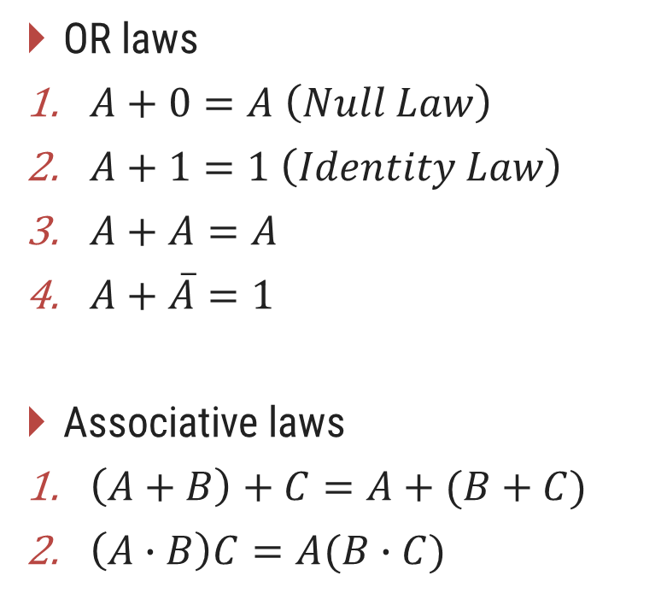
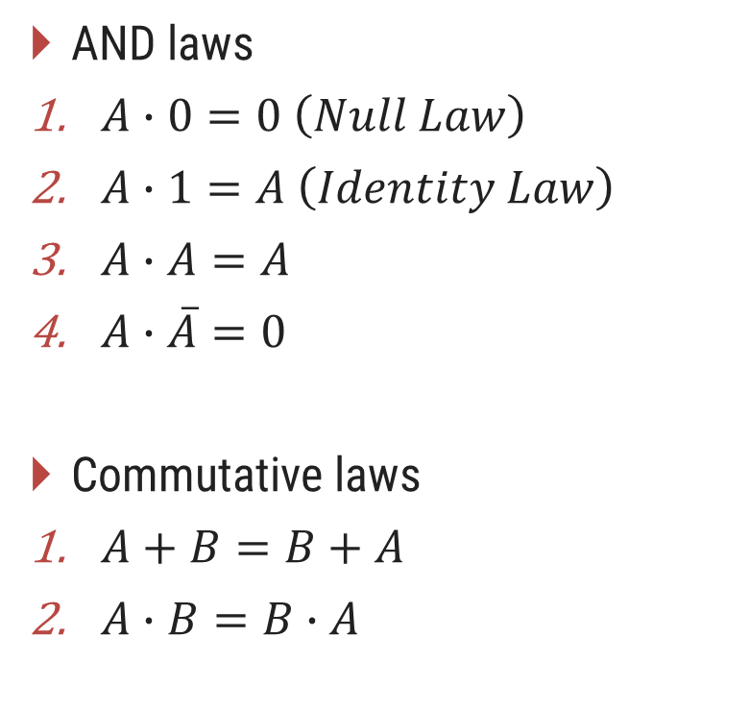
Boolean Algebra Laws
AND laws
$A∙0=0 \left(Null Law\right)$
$A∙1=A \left(Identity Law\right)$
$A∙A=A$
$A∙\overline{A}=0$
Commutative laws
$A+B=B+A$
$A∙B=B∙A$
OR laws
$A+0=A \left(Null Law\right)$
$A+1=1 \left(Identity Law\right)$
$A+A=A$
$A+\overline{A}=1$
Associative laws
$\left(A+B\right)+C=A+(B+C)$
$\left(A∙B\right)C=A(B∙C)$

Slide 10
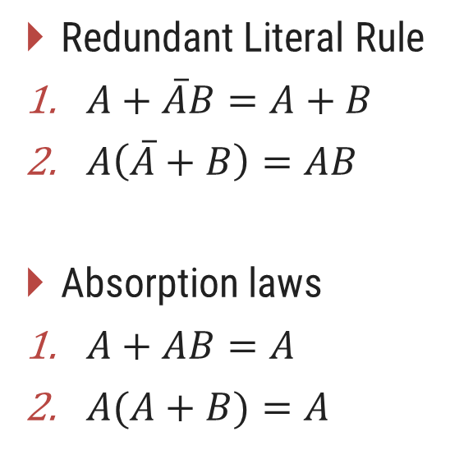
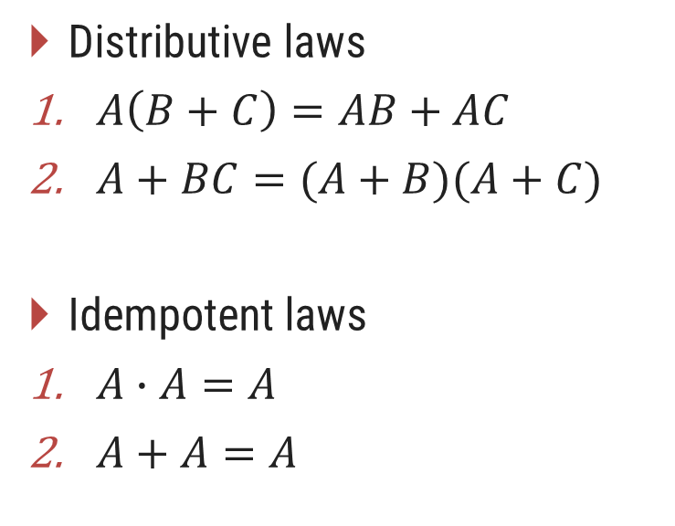
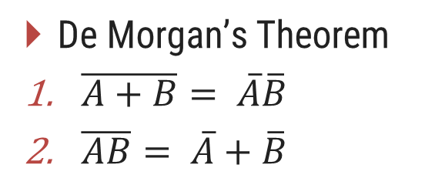
Boolean Algebra Laws
Distributive laws
$A\left(B+C\right)=AB+AC$
$A+BC=(A+B)(A+C)$
Idempotent laws
$A∙A=A$
$A+A=A$
Redundant Literal Rule
$A+\overline{A}B=A+B$
$A\left(\overline{A}+B\right)=AB$
Absorption laws
$A+AB=A$
$A(A+B)=A$
De Morgan’s Theorem
$\overline{A+B}= \overline{A}\overline{B}$
$\overline{AB}= \overline{A}+\overline{B}$
Break the line change the sign

Slide 11
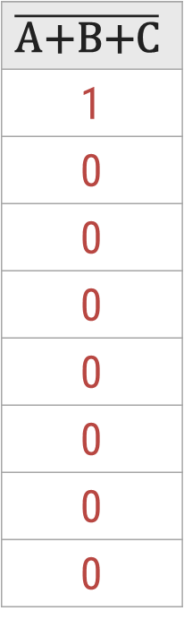
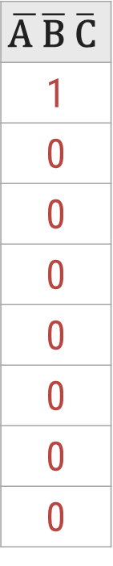
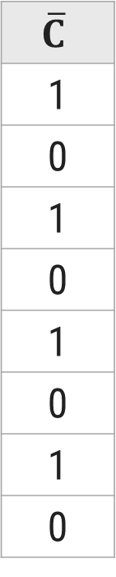
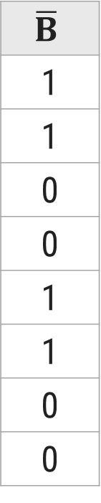
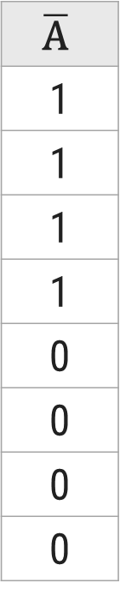
Proof of $\overline{A+B+C}=\overline{A} \overline{B} \overline{C}$
L.H.S.
R.H.S.
A
0
0
0
0
1
1
1
1
B
0
0
1
1
0
0
1
1
C
0
1
0
1
0
1
0
1
A+B+C
0
1
1
1
1
1
1
1
$$\overline{\text{A}\text{+}\text{B}\text{+}\text{C}}$$
1
0
0
0
0
0
0
0
$$\overline{\text{A}}$$
1
1
1
1
0
0
0
0
$$\overline{B}$$
1
1
0
0
1
1
0
0
$$\overline{C}$$
1
0
1
0
1
0
1
0
$$\overline{\text{A} }\overline{\text{B}} \overline{\text{C}}$$
1
0
0
0
0
0
0
0
From truth table, it is clearly visible that L.H.S. = R.H.S. Hence, the complement of a sum of variables is equal to the product of their individual complements.

Slide 12
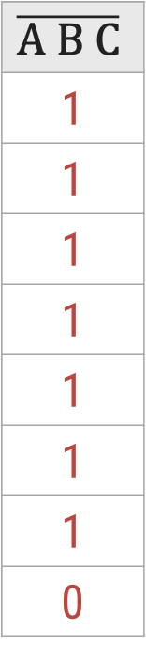
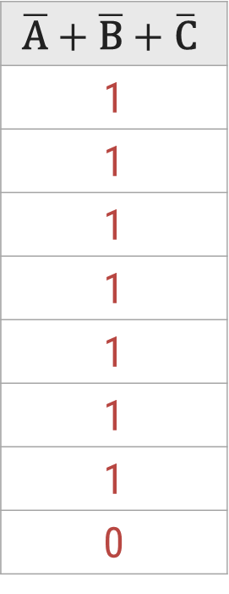
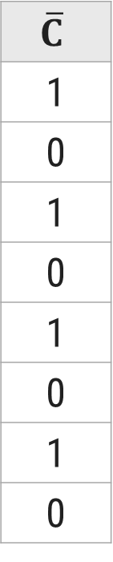
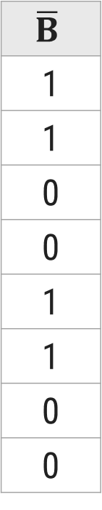
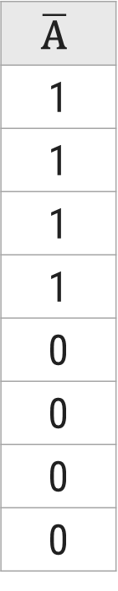
Proof of $\overline{ABC}=\overline{A}+\overline{B}+ \overline{C}$
L.H.S.
R.H.S.
A
0
0
0
0
1
1
1
1
B
0
0
1
1
0
0
1
1
C
0
1
0
1
0
1
0
1
A B C
0
0
0
0
0
0
0
1
$$\overline{\text{A} \text{B} \text{C}}$$
1
1
1
1
1
1
1
0
$$\overline{\text{A}}$$
1
1
1
1
0
0
0
0
$$\overline{B}$$
1
1
0
0
1
1
0
0
$$\overline{C}$$
1
0
1
0
1
0
1
0
$$\overline{\text{A}}+\overline{\text{B}}+\overline{\text{C}}$$
1
1
1
1
1
1
1
0
From truth table, it is clearly visible that L.H.S. = R.H.S. Hence, the complement of a product of variables is equal to the sum of their individual complements.

Slide 13






Reducing Boolean Expression (Example – 1)
Reduce the expression $f=A+B[AC+\left(B+\overline{C}\right)D]$
$$f=A+B[AC+\left(B+\overline{C}\right)D]$$
$$f=A+B[AC+BD+\overline{C}D]$$
(Distributive law)
$$f=A+BAC+BBD+B\overline{C}D$$
(Distributive law)
$$f=A+ABC+BD+B\overline{C}D$$
(A.A = A)
$$f=A(1+BC)+BD(1+\overline{C})$$
$$f=A+BD$$
(1 + A = 1)

Slide 14







Reducing Boolean Expression (Example – 2)
Reduce the expression $f=A[B+\overline{C}(\overline{AB+A\overline{C}})]$
$$f=A[B+\overline{C}(\overline{AB+A\overline{C}})]$$
$$f=A[B+\overline{C}(\overline{AB}\overline{A\overline{C}})]$$
(De-Morgan’s law)
$$f=A[B+\overline{C}(\overline{A}+\overline{B})(\overline{A}+C)]$$
(De-Morgan’s law)
$$f=A[B+\overline{C}(\overline{A}\overline{A}+\overline{A}C+\overline{B}\overline{A}+\overline{B}C)]$$
(Distributive law)
$$f=A[B+\overline{C}\overline{A}+\overline{C}\overline{A}C+\overline{C}\overline{B}\overline{A}+\overline{C}\overline{B}C]$$
(Distributive law)
$$f=A[B+\overline{C}\overline{A}+0+\overline{C}\overline{B}\overline{A}+0]$$
(A.A’ = 0)
$$f=AB+A\overline{C}\overline{A}+A\overline{C}\overline{B}\overline{A}$$
(Distributive law)
$$f=AB+0+0$$
(A.A’ = 0)
$$f=AB$$

Slide 15



Exercise
$f=\left(\overline{A+\overline{BC}}\right)(A\overline{B}+ABC)$
$f=(B+BC)(B+\overline{B}C)(B+D)$
$$f=0$$
$$f=B$$

Slide 16
K-map representation
Section - 3

Slide 17
Introduction to K-Maps
Simplification of Boolean functions leads to simpler (and usually faster) digital circuits.
Simplifying Boolean functions using identities is time-consuming and error-prone.
This special section presents an easy, systematic method for reducing Boolean expressions.
A K-Map is a matrix consisting of rows and columns that represent the output values of a Boolean function.
The output values placed in each cell are derived from the minterms of a Boolean function.
A minterm is a product term that contains all of the function’s variables exactly once, either complemented or not complemented.

Slide 18
2 – Variable K-Map
The two variables A and B have four possible combinations that can be represented by the map as follows
A
0
1
B
A | B | Minterm
0 | 0 | m₀ = A’B’
0 | 1 | m₁ = A’B
1 | 0 | m₂ = AB’
1 | 1 | m₃ = AB
0
2
0
1
3
1

Slide 19
3 – Variable K-Map
The three variables A, B and C have eight possible combinations that can be represented by the map as follows
A | B | C | Minterm
0 | 0 | 0 | m₀ = A’B’C’
0 | 0 | 1 | m₁ = A’B’C
0 | 1 | 0 | m₂ = A’BC’
0 | 1 | 1 | m₃ = A’BC
1 | 0 | 0 | m₄ = AB’C’
1 | 0 | 1 | m₅ = AB’C
1 | 1 | 0 | m₆ = ABC’
1 | 1 | 1 | m₇ = ABC
AB
00
01
11
10
C
0
2
6
4
0
1
3
7
5
1
Minterm Number

Slide 20
4 – Variable K-Map
The four variables A, B, C and D have sixteen possible combinations that can be represented by the map as follows
AB
00
01
11
10
A | B | C | D | Minterm
0 | 0 | 0 | 0 | m₀ = A’B’C’D’
0 | 0 | 0 | 1 | m₁ = A’B’C’D
0 | 0 | 1 | 0 | m₂ = A’B’CD’
0 | 0 | 1 | 1 | m₃ = A’B’CD
0 | 1 | 0 | 0 | m₄ = A’BC’D’
0 | 1 | 0 | 1 | m₅ = A’BC’D
0 | 1 | 1 | 0 | m₆ = A’BCD’
0 | 1 | 1 | 1 | m₇ = A’BCD
A | B | C | D | Minterm
1 | 0 | 0 | 0 | m₈ = AB’C’D’
1 | 0 | 0 | 1 | m₉ = AB’C’D
1 | 0 | 1 | 0 | m₁₀ = AB’CD’
1 | 0 | 1 | 1 | m₁₁ = AB’CD
1 | 1 | 0 | 0 | m₁₂ = ABC’D’
1 | 1 | 0 | 1 | m₁₃ = ABC’D
1 | 1 | 1 | 0 | m₁₄ = ABCD’
1 | 1 | 1 | 1 | m₁₅ = ABCD
CD
0
4
12
8
00
1
5
13
9
01
3
7
15
11
11
2
6
14
10
10

Slide 21
Simplification using K-map
Section - 4

Slide 22
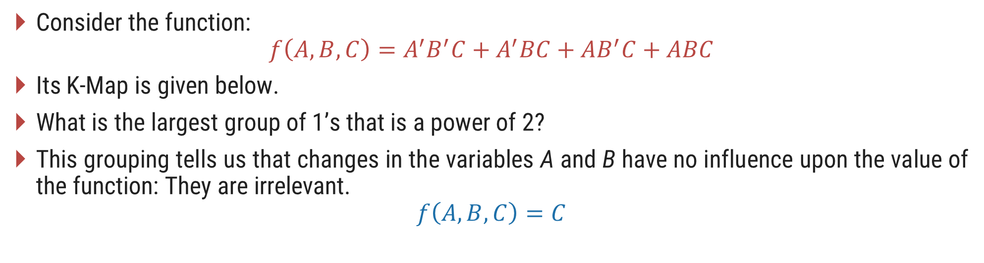
Reduce Boolean Expression
Consider the function:
$$f\left(A,B,C\right)=A^{′}B^{′}C+A^{′}BC+AB^{′}C+ABC$$
Its K-Map is given below.
What is the largest group of 1’s that is a power of 2?
This grouping tells us that changes in the variables A and B have no influence upon the value of the function: They are irrelevant.
$$f\left(A,B,C\right)=C$$
AB
00
01
11
10
C
0
2
6
4
0
1
3
7
5
1
1
1
1
1

Slide 23



Examples (SOP)
$$f=AB^{′}C+A^{′}B′C$$
$$f=ABC′D+ABCD+A^{′}BC^{′}D+A^{′}BCD$$
AB
AB
00
01
11
10
CD
00
01
11
10
0
4
12
8
C
00
0
2
6
4
0
1
5
13
9
01
1
1
1
3
7
5
1
1
1
3
7
15
11
11
1
1
$$f=B^{′}C$$
2
6
14
10
10
$$f=BD$$

Slide 24





Examples (SOP)
$$f=ABC^{′}D+AB^{′}C^{′}D^{′}+AB^{′}CD^{′}+A^{′}B^{′}CD^{′}+A^{′}B^{′}C^{′}D′$$
$$f=A^{′}BC^{′}D+A^{′}B^{′}C^{′}D+A^{′}B^{′}C^{′}D′$$
AB
AB
00
01
11
10
00
01
11
10
CD
CD
0
4
12
8
0
4
12
8
00
1
1
00
1
1
5
13
9
1
5
13
9
01
1
01
1
1
3
7
15
11
3
7
15
11
11
11
2
6
14
10
2
6
14
10
10
1
1
10
$$f=ABC^{′}D$$
$${+ B}^{′}D^{′}$$
$$f=A^{′}B^{′}C^{′}$$
$$+ A^{′}C^{′}D$$

Slide 25

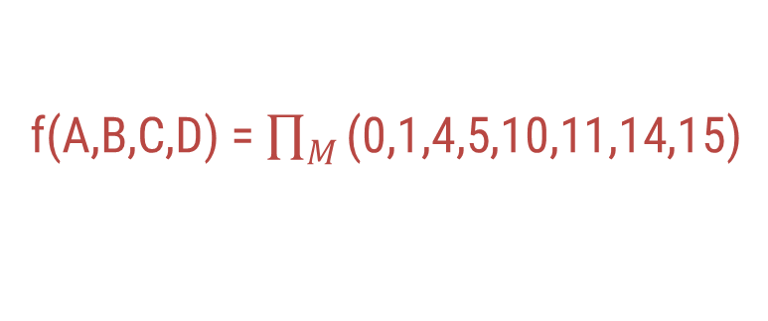

Example (POS)
f(A,B,C,D) = $\prod_{M}{\text{(0,1,4,5,10,11,14,15)}}$
AB
00
01
11
10
CD
0
4
12
8
00
0
0
1
5
13
9
01
0
0
$$f=(A+C)$$
$$(A^{′}+C^{′})$$
3
7
15
11
11
0
0
2
6
0
14
0
10
10

Slide 26
K-map with Don’t care conditions
Section - 5

Slide 27


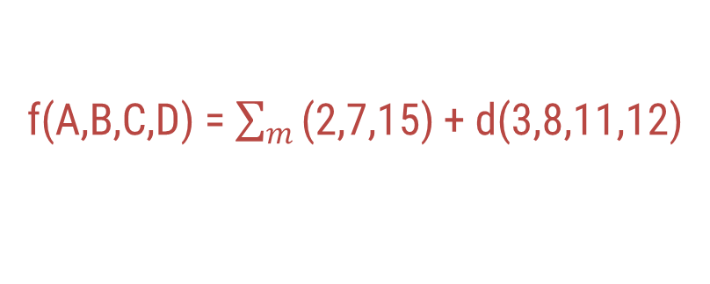
Don’t care conditions
Suppose we are given a problem of implementing a circuit to generate a logical 1 when a 2, 7, or 15 appears on a four-variable input.
A logical 0 should be generated when 0, 1, 4, 5, 6, 9, 10, 13 or 14 appears.
The input conditions for the numbers 3, 8, 11 and 12 never occur in the system. This means we don’t care whether inputs generate logical 1 or logical 0.
Don’t care combinations are denoted by ‘x’ in K-Map which can be used for the making groups.
The above example can be represented as
f(A,B,C,D) = $\sum_{m}{\text{(2,7,15)}}$ + d(3,8,11,12)
AB
00
01
11
10
CD
0
4
12
8
00
x
x
1
5
13
9
01
3
7
15
11
11
x
1
1
x
2
6
14
10
10
1
$$f=CD$$
$$+ A^{′}B^{′}C$$

Slide 28


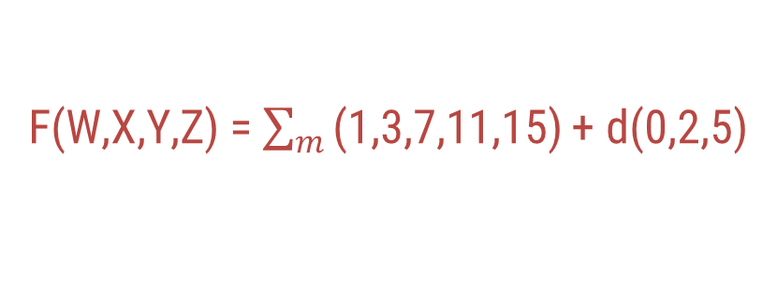
Example (Don’t care)
F(W,X,Y,Z) = $\sum_{m}{\text{(}\text{1}\text{,}\text{3}\text{,}\text{7,11,15}\text{)}}$ + d(0,2,5)
WX
00
01
11
10
YZ
0
4
12
8
00
x
1
5
13
9
01
1
x
$$F=W^{′}X′$$
$$+YZ$$
3
7
15
11
11
1
1
1
1
2
6
14
10
10
x

Slide 29
Variable Entered Map (VEM) method
Section - 6

Slide 30
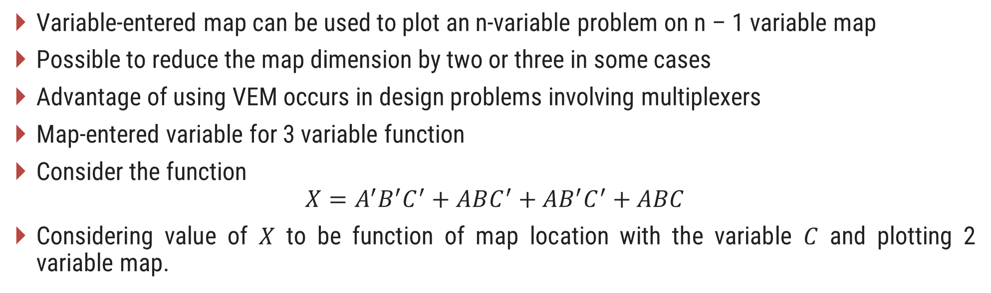
Variable-Entered Map (VEM)
Variable-entered map can be used to plot an n-variable problem on n – 1 variable map
Possible to reduce the map dimension by two or three in some cases
Advantage of using VEM occurs in design problems involving multiplexers
Map-entered variable for 3 variable function
Consider the function
$$X=A^{′}B^{′}C^{′}+ABC^{′}+AB^{′}C^{′}+ABC$$
Considering value of $X$ to be function of map location with the variable $C$ and plotting 2 variable map.
A
A
0
1
0
1
B
B
X=1 if C’=1
X=1 if C’=1
0
0
C’
C’
X=1 if C’=1 or if C = 1
1
X=0
1
0
C + C’

Slide 31



Reducing Expressions with VEM (Example)
Choose groups of similar terms to cover all nonzero terms appearing in the map except “don’t care” terms.
Rest complete process is similar to K-Map
$$f=AB^{′}CD+A^{′}BC^{′}D+AB^{′}CD^{′}+ABC^{′}D+A^{′}B^{′}C^{′}D$$
AB
00
01
11
10
C
0
D
D
D
$$f=A^{′}C^{′}D$$
$$+ BC′D$$
$$+ AB^{′}C$$
D
1
D+D’

Slide 32





Reducing Expressions with VEM (Example)
$$f=A^{′}B^{′}C^{′}D+A^{′}BC^{′}D^{′}+A^{′}BC^{′}D+AB^{′}C^{′}D′+AB^{′}CD^{′}+AB^{′}CD+ABCD′$$
AB
00
01
11
10
C
D
D+D’
D’
0
D’
$$f=A^{′}C^{′}D$$
$$+ A^{′}BC′$$
$$+ ACD′$$
$$+ AB′D′$$
$$+ AB^{′}C$$
D’
D+D’
1
D’

Slide 33




Reducing Expressions with VEM (Example)
f $=A^{′}B^{′}C^{′}D^{′}E+A^{′}B^{′}C^{′}DE+A^{′}BCD^{′}E^{′}+A^{′}BCD^{′}E+AB^{′}C^{′}D^{′}E^{′}+ AB^{′}C^{′}D^{′}E$
$$+ AB^{′}C^{′}D+A^{′}BCDE′$$
AB
00
01
11
10
CD
E
E+E’
00
E’
01
E
E+E’
$$f=B^{′}C^{′}E$$
$$+ AB^{′}C′$$
$$+ A^{′}BCD^{′}$$
$$+ A^{′}BCE′$$
11
E’
E+E’
10
E’

Slide 34
Tabulation (Q-M) method of function realization
Section - 7

Slide 35
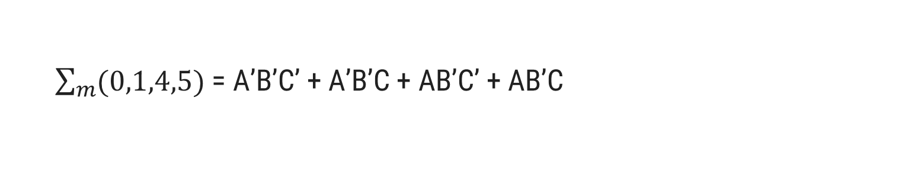
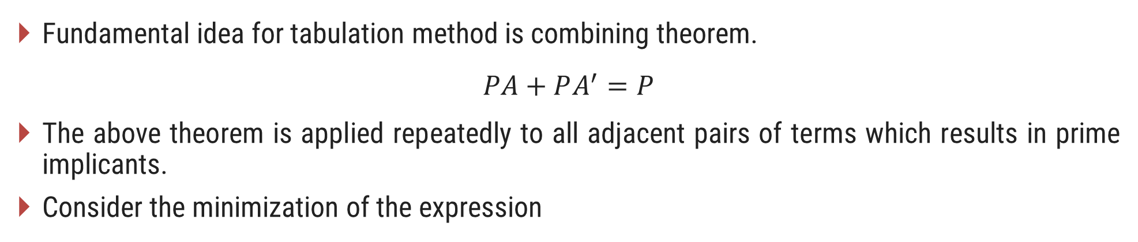
Tabulation Method (Quine-McCluskey Method)
Fundamental idea for tabulation method is combining theorem.
$$PA+PA^{′}=P$$
The above theorem is applied repeatedly to all adjacent pairs of terms which results in prime implicants.
Consider the minimization of the expression
$\sum_{m}{(0,1,4,5)}$ = A’B’C’ + A’B’C + AB’C’ + AB’C
= A’B’(C + C’) + AB’(C + C’)
= A’B’ + AB’
= B’(A + A’)
= B’

Slide 36
Procedure for minimization using Tabulation Method
List all the minterms.
Arrange all minterms in groups of the same number of 1s in their binary representation in column 1. Start with the least number of 1s group and continue with groups of increasing number of 1s.
Compare each term of the lowest index group with every term in the succeeding group. Whenever possible, combine the two terms being compared by means of the combining theorem. Two terms from adjacent groups are combinable, if their binary representations differ by just a single digit in the same position; the combined terms consist of the original fixed representation with the differing one replaced by a dash (-). Place a check mark (√) next to every term, which has been combined with at least one term and write the combined terms in column 2. Repeat this by comparing each term in a group of index i with every term in the group of index i + 1, until all possible applications of the combining theorem have been exhausted.

Slide 37
Procedure for minimization using Tabulation Method
Compare the terms generated in step 3 in the same fashion; combine two terms which differ by only a single 1 and whose dashes are in the same position to generate a new term. Two terms with dashes in different positions cannot be combined. Write the new terms in column 3 and put a check mark next to each term which has been combined in column 2. Continue the process with terms in columns 3, 4 etc. until no further combinations are possible. The remaining unchecked terms constitute the set of prime implicants of the expression.
List all the prime implicants and draw the prime implicant chart. (The don’t cares if any should not appear in the prime implicant chart).
Obtain the essential prime implicants and write the minimal expression.

Slide 38
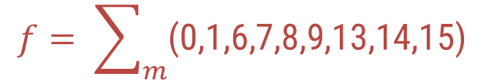
Tabulation Method (Example)
$$f= \sum_{m}{\text{(0,1,6,7,8,9,13,14,15)}}$$
Step – 2: Arrange all minterms in groups of same number of 1s
Step – 1: List all minterms
Column 1
Index | Minterms | Binary Designation
Index 0 | 0 | 0 0 0 0
Index 1 | 1 8 | 0 0 0 1 1 0 0 0
Index 2 | 6 9 | 0 1 1 0 1 0 0 1
Index 3 | 7 13 14 | 0 1 1 1 1 1 0 1 1 1 1 0
Index 4 | 15 | 1 1 1 1
Minterms | Binary Designation
0 | 0 0 0 0
1 | 0 0 0 1
6 | 0 1 1 0
7 | 0 1 1 1
8 | 1 0 0 0
9 | 1 0 0 1
13 | 1 1 0 1
14 | 1 1 1 0
15 | 1 1 1 1

Slide 39
Tabulation Method (Example) Cont..
Step – 3: Compare each term of the lowest index group with every term in the succeeding group till no change
Column 1
Index | Minterms | Binary Designation
Index 0 | 0 | 0 0 0 0
Index 1 | 1 8 | 0 0 0 1 1 0 0 0
Index 2 | 6 9 | 0 1 1 0 1 0 0 1
Index 3 | 7 13 14 | 0 1 1 1 1 1 0 1 1 1 1 0
Index 4 | 15 | 1 1 1 1
Column 2
Pairs | A B C D
0, 1 0, 8 | 0 0 0 _ _ 0 0 0
1, 9 8, 9 | _ 0 0 1 1 0 0 _
6, 7 6, 14 9, 13 | 0 1 1 _ _ 1 1 0 1 _ 0 1
7, 15 13, 15 14, 15 | _ 1 1 1 1 1 _ 1 1 1 1 _
√
√
√
√
√
√
√
√
√

Slide 40
Tabulation Method (Example) Cont..
Step – 4: Compare the terms generated in step 3 in the same fashion until no further combinations are possible
Pairs | A B C D
0, 1 0, 8 | 0 0 0 _ _ 0 0 0
1, 9 8, 9 | _ 0 0 1 1 0 0 _
6, 7 6, 14 9,13 | 0 1 1 _ _ 1 1 0 1 _ 0 1
7, 15 13, 15 14, 15 | _ 1 1 1 1 1 _ 1 1 1 1 _
Quads | A B C D
0, 1, 8, 9 | _ 0 0 _
6, 7, 14, 15 | _ 1 1 _
√
Q
√
P
√
√
√
√
S
√
R
√

Slide 41
Tabulation Method (Example) Cont..
Step – 5: List all prime implicants and draw prime implicants chart
Prime Implicants : P(BC), Q(B’C’), R(ABD), S(AC’D)
 | √ | √ | √ | √ | √ | √ |  | √ | √
PIs | 0 | 1 | 6 | 7 | 8 | 9 | 13 | 14 | 15
P (6,7,14,15) |  |  | x | x |  |  |  | x | x
Q (0,1,8,9) | x | x |  |  | x | x
R (13,15) |  |  |  |  |  |  | x |  | x
S (9,13) |  |  |  |  |  | x | x
Step – 6: Obtain essential prime implicants and minimal expression
Essential Prime Implicants : P(BC)
, Q(B’C’)
As minterm 13 is covered by R and S
Minimal expression : P + Q + R = BC + B’C’ + ABD
OR P + Q + S = BC + B’C’ + AC’D

Slide 42
Realize logic function using gates
Section - 8

Slide 43
Realizing Logic Function with Gates
Implement AB’ + C’D using AND, OR & Invert Gates
A
B
C
D

Slide 44
Converting AND/OR/Invert Logic to NAND/NOR Logic
Draw the circuit in AOI logic.
If NAND hardware is chosen, add a circle at the output of each AND gate and at the inputs to all the OR gates.
If NOR hardware is chosen, add a circle at the output of each OR gate and at the inputs to all the AND gates.
Add or subtract an inverter on each line that received a circle in steps 2 or 3 so that the polarity of signals on those lines remains unchanged from that of the original diagram.
Replace bubbled OR by NAND and bubbled AND by NOR.
Eliminate double inversions.

Slide 45
Converting AND/OR/Invert Logic to NAND/NOR Logic (Example)
Implement the following AOI logic using NAND logic
Put a circle at the output of each AND gate and at the inputs to all OR gates

Slide 46
Converting AND/OR/Invert Logic to NAND/NOR Logic (Example)
Add an inverter to each of the lines that received only one circle at input so that polarity remains unchanged.

Slide 47
Converting AND/OR/Invert Logic to NAND/NOR Logic (Example)
Replace bubbled OR gates and NOT gates by NAND gates.

